Slide 1


Flight Delays By Time of Day and Day of the Week
ST 599 – Big Data Project 2
Sarah Guermond
Andy Olstad
Jasmine Pahukula
Tim Skalland

Slide 2
Question of Interest
What time of the day and day of the week is best for avoiding flight delays?
-Bureau of Transportation Statistics (BTS)
-on-time performance data

Slide 3
Assumptions
Redefined the population to only include the last 3 years (2011-2013)
Arrival delay
Made negative times zero
Ignored cancelled and diverted flights

Slide 4
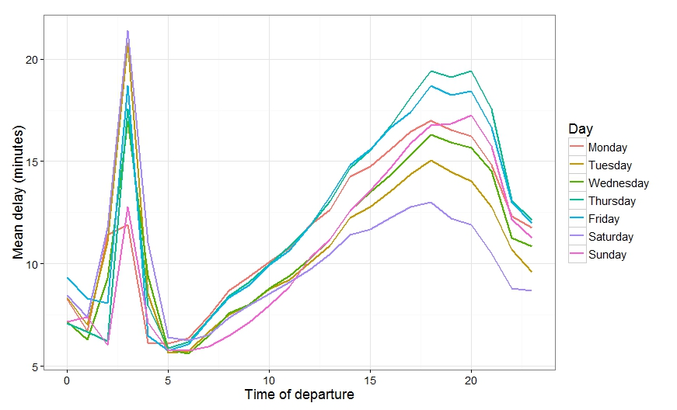
Population-based Findings
-Wednesday 5:00 am ~23%
- Thursday 8:00 pm ~ 51%
Saturday 3:00 am ~21.5 min
Wednesday
6:00 am ~5.5 min
Notes:
Animations!

Slide 5
Sampling Method
Method 1: Simple Random Sample
Small subsamples for late evenings/early mornings
Omitted some hours entirely
Method 2: Stratify by day of week and hour of day
24 hrs * 7 days = 168 strata
About 2000 flights each (or population if smaller)
Notes:
We considered several sampling designs and decided to stratify by day of week and hour of day. Our initial simple random sample gave small subsamples for late evening/early morning flights, and omitted some hours entirely on some days. By stratifying, we ensured we could estimate a value for all 168 (24 hours * 7 days) times. We sampled roughly 2000 flights in each stratum, or the whole population if that was smaller. We used a weighted sample by setting our sampling probability for each stratum (of size N) to be 2000/N.

Slide 6
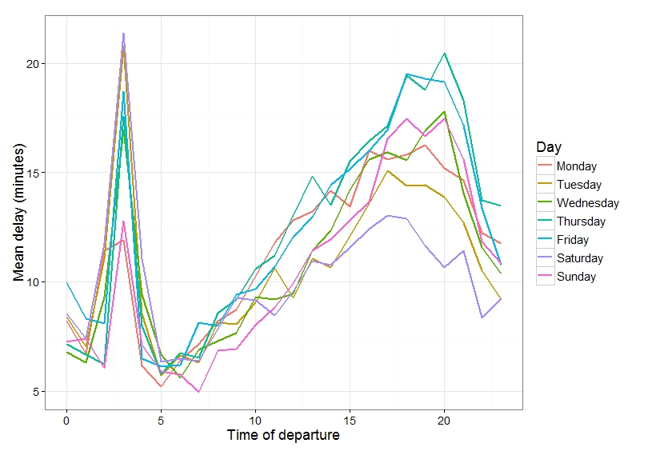
Sample-based Findings
Saturday 3:00 am ~21.5 min
Sunday
7:00 am ~4.9 min
-Wednesday 5:00 am ~22%
- Thursday 8:00 pm ~ 53%
Notes:
Saturday morning at 3:00 am still highest delay and Thursday at 8:00 pm still largest proportion. But now we have Sunday at 7:00 am with the shortest delay and Wednesday at 5:00 am with the lowest proportion.
The sample data was able to show statistically significant differences between days for nearly all the daytime hours (p-values were inconclusive between 1 and 6 am) using ANOVA tests. The margin of error for each of the 168 95% confidence intervals, without any multiple comparisons correction, ranged from 1 to 10 minutes (2 minute average ME).

Slide 7
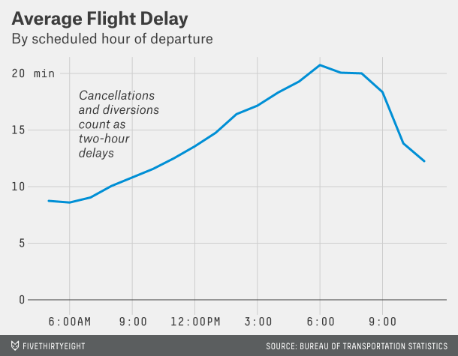
Fivethirtyeight
Nate Silver (of fivethirtyeight.com fame) answered our question of interest on April 19, using just the 2013 BTS data
Our (independent) results are similar
The fivethirtyeight.com
graph was conveniently
limited to 5am-11pm
Notes:
The fivethirtyeight approach resulted in a very similar graph.
Fivethirtyeight also chose to treat negative delays as zero.
Fivethirtyeight counted cancels and diversions as 120-minute delays. Seems strange, in that we might prefer a 2.5 hour delay to a cancellation.
The analysis pointed out that the absolute difference in median delay is pretty small.
The article is here: http://fivethirtyeight.com/datalab/fly-early-arrive-on-time/
(it also shows that weather is a small, constant factor in delays across departure time)

Slide 8
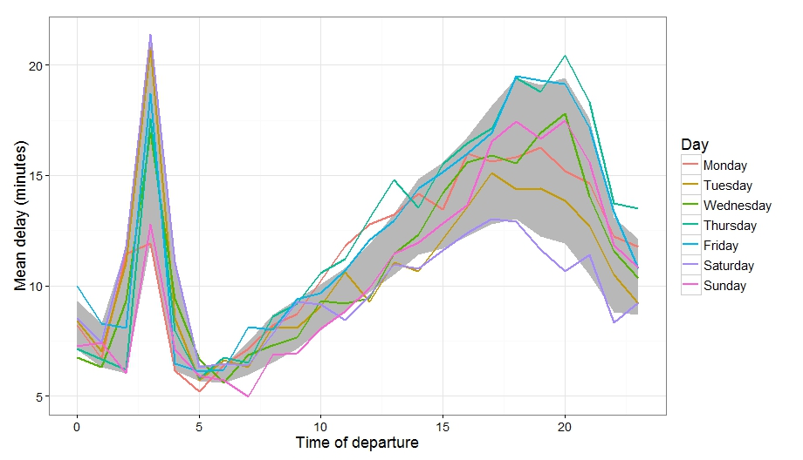
Comparison
Notes:
Our sample data was consistent with the population data. Similar trend. The grey band represents the minimum and maximum average delay for each time of day from our population.

Slide 9
Obstacles and Solutions
Defining the population
Deciding which delay was worse
(arrival or departure)
Specific times, not indexed
Size of data

Slide 10
Thank You! Questions?

Slide 12
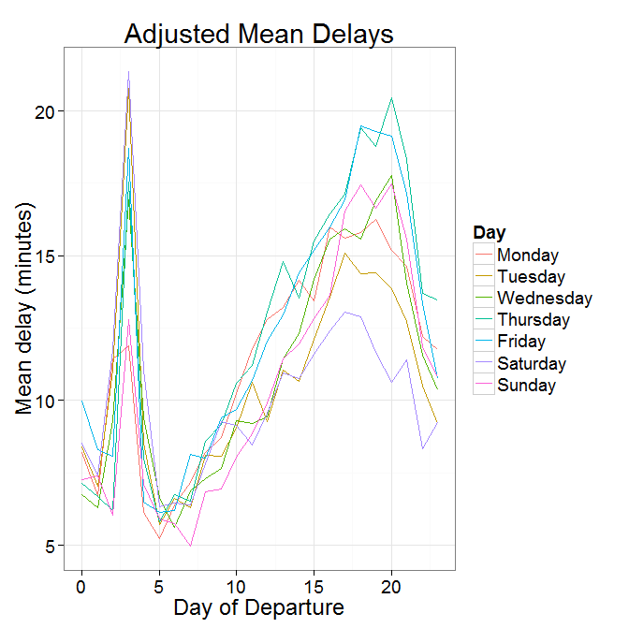
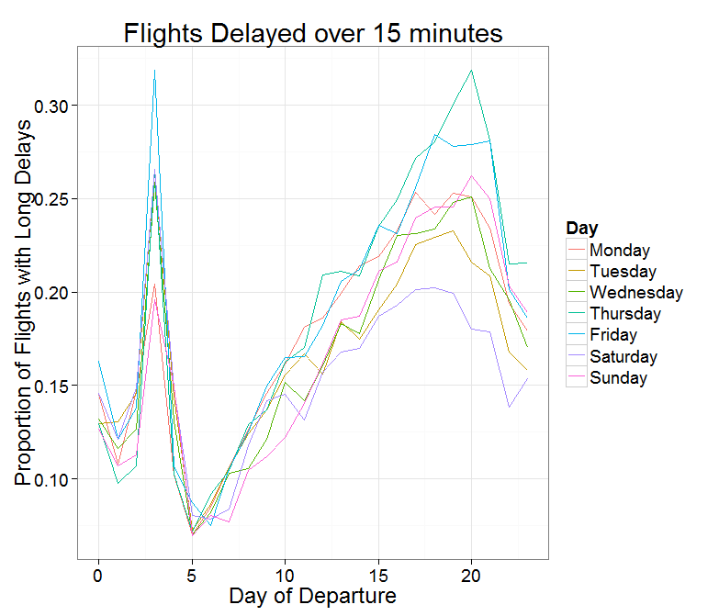
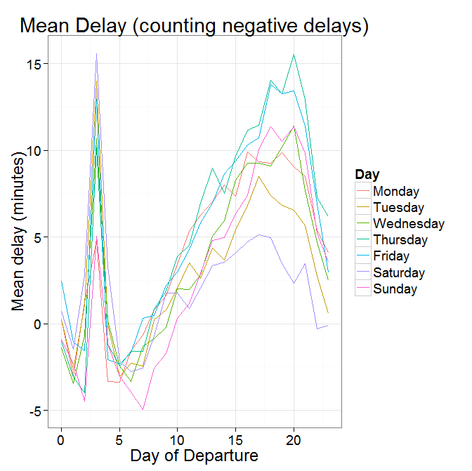
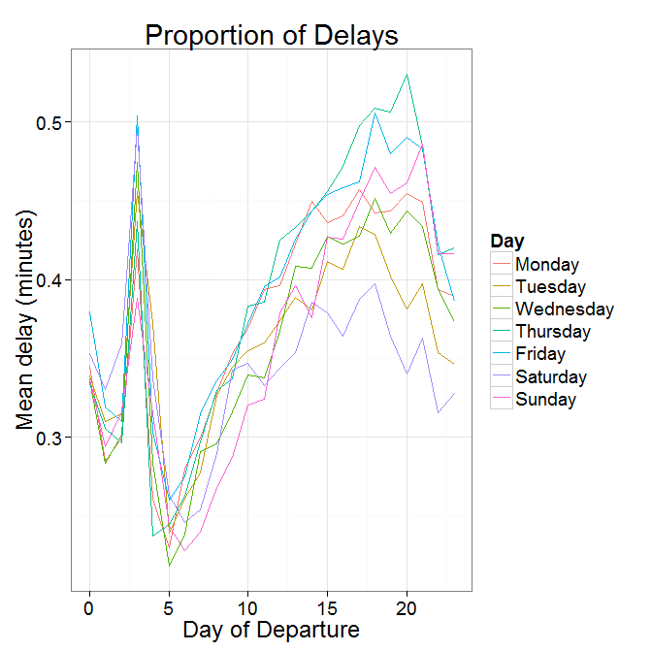
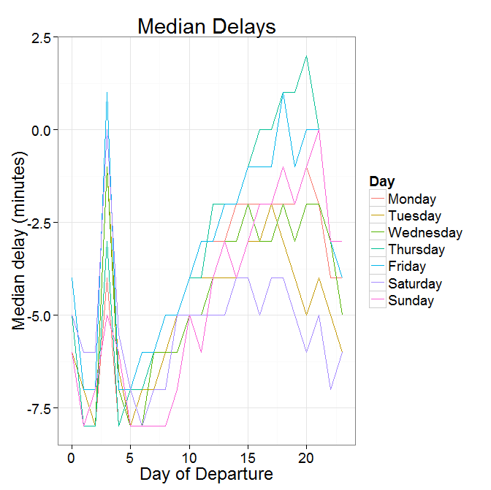
Consistent Shape
Across Different
Metrics

Slide 13
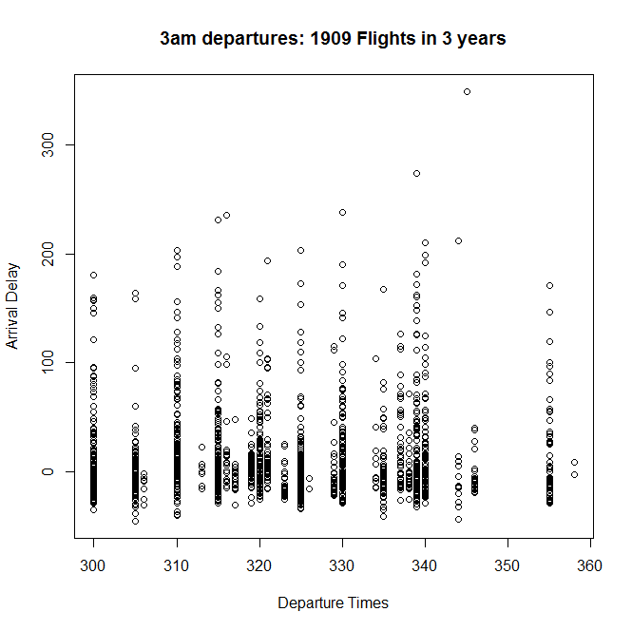
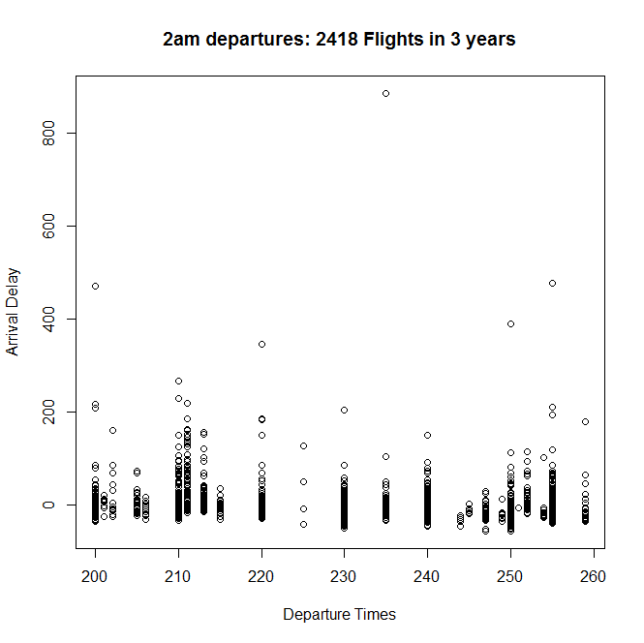
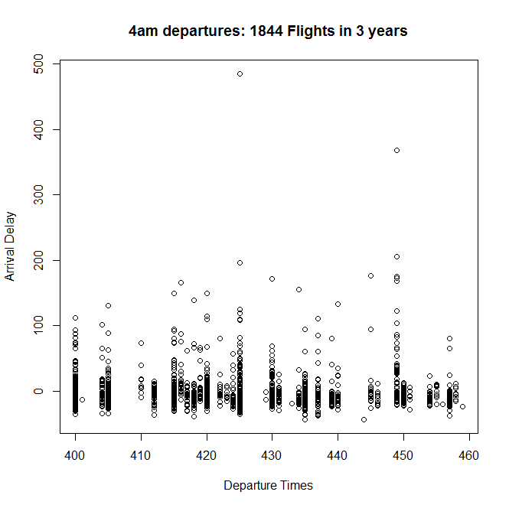
The 3am spike is consistent across days in
both all three years. Median and lower quartiles
look similar, and 2am has a more extreme outlier;
The 75th percentile is noticeably bigger for 3am
(16 vs 4 minutes)

