Slide 1


Flight Delays By Time of Day and Day of the Week
ST 599 – Big Data Project 2
Sarah Guermond
Andy Olstad
Jasmine Pahukula
Tim Skalland

Slide 2
Question of Interest
What time of the day and day of the week is best for avoiding flight delays?

Slide 3
Assumptions
Redefined the population to only include the last 3 years (2011-2013)
Arrival delay
Made negative times zero

Slide 4
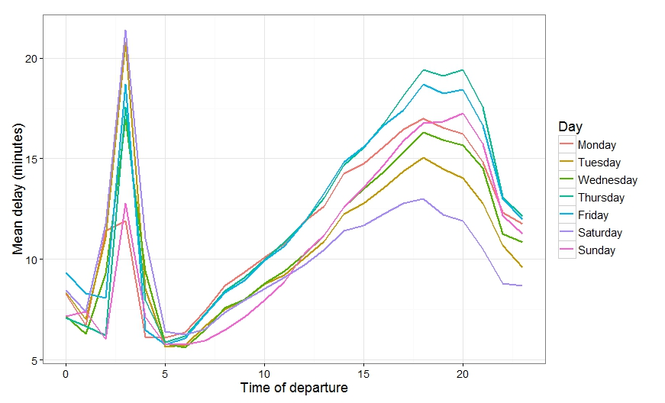
Population-based Findings

Slide 5
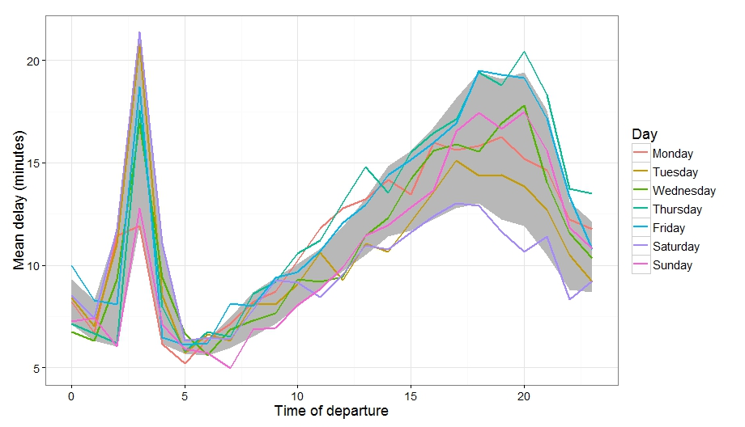
Sample-based Findings

Slide 6
Discussion?

Slide 7
Obstacles and Solutions
Defining the population
Deciding which delay was worse
(arrival or departure)
Specific times, not indexed
Size of data

