Slide 1

Machine Learning: Million Song Dataset
ST 599 – Big Data Project 3
Sarah Guermond
Andy Olstad
Jasmine Pahukula
Tim Skalland

Slide 2
Question of Interest
Can we use song feature data to predict the year of a song?
Principal Component Analysis (PCA)

Slide 3
Data
Data: Million Song Subset (UCI)
515,345 songs
91 attributes (year, 12 mean timbre features, 78 covariances)
No column headings!
PCA
Identify patterns
Reduce dimensionality of data set

Slide 4
Principal Components Analysis

Slide 5
Principal Components Analysis

Slide 6
Principal Components Analysis

Slide 7
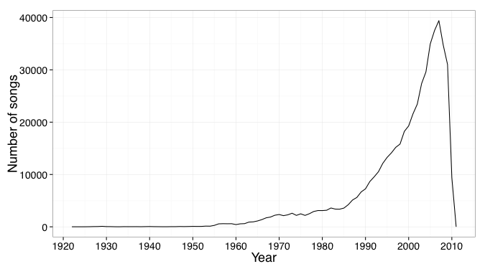
Findings
Notes:
Original distribution of songs in dataset

Slide 8
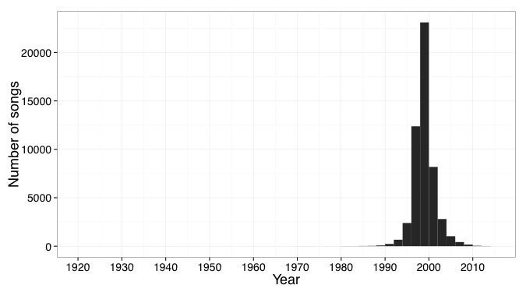
Findings
Notes:
Predicted years for songs

Slide 9
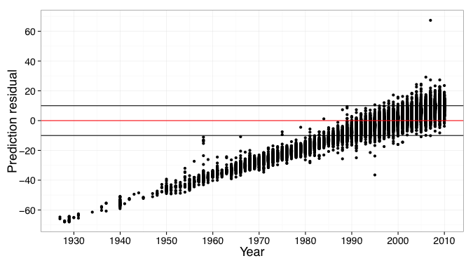
Findings

Slide 10
Assumptions & Limitations
Considered year as continuous variable
80/20 rule to get PC
Difficult to interpret results with PCA

Slide 11
Scalability
Practiced with small subset (10,000 songs)
Revealed same number of PCs as full data set (515,345 songs)

Slide 12
Questions?
Reference: Thierry Bertin-Mahieux, Daniel P.W. Ellis, Brian Whitman, and Paul Lamere. The Million Song Dataset. In Proceedings of the 12th International Society for Music Information Retrieval Conference (ISMIR 2011), 2011.

