Slide 1

Machine Learning: Million Song Dataset
ST 599 – Big Data Project 3
Sarah Guermond
Andy Olstad
Jasmine Pahukula
Tim Skalland

Slide 2
Question of Interest
Can we use song feature data to predict the year of a song?
Principal Component Analysis (PCA)

Slide 3
Data
Data: Million Song Subset (UCI)
515,345 songs
91 attributes (year, 12 mean timbre features, 78 covariances)
No column headings!
PCA
Identify patterns
Reduce dimensionality of data set

Slide 4
Principal Components Analysis
In general, PCA is used as a dimension reduction technique.
It finds linear combinations of the variables that explain maximal possible variance under a constraint.
Constraint 1: The principal components are uncorrelated with each other.

Slide 5
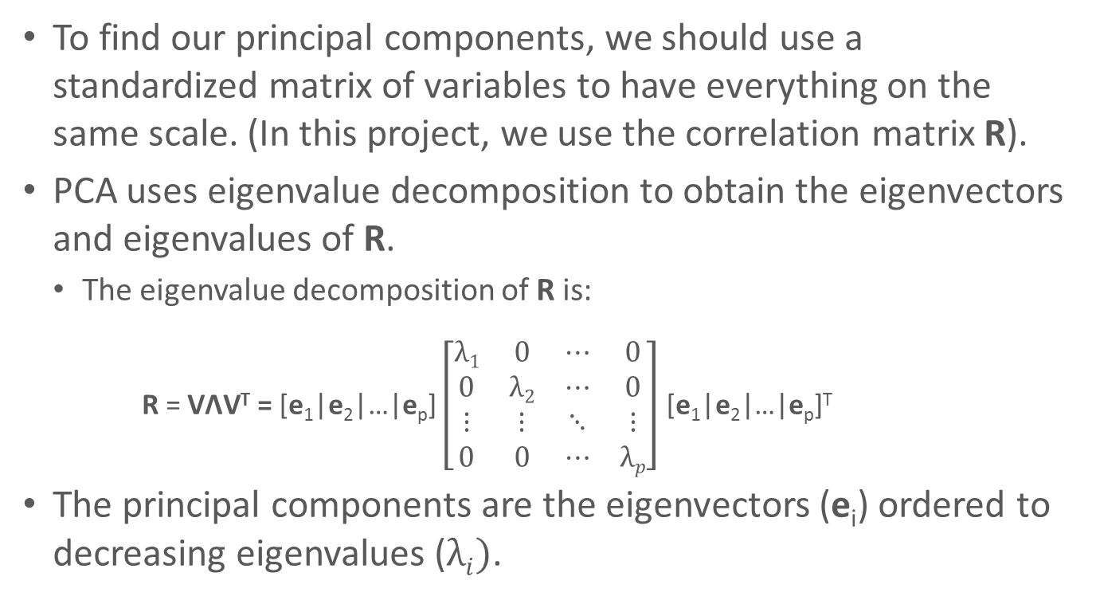
Principal Components Analysis
To find our principal components, we should use a standardized matrix of variables to have everything on the same scale. (In this project, we use the correlation matrix R).
PCA uses eigenvalue decomposition to obtain the eigenvectors and eigenvalues of R.
The eigenvalue decomposition of R is:
R = VΛV^{T} = [e₁|e₂|…|e_{p}] $\left[\begin{matrix}λ1 & 0 & ⋯ & 0 \\ 0 & λ2 & ⋯ & 0 \\ ⋮ & ⋮ & ⋱ & ⋮ \\ 0 & 0 & ⋯ & λp\end{matrix}\right]$ [e₁|e₂|…|e_{p}]^{T}
The principal components are the eigenvectors (e_{i}) ordered to decreasing eigenvalues ($λi)$.
Notes:
Eigenvector is PCA

Slide 6
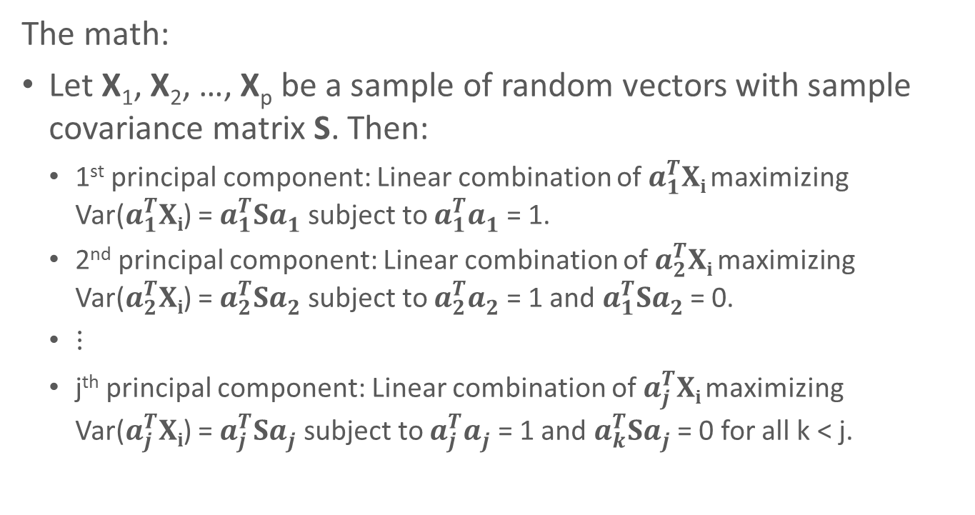
Principal Components Analysis
The math:
Let X₁, X₂, …, X_{p} be a sample of random vectors with sample covariance matrix S. Then:
1st principal component: Linear combination of $a_{1}^{T}Xi$ maximizing Var($a_{1}^{T}Xi$) = $a_{1}^{T}Sa_{1}^{}$ subject to $a_{1}^{T}a_{1}^{}$ = 1.
2nd principal component: Linear combination of $a_{2}^{T}Xi$ maximizing Var($a_{2}^{T}Xi$) = $a_{2}^{T}Sa_{2}^{}$ subject to $a_{2}^{T}a_{2}^{}$ = 1 and $a_{1}^{T}Sa_{2}^{}$ = 0.
$⋮$
j^{th} principal component: Linear combination of $a_{j}^{T}Xi$ maximizing Var($a_{j}^{T}Xi$) = $a_{j}^{T}Sa_{j}^{}$ subject to $a_{j}^{T}a_{j}^{}$ = 1 and $a_{k}^{T}Sa_{j}^{}$ = 0 for all k < j.

Slide 7
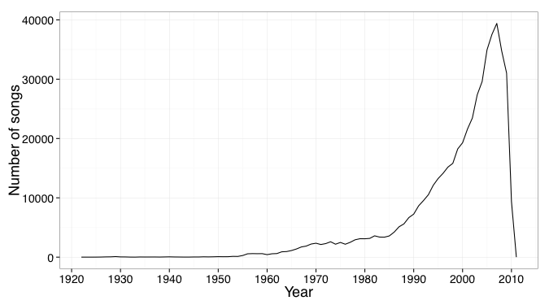
Findings
Notes:
Original distribution of songs in dataset

Slide 8
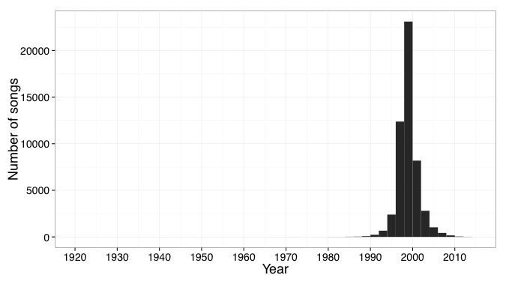
Findings
Notes:
Predicted years for songs

Slide 9
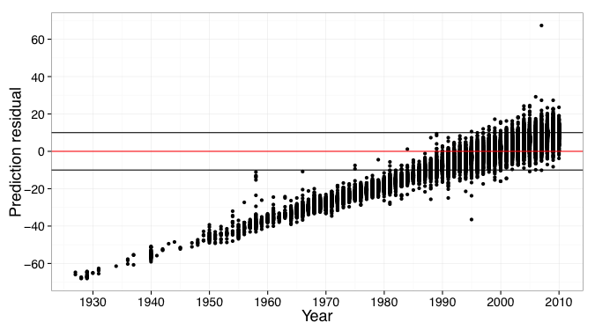
Findings

Slide 10
Assumptions & Limitations
Considered year as continuous variable
80/20 rule to get PC
Difficult to interpret results with PCA

Slide 11
Scalability
Practiced with small subset (10,000 songs)
Revealed same number of PCs as full data set (515,345 songs)

Slide 12
Questions?
Reference: Thierry Bertin-Mahieux, Daniel P.W. Ellis, Brian Whitman, and Paul Lamere. The Million Song Dataset. In Proceedings of the 12th International Society for Music Information Retrieval Conference (ISMIR 2011), 2011.

