Slide 1

Machine Learning: Million Song Dataset
ST 599 – Big Data Project 3
Sarah Guermond
Andy Olstad
Jasmine Pahukula
Tim Skalland

Slide 2
Question of Interest
Can we use song feature data to predict the year of a song?
Machine Learning Tools Used:
Principal Component Analysis (PCA)
Multiple Linear Regression

Slide 3
Data
Data: Million Song Subset (UCI)
515,345 songs
91 attributes (year, 12 mean timbre features, 78 covariances)
No column headings!
PCA
Identify patterns
Reduce dimensionality of data set

Slide 4
Principal Components Analysis
In general, PCA is used as a dimension reduction technique.
It finds linear combinations of the variables that explain maximal possible variance under a constraint.
Constraint: The principal components are uncorrelated with each other and orthogonal.

Slide 5
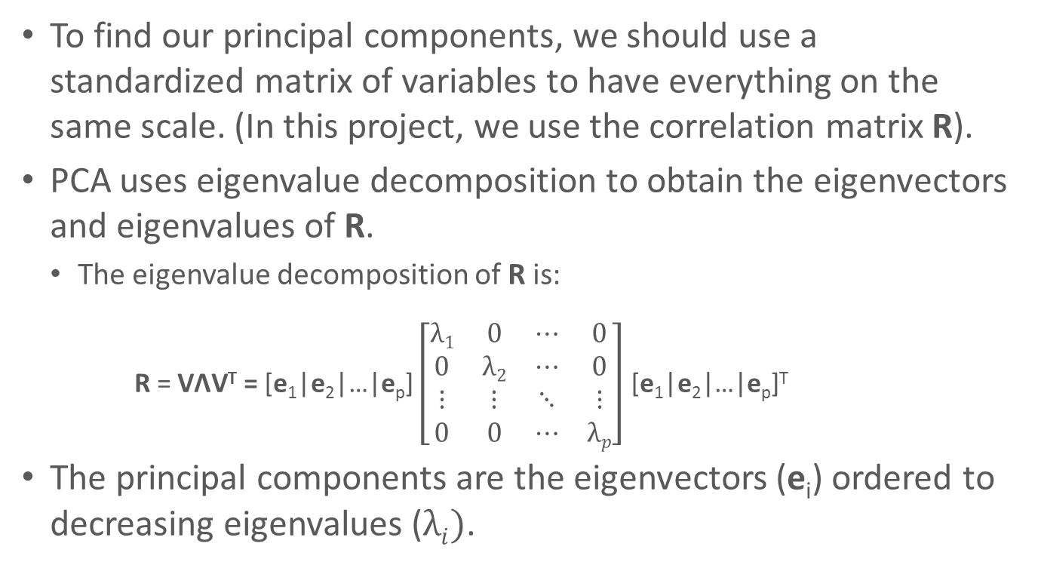
Principal Components Analysis
To find our principal components, we should use a standardized matrix of variables to have everything on the same scale. (In this project, we use the correlation matrix R).
PCA uses eigenvalue decomposition to obtain the eigenvectors and eigenvalues of R.
The eigenvalue decomposition of R is:
R = VΛV^{T} = [e₁|e₂|…|e_{p}] $\left[\begin{matrix}λ1 & 0 & ⋯ & 0 \\ 0 & λ2 & ⋯ & 0 \\ ⋮ & ⋮ & ⋱ & ⋮ \\ 0 & 0 & ⋯ & λp\end{matrix}\right]$ [e₁|e₂|…|e_{p}]^{T}
The principal components are the eigenvectors (e_{i}) ordered to decreasing eigenvalues ($λi)$.
Notes:
Eigenvector is PCA

Slide 6
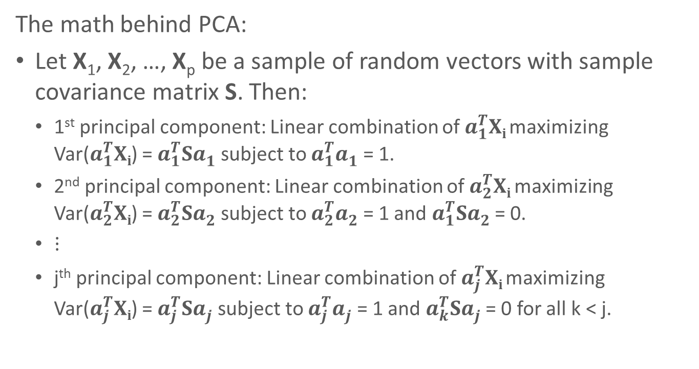
Principal Components Analysis
The math behind PCA:
Let X₁, X₂, …, X_{p} be a sample of random vectors with sample covariance matrix S. Then:
1st principal component: Linear combination of $a_{1}^{T}Xi$ maximizing Var($a_{1}^{T}Xi$) = $a_{1}^{T}Sa_{1}^{}$ subject to $a_{1}^{T}a_{1}^{}$ = 1.
2nd principal component: Linear combination of $a_{2}^{T}Xi$ maximizing Var($a_{2}^{T}Xi$) = $a_{2}^{T}Sa_{2}^{}$ subject to $a_{2}^{T}a_{2}^{}$ = 1 and $a_{1}^{T}Sa_{2}^{}$ = 0.
$⋮$
j^{th} principal component: Linear combination of $a_{j}^{T}Xi$ maximizing Var($a_{j}^{T}Xi$) = $a_{j}^{T}Sa_{j}^{}$ subject to $a_{j}^{T}a_{j}^{}$ = 1 and $a_{k}^{T}Sa_{j}^{}$ = 0 for all k < j.

Slide 7
Methods of Prediction
PCA reduced the number of the predictors from 90 to 8.
Used these 8 PCs as predictors in a linear regression on year
Looked at original 90 predictors using regression
Looked at using the 12 timbre averages as predictors
Lastly, looked at grouping the song years into three categories and using the 8 principal components in a multinomial regression
Pre-1960
1960-1989
Post-1990

Slide 8
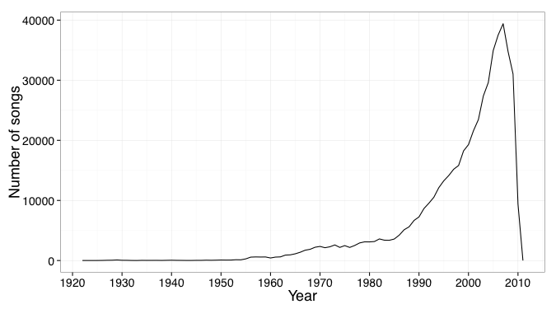
Findings
The data was heavily skewed in favor of the 1990s and 2000s
Notes:
Original distribution of songs in dataset

Slide 9
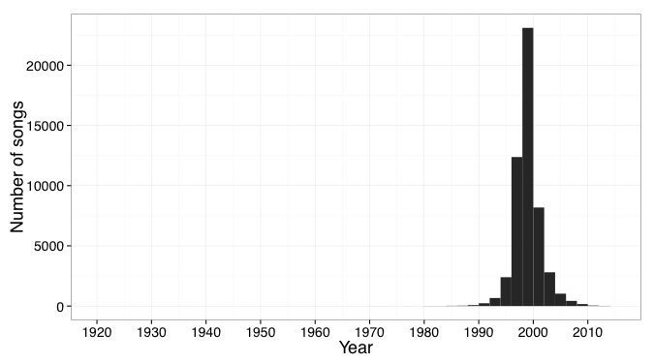
Findings
Notes:
Predicted years for songs

Slide 10
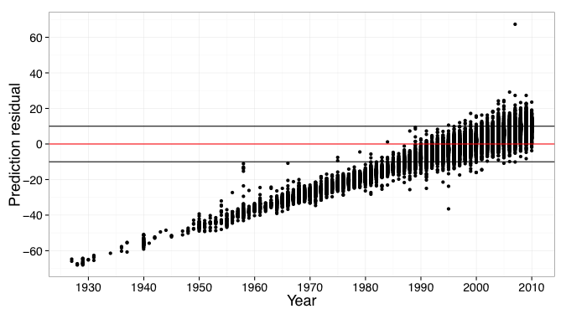
Findings
The model overestimated the year of release for earlier songs (1920 to 1980).

Slide 11
Findings
All the multiple linear regressions showed “statistically significance”, yet were of little practical significance since all coefficients were near zero.
Multinomial regression favored the Post-1990’s as well, wanting to put almost all predictions in that category with about 80% probability.
Notes:
Predicted years for songs

Slide 12
Assumptions & Limitations
First considered year as continuous variable
80/20 rule to get PC
Difficult to interpret results with PCA

Slide 13
Scalability
Practiced with small subset (10,000 songs)
Revealed same number of PCs as full data set (515,345 songs)
PCA is easily scalable to bigger data, but could be computationally slow

Slide 14
Questions?
Reference: Thierry Bertin-Mahieux, Daniel P.W. Ellis, Brian Whitman, and Paul Lamere. The Million Song Dataset. In Proceedings of the 12th International Society for Music Information Retrieval Conference (ISMIR 2011), 2011.

Slide 16
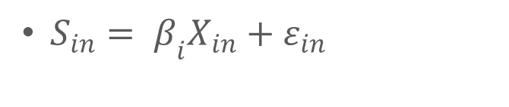
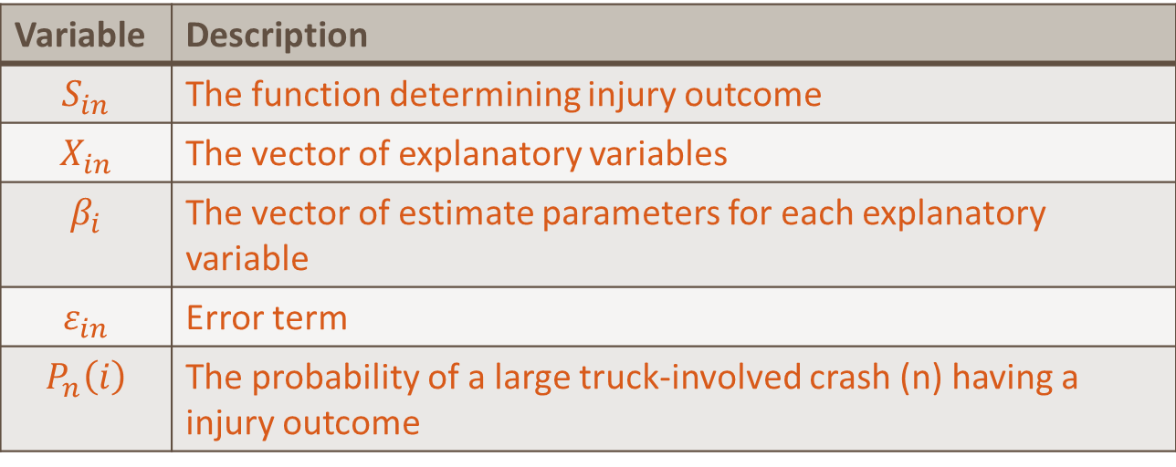
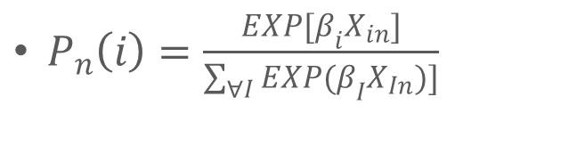
Discrete Choice Model – Multinomial Logit Model
$S_{in}= β_{i}X_{in}+ε_{in}$
$P_{n}\left(i\right)=\frac{EXP[β_{i}X_{in}]}{\sum_{∀I}{EXP(β_{I}X_{In})]}}$
Variable | Description
$$S_{in}$$ | The function determining injury outcome
$$X_{in}$$ | The vector of explanatory variables
$$β_{i}$$ | The vector of estimate parameters for each explanatory variable
$$ε_{in}$$ | Error term
$$P_{n}\left(i\right)$$ | The probability of a large truck-involved crash (n) having a injury outcome

