Slide 1

Machine Learning: Million Song Dataset
ST 599 – Big Data Project 3
Sarah Guermond
Andy Olstad
Jasmine Pahukula
Tim Skalland

Slide 2
Question of Interest
Can we use song feature data to predict the year of a song?
Principal Component Analysis (PCA)

Slide 3
Data
Data: Million Song Subset (UCI)
515,345 songs
91 attributes (year, 12 mean timbre features, 78 covariances)
No column headings!
PCA
Identify patterns
Reduce dimensionality of data set

Slide 4
Principal Components Analysis

Slide 5
Principal Components Analysis

Slide 6
Principal Components Analysis

Slide 7
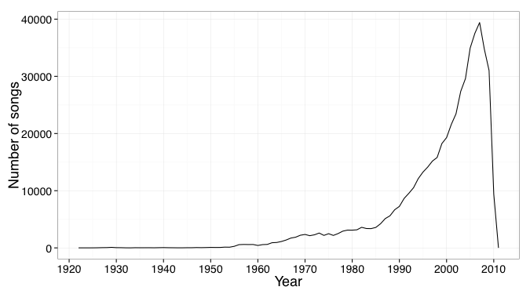
Findings
Notes:
Original distribution of songs in dataset

Slide 8
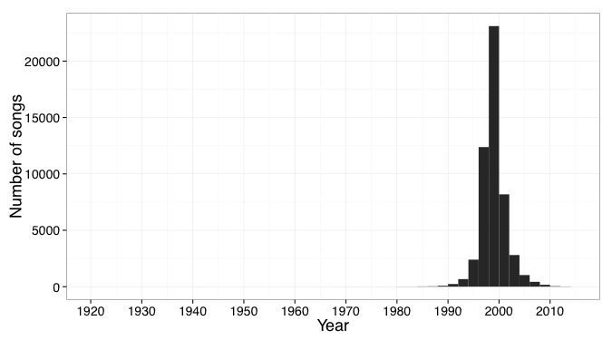
Findings
Notes:
Predicted years for songs

Slide 9
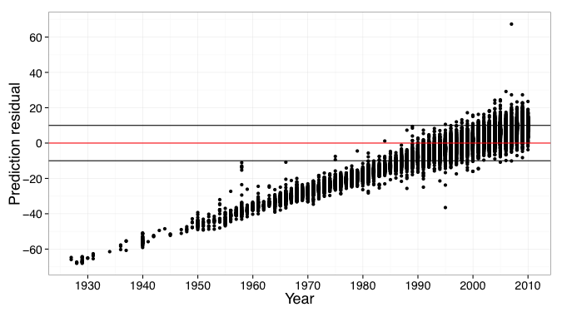
Findings

Slide 10
Assumptions & Limitations

Slide 11
Scalability
Practiced with small subset (10,000 songs)
Revealed same number of PCs as full data set (515,345 songs) with 80% of variance explained.

Slide 12
Questions?
Reference: Thierry Bertin-Mahieux, Daniel P.W. Ellis, Brian Whitman, and Paul Lamere. The Million Song Dataset. In Proceedings of the 12th International Society for Music Information Retrieval Conference (ISMIR 2011), 2011.

