Slide 1

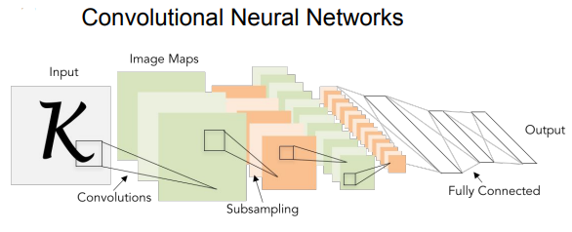
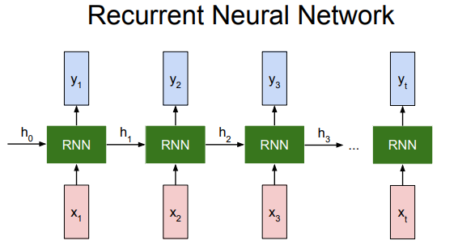
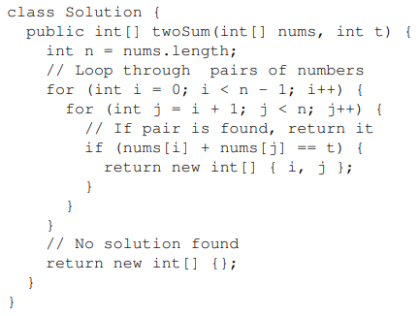
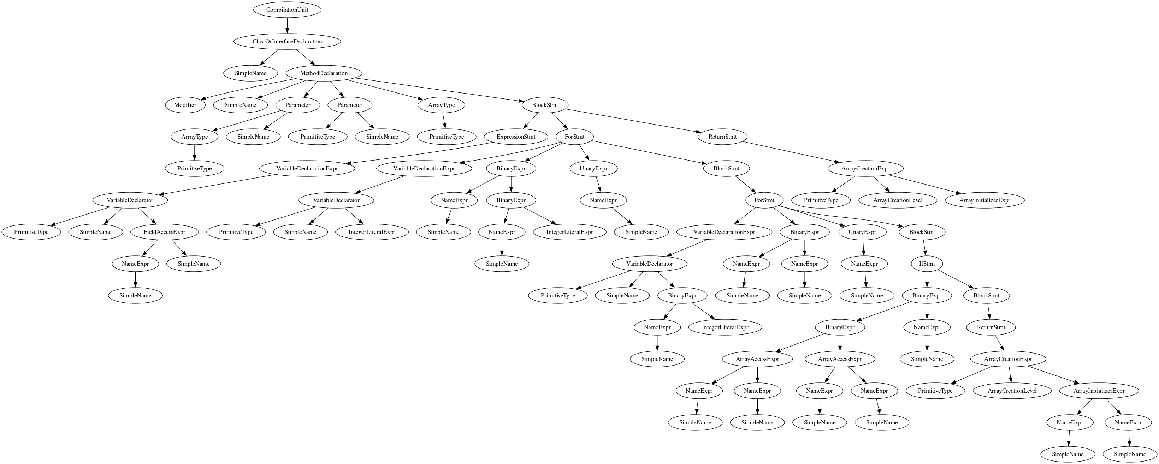
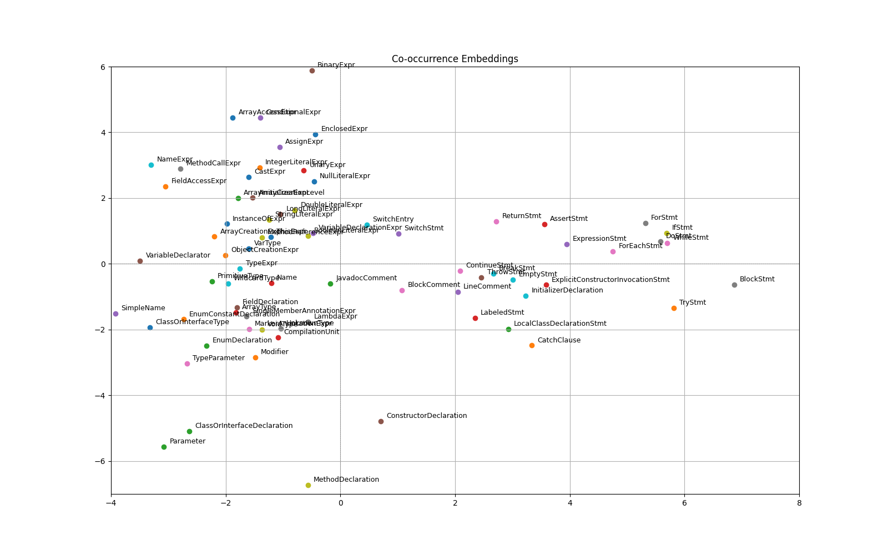
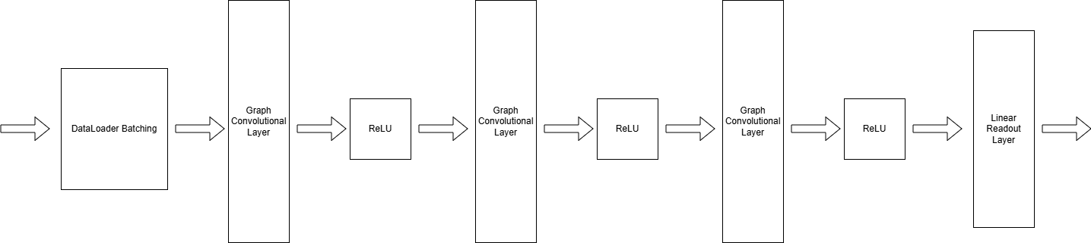
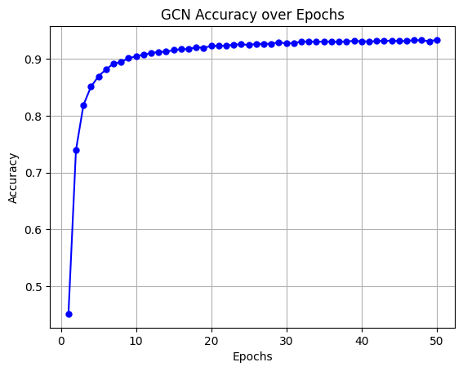
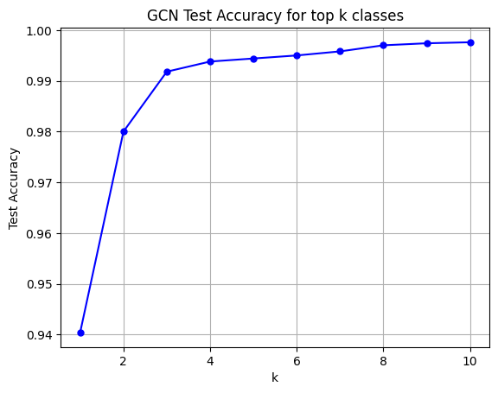
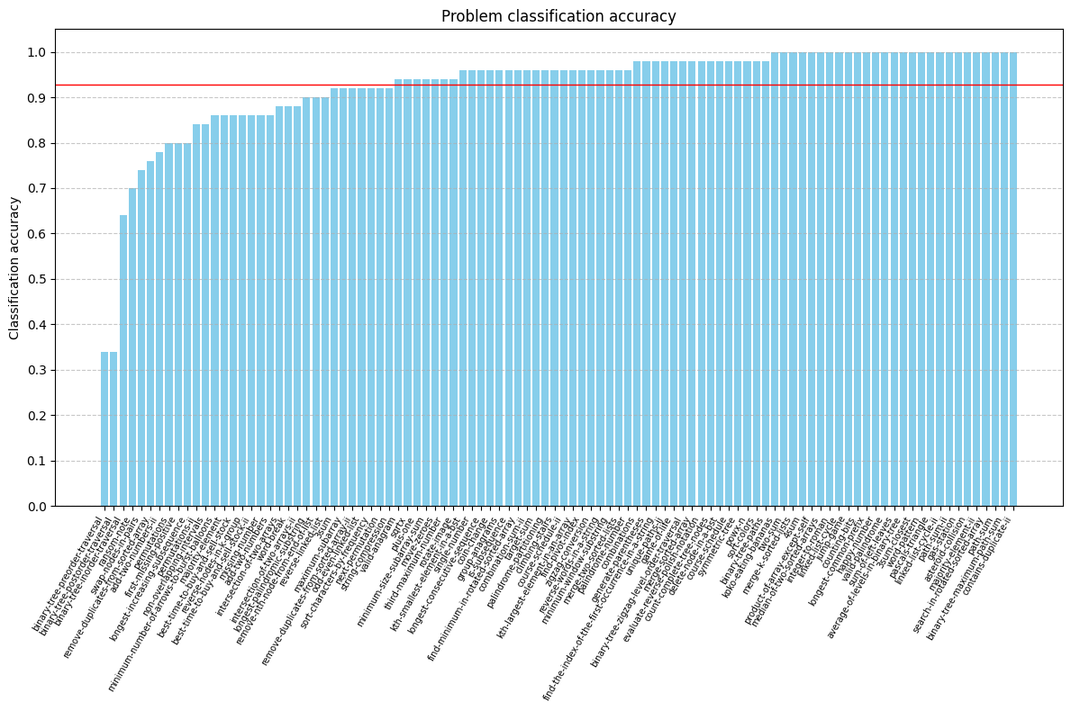
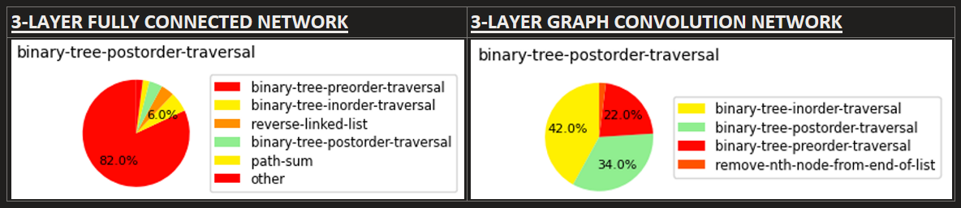
Graph Convolutional Networks for
AST-Based Representations of Code
Rich Chen and Andy Stanciu
Neural network architectures can be specialized for various kinds of data (spatial, sequence) exist:
Graph Neural Networks
Allow us to take in input data in the format of a graph and perform various operations such as graph-convolutions to learn properties of graph-based data.
Abstract Syntax Trees
In compilers, abstract syntax trees are ubiquitous as an intermediate representation of code. Programs are compiled into this tree structure, preserving the fundamental structure and meaning of the code.
What about code for programs?
We could model it as a sequence like regular text and use methods for that such as RNNs, LSTMs, Transformers, etc.
But code has logical connections between statements that can’t be easily represented with sequences
AST Representations for Neural Networks
Construct co-occurrence matrix from abstract syntax tree nodes:
Graph Convolutional Networks (GCNs)
Experimentation
Data: 100 LeetCode problems and solution examples for each
Vectorize code examples into co-occurrence matrix
Construct train set from 90% of the data and test set from 10%
Train various architectures on train set
Evaluate on test set with top-1, top-5, and top-10 accuracy:
Model | Top-1 Accuracy | Top-5 Accuracy | Top-10 Accuracy
Linear | 85.90% | 97.68% | 99.06%
3-Layer MLP | 90.64% | 98.68% | 99.30%
3-Layer GCN | 94.04% | 99.44% | 99.76%
Adversarial Examples
Certain problems were chosen to be very similar:
Post-order, in-order, and pre-order traversal of binary tree
GCN performance is much better in these cases

