Slide 1

acomodation
Context-based document correction
G. Dominedò & K. Lo

Slide 2
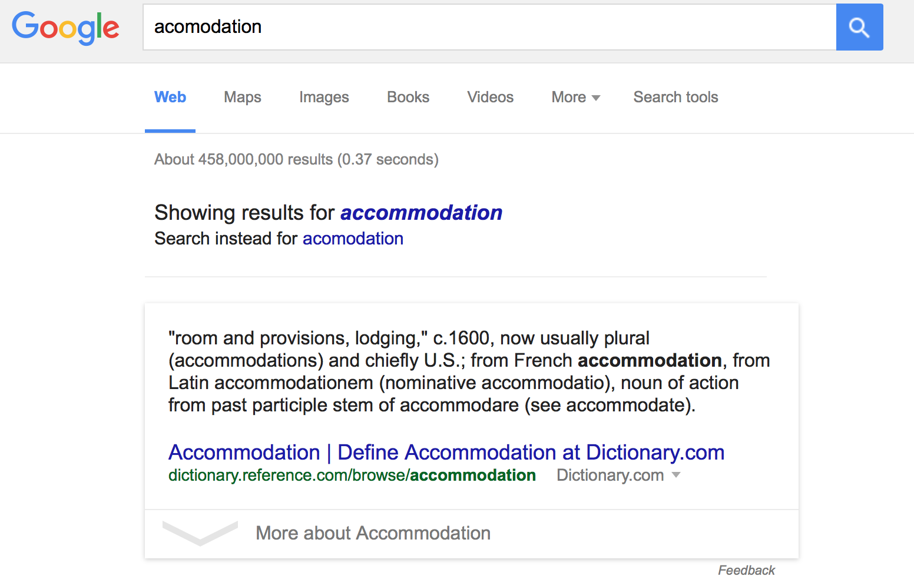
Context-based document correction
G. Dominedò & K. Lo

Slide 3
SPELLING CORRECTION ALGORITHMS
Applications
Web searching
Word processing applications
E-mail and text messaging applications
Optical Character Recognition (OCR) scanning
…
Context-based document correction
G. Dominedò & K. Lo

Slide 4
EDIT DISTANCE
Deletes
Transpositions
Replaces
Insertions
RTHERE → THERE
THEER → THERE
TYERE → THERE
TERE → THERE
Context-based document correction
G. Dominedò & K. Lo

Slide 5
SYMMETRIC DELETE
Deletes
RTHERE → THERE
THEER → THEE
TYERE → TERE
TERE → THERE
THERE
THERE
Context-based document correction
G. Dominedò & K. Lo

Slide 6
WORD-LEVEL SPELL-CHECKING
this
is
ax
test
this
is
ax
test
Context-based document correction
G. Dominedò & K. Lo

Slide 7
CONTEXT-LEVEL SPELL-CHECKING
this
is
ax
test
this
is
a
test
Context-based document correction
G. Dominedò & K. Lo

Slide 8
CONTEXT-LEVEL SPELL-CHECKING
Yelp reviews
Words
Context-based document correction
G. Dominedò & K. Lo

Slide 9
SPARK-n-SPELL.com
Context-based document correction
G. Dominedò & K. Lo

