Slide 1
and
SPARK-n-SPELL
Context-based document correction in Apache SPARK
Gioia Dominedò and Kendrick Lo

Slide 2

acomodation

Slide 3
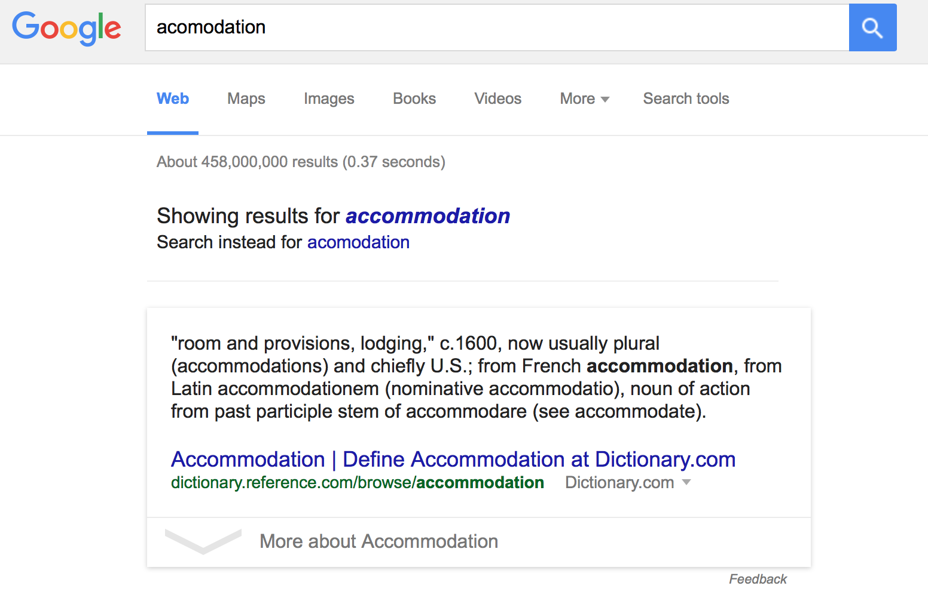

Slide 5
MOTIVATION
web searching
word processing applications
e-mail and text messaging applications
Optical Character Recognition (OCR) scanning

Slide 6
EDIT DISTANCE
deletes
transpositions
replaces
insertions
RTHERE → THERE
THEER → THERE
TYERE → THERE
T ERE → THERE

Slide 7
EDIT DISTANCE
deletes
transpositions
replaces
insertions
RTHERE → THERE
THEER → THEE ← THERE
TYERE → TERE ← THERE
TERE ← THERE

Slide 8
WORD-LEVEL CORRECTION
SERIAL VS PARALLEL RUNTIMES
Yelp reviews
Words
AWS runtimes based on: 4 executors, 4 cores, 16 partitions
Notes:
serial 19.87s 384.75s 4305.46s
local spark 56.3 s 207.07s 13554.26s
AWS 2 executors, 4 cores, 16 partitions 41.82s 125.45s 995.66 s
AWS 4 executors, 4 cores, 64 partitions 198.92s 286.15s 1283.60s

Slide 9
WORD-LEVEL SPELL-CHECKING
this
is
ax
test

Slide 10
WORD-LEVEL SPELL-CHECKING
this
is
ax
test

Slide 11
WORD-LEVEL SPELL-CHECKING
this
is
ax
test
this
his
thus
thin

Slide 12
WORD-LEVEL SPELL-CHECKING
this
is
ax
test
this

Slide 13
WORD-LEVEL SPELL-CHECKING
this
is
ax
test
this
is
in
it
his

Slide 14
WORD-LEVEL SPELL-CHECKING
this
is
ax
test
this
is

Slide 15
WORD-LEVEL SPELL-CHECKING
this
is
ax
test
this
is
ax
a
as
at

Slide 16
WORD-LEVEL SPELL-CHECKING
this
is
ax
test
this
is
ax

Slide 17
WORD-LEVEL SPELL-CHECKING
this
is
ax
test
this
is
ax
test
west
best
rest

Slide 18
WORD-LEVEL SPELL-CHECKING
this
is
ax
test
this
is
ax
test

Slide 19
WORD-LEVEL SPELL-CHECKING
this
is
ax
test
this
is
ax
test

Slide 20
CONTEXT-LEVEL SPELL-CHECKING
this
is
ax
test

Slide 21
CONTEXT-LEVEL SPELL-CHECKING
this
is
ax
test

Slide 22
CONTEXT-LEVEL SPELL-CHECKING
this
is
ax
test
this
his
thus
thin

Slide 23
CONTEXT-LEVEL SPELL-CHECKING
this
is
ax
test
this
0.99
his
thus
thin

Slide 24
CONTEXT-LEVEL SPELL-CHECKING
this
is
ax
test
this
0.99
his
0.01
thus
thin

Slide 25
CONTEXT-LEVEL SPELL-CHECKING
this
is
ax
test
this
0.99
his
0.01
thus
0.001
thin

Slide 26
CONTEXT-LEVEL SPELL-CHECKING
this
is
ax
test
this
0.99
his
0.01
thus
0.001
thin
0.0001

Slide 27
CONTEXT-LEVEL SPELL-CHECKING
this
is
ax
test
this
0.99
is
his
0.01
in
thus
0.001
it
thin
0.0001
his

Slide 28
CONTEXT-LEVEL SPELL-CHECKING
this
is
ax
test
this
0.99
is
his
0.01
in
thus
0.001
it
thin
0.0001
his

Slide 29
CONTEXT-LEVEL SPELL-CHECKING
this
is
ax
test
this
0.99
this is
0.99
his
0.01
in
thus
0.001
it
thin
0.0001
his

Slide 30
CONTEXT-LEVEL SPELL-CHECKING
this
is
ax
test
this
0.99
this is
0.99
his
0.01
in
thus
0.001
it
thin
0.0001
his

Slide 31
CONTEXT-LEVEL SPELL-CHECKING
this
is
ax
test
this
0.99
this is
0.99
his
0.01
this in
0.001
thus
0.001
it
thin
0.0001
his

Slide 32
CONTEXT-LEVEL SPELL-CHECKING
this
is
ax
test
this
0.99
this is
0.99
his
0.01
this in
0.001
thus
0.001
it
thin
0.0001
his

Slide 33
CONTEXT-LEVEL SPELL-CHECKING
this
is
ax
test
this
0.99
this is
0.99
his
0.01
this in
0.001
thus
0.001
this it
0.0001
thin
0.0001
his

Slide 34
CONTEXT-LEVEL SPELL-CHECKING
this
is
ax
test
this
0.99
this is
0.99
his
0.01
this in
0.001
thus
0.001
this it
0.0001
thin
0.0001
his

Slide 35
CONTEXT-LEVEL SPELL-CHECKING
this
is
ax
test
this
0.99
this is
0.99
his
0.01
this in
0.001
thus
0.001
this it
0.0001
thin
0.0001
this his
0.0001

Slide 36
CONTEXT-LEVEL SPELL-CHECKING
this
is
ax
test
this is
0.99
this in
0.001
this it
0.0001
this his
0.0001

Slide 37
CONTEXT-LEVEL SPELL-CHECKING
this
is
ax
test
this is
0.99
ax
this in
0.001
a
this it
0.0001
as
this his
0.0001
at

Slide 38
CONTEXT-LEVEL SPELL-CHECKING
this
is
ax
test
this is
0.99
ax
this in
0.001
a
this it
0.0001
as
this his
0.0001
at

Slide 39
CONTEXT-LEVEL SPELL-CHECKING
this
is
ax
test
this is
0.99
this is ax
0.001
this in
0.001
a
this it
0.0001
as
this his
0.0001
at

Slide 40
CONTEXT-LEVEL SPELL-CHECKING
this
is
ax
test
this is
0.99
this is ax
0.001
this in
0.001
a
this it
0.0001
as
this his
0.0001
at

Slide 41
CONTEXT-LEVEL SPELL-CHECKING
this
is
ax
test
this is
0.99
this is ax
0.001
this in
0.001
this is a
0.88
this it
0.0001
as
this his
0.0001
at

Slide 42
CONTEXT-LEVEL SPELL-CHECKING
this
is
ax
test
this is
0.99
this is ax
0.001
this in
0.001
this is a
0.88
this it
0.0001
as
this his
0.0001
at

Slide 43
CONTEXT-LEVEL SPELL-CHECKING
this
is
ax
test
this is
0.99
this is ax
0.001
this in
0.001
this is a
0.88
this it
0.0001
this is as
0.06
this his
0.0001
at

Slide 44
CONTEXT-LEVEL SPELL-CHECKING
this
is
ax
test
this is
0.99
this is ax
0.001
this in
0.001
this is a
0.88
this it
0.0001
this is as
0.06
this his
0.0001
at

Slide 45
CONTEXT-LEVEL SPELL-CHECKING
this
is
ax
test
this is
0.99
this is ax
0.001
this in
0.001
this is a
0.88
this it
0.0001
this is as
0.06
this his
0.0001
this is at
0.06

Slide 46
CONTEXT-LEVEL SPELL-CHECKING
this
is
ax
test
this is ax
0.001
this is a
0.88
this is as
0.06
this is at
0.06

Slide 47
CONTEXT-LEVEL SPELL-CHECKING
this
is
ax
test
this is ax
0.001
test
this is a
0.88
west
this is as
0.06
best
this is at
0.06
rest

Slide 48
CONTEXT-LEVEL SPELL-CHECKING
this
is
ax
test
this is ax
0.001
test
this is a
0.88
west
this is as
0.06
best
this is at
0.06
rest

Slide 49
CONTEXT-LEVEL SPELL-CHECKING
this
is
ax
test
this is ax
0.001
this is a test
0.99
this is a
0.88
west
this is as
0.06
best
this is at
0.06
rest

Slide 50
CONTEXT-LEVEL SPELL-CHECKING
this
is
ax
test
this is ax
0.001
this is a test
0.99
this is a
0.88
west
this is as
0.06
best
this is at
0.06
rest

Slide 51
CONTEXT-LEVEL SPELL-CHECKING
this
is
ax
test
this is ax
0.001
this is a test
0.99
this is a
0.88
this is a west
<0.0001
this is as
0.06
best
this is at
0.06
rest

Slide 52
CONTEXT-LEVEL SPELL-CHECKING
this
is
ax
test
this is ax
0.001
this is a test
0.99
this is a
0.88
this is a west
<0.0001
this is as
0.06
best
this is at
0.06
rest

Slide 53
CONTEXT-LEVEL SPELL-CHECKING
this
is
ax
test
this is ax
0.001
this is a test
0.99
this is a
0.88
this is a west
<0.0001
this is as
0.06
best
0.003
this is at
0.06
rest

Slide 54
CONTEXT-LEVEL SPELL-CHECKING
this
is
ax
test
this is ax
0.001
this is a test
0.99
this is a
0.88
this is a west
<0.0001
this is as
0.06
best
0.003
this is at
0.06
rest

Slide 55
CONTEXT-LEVEL SPELL-CHECKING
this
is
ax
test
this is ax
0.001
this is a test
0.99
this is a
0.88
this is a west
<0.0001
this is as
0.06
best
0.003
this is at
0.06
this is a rest
0.007

Slide 56
CONTEXT-LEVEL SPELL-CHECKING
this
is
ax
test
this is a test
0.99
this is a west
<0.0001
best
0.003
this is a rest
0.007

Slide 57
CONTEXT-LEVEL SPELL-CHECKING
this
is
ax
test
this is a test
0.99
this is a west
<0.0001
best
0.003
this is a rest
0.007

Slide 58
CONTEXT-LEVEL SPELL-CHECKING
this
is
ax
test
this is a test

Slide 59
CONTEXT-LEVEL SPELL-CHECKING
this
is
ax
test
this
is
a
test

Slide 60
SPARK IMPLEMENTATIONS
1. Naïve parallelization
sentence
sentence
sentence
sentence
sentence
sentence
document
sentence
sentence
suggested
corrections
sentence
sentence
sentence
sentence
sentence
sentence

Slide 61
SPARK IMPLEMENTATIONS
2. Approximate parallelization
potential
correction
sentence
potential
correction
potential
correction
document
best
corrections
potential
correction
sentence
potential
correction
potential
correction

Slide 62
SPARK IMPLEMENTATIONS
3. Full parallelization
sentence
word 1
word 2
word 3
word 4
sentence
word 1
word 2
word 3
word 4
sentence
word 1
word 2
word 3
word 4
suggested
corrections
document
sentence
word 1
word 2
word 3
word 4
sentence
word 1
word 2
word 3
word 4
sentence
word 1
word 2
word 3
word 4
iterations per word position

Slide 63
SERIAL VS PARALLEL RUNTIMES
Yelp reviews
Words
AWS runtimes based on: 4 executors, 4 cores, 16 partitions

Slide 64
SPARK-n-SPELL.com

