Slide 1
Information Security
Protecting Capstone Project Data

Slide 2
DEFINITIONS for storage at UML
RESTRICTED DATA
REQUIRED BY LAW to PROTECT
Social Security #, Credit Card #, Bank Account #, Medical Records
Business / financial / legal loss – possible civil / criminal penalties
Legal Counsel and Attorney General’s office
Can be stored on protected UML file server or encrypted computers
Cannot be stored in OneDrive/Cloud Storage

Slide 3
DEFINITIONS for storage at UML
Can be stored on campus OneDrive, protected UML file server
or encrypted computers
CONFIDENTIAL DATA
Student grades, UML ID #, Financial records, Visa / passport, FERPA
Business / financial / legal loss
OPERATIONAL USE ONLY
Meeting notes, system configurations, documentation, campus plan
UNCLASSIFIED
Campus maps, schedules, policies

Slide 4
Data Storage Locations
Cloud Storage
OneDrive, Dropbox
Data is only as secure as you make it
Two Factor Authentication
Be cautious of sharing
Syncing applications store data locally as well

Slide 5
Data Storage Locations
Computer local storage
Full disk encryption (Bitlocker / FileVault)
Strong password for computer accounts
Security patches and malware / anti-virus software to protect against intrusions

Slide 6
Data Storage Locations
Removable Devices
(USB / DVD)
Encrypt USB devices with Bitlocker or FileVault
Password protected files / folders on DVD

Slide 7


Data Storage Locations
MOBILE DEVICES / TABLETS
Pin Code/Password and lock timeout
Apps: Only use App Store/Google Play Store
Flashlight Apps (can leak data - use Snoopwall Privacy Flashlight)
Emoji Keyboards (can steal keystrokes)
Enable “Find My iPhone” and “Google Device Manager”
Install security updates when made available
Don’t let others use your device

Slide 8
Data Storage Locations
Paper Copies
Store in locked file cabinet if possible
Keep track of where it is

Slide 9
Data Sharing
Email
Not secure by default
Password protect or encrypt data before emailing it
Don't send the password over email (call, text instead)
Use Proofpoint encryption for email
Use Cloud sharing, only with those who need access

Slide 10
Data Destruction
Cloud Storage
Remove data from the storage site after project is done
If you need to keep it, disable any sharing of it
Ensure that you don't have local copies (i.e. syncing) elsewhere

Slide 11
Data Destruction
Computer Local Storage
Use secure delete utilities to remove file(s) and free space
Using the standard removal procedures isn't enough

Slide 12


Data Destruction
Secure Deletion Tools for Windows local and removable devices
sdelete: Command line tool, can remove files/folders and clean up free space.
https://docs.microsoft.com/en-us/sysinternals/downloads/sdelete
CCLEANER: Securely erase or clean up free space on disks / removable storage
https://www.ccleaner.com

Slide 13
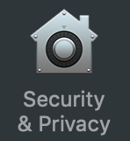
Data Destruction
Secure Deletion Tools for macOS local and removable devices
Apple macOS uses a stronger method of natively overwriting files and clearing free space
Disks encrypted with FileVault (local and removable) are secure even for deleted files (System Preferences / Security & Privacy)

Slide 14
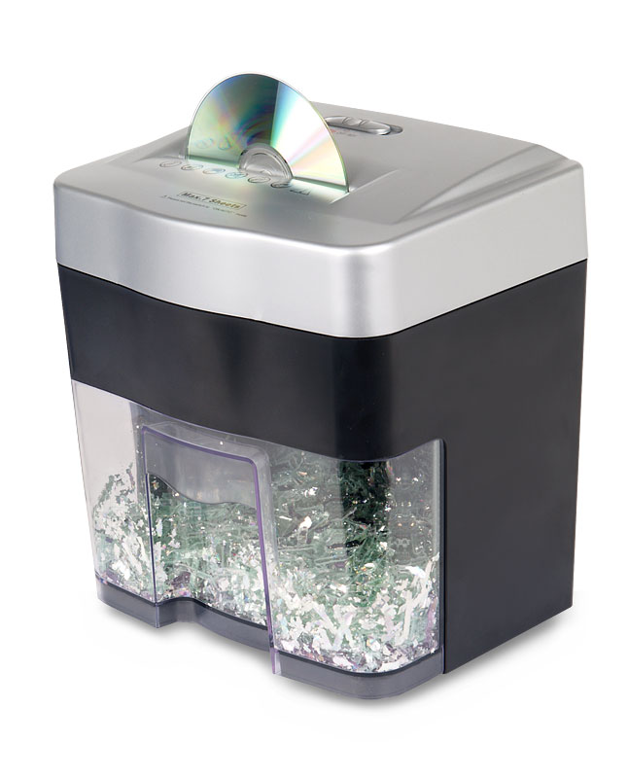
Data Destruction
Paper and DVD storage
DVD / CD media should be physically destroyed.
Paper records must be shredded
Use a cross-shredder

Slide 15
Summary
Be Vigilant with the Data you receive
Store on OneDrive or Dropbox on UML network
Share access only with team, faculty advisor, sponsor and CP instructor (ME)
Use Bitlocker / FileVault on local drives
Avoid downloading data on
PC
USB
External drives
Destroy, if downloaded, after use.
Delete all data on the Cloud Drive once project is over
If PC hacked or USB lost make sure to report to UML IT right away

