Slide 1
Web App Deployment
Andy

Slide 2












Pipeline
Framework
Framework
Access
API
Frontend
Database
Live server
DL model
Backend

Slide 3



Pipeline(Simplified)
Access
API
Frontend
DL model
Backend

Slide 4
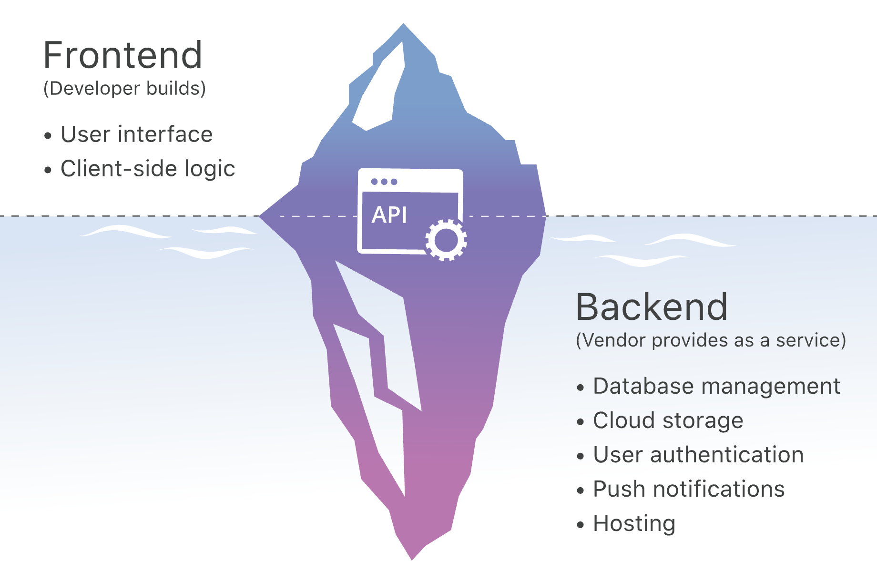
Frontend v.s. Backend

Slide 5
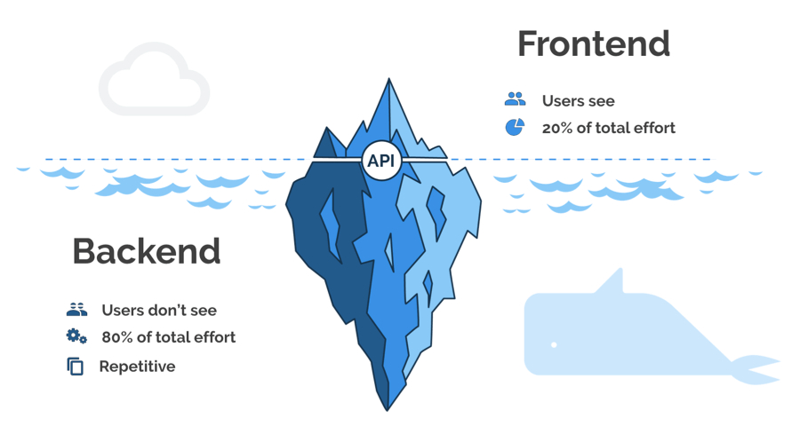
Frontend v.s. Backend

Slide 6

Frontend
Ancestor
Descendant
Endless ∞

Slide 7


Backend
Framework
API tester

Slide 8



Deployment

Slide 9
Useful Tool
Tailwind CSS
Material UI
Neumorphism.io

Slide 10
Github
Create personal account
Create a new repository
Add the local file into the online repository (SSH keys)
Finshed!

Slide 11
Vercel deployment
vercel.com

