Slide 1
Web App Deployment
Andy

Slide 2
Google drive

Slide 3












Pipeline
Framework
Framework
Access
API
Frontend
Database
Live server
DL model
Backend

Slide 4



Pipeline(Simplified)
Access
API
Frontend
DL model
Backend

Slide 5
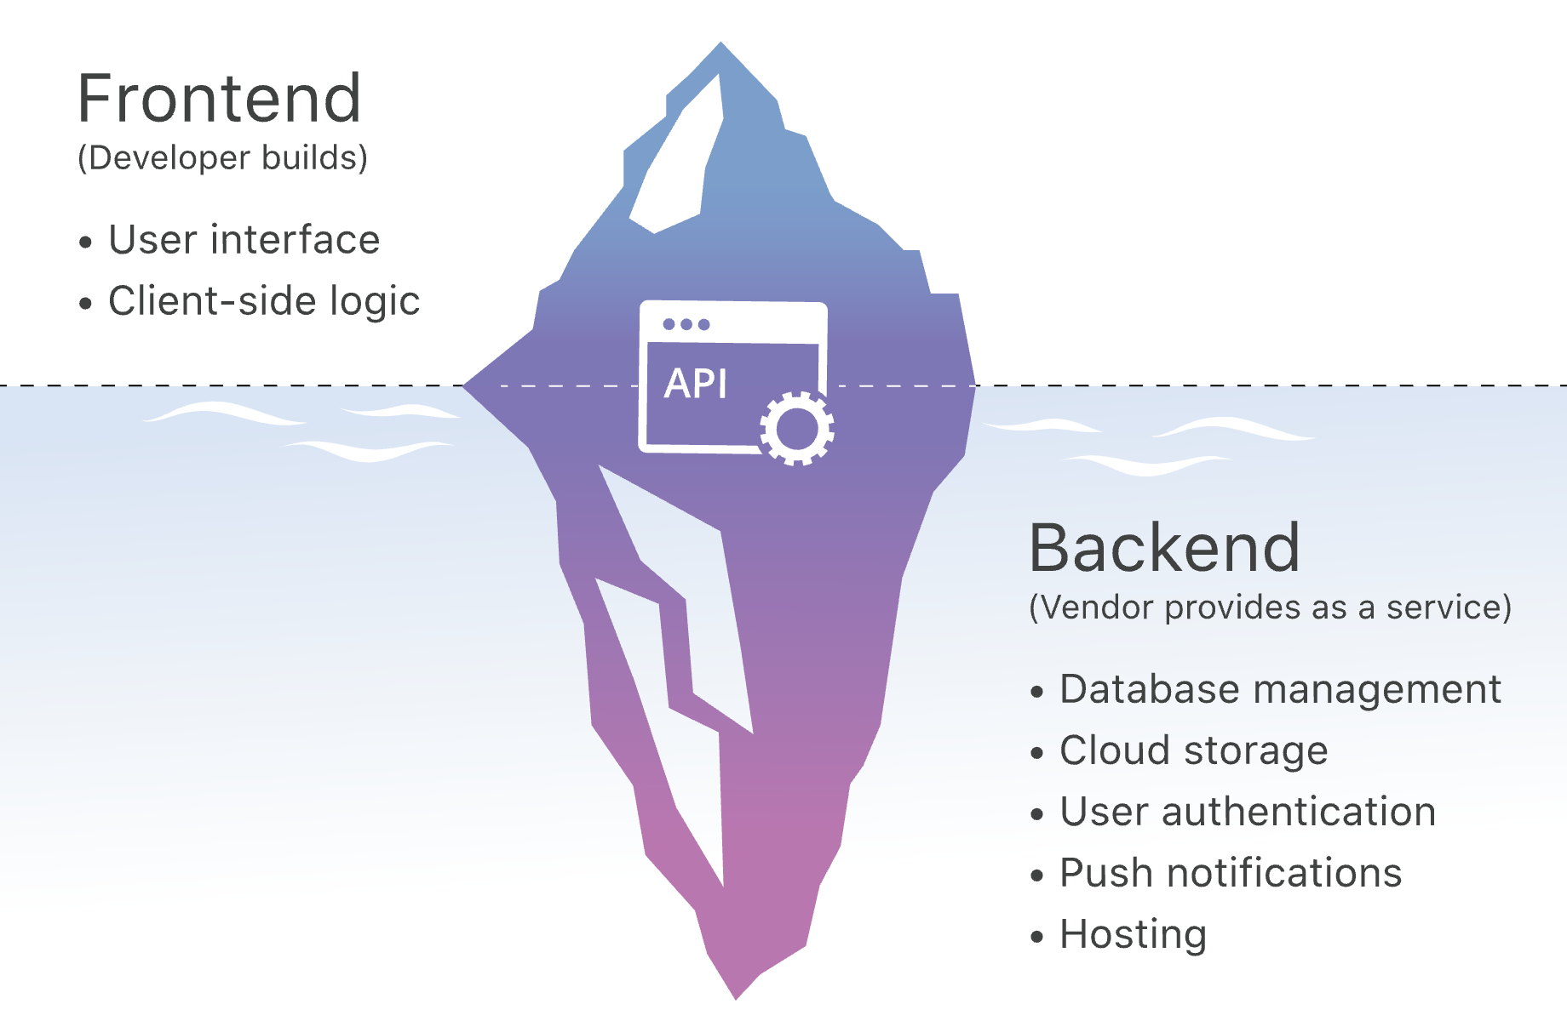
Frontend v.s. Backend

Slide 6
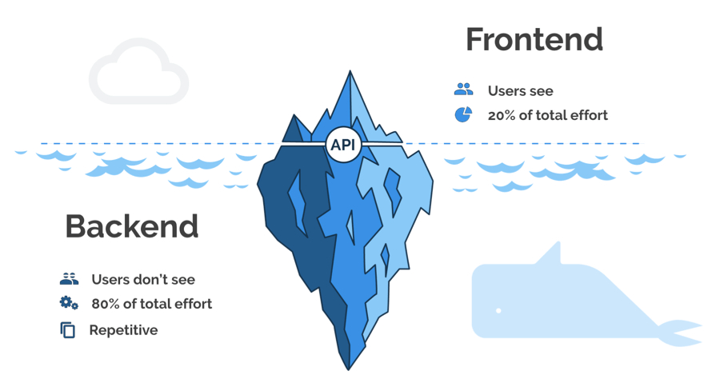
Frontend v.s. Backend

Slide 7

Frontend
Ancestor
Descendant
Endless ∞

Slide 8


Backend
Framework
API tester

Slide 9



Deployment

Slide 10
Useful Tool
Tailwind CSS
Material UI
Neumorphism.io

Slide 11
Github
Create personal account
Create a new repository
Add the local file into the online repository (SSH keys)
Finshed!

Slide 12
Vercel deplyment
vercel.com

