Slide 1
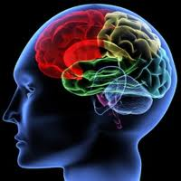
LONI Team 2 The Brain Puzzle
Bilal Bhakhrani
Emily Li
Tianyuan Qin
Ding Zhao
Mengyi Zhu

Slide 2
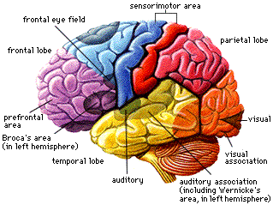
Motivation
Learn the anatomy of brain in a fun way
Make a free, open source alternative to similar commercial products
Challenge ourselves!

Slide 3
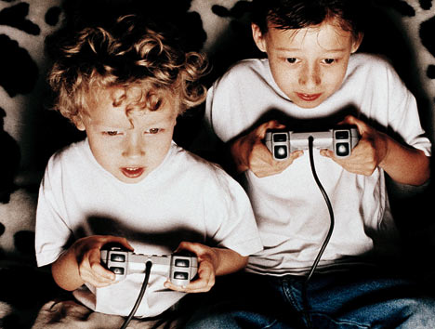
General Requirements
Generally, a playable game
Move and combine brain pieces freely using the mouse
Enable/Disable both visual and textual hints
Calculate/Show score
Select different levels
End game

Slide 4
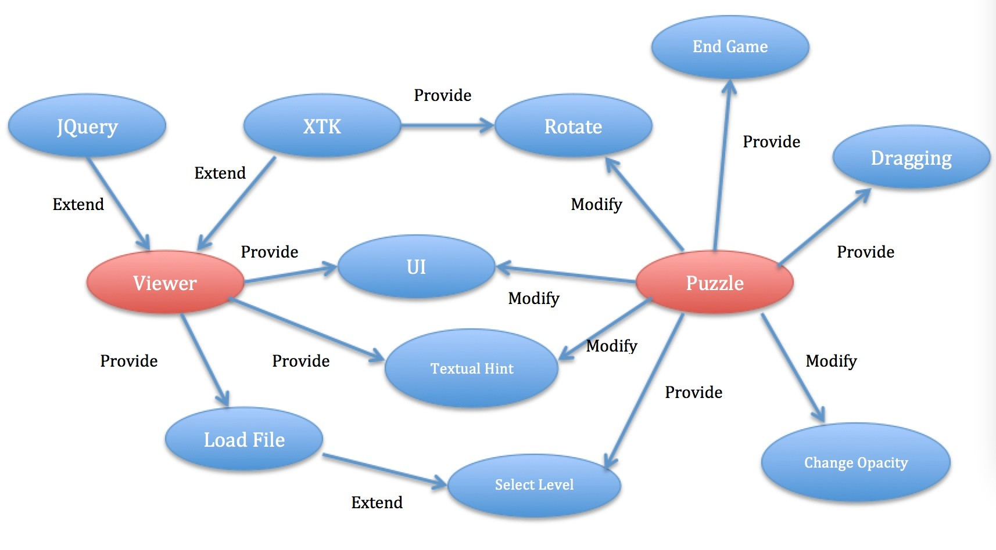
Design Interaction

Slide 5
Design Constraints
Extended from the original program
Tools
JavaScript
HTML, CSS
XTK Toolkit - The library provides the 3D rendering functionality; based on WebGL

Slide 6
Design – Selecting Level
Three levels can be chosen:
Easy: 13 pieces
Hard: 56 pieces
Custom: User-uploaded pieces
Each level has an option to show its answer

Slide 7
Design – Dragging and Rotation
Checkbox to toggle between dragging and rotation
Rotation
By clicking and dragging the mouse, rotate the scene around the center
Dragging
Move a selected brain piece in a 2D plane
Combining dragging and rotation, user can move a piece to anywhere in the 3D space

Slide 8
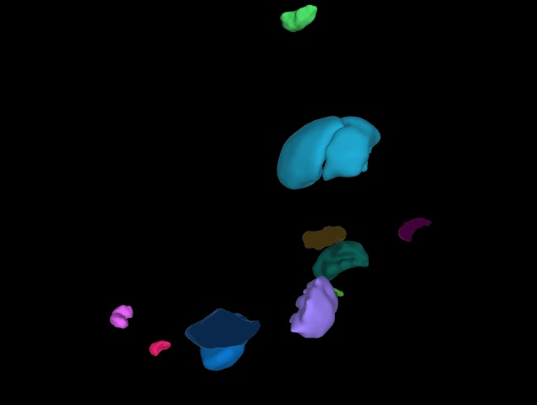
Design – Combining Pieces
Detect whether two pieces are combined
Indicate connection by changing the combined pieces to one color
End the game when all pieces are combined

Slide 9
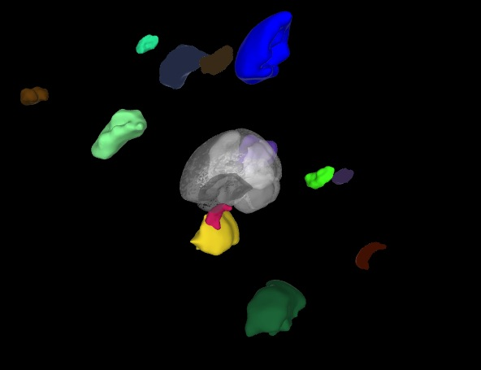
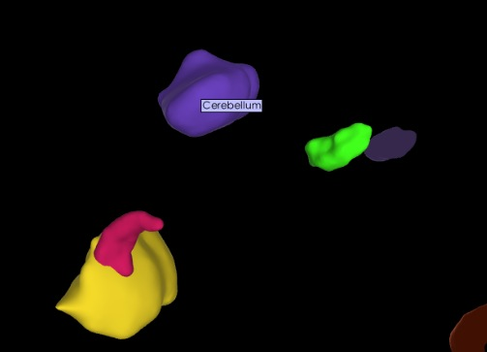
Design - Hints
Textual hints
Label a brain piece with its name
Visual hint
A transparent brain with all pieces combined
Both can be enabled and disabled

Slide 10

Design – Piece Properties
Enabled with dragging
Change the property of a selected piece
Property | Controller | Value
Color | Color panel | All RGB colors
Opacity | Slider | 0 ~ 1
Show/Hide | Icon | True/False

Slide 11
Design – End Game
Game ends when either
All pieces are combined
The “end-game” button is clicked
After the game ends, the score is calculated based on
Completion
Time spent
Hints used

Slide 12
Workload and Timeline
Week 5
SRS
Initialization
Week 6
Familiarity with code
Dragging
Week 7
Dragging
Hints, opacity/color change
Week 8
Week 9
Week 10
Combining pieces
Score calculation
Level selection
UI design and refinement
Testing
Final refinement
Design specification
Final report
Workload
light
medium
heavy

Slide 13

Challenges
Understanding the code:
LONI project
XTK library
Dragging
Transformation matrix
Camera view
Event handling

Slide 14

What We Have Learned…
Web-based graphic programming
UI design
Game design
Teamwork
Documentation Writing

Slide 15
Future Work
Security
Sound effects
Save game
Scoreboard
Competing with others

Slide 16
Thank you!

