Slide 1
3211 Project
Presentation of Part 1
Group Number : 8
Design : Elyse Wise
Implementation : Mikkel Myronenko
Results : Sacha Béraud

Slide 2
C/MIPS Translation
1a
loopj: BEQ j, N, end
ADDI i, $zero, 0
Loopi: BEQ i, N, end_i
ADDI k, $zero, 0
Loopk: BEQ k, N, end_k
ADD indexA, i, kN
ADD indexB, k, jN
ADD indexC, i, jN
LOAD temp1, indexA(Amem)
LOAD temp2, indexB(Bmem)
SUB temp1, temp1, temp2
ADD temp3, temp3, temp1
ADDI k, k, 1
ADD kN, kN, N
J loopk
end_k: STORE temp3, indexC(Cmem)
ADDI temp3, $zero, 0
ADDI i, i, 1
J loopi
end_i: ADDI j, j, 1
ADD jN, jN, N
J loopj
end:
int i=0, j=0,k=0, N=4;
while(i < N) {
j=0;
while(j < N) {
k=0;
while (k<N) {
c[i][j] += a[i][k] - b[k][j];
//taking care of abs
if (c[i][j] < 0) {
c[i][j] = -c[i][j];
}
//taking care of OVF
if(c[i][j] >= 127) {
c[i][j] = 127;
}
k++;
}
j++;
}
i++;
}
Elyse Wise

Slide 3
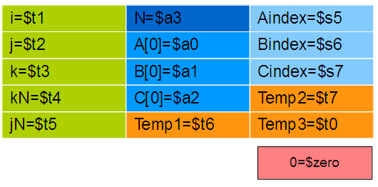
AL
1b
#init regiters to 0
ADD $t1, $zero, $zero
ADD $t2, $zero, $zero
ADD $t3, $zero, $zero
ADD $t4, $zero, $zero
ADD $t5, $zero, $zero
loopj: BEQ $t2, $a3, end #branch on j == N
ADD $t1, $zero, $zero
loopi: BEQ $t1, $a3, end_i #branch on i == N
ADD $t3, $zero, $zero
kloop: BEQ $t3, $a3, end_k #branch on k == N
ADD $s5, $t1, $t4 #find address of A to read
ADD $s5, $s5, $a0
ADD $s6, $t3, $t5 #find address of B to read
ADD $s6, $s6, $a1
ADD $s7, $t1, $t5 #find address of C to read
ADD $s7, $s7, $a2
LOAD $t6, 0($s5) #load value from A
LOAD $t7, 0($s6) #load value from B
SUB $t6, $t6, $t7 #absolute subtraction stored in temp1
ADD $t0, $t0, $t6 #keep new C value in temp3
ADDI $t3, $t3, 1 #increment k
ADD $t4, $t4, $a3 # add N to kN
J loopk #jump back to top of loop
end_k: STORE $t0, 0($s7) #store new C value once it is fully calculated
ADDI $t0, $zero, 0 #clear temp
ADDI $t1, $t1, 1 #increment i
J loopi #jump back to top of loop
end_i: ADDI $t2, $t2, 1 #increment j
ADD $t5, $t5, $a3 #add N to jN
J loopj #jump back to top of loop
end:
Elyse Wise

Slide 4
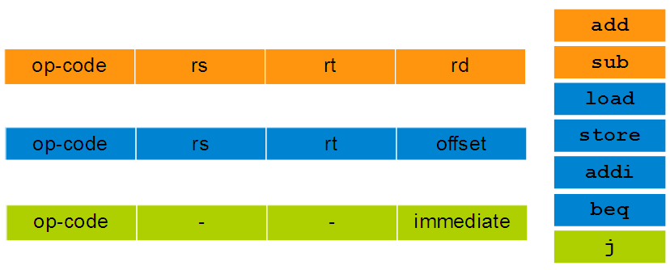

ISA
1c
Instruction Count
Elyse Wise

Slide 5
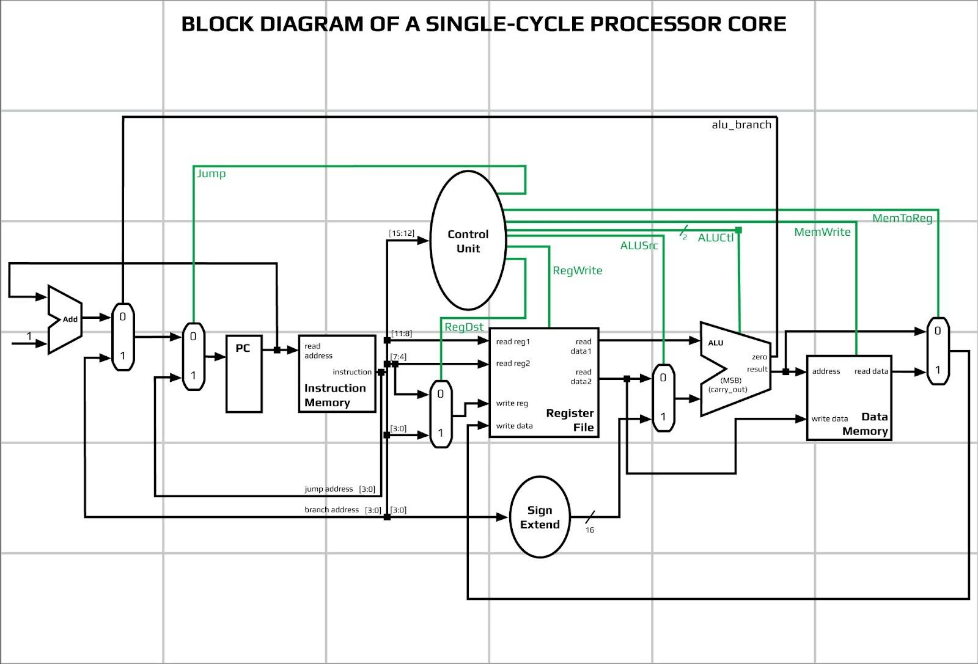
Block Diagram
2a
Mikkel Myronenko

Slide 6
ALU Block Diagram
2b
8
BEQ
0
1
8-bit Look-Ahead
Adder
cout
c7
sum
0
1
A
"7F"
Cin
sub
0
1
sum7
Res
0
1
8-bit Look-Ahead
Adder
0
1
sum
B
Cin
Mikkel Myronenko

Slide 7
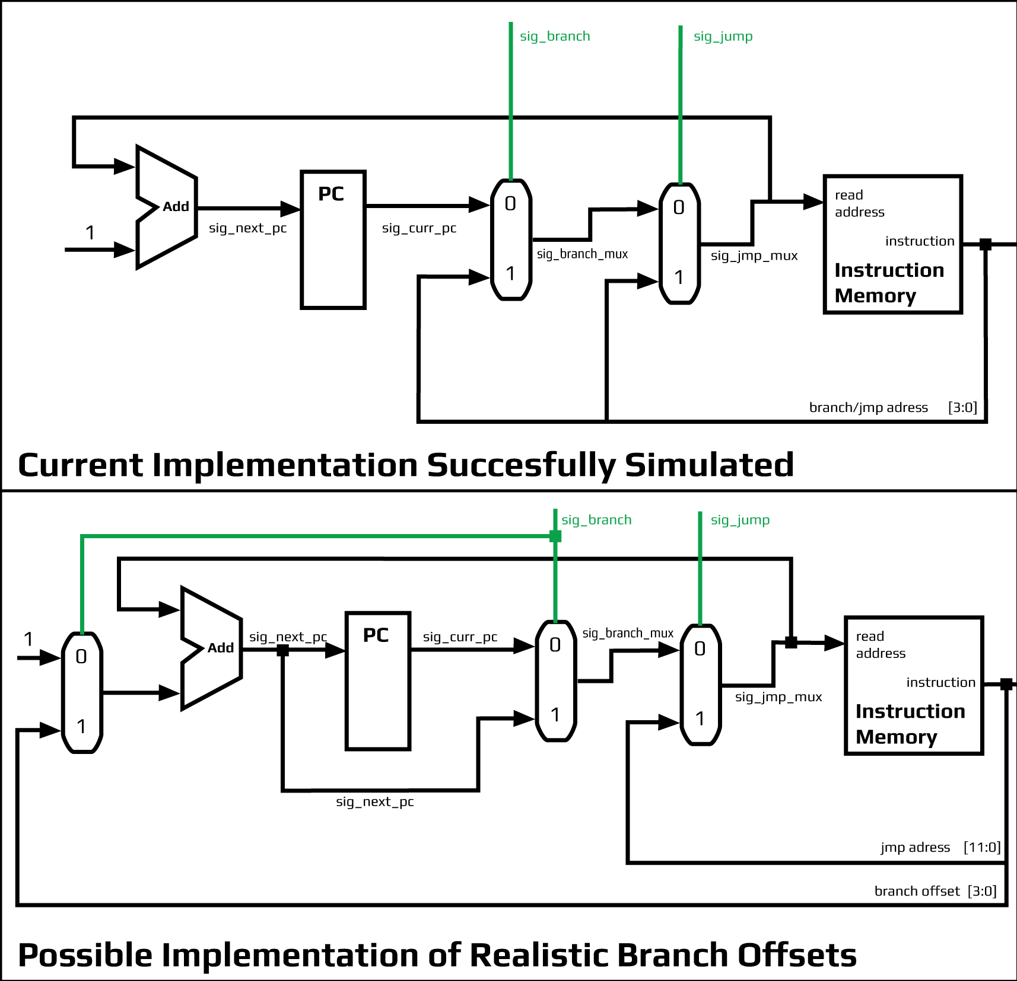
Branching and Jumping
2b
Mikkel Myronenko

Slide 8
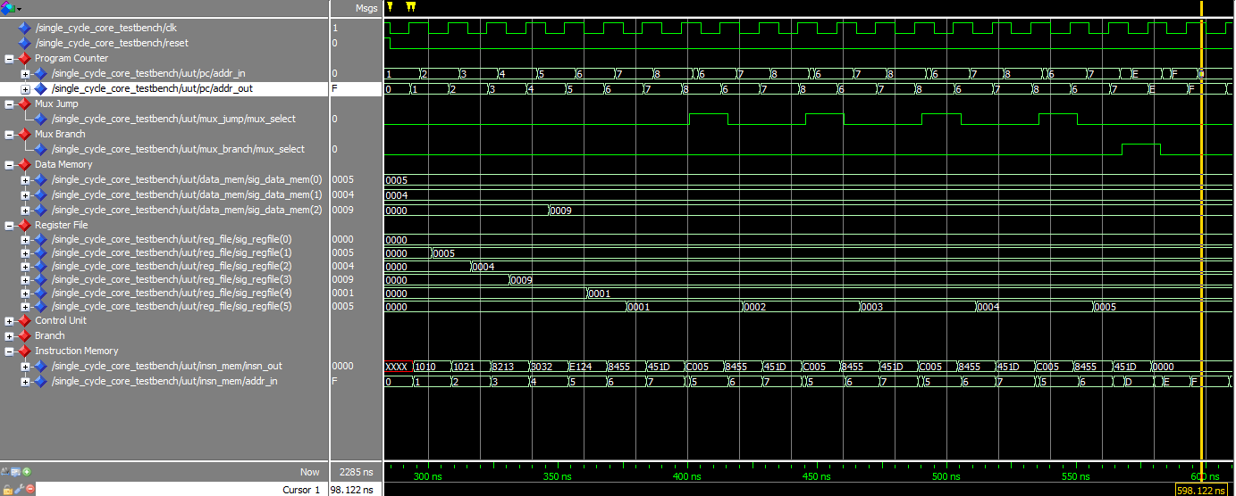
Program Walk through
3a
Waveform
Instructions
0 - load 5 -> $1
1 - load 4 -> $2
2 - add $1, $2 -> $3
3 - store $3 -> (0)$2
4 - subabs $1,$2 -> $4
5 - add $4, $5 -> $5
6 - beq $5, $1 -> insn D
7 - jmp insn 5
8 – nop
Nop
Nop
Nop
…
15 - Nop
Sacha Béraud

Slide 9
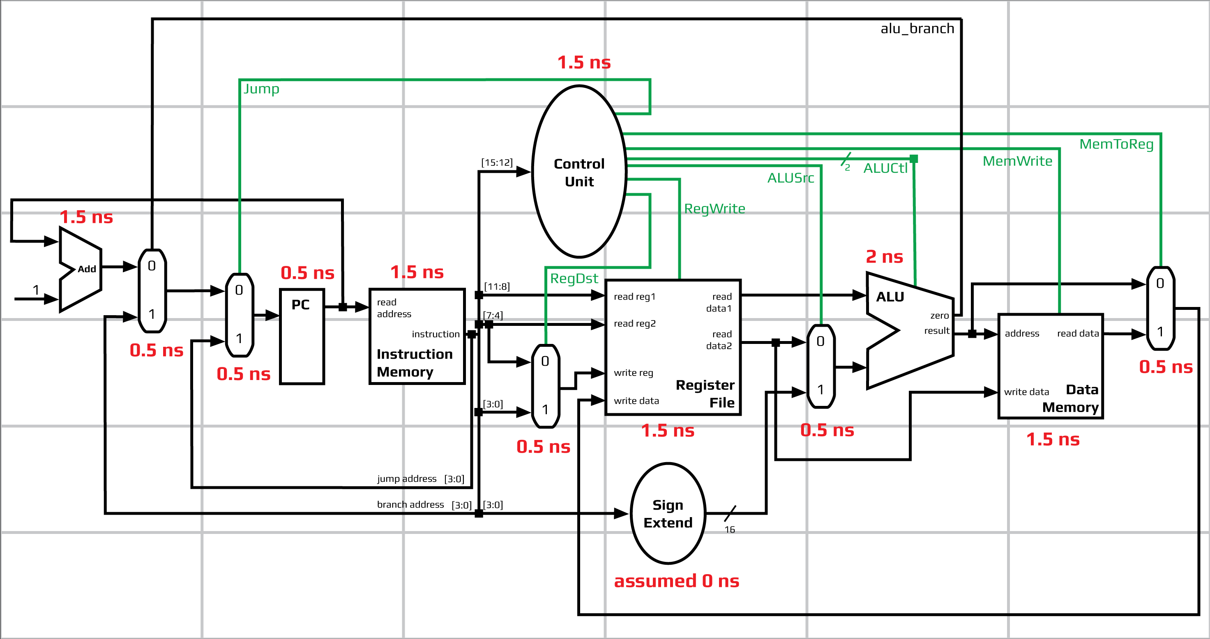
Cycle and Execution Time
3c
Block Diagram
Critical Path Derivation
PC
0.5 ns
+
Instruction
Memory
1.5 ns
+
+
+
Data
Memory
1.5 ns
+
=
TOTAL
8 ns
+
Control Unit
1.5 ns
Mux_ALU
0.5 ns
ALU
2 ns
Mux_write
0.5 ns
Sacha Béraud

Slide 10
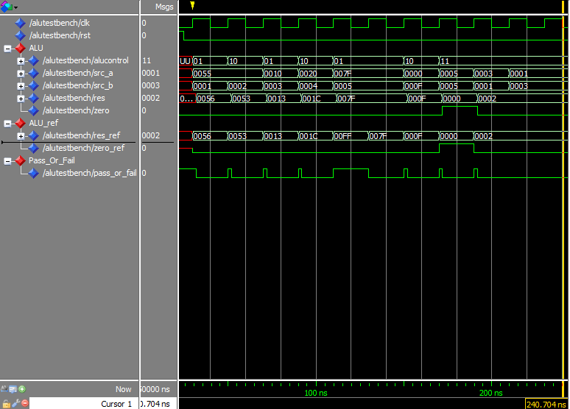
Results
3
b
d
ALU
Branch and Jump
Sacha Béraud

Slide 11
Thank You
Easter Break ! Yeah !

