Slide 1
SQL DATA ANALYST PORTFOLIO PROJECT
ZEPTO SALES
ANALYSIS
Prepared by
Aniket Bhanudas Agunde
MYSQL WORKBENCH • SQL QUERIES • BUSINESS INSIGHTS

Slide 2
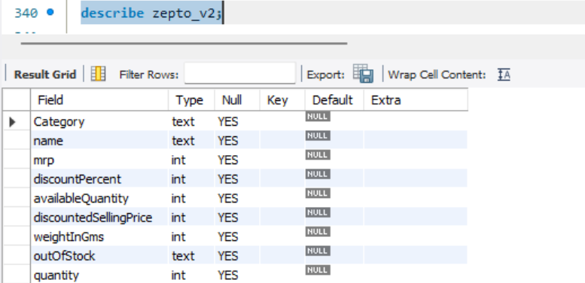
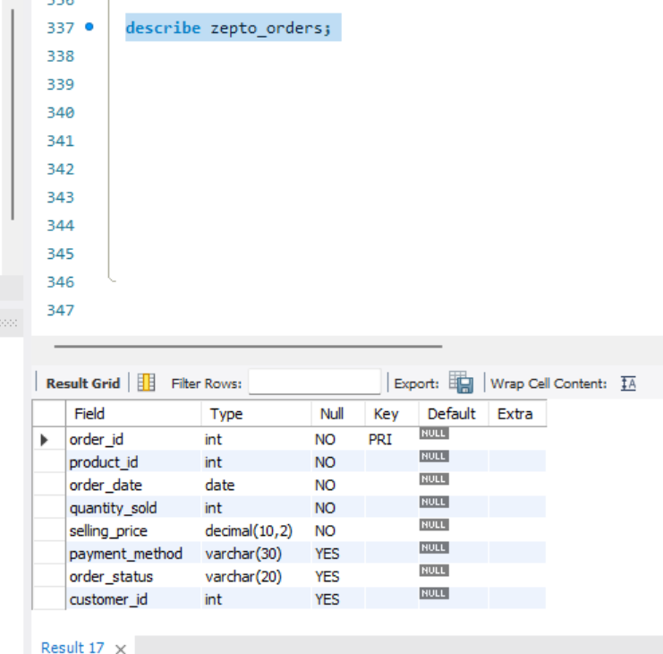
Database Schema & Tables
01 / UNDERSTAND THE DATA
Product table — zepto_v2
Product-level information such as product_id, name, category, MRP and quantity (confirm exact columns).
Orders table — zepto_orders
Order-level/transaction fields such as order_id, product_id, order_date, quantity_sold, selling_price and order_status.
Purpose: confirm table names, column names and data types before writing joins or calculations.
02 / 10

Slide 3
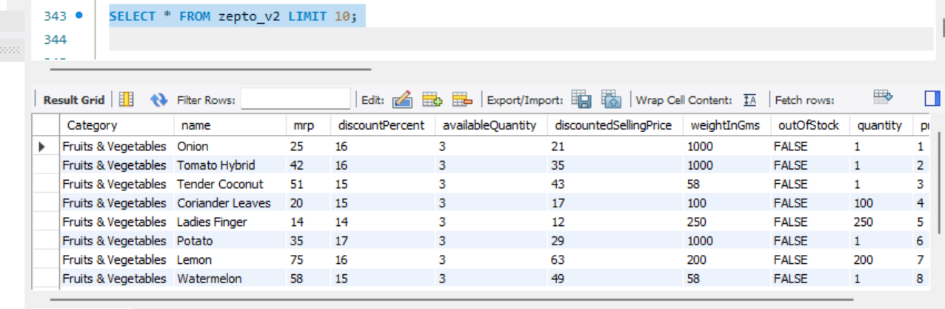
Product Table — zepto_v2
02 / EXPLORE PRODUCT DATA
SELECT *
FROM zepto_v2
LIMIT 10;
Query explanation
Returns the first 10 product records so you can inspect product names, categories and available pricing fields.
Business use: understand the product catalog before analyzing sales.
03 / 10

Slide 4
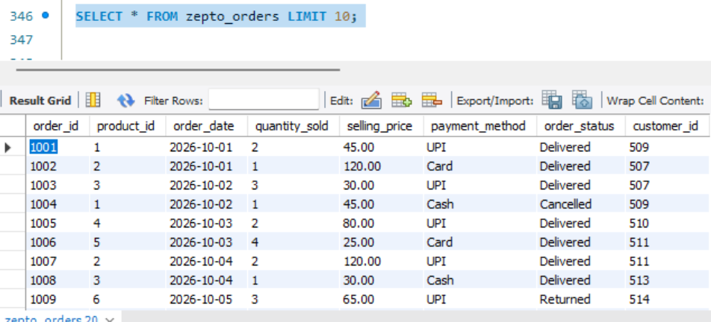
Orders Table — zepto_orders
SCREENSHOT TO ADD
Orders output grid
Show the query and 10 actual order rows.
03 / EXPLORE TRANSACTION DATA
SELECT *
FROM zepto_orders
LIMIT 10;
Query explanation
Displays sample order records and helps verify order IDs, product IDs, quantities, prices, dates and statuses.
Business use: validate the fields required for sales and status analysis.
04 / 10

Slide 5
Business Problem & Objectives
04 / DEFINE THE QUESTIONS
Business problem
The store needs a clearer view of product sales, revenue contribution and order-status performance to support inventory and sales decisions.
01 Product performance
02 Revenue contribution
03 Order status
Which products sell the most units?
Which products generate the highest sales revenue?
How are orders distributed by status?
Objective: use SQL JOINs, aggregation and sorting to turn raw records into actionable business insights.
05 / 10

Slide 6
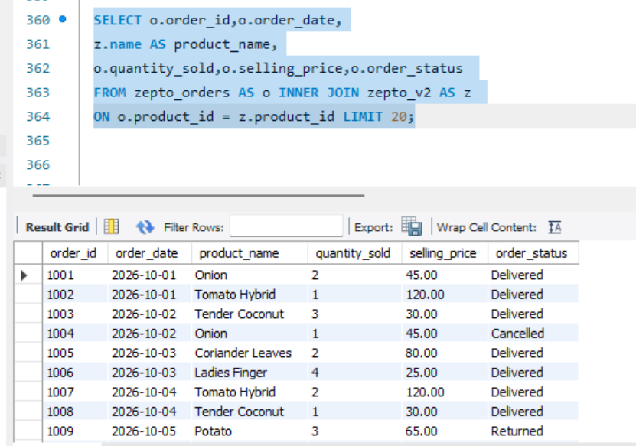
JOIN Analysis — Orders + Products
05 / COMBINE RELATED DATA
SCREENSHOT TO ADD
Query + results
Add your actual MySQL screenshot.
SELECT
o.order_id,
o.order_date,
z.name AS product_name,
o.quantity_sold,
o.selling_price,
o.order_status
FROM zepto_orders AS o
INNER JOIN zepto_v2 AS z
ON o.product_id = z.product_id
LIMIT 20;
What the JOIN does
Matches orders to product details using product_id.
Why it matters
Product names and transaction details can now be analyzed together.
06 / 10

Slide 7
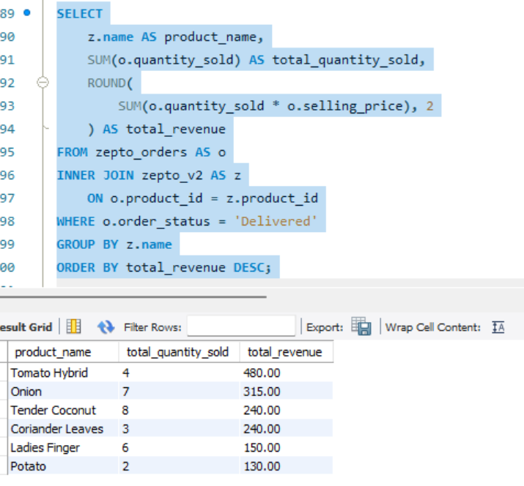
Revenue Analysis by Product
SCREENSHOT TO ADD
Revenue query output
Capture product name, quantity and revenue.
06 / MEASURE SALES CONTRIBUTION
SELECT
z.name AS product_name,
SUM(o.quantity_sold) AS total_quantity_sold,
ROUND(SUM(o.quantity_sold * o.selling_price), 2)
AS total_revenue
FROM zepto_orders AS o
INNER JOIN zepto_v2 AS z
ON o.product_id = z.product_id
WHERE o.order_status = 'Delivered'
GROUP BY z.name
ORDER BY total_revenue DESC;
Calculation
Assumes selling_price is the per-unit price. If it is already a line total, do not multiply by quantity again.
How to read it
The first rows are the products with the highest calculated delivered sales revenue.
07 / 10

Slide 8
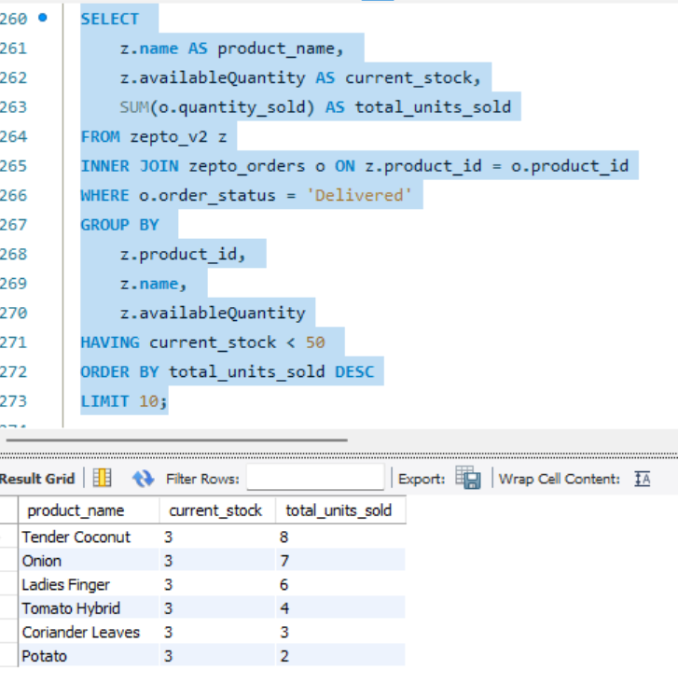
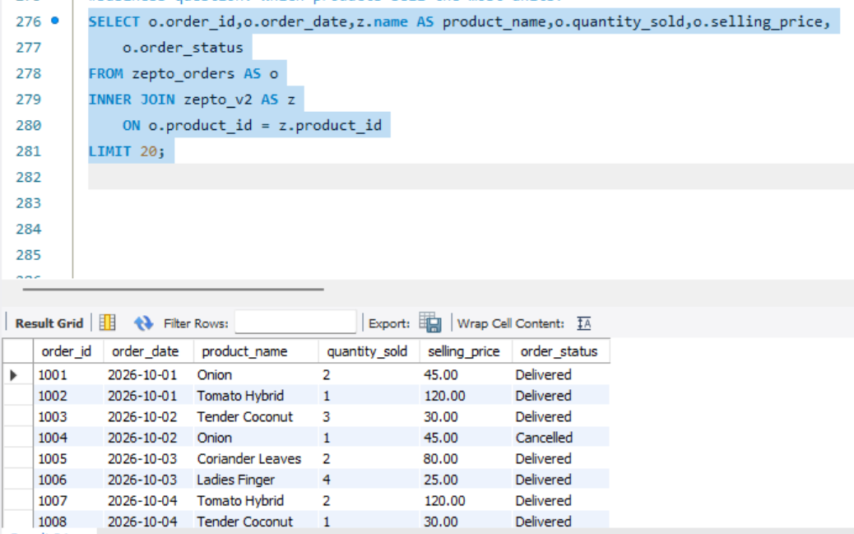
Top Products & Order Status
B. Orders by status
07 / COMPARE VOLUME AND FULFILMENT
A. Top 10 products by quantity
SELECT z.name AS product_name,
SUM(o.quantity_sold) AS total_quantity_sold
FROM zepto_orders o
JOIN zepto_v2 z ON o.product_id = z.product_id
WHERE o.order_status = 'Delivered'
GROUP BY z.name
ORDER BY total_quantity_sold DESC
LIMIT 10;
SELECT order_status,
COUNT(DISTINCT order_id) AS total_orders
FROM zepto_orders
GROUP BY order_status
ORDER BY total_orders DESC;
SCREENSHOT TO ADD
Status result grid
Capture actual status counts.
Insight: high-volume products may need closer stock monitoring.
08 / 10

Slide 9
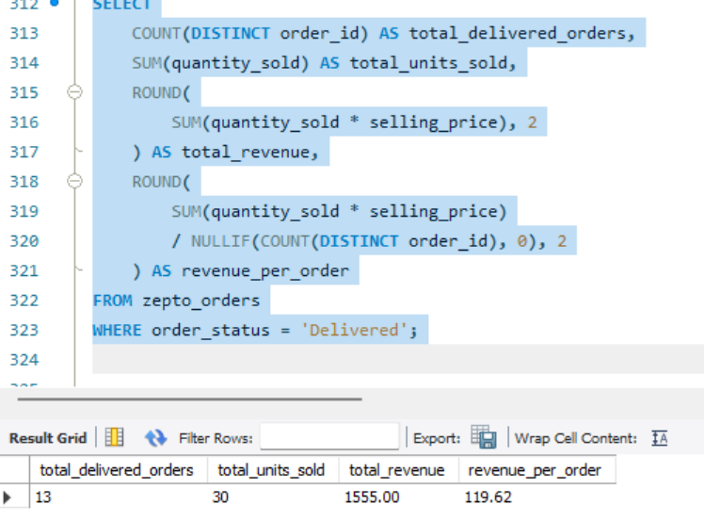
KPI Summary
Delivered orders
Revenue & revenue/order
Units sold
08 / ONE-ROW PERFORMANCE SNAPSHOT
SELECT
COUNT(DISTINCT order_id) AS total_delivered_orders,
SUM(quantity_sold) AS total_units_sold,
ROUND(SUM(quantity_sold * selling_price), 2) AS total_revenue,
ROUND(
SUM(quantity_sold * selling_price) /
NULLIF(COUNT(DISTINCT order_id), 0), 2
) AS revenue_per_order
FROM zepto_orders
WHERE order_status = 'Delivered';
13
30
R1555 &
119.62
SCREENSHOT TO ADD
KPI output grid
Insert actual MySQL results; do not invent values.
09 / 10

Slide 10
PROJECT TAKEAWAYS
Conclusion & Recommendations
01 Inventory
02 Sales strategy
Monitor high-volume products and plan replenishment.
Review pricing and promotions for high-revenue products.
03 Order fulfilment
04 KPI monitoring
Review cancellation patterns and investigate causes.
Track delivered orders, units sold and revenue regularly.
Thank you • Aniket Bhanudas Agunde

