Slide 1




10 2CHII
cz;
a formidable body of great mathem .al interest aid j ""
PROBABILITY
The theory of probabilities and the th o' of errors now con .
i' _.
.,I
practical importance.
,,
,v
15.1 Introduction
In Class IX, you have studie o which were based on the r s of tossing a coin 1000 times 1
·V.
odward
thefr,, e
) probabilities of events t e discussed an experiment he outcomes were as follows:
xpe mental (
a ual expe·
Head : 455 i :545
455
Based on this expe , the empie,.obability of a head is 000 , i.e., 0.455 and
1
Example 1, Chapter 15 of Class IX Mathematics
that of getting a tail is 0.545.
Textbook.) Note that the e r b s are based on the results of an actual experiment
of tossing a coin 1000 ti e . or this reason, they are called experimental or empirical
probabilities. In f el\i ental probabilities are based on the results of actual
prob:a?-c
experiments and ad e recordings of the happening of the events. Moreover,
these only 'estimates'. If we pcrform the same experiment for another
1000 time
get different data giving different probability estimates.
head numb
, you tossed a coin many times and noted the number of times it turned up
s) (refer to Activities 1 and 2 of Chapter 15). You also noted that as the osses of the coin increased, the experimental probability of getting a head
1
(or tail) came closer and closer to the number ₂· Not only you, but many other

Slide 2

296
MATHEMATICS
persons from different parts of the world have done this kind of experiment and recorded the number of heads that turned up.
For example, the eighteenth century French naturalist Comte de Buffon tossed a coin 4040 times and got 2048 heads. The experimental probabilility of getting a head,
in this case, was ²⁰⁴⁸ , i.e., 0.507. J.E. Kerrich, from Britain, recorded 5067 heads in 4040
10000 tosses of a coin. The experimental probability of getting a head, in this ca0
was
5067
10000
= 0.5067. Statistician Karl Pearson spent some more time, making 24 0
tosses of a coin. He got 12012 heads, and thus, the experimental probab -lit o d obtained by him was 0.5005.
Now, suppose we ask, 'What will the expp ntal probabii.y f
be if the d so on?'
2, which is what we calli pmbabM"Vi;ng a head (or getting a
experiment is carried on upto, say, one milli e s.
10 mil,
"V g do
You would intuitively feel that as th :, o
sses
he experimental
Vn enumber 0.5 , i.e.,
p;obability of a head (or a tail) seems.
tail), as you will see in the · on. In thi iN:we provide an introduction to the theoretical (also called class 1) probab vent, and discuss simple problems
based on this concr5j'\ '
15.2 Probabilithy eoreti:@,proach
Let us consider the followin n : Suppose a coin is tosseddom.
When we speak a that there is no reas
e assume it to be 'fair', that is, it is symmetrical so r it to come down more often on one side than the other.
We call this we mea
perty of the coin as being 'unbiased'. By the phrase 'random toss', coin is allowed to fall freely without any bias or inte,ference.
w, in advance, that the coin can only land in one of two possible ways­ eitherd:p or tail up (we dismiss the possibility of its 'landing' on its edge, which may be possible, for example, if it falls on sand). We can reasonably assume that each outcome, head or tail, is as likely to occur as the other. We refer to this by saying that the outcomes head and tail, are equally likely.

Slide 3
PROBABILITY
297
For another example of equally likely outcomes, suppose we throw a die once. For us, a die will always mean a fair die. What are the possible outcomes? They are 1, 2, 3, 4, 5, 6. Each number has the same possibility of showing up. So
the equally likely outcomes of throwing a die are 1, 2, 3, 4, 5 and 6.
and a blue ball equally likely? Since there are 4 red balls and only one blue ball,to
Are the outcomes of every experiment equally likely? Let us see.
Suppose that a bag contains 4 red balls and 1 blue ball, and you draw a ball
without looking into the bag. What are the outcomes? Are the outcomes - a red ball
would agree that you are more likely to get a red ball than a blue ball. So, the outco (a red ball or a blue ball) are not equally likely. However, the outcome of dr · ball of any colour from the bag is equally likely. So, all experiments do not nee have equally likely outcomes.
i
However, in this chapter, from now on, we assume that all rnnents
have equally likely outcomes.
In Class IX, we defined the experi
•
pir ·cal ity P(E) of an
'-.
event E as ► '-._
Number of
ch thee en ened mber o · s
P(E)= otal
The empirical interpr p abilit:e;n a lied to every event associated with an experiment which c be peatei:r u er of times. The requirement of repeating an ex · ent ha some li tat , as it may be very expensive or
unfeasible in many· experiments. Buth
ati ns. Of course, it w ked well in coin tossing or die throwing ut repeatiQ.t;.experiment of launching a satellite in order
to compute the empirical pro ··'IJfailure during launching, or the repetition of
the phenomenon of an earthq e storeyed building gettin stroy
compute the empirical probability of a multi­ in an earthquake?
In experimen e of an experiment c e
are prepared to make certain assumptions, the repetition oided, as the assumptions help in directly calculating the
exact (theoretyl) pro15a ility. The assumption of equally likely outcomes (which is valid in ents, as in the two examples above, of a coin and of a die) is one such assu -e that leads us to the following definition of probability of an event.
oretical probability (also called classical probability) of an event E, writte P(E), is defined as
_{P(E) =} Number of outcomes favourable to E , Number of all possible outcomes of the experiment

Slide 4
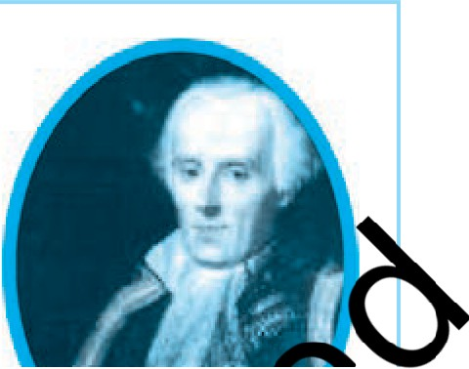
298
MATHEMATICS
where we assume that the outcomes of the experiment are equally likely.
We will briefly refer to theoretical probability as probability.
This definition of probability was given by Pierre Simon Laplace in 1795.
Probability theory had its origin in the 16th century when an Italian physician and mathematician J.Cardan wrote the first book on the subject, The Book on Games of Chance. Since its inception, the study of probability has attracted the attention of great mathematicians. James Bernoulli (1654 - 1705), A. de Moivre (1667 - 1754), and
Pierre Simon Laplace are among those who made significant contributions to this field. Laplace's Theorie Analytique des Probabilites, 1812, is considered to be h greatest contribution by a single person to the theory o obability.
I
Pi re I"• aplace
'-.'1"J
In recent years, probability has been us te ·yely in
-i/1827)
I
many areas such as biology, economics, n · p ysics,,
""''
sociology etc.
"""4,
Let us find the probability o he even iated with experiments
where the equally likely ass i . <'t
Example 1 : Find the proba· 1 getti :O n a coin is tossed once. Also
find the probability f etting a il.
Solution : In the e ri nt of tossra·
'Ci/
a coi nee, the number of possible outcomes
is two - Head (HJ ail (T). L outcomes favourable to E, (
the event 'getting a head'. The number of g a head) is 1. Therefore,
'Vrriber of outcomes favourable to E 1
^{P(E)}.^{=P}'⁽V⁼_ Number of all possible outcomes
- ₂
Similarly, ifF is th getting a tail', then
P(F) = P(tail) = ½
(Why ?)
Exa Qagcontains a red ball, a blue ball and a yellow ball, all the balls being of the esize. Kritika takes out a ball from the bag without looking into it. What is the probability that she takes out the
(i) yellow ball? (ii) red ball? (iii) blue ball?

Slide 5
PROBABILITY
299
Solution : Kritika takes out a ball from the bag without looking into it. So, it is equally likely that she takes out any one of them.
Let Y be the event 'the ball taken out is yellow', B be the event 'the ball taken out is blue', and R be the event 'the ball taken out is red'.
Now, the number of possible outcomes= 3.
(i) The number of outcomes favourable to the event Y = 1.
eo
1
So, P(Y) = -
3
Similarly, (ii) P(R) =
1
3
and (iii) P(B) =i
1
Remarks:
1. An event having only one outcome of th eriment is c♦ller m:ntary
event. In Example 1, both the events E an are ementar ..,,...Jlmilarly, in
Example 2, all the three events, Y, B and r enta ,'
2. In Example 1, we note that: P(E)
'-.V
elementary events of
In Example 2, we note that: P(Y(f"P (B) = 1...
general al x►
Observe that the sum abilitie V.
an experiment is 1. This·
Example 3 : Suppose we thro a die ollfi. at is the probability of getting a number greater th i) What is the p bility of getting a number less than or
equalto4?
Solution : (i) Here, let E be
f"> ...
ting a number greater than 4'. The number
o=numbcr(P greater than 4) = ¾ = 3
of possible outcomes is six: 1, 3, , 5 and 6, and the outcomes favourable to E are 5
and 6. Therefore, the number of tcomes favourable to E is 2. So,
(ii) Let F be t vent 'getting a number less than or equal to 4'. Number oA'Veoutcomes = 6
Outc Vurable to the event Fare 1, 2, 3, 4. So, th ;ber of outcomes favourable to F is 4.
4 2
Therefore,
P(F) = - = -
6 3

Slide 6
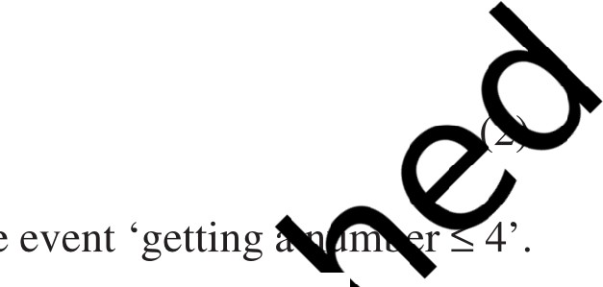

300
MATHEMATICS
Are the events E and Fin the example above elementary events? No, they are
not because the event E has 2 outcomes and the event F has 4 outcomes.
Remarks: From Example 1, we note that
1 1
P(E) + P(F) = ₂ + ₂ = 1
where Eis the event 'getting a head' and Fis the event 'getting a tail'.
From (i) and (ii) of Example 3, we also get
(1)
1 2
P(E) + P(F) = ₃+ ₃ = 1
Note that getting a number not greater th than or equal to 4, and vice versa.
is same as g;/ti
ber less
'? Y '
'-. ,._.,,/
In (1) nd (2) above, is F not the a e
note the event
P(E) + P(not:) = 1 r .;::,..
'notE' by E.
y'-.
So,
i.e.,
P(E) + P( E =
In general, it is tr e
- )=
gives E) = 1 - P(E).
an eve
-P(E)
The event E enting ' ', is called the complement of the event E. We also say that E and E eSAlliJ ff1entary events.
Before proceeding furthe , try to find the answers to the following questions:
What is the probaWffl'\of getting a number 8 in a single throw of a die?
What is the p "-/of getting a number less than 7 in a single throw of a die?
Let us answyi) :
We know AVare only six possible outcomes in a single throw of a die. These outc ,liwl2, 3, 4, 5 and 6. Since no face of the die is marked 8, so there is no outc e ourable to 8, i.e., the number of such outcomes is zero. In other words,
getting ·n a single throw of a die, is impossible.
0
So,
P(getting 8) = ₆ = 0

Slide 7
PROBABILITY
301
That is, the probability of an event which is impossible to occur is 0. Such an event is called an impossible event.
Let us answer (ii) :
Since every face of a die is marked with a number less than 7, it is sure that we will always get a number less than 7 when it is thrown once. So, the number of favourable outcomes is the same as the number of all possible outcomes, which is 6.
6
Therefore,
P(E) = P(getting a number less than 7) = ₆ = 1
)..
So, the probability of an event which is sure (or certain) to occur is 1. Such a V
is called a sure event or a certain event.
Note : From the definition of the probability P(E), we see that the num er of outcomes favourable to the event E) is alway!Jt.s than or equal to rmnator
(the number of all possible outcomes). Theref(e,°' "'
Now, let us take an exampl:,:12,£:c:ar you seen a deck of
dia4'
playing cards? It consists of 52 ca
divide ·n of 13 cards each­
clubs ( and spades are of black
spades ( ), hearts (y), ♦) a
colour, while hearts and di mo s of red col
. e cards in each suit are ace,
king, queen, jack, 10, 9, 8,
cards.
, , , 3 and 2. i eens and jacks are called face
probability that the ll e
be an ace,
not be an ace.
.('Ci/
Example 4 : Onerawn from a we uffled deck of 52 cards. Calculate the
"'
V
Solution : Well-s ioures equally likely outcomes.
(i) There are 4 a a deck. Let Ebe the event 'the card is an ace'.
The0rof possible outcomes = 52 (Why ?)
P(E) = ₅₂ = ₁₃!_
The nu
outcomes favourable to E = 4
re
ore'
(ii) Let F be the event 'card drawn is not an ace'.
The number of outcomes favourable to the event F = 52 - 4 = 48 (Why?)

Slide 8

302
MATHEMATICS
The number of possible outcomes = 52
Therefore, P(F) = -=-
48 12
52 13
Remark : Note that Fis nothing but E. Therefore, we can also calculate P(F) as
_ 1 12
follows: P(F) = P(E) = 1 - P(E) = 1-₁₃=₁₃·
Example 5 : Two players, Sangeeta and Reshma, play a tennis match. It is kno that the probability of Sangeeta winning the match is 0.62. What is the probat:fl!)>
Reshma winning the match?
Solution : Let S and R denote the events that a wins the match, respectively.
."-/
eeta wins the ma shrna
The probability ofReshma₀'s winn _{'17(_c} - P
♦
K"T:
The probability of Sangeeta's winning= -
(give
vcnt },,'are complementaryl
0
Example 6 : Savita and have (i) different birthday
e friends ! the probability that both will he samz, ? gnoring a leap year).
Solution : Out of t riends, one girl, year. Now, Hamid day can
Savita's birthday can be any day of the any day of 365 days in the year.
We assume that these 365 o qually likely.
IfHamida's birthday is di from Savita's, the number of favourable outcomes for her birthday is 1 = 364
So, P (Hami "'ay is different from Savita's birthday) = ;:
P(S_{o}avit amida have the same birthday)
= 1 - P (both have different birthdays)
"
,.
₌ ₁₋ 364 -
₃₆₅ [Using P(E) = 1 - P(E)]
=
1
365

Slide 9
PROBABILITY
303
Example 7 : There are 40 students in Class X of a school of whom 25 are girls and 15 are boys. The class teacher has to select one student as a class representative. She writes the name of each student on a separate card, the cards being identical. Then she puts cards in a bag and stirs them thoroughly. She then draws one card from the bag. What is the probability that the name written on the card is the name of (i) a girl?
(ii) a boy?
Solution : There are 40 students, and only one name card has to be chosen.
The number of outcomes favourable for a card with the name of a girl = 25(Who
(i) The number of all possible outcomes is 40
n
25 5
":(
l ny?)
Therefore, P (card with name of a girl)= P(Girl) = =
40 8
(ii) The number of outcomes favourable for a c ith the name of a;
Therefore, P(card with name of a bo
_{J =} 15 '
40
Note : We can also determine P(Boy
-
P( GotBoyn..:::ir,,_n= 2 |  |  | =:3
Example 8 : A box contai | 2 white, | )(marbles. Ifa m:rbl:isdrawn
at random from the box, what | he proba i | it will be
(i) white? lue? |  | red?
Solution : Saying t arble isd marbles are equally likely t
number of possible outco
random is a short way of saying that all the
. herefore, the
(Why?)
Let W denote the event arble iswhite', B denote the event 'the marble is blue' and R denote the e -le isred'.
(i) The num utcomes favourable to the event W = 2
So, 0 P(W)= 3_
Similar (ii) P(B) = ;
= _I_ and (iii) P(R) = - ⁴
9 3
9
Note that P(W) + P(B) + P(R) = 1.

Slide 10
304
MATHEMATICS
Example 9 : Harpreet tosses two different coins simultaneously (say, one is of 1 and other of 2). What is the probability that she gets at least one head?
Solution : We write H for 'head' and T for 'tail'. When two coins are tossed simultaneously, the possible outcomes are (H, H), (H, T), (T, H), (T, T), which are all equally likely. Here (H, H) means head up on the first coin (say on 1) and head up
The outcomes favourable to the event E, 'at least one head' are (H, H), (H,o
on the second coin( 2). Similarly (H, T) means head up on the first coin and tail up on
the second coin and so on.
and (T, H). (Why?)
e,
So, the number of outcomes favourable to Eis 3.
letd
Therefore,
P(E) = ¾
3
i.e., the probability that Harpreet gets at is 4·''"
Note: You can also find P(E) as foll°7
'
p (E) = 1- pry,
M=P(no head) = ¹ )
4
4
Did you observe that in a uples disAo far, the number of possible outcomes in each experim ·nite? If n t now.
There are ma y ex erime s in whi<Ji ome is any number between two given numbers, o·r jl'lhii the outcome is y point within a circle or rectangle, etc. Can you now cou mber of ssible outcomes? As you know, this is not
possible since there are mfin ·tel are infinitely many points wi which you have learnt so far ca
mbers between two given numbers, or there a cle. So, the definition of (theoretical) probability be applied in the present form. What is the way
out? To answer this, let sider the following example :
Example 10* : Irt\( l chair game, the person playing the music has been advised to stop play1 music at any time within 2 minutes after she starts playing. What is the pr bility that the music will stop within the first half-minute after starting?
Solution : possible outcomes are all the numbers between O and 2. This is the p "1J.e number line from Oto 2 (see Fig. 15.1).
" 011₂
2
Fig. 15.1
* Not from the examination point of view.

Slide 11
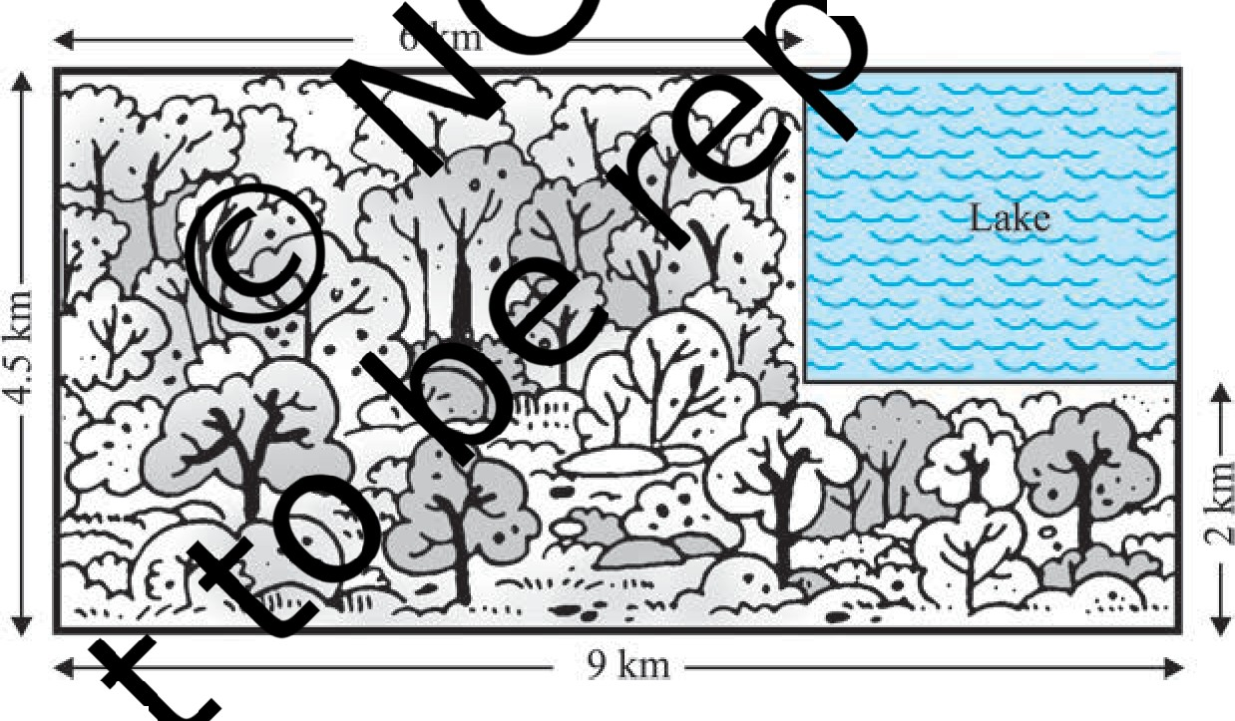
PROBABILITY
305
Let Ebe the event that 'the music is stopped within the first half-minute'.
The outcomes favourable to E are points on the number line from O to _!_.
2
The distance from Oto 2 is 2, while the distance from O to ₂ is ₂.
1 1
0
Since all the outcomes are equally likely, we can argue that, of the total distance
1
of 2, the distance favourable to the event Eis 2.
_ 1 n
So '
P(E)=
Distance favourable to the event E
=- 'C./
Total distance in which utc mes can lie 2 ,2' ...,
the favourable area to the total area? <1-.: "7
Can we now extend the idea of Example 10 f i · ng the prob he ratio of
Example 11*: A missing helicopter r ii' rectangular region shown in Fig. 1 . ·t lake shown in the figure?
have
he prob b
somewhere in the t crashed inside the
0
Fig. 15.2
Solu e helicopter is equally likely to crash anywhere in the region. Area e...e. ntire region where the helicopter can crash
= (4.5 x 9) km² = 40.5 km²
* Not from the examination point of view.

Slide 12
306
MATHEMATICS
Area of the lake= (2.5 x 3) km² = 7.5 km²
7.5 75 5
Therefore, P (helicopter crashed in the lake)= ₄₀_₅ = ₄₀₅ = ₂₇
Example 12 : A carton consists of 100 shirts of which 88 are good, 8 have minor defects and 4 have major defects. Jimmy, a trader, will only accept the shirts which are good, but Sujatha, another trader, will only reject the shirts which have major
e V
defects. One shirt is drawn at random from the carton. What is the probability tha
(i) it is acceptable to Jimmy?
(ii) it is acceptable to Sujatha?
Solution: One shirt is drawn at random fro rton of 1 ",).erefore,
there are 100 equally likely outcomes.
\gimmy )88
(i) The number of outcomes favou '•c e;tab y =88 (Why?)
Therefore,P (shirt is
(ii) The number of outco
rable to 88 + 8 = 96 (Why?)
So, P (shirt is able to Sujatha) ₀₀ = 0.96
Example 13 : Tw one blue &Jt'Qe grey, are thrown at the same time. Write down all the possible outcom e probability that the sum of the two numbers
lo (iii) less than or equal to 12?
appearing on the top of the die'¥
(i) 8?
Solution : numbers 1
'6'. T e
t e die shows '1', the grey die could show any one of the
' 6. The same is true when the blue die shows '2', '3', '4', '5' or outcomes of the experiment are listed in the table below; the first
num in number
ch ordered pair is the number appearing on the blue die and the second that on the grey die.

Slide 13
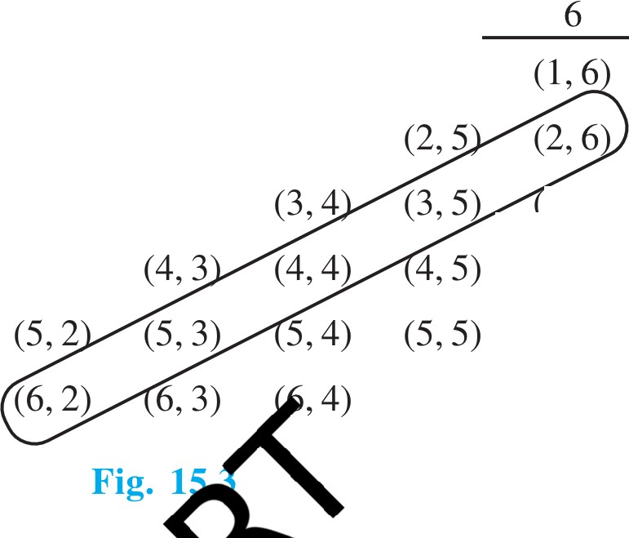
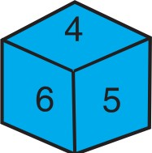

PROBABILITY
307
®
3 4
1
2
5
1 | (1, 1) | (1, 2) | (1, 3) | (1, 4) | (1, 5)
2 | (2, 1) | (2,2) | (2,3) | (2,4)
3 | (3, 1) | (3, 2) | (3, 3) |  | 3,6)
4 | (4, 1) | (4, 2) |  |  | (4,6)
5 | (5, 1) |  |  |  | (5,6)
X.
nY
'C...f
6
(6, 1)
(6,5).
Note that the pair (I, 4) is different So, the number of possible outco -v.= 6
- y?)
36. ... '-. V
(i) The outcomes favour e ev t 'the s o numbers is 8' denoted
by E, are: (2, 6), (3, 5 4,
es avou,,e;;
, , (6, 2) e F . 15.3)
i.e., the number of outc
© PCf>_₃₆
Hence,
(ii) As you can see frVom
ereis no outcome favourable to the event F,
So, o P(F)= 306 =0
'the sum of two numbers'¥'.
(iii) As you from Fig. 15.3, all the outcomes are favourable to the event G,
'su::eo numbers::; 12'.
36
P(G) = - = 1
36

Slide 14
308
MATHEMATICS
EXERCISE 15.1
Complete the following statements:
Probability of an event E + Probability of the event 'not E' = _
The probability of an event that cannot happen is .Such an event is called _
The probability of an event that is certain to happen is .Such an event is called _
(iv) The sum f the probabilities of all the elementary events of an experimen
and les Y
(v) The probability of an event is greater than or equal to equal to
Which of the following experiments have equall ikely outcomes?
A driver attempts to start a car. The c ts or does not •ar
·"-'
A player attempts to shoot a bask
A trial is made to answer a tru ls
A baby is born. It is a boEa· .
a She shoots eshot.
... 'V
est10n. Th ght or wrong.
3. Why is tossing a coin conside d to be a ir way of d hich team should get the
ball at the beginning o e?
4. Whic: of the followin'e the probe n event?
(A) 1.5
(C) (D) 0.7
'notE'?
candies only. Malini takes out one candy without probability that she takes out
3
If P(E) = 0.05 the proba
A bag contains lemon looking into the bag. Whary
an orange fla candy?
a lemonVo andy?
It is giv n hatroup of 3 students, the probability of 2 students not having the same bi ay is 0.992. What is the probability that the 2 students have the same birth"'
A,; ins3red balls and 5 black balls. A ball is drawn at random from the bag.
- the probability that the ball drawn is (i) red ? (ii) not red?
A Box contains 5 red marbles, 8 white marbles and 4 green marbles. One marble is taken out of the box at random. What is the probability that the marble taken out will be
(i) red? (ii) white? (iii) not green?

Slide 15
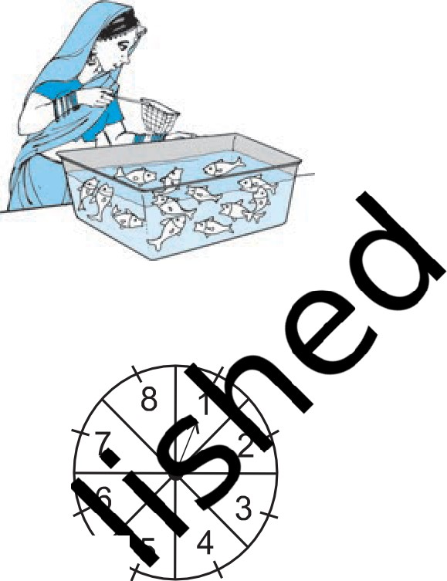

PROBABILITY
309
A piggy bank contains hundred 50p coins, fifty 1 coins, twenty 2 coins and ten 5 coins. If it is equally likely that one of the coins will fall out when the bank is turned upside down, what is the probability that the coin (i) will be a 50 p coin ? (ii) will not be a 5coin?
Gopi buys a fish from a shop for his aquarium. The shopkeeper takes out one fish at random from a tank containing 5 male fish and 8 female fish (see Fig. 15.4). What is the probability that the fish taken out is a male fish?
12. A game of chance consists of spinning an arrow which comes to rest pointing at one of the numbers 1, 2, 3,4,5,6, 7, 8 (seeFig.15.5 ),and these are equally likely outcomes. What is the probability that it will
Fig. 15.4
point at
8?
an odd number?
a number greater than 2?
a number less than 9?
(\..
'
--
'-,.-
15 5
13. A die is thrown once. Find th ba of getting
ig. ·
(i) a prime number; i-
14. One card is drawn fro
(i) a king of red colour
(iv) thejack{Q
a...ing betw
; (iii) an odd number.
s. Find the probability of getting
(iii) a red face card
(vi) the queen of diamonds
uffled deer;
(ii) aT
(v) a e
15. Five cards-
face downwar e card is th
e · ck, queen and ace of diamonds, are well-shuffled with their
c d up at random. e card is the queen?
ut aside, what is the probability that the second card
) a queen?
What is the proba
If the queen is drawn picked up is ( ce?
12 defective ac dentally mixed with 132 good ones. It is not possible to just look at a pen a 11 ether or not it is defective. One pen is taken out at random from this lot.itermine e probability that the pen taken out is a good one.
(i) ulbs contain 4 defective ones. One bulb is drawn at random from the lot. hat the probability that this bulb is defective?
ose the bulb drawn in (i) is not defective and is not replaced. Now one bulb Brawn at random from the rest. What is the probability that this bulb is not
defective?
A box contains 90 discs which are numbered from 1 to 90. If one disc is drawn at random from the box, find the probability that it bears (i) a two-digit number (ii) a perfect square number (iii) a number divisible by 5.

Slide 16

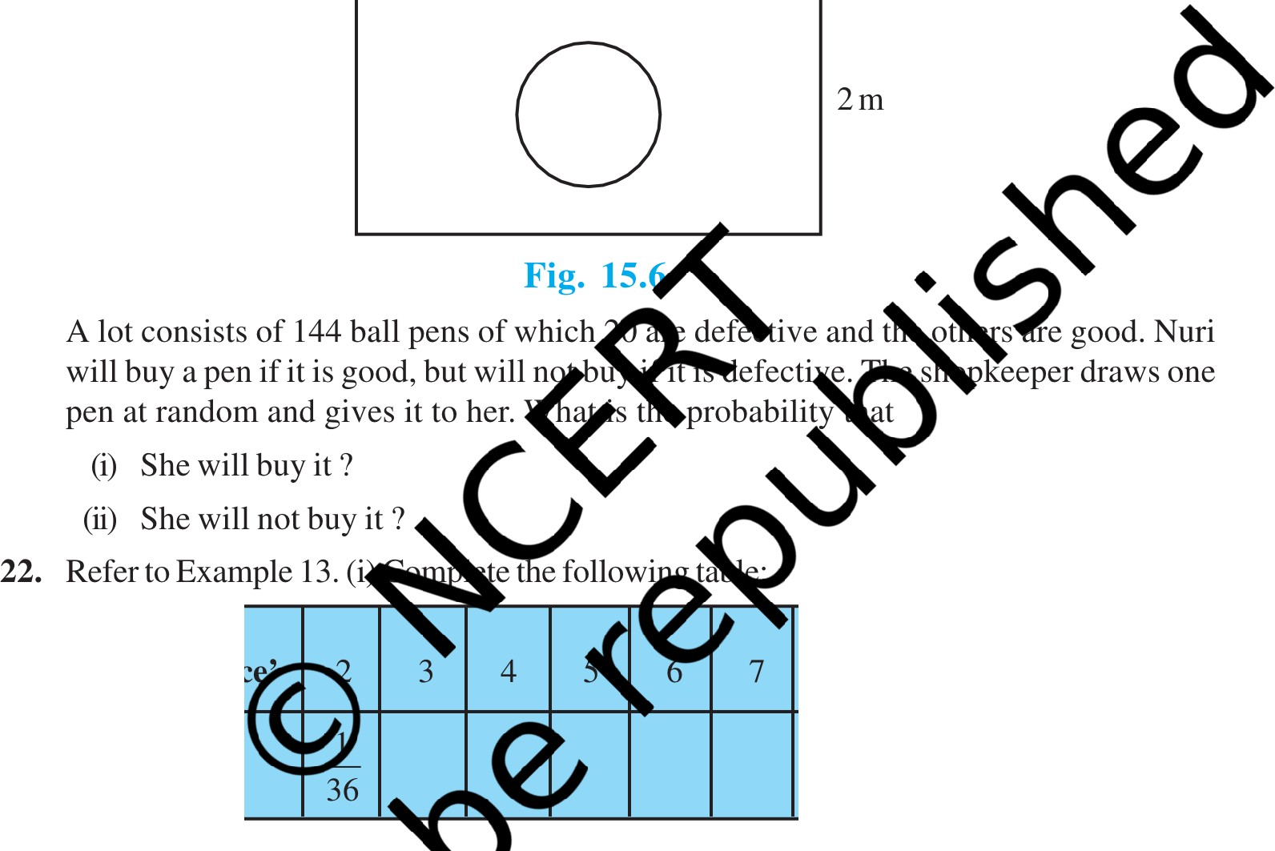
310
MATHEMATICS
19. A child has a die whose six faces show the letters as given below:
The die is thrown once. What is the probability of getting (i) A? (ii) D?
20*. Suppose you drop a die at random on the rectangular region shown in Fig. 15.6. What is the probability that it will land inside the circle with diameter lm?
3m
21.
Event:
'Sum on 2 die '
8
9
10 11 12
Probability
5
36
1
36
(ii) A student argues that 't
are 11 possible outcomes 2, 3, 4, 5, 6, 7, 8, 9, 10, 11 and
Justify yVa'-l.
23. A game5ists ssing a one rupee coin 3 times and noting its outcome each time. Hanif wi ·fa 1 the tosses give the same result i.e., three heads or three tails, and loses
12. Therefore f them has a probability ₁\ . Do you agree with this argument?
othe culate the probability that Hanif will lose the game.
24". 1..J:own twice. What is the probability that
_ will not come up either time? (ii) 5 will come up at least once?
[Hmt : Throwing a die twice and throwing two dice simultaneously are treated as the same experiment]
* Not from the examination point of view.

Slide 17
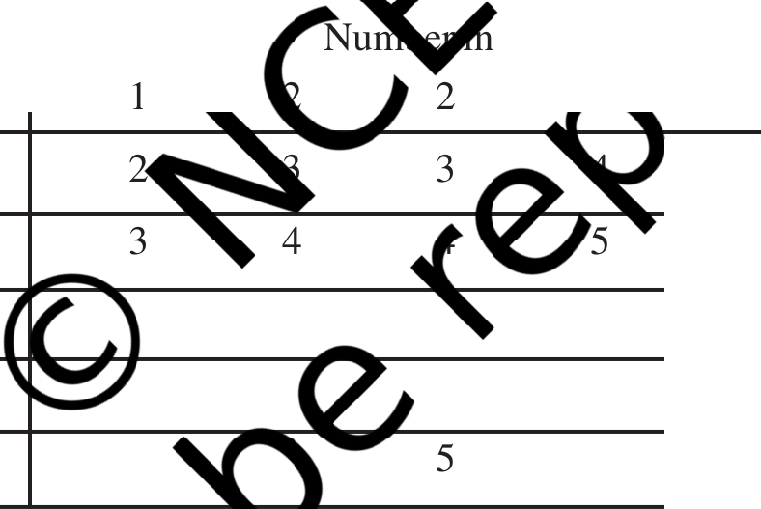
PROBABILITY
311
Which of the following arguments are correct and which are not correct? Give reasons for your answer.
If two coins are tossed simultaneously there are three possible outcomes-two heads, two tails or one of each. Therefore, for each of these outcomes, the
probability isi ¹
If a die is thrown, there are two possible outcomes-an odd number or an even
1
number. Therefore, the probability of getting an odd number is ₂.
)..
V
EXERCISE 15.2 (Optional)*
1. Two customers Shyam and Ekta are visiting a particular shop in the same week (Q:.
to Saturday). Each is equally likely to visit the shop on any day as on an Vs.:r
is the probability that both will visit the shop days? (iii) different days?
2. A die is numbered in such a way that i thrown two times and the total scor
(i) the same day?s nsecutive
♦
the num ' ,3, 3, 6. It is s is ete the following the '-. s:
table which gives a few values of t
+
first thr
3
4
5
5
6
7
8
2
2
....
3
3
6
<l)
9
12
s
.D
_{z}::l
7 8
9
9
What is the p bcatthe total score is
(i) even? - ) 6? (iii) at least 6?
is doAVoia red ball, determine the number of blue balls in the bag.
4. ains 12 balls out of which x are black.If one ball is drawn at random from the
3. A bag cX;ns "red balls and some blue balls. If the probability of drawing a blue ball
x, at is the probability that it will be a black ball?
If more black balls are put in the box, the probability of drawing a black ball is now
double of what it was before. Find x.
* These exercises are not from the examination point of view.

Slide 18


312
MATHEMATICS
5. A jar contains 24 marbles, some are green and others are blue. If a marble is drawn at
random from the jar, the probability that it is green is • Find the number of blue balls
3
in the jar.
15.3 Summary
In this chapter, you have studied the following points :
1. The difference between experimental probability and theoretical probability.
2. The theoretical (classical) probability of an event E, written as P(E), is defined asv
)..
n
Number of outcomes favourable to E
^{P(E)=} Number of all possible outcomes of the experim
where we assume that the outcomes of the ex ent are equall li
'(/
3. The probability ofa sure event (or certai8: t
''
5. The probability of an event Era·s l:v
4. The probability of an impossible e }
'
sucha, V
O P) l
6. An event having only e tc is called entary event. The sum of the
7. For any event@;+ P ,) = 1, .w..J;e""ndsfor 'not E'. E and E are called
probabilities of all thee
events of ttf'> entis 1.
complementar.o .
e
N TE TO THE READER
The experimWa mpirical probability of an event is based on what ha ua appened while the theoretical probability of the
event at assu i
t to predict what will happen on the basis of certain
. As the number of trials in an experiment, go on wme aexpyect the experimental and theoretical
b ·1ities to be nearly the same.

