Slide 1
MINI PROJECT · PROBABILITY & STATISTICS
CRICSHEET · IPL 2008–2025
The First Six Overs
Broadcasts say the powerplay sets up the match. This project tests that claim with 1,227 IPL matches — and finds the toss is close to worthless, while wickets lost in the first six overs are not.
2,454 TEAM INNINGS · 18 SEASONS · 15 TEAMS · 60 VENUES · R · ONE REPRODUCIBLE SCRIPT
Notes:
Open on the claim, not on the method. One line: 1,227 IPL matches, two questions — did the toss matter, did the powerplay matter. Answer up front: toss barely, powerplay clearly. Detail follows.

Slide 2
CONTENTS
02 / 26
Eight beats, in the order the brief asks for.
01
Project title
05
Data cleaning
The First Six Overs
Filters, standardised names, derived columns
02
Aim / problem statement
06
Data implementation
Six research questions, no outcome leakage
R · cricketdata, dplyr, ggplot2, broom
03
Domain theory
07
Data analysis
Powerplay, fielding restrictions, the toss
RQ1–RQ6 · tests, bands, regression
04
Data description with reference
08
Conclusion
Cricsheet ball-by-ball IPL · cited in full
The verdict, the limits, what stays open
BEATS 1–8 FOLLOW IN THAT ORDER; EACH OPENS WITH ITS OWN SECTION DIVIDER.
Notes:
Read the eight beats once, quickly, then move on. This is the map the rest of the deck walks: title, aim, theory, data and its source, cleaning, implementation, analysis, conclusion.

Slide 3
BEFORE WE START
03 / 26
“Win the powerplay, win the match.”
COMMENTARY FOLKLORE — PRESUMED TRUE, NEVER TESTED
Momentum is an argument from memory. Conditional probability is an argument from data. Six research questions later the folklore survives — but not the half of it that blames the toss.
Notes:
Frame the stakes: this is a claim everyone repeats. We treat it as a hypothesis.

Slide 4
01
SECTION 01
Aim
Turn a claim made in the commentary box into a testable question about conditional probability.
01 · AIM
Notes:
Six sections. Aim, theory, data, implementation, analysis, conclusion.

Slide 5
01 · AIM
PROBLEM STATEMENT · RQ1–RQ6
Estimate how the toss and the powerplay are associated with winning.
The match result is a binary outcome. Every explanatory variable is known by the end of the sixth over, so the model never sees the final score of the match it is predicting — no outcome leakage.
RQ1
Probability of winning after winning the toss?
CONDITIONAL PROBABILITY · BAYES
RQ2
Is the toss independent of the match result?
CHI-SQUARE TEST OF INDEPENDENCE
RQ3
Do winners score more in the powerplay?
MEAN · VARIANCE · CI · T-TEST
RQ4
Do powerplay wickets follow Poisson?
POISSON · GOODNESS OF FIT
RQ5
How does win probability move across score and wicket bands?
BIVARIATE · CONDITIONAL PROBABILITY
RQ6
Which early variables matter most?
CORRELATION · LOGISTIC REGRESSION
EXPLANATORY VARIABLES: TOSS OUTCOME · TOSS DECISION · POWERPLAY RUNS · POWERPLAY WICKETS
Notes:
Walk the six questions in two rows. Emphasise the leakage rule — it is the design decision that makes the model honest.

Slide 6
01 · AIM
H0 / H1 · Α = 0.05
Three null hypotheses, stated before the data was touched.
TOSS IMPACT
POWERPLAY SCORE
POWERPLAY WICKETS
H₀ Toss result and match result are independent.
H₁ Toss result and match result are associated.
H₀ Winning and losing teams share the same mean powerplay score.
H₁ Winning teams score higher.
H₀ Wickets lost follow a Poisson distribution with estimated λ.
H₁ Observed wickets differ from Poisson.
WHY IT MATTERS
A hypothesis written after seeing the result is not a test — it is a caption. These three were fixed first.
Notes:
Small slide, big point: pre-registered hypotheses. α = 0.05 throughout.

Slide 7
02
SECTION 02
Domain theory
Why the first six overs are the most volatile — and the best-documented — part of a T20 innings.
02 · THEORY
Notes:
Necessary context before any number: what the powerplay is, and why it is a trade-off rather than a free run-scoring window.

Slide 8
02 · DOMAIN THEORY
OVERS 1–6
Restrictions cut both ways.
In the powerplay only two fielders may stand outside the 30-yard circle. Boundaries get cheaper — and so do wickets, because batters attack from ball one.
Fielders allowed outside the circle
2
Balls per powerplay
36
Share of the innings
30%
That is the momentum story: a fast start, the argument goes, forces the opposition onto the back foot for the remaining fourteen overs.
Observations per team
36 balls
Outcome variable
win / loss
Predictor cutoff
end of over 6
DESIGN CONSEQUENCE
Rules were relaxed after 2015 and pitches differ by venue, so this is an observational study: it measures association, never causation.
EVERYTHING THE MODEL KNOWS ABOUT A TEAM, IT KNOWS BY THE END OF ITS SIXTH OVER.
Notes:
Two minutes. The importance is the trade-off: attacking raises the ceiling and the variance at the same time. That is why wickets later turn out to matter more than runs.

Slide 9
03
SECTION 03
Data
Eighteen seasons of ball-by-ball IPL records, reduced to a single clean table.
03 · DATA
Notes:
Two slides: the description and its reference, then the cleaning rules.

Slide 10
03 · DATA DESCRIPTION WITH REFERENCE
SOURCE & SCOPE
1,227 matches, 2,454 innings.
Ball-by-ball JSON from Cricsheet, one file per match, pulled and parsed in R with the cricketdata package. Each match contributes two rows — one per team.
1,227
2,454
18
completed matches
team-match rows
seasons
CITATION Cricsheet. Available match data downloads. cricsheet.org/downloads/
ANALYSED
TWO PER MATCH
2008–2025
15
60
16
franchises
venues
matches excluded
NAME-STANDARDISED
NOT MODELLED
NO-RESULT · SHORT
COVERAGE
Every completed IPL match with a full six-over powerplay for both sides — the whole population, not a sample.
Notes:
Cricsheet is the reference dataset for cricket analytics. Stress that this is the full population of completed IPL matches, so the confidence intervals describe the league, not an experiment.

Slide 11
03 · DATA CLEANING
RULES & REPRODUCIBILITY
Raw files are never modified.
FILTER
Drop 9 abandoned / no-result matches and 7 without a complete six-over powerplay.
# ONE COMMAND REPRODUCES EVERYTHING
Rscript R/01_analysis.R
FILTER
Keep only deliveries in overs 1–6 of each innings.
STANDARDISE
Merge renamed franchises (Kings XI Punjab → Punjab Kings) across seasons.
BUILD
powerplay_runs, powerplay_wickets and powerplay_run_rate per team-innings.
Matches in the download
1,243
Matches analysed
1,227
ENCODE
Binary toss_win and match_win; banded score and wicket columns.
Team rows out
2,454
CHECK
Missing values, duplicate match IDs, impossible scores — all clean.
Columns
21
READS DATASET/*.JSON → WRITES THE CLEANED TABLE, RESULT TABLES AND ALL SEVEN FIGURES INTO OUTPUT/.
Notes:
One slide for reproducibility. The single script reads the raw JSON and regenerates every number in this deck — no manual steps, and the raw download is never written to.

Slide 12
04
SECTION 04
Implementation
One script, seven visuals, no manual steps — the analysis is reproducible from the raw download.
04 · IMPLEMENTATION
Notes:
Tooling slide. Short: packages, outputs, and the guarantee that everything is traceable.

Slide 13
04 · DATA IMPLEMENTATION
R · 6 PACKAGES
Statistics in the open.
Every test is a named function and its output is tidied with broom, so each p-value, confidence interval and odds ratio in this deck traces back to one line of code.
OUTPUT
ipl_powerplay_match_level.csv
2,454 × 21 analysis table
cricketdata — download and parse Cricsheet JSON
figures/01–07
toss, runs, heatmap, Poisson, trends, odds ratios
DATA
WRANGLE
dplyr · tidyr — cleaning, grouping, reshaping
result tables
descriptives, hypothesis tests, regression
PLOTS
ggplot2 · scales — all seven figures
analysis.md
final written verdict
TESTS
broom — tidy output for χ², t-test and regression
THE RAW DATASET/ FOLDER IS AN INPUT ONLY — NOTHING IN THE PIPELINE OVERWRITES IT.
Notes:
Technical slide — keep it to a minute. The point is auditability: no spreadsheet steps, no hand-tuned numbers.

Slide 14
05
SECTION 05
Analysis
Six questions, six tests. The toss disappoints; the wickets decide.
05 · ANALYSIS
Notes:
The core of the talk — eight slides. Pace: roughly one minute each, more on the heatmap and the regression.

Slide 15
05 · DATA ANALYSIS
POWERPLAY RUNS · N = 2,454
A typical powerplay is 48 for 1.
Runs are right-skewed: a handful of explosive starts, up to 125, drag the mean above the median. Wickets are far tighter — most sides lose one or two.
STATISTIC
RUNS
WICKETS
Mean
48.49
1.44
Median
48.0
1.0
48.5 runs
Std. deviation
13.51
1.12
Variance
182.6
1.26
Skewness
+0.59
+1.29
MEAN POWERPLAY SCORE PER TEAM INNINGS — 8.08 RUNS AN OVER.
Excess kurtosis
+1.15
+2.34
Range
13 – 125
0 – 6
BOTH TAILS ARE HEAVIER THAN A NORMAL DISTRIBUTION: VERY GOOD AND VERY BAD STARTS HAPPEN MORE OFTEN THAN THE BELL CURVE PREDICTS.
Notes:
Descriptive slide. Two things to say: the mean sits above the median because a few innings explode, and the excess kurtosis tells you the tails matter. This is why the analysis uses bands and a logistic model rather than the mean alone.

Slide 16
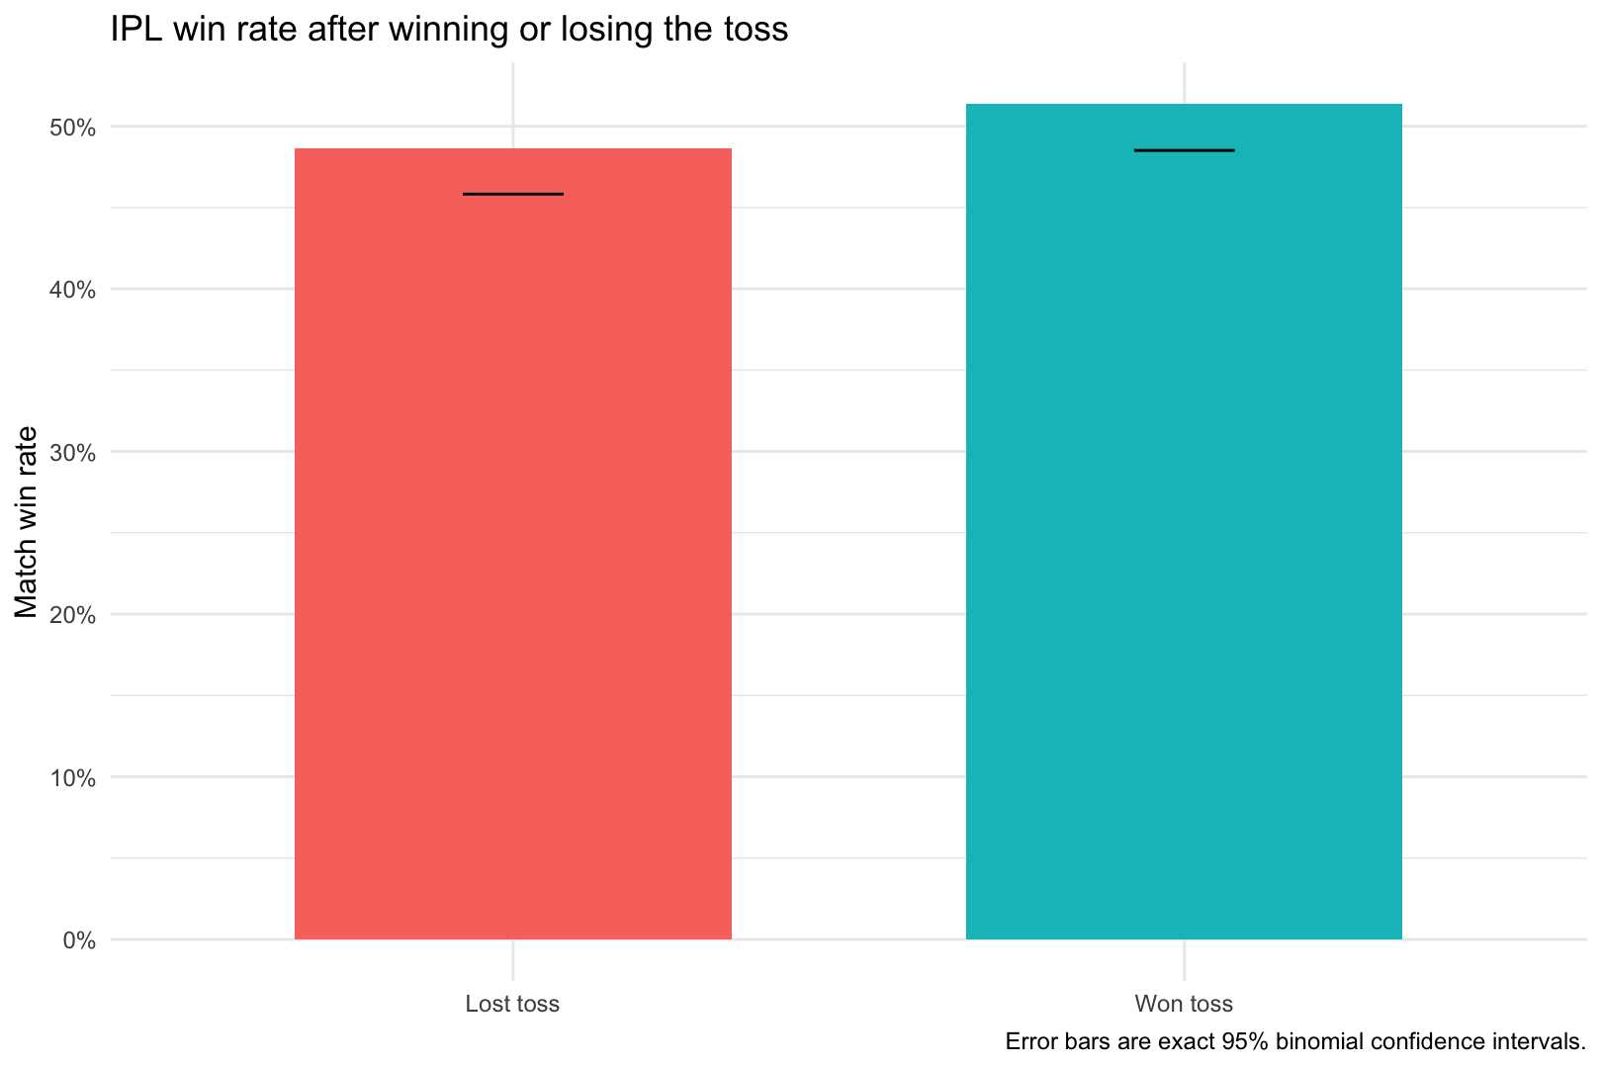
05 · DATA ANALYSIS · RQ1 RQ2
CONDITIONAL PROBABILITY · Χ²
51.3%
Win rate after winning the toss — against 48.7% after losing it.
95% confidence interval
48.5 – 54.1%
Chi-square p-value
0.183
Decision at α = 0.05
fail to reject H0
RQ1 · RQ2
The interval contains 50%. The toss buys a 2.6-point edge that could easily be noise — it is not a decision-maker.
FIG. 01 Win rate after winning or losing the toss, with exact 95% binomial confidence intervals.
Notes:
The headline number everyone expects to be bigger. 51.3% against 48.7% — a 2.6 point gap. The confidence interval runs from 48.5 to 54.1, so 50% is well inside it, and the chi-square p-value of 0.183 means we cannot reject independence. The toss is a coin.

Slide 17
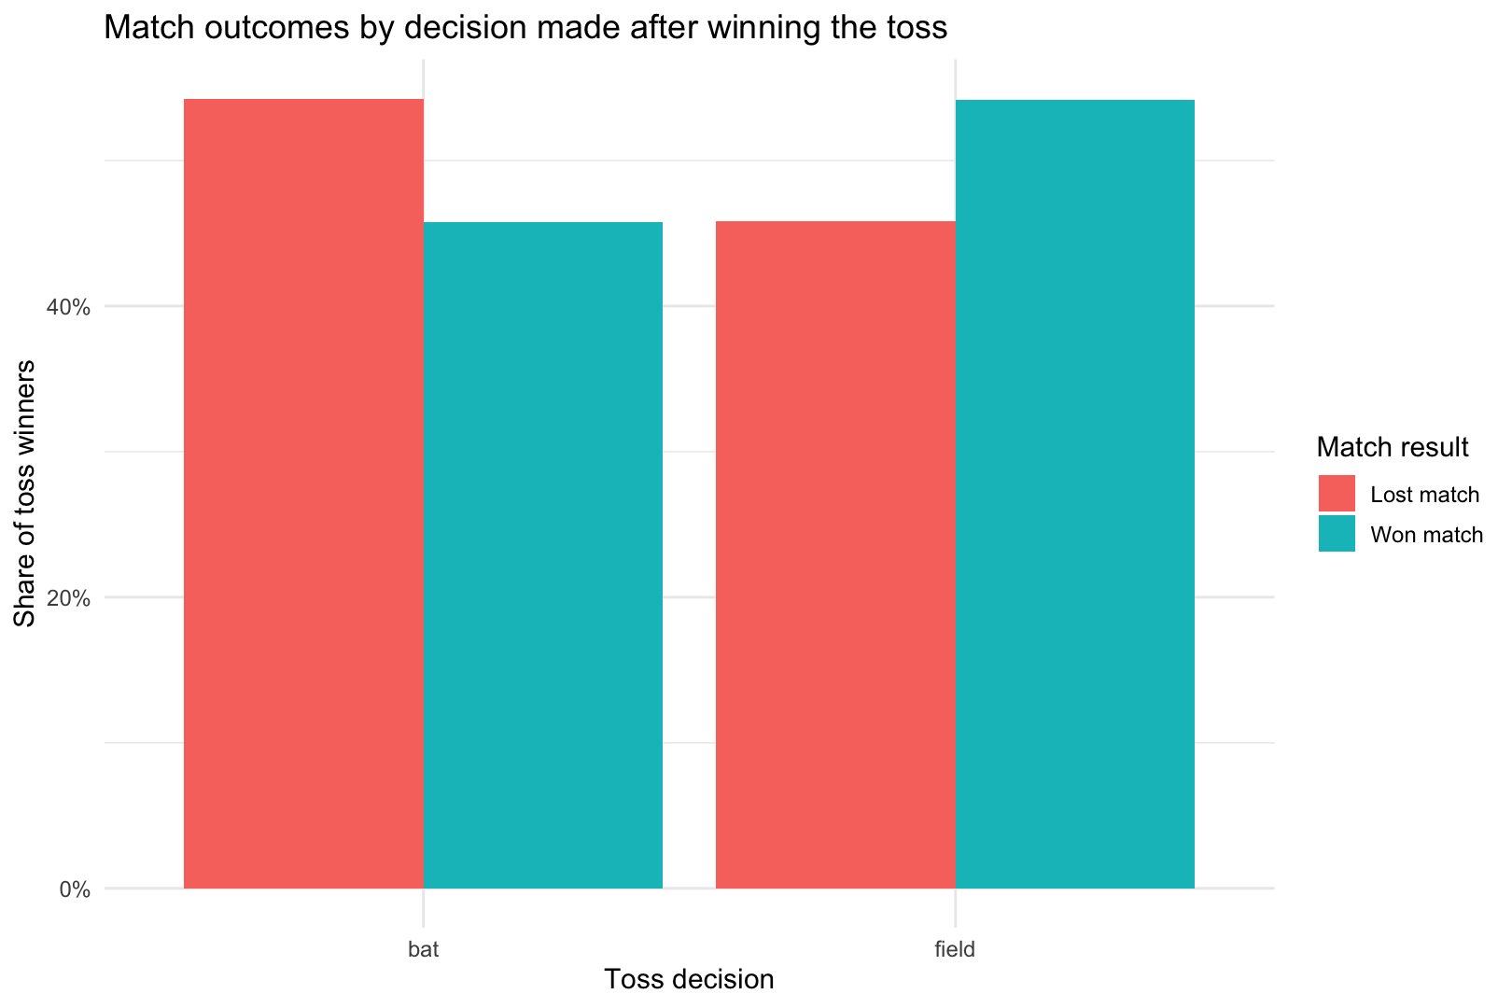
05 · DATA ANALYSIS · RQ2
POST-TOSS DECISION
Field first, and the toss starts to pay.
Captains chase: 816 of 1,227 matches were field-first. Among toss winners the choice divides them — 54.2% of those who elected to field went on to win, against 45.7% of those who batted first.
Chose to field first
816 matches
Chose to bat first
411 matches
Win rate after fielding first
54.2%
Win rate after batting first
45.7%
RQ2B · SECONDARY FINDING
An 8.5-point gap (95% CI 2.6–14.4, χ² = 7.8, p = 0.005, recomputed from the cleaned CSV). It does not survive adjustment — in the regression on slide 20 the same choice sits at OR ≈ 1, so read this as a raw comparison, not an established edge.
FIG. 02 Outcome split within each decision among toss winners — the field-first group converts better.
Notes:
Secondary finding, flagged as such: among toss winners, electing to field is associated with an 8.5-point higher win rate. Two caveats — it is recomputed from the cleaned CSV rather than part of the pre-registered toss test, and teams that choose to bat may differ systematically. Association, not proof.

Slide 18
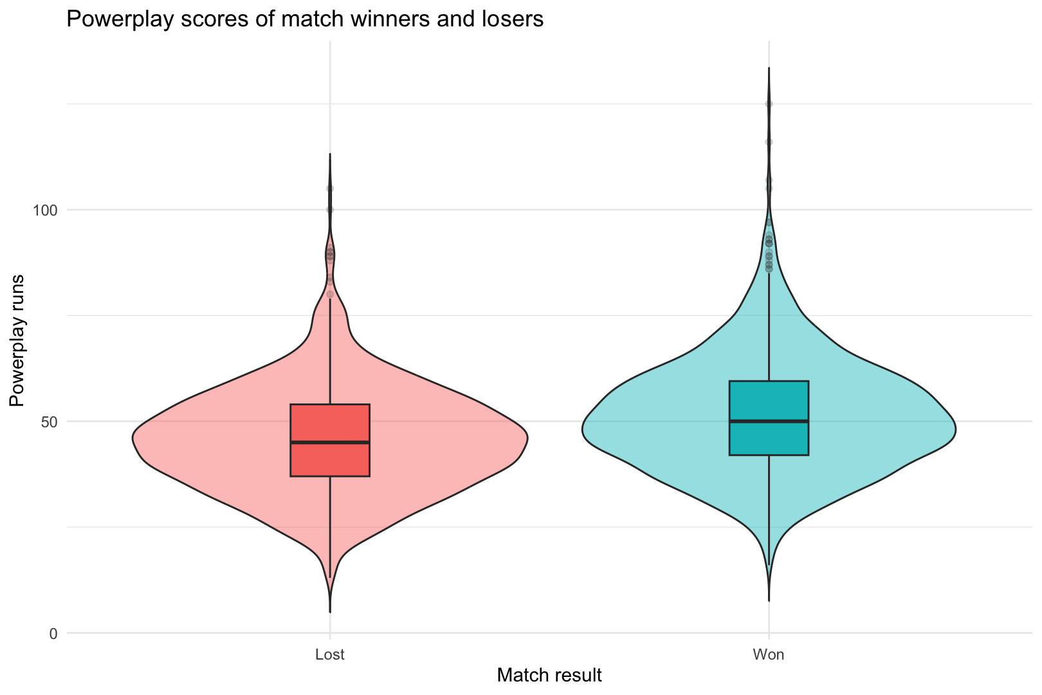
05 · DATA ANALYSIS · RQ3
T-TEST · P < 0.001
Winners start 5.8 runs faster.
51.4
45.6
59.7%
winners
losers
win rate at 50+ runs
MEDIAN 50
MEDIAN 45
VS 42.3% BELOW 50
The difference is small in absolute terms — under one run an over — but with 2,454 innings the two-sample t-test rejects H0 decisively (p < 0.001).
RQ3
Scoring more in the powerplay is a real signal, but a weak one: it moves the odds by about seventeen points, not by the match.
FIG. 03 Powerplay runs for winners and losers — the distributions overlap heavily.
Notes:
Significant, but look at the violin plots — the overlap is enormous. Statistically significant is not the same as useful for prediction. That distinction sets up the heatmap on the next slide.

Slide 19
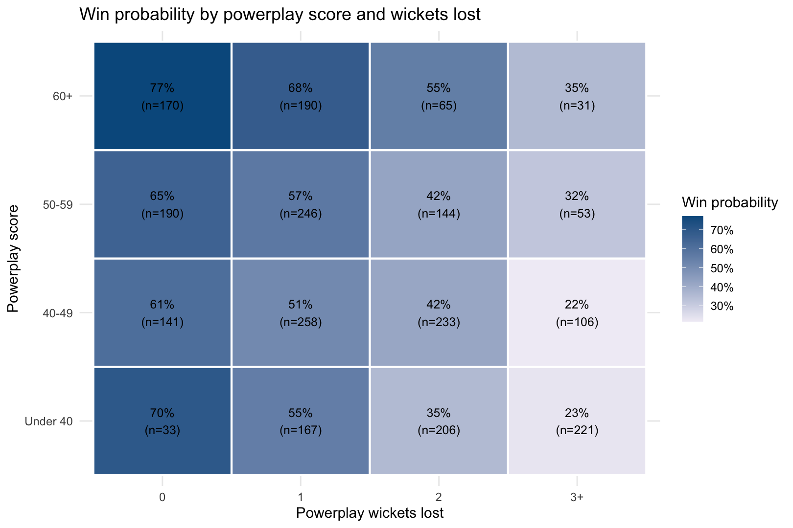
05 · DATA ANALYSIS · RQ5
16 CELLS · CONDITIONAL PROBABILITY
Runs raise the ceiling.
Wickets decide.
60+ runs, no wicket lost
77.1%
60+ runs, 3+ wickets lost
35.5%
Under 40 runs, no wicket lost
69.7%
Under 40 runs, 3+ wickets lost
23.1%
MOVE DOWN A COLUMN AND THE COLOUR BARELY CHANGES. MOVE ACROSS A ROW AND IT COLLAPSES.
FIG. 04 Win probability by powerplay score band and wickets lost, with cell sample sizes.
Notes:
The single most important chart in the deck. Hold on it. The vertical axis — runs — matters far less than the horizontal axis — wickets. A team that is 60 for none wins about 77% of the time; a team that is 60 for three, roughly 35%. Protection beats acceleration.

Slide 20
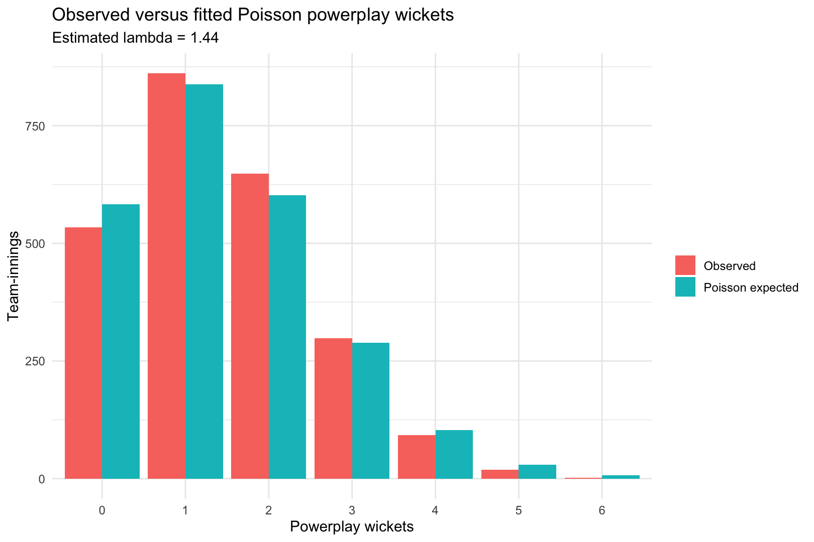
05 · DATA ANALYSIS · RQ4
POISSON GOODNESS OF FIT
Wickets are not random events.
If powerplay wickets were memoryless, Poisson with λ = 1.44 would fit. It does not: the observed spread, variance 1.26, is narrower than Poisson demands, and six-wicket powerplays almost never happen.
Mean wickets per innings
1.44
Variance (Poisson: equal to mean)
1.26
Goodness-of-fit test
reject H0 · p ≈ 0.002
RQ4
Wicket loss is under-dispersed — teams actively protect wickets in the powerplay rather than losing them at a constant rate.
FIG. 05 Observed versus Poisson-expected wicket counts — thinner tails than the model predicts.
Notes:
One caution for the room: the goodness-of-fit p-value near 0.002 was recomputed from the cleaned CSV, so quote it as approximate. The qualitative result is what matters — the tails are thinner than Poisson, which means wicket loss is a managed, deliberate process, not a memoryless one.

Slide 21
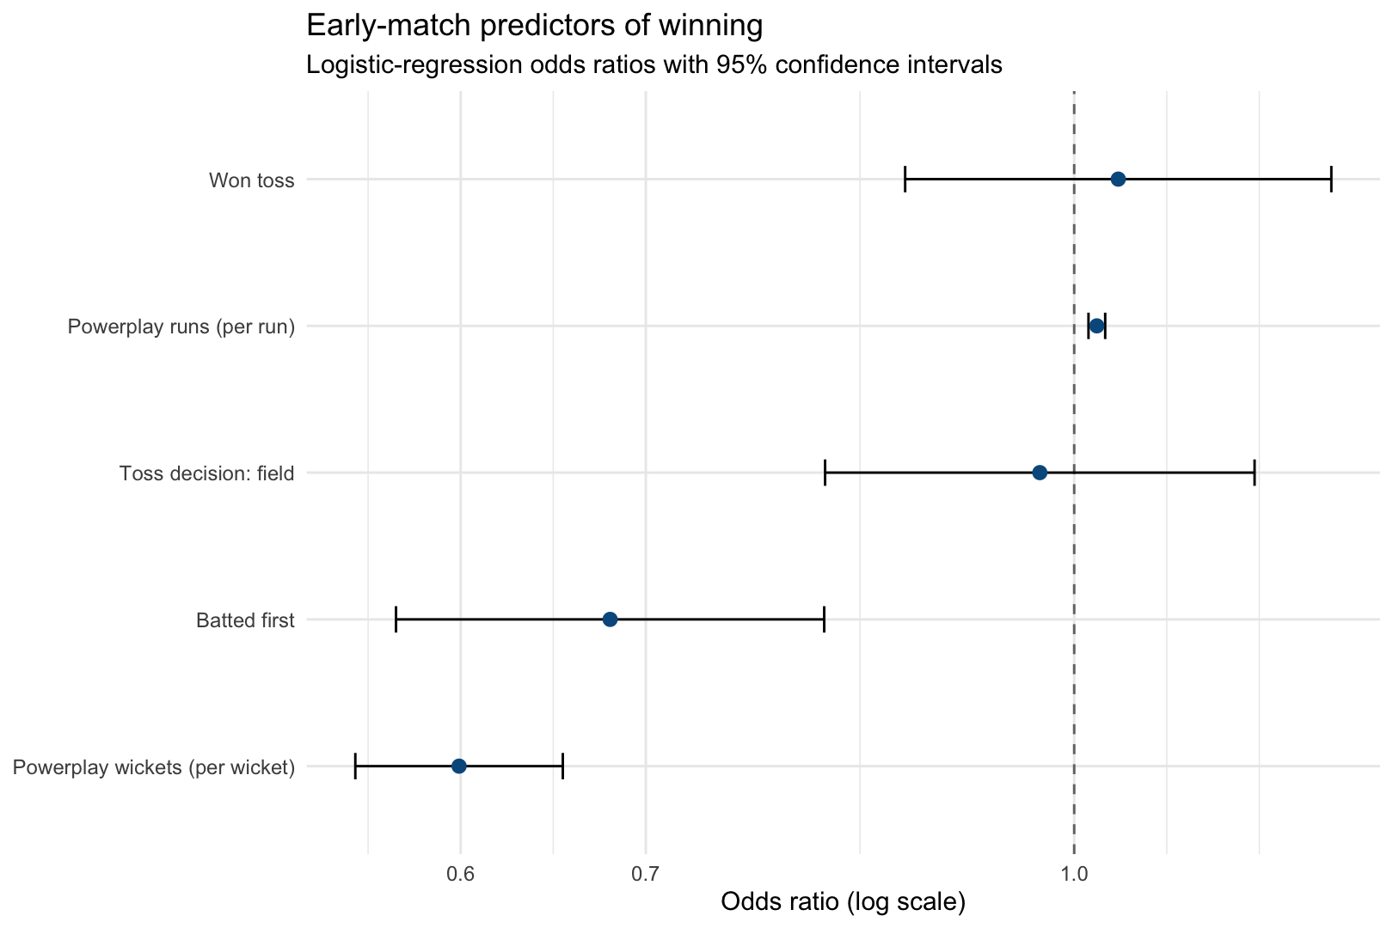
05 · DATA ANALYSIS · RQ6
LOGISTIC REGRESSION · ODDS RATIOS
0.60 × odds
For every extra wicket lost in the powerplay, estimated win odds fall about 40%.
Powerplay wickets (per wicket)
OR 0.60
Powerplay runs (per run)
OR > 1
Toss won
OR ≈ 1
Toss decision: field
OR ≈ 1
RQ6
The strongest early indicator of an IPL win is not losing wickets in the first six overs. The toss adds nothing once wickets are in the model.
FIG. 07 Odds ratios with 95% confidence intervals for early-match predictors.
Notes:
The model that answers RQ6. Wickets carry the signal, runs carry a smaller one, and the toss confidence interval sits across 1.0 — no effect. Note the honest caveat: an odds ratio of 0.60 is an association, not a lever.

Slide 22
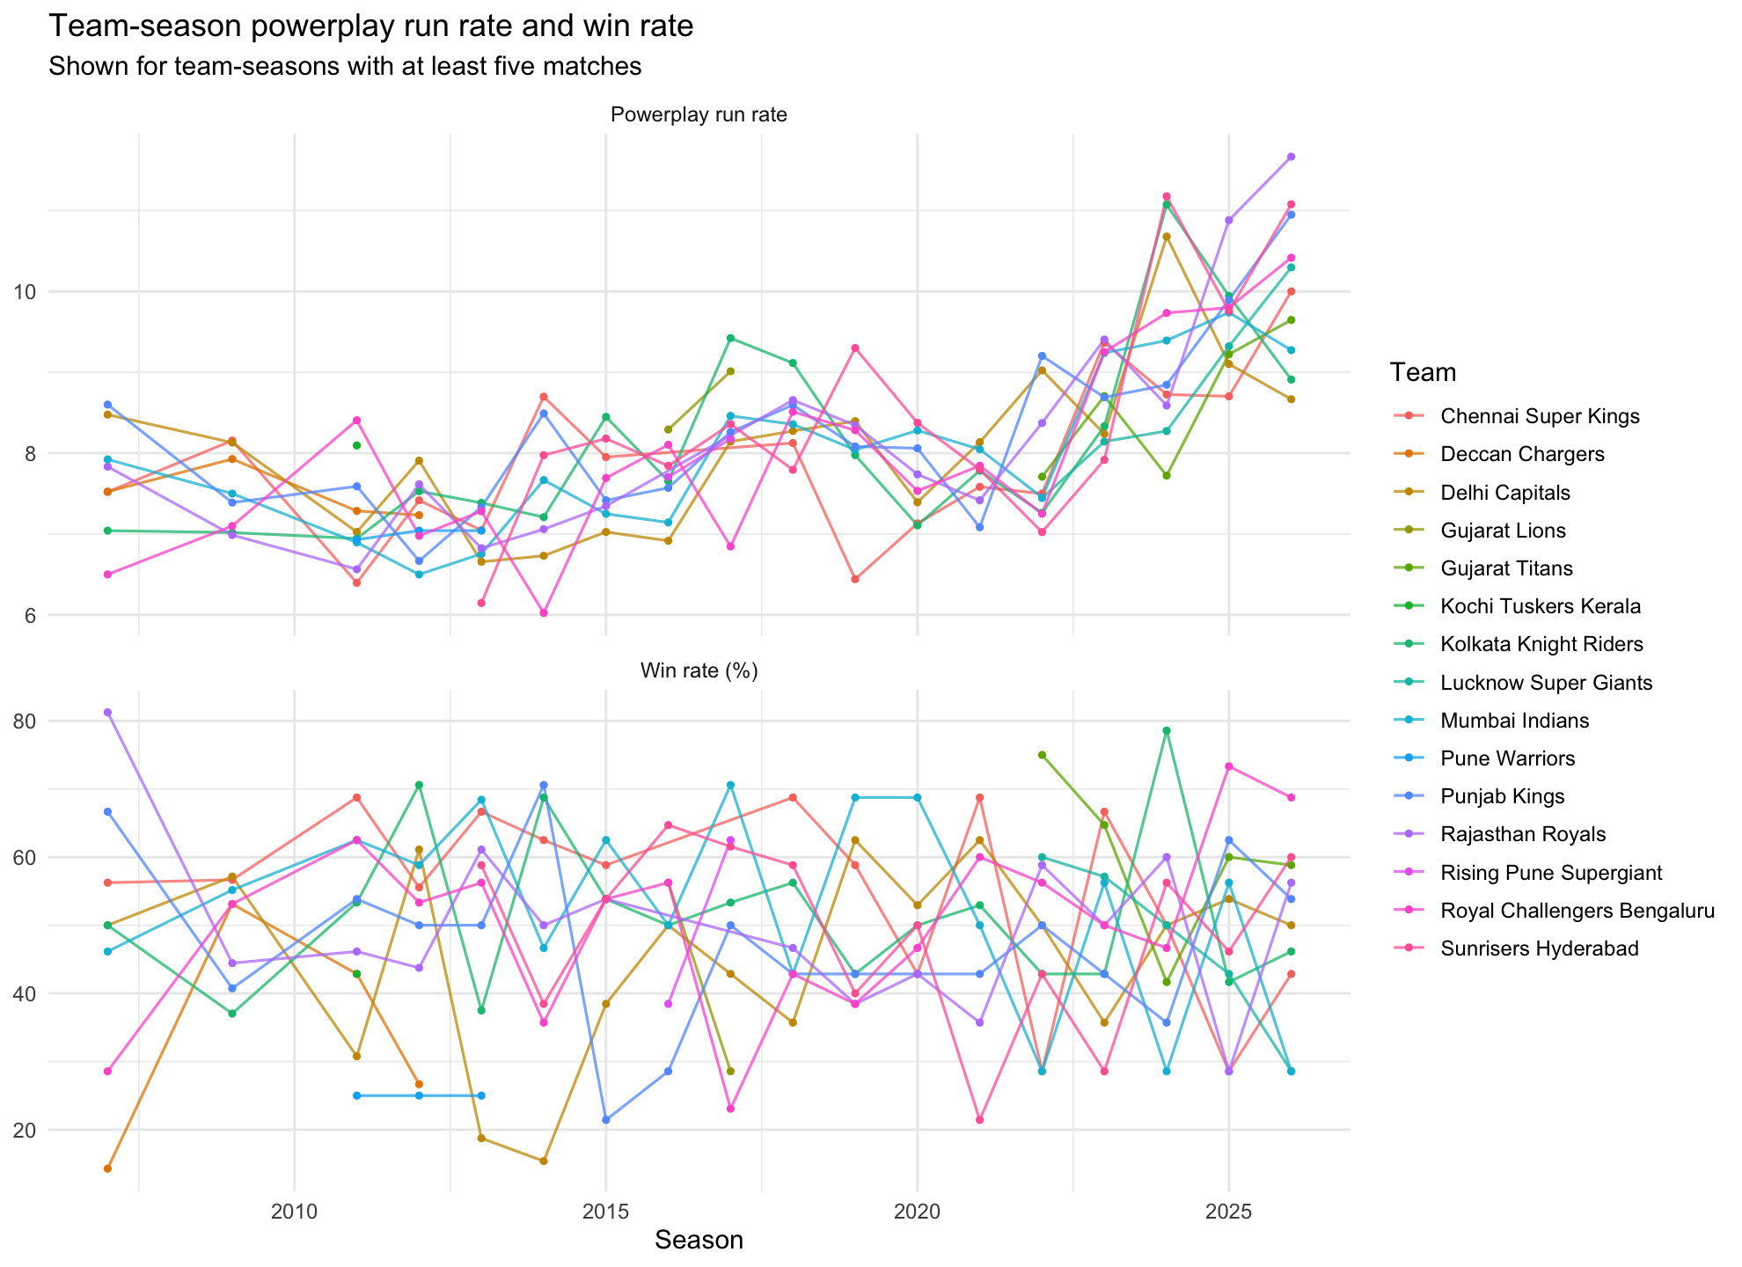
05 · DATA ANALYSIS
18 SEASONS · 15 FRANCHISES
A fast start is not a habit that wins.
Teams with the same powerplay run rate convert it into wins at very different rates, and the gap moves season to season. Squad quality, venue and conditions sit behind both the start and the result — which is exactly why this study claims association, not cause.
CONTEXT WORTH NAMING
Sixty venues, rule changes after 2015, and franchise reshuffles across eighteen seasons all feed into the spread beside you.
FIG. 06 Powerplay run rate and win rate by team and season.
Notes:
This is the confounder slide in disguise. If the powerplay caused wins, the teams with high run rates would convert consistently. They do not.

Slide 23
06
SECTION 06
Conclusion
What the tests actually license us to say — and what they do not.
06 · CONCLUSION
Notes:
Close on the verdict, then spend real time on the limitations. Exam answers live here.

Slide 24
06 · CONCLUSION
SIX ANSWERS
Answers, in the order the questions were asked.
RQ1 · Win after the toss
Marginal
51.3% · CI 48.5–54.1
RQ2 · Toss independent of result
No evidence of association
p = 0.183
RQ3 · Winners score more
Yes, narrowly
51.4 vs 45.6 · p < 0.001
RQ4 · Wickets Poisson
No — thinner tails
var 1.26 vs mean 1.44
RQ5 · Best early situation
60+ runs, no wicket lost
77.1% wins
RQ6 · Strongest early signal
Wickets lost in the powerplay
OR 0.60
VERDICT
The toss is a small advantage at most. A strong, low-wicket powerplay is the clearer sign of an IPL win — and protecting wickets matters more than scoring quickly.
Notes:
Read the six rows quickly, land on RQ6, then say the verdict sentence verbatim. This is the sentence the grader is looking for.

Slide 25
06 · CONCLUSION
SCOPE & LIMITS
What this cannot tell you.
CAUSALITY
Observational data. Stronger squads produce both good powerplays and wins.
HONEST HEADLINE
The powerplay describes a winning team well. It does not prove the powerplay made the win — and no observational dataset of 1,227 matches can settle that.
CONFOUNDERS
Opposition, venue, pitch, weather, season and rule changes are unmodelled.
REVERSE PATH
Teams already ahead may bat conservatively — low wickets can be a consequence of winning, not only a cause.
NEXT STEPS: VENUE-NORMALISED BASELINES, A WITHIN-MATCH DESIGN, AND MIXED-EFFECTS MODELS WITH SEASON AND TEAM AS RANDOM EFFECTS.
GENERALISABILITY
IPL only. These numbers should not be assumed for other T20 leagues or formats.
Notes:
Do not skip this slide — for a statistics module it is often where the marks are. Association is not causation, and the reverse path is subtle: a team that is cruising protects wickets, so part of the effect runs the other way.

Slide 26
THE FIRST SIX OVERS
26 / 26
The toss is a coin.
The powerplay is a signal.
And the sharpest part of that signal is not how fast a team scored — it is how few wickets it lost getting there.
DATA · CRICSHEET BALL-BY-BALL IPL · 1,227 MATCHES · 2,454 INNINGS · R · R/01_ANALYSIS.R
Notes:
Land the verdict and stop. Invite questions on the bowling side: wicket protection looks like the real lever, and the next version of this study should test it properly.

