Slide 1

Title : Cyborg
Publishing year : march 2014
Author : M. Sai Kumar
Name : Aniket Ashok Mhatre
Roll no: 317

Slide 2
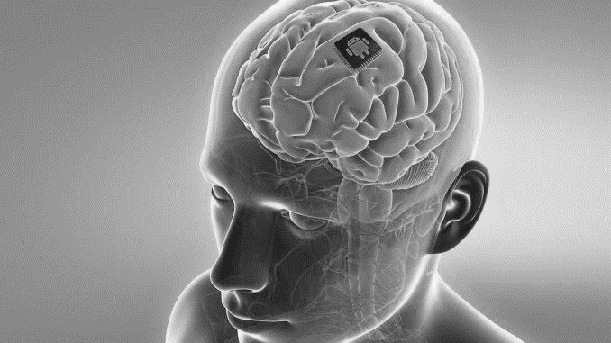
(A) Introduction :
CYBORG = CYB(cybernetic) + ORG(organism)
Combination of neurons and wires
A silicon chip is implanted into human body especially where nerves are interconnected.
Silicon chip receive signals, amplify them, and convert it into digital format.

Slide 3
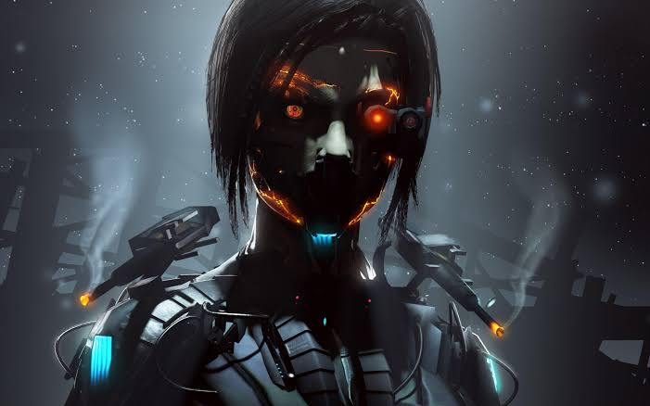
(B) Abstract
Cyborgs is cybernetic organisms
Organism that is a self-regulating, combination of artificial and natural systems.
Here we discuss some features of cyborgs.
its an attempt to promote greater interaction between humans and computers.

Slide 4
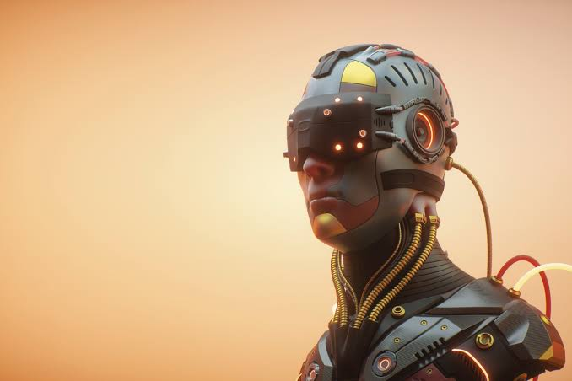
(C) Implementation
To help blind peoples.
There are possibilities to capture signals responsible for happiness, pain etc.
to establish wireless communication between two persons.
Curing disease.

Slide 5
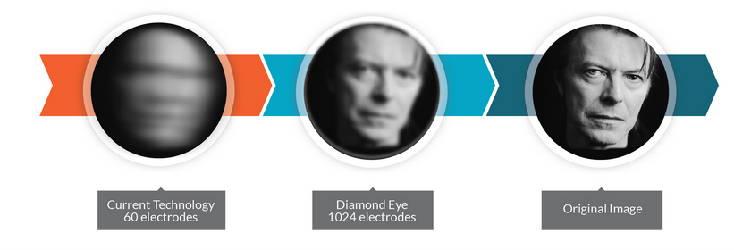
(D) Future Scope:
So we have the bionic hearing, but what about eyes? well it turns out that bionic eyes do exits but they are not widespread as ear implants.
one product already on the market is 'second sight's argus II’.
camera -> implants -> tiny electrode array -> optic nerve -> brain

Slide 6
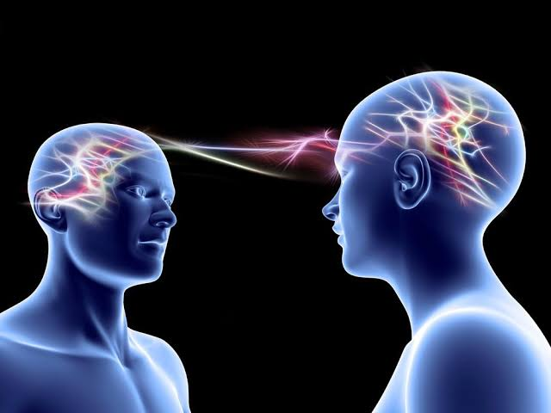
Telepathic communication :
If we could somehow decode the patterns of electrical signals coming from the brain, then we would be able to send messages with just the power of thoughts!
Recently , a US government study found that it was possible to discern the consonants an vowels of imagined words just by analysis of brain signals.

Slide 7
(E) Conclusion :
(F) Reference :
Though bioelectronics has many advantages it may lead to negative arguments with the invention of biological machines called "Cyborgs".
When humans being offered the chance to utilize computers within their bodies to achieve the same results, it would be unrealistic to ban such technologies.
http://brikrijen.weebly.com/a-shocking-revelation.html
Military Plans Cyborg Sharks. LiveScience (7 March 2006). Retrieved on 29 August 2011.
Warwick, K, Gasson, M, Hutt, B, Goodhew, I, Kyberd, P, Schulzrinne, H and Wu, X: "Thought Communication and Control: A First Step using Radiotelegraphy", IEE Proceedings on Communications, 151(3), pp.185– 189, 2004

Slide 8
THANK YOU !
Aniket Mhatre

