Slide 1
Networking 2
Minlan Yu
Harvard University

Slide 2
Clients and Servers
Clients
Request services
Sometimes on
Initiates communication
Servers
Host services
Always on
Waits to be connected
Clients and servers are roles. One computer can be both clients and servers. E.g., proxy
Notes:
servers: Don’t initiate communication to clients
Server is passive, client is active

Slide 3
How to implement client-server communications? E.g., Stream sockets (TCP)
Server
socket()
Create a socket
bind()
Bind the socket
Client
listen()
Listen for client
(Wait for incoming connections)
socket()
Create a socket
establish connection
Connect to server
connect()
accept()
Accept connection
data (request)
write()/send()
Send the request
read()/recv()
Receive Request
write()/send()
data (reply)
Send response
read()/recv()
Receive response
Notes:
Can talk both ways through the same connection

Slide 4
Review code socket
A simple client-server code

Slide 5
What’re the differences between Pipes and Sockets?

Slide 6
Pipe vs socket: Function
Pipe is unidirectional, socket is bidirectional (two channels)
Pipe is in a computer; socket can be in or across computers

Slide 7
Pipe vs socket: Creation
Pipe: Prepared
A parent process sets up pipe (pipe(), fork(), close(), etc)
Before a child process runs a new program (execvp())
Socket: Unprepared, no parent process
Client and server create socket independently
Server waits for connections
Client initiates the connection

Slide 8
Pipes vs Sockets: Send messages
Buffer
Pipe is a FIFO buffer
Sockets: two channels, each with send and receive buffers
Read/write bytestreams
Pipe: bytestreams; socket: bytestreams (break down into packets in the network)
Robustness
Pipe is reliable: bytes will be there
Network is not: packets may get lost, delayed, reordered

Slide 9
Which system call is blocking?
Server
socket()
Create a socket
bind()
Bind the socket
Client
listen()
Listen for client
(Wait for incoming connections)
socket()
Create a socket
establish connection
Connect to server
connect()
accept()
Accept connection
data (request)
write()/send()
Send the request
read()/recv()
Receive Request
write()/send()
data (reply)
Send response
read()/recv()
Receive response
Notes:
Can talk both ways through the same connection
Accept and connect are across the network and thus are blocking
All the others are not
Need to run gdb to check this blocking out

Slide 10
Which system call is blocking?
Socket, bind, listen are local, do not block
Connect, accept go through the network
Connect: block until establish the connection
Accept: block if there’s not connection

Slide 11
Google Telnet and Strace

Slide 12
Is Socket still the right abstraction today?
Socket is on a connection between two hosts/processes
Was invented in early 80s
Today, is socket still the right abstraction?
Google running on multiple servers
Content duplicated at different places
What’s the next right abstraction?
Notes:
One abstraction to support such communications: Sockets
Sockets have a client and a server
Socketfd = Int socket(int domain, int type, int protocol);
More details on the parameters later. Basically it allows you to initiate the socket descriptor just like a file descriptor

Slide 13
Connect in TCP
Connection is established through sending packets
Three-way handshake to establish connection
Client sends a SYN (open; “synchronize sequence numbers”) to server
Server returns a SYN acknowledgment (SYN ACK)
Client sends an ACK to acknowledge the SYN ACK
Why three way?
listen()
connect()
SYN [Hello?]
Client
SYN + ACK [Hi, I got your hello]
server
ACK (I got your response to hello)

Slide 14
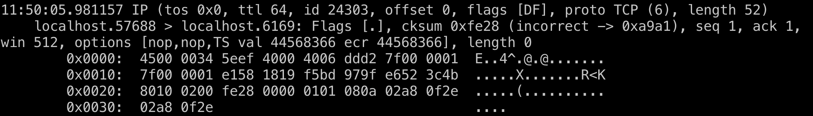
Breakouts
sudo tcpdump -vvX -i lo
Open another window, run docker with the same directory
./server &
./client
See what you can learn about this tcp connection

Slide 15
TCP Stream of bytes
Host A
Byte 0
Byte 1
Byte 2
Byte 3
Byte 80
TCP Data
TCP Data
Host B
Byte 0
Byte 1
Byte 2
Byte 3
Byte 80

Slide 16
Sequence Numbers
ISN (initial sequence number)
k
Host A
Sequence number = 1st byte in segment = ISN + k
TCP Data
TCP
HDR
ACK sequence number
= next expected byte
= seqno + length(data)
TCP Data
TCP
HDR
Host B

Slide 17
TCP: Reliability
When to retransmit a packet?
When we received duplicated ACKs
When we do not receive any ACKs for a long time (what time)
Example dup ACK
Send packets with seq no
10, 20, 30,… 90, 100
Say 50 is lost
ACK: 10, 20, 30, 40, 50, 50, 50….
Notes:
Why wait for the ACK? Instead of marking which packet is lost?

Slide 18
TCP: Reliability
When to retransmit a packet?
When we received duplicated ACKs?
When we do not receive any ACKs during a long time (what time)
RTO: Retransmission timeout (one example algorithm)
RTO = 2 * round-trip time
Exponential backoff: Every time RTO expires, RTO = RTO * 2
If any successful new transmission, RTO = 2 * round-trip time
Notes:
Exponential backoff is awesome because it responds to short outages quickly, but imposes only logarithmic overhead (i.e., the number of messages sent during the outage is logarithmic in the length of the outage). It’s ubiquitous: Ethernet is built on it, and the next time your Gmail goes offline, check out the numbers that appear after “Not connected. Trying again in...”.

Slide 19
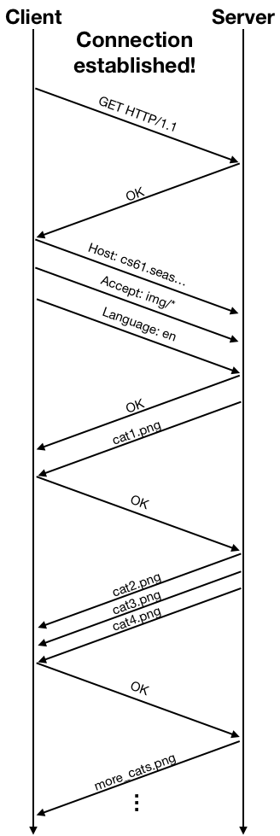
Send data and get ACKs
Why do we need ACK (ok)?
Packets may get delayed of lost because of busy server or network
Notes:
Client may send
Get http1.1.
Server says ok
HTTP request: Client: host: cs61: accept img; languages: en
Server: ok
Data flies from client to the server
Server: cat 1, cat ….
Client: ok
Many interesting networking topics: CC

Slide 20
Packet Headers
Client
Server
HTTP
request/response
TCP header
IP header
Notes:
Deepest level most header

Slide 21
Breakout: Representing a TCP packet
We have:
32 bit source address, 32 bit destination address
16 bit source port, 16 bit destination port
What other information would you include? What’s the layout that ensure alignment (to 32 bits)?
Notes:
14 byte Ethernet header
16 bit checksum
32 bit sequence number
32 bit ack number
Minimize confusion (big endians vs little endian)

Slide 22
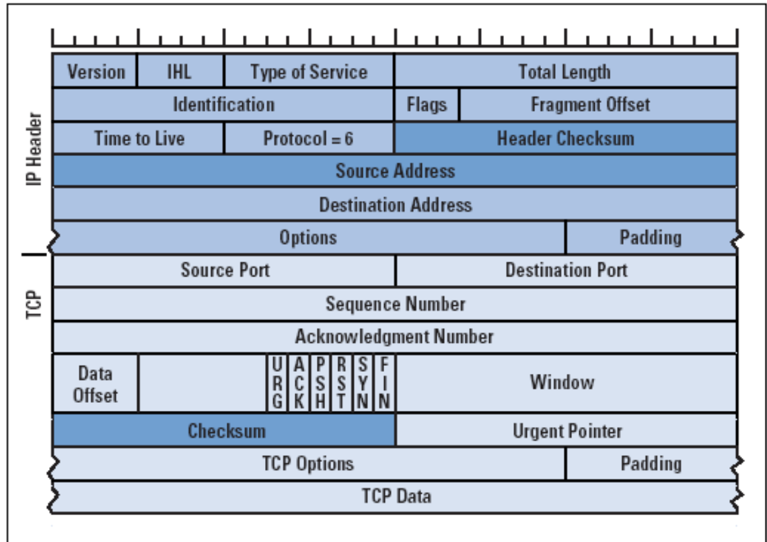

Slide 23
Networking 3:
Minlan Yu
Harvard University
Notes:
We’re going to use some of our additional lectures to highlight our own research work and advanced topics. I work in super-fast networked systems! I make data centers, like Google's or Amazon's, work better and transfer data faster. And to do that I use data representation all the time.

Slide 24
What is a database?
A database is a program that stores data
E.g., store data for search queries, your FB posts, your school records and scores
Key-value stores
Key: keyword; Value: web pages
Key: FB account name; Value: #friends
Key: student ID; value: score
FB maintains a distributed key-value store with trillions of items, billions of requests/second

Slide 25
Review code: weensydb
Key-values
Network connections
Run client-server
Problems

Slide 26
Parallelism
Parallel hardware
Multicore: Multiple separate processors on single chip
These processors share primary memory
Each processor has its own set of registers, logical computations
Core 0
Core n-1
Regs
Regs
cache
…
cache
Main memory
Notes:
Hyperthreading
Efficient execution of multiple threads on single core

Slide 27
Two ways to use multiple processors
Run different programs/processes on different processors
One process on each processor
Run one process (e.g., weensydb) on multiple processors
The thread abstraction

Slide 28
Threads
User-level abstraction of multiple execution processes in one process
One process can have multiple threads
Question: What resources do one process have, how to threads share or duplicate them?
Notes:
By using multiple threads with shared virtual memory space
Cache, registers, rip, stack

Slide 29
Process vs Threads
Process: individual view of hardware resources
Separate memory, separate address space, separate file abstraction
Separate sets of registers, stacks, logical computation
Threads
Shared memory and file descriptor table
Separate sets of registers, stacks, logical computation
Notes:
Same virtual memory

Slide 30
Fix weensydb with threads
Notes:
Construct a thead, with two arguents. The first argument is a function tells the thread what
Put the instruction of the pointer to the func, pass the arguments there too.
Different with fork, start at this function, not start where I am
Detach: the current thread is detached from the thread, I don’t need to know when that thread is finished
Join: the current thread will block until the other thread finishes

Slide 31
Introduction of incr-basic and its problems

Slide 32
Synchronization
Minlan Yu
Harvard University
Notes:
We’re going to use some of our additional lectures to highlight our own research work and advanced topics. I work in super-fast networked systems! I make data centers, like Google's or Amazon's, work better and transfer data faster. And to do that I use data representation all the time.

Slide 33
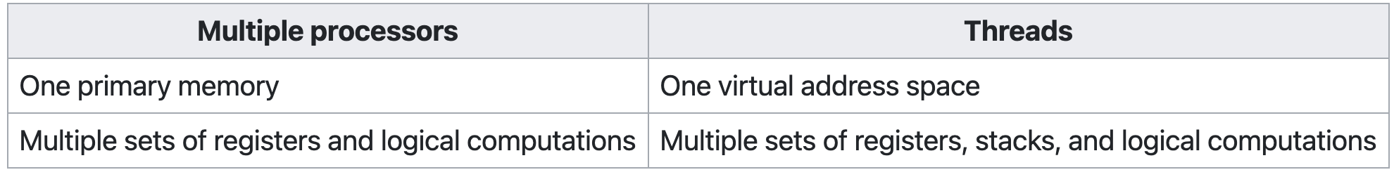
Multiple Processors (Hardware features) vs Multiple Threads (Abstraction)

Slide 34
Notes:
While true; do ./incr-basic; done | uniq

Slide 35
Backup

Slide 36
Key challenges for Networking: Robustness
What are the ways to attack weensydb?
Many connections may overload the network, servers
Traffic from/to weensydb may get eavesdropped, intercepted

Slide 37
Sockets between two processes/hosts
How does two computers actually talk to each other?
When you send a search request to Google?
When you join a zoom call?

Slide 38
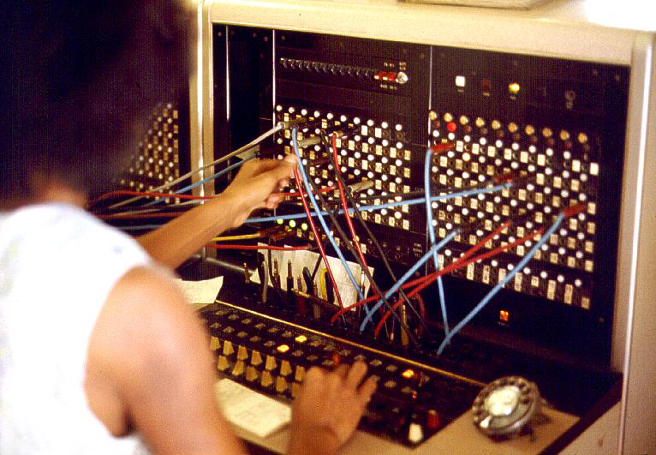
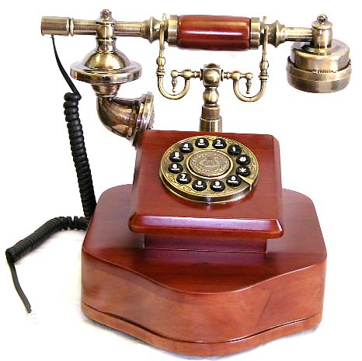
Previously: Circuit Switching
Sources establish connections, send data and take off the connections
Pros/cons?
Notes:
Pros: reserved channel/resources for your communication
Cons: wasteful

Slide 39
Socket system calls
socket(): Analogous to pipe(), it creates a networking socket and returns a file descriptor to the socket.
Server side
bind(fd, ...) -> int: Picks a port and associate it with the socket fd.
listen(fd) -> int: Set the state of socket fd to indicate that it can accept incoming connections.
accept(fd) -> cfd: Wait for a client connection, and returns a new socket file descriptor cfd after establishing a new incoming connection from the client. cfd correspond to the active connection with the client.
Notes:
More on port next lecture

Slide 40
Socket system calls
Client side
connect(fd, …) -> int: Establish a connection.fd: socket file descriptor returned by socket()
Returns 0 on success and a negative value on failure.

Slide 41
How to implement client-server communications? E.g., Stream sockets (TCP)
Server
socket()
Create a socket
bind()
Bind the socket
Client
listen()
Listen for client
(Wait for incoming connections)
socket()
Create a socket
establish connection
Connect to server
connect()
accept()
Accept connection
data (request)
write()/send()
Send the request
read()/recv()
Receive Request
write()/send()
data (reply)
Send response
read()/recv()
Receive response
Notes:
Can talk both ways through the same connection

Slide 42
Create a socket
int socket(int domain, int type, int protocol)
create a networking socket and returns a file descriptor to the socket
Not connected yet
Reserve kernel state for a future network connection
Domain:
E.g., PF_INET for IPv4
Type:
SOCK_STREAM: reliable byte stream (TCP)
SOCK_DGRAM: message-oriented service (UDP)

Slide 43
Socket identification
Process
A
Process
B
port X
port Y
Port Number
TCP/UDP
Protocol
IP
Host Address
Network devices

Slide 44
Server side
int bind(int sockfd, struct sockaddr *my_addr, socklen_t addrlen )
Bind socket to the local address and port number
int listen(int sockfd, int backlog)
Set the state of socket fd to indicate that it can accept incoming connections.
int accept(int sockfd, struct sockaddr *addr, socketlen_t *addrlen)
Accept a new connection from a client
Return a new socket file descriptor corresponding to the active connection with the client.

Slide 45
Client side
int connect(int sockfd, struct sockaddr *server_address, socketlen_t addrlen )
Establish a connection.fd: socket file descriptor returned by socket()
Returns 0 on success and a negative value on failure.
Server can only accept connections after listen(). Any connection before listen would fail

