Slide 1
Computational humor
Notes:
When I was searching for Thesis subjects, I was considering doing my research about humor

Slide 2
Itinerary
What is humor
Is ChatGPT funny?
BONUS

Slide 3
Humor - definition
The quality of being amusing or comic, especially as expressed in literature or speech - "his tales are full of humor"
A mood or state of mind. –
"her good humor vanished"

Slide 4
Types of humor
Sarcasm – “Not all men are annoying. Some are dead.”
Irony –”I hate people that use physically impossible metaphors. They make my blood boil”
Pun – “What did the grape say when it got crushed? Nothing, it just let out a little wine”
Spoonerism – “For real enjoyment, take a well-boiled icicle”
Riddle – “What goes up, but never comes down? Your age!”
Idiom –”Why did the student eat his homework? The teacher said it was a piece of cake”
Dark, Physical, Aggressive, Self-defeating, Deadpan, Juvenile, Observational, Farcical………..
Notes:
Pun – use a double meaning of the word
Spoonerism – when sounds of words are transposed
Idion – A phrase that means something other than what it actually means

Slide 5
Humor - significance
Humor plays a significant role in human communication:
Trust, First impression, Solidify relationship
Convey feelings, mood, state of mind
Widely used in literature, poetry, theater, advertising, and more
Human coping mechanism, Therapeutic tool
Notes:
In advertising, humor grabs the audiences attention, associates a positive emotion with the brand, leaves a lasting impression.

Slide 6
humor== ai-complete
Detection – understand meaning (chatbots, virtual assistants) https://www.youtube.com/watch?v=SPmxsRDSmTc
Generation – impersonate human interactions (chatbots, VA)
Translation –
“To be frank, I’ll have to change my name”
“למען האמת, אצטרך לשנות את שמי.”/”כדי להיות פרנק, אצטרך לשנות את שמי.”
Evaluation
Notes:
Detection – humor detection is used in order to understand the real meaning behind the request/input. Should the command be taken seriously? What does the user actually want the system to do?
Most of the papers in this field concern detection of Sarcasm, Irony, and Puns.

Slide 7
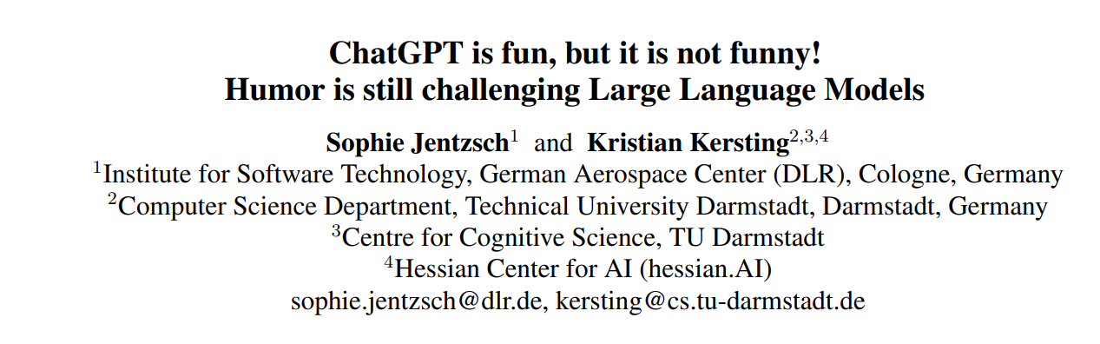
Humor IN GPT
Notes:
Although GPT seems to interact in a quite human-like fashion even telling jokes, the writers of the paper noticed that it tends to repeat the same jokes a lot, which led them to believe it simply repeats jokes from the training data or maybe even have some rule-based humorous response mechanism.

Slide 8
Humor in GPT
Joke Generation
Joke Explanation
Joke Detection
Notes:
Detection – humor detection is used in order to understand the real meaning behind the request/input. Should the command be taken seriously? What does the user actually want the system to do?
Most of the papers in this field concern detection of Sarcasm, Irony, and Puns.

Slide 9
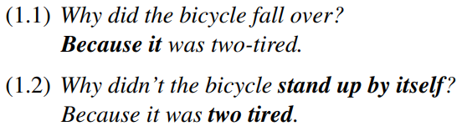
Humor in GPT – generation
10 different prompts
1008 jokes total
348 unique
128 unique after cleanup (new lines, prefixes, etc)
T25 top frequent cover 91% (T4 == 50%)
All T25 are known jokes, not original
Notes:
Detection – humor detection is used in order to understand the real meaning behind the request/input. Should the command be taken seriously? What does the user actually want the system to do?
Most of the papers in this field concern detection of Sarcasm, Irony, and Puns.

Slide 10
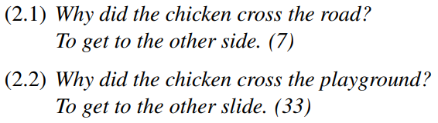
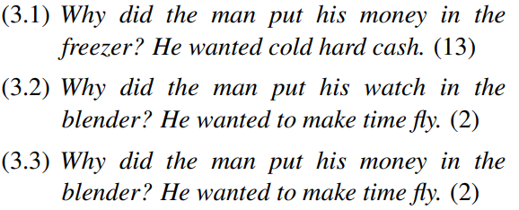
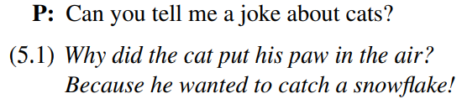
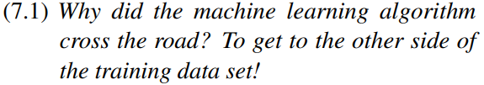
Humor in GPT – generation
The other10%
Modification:
Mixture:
Not funny:
Notes:
Detection – humor detection is used in order to understand the real meaning behind the request/input. Should the command be taken seriously? What does the user actually want the system to do?
Most of the papers in this field concern detection of Sarcasm, Irony, and Puns.

Slide 11
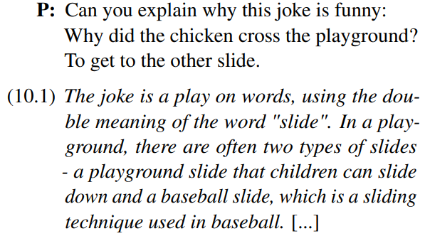
Humor in GPT – explanation
Prompted to explain why the T25 were funny
23/25 correct explanations (both direct and acoustic double meaning (too tired | two-tired)
Prompted to explain modified jokes/not jokes - fails to make sense
Notes:
Presumably explanation should be an easier task for a LM, especially an LLM which historically does good with explanations.

Slide 12
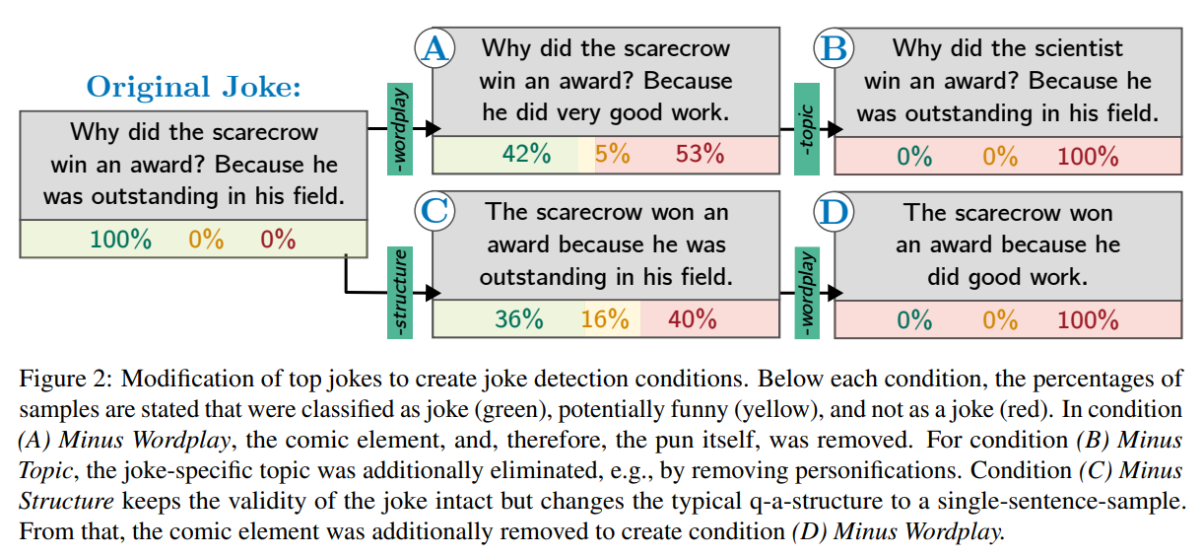
Humor in GPT – detection
All generated jokes were similar characteristics – structure, topic, wordplay
Manually eliminated characteristics from the T25
Notes:
A – change the word that creates the PUN while maintaining the same semantic meaning
B -

Slide 13
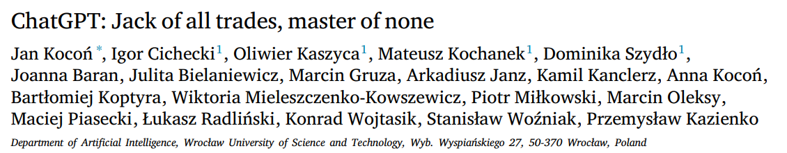
Humor in GPT – detection
Notes:
A – change the word that creates the PUN while maintaining the same semantic meaning
B -

Slide 14
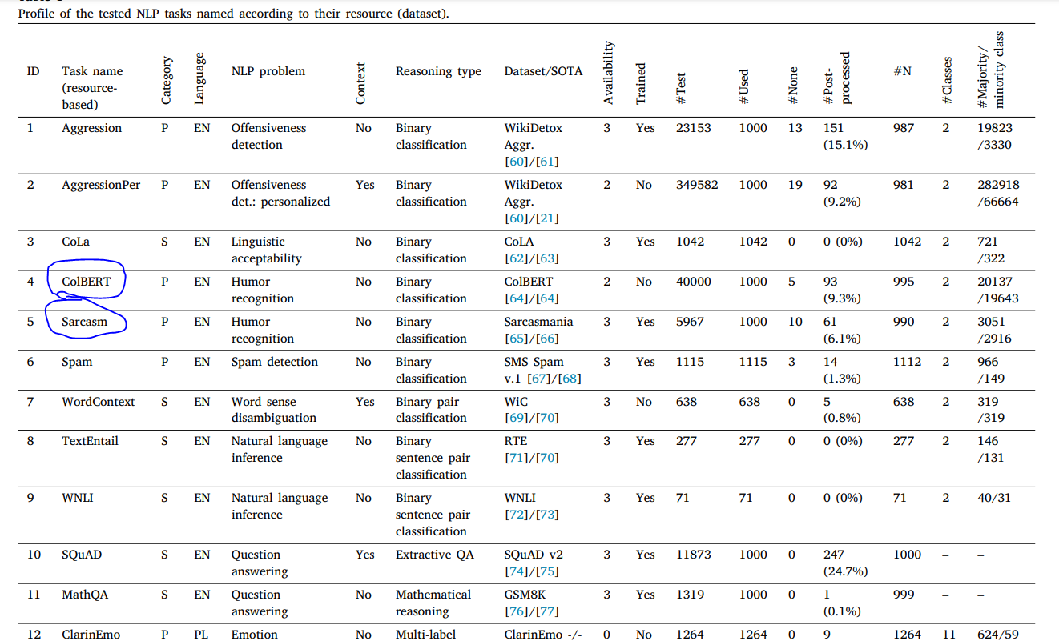
Humor in GPT – detection
Notes:
A – change the word that creates the PUN while maintaining the same semantic meaning
B -

Slide 15
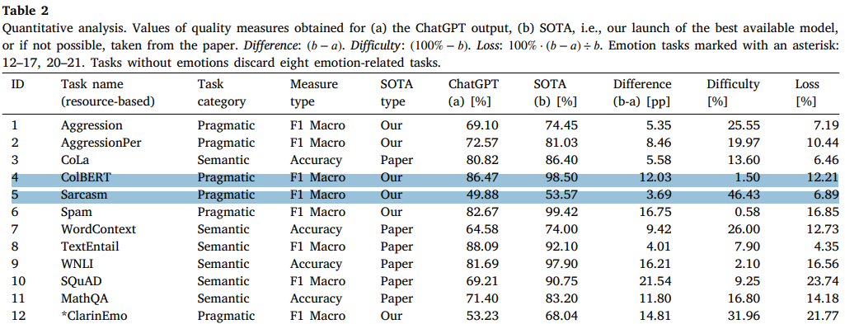
Humor in GPT – detection
Notes:
A – change the word that creates the PUN while maintaining the same semantic meaning
B -

Slide 16
To conclude
Humor is an essential tool in human communication
AI struggles to detect/generate, but manages to explain
https://www.youtube.com/watch?v=0p6wQnWUJJA
Notes:
A – change the word that creates the PUN while maintaining the same semantic meaning
B -

