Slide 1
AA-HLS LAB-B #10: Matrix Multiplication
107062205 鍾宇騫
2022 / 3 / 29

Slide 2
Index
Algorithm Introduction
Simple implementation: Brutal force
#pragma HLS PIPELINE
#pragma HLS RESHAPE
Complex implementation: Block matrix
#pragma HLS DATAFLOW
Compute optimization
Problem & Solution

Slide 3
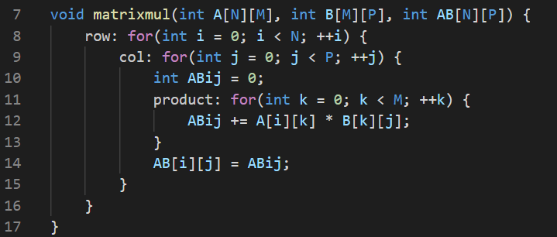


Algorithm Introduction
Common numerical operation for image processing, neural network, etc.
Basic multiplication and accumulation (MAC), with high parallelism.

Slide 4
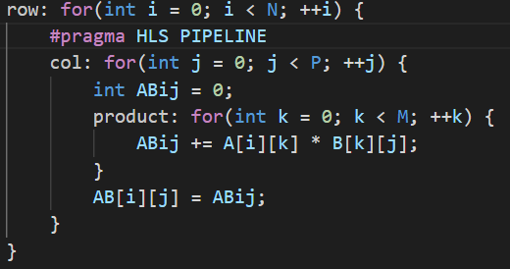
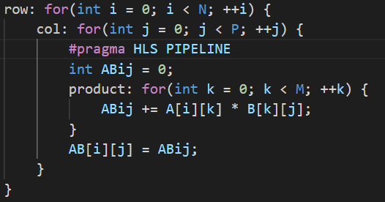
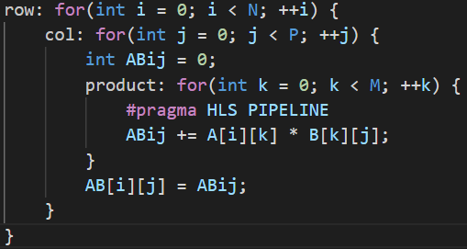
Simple Implementation with Different Pipelining
N = P = M = 32
If not set II in directive, tool will increase from 1 until meet constraint.
Pipeline | Latency | Interval | DSP
row | 45 | 45 | 3072
col | 1035 | 1036 | 96
product | 322775 | 322775 | 3

Slide 5
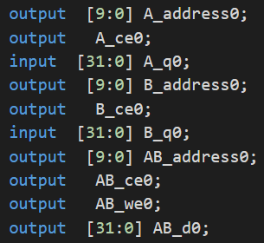
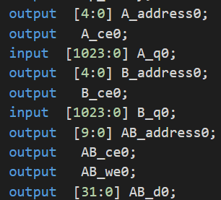
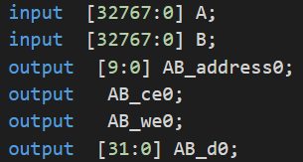
HLS ARRAY_RESHAPE
Reshape array to different bandwidth memory (SRAM, register files)
#pragma HLS ARRAY_RESHAPE variable=<NAME> dim=<D>
D = 0, reshape all
D > 0, reshape specific dimension
Without reshape
A: dim 1, B: dim 2
A: dim 0, B: dim 0

Slide 6
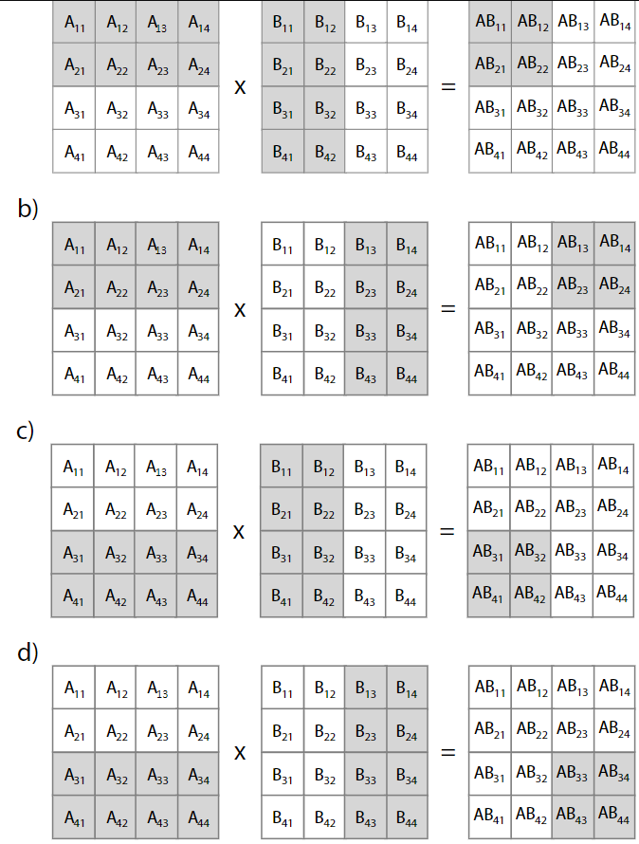
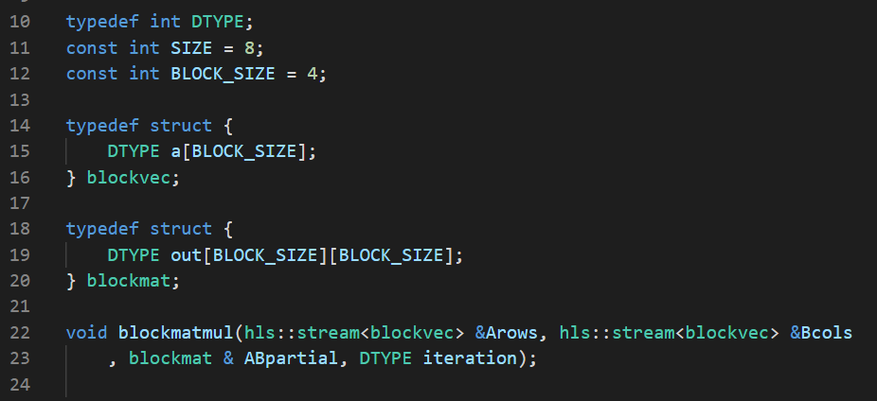
Block Matrix Multiplication
Fixed basic computing block (2x2 output matrix)
Data tiling to split a large task
Scalable computing height/width
Using hls:stream to transfer input matrix

Slide 7
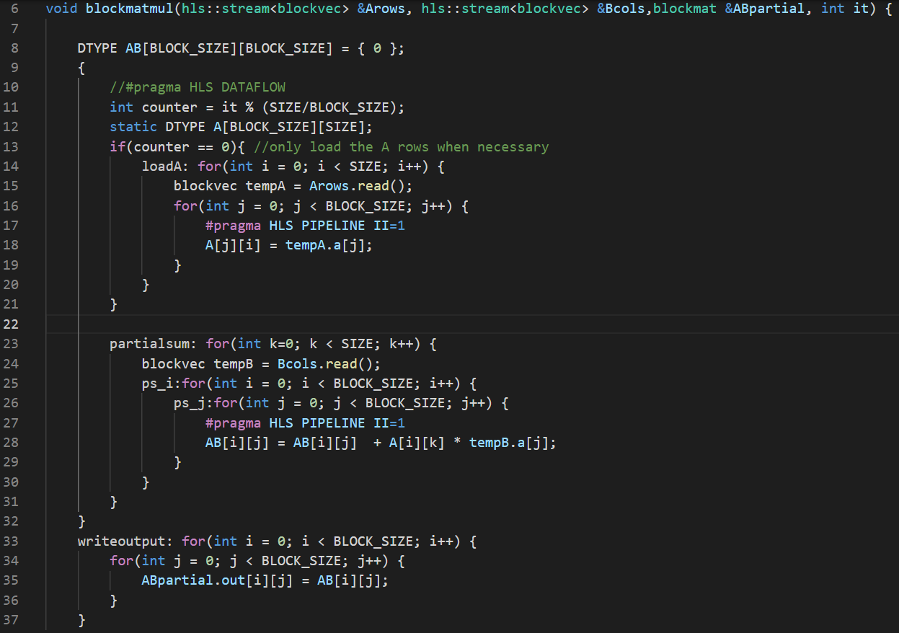
Implementation of Block MM
BLOCK_SIZE=4, SIZE=8
Input
Stream A row (4x1)
Stream B column (1x4)
Output
Block matrix (4x4)
Load
Load required rows of A
Compute
Load required columns of B
row by row.
MAC matrix A and B
Store
Write result to output matrix

Slide 8
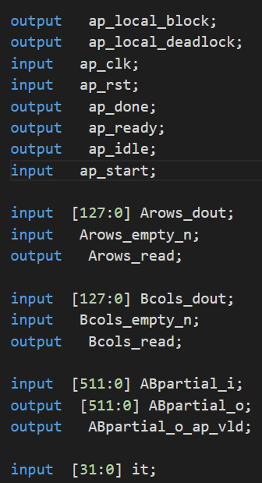
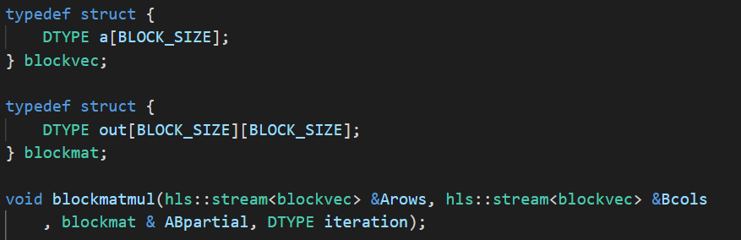
Synthesis Result: I/O
hls:stream: Arwos and Bcols
Data port
Two handshaking port
Writable direct map registers: APpartial
Two way data port
One handshaking port
Read only registers: it

Slide 9
Synthesis Result: Latency
Load
Latency = Interval * SIZE(8) = 72 cycles
Compute
Latency = Interval * SIZE(8) = 192 cycles
MAC need to 2 adder and 1 multiplier = 3 DSP
Store
Latency = Interval * BLOCK_SIZE(4) + overhead = 18 cycles
Loop name | Latency (cycles) | Interval (cycles) | DSP (count)
Load | 72 | 9 | 0
Compute | 192 | 24 | 3
Store | 18 | 4 | 0

Slide 10
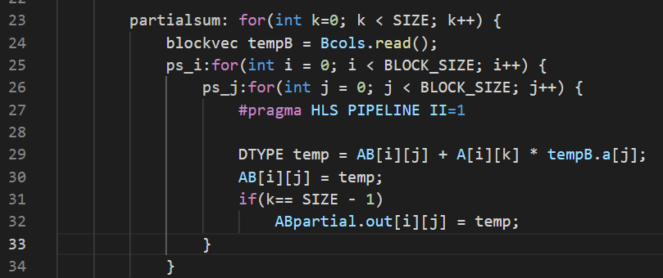
Compute/Store Optimization
Merger store part into compute loop to hide write out latency
Loop name | Latency (cycles) | Interval (cycles) | DSP (count)
Load | 72 | 9 | 0
Compute | 192 | 24 | 3
Store | 0 | 0 | 0

Slide 11

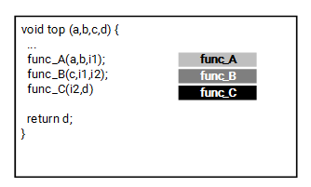
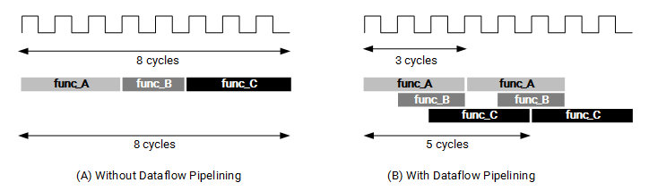
Problems & Solution
Load-Store issue (Write after Read)
SRAM: II >= 2, lower area
Registers: II >= 1, higher are
Tool will apply corresponding memory type based on II setting.
#pragma HLS DATAFLOW
Task-level pipeline
May cause R/W to the same address (port conflict)
Manually merge write & compute loop in previous slide.

Slide 12
GitHub Repo Link
https://github.com/andy39866821/AAHLS-LabB-Matrix-Multiplication

