Slide 1
EE6470 Implementation of Many-core Systems Final Project - Deep Neural Network
107062205 鍾宇騫

Slide 2
Guide line
Design Model
Data Reuse Method
Design Architecture
DNN in HLS
DNN in TLM model

Slide 3
Introduction of Design Model

Slide 4
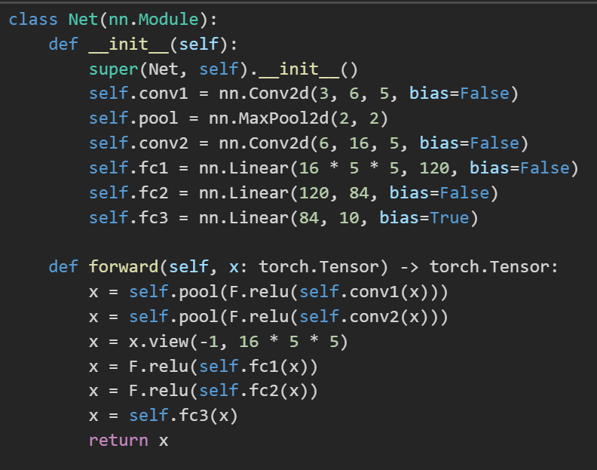
CIFAR-10 Image classification model

Slide 5
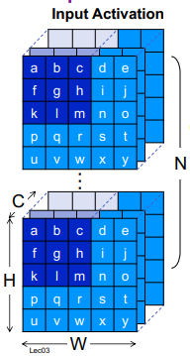
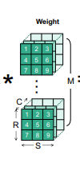
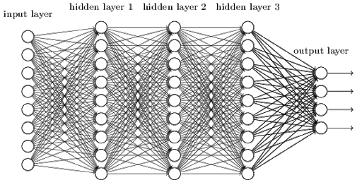
CIFAR-10 Image classification model

Slide 6
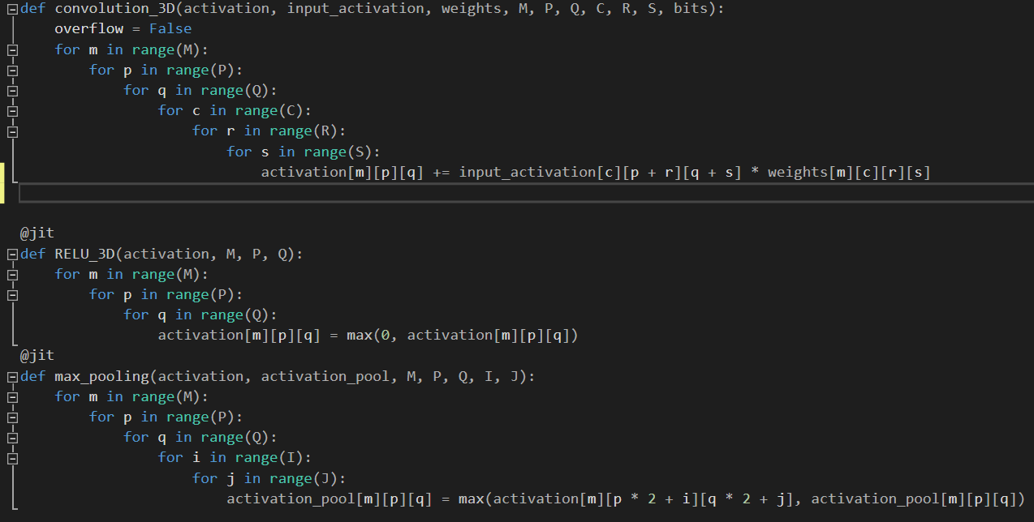
Convolution layer golden code

Slide 7
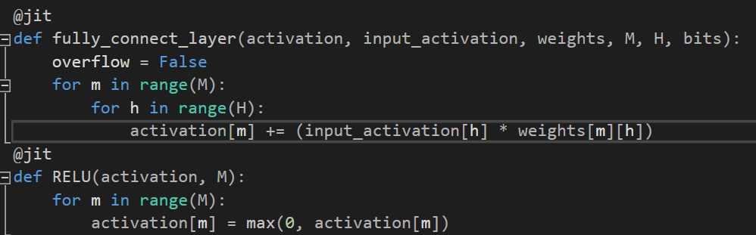
Fully Connection layer golden code

Slide 8
Each layer parameters
Input layer : 3 channels, 32 pixels width, and 32 pixels height
1st 3D Convolution layer : 6 batches, 3 channels, 5x5 kernels
1st max-pooling layer : 6 batches, 2x2 max-pooling
2nd 3D Convolution layer : 16 batches, 6 channels, 5x5 kernels
2nd max-pooling layer : 16 batches, 2x2 max-pooling
1st Fully Connection layer : 400 to 120 FC
2nd Fully Connection layer : 120 to 84 FC
3rd Fully Connection layer : 84 to 10 FC with bias addition
Output layer : predicted value of 10 classes

Slide 9
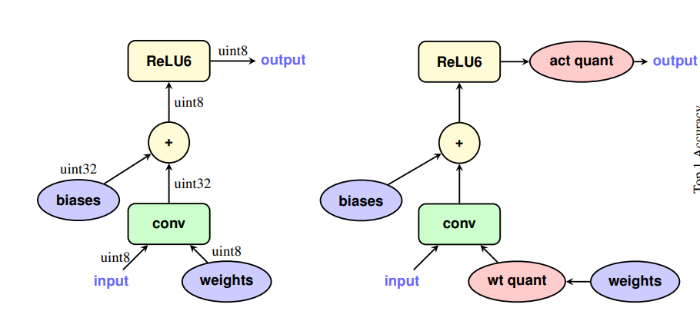
Quantization for hardware design
MAC bit-width
8-bits Integer Multiplication
24-bits Integer Multiplication
Effect
Lower Area
Lower power

Slide 10
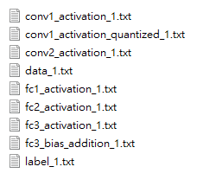
Golden Model & Result Verification
Python training model
Input
Weight
Label (Output)
Python golden model
Each layers activation

Slide 11
Data Reuse

Slide 12
Method Analysis
Non-Reuse Data
Advantage: No need buffer, computation is simple
Disadvantage: I/O bound System
Reuse Data
Advantage: Lower IO times
Disadvantage: Need buffer and complicated computation

Slide 13
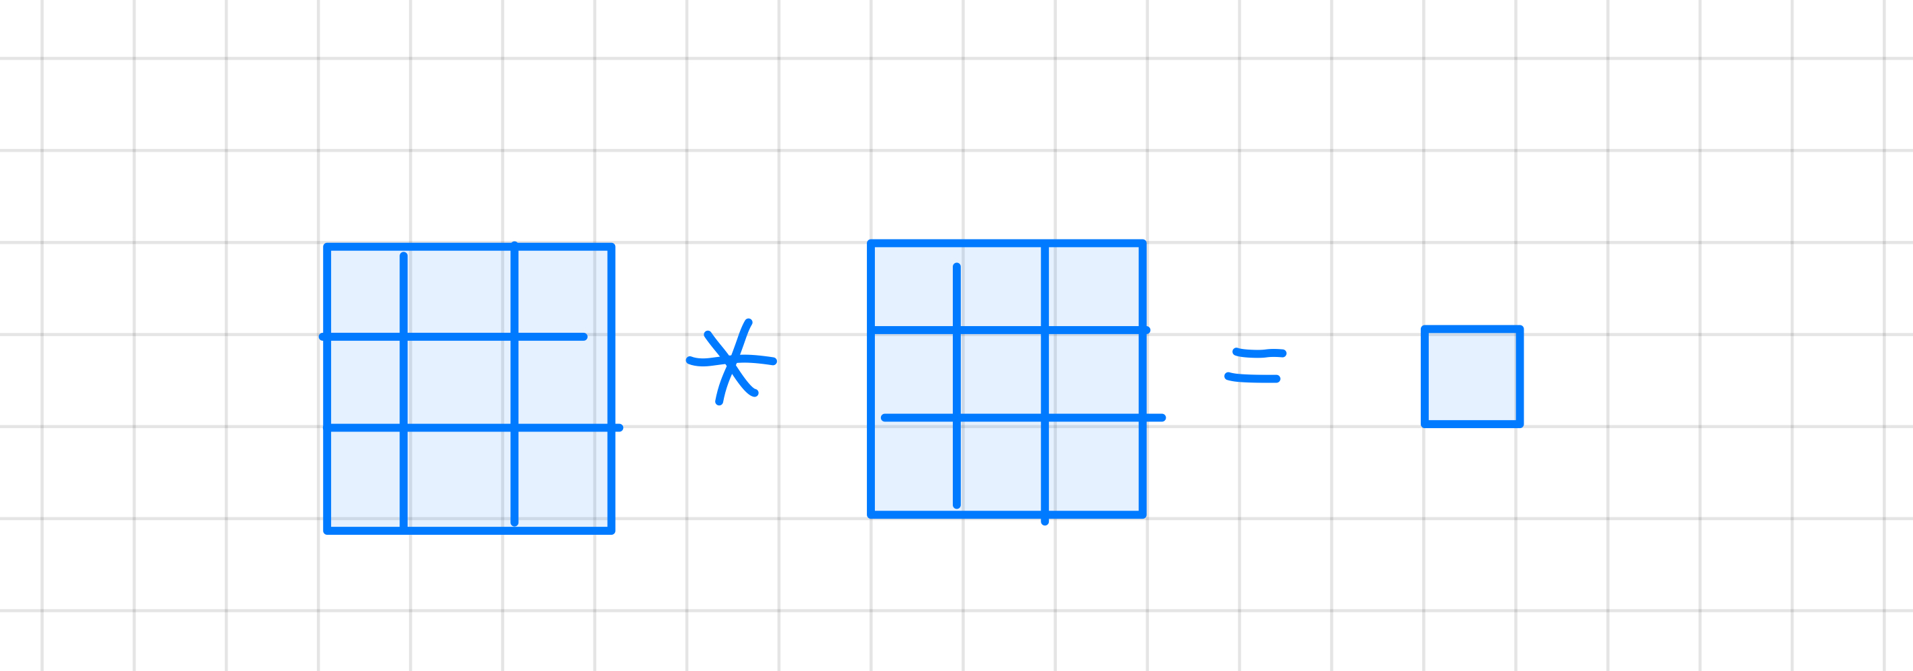
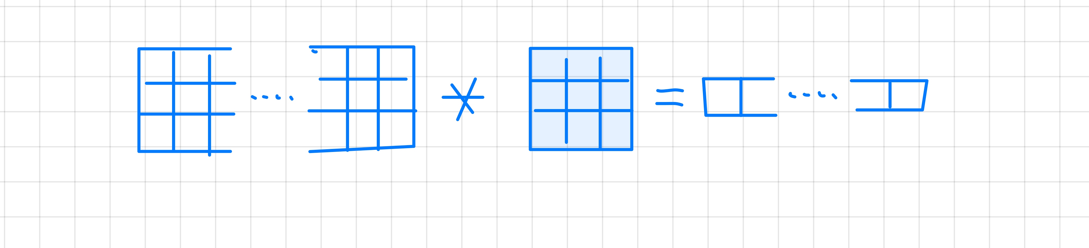
Data Reuse: Convolution
Non-Reuse Data (3x3 Example)
Reuse Data: Need buffer R rows input (3x3 Example)
Notes:
For the non-reuse version, it need to load whole source and weights in each round
For the reuse version, I buffered 5-rows source and 5 by 5 kernel to calculate a row of result

Slide 14
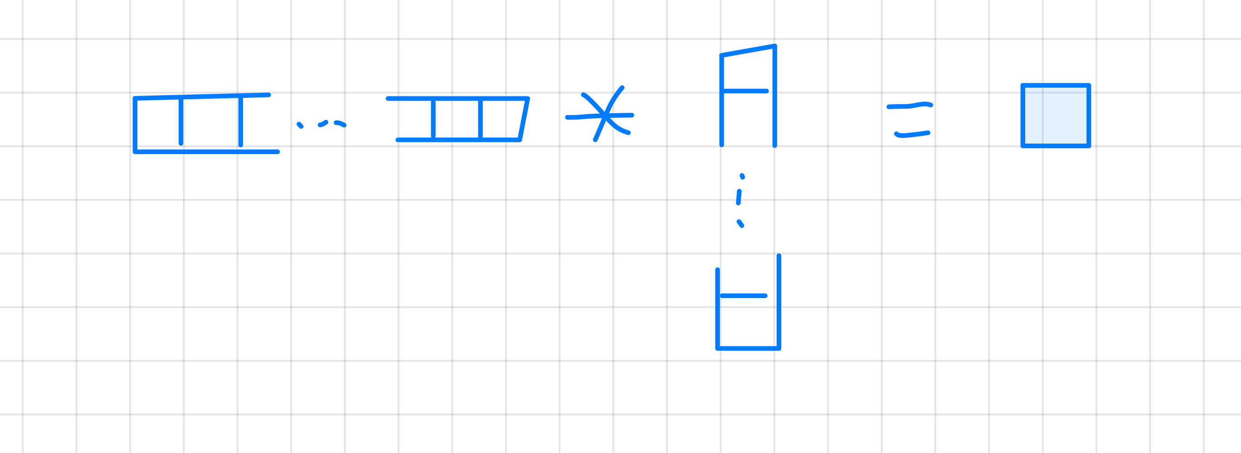
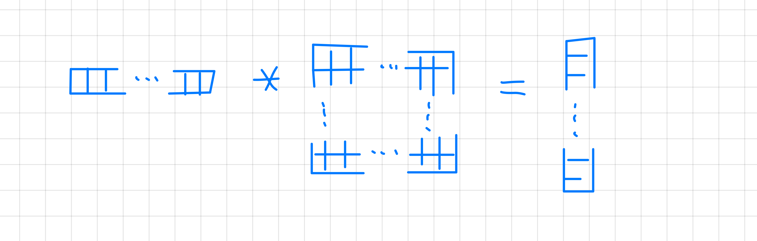
Data Reuse: Fully Connection
Non-Reuse Data
Reuse Data: Need buffer for each accumulation
Notes:
For the non-reuse version, I did not buffer any thing, so I need to load every data we need to calculate one result
But in reuse version, I buffer result array, that is, we only need to load source one times.

Slide 15
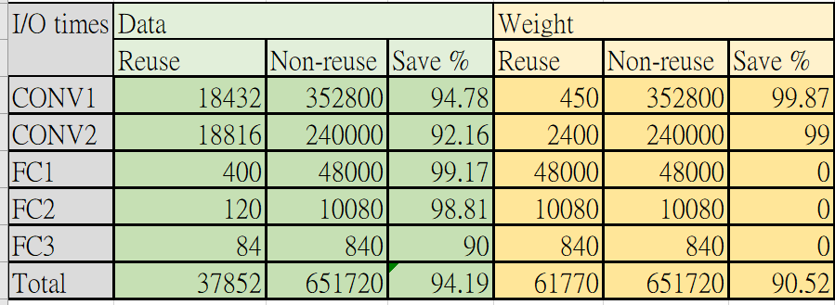
Data Reuse Method Comparison
Notes:
Here is the table of comparing 2 different data reuse method, we can find that reuse version can save up to 90 % Input time.

Slide 16
Design Architecture

Slide 17
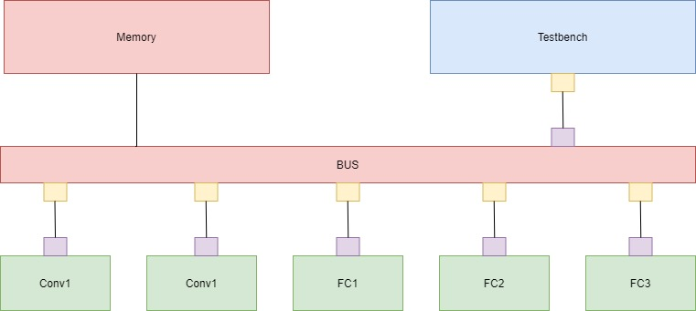
TLM Overview

Slide 18
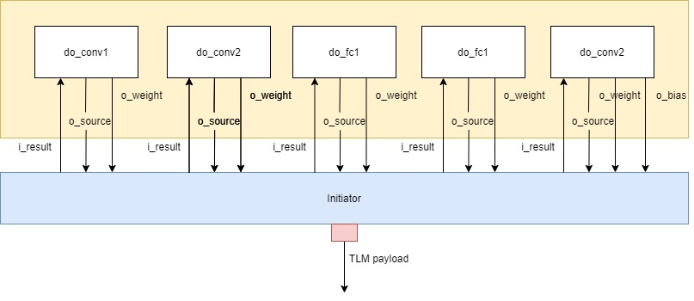
Testbench

Slide 19
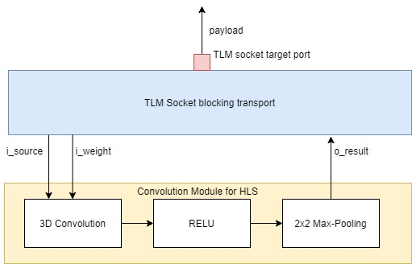
3D Convolution module

Slide 20
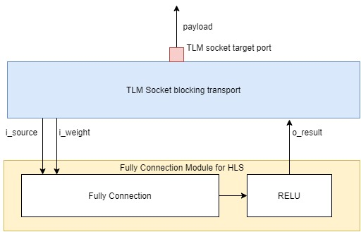
Fully Connection Module (No bias)

Slide 21
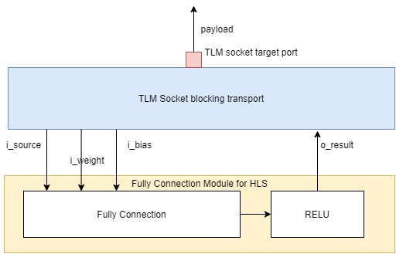
Fully Connection Module (With bias)

Slide 22
DNN in HLS

Slide 23
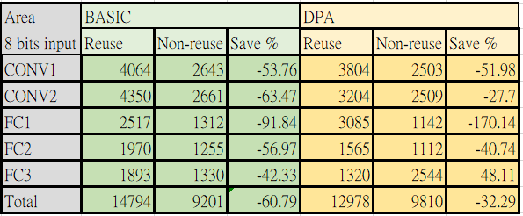
Stratus Synthesis Result 8-bits Multiplier and 24-bits Accumulator

Slide 24
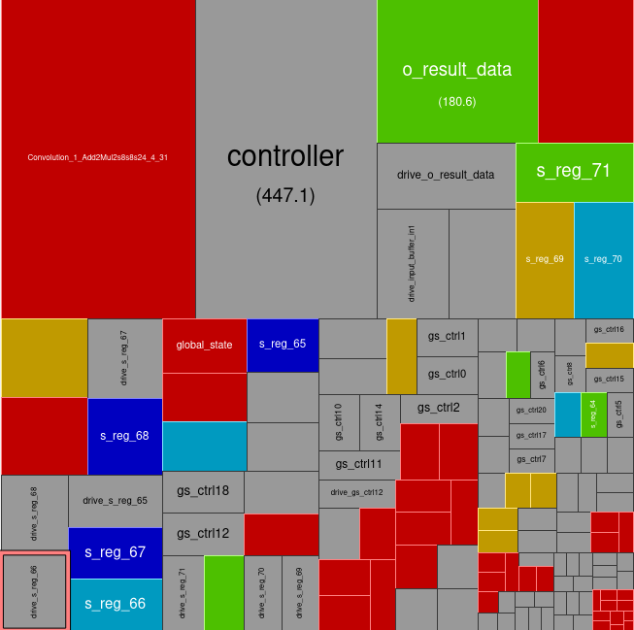
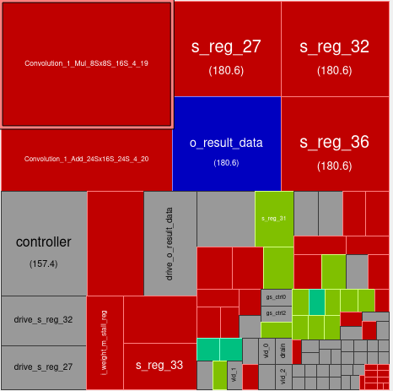
Reason for Higher Area
Row-based buffer version need extra area to place
Controller, buffer, and data path for buffer
Both version has same area of data path (MAC)
Reuse-Conv1 Non-reuse-Conv1

Slide 25
DNN in RISCV-VP

Slide 26
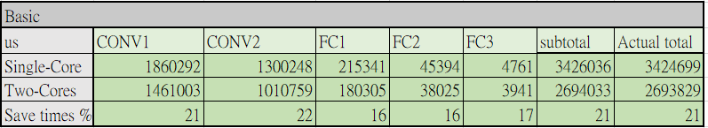
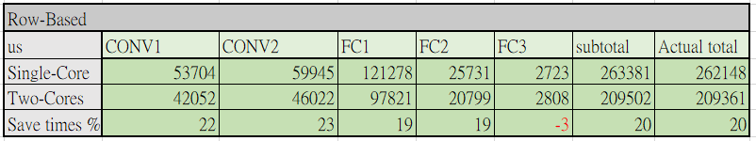
Different-Cores Simulation Times

Slide 27
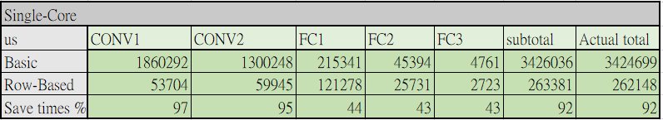
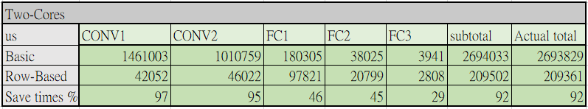
Different-Ways Simulation Times

Slide 28
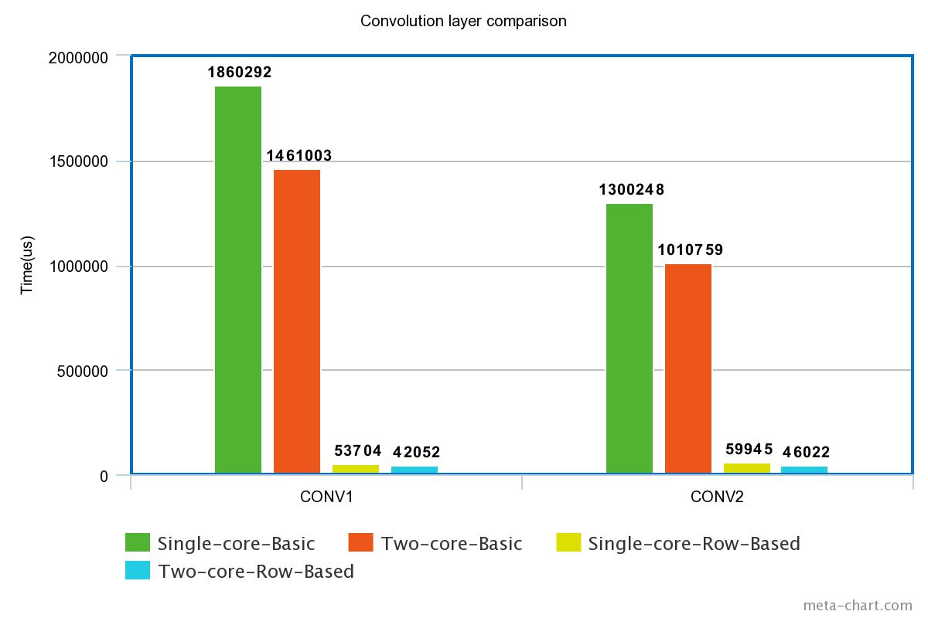
Comparison - Convolution

Slide 29
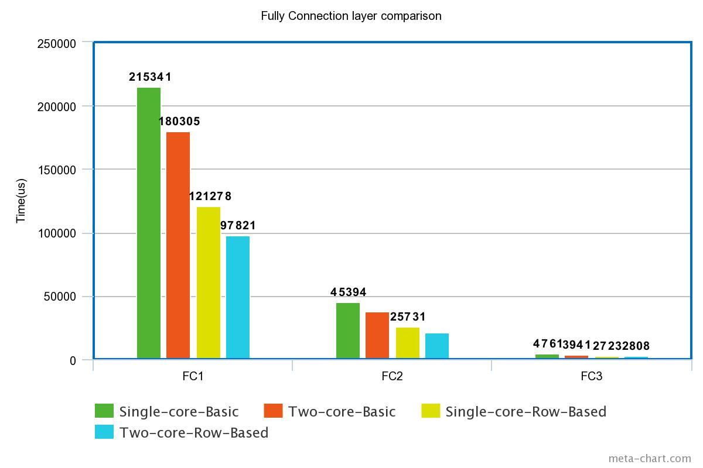
Comparison – Fully Connection

Slide 30
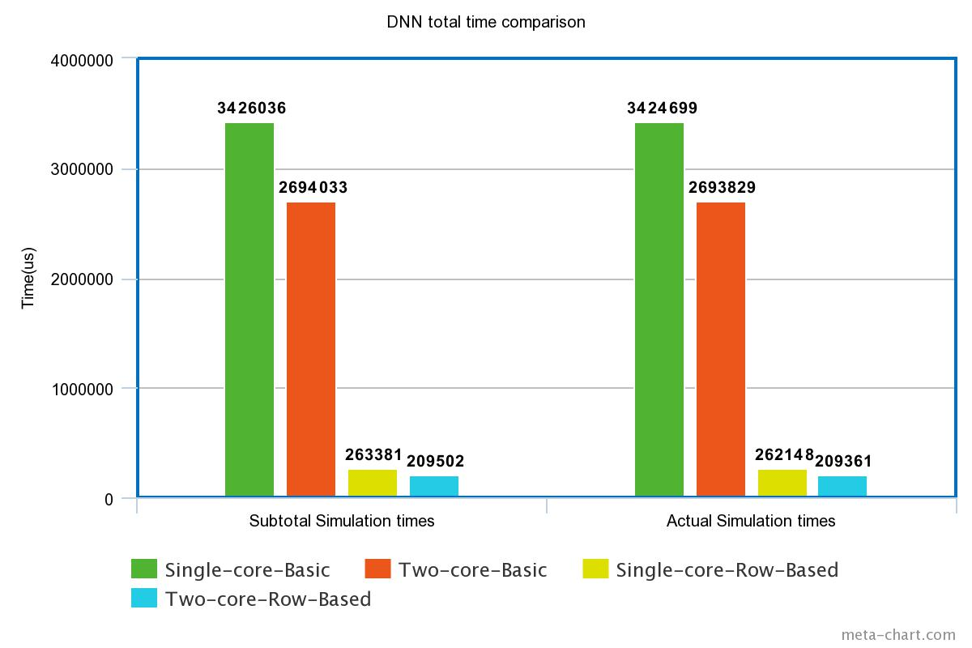
Comparison – Entire DNN

Slide 31
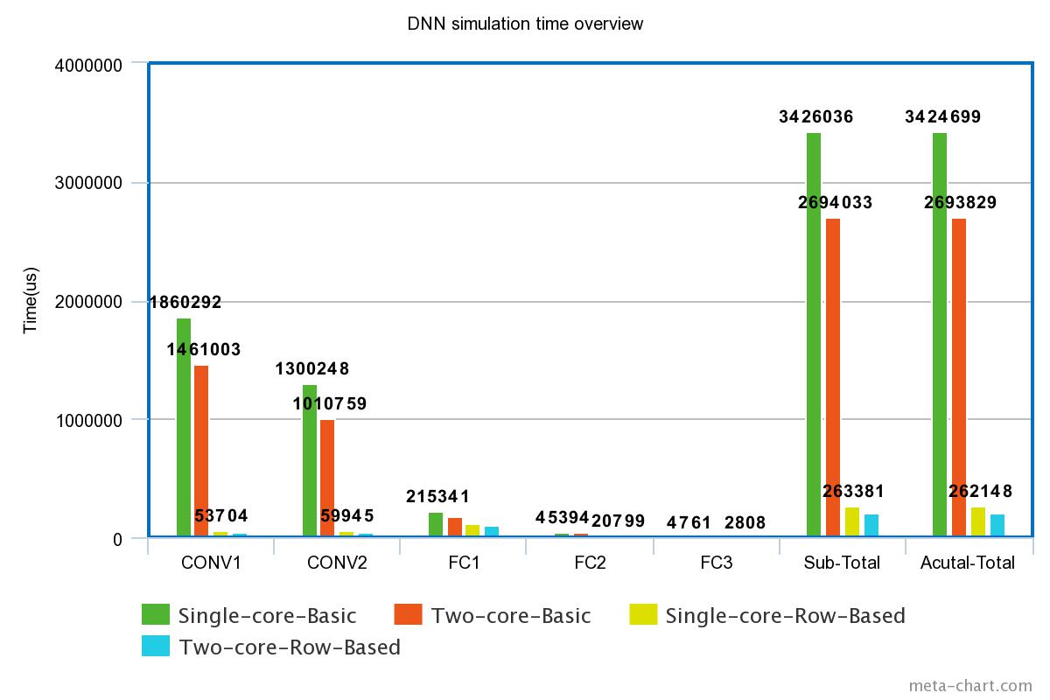
Comparison - Overview

Slide 32
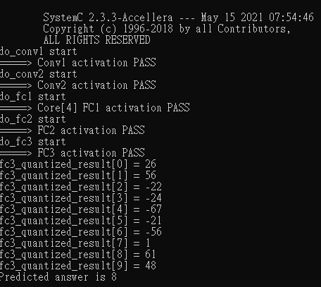
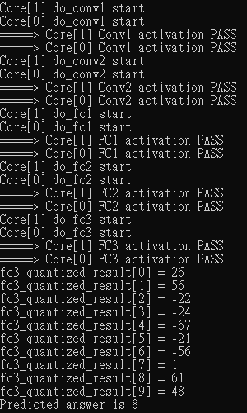
Simulation Results

Slide 33
Thanks You

