Slide 1
AAHLS Final Project Presentation 2D Mesh Interconnection Network on Chip
Group 03: 鍾宇騫 許鏡瑋
2022 / 06 / 15

Slide 2
System Architecture
2x2 Interconnection Network on Chip in Structural Design
Exploring possibility of Xilinx HLS for NoC system design
Testbench
System
NoC Design
Router
Router
Feed & Fetch
NI
NI
Feed & Fetch
Router
Router
Feed & Fetch
NI
NI
Feed & Fetch

Slide 3
Transmission Data Structure
Packet
4 bits
4 bits
512 bits
Seq#
Dest
Payload
5 Flits
104 bits
104 bits
104 bits
104 bits
104 bits
Head Flit (0)
Body Flit (1)
Body Flit (2)
Body Flit (3)
Tail Flit (4)

Slide 4

5x5 Router
Arbiter
...
Input Flit 0
Input Unit 0
Input Valid 0
Virtual Channel 0
Data in
Control
VC Full 0
Virtual Channel 4
Data out
…
…
Output Unit 0
Output Valid 0
…
FIFO Buffer
Output Flit 0
...
…
VC Full 0
Input Flit 4
Input Unit 4
…
…
Input Valid 4
Virtual Channel 0
Output Unit 4
Output Valid 4
VC Full 4
Output Flit 4
Virtual Channel 4
FIFO Buffer
VC Full 4
Reference: https://www.sciencedirect.com/topics/computer-science/output-virtual-channel

Slide 5
FIFO Buffer (flit_buffer.h)
Buffer for input unit and output unit
16x104b Registers
read data
Read
Read index = 2
…
R0
R1
R2
…
R61
R62
R63
…
Write data
enable[64]
Write index = 1
Write
write data & enable

Slide 6
Input Unit (input_unit.h)
Grants[5]
Requests[5]
Virtual Channel 0
Virtual Channel 1
VC Full 4
Routing
Input Valid 4
Flit valid
Virtual Channel 2
MUX
Input Flit 4
Flit to switch
Virtual Channel 3
Virtual Channel 4

Slide 7
Output Unit (output_unit.h)
FIFO Full
FIFO Buffer
VC Full
Switch Valid
Output Valid
Switch Flit
Output Flit

Slide 8
Arbiter (arbiter.h)
Round-Robin Arbitration
Each output port pass priority to next input unit after sending 5 flits
If send 0~4 flits and request valid, keep the priority
If send 5 flits, pass the priority
If send 0 flits and no request, pass the priority
If send 1~4 flits but no request, keep the priority
Arbiter
Output FIFO State[5]
Requests[5][5]
Grants[5][5]

Slide 9
Mux Based Switch (router_top.h)
Switch
…
MUX
FIFO
Output Unit 0
VC0
VC1
Input Unit 0
VC2
…
MUX
FIFO
Output Unit 1
VC3
VC4
…
MUX
FIFO
Output Unit 2
…
VC0
VC1
MUX
Input Unit 4
…
FIFO
Output Unit 3
VC2
VC3
VC4
…
MUX
FIFO
Output Unit 4

Slide 10
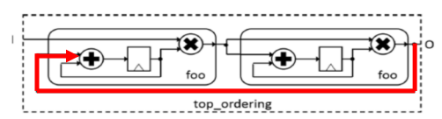
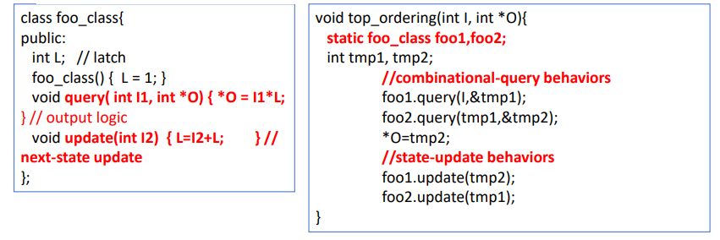
Structural Design Technique (I)
Recall: Combinational & sequential part description

Slide 11
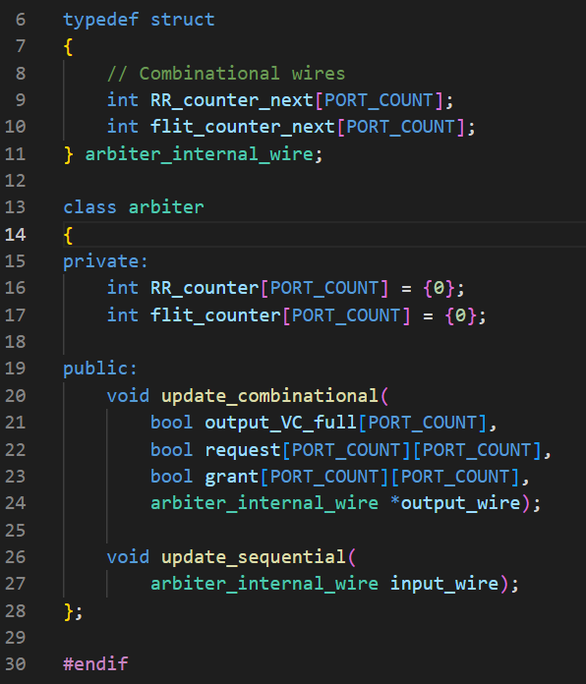
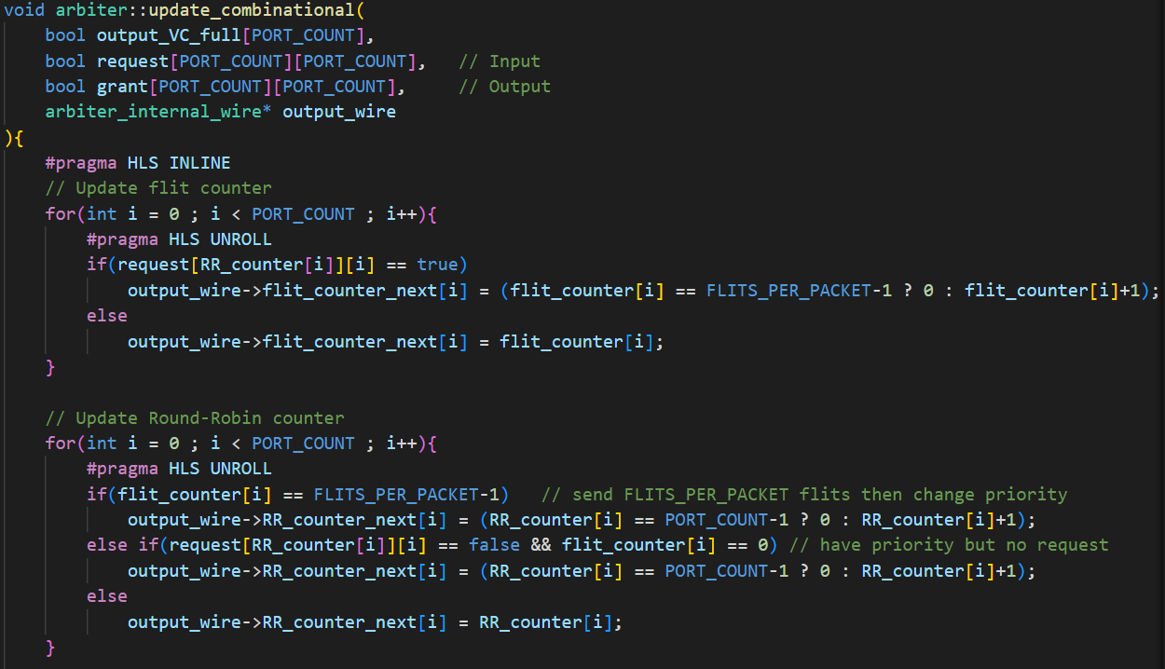
Structural Design Technique (II)

Slide 12
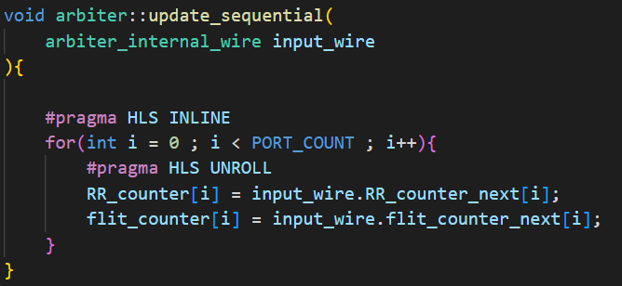
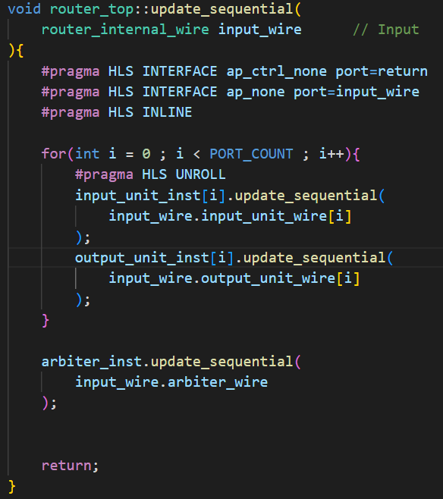
Structural Design Technique (III)

Slide 13
Performance & Resource Utilization
Item | Result | Utilization
Board | AlveoU280
Clock rate | 100 MHZ
FF | 49,987 | 1%
DSP | 0 | 0%
LUT | 131283 | 10%
Actual throughput (single router) | 5.98 GBps
Ideal throughput (single router) | 6.50 GBps | 92%
Worst throughput (single router) | 1.30 GBps
Actual throughput (system) | 3.74 GBps
Ideal throughput (system) | 5.20 GBps | 72%
Worst throughput (system) | 1.30 GBps

Slide 14
Conclusion & Contribution
Xilinx Vitis is not suitable for structural design
Bad utilization when synthesis
It is developed for high-level algorithm hardware-mapping (RestNet50, Signal processing)
Lack of documentation about structural design
Our contribution
Build a 2-by-2 2D mesh NoC with classical router implementation
Explore structural design coding style
Combinational & sequential updating in class level (Lecture and paper provide function-level design)
RTL-like coding style, explore the design style of independent module
Future of our work
Use Vivado to design hardware in RTL coding
Using Vitis for IP integration and prototyping
Software stack of Vitis is powerful

Slide 15
Team collaboration
Job | Student
Router | 鍾宇騫
Network Interface | 鍾宇騫
System Integration | 鍾宇騫
OpenCL & prototyping | 許鏡瑋

Slide 16
Reference
[1] Using Vivado-HLS for Structural Design: a NoC Case Study
[2] principle and practice of interconnection network
[3] HLS text book from Bridge of Life Education
[4] Parallel Programming for FPGA

Slide 17
GitHub Repository
https://github.com/andy39866821/Vitis-HLS-2D-Mesh-NoC-Implementation

