Slide 1


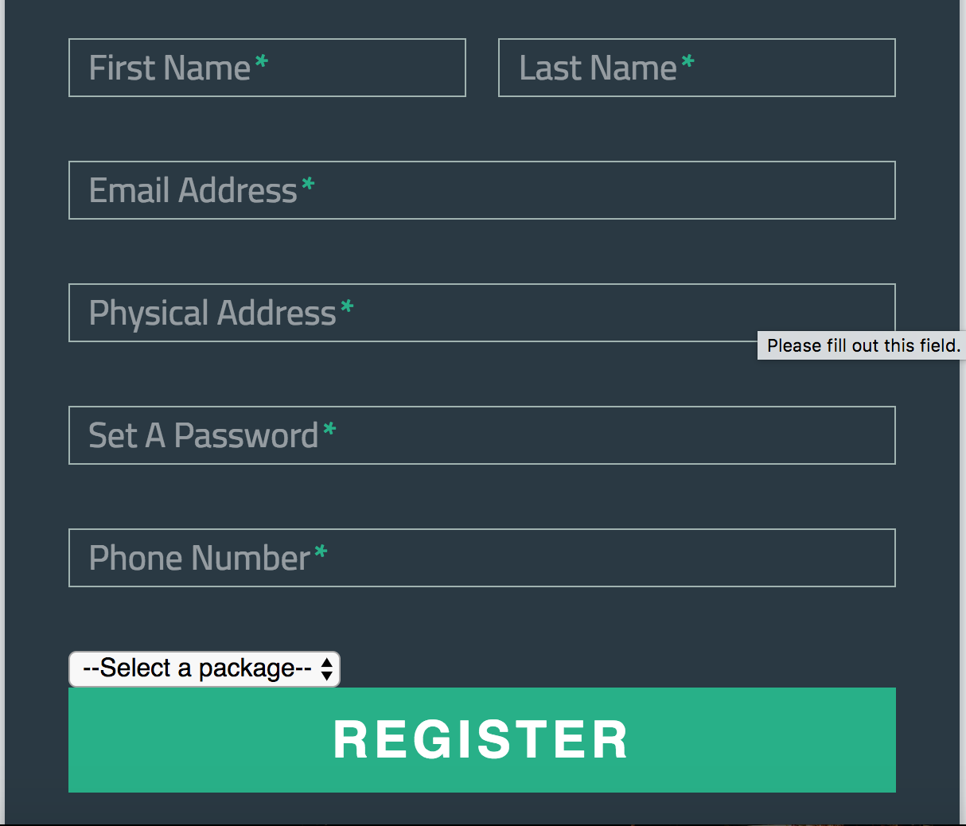

Senior Butler
On-Line Management System
Robert Andreyka, randreyka@seniorbutlers.com; Jorge Cobb, cobb@utdallas.edu
ChienChi Liu, cxl153330@utdallas.edu; Chon Him Ip, cxi150030@utdallas.edu;
Cassidy Hoang, cth130030@utdallas.edu; Vasanti Dholaria, vmd140230@utdallas.edu
CS 4485 / Fall 2017
Department of Computer Science
Erik Jonsson School of Engineering & Computer Science
The University of Texas at Dallas
Richardson, TX 75080, USA
Senior Butler
Abstract
Senior Butler is a platform that provides seniors and their family a simple one shop of bundled and on-demand services. Since seniors feel more comfortable to remain in their home, safety checks and home maintenance are necessary to keep the home in the best condition for aging in place. Senior Butler is designed to offer and help seniors arrange package of services for their home with a fair pricing, while providing constant feedback to their family members. In this way, both parties can assure that the living place is safe and secure. This semester, the team was assigned the task of creating the fundamentals of the Senior Butler platform.
Results
Senior Butler provides a website with a:
Subscribers Interface
Written in php and html
Register/View account information
Provider Interface
Written in php and html
Assign workers to customers’ home
Back-office Interface
Using phpmyadmin to control the database
Add/Edit/Delete all the database entries and customer information
GoCanvas Interface
Upload the data to GoCanvas from database using .csv
Send the dispatch information to the workers’ phones using GoCanvas Apps
+++++
Architecture
Subscriber Portal
GoCanvas Apps
Subscriber:
Register an account
Select package
Log in and view
Database
Workers:
Upload the checklist details through .csv files to Senior Butler Database
Backoffice Portal
Provider Portal
Senior Butler Admin:
Add/Edit/Delete entries
Provider:
Assign subscriber to the workers who is available
Impact
Senior Butler provides a primary means for aging adults to “age well in place.” In particular, customers will be able to purchase packages of services so that they can age in the comfort of their home. This is important due to the growth of the elderly population in the United States. As people get older, they will no longer have the ability to (safely) complete everyday tasks that they used to be able to do. Senior Butler addresses this problem by providing a one-stop shop for packages of services that will make the once easy/everyday chores and tasks easier to complete for those who will need it.
This project will not only assist the company with company productivity, but it will also open the doors for upcoming phases to add and incorporate further implementations to the Senior Butler platform.
Metrics
This project created some fundamental components of the Senior Butler platform. A database was created as well as various web pages. With this, a user can successfully register for and log in to Senior Butler, thus allowing the user to choose a package. Each interface was developed with the idea of helping customers “age well in place.”
Summary
Our team spent the first couple of weeks researching different software and technologies that would make up the Senior Butler platform. We then applied the knowledge learned into the development of the platform, which resulted in a website with pages (registration, dispatch, and back office admin) that can connect to the company database.
Notes:
*Rewrite impact section*
*rewrite summary*
*add metrics section*
"impact" section: this is how is that the project will affect/benefit the sponsor company, your community/city/country, etc.
Metrics from midterm proposal:
The project can be deemed as successful if the group has made some progress on the project by the end of the semester. Ideally, the group will have an end product/prototype so that the company may begin work through the actual product. The product will be considered on time if the different phases (and end product) are delivered by the due dates. Team members will monitor the project weekly in order to determine the amount of progress made. Test plans include the successful running of the app/website and the working connections between the database, app, and website.
One form of quantitative feedback is the mentor’s feedback. The mentor’s feedback would be most valuable such that he is aware of what happens with/during the project and can determine how successful the project was.

