Slide 1

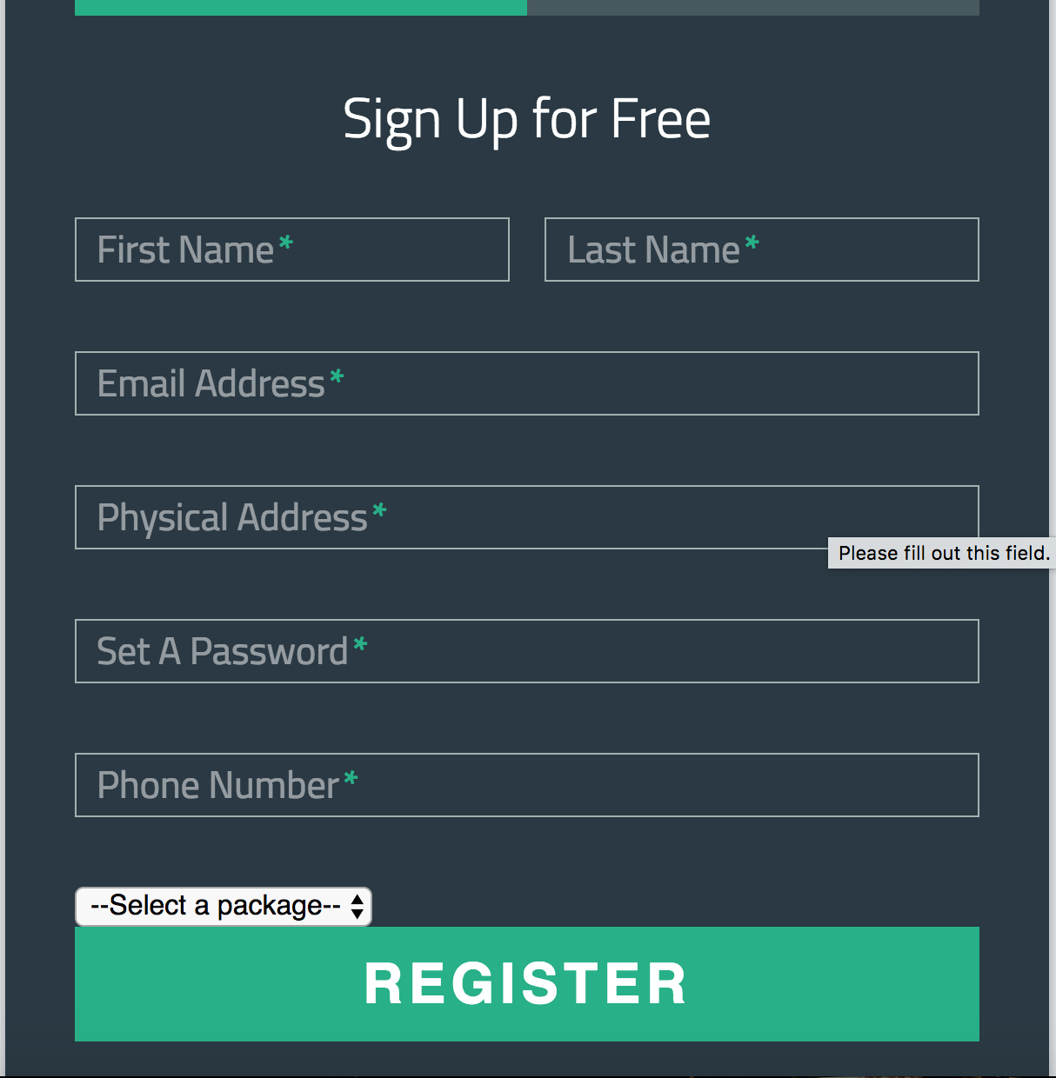
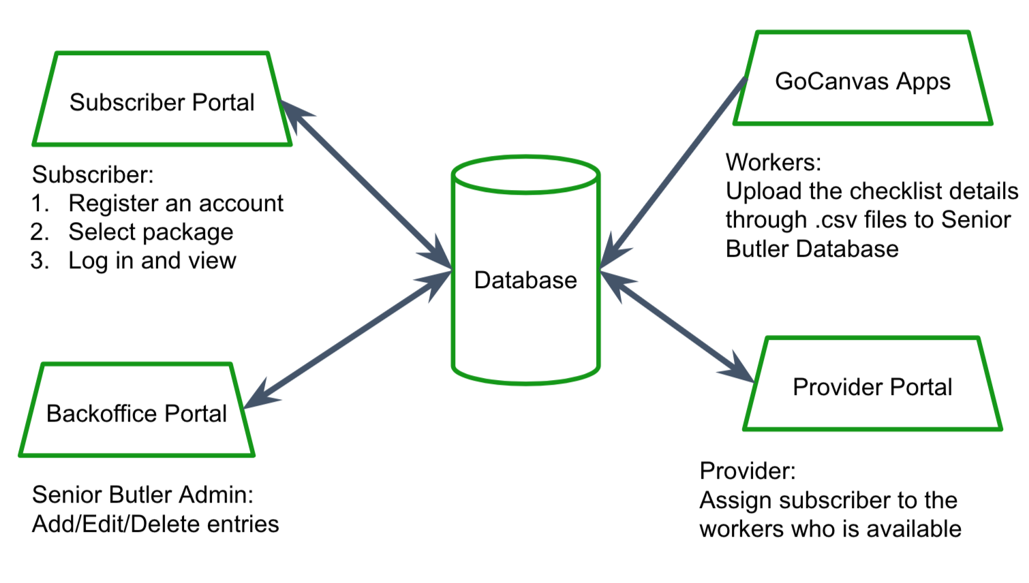
Senior Butler
On-Line Management System
Chien Chi Liu, Cassidy Hoang, Chon Him Ip, Vasanti Dholaria
Goal: Senior Butler is designed to offer a variety of services that assists seniors with day-to-day tasks and help seniors arrange package(s) of services for their home with fair pricing.
Approach: We created a system which includes several websites:
Registration page - customers can register for Senior Butler and select the package(s) they want to operate on their home.
Dispatch page - providers can assign workers to certain customers and dispatch an inspection notice to its workers.
Back office admin page - back office staff can edit customer information.
Notes:
Registration page - customers can register for Senior Butler and select the package(s) they want to operate on their home.
Dispatch page - providers can assign workers to certain customers and dispatch an inspection notice to its workers.
Back office admin page - back office staff can edit customer information.

