Slide 1
An Introduction to the Theory of NP
Wen-Lin Yang,
CSIE, National University of Tainan

Slide 2
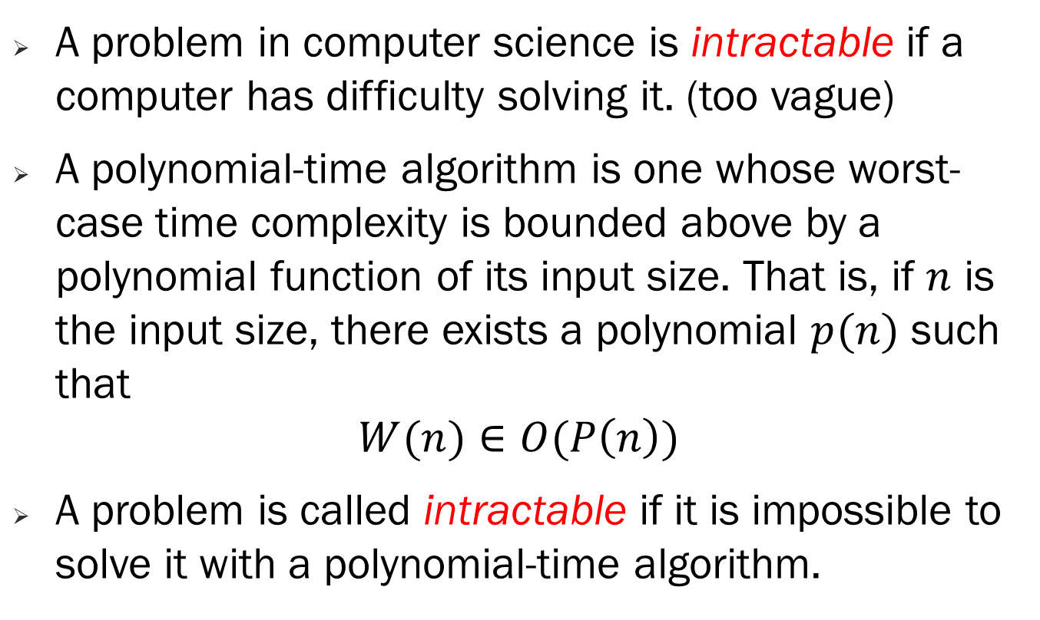
Intractability
A problem in computer science is intractable if a computer has difficulty solving it. (too vague)
A polynomial-time algorithm is one whose worst-case time complexity is bounded above by a polynomial function of its input size. That is, if $n$ is the input size, there exists a polynomial $p(n)$ such that
$$W(n)∈O(P\left(n\right))$$
A problem is called intractable if it is impossible to solve it with a polynomial-time algorithm.

Slide 3
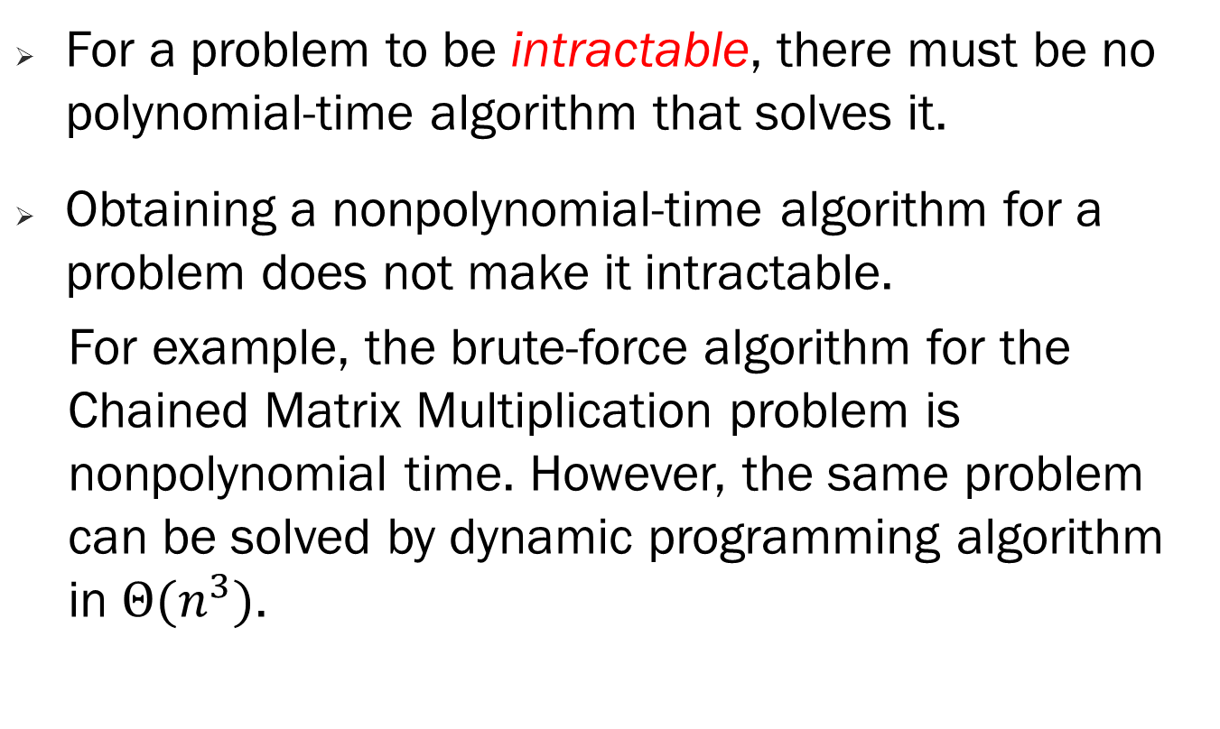
Intractability
For a problem to be intractable, there must be no polynomial-time algorithm that solves it.
Obtaining a nonpolynomial-time algorithm for a problem does not make it intractable.
For example, the brute-force algorithm for the Chained Matrix Multiplication problem is nonpolynomial time. However, the same problem can be solved by dynamic programming algorithm in $Θ(n^{3})$.

Slide 4
Intractability
There are three general categories of problems as far as intractability is concerned:
Problems for which polynomial-time algorithms have been found.
Problems that have been proven to be intractable.
Problems that have not been proven to be intractable, but for which polynomial-time algorithms have never been found.
most problems in computer science seem to fall into either the first or third category.

Slide 5
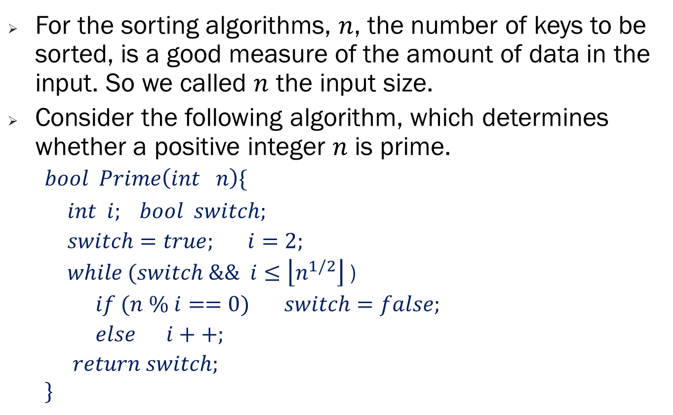
Input size
For the sorting algorithms, $n$, the number of keys to be sorted, is a good measure of the amount of data in the input. So we called $n$ the input size.
Consider the following algorithm, which determines whether a positive integer $n$ is prime.
$$bool Prime\left(int n\right)\{$$
$int i; bool switch;$
$switch=true;$ $i=2;$
$while (switch \&\& i≤\left\lfloor n^{1/2}\right\rfloor$ )
$if (n \% i==0)$ $switch=false;$
$else i++;$
$return switch;$
$$\}$$

Slide 6
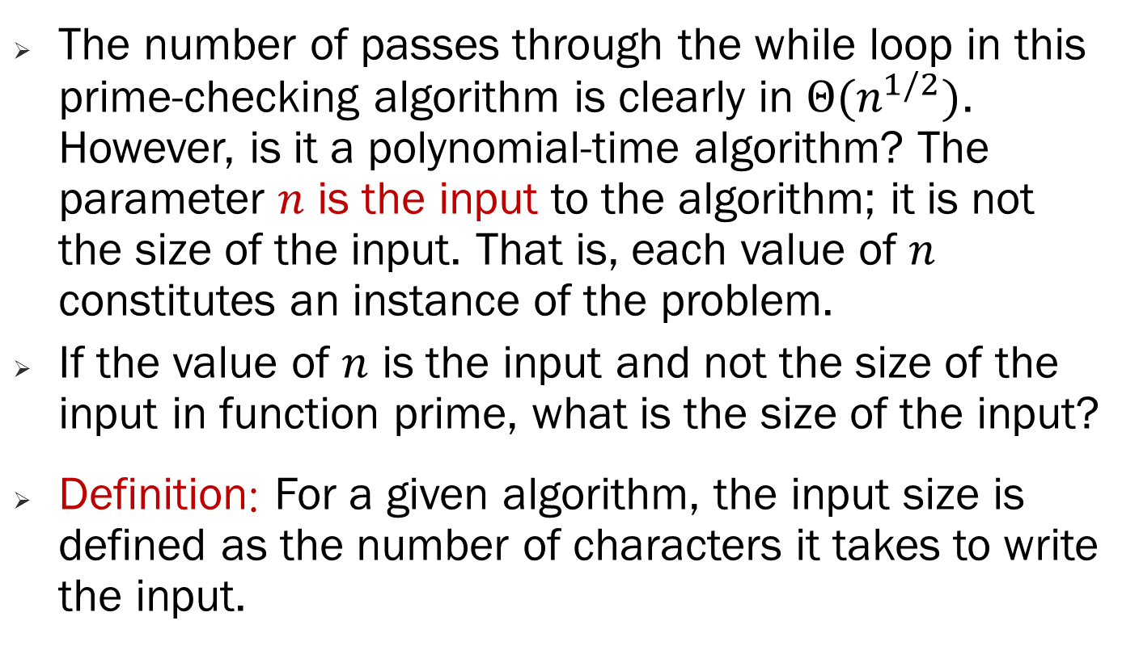
Input size
The number of passes through the while loop in this prime-checking algorithm is clearly in $Θ(n^{1/2})$. However, is it a polynomial-time algorithm? The parameter $n$ is the input to the algorithm; it is not the size of the input. That is, each value of $n$ constitutes an instance of the problem.
If the value of $n$ is the input and not the size of the input in function prime, what is the size of the input?
Definition: For a given algorithm, the input size is defined as the number of characters it takes to write the input.

Slide 7
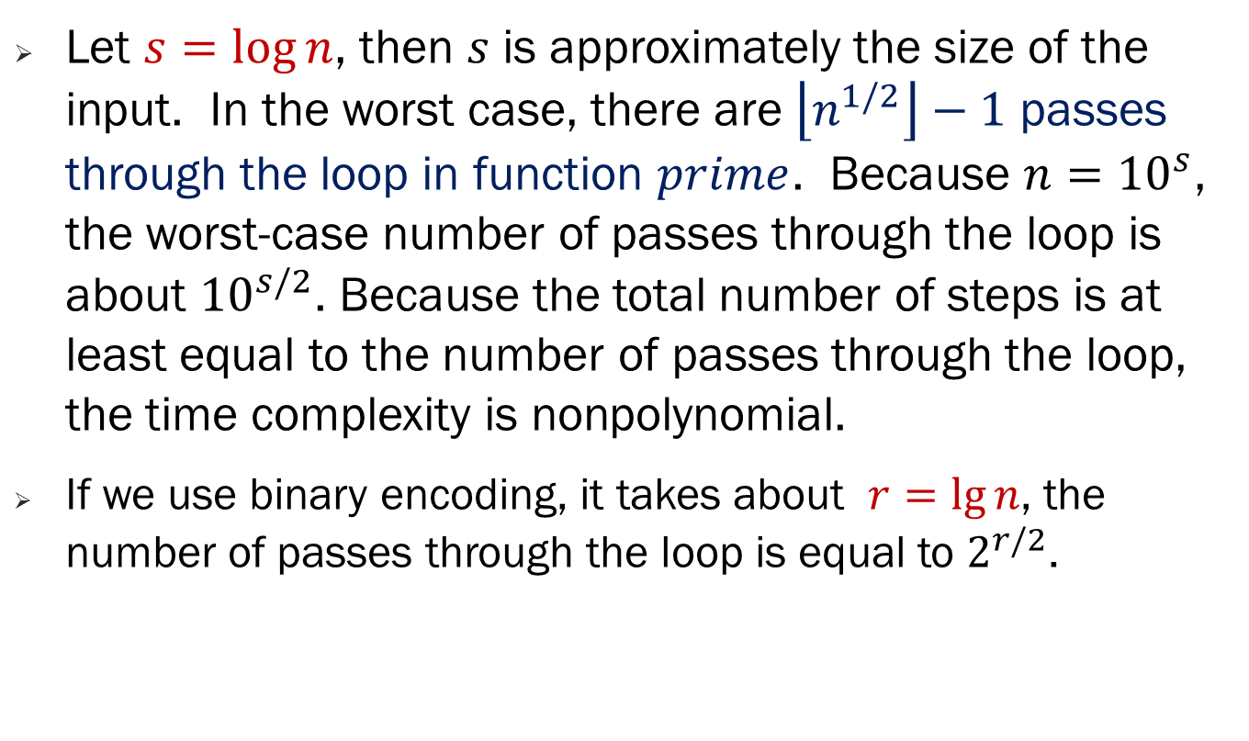
Input size
Let $s=\log{n}$, then $s$ is approximately the size of the input. In the worst case, there are $\left\lfloor n^{1/2}\right\rfloor −1$ passes through the loop in function $prime$. Because $n={10}^{s}$, the worst-case number of passes through the loop is about ${10}^{s/2}$. Because the total number of steps is at least equal to the number of passes through the loop, the time complexity is nonpolynomial.
If we use binary encoding, it takes about $r=\lg{n}$, the number of passes through the loop is equal to $2^{r/2}$.

Slide 8
The Three General Problem Categories
Problems for Which Polynomial-Time Algorithms Have Been Found.
Any problem for which we have found a polynomial-time algorithm falls in this first category. However, there are algorithms are not polynomial-time for these problems.
Problems That Have Been Proven to Be Intractable.
There are two types of problems in this category.
The first type is problems that require a nonpolynomial amount of output. -

Slide 9
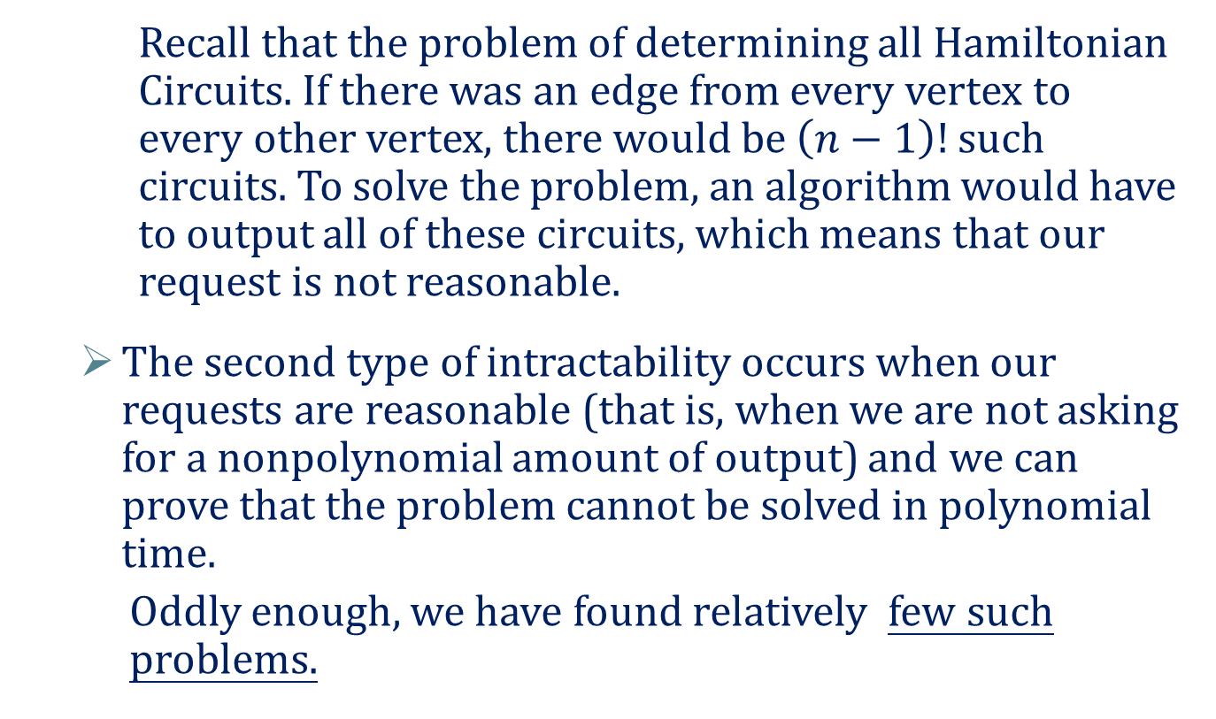
The Three General Problem Categories
Recall that the problem of determining all Hamiltonian Circuits. If there was an edge from every vertex to every other vertex, there would be $\left(n−1\right)!$ such circuits. To solve the problem, an algorithm would have to output all of these circuits, which means that our request is not reasonable.
The second type of intractability occurs when our requests are reasonable (that is, when we are not asking for a nonpolynomial amount of output) and we can prove that the problem cannot be solved in polynomial time.
Oddly enough, we have found relatively few such problems.

Slide 10
The Three General Problem Categories
The first ones were undecidable problems. These problems are called "undecidable" because it can be proven that algorithms that solve them cannot exist.
The most well-known of these is the Halting problem. In this problem we take as input any algorithm and any input to that algorithm, and decide whether or not the algorithm will halt when applied to that input.
Presburger Arithmetic, which was proven intractable by Fischer and. Rabin in 1974.
All the above problems that to this date have been proven intractable have also been proven not to be in the set NP . However, most problems that appear to be intractable are in the set NP.

Slide 11
The Three General Problem Categories
Problems That Have Not Been Proven to Be Intractable but for Which Polynomial-Time Algorithms Have Never Been Found.
This category includes any problem for which a polynomial-time algorithm has never been found, but yet no one has ever proven that such an algorithm is not possible. As already discussed, there are many such problems.
For example, if we state the problems so as to require one solution, the 0–1 Knapsack problem, the Traveling Salesperson problem, the Sum-of-Subjects problem, the m-Coloring problem for m ≥ 3, the Hamiltonian Circuits problem.

Slide 12
The Theory of NP
It is more convenient to develop the theory if we originally restrict ourselves to decision problems. Recall that the output of a decision problem is a simple "yes" or "no" answer.
Each optimization problem, however, has a corresponding decision problem, as the examples that follow illustrate.
Example 1. Traveling Salesperson Problem
Let a weighted, directed graph be given. Recall that a tour in such a graph is a path that starts at one vertex, ends at that vertex, and visits all the other vertices in the graph exactly once, and that the Traveling Salesperson Optimization problem is to determine a tour with minimal total weight on its edges.

Slide 13
The Theory of NP
The Traveling Salesperson Decision problem is to determine for a given positive number d whether there is a tour having total weight no greater than d. This problem has the same parameters as the Traveling Salesperson Optimization problem plus the additional parameter d.
Example 2. 0–1 Knapsack Problem
Recall that the 0–1 Knapsack Optimization problem is to determine the maximum total profit of the items that can be placed in a knapsack given that each item has a weight and a profit, and that there is a maximum total weight W that can be carried in the sack.

Slide 14
The Theory of NP
The 0–1 Knapsack Decision problem is to determine, for a given profit P, whether it is possible to load the knapsack so as to keep the total weight no greater than W, while making the total profit at least equal to P . This problem has the same parameters as the 0–1 Knapsack Optimization problem plus the additional parameter P.
Example 3. Graph–Coloring Problem
The Graph-Coloring Optimization problem is to determine the minimum number of colors needed to color a graph so that no two adjacent vertices are colored the same color. That number is called the chromatic number of the graph.

Slide 15
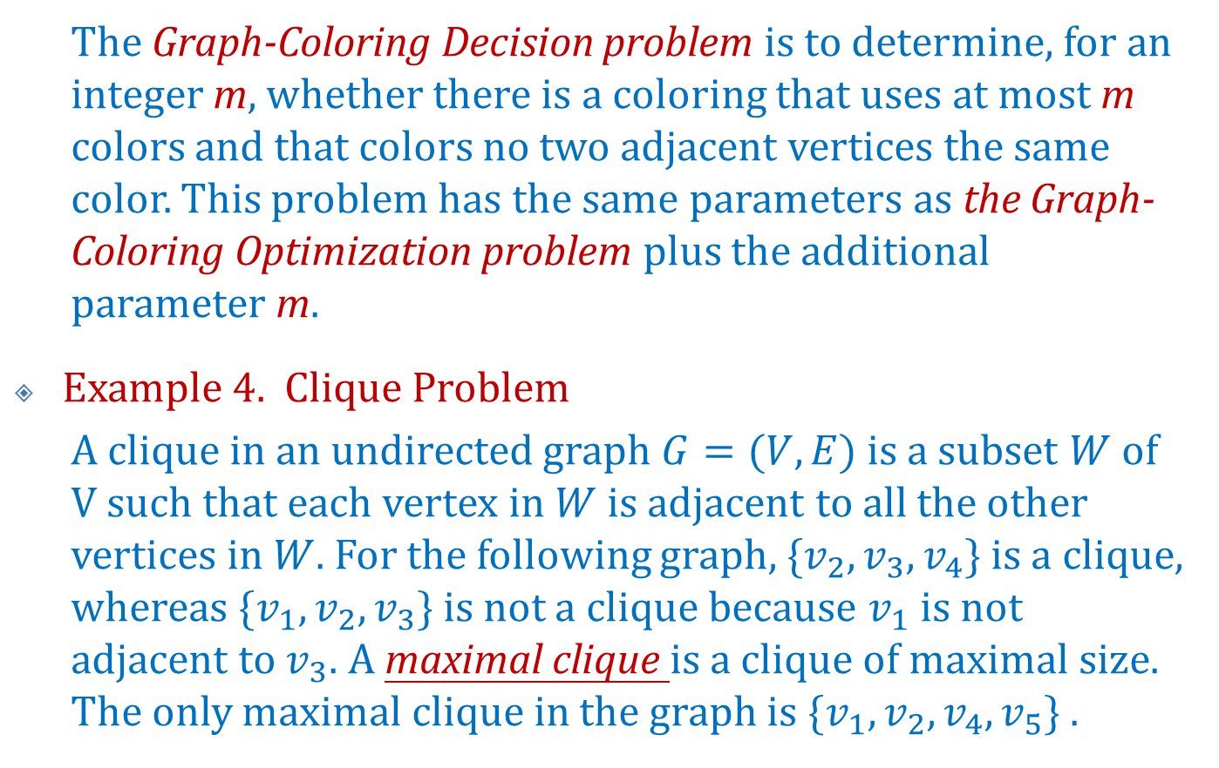
The Theory of NP
The Graph-Coloring Decision problem is to determine, for an integer m, whether there is a coloring that uses at most m colors and that colors no two adjacent vertices the same color. This problem has the same parameters as the Graph-Coloring Optimization problem plus the additional parameter m.
Example 4. Clique Problem
A clique in an undirected graph $G=(V,E)$ is a subset $W$of $V$ such that each vertex in$W$ is adjacent to all the other vertices in $W$. For the following graph, $\{v_{2},v_{3},v_{4}\}$ is a clique, whereas $\{v_{1},v_{2},v_{3}\}$ is not a clique because $v_{1}$ is not adjacent to $v_{3}$. A maximal clique is a clique of maximal size. The only maximal clique in the graph is $\{v_{1},v_{2},v_{4}, v_{5}\}$ .

Slide 16





The Theory of NP
The Clique Optimization problem is to determine the size of a maximal clique for a given graph.
The Clique Decision problem is to determine, for a positive integer k, whether there is a clique containing at least k vertices. This problem has the same parameters as the Clique Optimization problem plus the additional parameter k.
$$v_{1}$$
$$v_{2}$$
$$v_{3}$$
$$v_{5}$$
$$v_{4}$$

Slide 17
The Theory of NP
We have not found polynomial-time algorithms for either the decision problem or the optimization problem in any of these examples.
However, if we could find a polynomial-time algorithm for the optimization problem in any one of them, we would also have a polynomial-time algorithm for the corresponding decision problem. This is so because a solution to an optimization problem produces a solution to the corresponding decision problem.

Slide 18
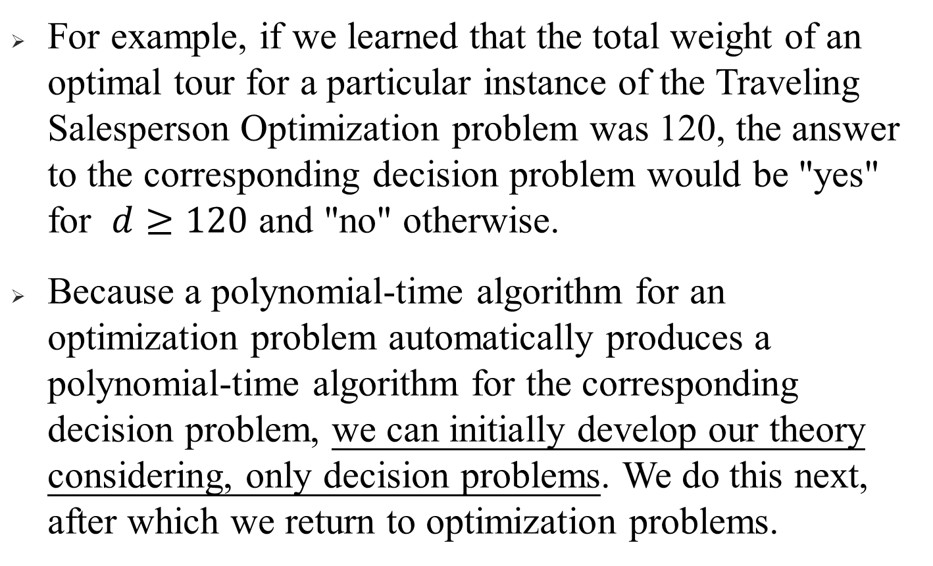
The Theory of NP
For example, if we learned that the total weight of an optimal tour for a particular instance of the Traveling Salesperson Optimization problem was 120, the answer to the corresponding decision problem would be "yes" for $d≥120$ and "no" otherwise.
Because a polynomial-time algorithm for an optimization problem automatically produces a polynomial-time algorithm for the corresponding decision problem, we can initially develop our theory considering, only decision problems. We do this next, after which we return to optimization problems.

Slide 19
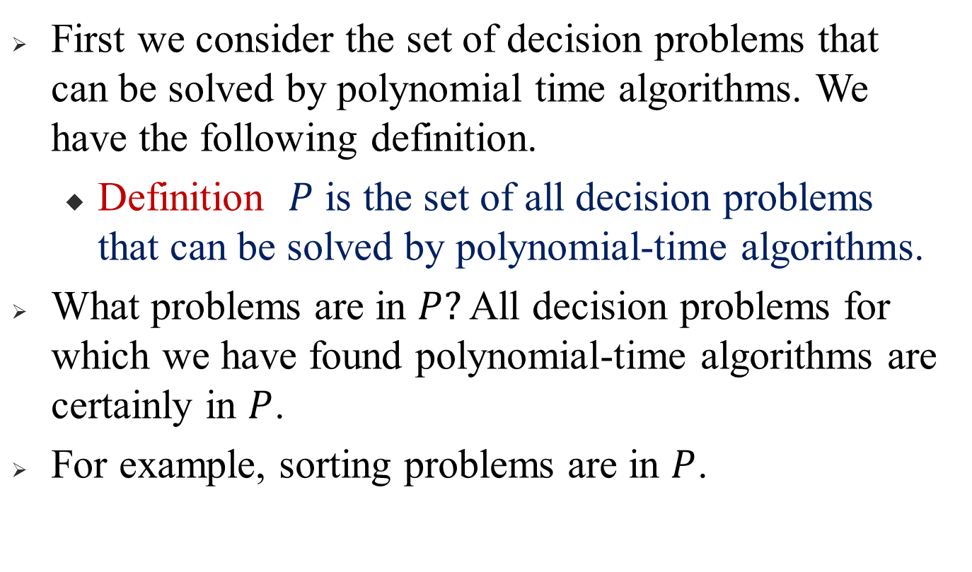

The sets $P$ and $NP$
First we consider the set of decision problems that can be solved by polynomial time algorithms. We have the following definition.
Definition $P$ is the set of all decision problems that can be solved by polynomial-time algorithms.
What problems are in $P?$ All decision problems for which we have found polynomial-time algorithms are certainly in $P$.
For example, sorting problems are in $P$.

Slide 20
The sets 𝑃 and 𝑁𝑃
However, could some decision problem for which we have not found a polynomial-time algorithm also be in P?
For example, could the Traveling Salesperson Decision problem be in P? Even though no one has ever created a polynomial-time algorithm that solves this problem, no one has ever proven that it cannot be solved with a polynomial time algorithm.

Slide 21
The sets 𝑃 and 𝑁𝑃
Therefore, it could possibly be in P. To know that a decision problem is not in P, we have to prove that it is not possible to develop a polynomial-time algorithm for it. This has not been done for the Traveling Salesperson Decision problem. The same considerations hold for the other decision problems.

Slide 22
The sets 𝑃 and 𝑁𝑃
What decision problems are not in P?
Because we do not know whether the decision problems in Examples 1~4 are in P, each of these may not be in P. We simply do not know. Furthermore, there are thousands of decision problems in this same category. That is, we do not know whether they are in P.
There are actually relatively few decision problems that we know for certain are not in P. These problems are decision problems for which we have proven that polynomial-time algorithms are not possible. Presburger Arithmetic is one of the most well-known.

Slide 23
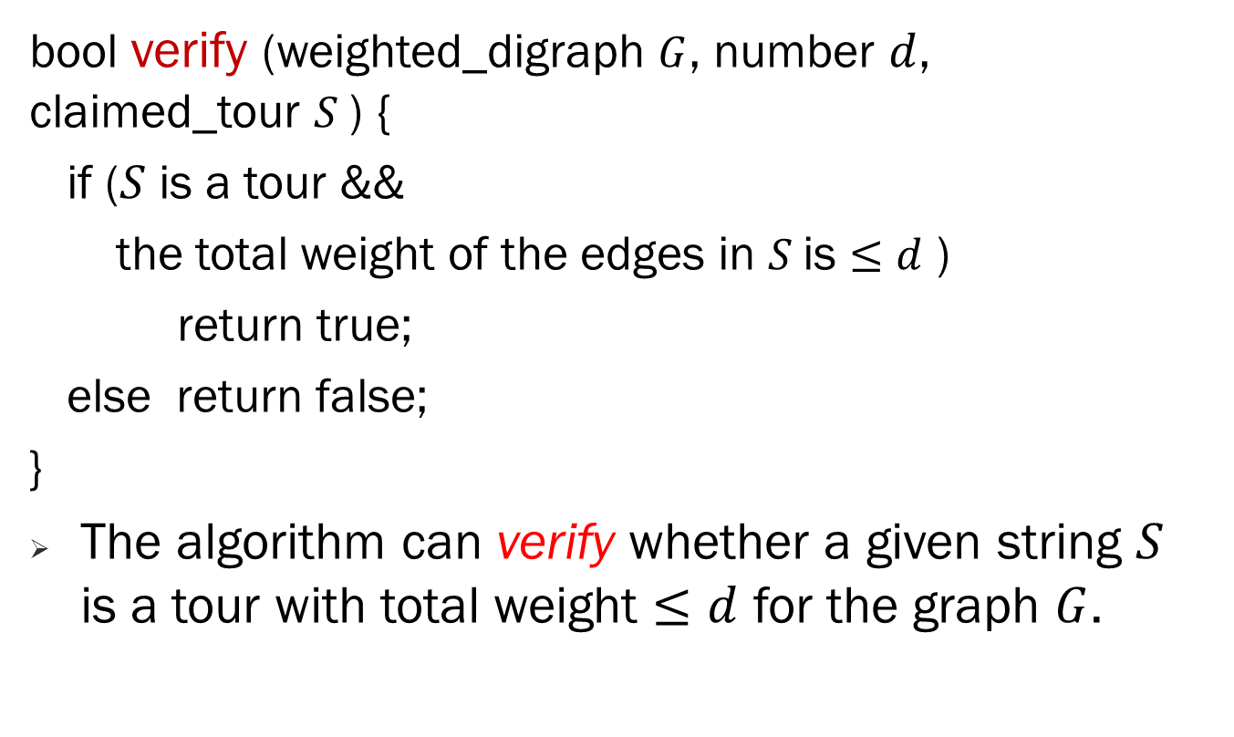
The sets 𝑃 and 𝑁𝑃
bool verify (weighted_digraph $G$, number $d$, claimed_tour $S$) {
if ($S$ is a tour &&
the total weight of the edges in $S$is $≤d$ )
return true;
else return false;
}
The algorithm can verify whether a given string $S$ is a tour with total weight $≤d$ for the graph $G$.

Slide 24
The sets 𝑃 and 𝑁𝑃
Given a candidate tour, we can verify in polynomial time whether this candidate proves that the answer to our decision problem is "yes".
If the proposed tour turns out not to be a tour or to have total length greater than d, we have not proven that the answer must be "no" to our decision problem. Therefore, we are not talking about being able to verify that the answer to our decision problem is "no" in polynomial time.

Slide 25
The sets 𝑃 and 𝑁𝑃
When we verify that a candidate tour has total weight no greater than d, we are not including the time it took to find that tour. We are only saying that the verification part takes polynomial time.
To state the notion of polynomial-time verifiability more concretely, we introduce the concept of a nondeterininistic algorithm. We can think of such an algorithm as being composed of the following two separate stages:

Slide 26
The sets 𝑃 and 𝑁𝑃
Guessing (Nondeterministic) Stage: Given an instance of a problem, this stage simply produces some string S. The string can be thought of as a guess at a solution to the instance. However, it could just be a string of nonsense.

Slide 27
The sets 𝑃 and 𝑁𝑃
Verification (Deterministic) Stage: The instance and the string S are the input to this stage. This stage then proceeds in an ordinary deterministic manner either (1) halting with an output of "true," which means that the answer for this instance is "yes," (2) halting with an output of "false," or (3) not halting at all.
In the latter two cases, it fails to verify that the answer for this instance is "yes."

Slide 28
The sets 𝑃 and 𝑁𝑃
Function verify() does the verification stage for the Traveling Salesperson Decision problem. Notice that it is an ordinary deterministic algorithm.
It is the guessing stage that is nondeterministic. This stage is called nondeterministic because unique step-by-step instructions are not specified for it. Rather, in this stage, the machine is allowed to produce any string in an arbitrary matter.

Slide 29
The sets 𝑃 and 𝑁𝑃
we say that a nondeterministic algorithm "solves" a decision problem if:
For any instance for which the answer is "yes," there is some string S for which the verification stage returns "true".
For any instance for which the answer is "no," there is no string for which the verification stage returns "true".

Slide 30
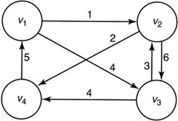
S | Output | Reason
[v₁, v₂, v₃, v₄, v₁] | False | Total weight is greater than 15
[v₁, v₄, v₂, v₃, v₁] | False | S is not a tour
#α12*&%a₁ / | False | S is not a tour
[v₁, v₃, v₂, v₄, v₁] | True | S is a tour with total weight no greater than 15

Slide 31
The sets 𝑃 and 𝑁𝑃
A nondeterministic algorithm that simply generates strings in the guessing state and calls function verify() in the verification stage therefore "solves" the Traveling Salesperson Decision problem.

Slide 32
The sets 𝑃 and 𝑁𝑃
Definition: A polynomial-time nondeterministic algorithm is a nondeterministic algorithm whose verification stage is a polynomial-time algorithm.
Definition: NP is the set of all decision problems that can be solved by polynomial-time nondeterministic algorithms.
Note that NP stands for "nondeterministic polynomial. " For a decision problem to be in NP, there must be an algorithm that does the verification in polynomial time.

Slide 33
The sets 𝑃 and 𝑁𝑃 - Traveling Salesperson Decision problem
The Traveling Salesperson Decision problem is in NP. It must be stressed that this does not mean that we have a polynomial-time algorithm that solves the problem.
If the answer for a particular instance of that problem were "yes," we might try all tours in the nondeterministic stage before trying one for which verify() returns "true."

Slide 34
The sets 𝑃 and 𝑁𝑃 - Traveling Salesperson Decision problem
If there were an edge from every vertex to every other vertex, there would be (n – 1)! tours. Therefore, if all tours were tried, the answer would not be found in polynomial time.
If the answer for an instance were "no," solving the problem using this technique would absolutely require that all tours be tried.

Slide 35
The sets 𝑃 and 𝑁𝑃 - Traveling Salesperson Decision problem
The purpose of introducing the concepts of non-deterministic algorithms and NP is to classify algorithms. There are usually better algorithms for actually solving a problem than an algorithm that generates and verifies strings.
For example, the branch-and-bound algorithm for the Traveling Salesperson problem.
What other decision problems are in NP? you are asked to establish that the other decision problems in Examples 1~4 are all in NP.

Slide 36
The sets 𝑃 and 𝑁𝑃
There are thousands of other problems that no one has been able to solve with polynomial-time algorithms but that have been proven to be in NP because polynomial-time nondeterministic algorithms have been developed for them.
Every problem in P is also in NP.
We may generate any nonsense input S in the nondeterministic stage and run the polynomial-time algorithm in the deterministic stage. Because the algorithm solves the problem by answering "yes" or "no," it verifies that, the answer is "yes" given any input string S.

Slide 37
The sets 𝑃 and 𝑁𝑃
What decision problems are not in NP? Curiously, the only decision problems that have been proven not to be in NP are the same ones that have been proven to be intractable.
The Halting problem, Presburger Arithmetic, etc are have been proven not to be in NP. Again, we have found relatively few such problems.

Slide 38
The sets 𝑃 and 𝑁𝑃
Notice that in this figure NP contains P as a proper subset. However, this may not be the case. That is, no one has ever proven that there is a problem in NP that is not in P. Therefore, NP – P may be empty.

Slide 39
The sets 𝑃 and 𝑁𝑃
The question of whether P equals NP is one of the most intriguing and important questions in computer science.
This question is important, because, as we have already mentioned, most decision problems we have developed are in NP. Therefore, if P = NP, we would have polynomial time algorithms for most known decision problems.

Slide 40
The sets 𝑃 and 𝑁𝑃
To show that P ≠ NP we would have to find a problem in NP that is not in P, whereas to show that P = NP we would have to find a polynomial-time algorithm for each problem in NP.
Next we see that this latter task can be greatly simplified. That is, we show that it is necessary to find a polynomial time algorithm for only one of a large class of problems.

Slide 41
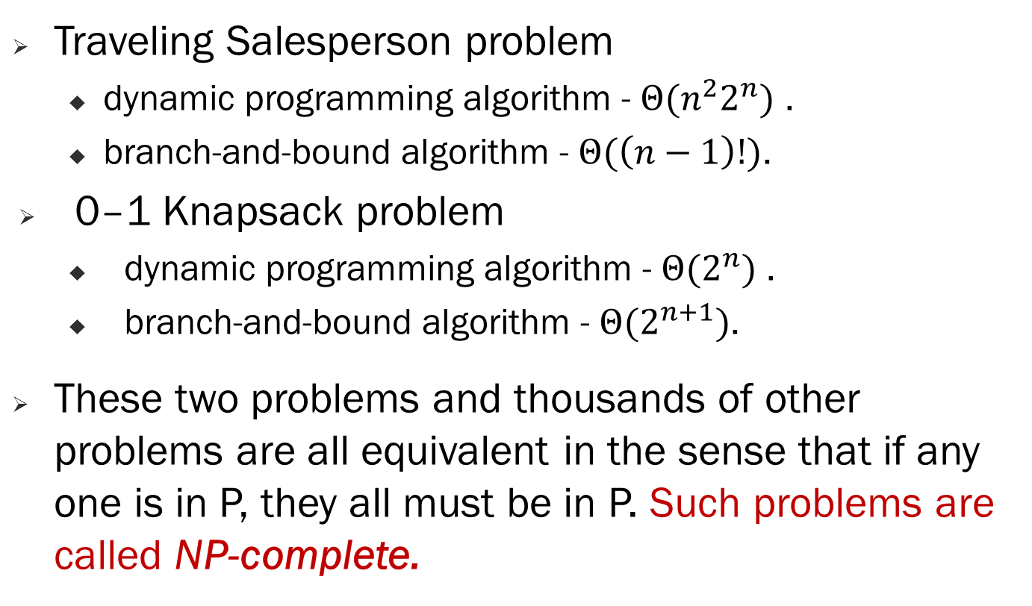
NP-Complete Problems
Traveling Salesperson problem
dynamic programming algorithm - $Θ({n^{2}2}^{n})$ .
branch-and-bound algorithm - $Θ(\left(n−1\right)!)$.
0–1 Knapsack problem
dynamic programming algorithm - $Θ(2^{n})$ .
branch-and-bound algorithm - $Θ(2^{n+1})$.
These two problems and thousands of other problems are all equivalent in the sense that if any one is in P, they all must be in P. Such problems are called NP-complete.

Slide 42
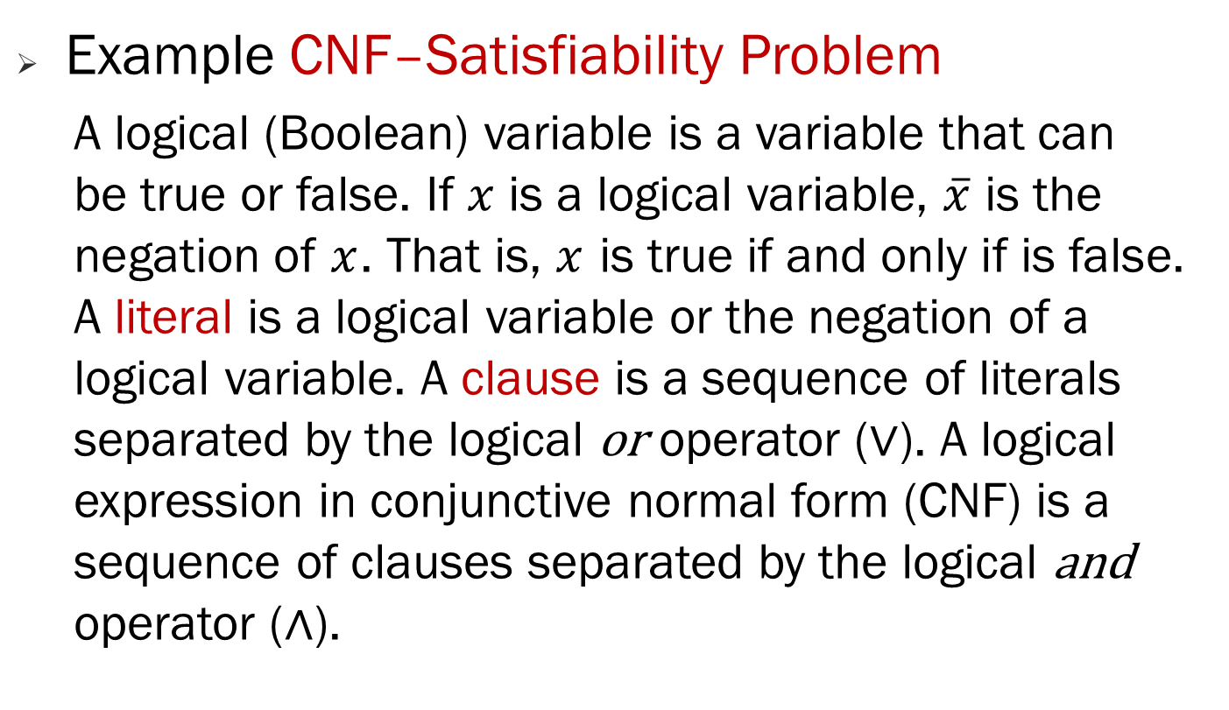
NP-Complete Problems
Example CNF–Satisfiability Problem
A logical (Boolean) variable is a variable that can be true or false. If $x$ is a logical variable, $\overline{x}$ is the negation of $x$. That is, $x$ is true if and only if is false. A literal is a logical variable or the negation of a logical variable. A clause is a sequence of literals separated by the logical or operator (∨). A logical expression in conjunctive normal form (CNF) is a sequence of clauses separated by the logical and operator (∧).

Slide 43
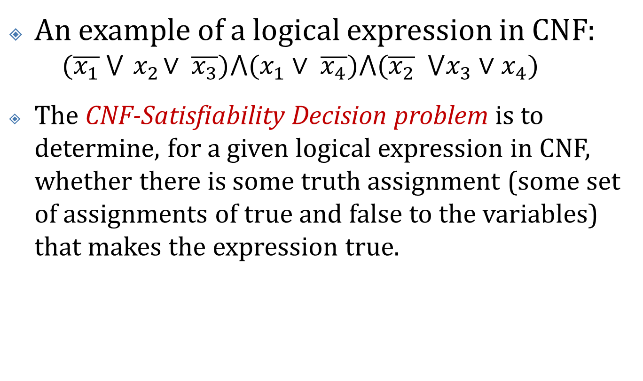
NP-Complete Problems
An example of a logical expression in CNF:
$$(\overline{x_{1}} ⋁{ x}_{2}∨ \overline{x_{3}})⋀(x_{1}∨ \overline{x_{4}})⋀(\overline{x_{2}} ⋁x_{3}∨x_{4})$$
The CNF-Satisfiability Decision problem is to determine, for a given logical expression in CNF, whether there is some truth assignment (some set of assignments of true and false to the variables) that makes the expression true.

Slide 44
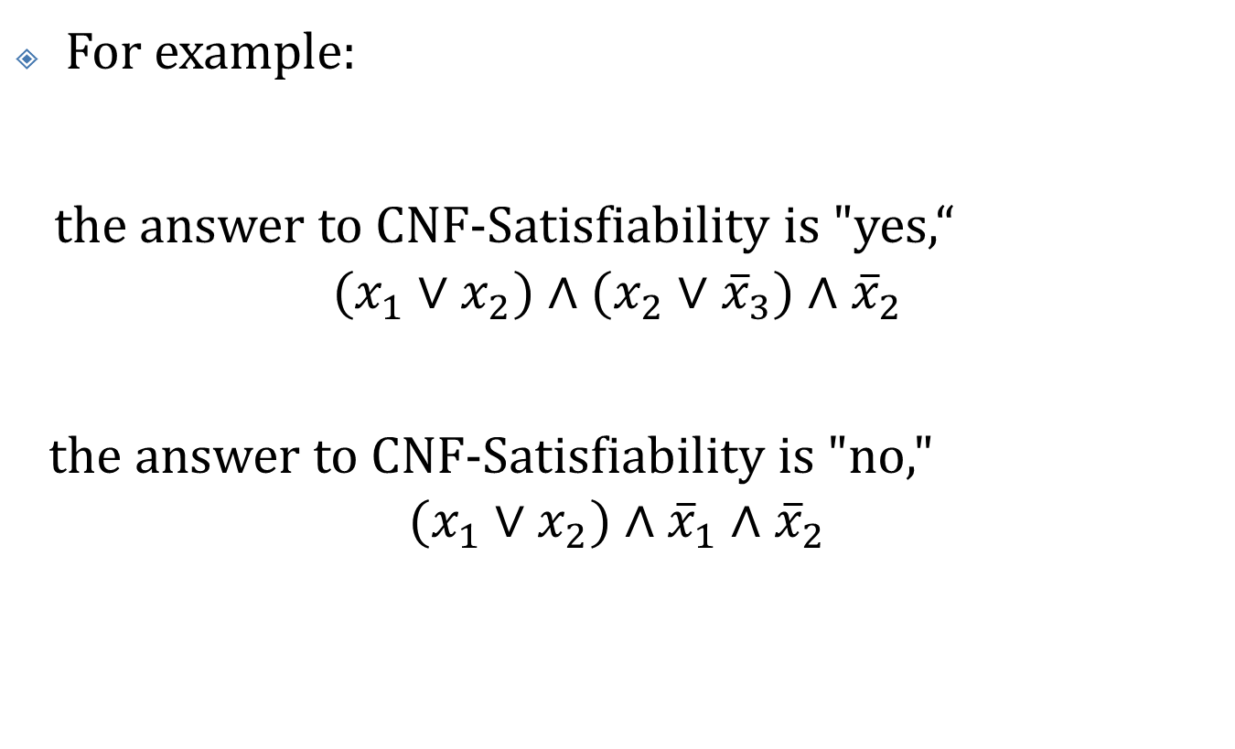
NP-Complete Problems
For example:
the answer to CNF-Satisfiability is "yes,“
$$(x_{1}∨x_{2})∧(x_{2}∨{\overline{x}}_{3})∧{\overline{x}}_{2}$$
the answer to CNF-Satisfiability is "no,"
$$(x_{1}∨x_{2})∧{\overline{x}}_{1}∧{\overline{x}}_{2}$$

Slide 45
NP-Complete Problems - CNF
It is easy to write a polynomial-time algorithm that takes as input a logical expression in CNF and a set of truth assignments to the variables and verifies whether the expression is true for that assignment. Therefore, the CNF problem is in NP.
No one has ever found a polynomial-time algorithm for this problem, and no one has ever proven that it cannot be solved in polynomial time. So we do not know if it is in P.

Slide 46
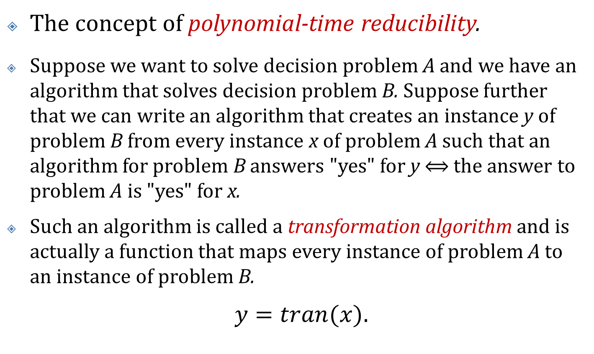
NP-Complete Problems - CNF
The concept of polynomial-time reducibility.
Suppose we want to solve decision problem A and we have an algorithm that solves decision problem B. Suppose further that we can write an algorithm that creates an instance y of problem B from every instance x of problem A such that an algorithm for problem B answers "yes" for y $⟺$ the answer to problem A is "yes" for x.
Such an algorithm is called a transformation algorithm and is actually a function that maps every instance of problem A to an instance of problem B.
$y=tran(x)$.

Slide 47
NP-Complete Problems
Algorithm tran is a transformation algorithm that maps each instance x of decision problem A to an instance y of decision problem B. Together with the algorithm for decision problem B, it yields an algorithm for decision problem A.

Slide 48
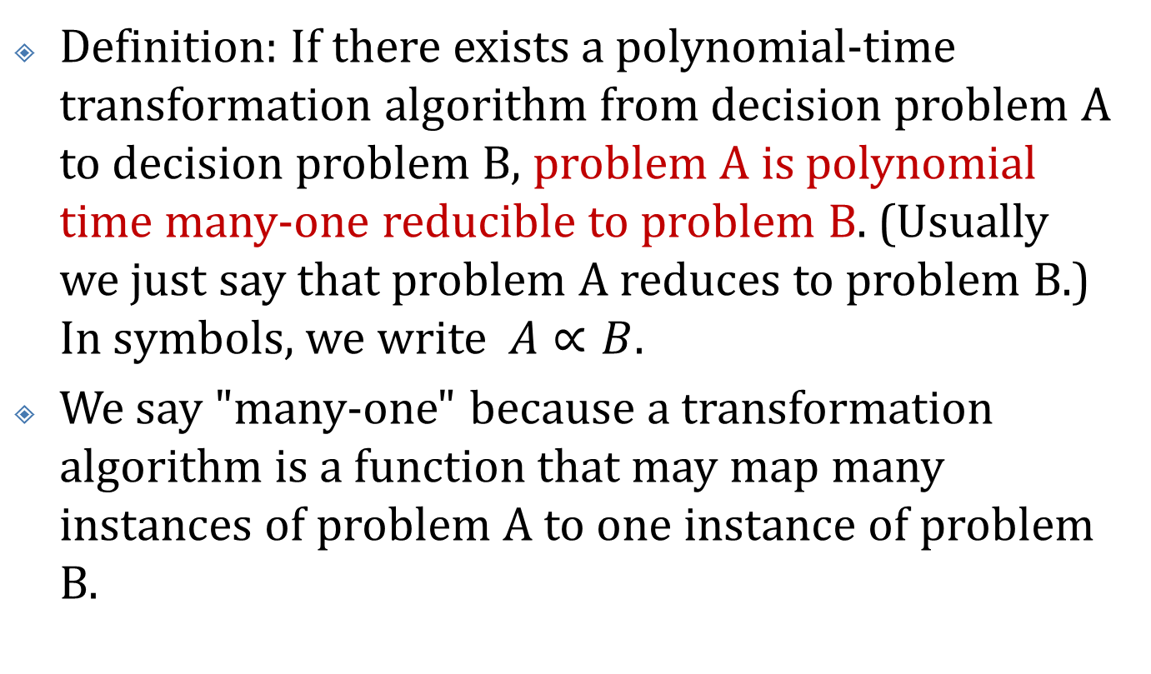
NP-Complete Problems
Definition: If there exists a polynomial-time transformation algorithm from decision problem A to decision problem B, problem A is polynomial time many-one reducible to problem B. (Usually we just say that problem A reduces to problem B.) In symbols, we write $A∝B$.
We say "many-one" because a transformation algorithm is a function that may map many instances of problem A to one instance of problem B.

Slide 49
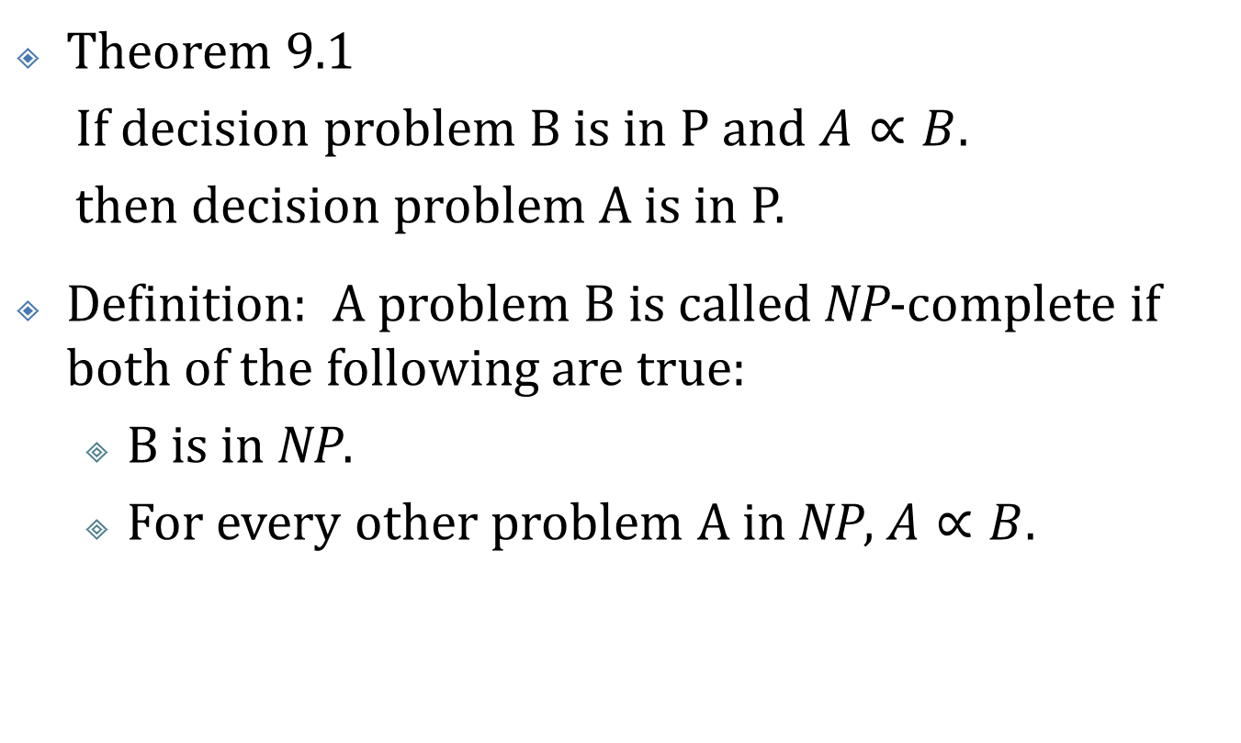
NP-Complete Problems
Theorem 9.1
If decision problem B is in P and $A∝B$.
then decision problem A is in P.
Definition: A problem B is called NP-complete if both of the following are true:
B is in NP.
For every other problem A in NP, $A∝B$.

Slide 50
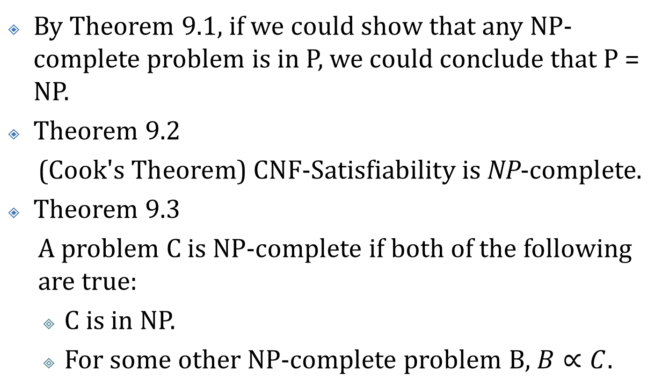
NP-Complete Problems
By Theorem 9.1, if we could show that any NP-complete problem is in P, we could conclude that P = NP.
Theorem 9.2
(Cook's Theorem) CNF-Satisfiability is NP-complete.
Theorem 9.3
A problem C is NP-complete if both of the following are true:
C is in NP.
For some other NP-complete problem B, $B∝C$.

Slide 51
NP-Complete Problems
Proof:
Because B is NP-complete, for any problem A in NP, A α B. It is not hard to see that reducibility is transitive. Therefore, A α C. Because C is in NP, we can conclude that C is NP-complete.

Slide 52
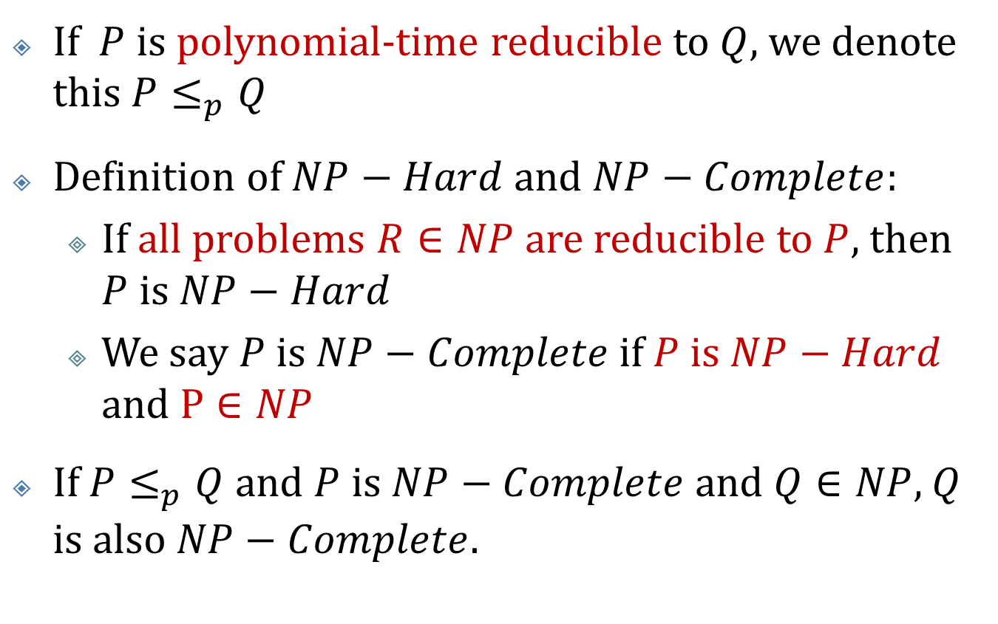
NP-Hard and NP-Complete
If $P$ is polynomial-time reducible to $Q$, we denote this $P≤_{p}Q$
Definition of $NP−Hard$ and $NP−Complete$:
If all problems $R∈NP$ are reducible to $P$, then $P$ is $NP−Hard$
We say $P$is $NP−Complete$if $P$is $NP−Hard$ and $P∈NP$
If $P≤_{p}Q$ and $P$ is $NP−Complete$ and $Q∈NP$, $Q$ is also $NP−Complete$.

Slide 53
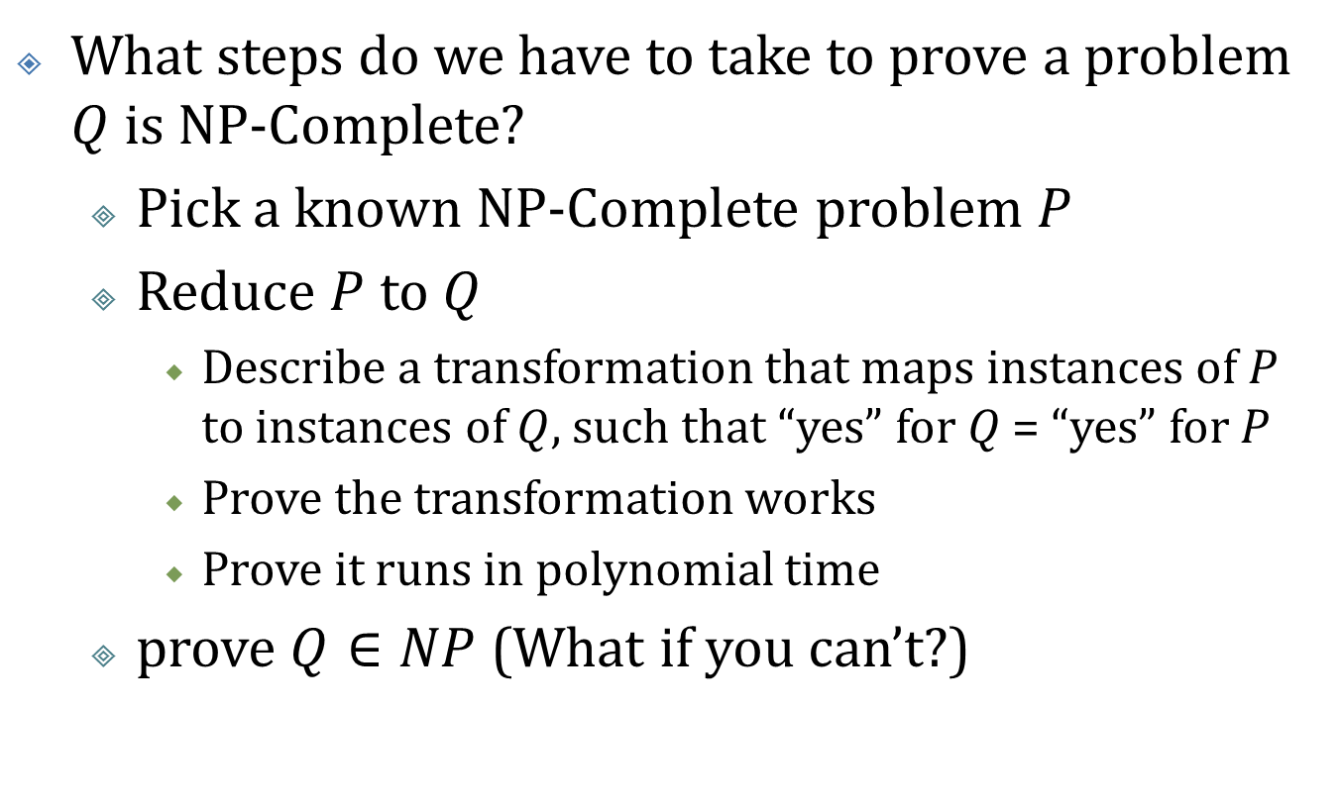
Proving NP-Completeness
What steps do we have to take to prove a problem $Q$ is NP-Complete?
Pick a known NP-Complete problem $P$
Reduce $P$ to $Q$
Describe a transformation that maps instances of $P$ to instances of $Q$, such that “yes” for $Q$ = “yes” for $P$
Prove the transformation works
Prove it runs in polynomial time
prove $Q∈NP$ (What if you can’t?)

Slide 54
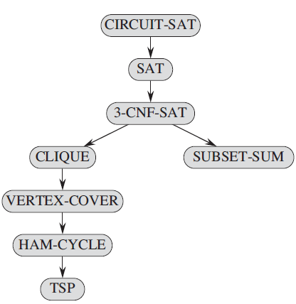

NP-Completeness proofs
The circuit-satisfiability problem is NP-complete by a direct proof that $L≤_{p}CIRCUIT−SAT$ for every language $L∈NP$.

Slide 55
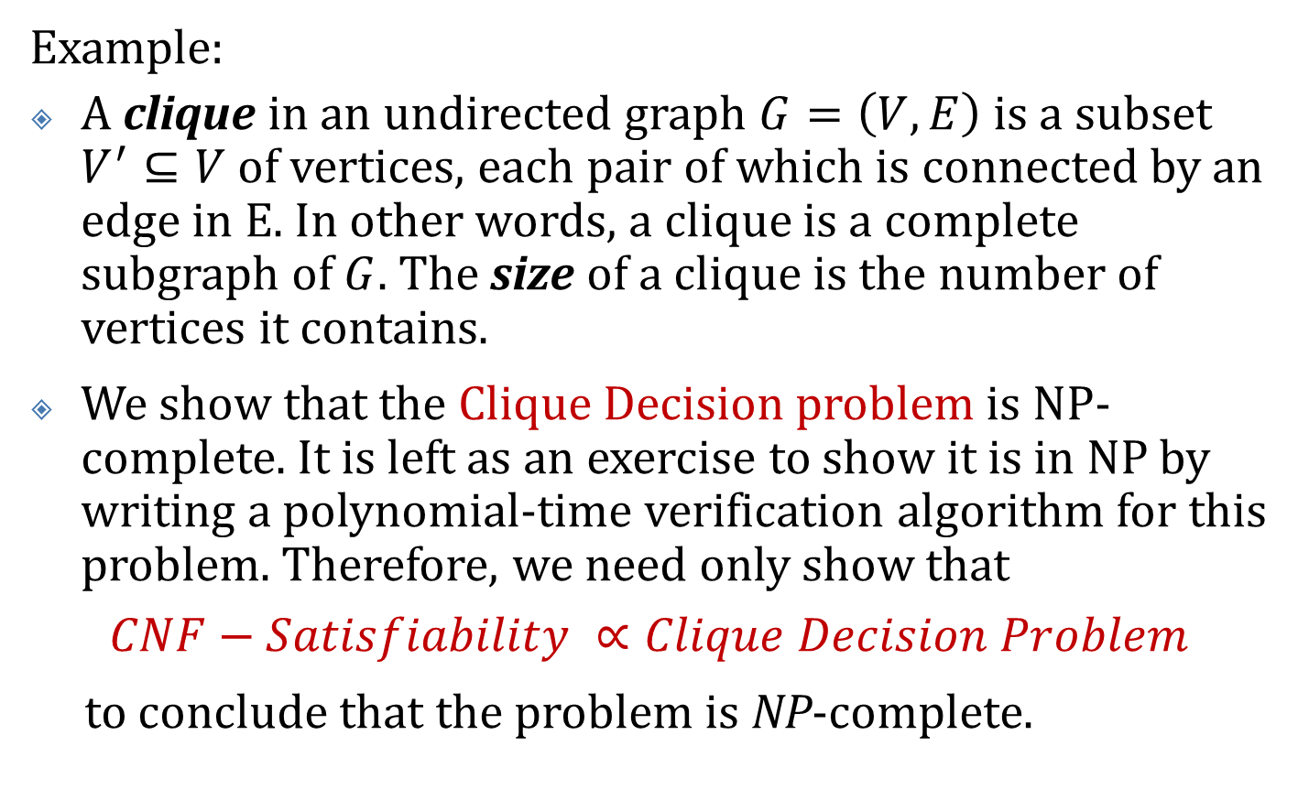
NP-Complete Problems - Clique Decision problem
Example:
A clique in an undirected graph $G=\left(V,E\right)$ is a subset $V^{′}⊆V$ of vertices, each pair of which is connected by an edge in E. In other words, a clique is a complete subgraph of $G$. The size of a clique is the number of vertices it contains.
We show that the Clique Decision problem is NP-complete. It is left as an exercise to show it is in NP by writing a polynomial-time verification algorithm for this problem. Therefore, we need only show that
$$CNF−Satisfiability ∝Clique Decision Problem$$
to conclude that the problem is NP-complete.

Slide 56
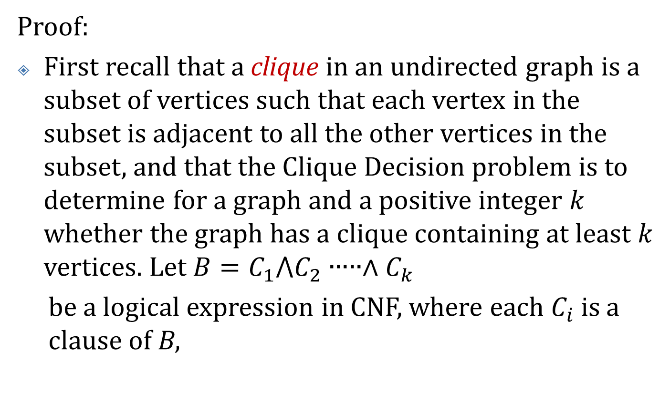
NP-Complete Problems - Clique Decision problem
Proof:
First recall that a clique in an undirected graph is a subset of vertices such that each vertex in the subset is adjacent to all the other vertices in the subset, and that the Clique Decision problem is to determine for a graph and a positive integer $k$ whether the graph has a clique containing at least $k$ vertices. Let $B=C_{1}⋀C_{2}∙∙∙∙∙∧C_{k}$
be a logical expression in CNF, where each $C_{i}$ is a clause of B,

Slide 57

NP-Complete Problems - Clique Decision problem
and let $x_{1}$,$x_{2}$,…,$x_{n}$ be the variables in B. Transform B
to a graph G = (V, E), as follows:
$$V=\left\{\left(y,i\right) such that y is a literal in clause C_{i}\right\}$$
$$E=\{\left(\left(y,i\right),\left(z,j\right)\right) such that i≠j and \overline{z}≠y\}$$

Slide 58
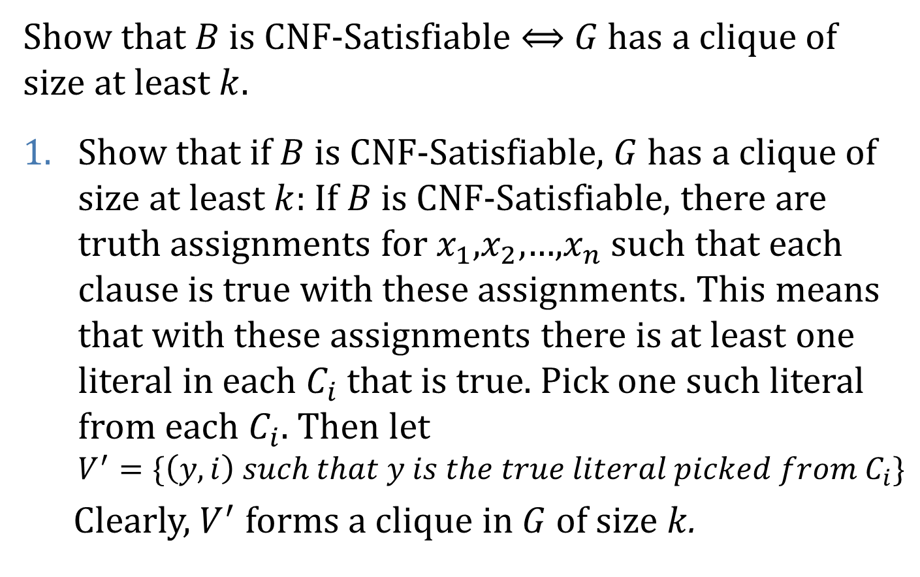
NP-Complete Problems - Clique Decision problem
Show that $B$ is CNF-Satisfiable $⟺$ $G$ has a clique of size at least $k$.
Show that if $B$ is CNF-Satisfiable, $G$ has a clique of size at least $k$: If $B$ is CNF-Satisfiable, there are truth assignments for $x_{1}$,$x_{2}$,…,$x_{n}$ such that each clause is true with these assignments. This means that with these assignments there is at least one literal in each $C_{i}$ that is true. Pick one such literal from each $C_{i}$. Then let $V^{′}=\{\left(y,i\right) such that y is the true literal picked from C_{i}\}$
Clearly, $V^{′}$ forms a clique in $G$ of size $k$.

Slide 59
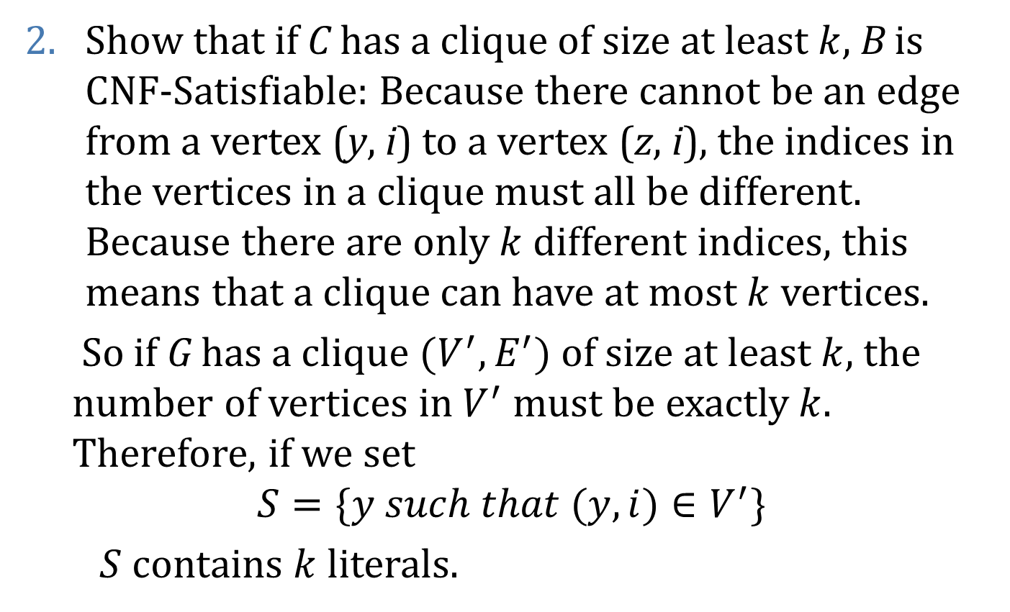
NP-Complete Problems - Clique Decision problem
Show that if C has a clique of size at least $k$, B is CNF-Satisfiable: Because there cannot be an edge from a vertex (y, i) to a vertex (z, i), the indices in the vertices in a clique must all be different. Because there are only $k$ different indices, this means that a clique can have at most $k$ vertices.
So if G has a clique $(V^{′},E^{′})$ of size at least $k$, the number of vertices in $V^{′}$ must be exactly $k$. Therefore, if we set
$$S=\{y such that (y,i)∈V^{′}\}$$
$S$ contains $k$ literals.

Slide 60
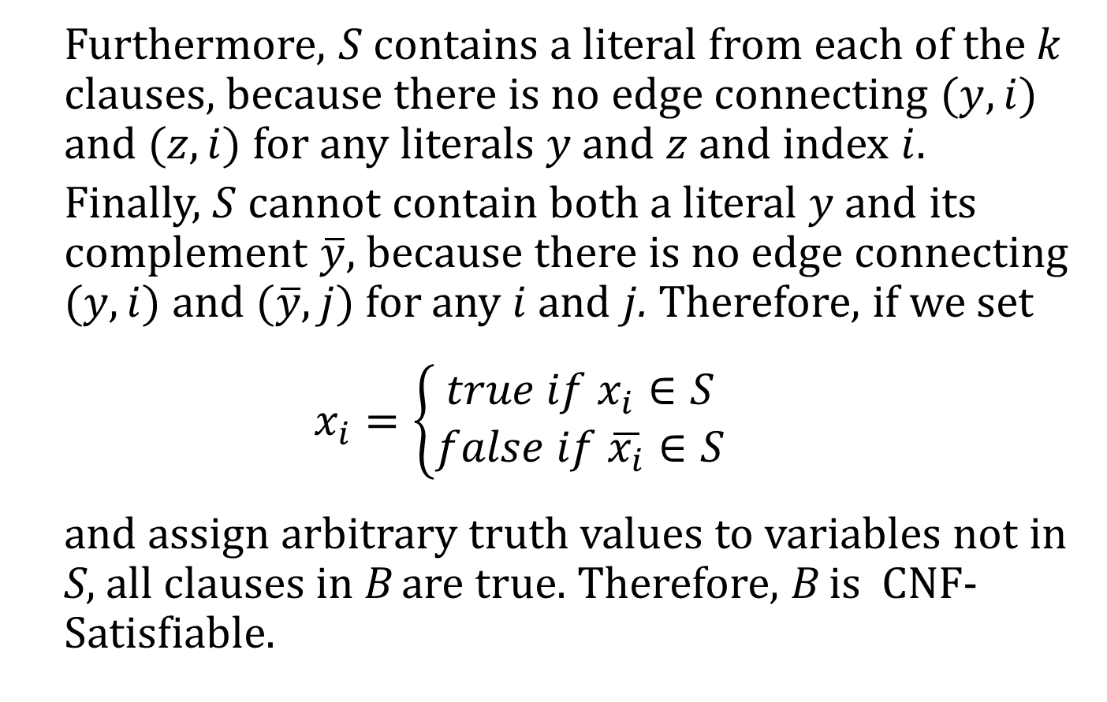
NP-Complete Problems - Clique Decision problem
Furthermore, $S$ contains a literal from each of the $k$ clauses, because there is no edge connecting $(y,i)$ and $(z,i)$ for any literals $y$ and $z$ and index $i$.
Finally, $S$ cannot contain both a literal $y$ and its complement $\overline{y}$, because there is no edge connecting $(y,i)$ and $(\overline{y},j)$ for any $i$ and $j$. Therefore, if we set
$$x_{i}=\left\{\begin{aligned}true if x_{i}∈S \\ false if \overline{x_{i}}∈S\end{aligned}\right.$$
and assign arbitrary truth values to variables not in S, all clauses in B are true. Therefore, B is CNF-Satisfiable.

Slide 61

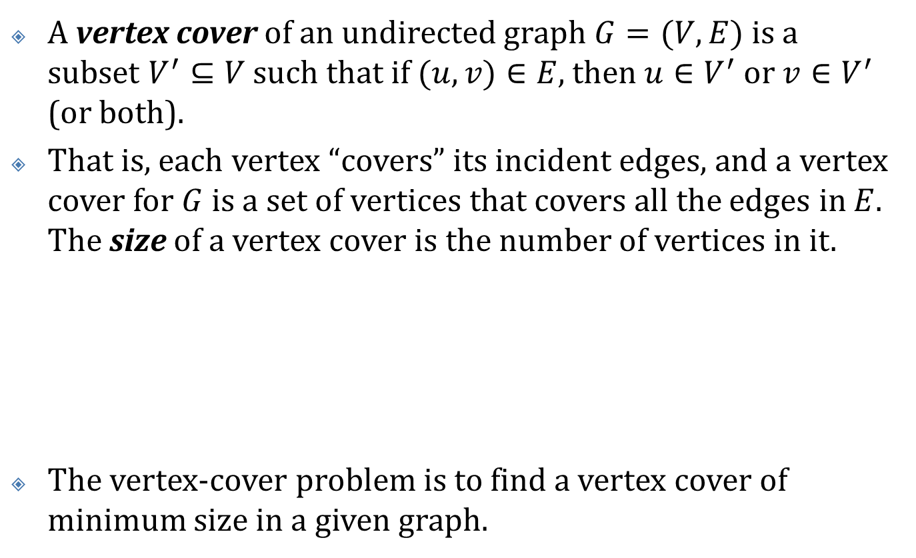
NP-Complete Problems - vertex-cover problem
A vertex cover of an undirected graph $G=(V,E)$ is a subset $V^{′}⊆V$ such that if $(u,v)∈E$, then $u∈V^{′}$ or $v∈V^{′}$ (or both).
That is, each vertex “covers” its incident edges, and a vertex cover for $G$ is a set of vertices that covers all the edges in $E$. The size of a vertex cover is the number of vertices in it.
The vertex-cover problem is to find a vertex cover of minimum size in a given graph.

Slide 62
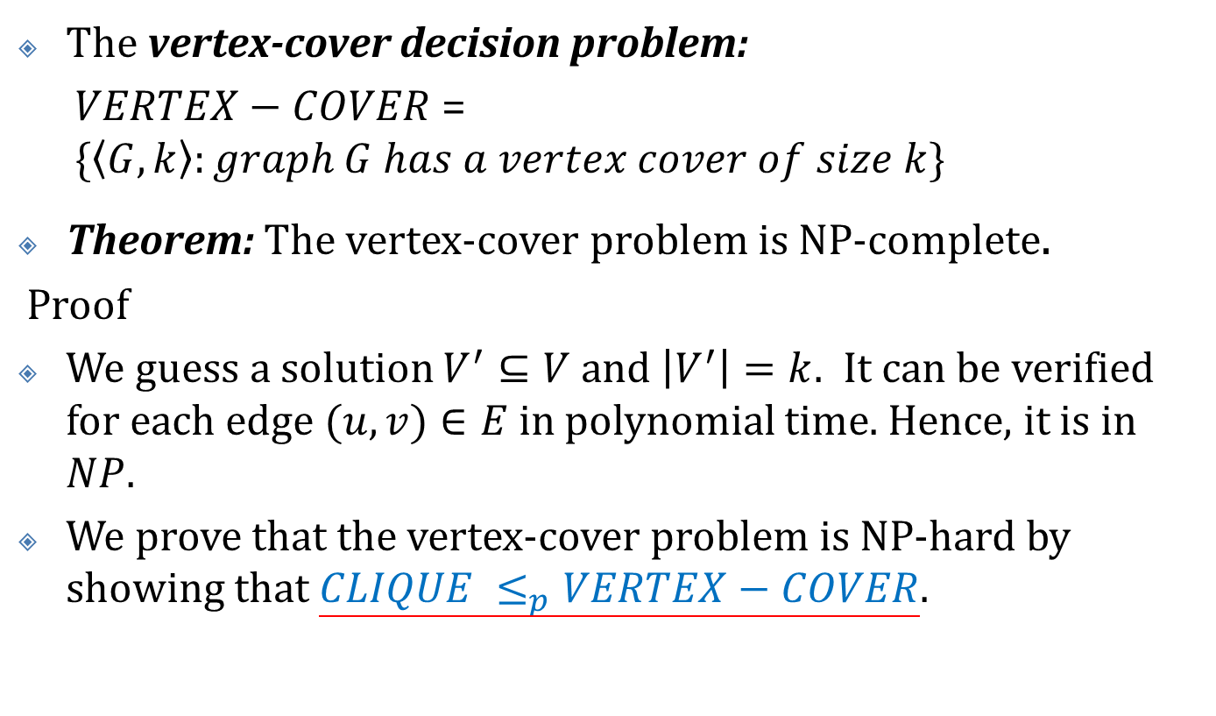
NP-Complete Problems – The vertex-cover problem
The vertex-cover decision problem:
$VERTEX−COVER$ = $\{\left\langle G, k\right\rangle :graph G has a vertex cover of size k\}$
Theorem: The vertex-cover problem is NP-complete.
Proof
We guess a solution $V^{′}⊆V$ and $\left|V^{′}\right|=k$. It can be verified for each edge $(u,v)∈E$ in polynomial time. Hence, it is in $NP$.
We prove that the vertex-cover problem is NP-hard by showing that $CLIQUE ≤_{p}VERTEX−COVER$.

Slide 63
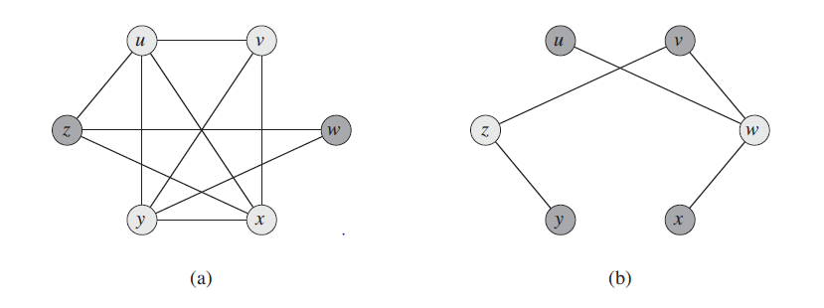

NP-Complete Problems – The vertex-cover problem
Given an undirected graph $G=(V,E)$ , we define the complement of $G$ as $\overline{G}=(V,\overline{E})$, where $\overline{E}=\{\left(u,v\right):u,v∈V, u≠v, and (u,v)∉E\}$. In other words, $\overline{G}$ is the graph containing exactly those edges that are not in $G$.

Slide 64
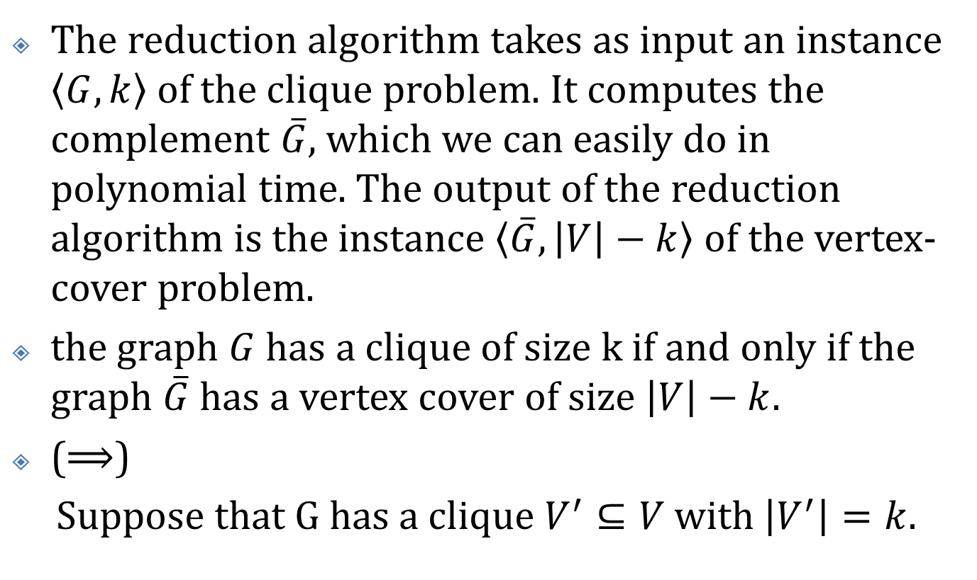
NP-Complete Problems – The vertex-cover problem
The reduction algorithm takes as input an instance $\left\langle G,k\right\rangle$ of the clique problem. It computes the complement $\overline{G}$, which we can easily do in polynomial time. The output of the reduction algorithm is the instance $\left\langle \overline{G},\left|V\right|−k\right\rangle$ of the vertex-cover problem.
the graph $G$ has a clique of size k if and only if the graph $\overline{G}$has a vertex cover of size $\left|V\right|−k$.
($⟹$)
Suppose that G has a clique $V^{′}⊆V$ with $\left|V^{′}\right|=k$.

Slide 65
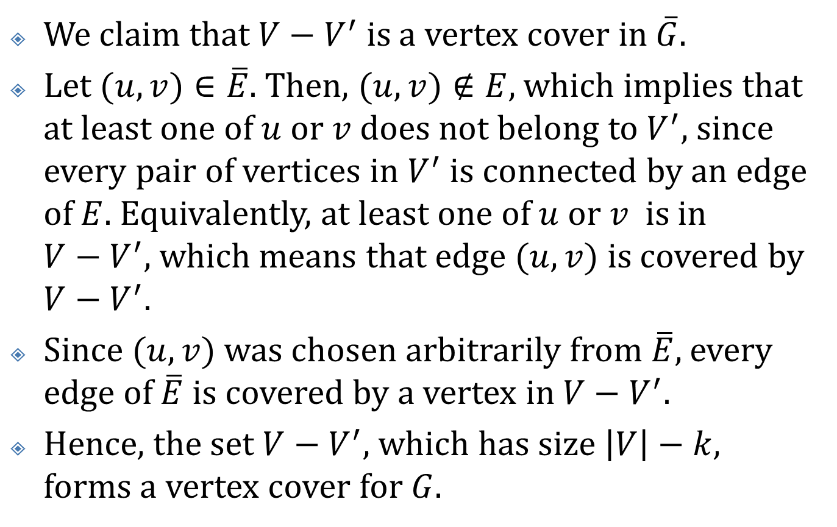
NP-Complete Problems – The vertex-cover problem
We claim that $V−V^{′}$ is a vertex cover in $\overline{G}$.
Let $(u,v)∈\overline{E}$. Then, $(u,v)∉E$, which implies that at least one of $u$ or $v$ does not belong to $V^{′}$, since every pair of vertices in $V^{′}$ is connected by an edge of $E$. Equivalently, at least one of $u$ or $v$ is in $V−V^{′}$, which means that edge $(u,v)$ is covered by $V−V^{′}.$
Since $(u,v)$ was chosen arbitrarily from $\overline{E}$, every edge of $\overline{E}$ is covered by a vertex in $V−V^{′}.$
Hence, the set $V−V^{′}$, which has size $\left|V\right|−k$, forms a vertex cover for $G$.

Slide 66
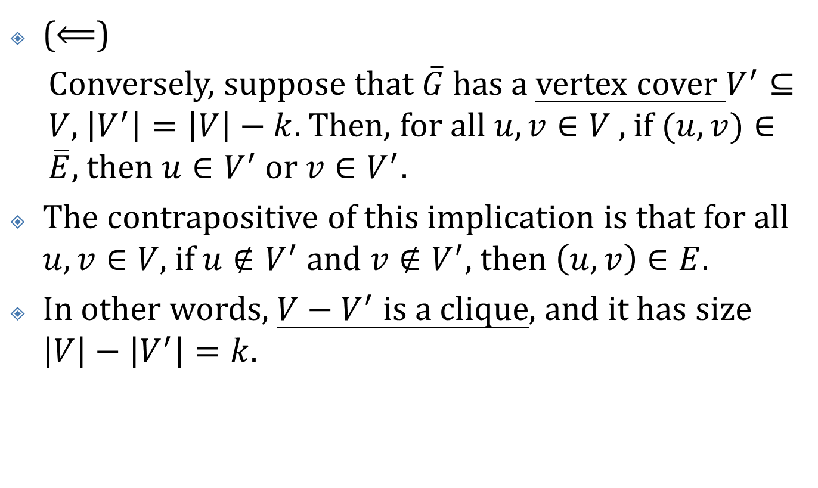
NP-Complete Problems – The vertex-cover problem
($⟸$)
Conversely, suppose that $\overline{G}$ has a vertex cover $V^{′}⊆V$, $\left|V^{′}\right|=\left|V\right|−k$. Then, for all $u,v∈V$ , if $(u,v)∈\overline{E}$, then $u∈V^{′}$ or $v∈V^{′}$.
The contrapositive of this implication is that for all $u,v∈V$, if $u∉V^{′}$ and $v∉V^{′}$, then $\left(u,v\right)∈E$.
In other words, $V−V^{′}$ is a clique, and it has size $\left|V\right|−\left|V^{′}\right|=k$.

Slide 67

NP-Complete Problems – The hamiltonian-cycle problem
A hamiltonian cycle of un undirected graph $G=(V,E)$ is a simple cycle that contains each vertex in $V$.
$vertex−cover≤_{p}hamiltonian−cycle$.
Proof: see textbook 34.5.3

Slide 68
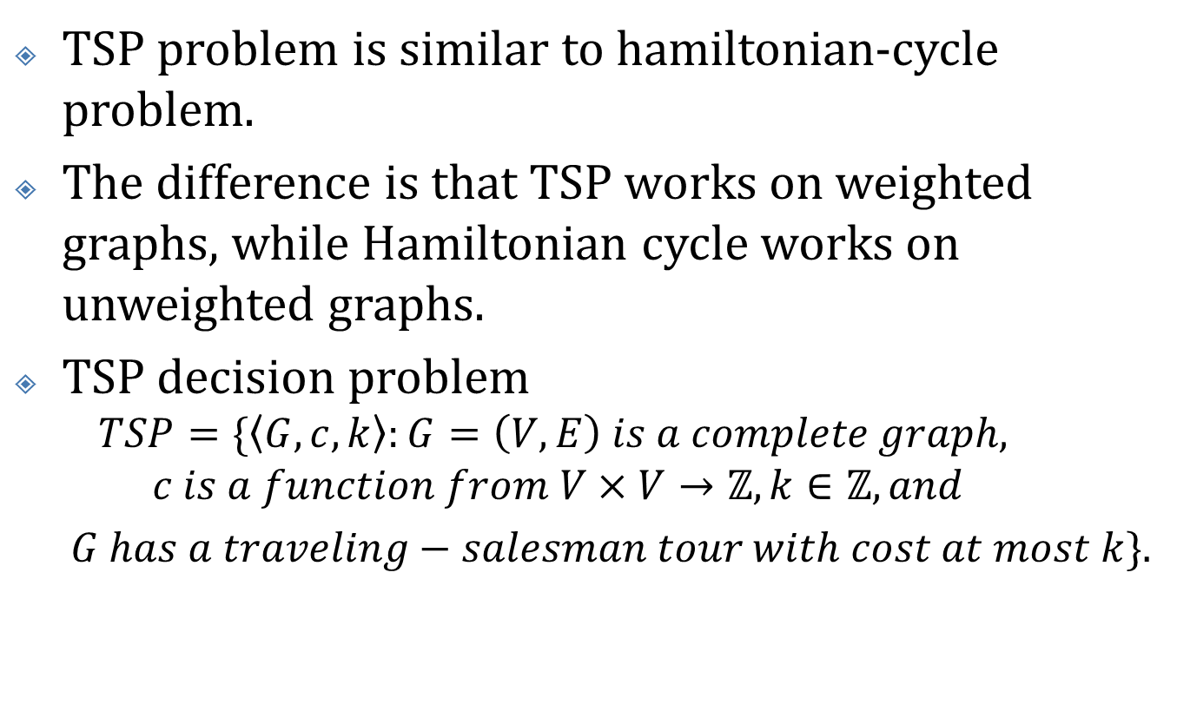
NP-Complete Problems – The traveling-salesman problem
TSP problem is similar to hamiltonian-cycle problem.
The difference is that TSP works on weighted graphs, while Hamiltonian cycle works on unweighted graphs.
TSP decision problem
$$TSP=\{\left\langle G,c,k\right\rangle :G=\left(V,E\right) is a complete graph,$$
$$c is a function from V×V→ℤ, k∈ℤ, and$$
$G has a traveling−salesman tour with cost at most k\}$.

Slide 69
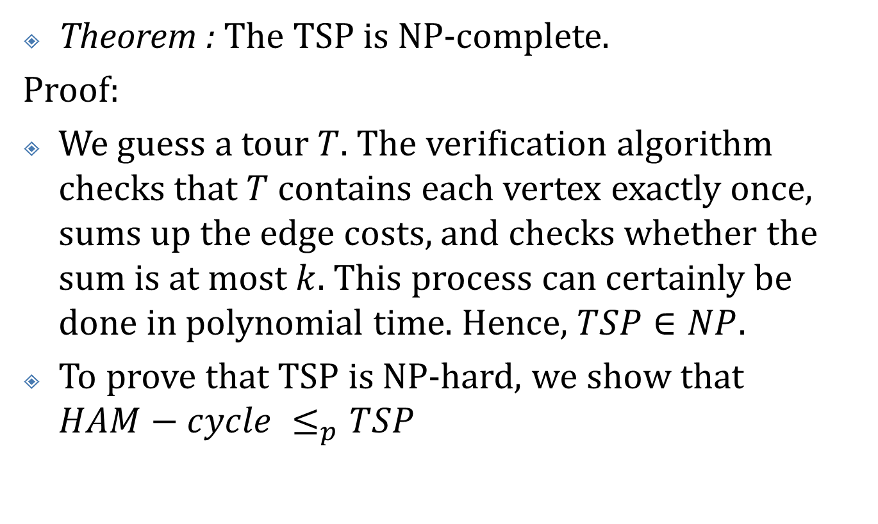
NP-Complete Problems – The traveling-salesman problem
Theorem : The TSP is NP-complete.
Proof:
We guess a tour $T$. The verification algorithm checks that $T$ contains each vertex exactly once, sums up the edge costs, and checks whether the sum is at most $k$. This process can certainly be done in polynomial time. Hence, $TSP∈NP$.
To prove that TSP is NP-hard, we show that $HAM−cycle ≤_{p}TSP$

Slide 70
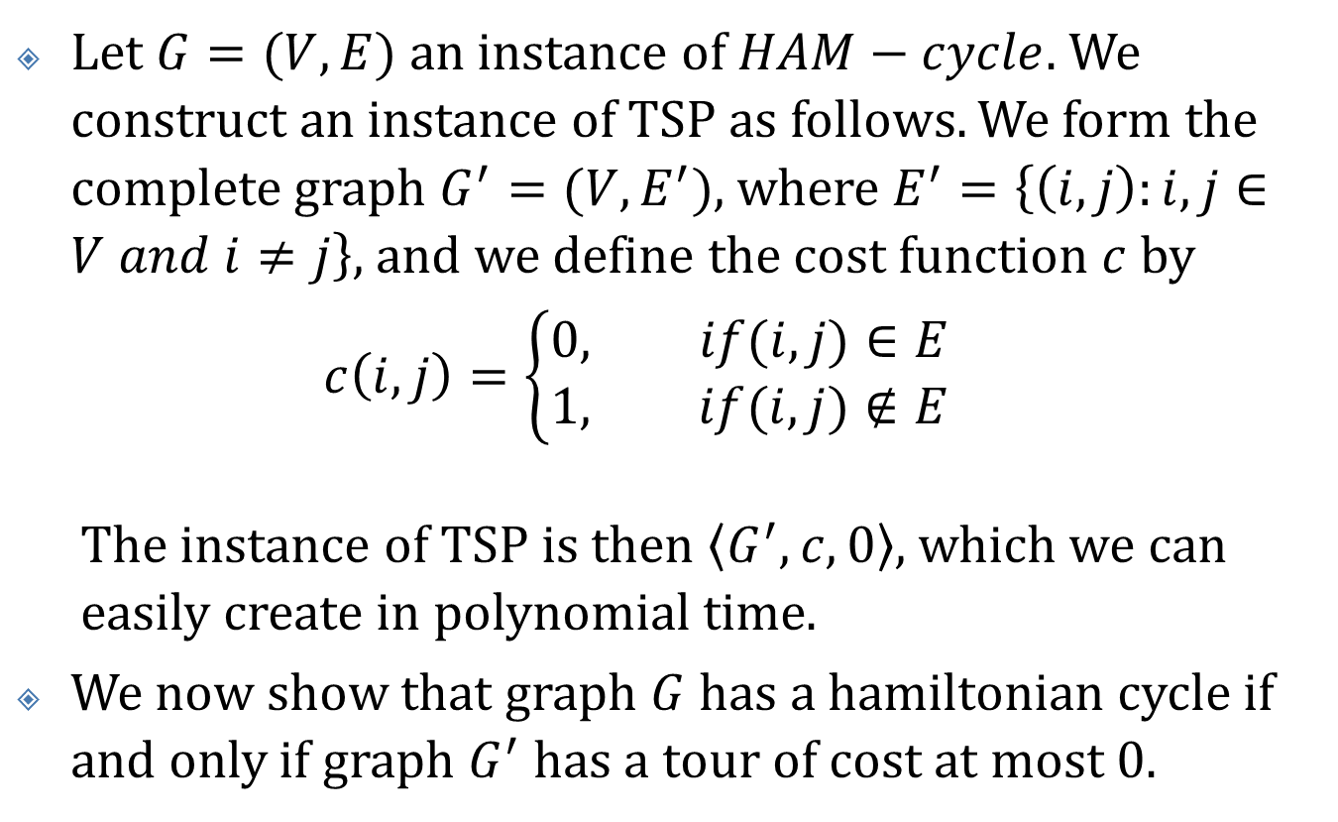
NP-Complete Problems – The traveling-salesman problem
Let $G=(V,E)$ an instance of $HAM−cycle$. We construct an instance of TSP as follows. We form the complete graph $G^{′}=(V,E^{′})$, where $E^{′}=\left\{\left(i,j\right):i,j∈V and i≠j\right\}$, and we define the cost function $c$ by
$$c\left(i,j\right)=\left\{\begin{aligned}0, if(i,j)∈E \\ 1, if(i,j)∉E\end{aligned}\right.$$
The instance of TSP is then $\left\langle G^{′},c,0\right\rangle$, which we can easily create in polynomial time.
We now show that graph $G$ has a hamiltonian cycle if and only if graph $G^{′}$ has a tour of cost at most 0.

Slide 71
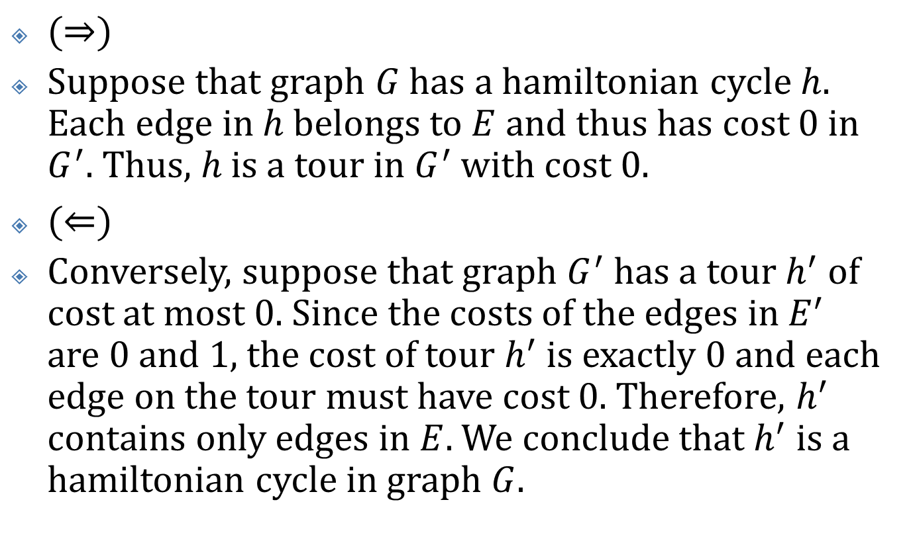
NP-Complete Problems – The traveling-salesman problem
$(⇒)$
Suppose that graph $G$ has a hamiltonian cycle $h$. Each edge in $h$ belongs to $E$ and thus has cost $0$ in $G^{′}$. Thus, $h$ is a tour in $G^{′}$ with cost 0.
$(⇐)$
Conversely, suppose that graph $G^{′}$ has a tour $h^{′}$ of cost at most 0. Since the costs of the edges in $E^{′}$ are 0 and 1, the cost of tour $h^{′}$ is exactly 0 and each edge on the tour must have cost 0. Therefore, $h^{′}$ contains only edges in $E$. We conclude that $h^{′}$ is a hamiltonian cycle in graph $G$.

