Slide 1
A Genetic Algorithm for the 0-1 Knapsack Problem

Slide 2

The 0-1 Knapsack Problem
A thief robbing a store finds 𝑛 items. The 𝑖th item is worth $v_{i}$ dollars and weighs $w_{i}$ pounds, where $v_{i}$ and $w_{i}$ are integers.
The thief wants to take as valuable a load as possible, but he can carry at most 𝑊 pounds in his knapsack, for some integer 𝑊. Which items should he take?

Slide 3
Steps Involved in Genetic Algorithm
Example
Let’s say, you are going to spend a month in the wilderness. Only thing you are carrying is the backpack which can hold a maximum weight of 30 kg. Now you have different survival items, each having its own “Survival Points” (which are given for each item in the table). So, your objective is to maximize the survival points.
Item | Weight | Survival points
Sleeping Bag | 15 | 15
Rope | 3 | 7
Pocket Knife | 2 | 10
Torch | 5 | 5
Bottle | 9 | 8
Glucose | 20 | 17

Slide 4
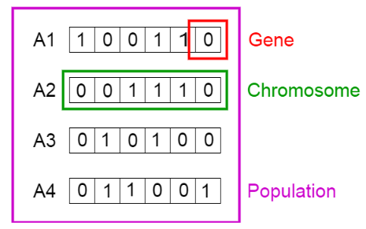
Initialisation
To solve this problem using genetic algorithm, our first step would be defining our population. So our population will contain a set of chromosomes.
A chromosome is a binary string, where for this problem 1 would mean that the following item is taken and 0 meaning that it is dropped.
This set of chromosome is considered as our initial population.

Slide 5
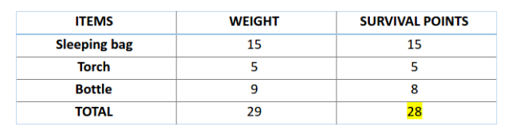
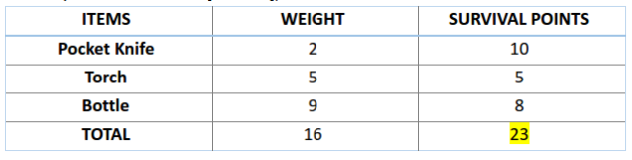
Fitness Function
Let us calculate fitness points for our first two chromosomes.
For A1 chromosome [100110],
Similarly for A2 chromosome [001110],

Slide 6
Fitness Function (continued)
So, for this problem, our chromosome will be considered as more fit when it contains more survival points.
Therefore chromosome 1 is more fit than chromosome 2.

Slide 7
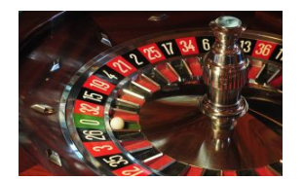
Selection
Now, we can select fit chromosomes from our population which can mate and create their off-springs.
General thought is that we should select the fit chromosomes and allow them to produce off-springs. But that would lead to chromosomes that are more close to one another in a few next generation, and therefore less diversity.
Therefore, we generally use Roulette Wheel Selection method. Don’t be afraid of name, just take a look at the image below.

Slide 8
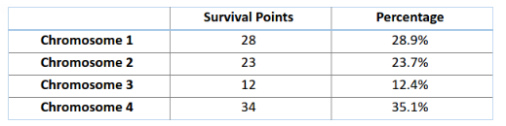
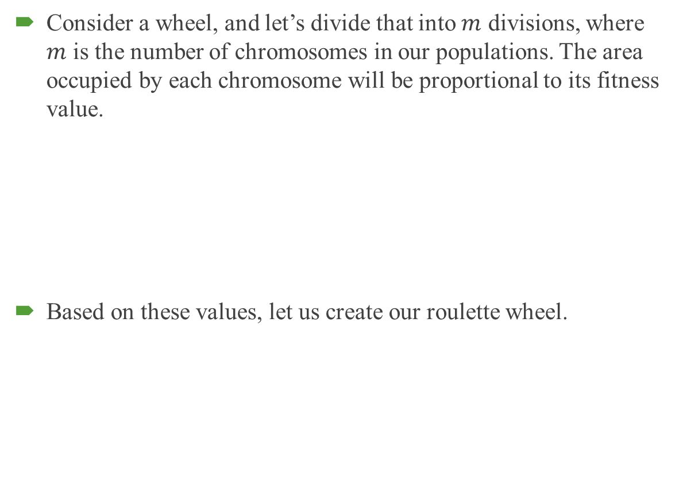
Selection (continued)
Consider a wheel, and let’s divide that into $m$ divisions, where $m$ is the number of chromosomes in our populations. The area occupied by each chromosome will be proportional to its fitness value.
Based on these values, let us create our roulette wheel.

Slide 9
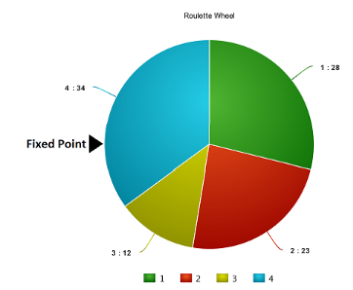
Selection (continued)
Based on these values, let us create our roulette wheel.

Slide 10
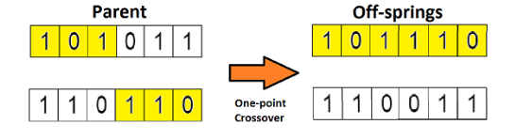
Crossover
So in this previous step, we have selected parent chromosomes that will produce off-springs. So in biological terms, crossover is nothing but reproduction.
So let us find the crossover of chromosome 1 and 4, which were selected in the previous step. Take a look at the image below.
This is the most basic form of crossover, known as one point crossover. Here we select a random crossover point and the tails of both the chromosomes are swapped to produce a new off-springs.

Slide 11
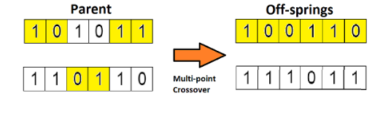
Crossover (continued)
If you take two crossover point, then it will called as multi point crossover which is as shown below.

Slide 12

Mutation
Now if you think in the biological sense, are the children produced have the same traits as their parents? The answer is NO. During their growth, there is some change in the genes of children which makes them different from its parents.
This process is known as mutation, which may be defined as a random tweak in the chromosome, which also promotes the idea of diversity in the population.
A simple method of mutation is shown in the image below.

Slide 13
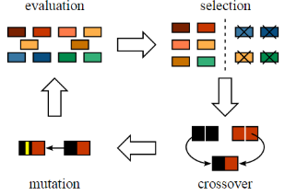
The Whole Process
So the entire process is summarized as shown in the figure.
The off-springs thus produced are again validated using our fitness function, and if considered fit then will replace the less fit chromosomes from the population.

Slide 14
Termination
So basically there are different termination conditions, which are listed below:
There is no improvement in the population for over x iterations.
We have already predefined an absolute number of generation for our algorithm.
When our fitness function has reached a predefined value.

