Slide 1
Chapter 4. Divide-and-Conquer
Hsu, Lih-Hsing
Yang, Wen-Lin

Slide 2
Divide-and Conquer
Solve a problem recursively, applying three steps at each level of the recursion:
Divide the problem into a number of sub-problems that are smaller instances of the same problem.
Conquer the sub-problems by solving them recursively. If the sub-problems sizes are small enough, however, just solve the sub-problems in a straightforward manner.
Combine the solutions to the sub-problems into the solutions for the original problem.

Slide 3
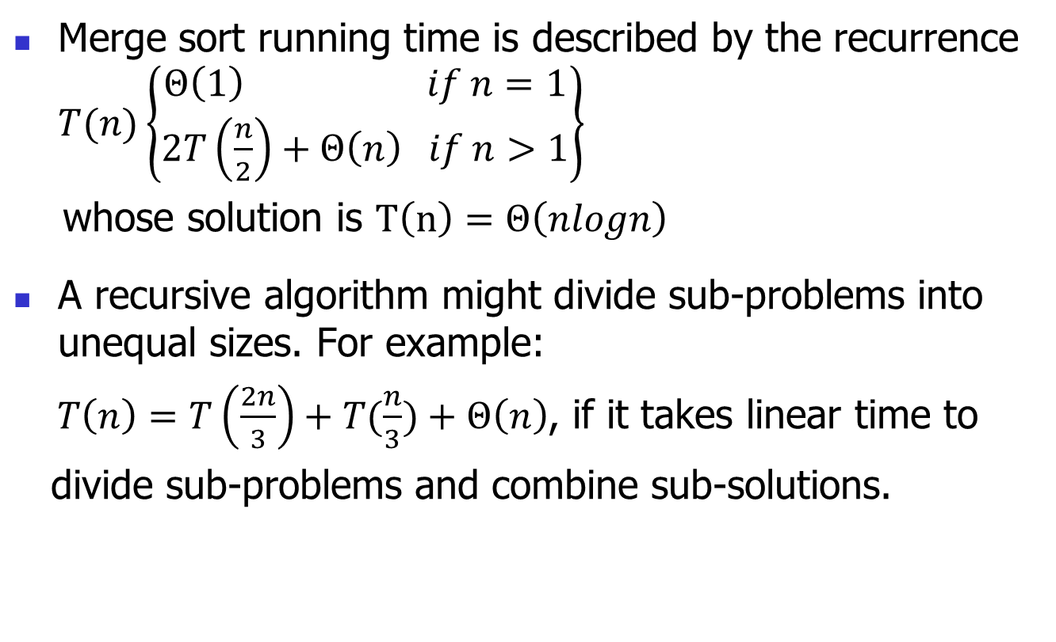
Recurrences
Merge sort running time is described by the recurrence $T(n)\left\{\begin{aligned}Θ\left(1\right) if n=1 \\ 2T\left(\frac{n}{2}\right)+Θ\left(n\right) if n>1\end{aligned}\right\}$
whose solution is $T\left(n\right)=Θ\left(nlogn\right)$
A recursive algorithm might divide sub-problems into unequal sizes. For example:
$T\left(n\right)=T\left(\frac{2n}{3}\right)+T(\frac{n}{3})+Θ\left(n\right)$, if it takes linear time to
divide sub-problems and combine sub-solutions.

Slide 4
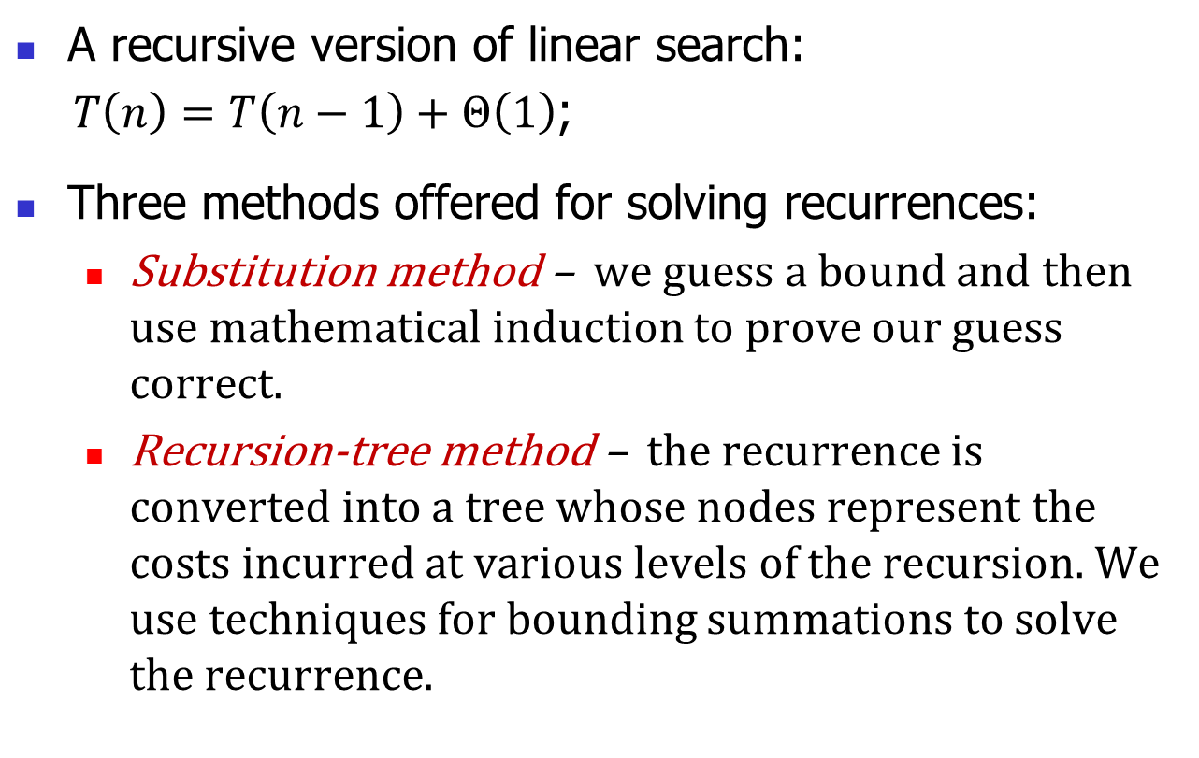
Recurrences
A recursive version of linear search:
$T\left(n\right)=T\left(n−1\right)+Θ\left(1\right)$;
Three methods offered for solving recurrences:
Substitution method – we guess a bound and then use mathematical induction to prove our guess correct.
Recursion-tree method – the recurrence is converted into a tree whose nodes represent the costs incurred at various levels of the recursion. We use techniques for bounding summations to solve the recurrence.

Slide 5
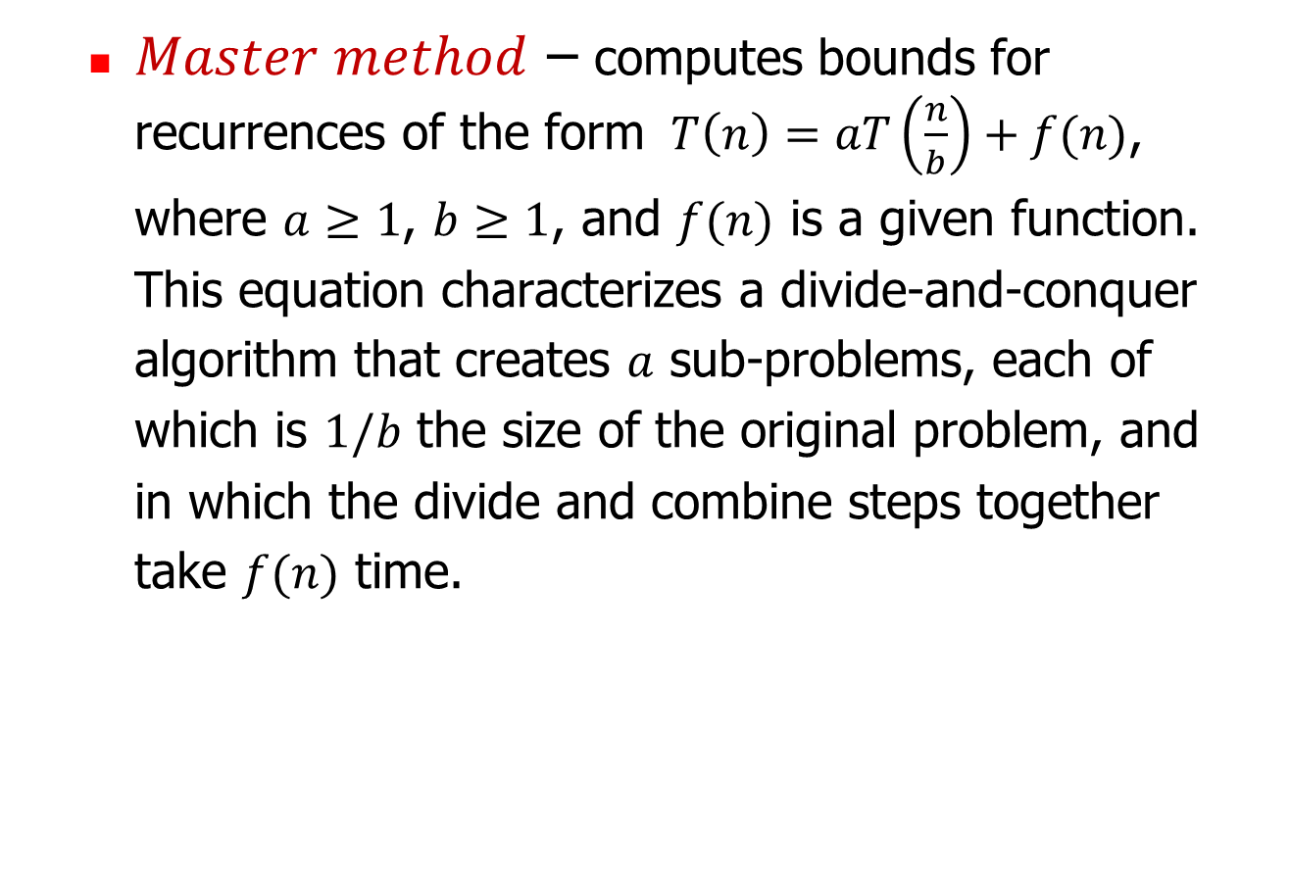
Recurrences
$Master method$ – computes bounds for recurrences of the form $T\left(n\right)=aT\left(\frac{n}{b}\right)+f(n)$,
where $a≥1$, $b≥1$, and $f(n)$ is a given function.
This equation characterizes a divide-and-conquer
algorithm that creates $a$ sub-problems, each of
which is $1/b$ the size of the original problem, and
in which the divide and combine steps together
take $f(n)$ time.

Slide 6
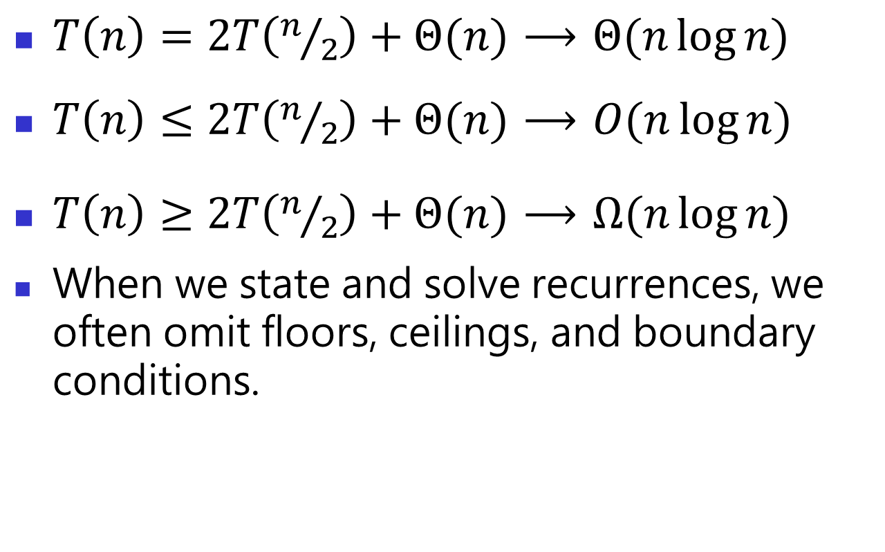
Recurrences
$T\left(n\right)=2T\left(n/2\right)+Θ(n)$ $⟶$ $Θ(n\log{n})$
$T\left(n\right)≤2T\left(n/2\right)+Θ(n)$ $⟶$ $O(n\log{n})$
$T\left(n\right)≥2T\left(n/2\right)+Θ(n)$ $⟶$ $Ω(n\log{n})$
When we state and solve recurrences, we often omit floors, ceilings, and boundary conditions.

Slide 7
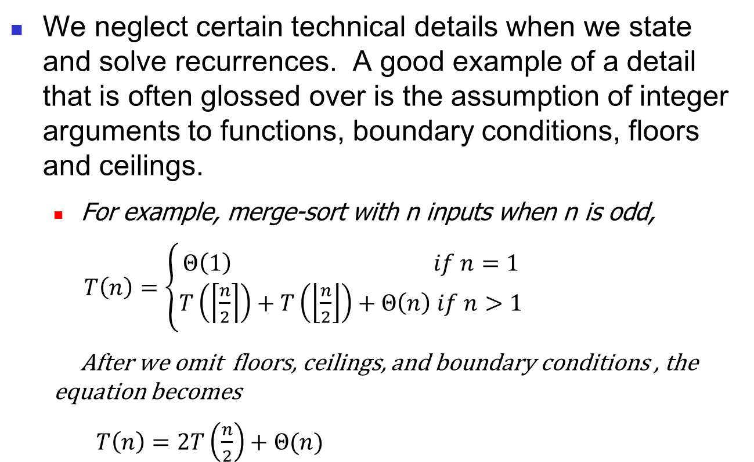
Technicalities in recurrences
We neglect certain technical details when we state and solve recurrences. A good example of a detail that is often glossed over is the assumption of integer arguments to functions, boundary conditions, floors and ceilings.
For example, merge-sort with n inputs when n is odd,
$T\left(n\right)=\left\{\begin{aligned}Θ\left(1\right) if n=1 \\ T\left(\left\lceil \frac{n}{2}\right\rceil \right)+T\left(\left\lfloor \frac{n}{2}\right\rfloor \right)+Θ\left(n\right) if n>1\end{aligned}\right.$
After we omit floors, ceilings, and boundary conditions , the equation becomes
$T\left(n\right)=2T\left(\frac{n}{2}\right)+Θ(n)$

Slide 8
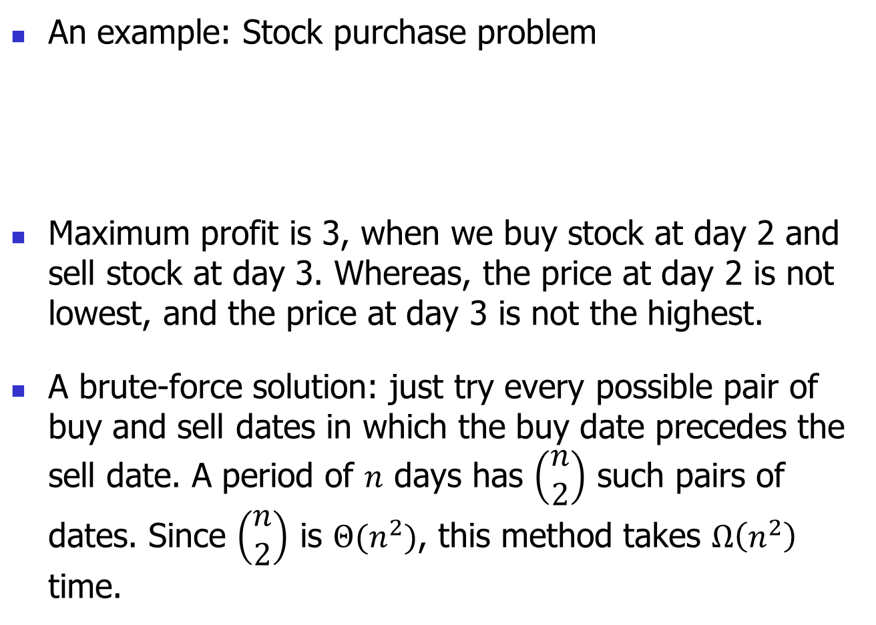
4.1 The maximum sub-array problem
An example: Stock purchase problem
Maximum profit is 3, when we buy stock at day 2 and sell stock at day 3. Whereas, the price at day 2 is not lowest, and the price at day 3 is not the highest.
A brute-force solution: just try every possible pair of buy and sell dates in which the buy date precedes the sell date. A period of $n$ days has $\left(\begin{aligned}n \\ 2\end{aligned}\right)$ such pairs of dates. Since $\left(\begin{aligned}n \\ 2\end{aligned}\right)$ is $Θ(n^{2})$, this method takes $Ω\left(n^{2}\right)$ time.
Day | 0 | 1 | 2 | 3 | 4
price | 10 | 11 | 7 | 10 | 6
change |  | 1 | -4 | 3 | -4

Slide 9
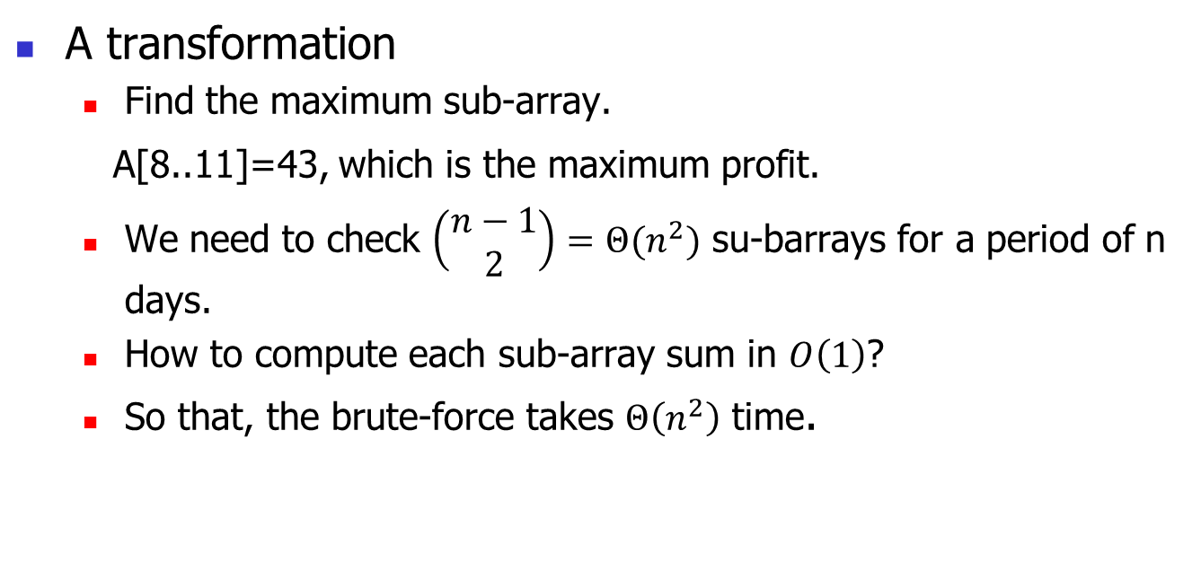
Day | 0 | 1 | 2 | 3 | 4 | 5 | 6 | 7 | 8 | 9 | 10 | 11 | 12 | 13 | 14 | 15 | 16
Price | 100 | 113 | 110 | 85 | 105 | 102 | 86 | 63 | 81 | 101 | 94 | 106 | 101 | 79 | 94 | 90 | 97
Change |  | 13 | -3 | -25 | 20 | -3 | -16 | -23 | 18 | 20 | -7 | 12 | -5 | -22 | 15 | -4 | 7
A transformation
Find the maximum sub-array.
A[8..11]=43, which is the maximum profit.
We need to check $\left(\begin{aligned}n−1 \\ 2\end{aligned}\right)=Θ(n^{2})$ su-barrays for a period of n days.
How to compute each sub-array sum in $O\left(1\right)$?
So that, the brute-force takes $Θ\left(n^{2}\right)$ time.

Slide 10
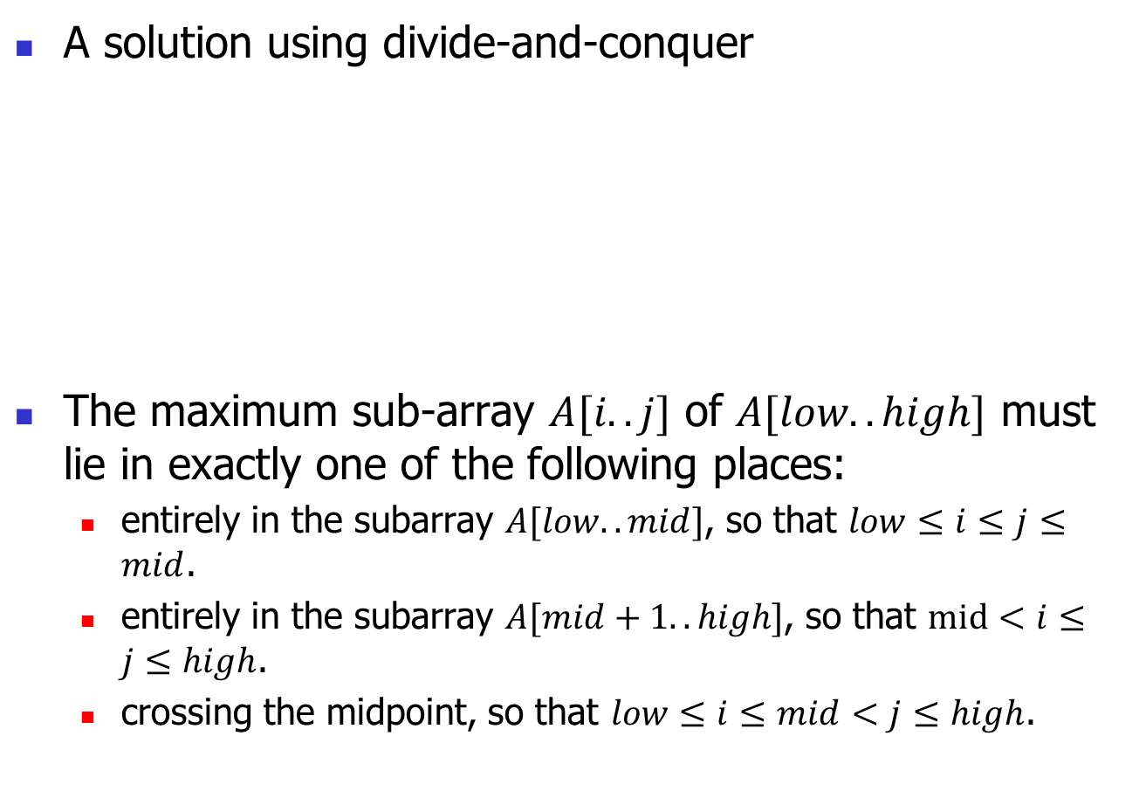
Cross the midpoint
A solution using divide-and-conquer
The maximum sub-array $A[i..j]$ of $A[low..high]$ must lie in exactly one of the following places:
entirely in the subarray $A[low.. mid]$, so that $low≤i≤j≤mid$.
entirely in the subarray $A[mid+1.. high]$, so that $mid<i≤j≤high$.
crossing the midpoint, so that $low≤i≤mid<j≤high$.
low
mid
high
mid+1
Entirely in A[low .. mid]
Entirely in A[mid+1 .. high]

Slide 11
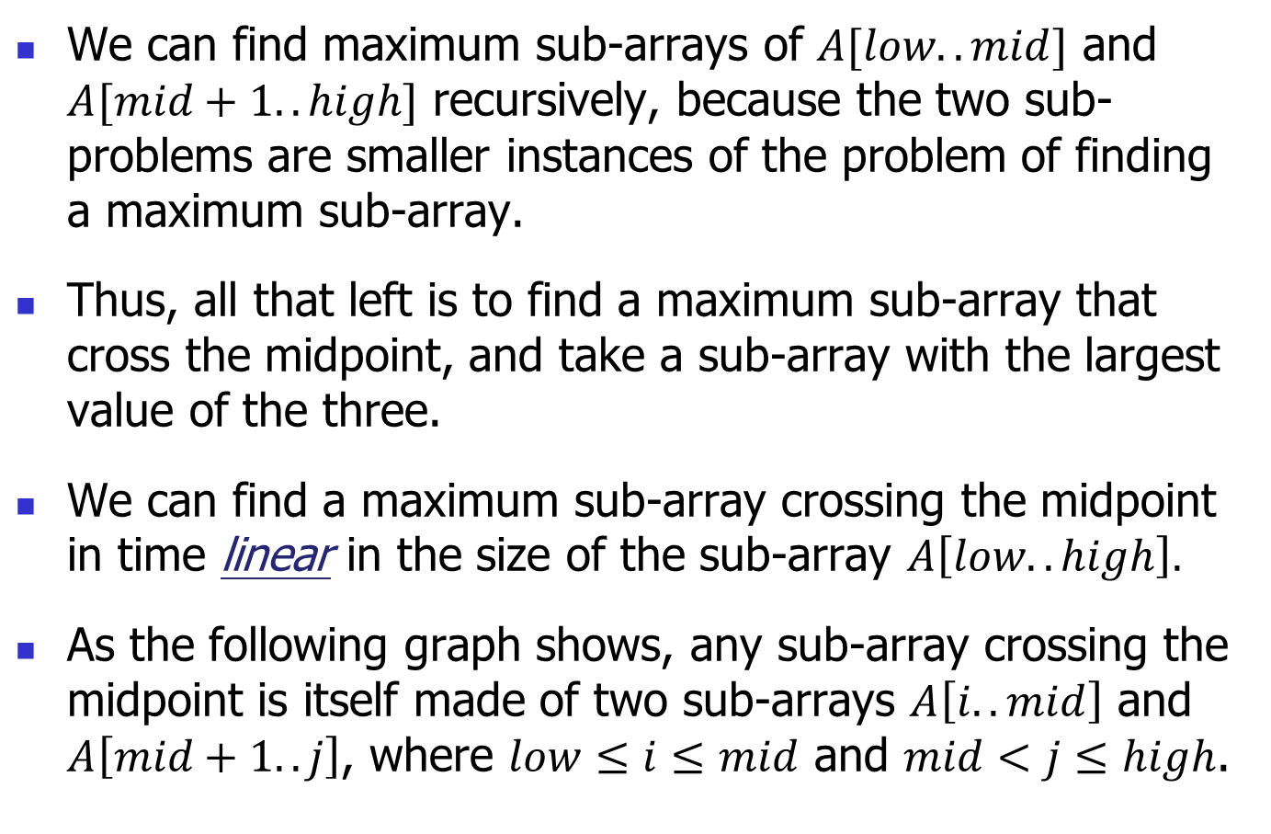
We can find maximum sub-arrays of $A[low..mid]$ and $A[mid+1..high]$ recursively, because the two sub-problems are smaller instances of the problem of finding a maximum sub-array.
Thus, all that left is to find a maximum sub-array that cross the midpoint, and take a sub-array with the largest value of the three.
We can find a maximum sub-array crossing the midpoint in time linear in the size of the sub-array $A\left[low..high\right].$
As the following graph shows, any sub-array crossing the midpoint is itself made of two sub-arrays $A\left[i..mid\right]$ and $A\left[mid+1..j\right]$, where $low≤i≤mid$ and $mid<j≤high$.

Slide 12

A[mid+1 .. j]
low
i
mid
high
mid+1
A[i .. mid]
Therefore, we need find maximum sub-arrays of the form $A\left[i..mid\right]$ and $A\left[mid+1..j\right]$ and then combine them.

Slide 13
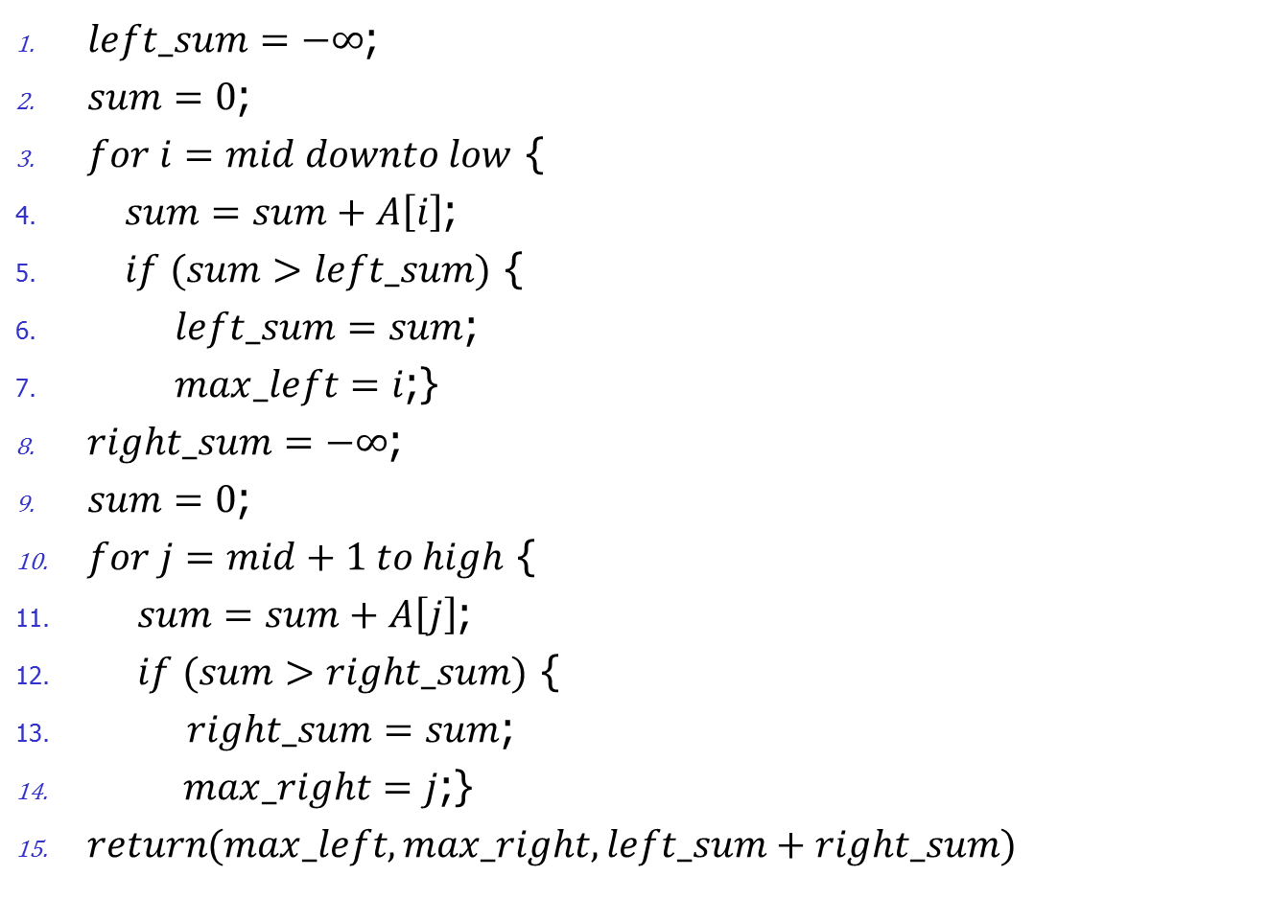
Find-Max-Crossing-Subarray(A, low, mid, high)
$left_sum=−∞$;
$sum=0$;
$for i=mid downto low$ {
$sum=sum+A\left[i\right]$;
$if (sum>left_sum)$ {
$left_sum=sum$;
$max_left=i$;}
$right_sum=−∞$;
$sum=0$;
$for j=mid+1 to high$ {
$sum=sum+A\left[j\right]$;
$if (sum>right_sum)$ {
$right_sum=sum$;
$max_right=j$;}
$return(max_left, max_right,left_sum+right_sum)$

Slide 14

$max−left$ and $max−right$ are two indices for left boundary and right boundary of the maximum sub-array.
It takes $Θ(n)$ time where $n=high−low+1$.

Slide 15
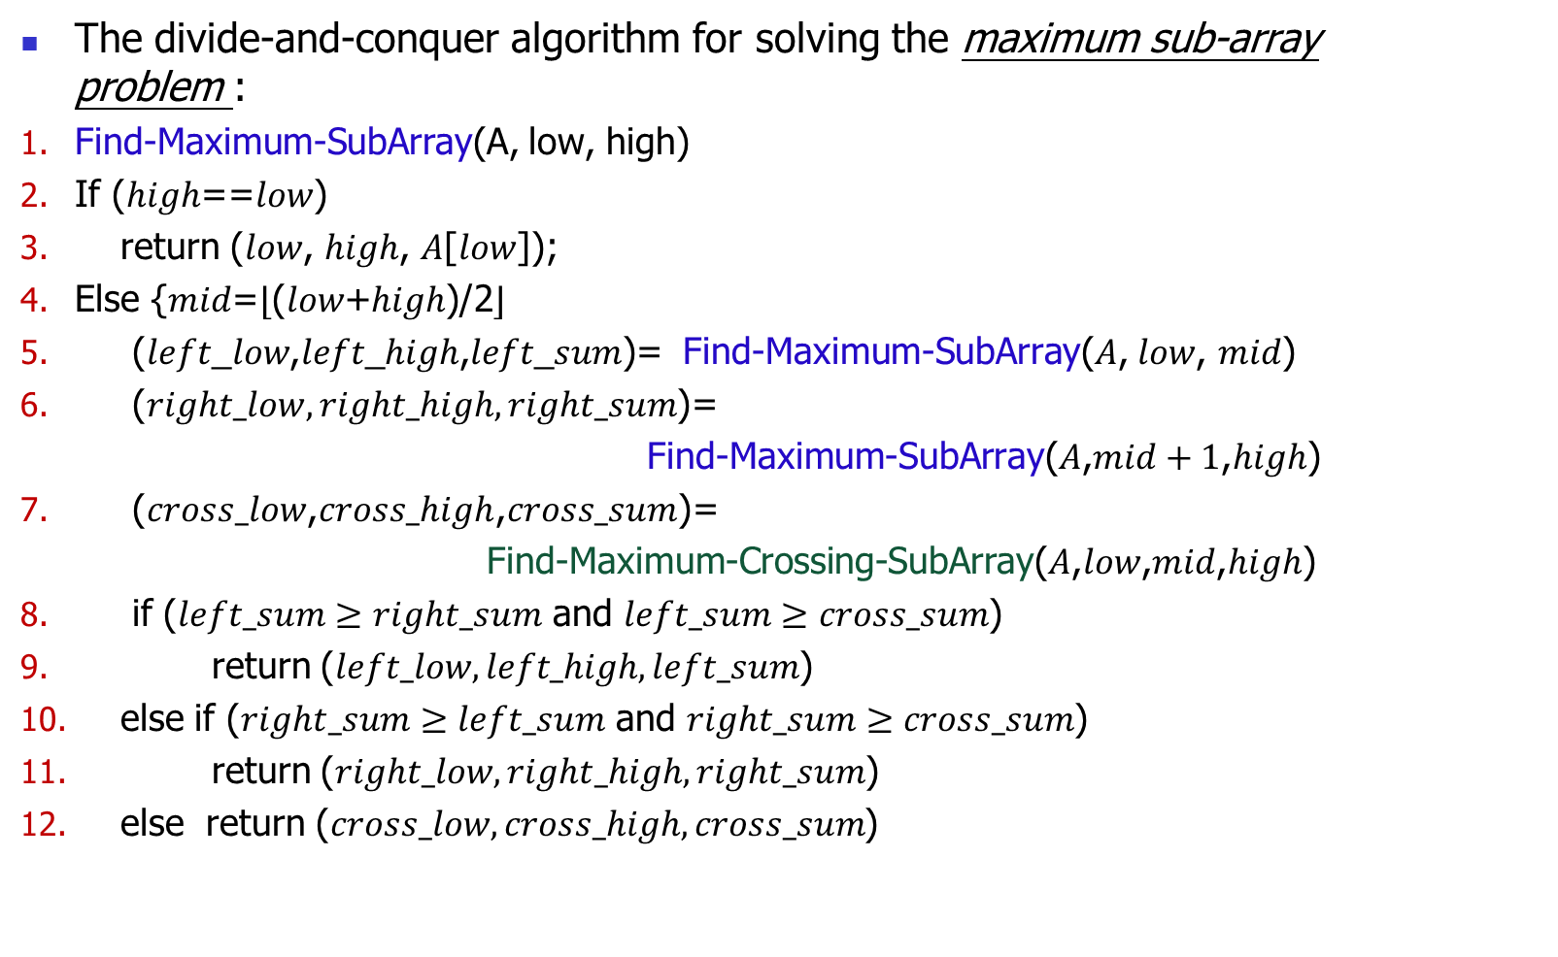
The divide-and-conquer algorithm for solving the maximum sub-array problem :
Find-Maximum-SubArray(A, low, high)
If (ℎ𝑖𝑔ℎ==𝑙𝑜𝑤)
return (𝑙𝑜𝑤, ℎ𝑖𝑔ℎ, 𝐴[𝑙𝑜𝑤]);
Else {𝑚𝑖𝑑=⌊(𝑙𝑜𝑤+ℎ𝑖𝑔ℎ)/2⌋
(𝑙𝑒𝑓𝑡_𝑙𝑜𝑤,𝑙𝑒𝑓𝑡_ℎ𝑖𝑔ℎ,𝑙𝑒𝑓𝑡_𝑠𝑢𝑚)= Find-Maximum-SubArray(𝐴, 𝑙𝑜𝑤, 𝑚𝑖𝑑)
($right_low, right_high,right_sum$)=
Find-Maximum-SubArray(𝐴,$mid+1$,$high$)
($cross_low$,$cross_high$,$cross_sum$)=
Find-Maximum-Crossing-SubArray($A$,$low$,$mid$,$high$)
if ($left_sum≥right_sum$ and $left_sum≥cross_sum$)
return ($left_low,left_high,left_sum$)
else if ($right_sum≥left_sum$ and $right_sum≥cross_sum$)
return ($right_low,right_high,right_sum$)
else return ($cross_low,cross_high,cross_sum$)

Slide 16
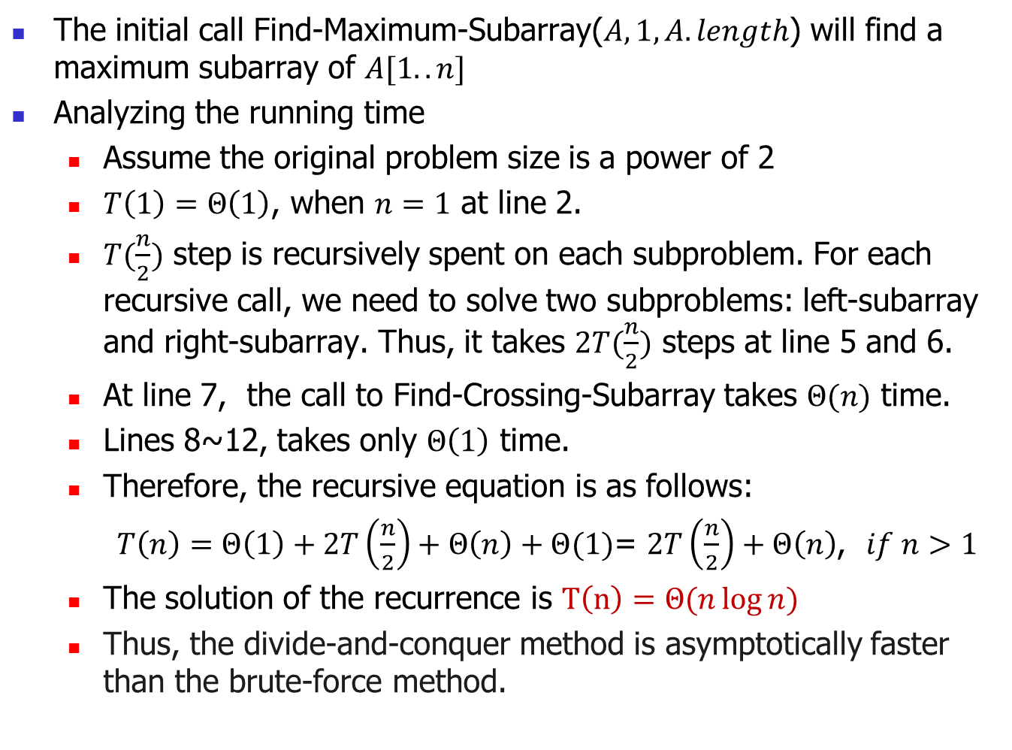
The initial call Find-Maximum-Subarray($A,1,A.length$) will find a maximum subarray of $A[1..n]$
Analyzing the running time
Assume the original problem size is a power of 2
$T\left(1\right)=Θ\left(1\right)$, when $n=1$ at line 2.
$T(\frac{n}{2})$ step is recursively spent on each subproblem. For each recursive call, we need to solve two subproblems: left-subarray and right-subarray. Thus, it takes $2T(\frac{n}{2})$ steps at line 5 and 6.
At line 7, the call to Find-Crossing-Subarray takes $Θ(n)$ time.
Lines 8~12, takes only $Θ\left(1\right)$ time.
Therefore, the recursive equation is as follows:
$T\left(n\right)=Θ\left(1\right)+2T\left(\frac{n}{2}\right)+Θ\left(n\right)+Θ(1)$= $2T\left(\frac{n}{2}\right)+Θ\left(n\right)$, $if n>1$
The solution of the recurrence is $T\left(n\right)=Θ(n\log{n})$
Thus, the divide-and-conquer method is asymptotically faster than the brute-force method.

Slide 17
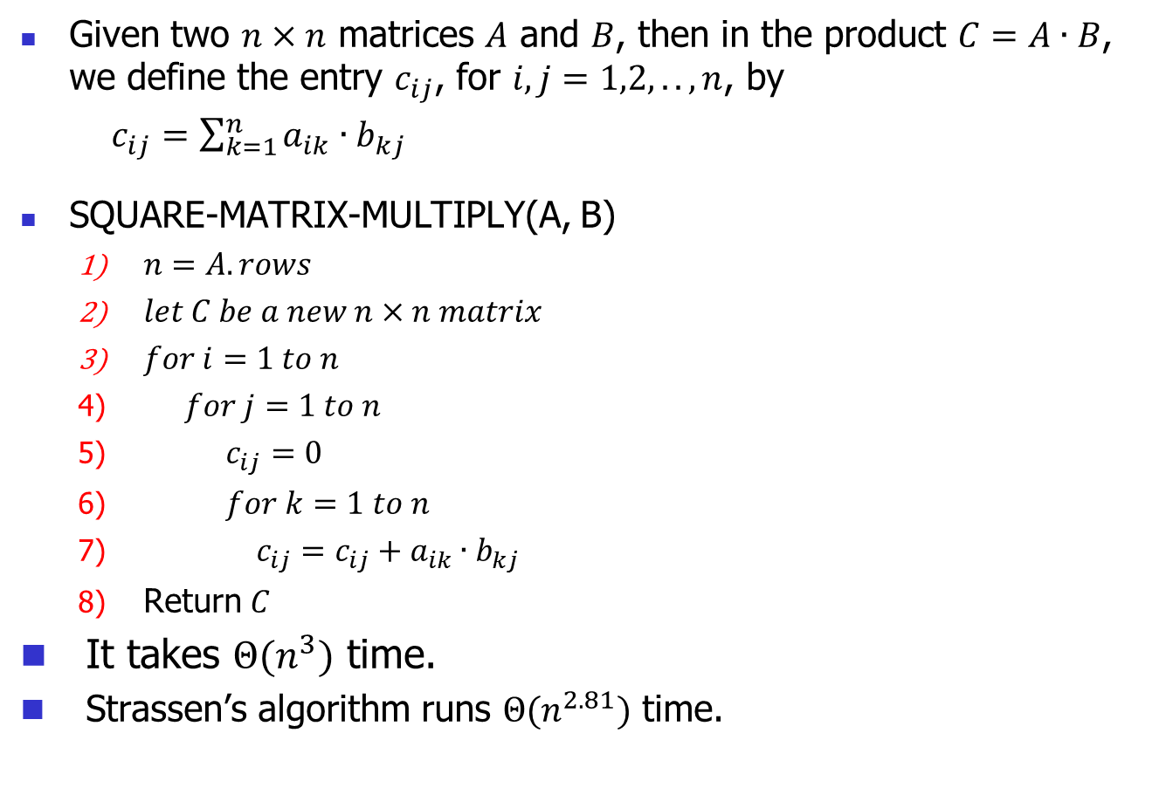
4.2 Strassen’s algorithm for matrix multiplication
Given two $n×n$ matrices $A$ and $B$, then in the product $C=A∙B$, we define the entry $c_{ij}$, for $i, j=1,2,..,n$, by
$c_{ij}=\sum_{k=1}^{n}{a_{ik}∙b_{kj}}$
SQUARE-MATRIX-MULTIPLY(A, B)
$n=A.rows$
$let C be a new n×n matrix$
$for i=1 to n$
$for j=1 to n$
$c_{ij}=0$
$for k=1 to n$
$c_{ij}=c_{ij}+a_{ik}∙b_{kj}$
Return $C$
It takes $Θ(n^{3})$ time.
Strassen’s algorithm runs $Θ(n^{2.81})$ time.

Slide 18
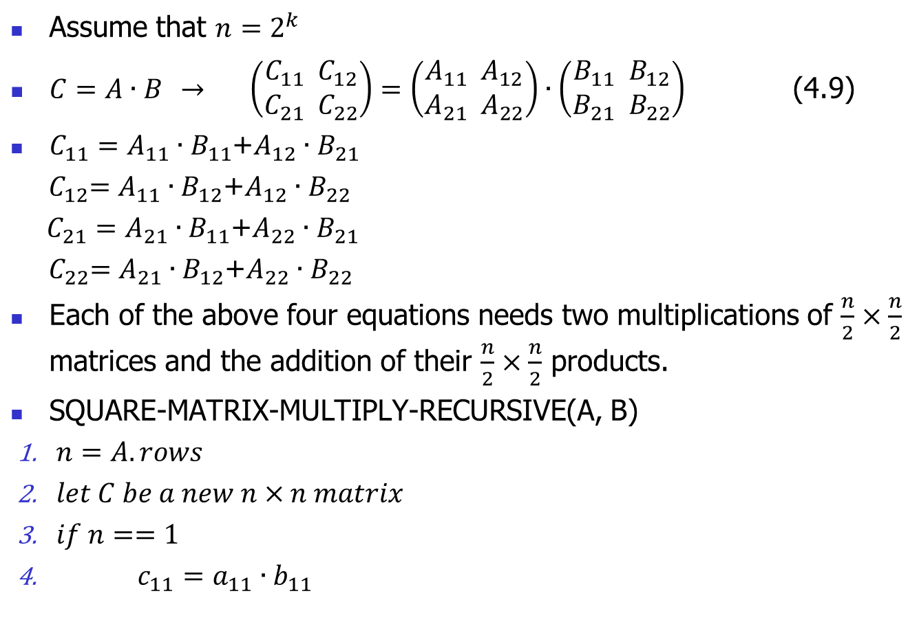
A simple divide-and-conquer algorithm
Assume that $n=2^{k}$
$C=A∙B$ $→$ $\left(\begin{aligned}C_{11} C_{12} \\ C_{21} C_{22}\end{aligned}\right)=\left(\begin{aligned}A_{11} A_{12} \\ A_{21} A_{22}\end{aligned}\right)∙\left(\begin{aligned}B_{11} B_{12} \\ B_{21} B_{22}\end{aligned}\right)$ (4.9)
$C_{11}=A_{11}∙B_{11}$+$A_{12}∙B_{21}$
${ C}_{12}=A_{11}∙B_{12}$+$A_{12}∙B_{22}$
$C_{21}=A_{21}∙B_{11}$+$A_{22}∙B_{21}$
${ C}_{22}=A_{21}∙B_{12}$+$A_{22}∙B_{22}$
Each of the above four equations needs two multiplications of $\frac{n}{2}×\frac{n}{2}$ matrices and the addition of their $\frac{n}{2}×\frac{n}{2}$ products.
SQUARE-MATRIX-MULTIPLY-RECURSIVE(A, B)
$n=A.rows$
$let C be a new n×n matrix$
$if n==1$
$c_{11}=a_{11}∙b_{11}$

Slide 19
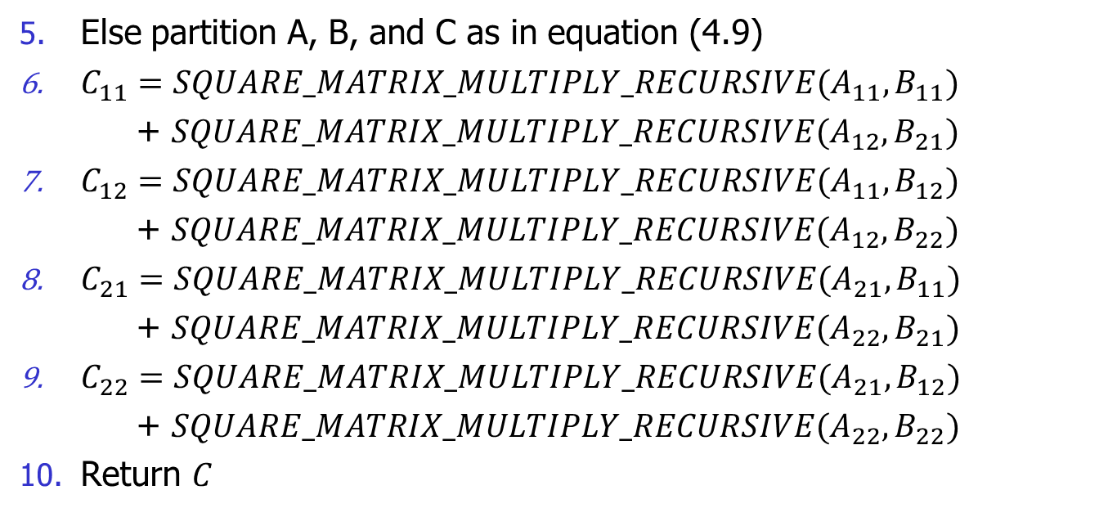
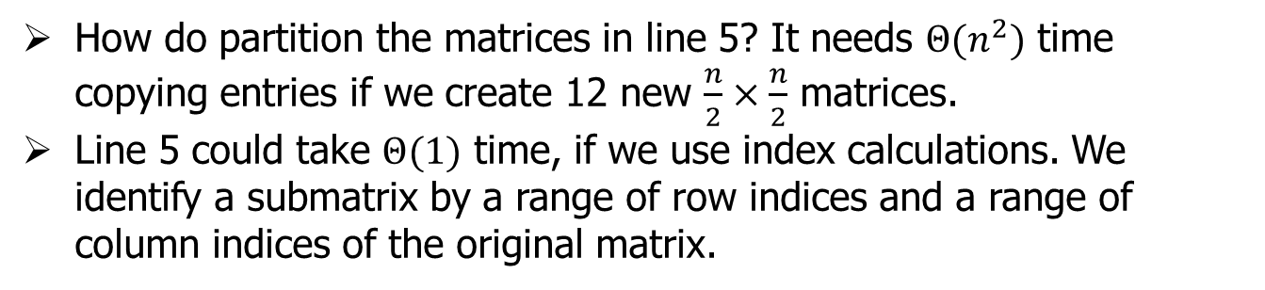
Else partition A, B, and C as in equation (4.9)
$C_{11}=SQUARE_MATRIX_MULTIPLY_RECURSIVE(A_{11},B_{11})$
+ $SQUARE_MATRIX_MULTIPLY_RECURSIVE(A_{12},B_{21})$
$C_{12}=SQUARE_MATRIX_MULTIPLY_RECURSIVE(A_{11},B_{12})$
+ $SQUARE_MATRIX_MULTIPLY_RECURSIVE(A_{12},B_{22})$
$C_{21}=SQUARE_MATRIX_MULTIPLY_RECURSIVE(A_{21},B_{11})$
+ $SQUARE_MATRIX_MULTIPLY_RECURSIVE(A_{22},B_{21})$
$C_{22}=SQUARE_MATRIX_MULTIPLY_RECURSIVE(A_{21},B_{12})$
+ $SQUARE_MATRIX_MULTIPLY_RECURSIVE(A_{22},B_{22})$
Return $C$
How do partition the matrices in line 5? It needs $Θ(n^{2})$ time copying entries if we create 12 new $\frac{n}{2}×\frac{n}{2}$ matrices.
Line 5 could take $Θ(1)$ time, if we use index calculations. We identify a submatrix by a range of row indices and a range of column indices of the original matrix.

Slide 20
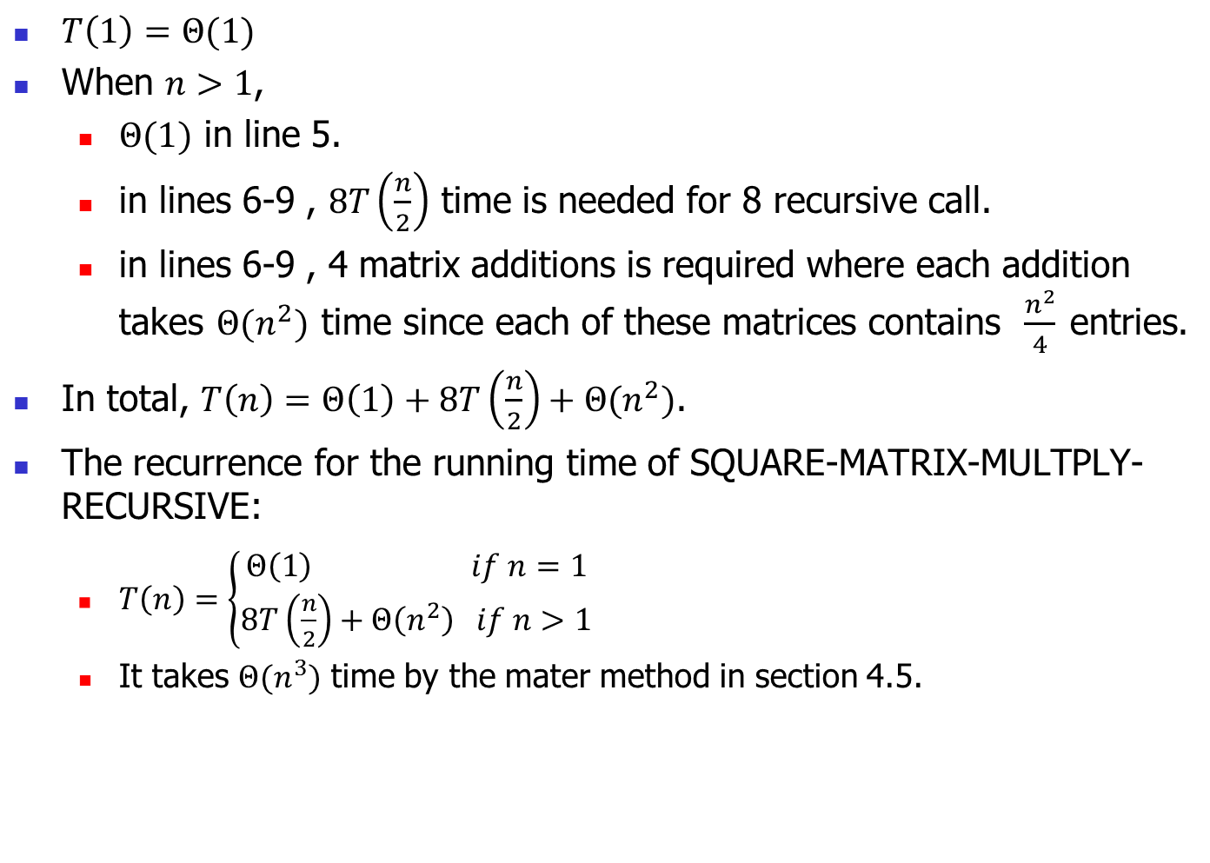
$T\left(1\right)=Θ(1)$
When $n>1$,
$Θ(1)$ in line 5.
in lines 6-9 , $8T\left(\frac{n}{2}\right)$ time is needed for 8 recursive call.
in lines 6-9 , 4 matrix additions is required where each addition takes $Θ(n^{2})$ time since each of these matrices contains $\frac{n^{2}}{4}$ entries.
In total, $T\left(n\right)=Θ\left(1\right)+8T\left(\frac{n}{2}\right)+Θ(n^{2})$.
The recurrence for the running time of SQUARE-MATRIX-MULTPLY-RECURSIVE:
$T\left(n\right)=\left\{\begin{aligned}Θ\left(1\right) if n=1 \\ 8T\left(\frac{n}{2}\right)+Θ\left(n^{2}\right) if n>1\end{aligned}\right.$
It takes $Θ(n^{3})$ time by the mater method in section 4.5.

Slide 21
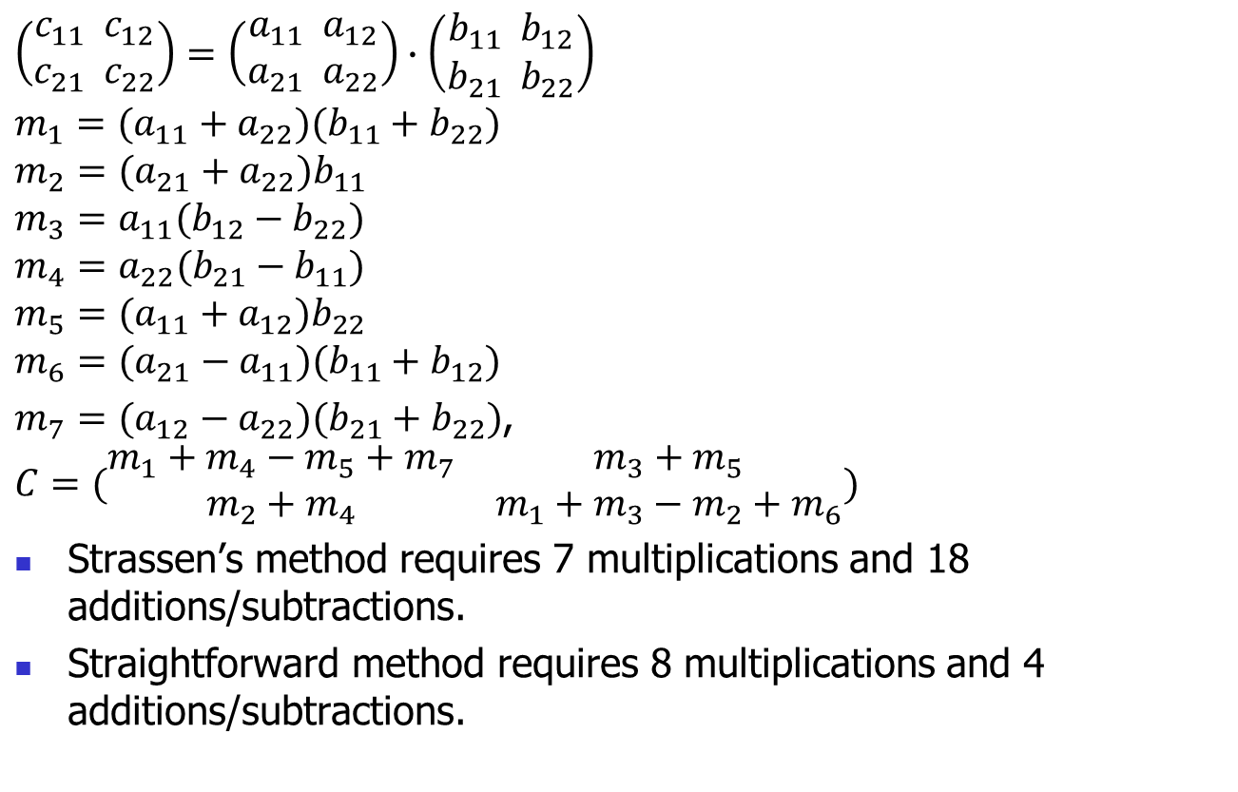
Strassen’s method
$$\left(\begin{aligned}c_{11} c_{12} \\ c_{21} c_{22}\end{aligned}\right)=\left(\begin{aligned}a_{11} a_{12} \\ a_{21} a_{22}\end{aligned}\right)∙\left(\begin{aligned}b_{11} b_{12} \\ b_{21} b_{22}\end{aligned}\right)$$
$$m_{1}=(a_{11}+a_{22})(b_{11}+b_{22})$$
$$m_{2}=(a_{21}+a_{22})b_{11}$$
$$m_{3}=a_{11}(b_{12}−b_{22})$$
$$m_{4}=a_{22}(b_{21}−b_{11})$$
$$m_{5}=(a_{11}+a_{12})b_{22}$$
$$m_{6}=(a_{21}−a_{11})(b_{11}+b_{12})$$
$m_{7}=(a_{12}−a_{22})(b_{21}+b_{22})$,
$$C=(\begin{matrix}m_{1}+m_{4}−m_{5}+m_{7} & m_{3}+m_{5} \\ m_{2}+m_{4} & m_{1}+m_{3}−m_{2}+m_{6}\end{matrix})$$
Strassen’s method requires 7 multiplications and 18 additions/subtractions.
Straightforward method requires 8 multiplications and 4 additions/subtractions.

Slide 22
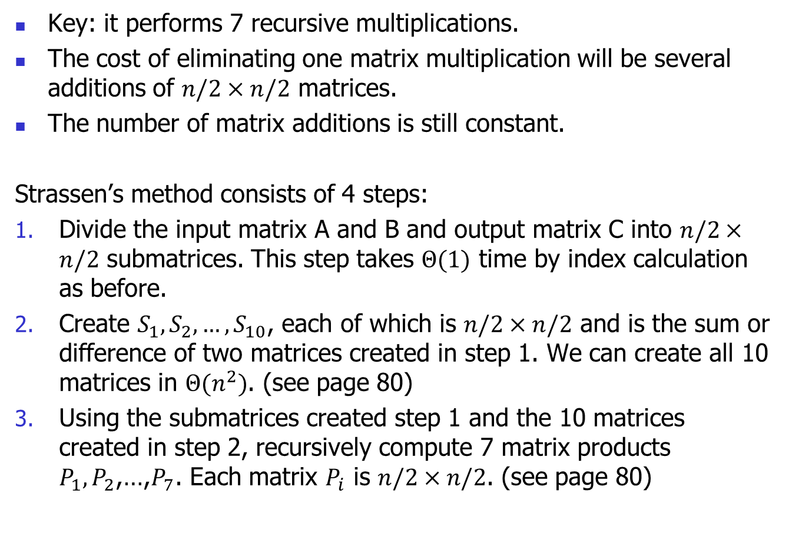
Strassen’s method
Key: it performs 7 recursive multiplications.
The cost of eliminating one matrix multiplication will be several additions of $n/2×n/2$ matrices.
The number of matrix additions is still constant.
Strassen’s method consists of 4 steps:
Divide the input matrix A and B and output matrix C into $n/2×n/2$ submatrices. This step takes $Θ(1)$ time by index calculation as before.
Create $S_{1}, S_{2},…,S_{10}$, each of which is $n/2×n/2$ and is the sum or difference of two matrices created in step 1. We can create all 10 matrices in $Θ(n^{2})$. (see page 80)
Using the submatrices created step 1 and the 10 matrices created in step 2, recursively compute 7 matrix products $P_{1}, P_{2}$,…,$P_{7}$. Each matrix $P_{i}$ is $n/2×n/2$. (see page 80)

Slide 23
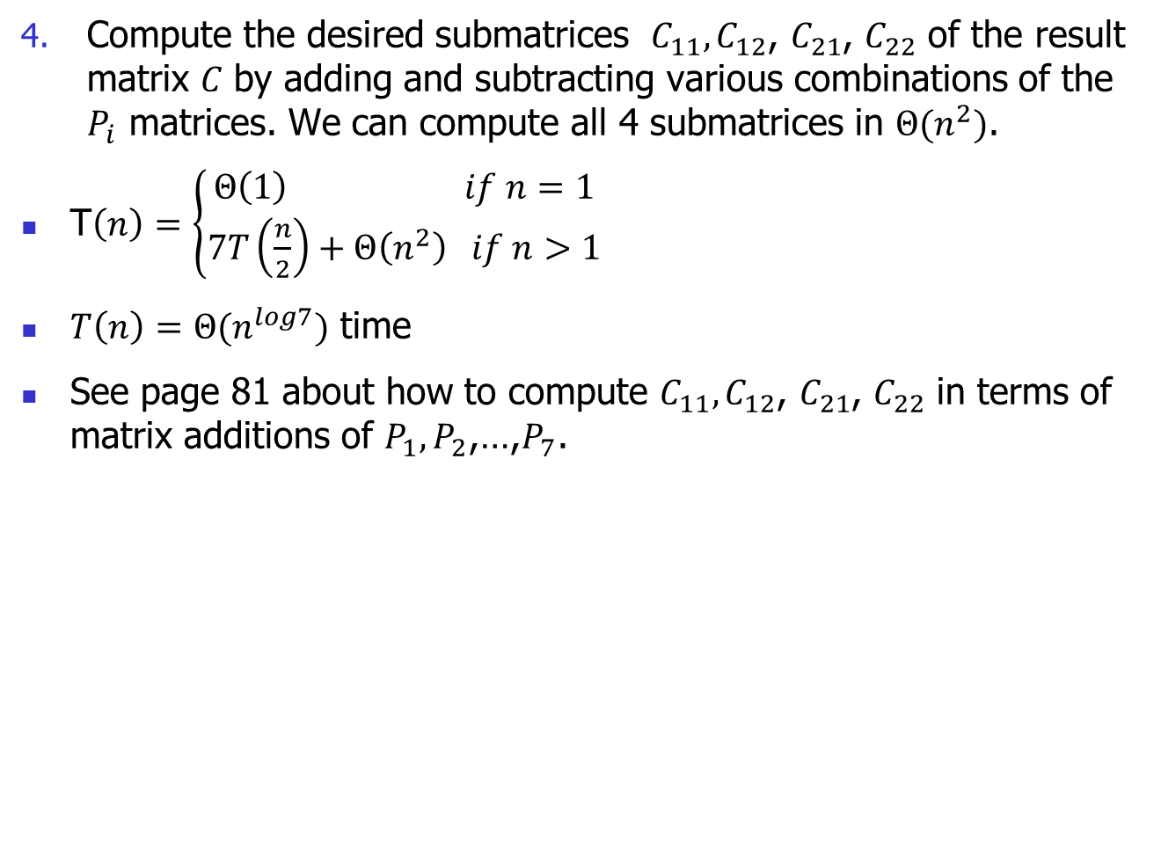
Compute the desired submatrices $C_{11}, C_{12}$, $C_{21}$, $C_{22}$ of the result matrix 𝐶 by adding and subtracting various combinations of the $P_{i}$ matrices. We can compute all 4 submatrices in $Θ(n^{2})$.
T$\left(n\right)=\left\{\begin{aligned}Θ\left(1\right) if n=1 \\ 7T\left(\frac{n}{2}\right)+Θ\left(n^{2}\right) if n>1\end{aligned}\right.$
$T\left(n\right)=Θ(n^{log7})$ time
See page 81 about how to compute $C_{11}, C_{12}$, $C_{21}$, $C_{22}$ in terms of matrix additions of $P_{1}, P_{2}$,…,$P_{7}$.

Slide 24
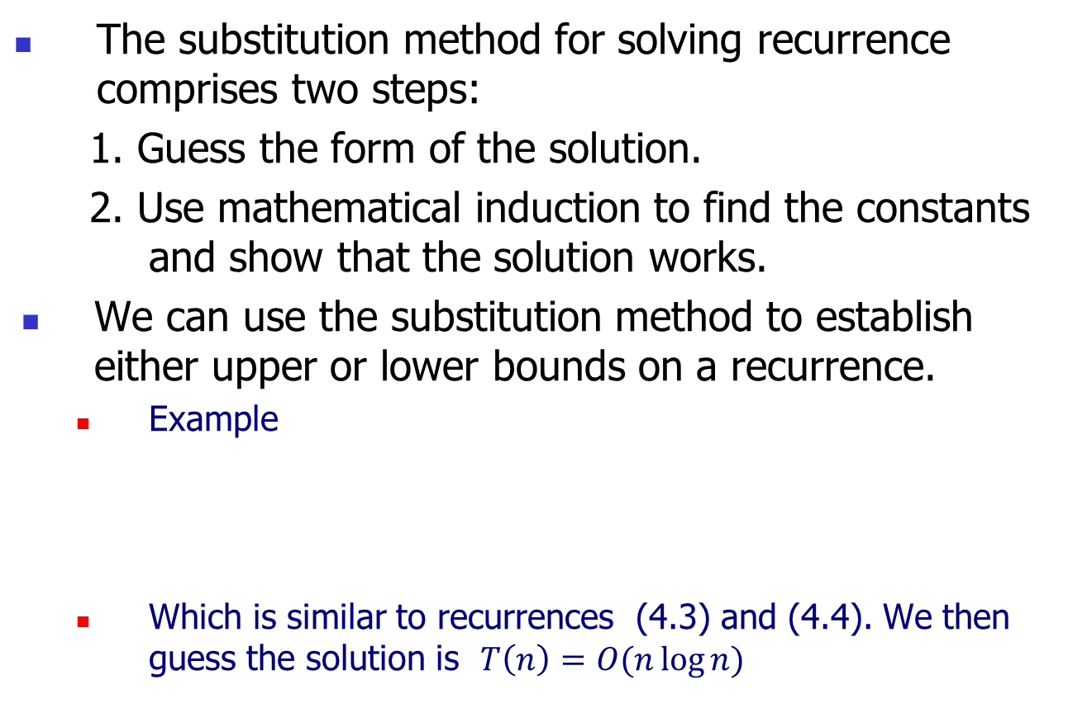
4.3 The substitution method for solving recurrences
The substitution method for solving recurrence comprises two steps:
1. Guess the form of the solution.
2. Use mathematical induction to find the constants and show that the solution works.
We can use the substitution method to establish either upper or lower bounds on a recurrence.
Example
Which is similar to recurrences (4.3) and (4.4). We then guess the solution is $T\left(n\right)=O(n\log{n})$

Slide 25
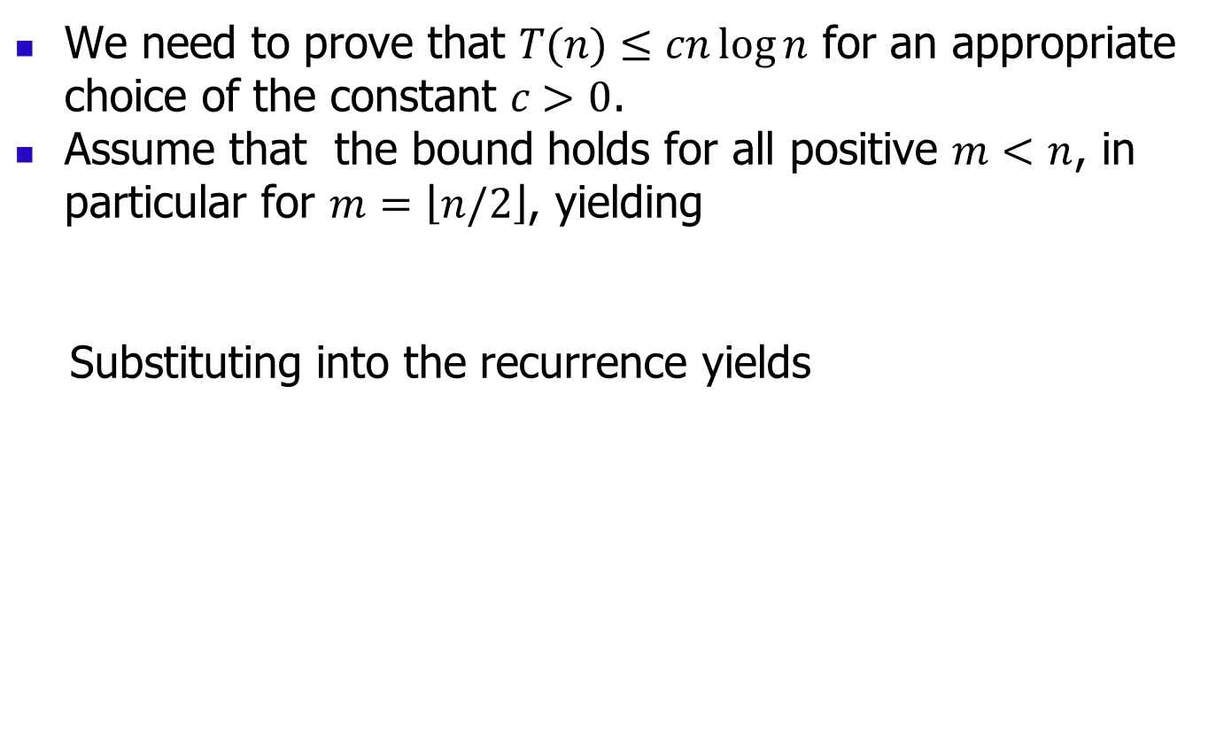
We need to prove that $T(n)≤cn\log{n}$ for an appropriate choice of the constant $c>0$.
Assume that the bound holds for all positive $m<n$, in particular for $m=\left\lfloor n/2\right\rfloor$, yielding
Substituting into the recurrence yields

Slide 26
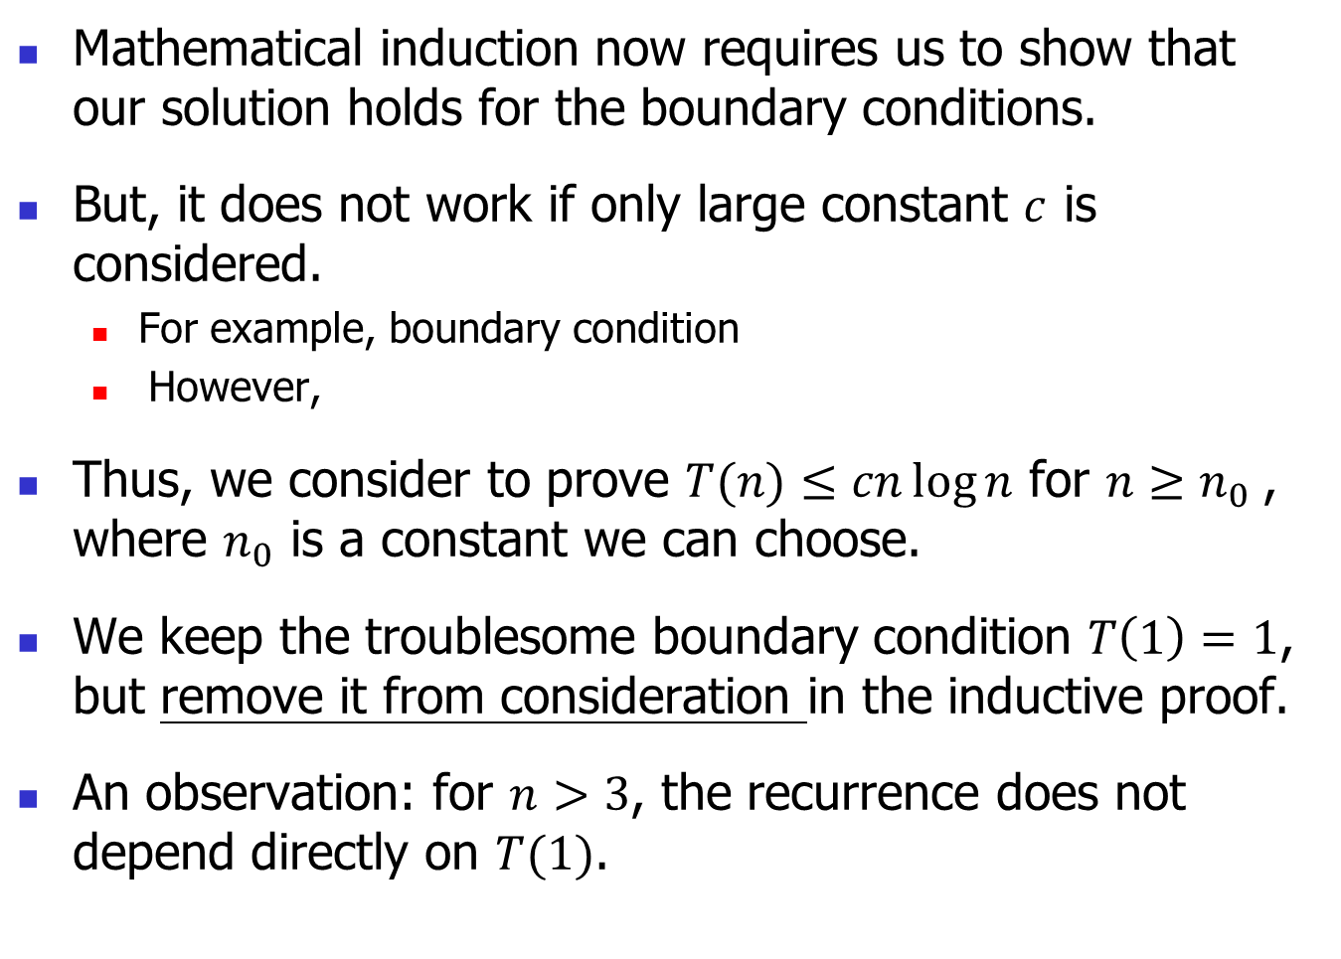
Mathematical induction now requires us to show that our solution holds for the boundary conditions.
But, it does not work if only large constant $c$ is considered.
For example, boundary condition
However,
Thus, we consider to prove $T(n)≤cn\log{n}$ for $n≥n_{0}$, where $n_{0}$ is a constant we can choose.
We keep the troublesome boundary condition $T\left(1\right)=1$, but remove it from consideration in the inductive proof.
An observation: for $n>3$, the recurrence does not depend directly on $T(1)$.

Slide 27
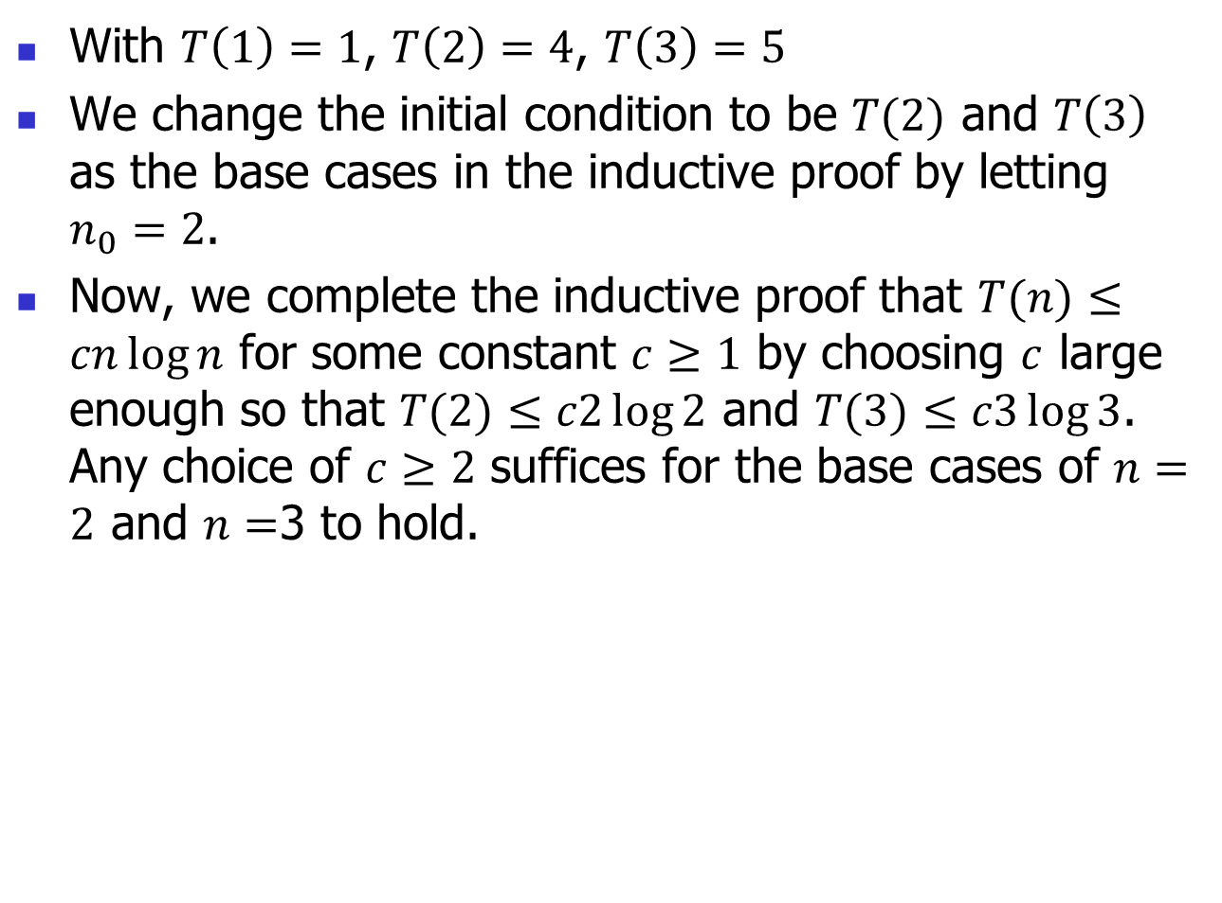
With $T\left(1\right)=1$, $T\left(2\right)=4$, $T\left(3\right)=5$
We change the initial condition to be $T(2)$ and $T\left(3\right)$ as the base cases in the inductive proof by letting $n_{0}=2$.
Now, we complete the inductive proof that $T(n)≤cn\log{n}$ for some constant $c≥1$ by choosing $c$ large enough so that $T(2)≤c2\log{2}$ and $T(3)≤c3\log{3}$. Any choice of $c≥2$ suffices for the base cases of $n=2$ and $n=$3 to hold.

Slide 28
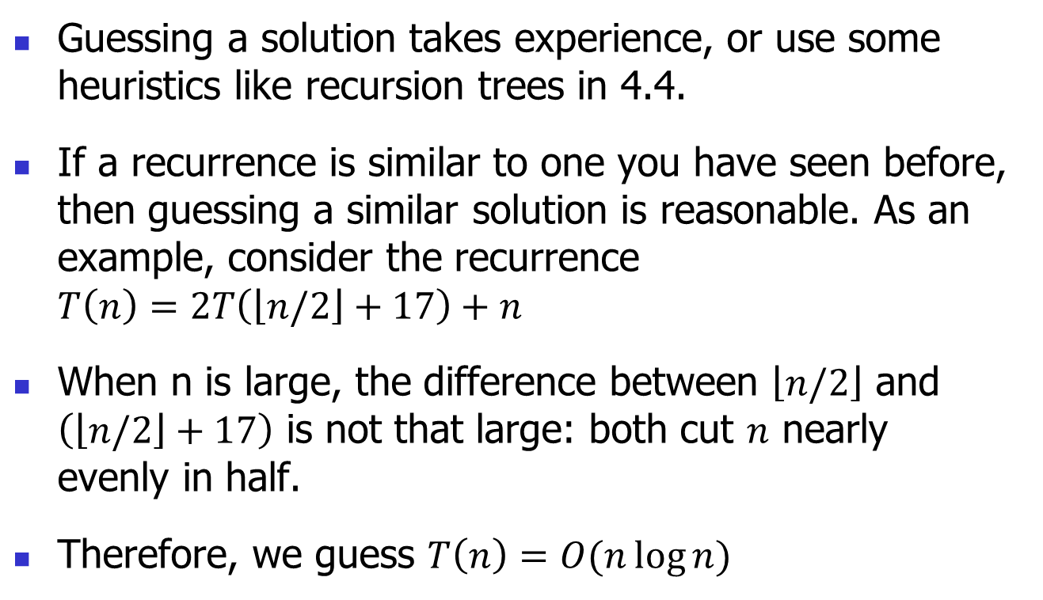
Making a good guess
Guessing a solution takes experience, or use some heuristics like recursion trees in 4.4.
If a recurrence is similar to one you have seen before, then guessing a similar solution is reasonable. As an example, consider the recurrence $T\left(n\right)=2T\left(\left\lfloor n/2\right\rfloor +17\right)+n$
When n is large, the difference between $\left\lfloor n/2\right\rfloor$ and $\left(\left\lfloor n/2\right\rfloor +17\right)$ is not that large: both cut $n$ nearly evenly in half.
Therefore, we guess $T\left(n\right)=O(n\log{n})$

Slide 29
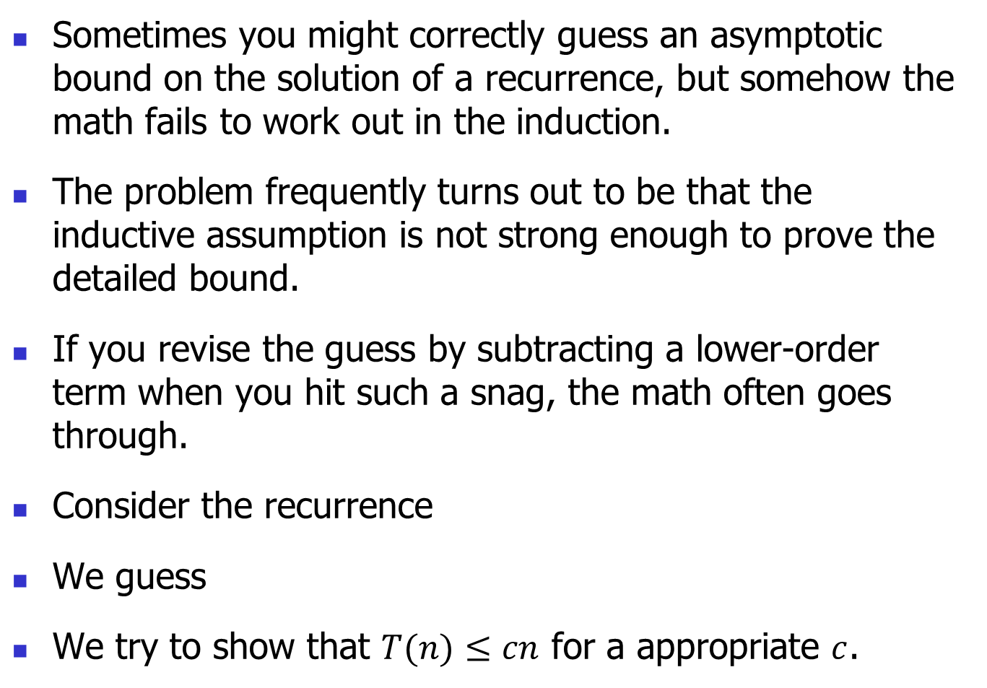
Subtleties
Sometimes you might correctly guess an asymptotic bound on the solution of a recurrence, but somehow the math fails to work out in the induction.
The problem frequently turns out to be that the inductive assumption is not strong enough to prove the detailed bound.
If you revise the guess by subtracting a lower-order term when you hit such a snag, the math often goes through.
Consider the recurrence
We guess
We try to show that $T(n)≤cn$ for a appropriate $c$.

Slide 30
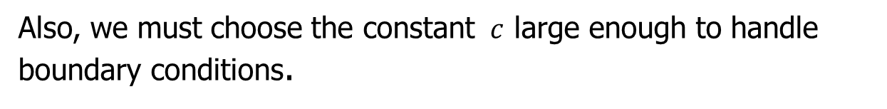
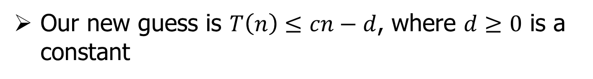
which does not imply $T\left(n\right)≤cn$ for any choice of $c$
Our new guess is $T\left(n\right)≤cn−d$, where $d≥0$ is a constant
Also, we must choose the constant $c$ large enough to handle boundary conditions.

Slide 31
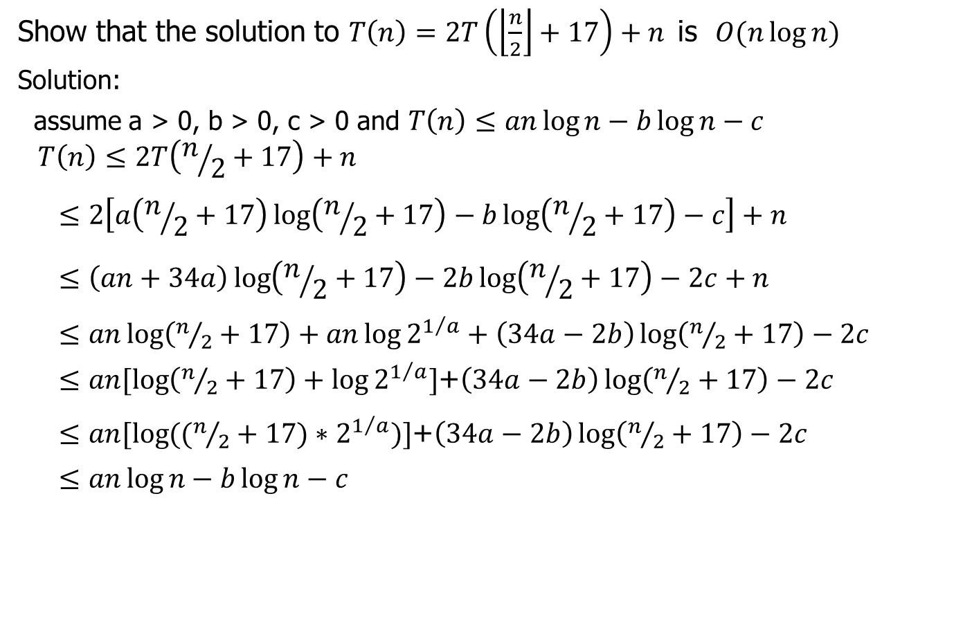
Show that the solution to $T\left(n\right)=2T\left(\left\lfloor \frac{n}{2}\right\rfloor +17\right)+n$ is $O(n\log{n})$
Solution:
assume a > 0, b > 0, c > 0 and $T\left(n\right)≤an\log{n}−b\log{n}−c$
$$T\left(n\right)≤2T\left(n/2+17\right)+n$$
$$≤2\left[a\left(n/2+17\right)\log\left(n/2+17\right)−b\log\left(n/2+17\right)−c\right]+n$$
$$≤\left(an+34a\right)\log\left(n/2+17\right)−2b\log\left(n/2+17\right)−2c+n$$
$≤an\log\left(n/2+17\right)+an\log{2^{1/a}}+\left(34a−2b\right)\log\left(n/2+17\right)−2c$
$≤an[\log\left(n/2+17\right)+\log{2^{1/a}}]$+$\left(34a−2b\right)\log\left(n/2+17\right)−2c$
$≤an[\log{((n/2+17)∗2^{1/a})}]$+$\left(34a−2b\right)\log\left(n/2+17\right)−2c$
$$≤an\log{n}−b\log{n}−c$$

Slide 32
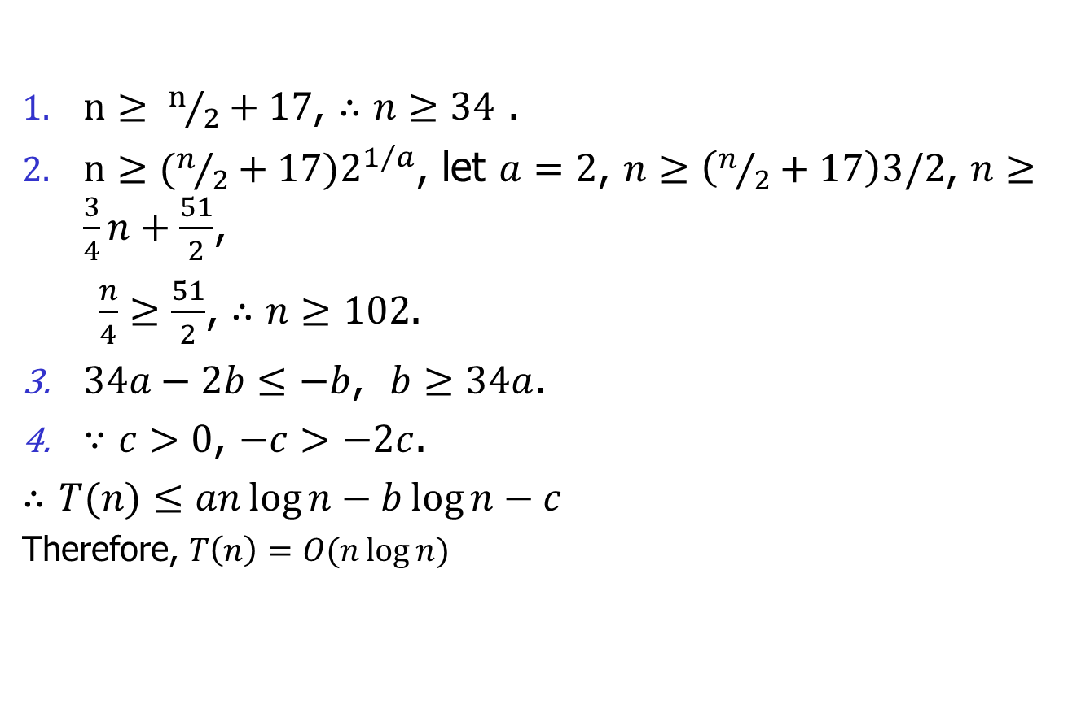
$n≥ n/2+17$, $∴n≥34$ .
$n≥(n/2+17)2^{1/a}$, let $a=2$, $n≥\left(n/2+17\right)3/2$, $n≥\frac{3}{4}n+\frac{51}{2}$,
$\frac{n}{4}≥\frac{51}{2}$, $∴n≥102$.
$34a−2b≤−b$, $b≥34a$.
$∵c>0$, $−c>−2c$.
$∴$ $T(n)≤an\log{n}−b\log{n}−c$
Therefore, $T\left(n\right)=O(n\log{n})$

Slide 33
Avoiding pitfalls
Assume
Hence
(WRONG!) You cannot find such a c.

Slide 34
Changing variables

Slide 35
4.4 the Recursion-tree method
Drawing out a recursion tree, serves as a straightforward way to devise a good guess.
In a recursion tree, each node represents the cost of a single sub-problem somewhere in the set of recursive function invocations.
We sum the costs within each level of the tree to obtain a set of per-level costs, and then we sum all the per-level costs to determine the total cost of all levels of the recursion.
A recursion tree is best used to generate a good guess, which you can then verify by the substitution method.

Slide 36
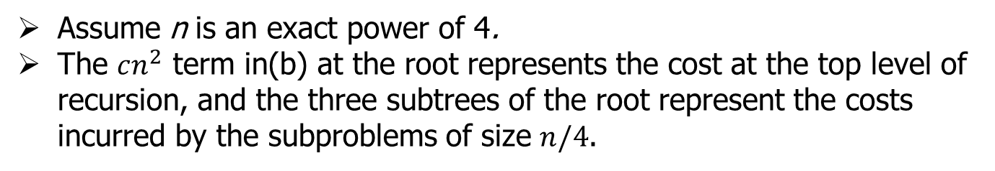
Assume n is an exact power of 4.
The $cn^{2}$ term in(b) at the root represents the cost at the top level of recursion, and the three subtrees of the root represent the costs incurred by the subproblems of size $n/4$.

Slide 37
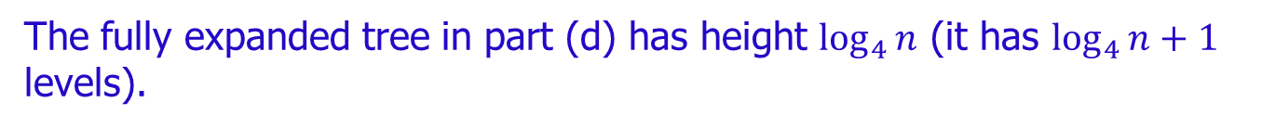
The fully expanded tree in part (d) has height $\log_{4}{n}$ (it has $\log_{4}{n}+1$ levels).

Slide 38
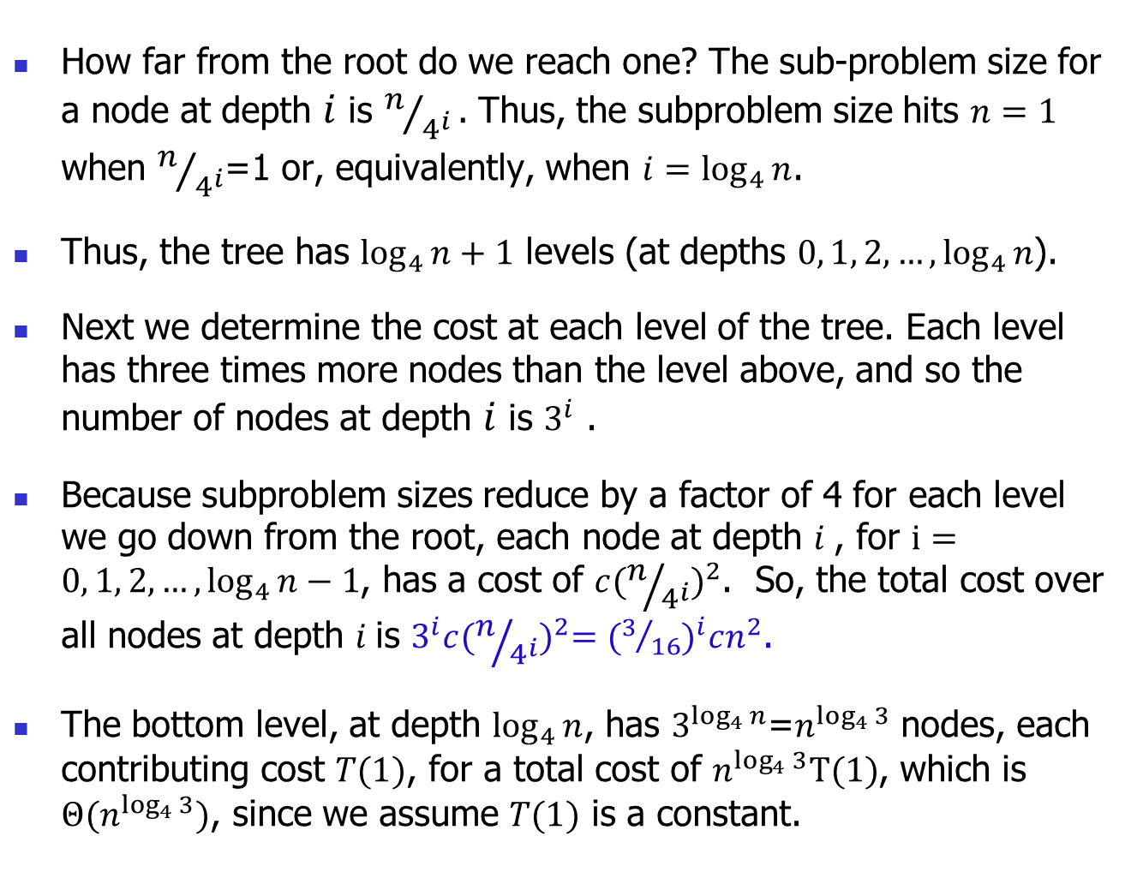
How far from the root do we reach one? The sub-problem size for a node at depth $i$ is $n/{4^{i}}.$ Thus, the subproblem size hits $n=1$ when $n/{4^{i}}$=1 or, equivalently, when $i=\log_{4}{n}$.
Thus, the tree has $\log_{4}{n}+1$ levels (at depths $0, 1, 2, …, \log_{4}{n}$).
Next we determine the cost at each level of the tree. Each level has three times more nodes than the level above, and so the number of nodes at depth $i$ is $3^{i}$ .
Because subproblem sizes reduce by a factor of 4 for each level we go down from the root, each node at depth $i$, for $i=0, 1, 2, …, \log_{4}{n}−1$, has a cost of $c{(n/{4^{i}})}^{2}$. So, the total cost over all nodes at depth $i$is $3^{i}c{(n/{4^{i}})}^{2}={(3/{16})}^{i}cn^{2}$.
The bottom level, at depth $\log_{4}{n}$, has $3^{\log_{4}{n}}$=$n^{\log_{4}{3}}$ nodes, each contributing cost $T(1)$, for a total cost of $n^{\log_{4}{3}}T(1)$, which is $Θ(n^{\log_{4}{3}})$, since we assume $T(1)$ is a constant.

Slide 39
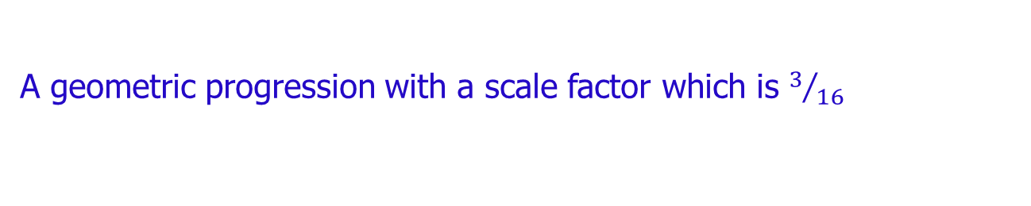
The cost of the entire tree
A geometric progression with a scale factor which is $3/{16}$

Slide 41
substitution method to verify the bound
We want to Show that T(n) ≤ dn² for some constant d > 0. using the same constant c > 0 as before, we have
Where the last step holds as long as d ≥(16/13)c.

Slide 42
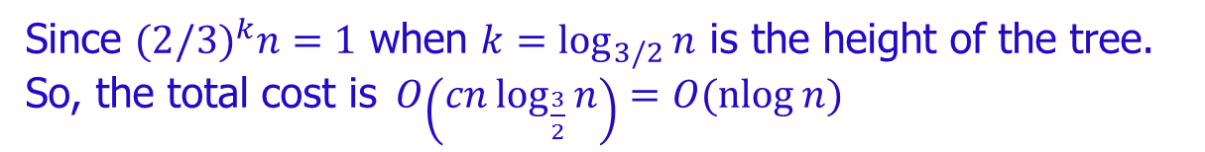
Another Example:
Figure 4.6
Since ${(2/3)}^{k}n=1$ when $k=\log_{3/2}{n}$ is the height of the tree.
So, the total cost is$O\left(cn\log_{\frac{3}{2}}{n}\right)=O(\operatorname{nlog}{n})$

Slide 43
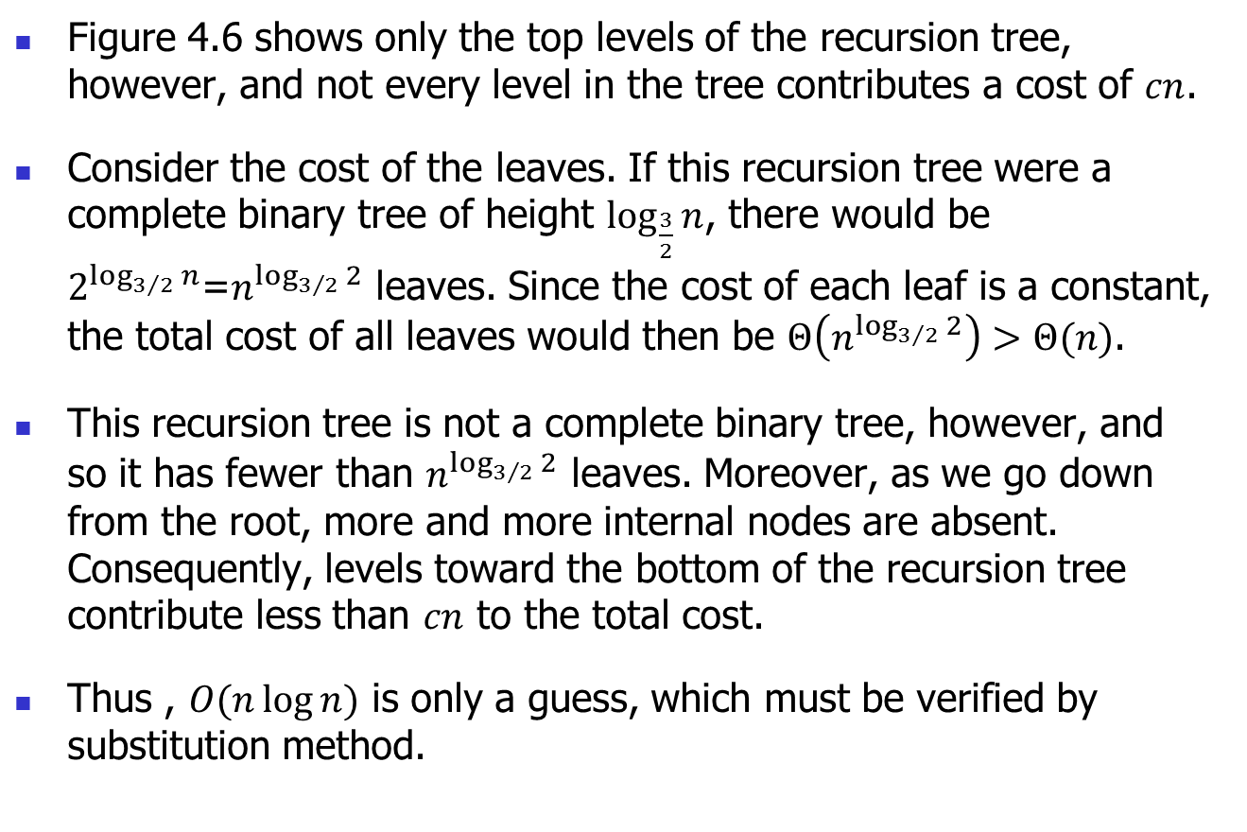
Figure 4.6 shows only the top levels of the recursion tree, however, and not every level in the tree contributes a cost of $cn$.
Consider the cost of the leaves. If this recursion tree were a complete binary tree of height $\log_{\frac{3}{2}}{n}$, there would be $2^{\log_{3/2}{n}}$=$n^{\log_{3/2}{2}}$ leaves. Since the cost of each leaf is a constant, the total cost of all leaves would then be $Θ\left(n^{\log_{3/2}{2}}\right)>Θ(n)$.
This recursion tree is not a complete binary tree, however, and so it has fewer than $n^{\log_{3/2}{2}}$ leaves. Moreover, as we go down from the root, more and more internal nodes are absent. Consequently, levels toward the bottom of the recursion tree contribute less than $cn$ to the total cost.
Thus , $O(n\log{n})$ is only a guess, which must be verified by substitution method.

Slide 44
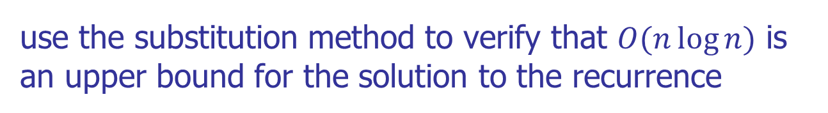
use the substitution method to verify that $O(n\log{n})$ is an upper bound for the solution to the recurrence
As long as d ≥ c/lg3 – (2/3)).

Slide 45
4.5 The master method

Slide 48
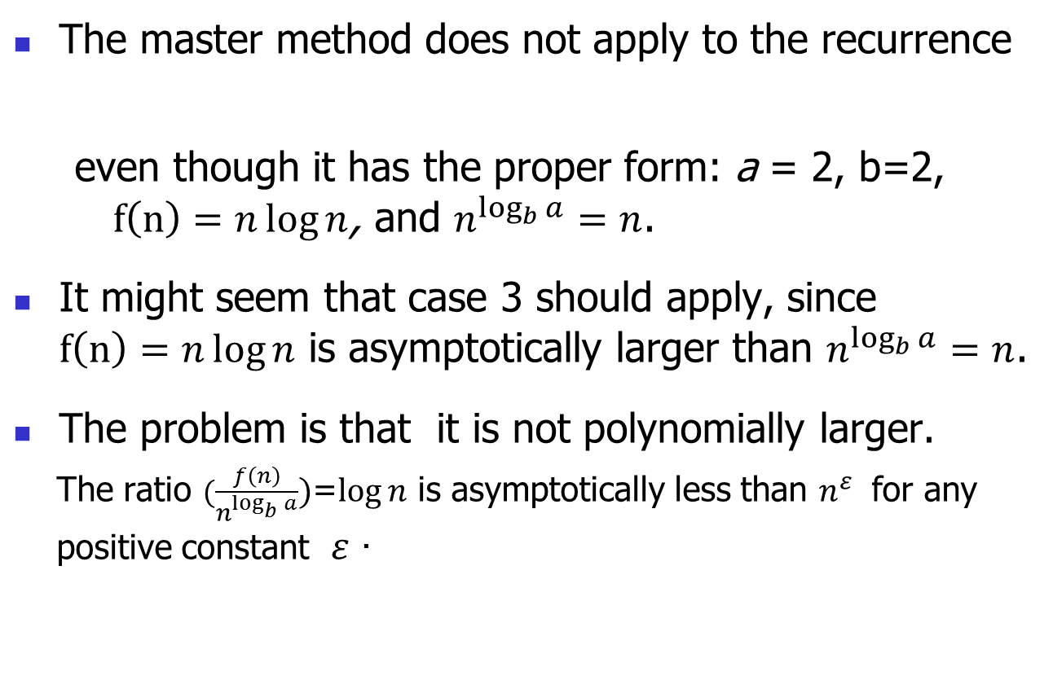
The master method does not apply to the recurrence
even though it has the proper form: a = 2, b=2, $f\left(n\right)=n\log{n}$, and $n^{\log_{b}{a}}=n$.
It might seem that case 3 should apply, since $f\left(n\right)=n\log{n}$ is asymptotically larger than $n^{\log_{b}{a}}=n$.
The problem is that it is not polynomially larger.
The ratio $(\frac{f\left(n\right)}{n^{\log_{b}{a}}})$=$\log{n}$ is asymptotically less than $n^{ε}$ for any positive constant $ε$ .

