Slide 1
Branch and Bound
Wen-Lin Yang
NUTN, CSIE

Slide 2
Branch-and-bound overview
for the 0–1 Knapsack problem:
dynamic programming
backtracking
branch-and-bound: an improvement on the backtracking
The branch-and-bound design strategy is very similar to backtracking in that a state space tree is used to solve a problem. The differences are that the branch-and-bound method:
does not limit us to any particular way of traversing the tree.
is used only for optimization problems.

Slide 3
As is the case for backtracking algorithms, branch-and-bound algorithms are ordinarily exponential-time (or worse) in the worst case. However, they can be very efficient for many large instances.
A branch-and-bound algorithm computes a number (bound) at a node to determine whether the node is promising. The number is a bound on the value of the solution that could be obtained by expanding beyond the node. If that bound is no better than the value of the best solution found so far, the node is nonpromising. Otherwise, it is promising.

Slide 4
The backtracking algorithm for the 0–1 Knapsack problem in Section 5.7 is actually a branch-and-bound algorithm. However, it does not exploit the real advantage of using branch-and-bound.
Besides using the bound to determine whether a node is promising, we can compare the bounds of promising nodes and visit the children of the one with the best bound. In this way we often can arrive at an optimal solution faster than we would by methodically visiting the nodes in some predetermined order (such as a depth-first search). This approach is called best-first search with branch-and-bound pruning.

Slide 5
breadth-first search with branch-and-bound pruning. This technique has no advantage over depth-first search.
In section 6.1, we will first solve the 0–1 Knapsack problem using a breadth-first search. This will enable us to more easily explain best-first search and use it to solve the 0–1 Knapsack problem.
Summary
Backtracking is based on depth-first search, and does not take full advantages of using the branch-and-bound.
Breadth-first search with branch-and-bound pruning. It is no much better than DFS.
Best-first search with branch-and-bound pruning. The performance is the best among these three methods.

Slide 6
Breadth-First Search
void breath_first_tree_search(tree T) {
queue_of_node Q;
node u, v;
initialize(Q);
v= root of T;
visit v;
enqueue(Q,v);
while (!empty(Q)) {
dequeue(Q,v);
for (each child u of v) {
visit u;
enqueue(Q,u);
}
}
}

Slide 7
Breadth-First Search with Branch-and-Bound Pruning
Example : 0-1 Knapsack Problem
Suppose n=4, W=16
i
1 | $40 | 2 | $20
2 | $30 | 5 | $6
3 | $50 | 10 | $5
4 | $10 | 2 | $2

Slide 8
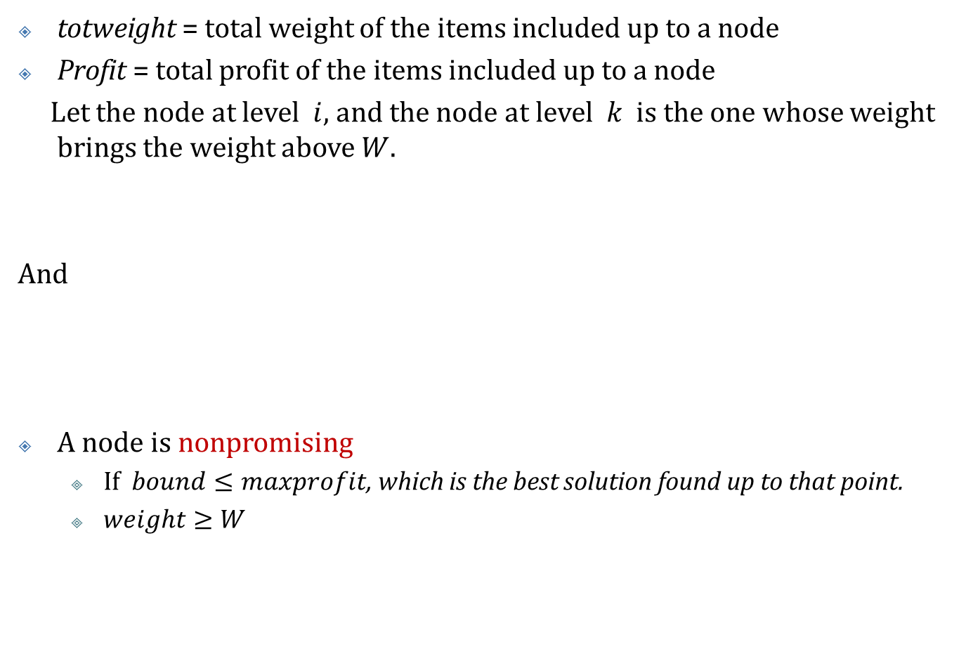
0-1 Knapsack Problem
totweight = total weight of the items included up to a node
Profit = total profit of the items included up to a node
Let the node at level $i$, and the node at level $k$ is the one whose weight brings the weight above $W$.
And
A node is nonpromising
If $bound≤maxprofit$, which is the best solution found up to that point.
$weight≥W$

Slide 9
(0,0)
Item 1
$0
0
$115
(1,1)
(1,2)
40+30+0.9*50=115
$40
2
$115
$0
0
$82
Item 2
(2,1)
(2,2)
(2,3)
(2,4)
$70
7
$115
$40
2
$98
$30
5
$82
$0
0
$60
Item 3
(3,1)
(3,2)
(3,3)
(3,4)
(3,5)
(3,6)
$120
17
$0
$70
7
$80
$90
12
$98
$40
2
$50
$80
15
$82
$30
5
$40
Item4
(4,1)
(4,2)
(4,3)
(4,4)
$profit
$weight
$bound
$80
12
$80
$70
7
$70
$100
17
$0
$90
12
$90

Slide 10
0-1 Knapsack Problem
The pruned state space tree produced using a BFS with branch pruned using the bounds indicated above.
The shaded node is where the maximum profit is found.
Nodes (3,1) and (4,3) have bound of $0, because they are nonpromising since their weight are not less than W.
A BB algorithm decides whether to expand beyond a node by checking whether its bound is better than the best solution found so far.
At the time node (1,2) is visited, its bound is $82 which is greater than the maxprofit value $40 found at (1,1).

Slide 11
0-1 Knapsack Problem
The decision of whether or not to visit a node’s children (whether they are pruned) is made at the time the node is visited.
At the time node (2,3) is visited, we decide to visit its children because it bound is $82, whereas the maxprofit=$70.
At the time node (3,5) is visited, the maxprofit=$90 and a waste to visit (3,5) and (3,6). – can be improved in best-first search.

Slide 12
BFS with branch-and-bound pruning algorithm
void breadth_first_branch_and_bound (state_space_tree T, int& best) {
queue_of_node Q;
node u,v;
initialize(Q); v = root of T;
enqueue(Q,v); best= value(v);
while(! Empty(Q)) {
dequeue(Q,v);
for (each child u of v) {
if (value(u) is better than best)
best= value(u) ;
if (bound(u) is better than best)
enqueue (Q,u);
}
}}

Slide 13
Best-First Search with Branch-and-Bound Pruning
In general, the breadth-first search strategy has no advantage over a depth-first search (backtracking).
After visiting all the children of a given node, we can look at all the promising, unexpanded nodes and expand beyond the one with the best bound.
We can arrive at an optimal solution more quickly than if we simply proceeded blindly in a predetermined order.
Example: 0-1 Knapsack Problem

Slide 14
0-1 Knapsack Problem
(0,0)
Item 1
$0
0
$115
(1,1)
(1,2)
$40
2
$115
$0
0
$82
Item 2
(2,1)
(2,2)
$70
0
$115
$40
2
$98
Item 3
(3,1)
(3,2)
(3,3)
(3,4)
$120
17
$0
$70
7
$80
$90
12
$98
$40
2
$50
Item4
(4,3)
(4,4)
$profit
$weight
$bound
$100
17
$0
$90
12
$90

Slide 15
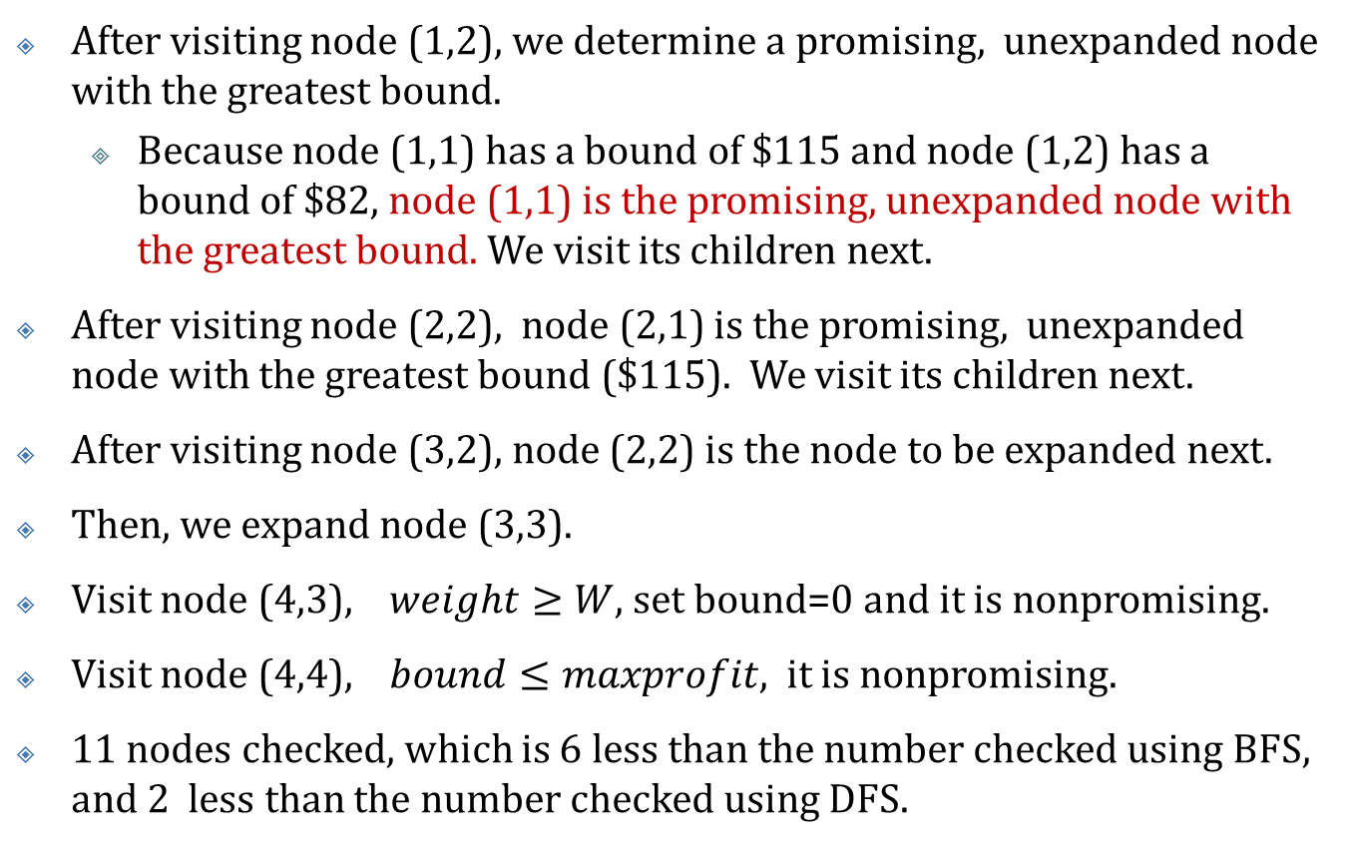
0-1 Knapsack Problem
After visiting node (1,2), we determine a promising, unexpanded node with the greatest bound.
Because node (1,1) has a bound of $115 and node (1,2) has a bound of $82, node (1,1) is the promising, unexpanded node with the greatest bound. We visit its children next.
After visiting node (2,2), node (2,1) is the promising, unexpanded node with the greatest bound ($115). We visit its children next.
After visiting node (3,2), node (2,2) is the node to be expanded next.
Then, we expand node (3,3).
Visit node (4,3), $weight≥W$, set bound=0 and it is nonpromising.
Visit node (4,4), $bound≤maxprofit$, it is nonpromising.
11 nodes checked, which is 6 less than the number checked using BFS, and 2 less than the number checked using DFS.

Slide 16
Best-First Search with branch-and-bound pruning algorithm
void best_first_branch_and_bound (state_space_tree T, int& best) {
priority_queue_of_node PQ;
node u,v;
initialize(PQ); v = root of T; best= value(v); insert(PQ,v);
while(! empty(PQ)) {
remove(PQ,v);
if(bound(v) is better than best)
for (each child u of v) {
if (value(u) is better than best)
best= value(u) ;
if (bound(u) is better than best)
insert (PQ,u);
}
} }

Slide 17
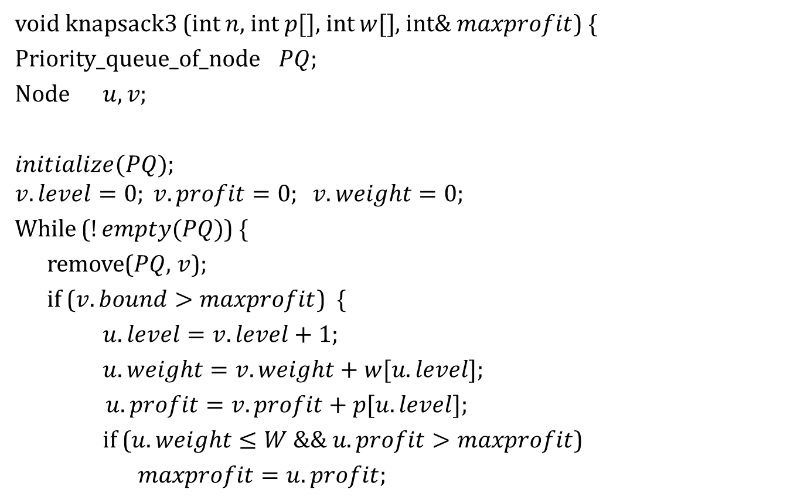
Best-First Search with Branch-and-Bound Pruning Algorithm for the 0-1 Knapsack problem
void knapsack3 (int $n$, int $p[]$, int $w[]$, int& $maxprofit$) {
Priority_queue_of_node $PQ$;
Node $u, v$;
$initialize(PQ)$;
$$v.level=0; v.profit=0; v.weight=0;$$
While ($!empty(PQ)$) {
remove($PQ$, $v$);
if ($v.bound>maxprofit$) {
$u.level=v.level+1$;
$u.weight=v.weight+w[u.level]$;
$u.profit=v.profit+p[u.level]$;
if ($u.weight≤W \&\& u.profit>maxprofit$)
$maxprofit=u.profit$;

Slide 18

$u.bound=bound\left(u\right);$
if ($u.bound>maxprofit$)
$insert(PQ, u)$;
$u.weight=v.weight$;
$u.profit=v.profit$;
$u.bound=v.bound$;
if ($u.bound>maxprofit$)
$insert\left(PQ, u\right)$;
}}}

Slide 19
The Traveling Salesperson Problem
v₁
v₂
10
4
7
v₄
7
v₃
2
v₅
Adjacent matrix representation of a graph that has an edge from every vertex to every other vertex.
Optimal tour: starts at a given node, visits each vertex exactly once, and ends up back at the starting vertex.

Slide 20
The Traveling Salesperson Problem
[1]
[1, 2]
[1, 3]
[1, 4]
[1, 5]
[1,2,3]
[1,2,4]
[1,2,5]
[1,2,3,4]=
[1,2,3,4,5,1]
[1,2,3,5]=
[1,2,3,5,4,1]
A state space tree for an instance of the Traveling Salesperson Problem

Slide 21
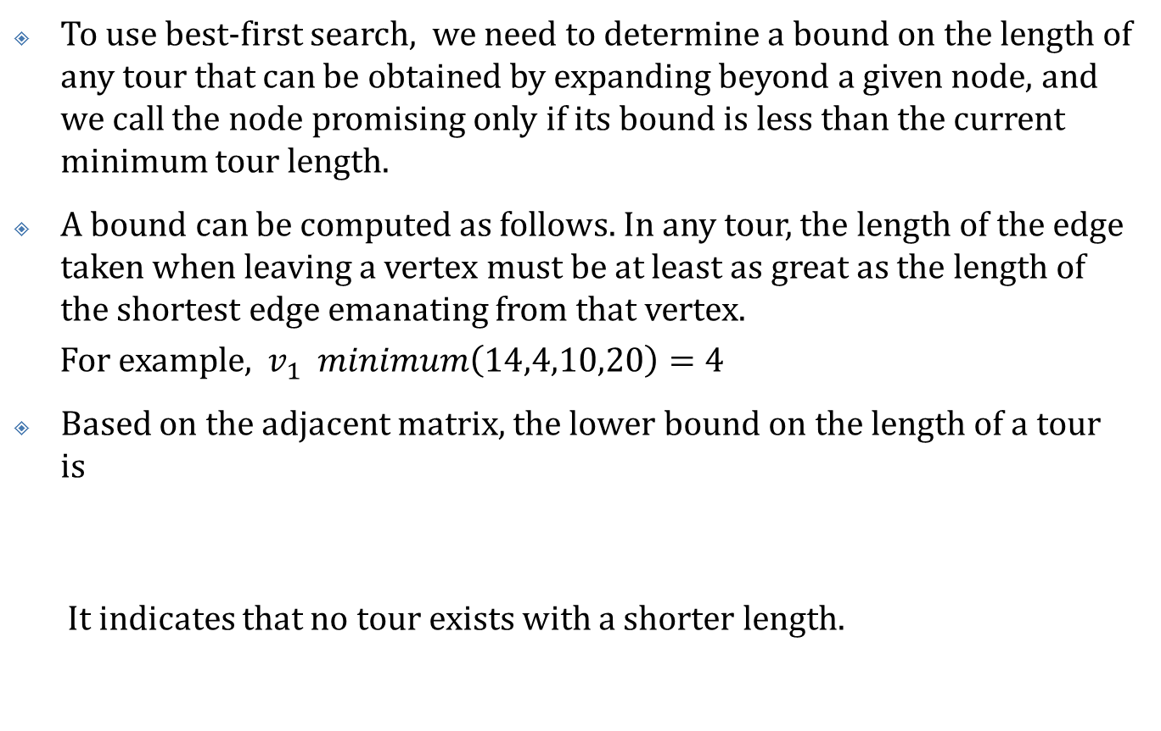
The Traveling Salesperson Problem
To use best-first search, we need to determine a bound on the length of any tour that can be obtained by expanding beyond a given node, and we call the node promising only if its bound is less than the current minimum tour length.
A bound can be computed as follows. In any tour, the length of the edge taken when leaving a vertex must be at least as great as the length of the shortest edge emanating from that vertex.
For example, $v_{1} minimum\left(14,4,10,20\right)=4$
Based on the adjacent matrix, the lower bound on the length of a tour is
It indicates that no tour exists with a shorter length.

Slide 22
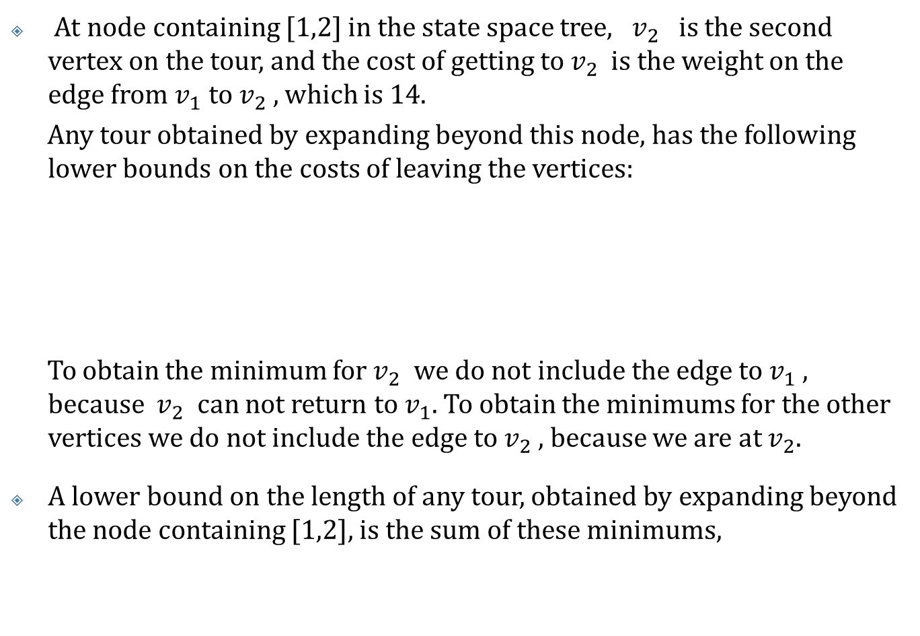
The Traveling Salesperson Problem
At node containing [1,2] in the state space tree, $v_{2}$ is the second vertex on the tour, and the cost of getting to $v_{2}$ is the weight on the edge from $v_{1}$ to $v_{2}$ , which is 14.
Any tour obtained by expanding beyond this node, has the following lower bounds on the costs of leaving the vertices:
To obtain the minimum for $v_{2}$ we do not include the edge to $v_{1}$ , because $v_{2}$ can not return to $v_{1}$. To obtain the minimums for the other vertices we do not include the edge to $v_{2}$ , because we are at $v_{2}$.
A lower bound on the length of any tour, obtained by expanding beyond the node containing [1,2], is the sum of these minimums,

Slide 23
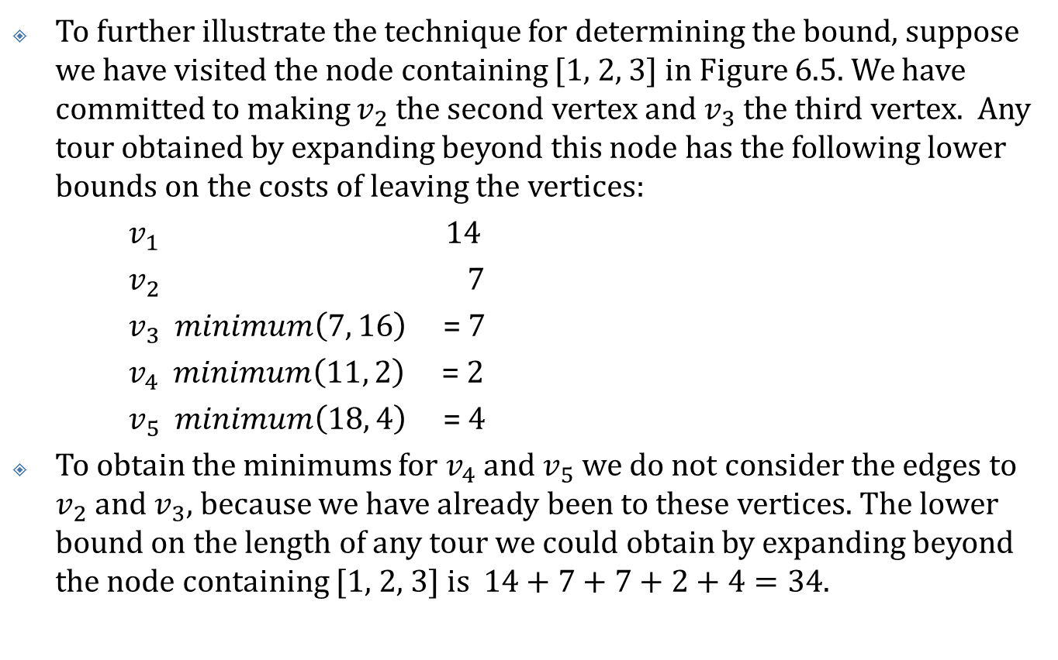
The Traveling Salesperson Problem
To further illustrate the technique for determining the bound, suppose we have visited the node containing [1, 2, 3] in Figure 6.5. We have committed to making $v_{2}$ the second vertex and $v_{3}$ the third vertex. Any tour obtained by expanding beyond this node has the following lower bounds on the costs of leaving the vertices:
$v_{1}$ 14
$v_{2}$ 7
$v_{3}$ $minimum\left(7, 16\right)$ = 7
$v_{4}$ $minimum\left(11, 2\right)$ = 2
$v_{5}$ $minimum\left(18, 4\right)$ = 4
To obtain the minimums for $v_{4}$ and $v_{5}$ we do not consider the edges to $v_{2}$ and $v_{3}$, because we have already been to these vertices. The lower bound on the length of any tour we could obtain by expanding beyond the node containing [1, 2, 3] is $14+7+7+2+4=34.$

Slide 24
[1]
Bound=21
[1, 2]
Bound=31
[1, 3]
Bound=22
[1, 4]
Bound=30
[1, 5]
Bound=42
[1, 3, 2]
Bound=22
[1, 3, 4]
Bound=27
[1, 3, 5]
Bound=39
[1, 4, 2]
Bound=45
[1, 4, 3]
Bound=38
[1, 4, 5]
Bound=30
[1, 3, 2, 4]
Bound=37
[1, 3, 2, 5]
Bound=31
[1, 3, 4, 2]
Bound=43
[1, 3, 4, 5]
Bound=34
[1, 4, 5, 2]
Bound=30
[1, 4, 5, 3]
Bound=48
The pruned state space tree produced using best-first search with branch-and-bound pruning.

Slide 25
The Traveling Salesperson Problem
Visit node containing [1] (the root).
Compute bound to be 21. {This is a lower bound on the length of a tour}
Set minlength to ∞.
Visit node containing [1, 2].
Compute bound to be 31.
…
Determine promising, unexpanded node with the smallest bound.
That node is the node containing [1, 3]. We visit its children next.
….
Determine promising, unexpanded node with the smallest bound.
That node is the node containing [1, 3, 2]. We visit its children next.
…
Visit node containing [1,3,2,4].
Because this node is a leaf, compute tour length to be 37.
Because its length 37 is less than ∞, the value of minlength, set minlength to 37.
The nodes containing [1, 5] and [1, 3, 5] become nonpromising because their bounds 42 and 39 are greater than or equal to 37, the new value of minlength .

