Slide 1
FAULT TOLERANT SYSTEMS http://www.ecs.umass.edu/ece/koren/FaultTolerantSystems
Part 1 - Introduction
Chapter 1 - Preliminaries

Slide 2
Prerequisites
Basic courses in
  Digital Design
  Hardware Organization/Computer Architecture
  Probability

Slide 3
References
Textbook
  I. Koren and C. M. Krishna, Fault Tolerant Systems, Morgan-Kaufman 2007.
Further Readings
  M.L. Shooman, Reliability of Computer Systems and Networks: Fault Tolerance, Analysis, and Design, Wiley, 2002, ISBN 0-471-29342-3.
  D.P. Siewiorek and R.S. Swarz, Reliable Computer Systems: Design and Evaluation, A.K. Peters, 1998.
  D.K. Pradhan (ed.), Fault Tolerant Computer System Design, Prentice-Hall, 1996.
  B.W. Johnson, Design and Analysis of Fault-Tolerant Digital Systems, Addison-Wesley, 1989.

Slide 4
Course Outline
Introduction - Basic concepts
Dependability measures
Redundancy techniques
Hardware fault tolerance
Error detecting and correcting codes
Redundant disks (RAID)
Fault-tolerant networks
Software fault tolerance
Checkpointing
Case studies of fault-tolerant systems
Defect tolerance in VLSI circuits
Fault detection in cryptographic systems
Simulation techniques

Slide 5
Fault Tolerance - Basic definition
Fault-tolerant systems - ideally systems capable of executing their tasks correctly regardless of either hardware failures or software errors
In practice - we can never guarantee the flawless execution of tasks under any circumstances
Limit ourselves to types of failures and errors which are more likely to occur

Slide 6
Need For Fault Tolerance
1.
2.
3.

Slide 7
Need For Fault Tolerance - Critical Applications
Aircrafts, nuclear reactors, chemical plants, medical equipment
A malfunction of a computer in such applications can lead to catastrophe
Their probability of failure must be extremely low, possibly one in a billion per hour of operation
Also included - financial applications

Slide 8
Need for Fault Tolerance - Harsh Environments
A computing system operating in a harsh environment where it is subjected to
  electromagnetic disturbances
  particle hits and alike
Very large number of failures means: the system will not produce useful results unless some fault-tolerance is incorporated

Slide 9
Need For Fault Tolerance - Highly Complex Systems
Complex systems consist of millions of devices
Every physical device has a certain probability of failure
A very large number of devices implies that the likelihood of failures is high
The system will experience faults at such a frequency which renders it useless

Slide 10
Hardware Faults Classification
Three types of faults:
Transient Faults - disappear after a relatively short time
  Example - a memory cell whose contents are changed spuriously due to some electromagnetic interference
  Overwriting the memory cell with the right content will make the fault go away
Permanent Faults - never go away, component has to be repaired or replaced
Intermittent Faults - cycle between active and benign states
  Example - a loose connection
Another classification: Benign vs malicious

Slide 11
Faults Vs. Errors
Fault - either a hardware defect or a software/programming mistake
Error - a manifestation of a fault
Example: An adder circuit with one output lines stuck at 1
This is a fault, but not (yet) an error
Becomes an error when the adder is used and the result on that line should be 0

Slide 12
Propagation of Faults and Errors
Faults and errors can spread throughout the system
  If a chip shorts out power to ground, it may cause nearby chips to fail as well
Errors can spread - output of one unit is frequently used as input by other units
  Adder example: erroneous result of faulty adder can be fed into further calculations, thus propagating the error

Slide 13
Redundancy
Redundancy is at the heart of fault tolerance
Redundancy - incorporation of extra components in the design of a system so that its function is not impaired in the event of a failure
We will study four forms of redundancy:
  1.
  2.
  3.
  4.

Slide 14
Hardware Redundancy
Extra hardware is added to override the effects of a failed component
Static Hardware Redundancy - for immediate masking of a failure
  Example: Use three processors and vote on the result.The wrong output of a single faulty processor is masked
Dynamic Hardware Redundancy - Spare components are activated upon the failure of a currently active component
Hybrid Hardware Redundancy - A combination of static and dynamic redundancy techniques

Slide 15
Software Redundancy – Example
Multiple teams of programmers
Write different versions of software for the same function
The hope is that such diversity will ensure that not all the copies will fail on the same set of input data

Slide 16
Information Redundancy
Add check bits to original data bits so that an error in the data bits can be detected and even corrected
Error detecting and correcting codes have been developed and are being used
Information redundancy often requires hardware redundancy to process the additional check bits

Slide 17
Time Redundancy
Provide additional time during which a failed execution can be repeated
Most failures are transient - they go away after some time
If enough slack time is available, failed unit can recover and redo affected computation

Slide 18
Fault Tolerance Measures
It is important to have proper yardsticks - measures - by which to measure the effect of fault tolerance
A measure is a mathematical abstraction, which expresses only some subset of the object's nature
Measures?

Slide 19
Traditional Measures - Reliability
Assumption: The system can be in one of two states: ‘’up” or ‘’down”
Examples:
  Lightbulb - good or burned out
  Wire - connected or broken
Reliability, R(t): Probability that the system is up during the whole interval [0,t], given it was up at time 0
Related measure - Mean Time To Failure, MTTF :
  Average time the system remains up before it goes down and has to be repaired or replaced

Slide 20
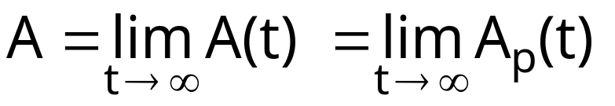
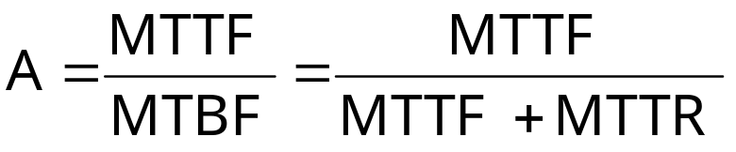
Traditional Measures - Availability
Availability, A(t) : Fraction of time system is up during the interval [0,t]
Point Availability, Ap(t) :
  Probability that the system is up at time t
Long-Term Availability, A:
Availability is used in systems with recovery/repair
Related measures:
  Mean Time To Repair, MTTR
  Mean Time Between Failures, MTBF = MTTF + MTTR

Slide 21
Need For More Measures
The assumption of the system being in state ‘’up” or ‘’down” is very limiting
Example: A processor with one of its several hundreds of millions of gates stuck at logic value 0 and the rest is functional - may affect the output of the processor once in every 25,000 hours of use
The processor is not fault-free, but cannot be defined as being ‘’down”
More detailed measures than the general reliability and availability are needed

Slide 22
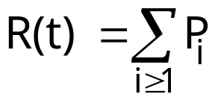
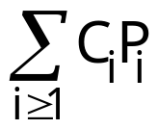
Computational Capacity Measures
Example: N processors in a gracefully degrading system
System is useful as long as at least one processor remains operational
Let Pi = Prob {i processors are operational}
Let c = computational capacity of a processor (e.g., number of fixed-size tasks it can execute)
Computational capacity of i processors: Ci = i • c
Average computational capacity of system:

Slide 23
Another Measure - Performability
Another approach - consider everything from the perspective of the application
Application is used to define ‘’accomplishment levels” L1, L2,...,Ln
Each represents a level of quality of service delivered by the application
Example: Li indicates i system crashes during the mission time period T
Performability is a vector (P(L1),P(L2),...,P(Ln)) where P(Li) is the probability that the computer functions well enough to permit the application to reach up to accomplishment level Li

Slide 24
Network Connectivity Measures
Focus on the network that connects the processors
Classical Node and Line Connectivity - the minimum number of nodes and lines, respectively, that have to fail before the network becomes disconnected
Measure indicates how vulnerable the network is to disconnection
A network disconnected by the failure of just one (critically-positioned) node is potentially more vulnerable than another which requires several nodes to fail before it becomes disconnected

Slide 25
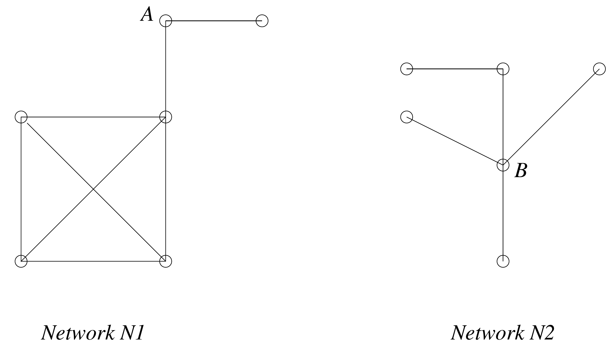
Connectivity - Examples

Slide 26
Network Resilience Measures
Classical connectivity distinguishes between only two network states: connected and disconnected
It says nothing about how the network degrades as nodes fail before becoming disconnected
Two possible resilience measures:
  Average node-pair distance
  Network diameter - maximum node-pair distance
Both calculated given probability of node and/or link failure

