Slide 1
FAULT TOLERANT SYSTEMS http://www.ecs.umass.edu/ece/koren/FaultTolerantSystems
Part 2 – Canonical Structures
Chapter 2 – Hardware Fault Tolerance

Slide 2
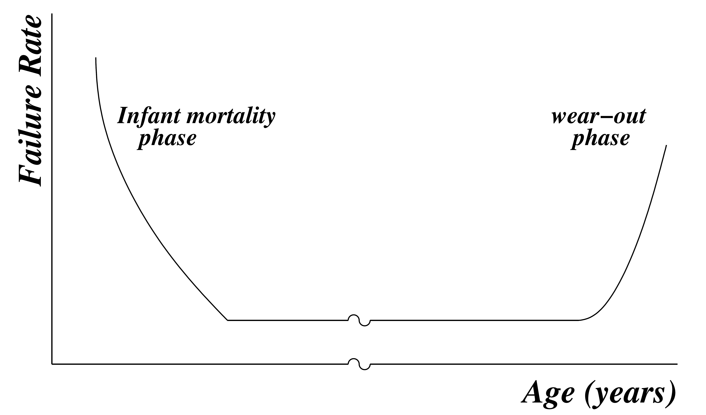
Failure Rate
Rate at which a component suffers faults
Depends on age, ambient temperature, voltage or physical shocks that it suffers, and technology
Dependence on age is usually captured by the bathtub curve:

Slide 3
Bathtub Curve
Young component – high failure rate
  Good chance that some defective units slipped through manufacturing quality control and were released
Later - bad units weeded out – remaining units have a fairly constant failure rate
As component becomes very old, aging effects cause the failure rate to rise again

Slide 4
Empirical Formula for λ - Failure Rate
λ = πL πQ (C1 πT πV + C2 πE)
  πL: Learning factor, (how mature the technology is)
  πQ: Manufacturing process Quality factor (0.25 to 20.00)
  πT: Temperature factor, (from 0.1 to 1000), proportional to exp(-Ea/kT) where Ea is the activation energy in electron-volts associated with the technology, k is the Boltzmann constant and T is the temperature in Kelvin
  πV: Voltage stress factor for CMOS devices (from 1 to 10 depending on the supply voltage and the temperature); does not apply to other technologies (set to 1)
  πE: Environment shock factor: from about 0.4 (air-conditioned environment), to 13.0 (harsh environment - e.g., space, cars)
  C1, C2: Complexity factors; functions of number of gates on the chip and number of pins in the package
  Further details: MIL-HDBK-217E handbook

Slide 5
Reliability and MTTF of a Single Component (Module)
Module operational at time t=0
Remains operational until it is hit by a failure
All failures are permanent
T - lifetime of module - time until it fails
T is a random variable
f(t) - density function of T
F(t) - cumulative distribution function of T

Slide 6
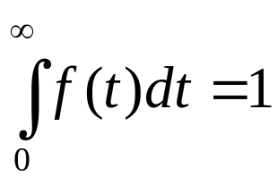
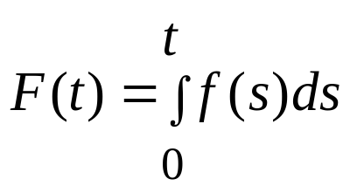
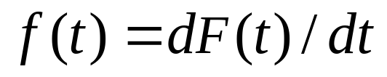
Probabilistic Interpretation of f(t) and F(t)
F(t) - probability that the component will fail at or before time t
  F(t) = Prob {T ≤ t}
f(t) – not a probability, but the momentary rate of probability of failure at time t
  f(t)dt = Prob {t ≤ T ≤ t+dt}
Like any density function (defined for t ≥ 0)
f(t) ≥ 0 (for all t ≥ 0) and
The functions F and f are related through
  and

Slide 7
Reliability and Failure (Hazard) Rate
The reliability of a single module - R(t)
  R(t) = Prob {T>t} = 1- F(t)
The conditional probability that the module will fail at time t, given it has not failed before, is
Prob {t ≤ T ≤ t+dt | T ≥ t} = Prob {t ≤T≤ t+dt} / Prob{T ≥ t} = f(t)dt / (1-F(t))
The failure rate (or hazard rate) of a component at time t, λ(t), is defined as
  λ(t) = f(t)/(1- F(t))
Since dR(t)/dt = - f(t), we get λ(t) = -1/R(t) • dR(t)/dt

Slide 8
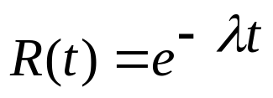
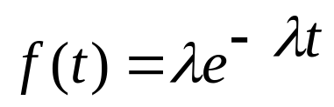
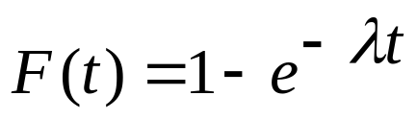
Constant Failure Rate
If the module has a failure rate which is constant over time -
  λ(t) = λ
  dR(t) / dt = - λ R(t) ; R(0)=1
The solution of this differential equation is
A module has a constant failure rate if and only if T, the lifetime of the module, has an exponential distribution

Slide 9
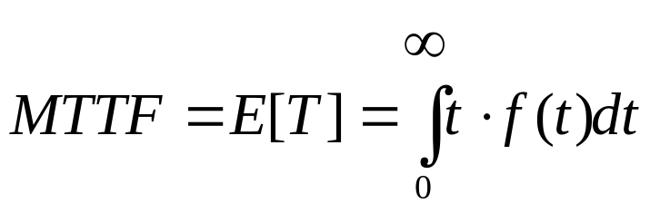

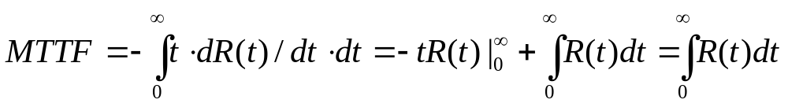
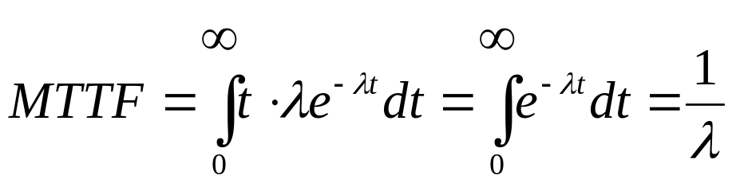
Mean Time to Failure (MTTF)
MTTF - expected value of the lifetime T
Two ways of calculating MTTF
First way:
Second way:
If the failure rate is a constant λ

Slide 10
Weibull Distribution - Introduction
Most calculations of reliability assume that a module has a constant failure rate λ (or equivalently - an exponential distribution for the module lifetime T)
There are cases in which this simplifying assumption is inappropriate
Example - during the ‘’infant mortality” and ‘’wear-out” phases of the bathtub curve
Weibull distribution for the lifetime T can be used instead

Slide 11
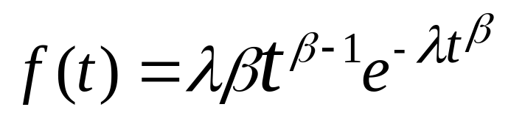
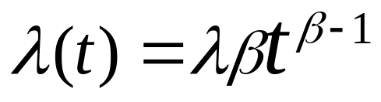
Weibull distribution - Equation
The Weibull distribution has two parameters, λ and β
The density function of the component lifetime T:
The failure rate for the Weibull distribution is
λ(t) is decreasing with time for β<1, increasing with time for β>1, constant for β=1, appropriate for infant mortality, wearout and middle phases, respectively

Slide 12
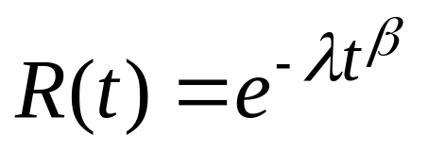
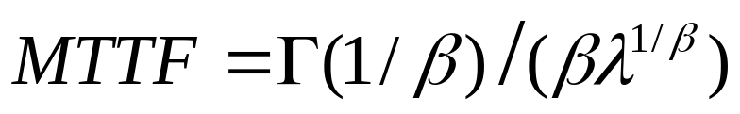
Reliability and MTTF for Weibull Distribution
Reliability for Weibull distribution is
MTTF for Weibull distribution is
( Γ(x) is the Gamma function )
The special case β = 1 is the exponential distribution with a constant failure rate λ

Slide 13
Canonical Structures
A canonical structure is constructed out of N individual modules
The basic canonical structures are
  A series system
  A parallel system
  A mixed system
We will assume statistical independence between failures in the individual modules

Slide 14

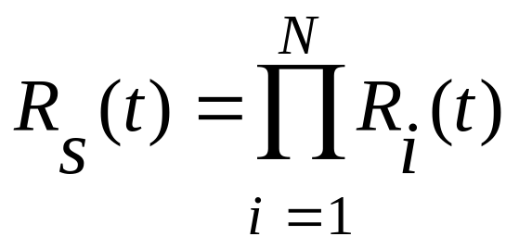
Reliability of a Series System
A series system - set of modules so that the failure of any one module causes the entire system to fail
Reliability of a series system - Rs(t) - product of reliabilities of its N modules
Ri(t) is the reliability of module i

Slide 15
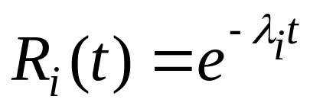
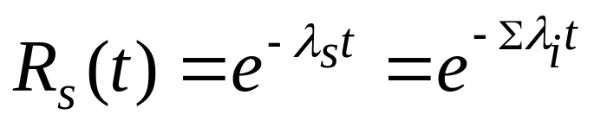
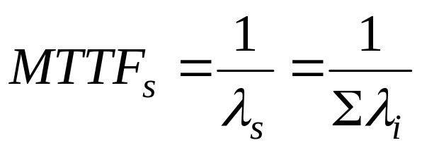
Series System – Modules Have Constant Failure Rates
Every module i has a constant failure rate λi
λs =Σλi is the constant failure rate of the series system
Mean Time To Failure of a series system -

Slide 16

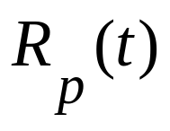
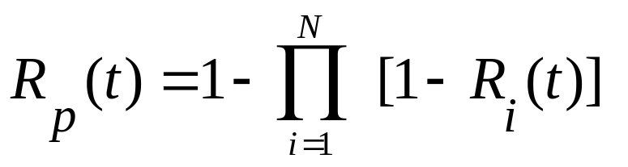
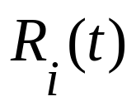
Reliability of a Parallel System
A Parallel System - a set of modules connected so that all the modules must fail before the system fails
Reliability of a parallel system -
is the reliability of module i

Slide 17
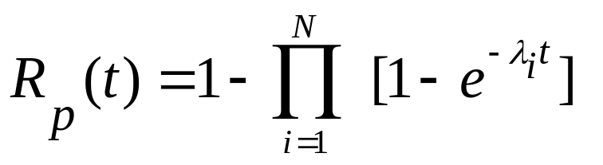
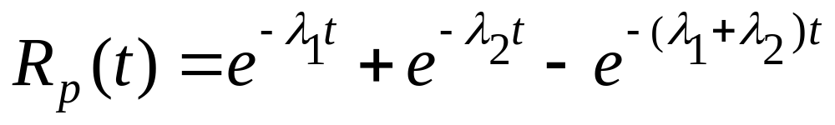
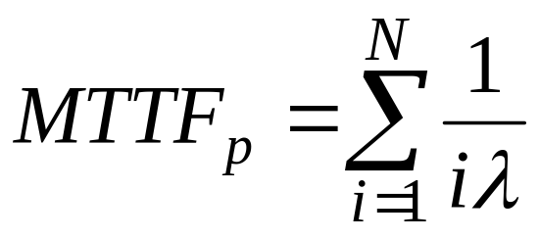
Parallel System – Modules have Constant Failure Rates
Module i has a constant failure rate, λi
Example - a parallel system with two modules
MTTF of a parallel system with the same λ

Slide 18
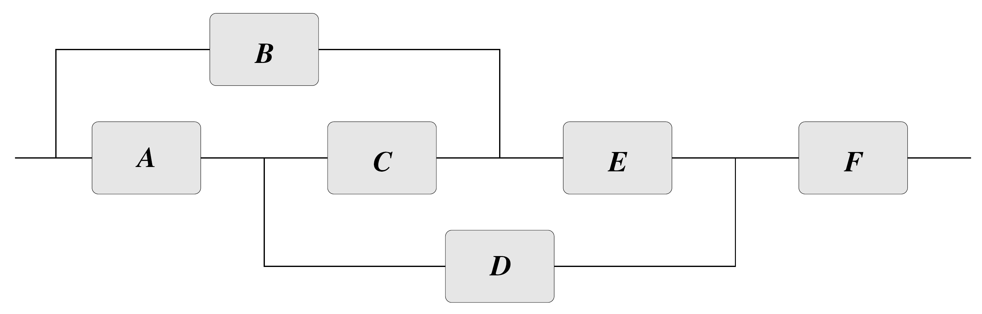
Non Series/Parallel Systems
Each path represents a configuration allowing the system to operate successfully, e.g., ADF
The reliability can be calculated by expanding about a single module i :
Rsystem=Ri Prob{System works | i is fault-free} +(1-Ri) Prob{System works | i is faulty}
Draw two new diagrams: in (a) module i is operational; in (b) module i is faulty
Module i is selected so that the two new diagrams are closer to simple series/parallel structures

Slide 19
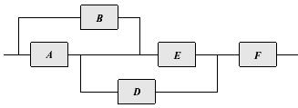

Expanding about C
(a)
(b)
The process of expanding can be repeated until the resulting diagrams are of the series/parallel type
Figure (a) needs further expansion about E
Figure (a) should not be viewed as a parallel connection of A and B, connected serially to D and E in parallel. Such a diagram will have the path BCDF which is not a valid path

Slide 20
Expanding about C and E
(a)
(b)
Rsystem=RC Prob {System works | C is operational} +(1-RC) RF [1-(1-RA RD)(1-RB RE)]
Expanding about E yields
Prob {System works | C is operational}= RE RF [1-(1-RA)(1-RB)] +(1-RE)RA RD RF
Substituting results in
Rsystem=RC [RE RF(RA+RB-RA RB)+(1-RE) RA RD RF] +(1-RC) [RF(RA RD+RB RE-RA RD RB RE)]
Example: RA=RB=RC=RD=RE=RF=R
Rsystem=R (R -3R +R+2)
3
3
2

Slide 21
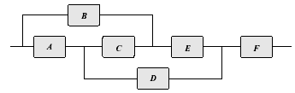
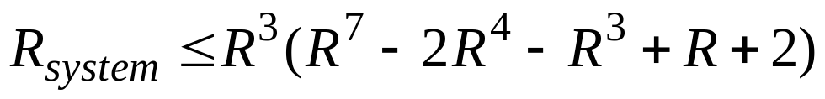


Upper Bound on Reliability
If structure is too complicated - derive upper and lower bounds on Rsystem
An upper bound - Rsystem ≤ 1 - ∏ (1-Rpath_i)
  Rpath_i - reliability of modules in series along path i
  Assuming all paths are in parallel
Example - the paths are ADF, BEF and ACEF
Rsystem ≤ 1 -(1-RA RD RF)(1-RB RE RF)(1-RA RC RE RF)
If RA=RB=RC=RD=RE=RF=R then
Upper bound can be used to derive the exact expression: perform multiplication and replace every occurrence of by

Slide 22
Lower Bound on Reliability
A lower bound is calculated based on minimal cut sets of the system diagram
A minimal cut set: a minimal list of modules such that the removal (due to a fault) of all modules will cause a working system to fail
Minimal cut sets: F, AB, AE, DE and BCD
The lower bound is
Rsystem ≥ ∏ (1-Qcut_i)
  Qcut_i - probability that the minimal cut i is faulty (i.e., all its modules are faulty)
Example - RA=RB=RC=RD=RE=RF=R

Slide 23
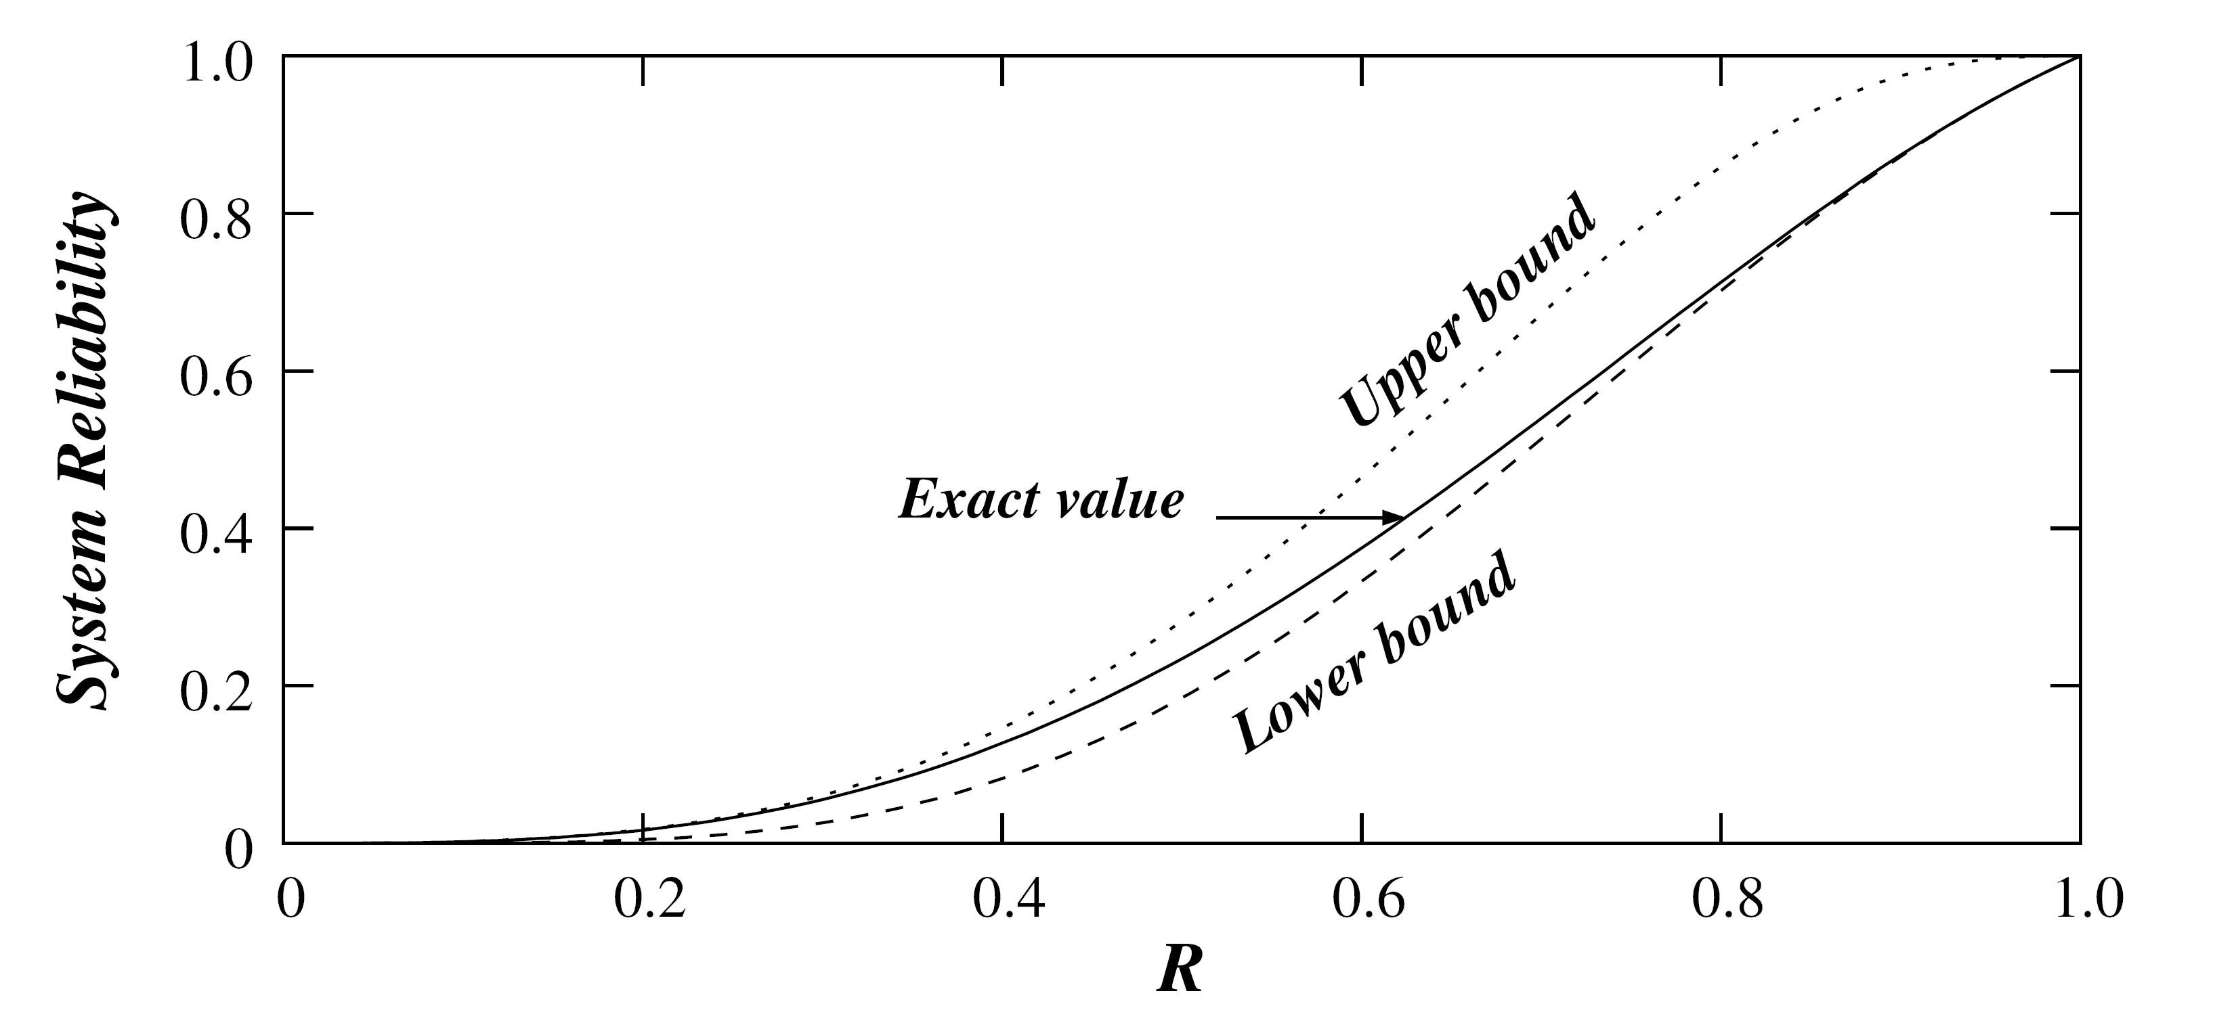
Example – Comparison of Bounds
Example - RA=RB=RC=RD=RE=RF=R
Lower bound here is a very good estimate for a high-reliability system

