Slide 1

UNIVERSITY OF MASSACHUSETTS
Dept. of Electrical & Computer Engineering
Digital Computer Arithmetic
ECE 666
Part 1
Introduction
Israel Koren
Spring 2008

Slide 2
Prerequisites and textbook
Prerequisites: courses in
  Digital Design
  Computer Organization/Architecture
Recommended book: Computer Arithmetic Algorithms, I. Koren, 2nd Edition, A.K. Peters, Natick, MA, 2002
Textbook web page: http://www.ecs.umass.edu/ece/koren/arith
Recommended Reading:
  B. Parhami, Computer Arithmetic: Algorithms and Hardware Design, Oxford University Press, 2000
  M. Ercegovac and T. Lang, Digital Arithmetic, Morgan Kaufman, 2003

Slide 3
Administrative Details
Instructor: Prof. Israel Koren
Office: KEB 309E, Tel. 545-2643
Email: koren@ecs.umass.edu
Office Hours: TuTh 2:30-3:30
Course web page: http://www.ecs.umass.edu/ece/koren/ece666/
Grading:
      Homework - No credit
      Two Mid-term exams - 25% each
      Final Exam or Project - 50%

Slide 4
Course Outline
Introduction: Number systems and basic arithmetic operations
Unconventional fixed-point number systems
Sequential algorithms for multiplication and division
Floating-point arithmetic
Algorithms for fast addition
High-speed multiplication
Fast division and division through multiplication
Efficient algorithms for evaluation of elementary functions
Logarithmic number systems
Residue number system; error correction and detection in arithmetic operations

Slide 5
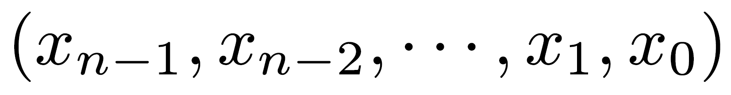
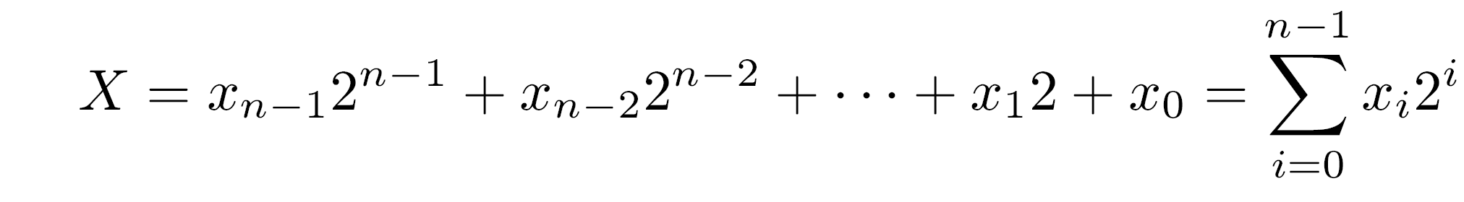
The Binary Number System
In conventional digital computers - integers represented as binary numbers of fixed length n
An ordered sequence of binary digits
Each digit x (bit) is 0 or 1
The above sequence represents the integer value X
Upper case letters represent numerical values or sequences of digits
Lower case letters, usually indexed, represent individual digits
i

Slide 6
Radix of a Number System
The weight of the digit x is the i th power of 2
2 is the radix of the binary number system
Binary numbers are radix-2 numbers - allowed digits are 0,1
Decimal numbers are radix-10 numbers - allowed digits are 0,1,2,…,9
Radix indicated in subscript as a decimal number
Example:
  (101) - decimal value 101
  (101) - decimal value 5
i
10
2

Slide 7
Range of Representations
Operands and results are stored in registers of fixed length n - finite number of distinct values that can be represented within an arithmetic unit
Xmin ; Xmax - smallest and largest representable values
[Xmin,Xmax] - range of the representable numbers
A result larger then Xmax or smaller than Xmin - incorrectly represented
The arithmetic unit should indicate that the generated result is in error - an overflow indication

Slide 8
Example - Overflow in Binary System
Unsigned integers with 5 binary digits (bits)
  Xmax = (31)10 - represented by (11111)2
  Xmin = (0)10 - represented by (00000)2
  Increasing Xmax by 1 = (32)10 =(100000)2
  5-bit representation - only the last five digits retained - yielding (00000)2 =(0)10
In general -
  A number X not in the range [Xmin,Xmax]=[0,31] is represented by X mod 32
  If X+Y exceeds Xmax - the result is S = (X+Y) mod 32
Example: X 10001 17 +Y 10010 18 1 00011 3 = 35 mod 32
  Result has to be stored in a 5-bit register - the most significant bit (with weight 2 =32) is discarded
5

Slide 9
Machine Representations of Numbers
Binary system - one example of a number system that can be used to represent numerical values in an arithmetic unit
A number system is defined by the set of values that each digit can assume and by an interpretation rule that defines the mapping between the sequences of digits and their numerical values
Types of number systems -
conventional (e.g.,binary, decimal)
unconventional (e.g., signed-digit number system)

Slide 10
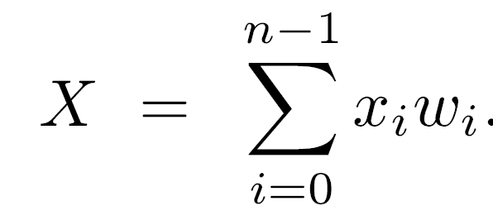
Conventional Number Systems
Properties of conventional number systems:
Nonredundant -
  Every number has a unique representation, thus
  No two sequences have the same numerical value
Weighted -
  A sequence of weights wn-1,wn-2,...,w1,w0 determines the value of the n-tuple xn-1,xn-2,...,x1,x0 by
  wi - weight assigned to xi - digit in ith position
Positional -
  The weight wi depends only on the position i of digit xi
  wi = r
i

Slide 11
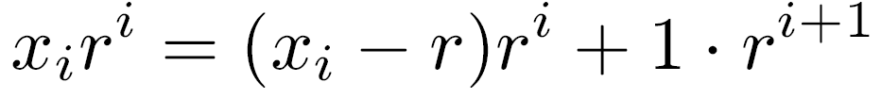
Fixed Radix Systems
r - the radix of the number system
Conventional number systems are also called fixed-radix systems
With no redundancy - 0 ≤ xi ≤ r-1
xi ≥ r introduces redundancy into the fixed-radix number system
If xi ≥ r is allowed -
two machine representations for the same value -(...,xi+1,xi,... ) and (...,xi+1+1,xi-r,... )

Slide 12
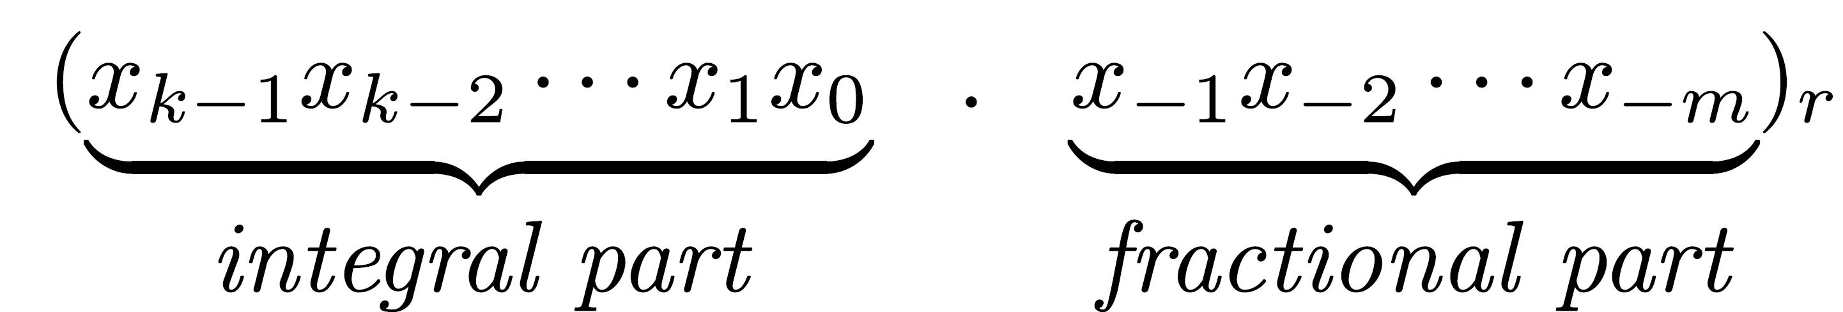
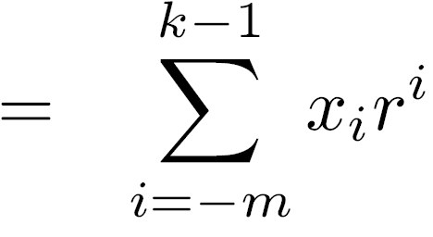
Representation of Mixed Numbers
A sequence of n digits in a register - not necessarily representing an integer
Can represent a mixed number with a fractional part and an integral part
The n digits are partitioned into two - k in the integral part and m in the fractional part (k+m=n)
The value of an n-tuple with a radix point between the k most significant digits and the m least significant digits
is

Slide 13
Fixed Point Representations
Radix point not stored in register - understood to be in a fixed position between the k most significant digits and the m least significant digits
  These are called fixed-point representations
Programmer not restricted to the predetermined position of the radix point
  Operands can be scaled - same scaling for all operands
Add and subtract operations are correct -
  aX ± aY=a(X ± Y) (a - scaling factor)
Corrections required for multiplication and division
  aX • aY=a X • Y ; aX/aY=X/Y
Commonly used positions for the radix point -
  rightmost side of the number (pure integers - m=0)
  leftmost side of the number (pure fractions - k=0)
2

Slide 14
ULP - Unit in Last Position
Given the length n of the operands, the weight r of the least significant digit indicates the position of the radix point
Unit in the last position (ulp) - the weight of the least significant digit
ulp = r
This notation simplifies the discussion
No need to distinguish between the different partitions of numbers into fractional and integral parts
Radix conversion - see textbook p. 4-6.
-m
-m

Slide 15
Representation of Negative Numbers
Fixed-point numbers in a radix r system
Two ways of representing negative numbers:
Sign and magnitude representation (or signed-magnitude representation)
Complement representation with two alternatives
  Radix complement (two's complement in the binary system)
  Diminished-radix complement (one's complement in the binary system)

Slide 16
Signed-Magnitude Representation
Sign and magnitude are represented separately
First digit is the sign digit, remaining n-1 digits represent the magnitude
Binary case - sign bit is 0 for positive, 1 for negative numbers
Non-binary case - 0 and r-1 indicate positive and negative numbers
Only 2r out of the r possible sequences are utilized
Two representations for zero - positive and negative
  Inconvenient when implementing an arithmetic unit - when testing for zero, the two different representations must be checked
n-1
n

Slide 17
Disadvantage of the Signed-Magnitude Representation
Operation may depend on the signs of the operands
Example - adding a positive number X and a negative number -Y : X+(-Y)
If Y>X, final result is -(Y-X)
Calculation -
  switch order of operands
  perform subtraction rather than addition
  attach the minus sign
A sequence of decisions must be made, costing excess control logic and execution time
This is avoided in the complement representation methods

Slide 18
Complement Representations of Negative Numbers
Two alternatives -
  Radix complement (called two's complement in the binary system)
  Diminished-radix complement (called one's complement in the binary system)
In both complement methods - positive numbers represented as in the signed-magnitude method
A negative number -Y is represented by R-Y where R is a constant
This representation satisfies -(-Y )=Y since R-(R-Y)=Y

Slide 19
Advantage of Complement Representation
No decisions made before executing addition or subtraction
Example: X-Y=X+(-Y)
-Y is represented by R-Y
Addition is performed by X+(R-Y) = R-(Y-X)
If Y>X, -(Y-X) is already represented as R-(Y-X)
No need to interchange the order of the two operands

Slide 20
Requirements for Selecting R
If X>Y - the result is X+(R-Y)=R+(X-Y) instead of X-Y - additional R must be discarded
R selected to simplify or eliminate this correction
Another requirement - calculation of the complement R-Y should be simple and done at high speed
Definitions:
Complement of a single digit xi
xi = (r-1)- xi
Complement of an n-tuple X
X = (xk-1,xk-2,...,x-m) obtained by complementing every digit in the sequence corresponding to X
-
-
-
-
-

Slide 21
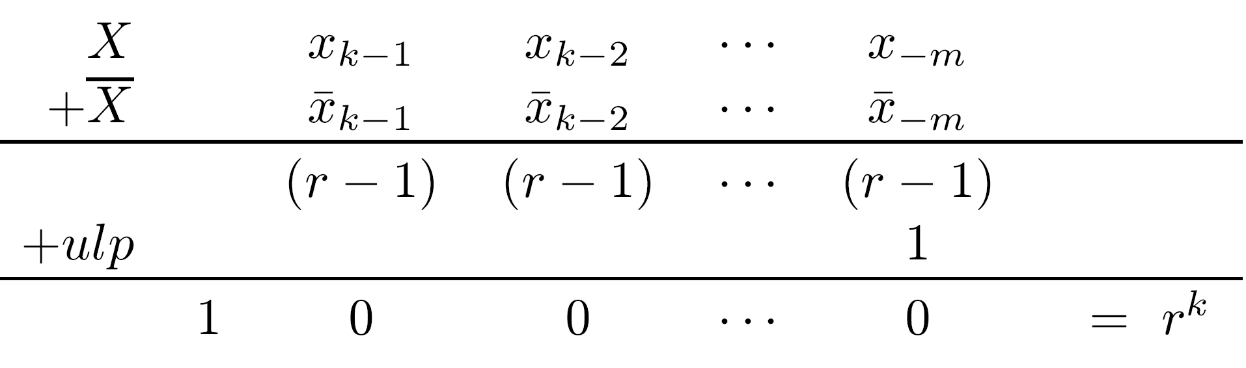
Selecting R in Radix-Complement Rep.
-
k
X+X+ulp = r
Result stored into a register of length n(=k+m)
Most significant digit discarded - final result is zero
In general, storing the result of any arithmetic operation into a fixed-length register is equivalent to taking the remainder after dividing by r
r - X = X + ulp
Selecting R = r : R - X = r - X = X + ulp
Calculation of R-X - simple and independent of k
This is radix-complement representation
R=r discarded when calculating R+(X-Y) - no correction needed when X+(R-Y) is positive (X>Y)
k
-
k
k
-
k
k

Slide 22
Example - Two’s Complement
0
r=2, k=n=4, m=0, ulp=2 =1
Radix complement (called two's complement in the binary case) of a number X = 2 - X
It can instead be calculated by X+1
0000 to 0111 represent positive numbers 010 to 710
  The two's complement of 0111 is 1000+1=1001 - it represents the value (-7)10
  The two's complement of 0000 is 1111+1=10000=0 mod 2 - single representation of zero
Each positive number has a corresponding negative number that starts with a 1
1000 representing (-8)10 has no corresponding positive number
Range of representable numbers is -8 ≤ X ≤ 7
4
-
4

Slide 23
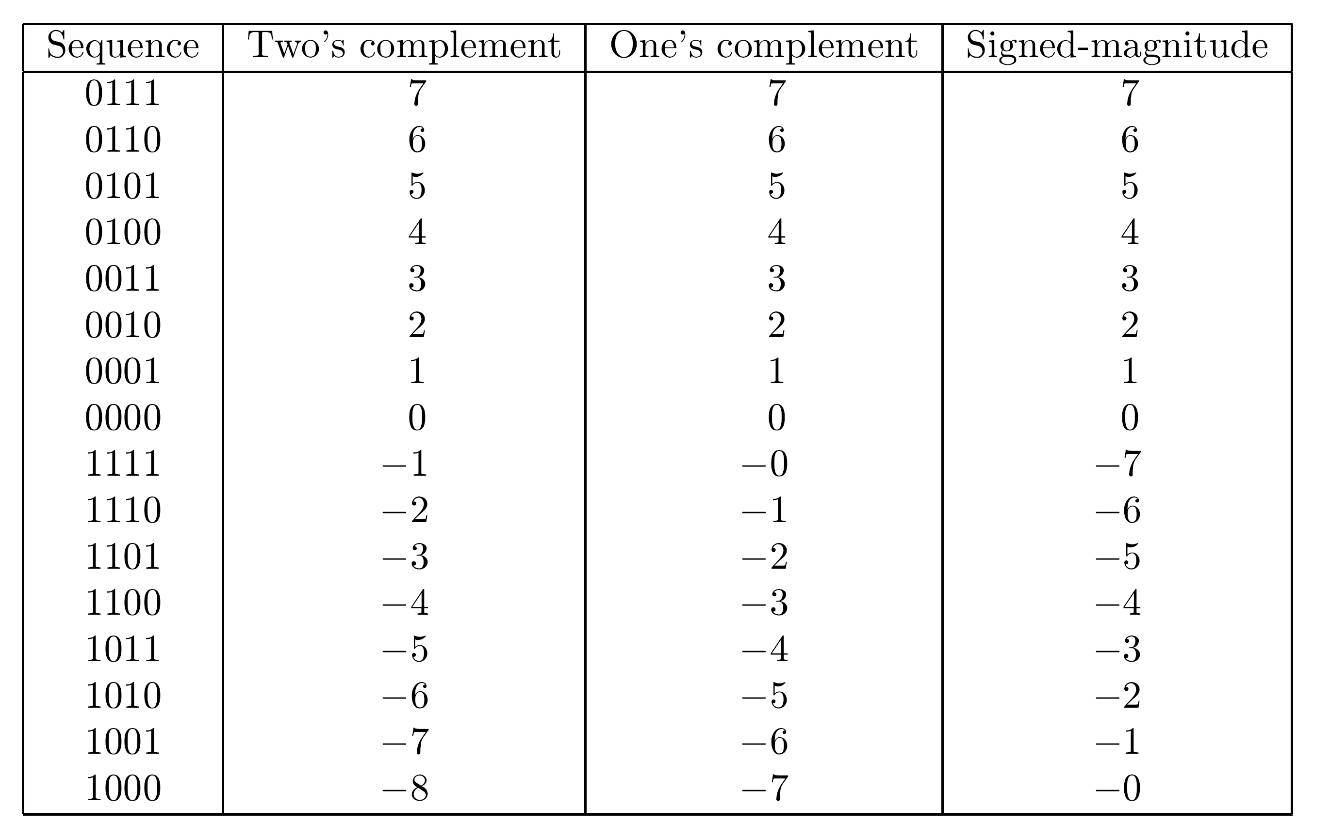
The Two’s Complement Representation

Slide 24
Example - Addition in Two’s complement
Calculating X+(-Y) with Y>X - 3+(-5) 0011 3 + 1011 -5 1110 -2
Correct result represented in the two's complement method - no need for preliminary decisions or post corrections
Calculating X+(-Y) with X>Y - 5+(-3) 0101 5 + 1101 -3 1 0010 2
Only the last four least significant digits are retained, yielding 0010

Slide 25
A 2nd Alternative for R : Diminished-Radix Complement Representation
k
Selecting R as R=r - ulp
This is the diminished-radix complement
R - X =(r - ulp ) - X = X
Derivation of the complement is simpler than the radix complement
All the digit-complements xi can be calculated in parallel - fast computation of X
A correction step is needed when R+(X-Y) is obtained and X-Y is positive
k
-
-
-

Slide 26
Example - One’s Complement in Binary System
0
r=2, k=n=4, m=0, ulp=2 =1
Diminished-radix complement (called one's complement in the binary case) of a number X = (2 - 1) - X = X
As before, the sequences 0000 to 0111 represent the positive numbers 010 to 710
The one's complement of 0111 is 1000, representing (-7)10
The one's complement of zero is 1111 - two representations of zero
Range of representable numbers is -7 ≤ X ≤ 7
4
-

Slide 27
Comparing the Three Representations in a Binary System

Slide 28
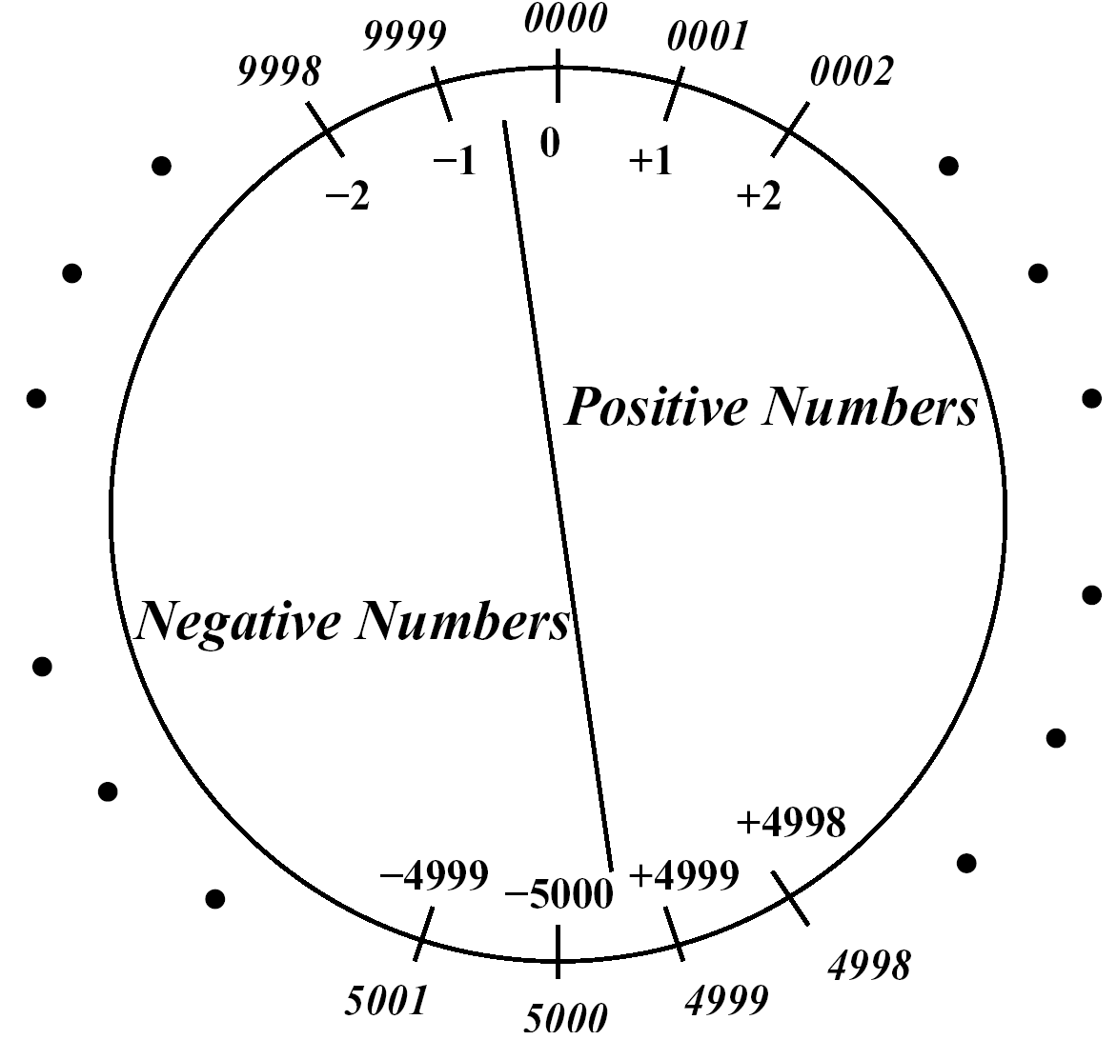
Example: Radix-Complement Decimal System
Leading digit 0,1,2,3,4 - positive
Leading digit 5,6,7,8,9 - negative
Example - n=4
0000 to 4999 - positive
5000 to 9999 - negative - (-5000) to -1
Range - -5000 ≤ X ≤ 4999
Y=1234
Representation of -Y=-1234 - radix complement R-Y with R=10
R-Y = Y + ulp
Digit complement = 9 - digit ; ulp=1
Y=8765 ; Y+1 =8766 - representation of -Y
Y+(-Y)=1234+8766=10 =0 mod 10
4
-
-
-
4
4

Slide 29
The Two's Complement Representation
From now on, the system is: r=2, k=n, ulp=1
Range of numbers in two’s complement method: -2 ≤ X ≤ 2 - ulp (ulp=2 =1)
Slightly asymmetric - one more negative number
-2 (represented by 10⋅⋅⋅0) does not have a positive equivalent
A complement operation for this number will result in an overflow indication
On the other hand, there is a unique representation for 0
n-1
n-1
0
n-1

Slide 30
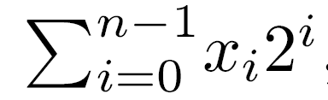
Numerical Value of a Two’s Complement Representation
Numerical value X of representation (xn-1,xn-2,...,x0) in two's complement -
If xn-1=0 - X =
If xn-1=1 - negative number - absolute value obtained by complementing the sequence (i.e., complementing each bit and adding 1) and adding a minus sign
Example - Given the 4-tuple 1010 - negative - complementing - 0101+1=0110 - value is 6 - original sequence is -6

Slide 31
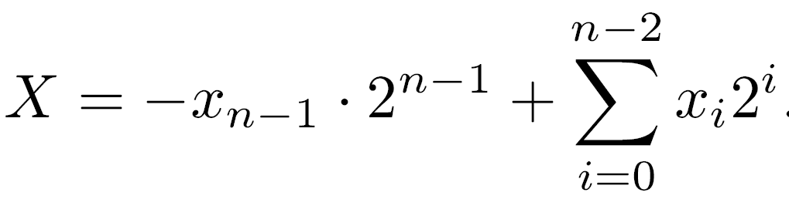
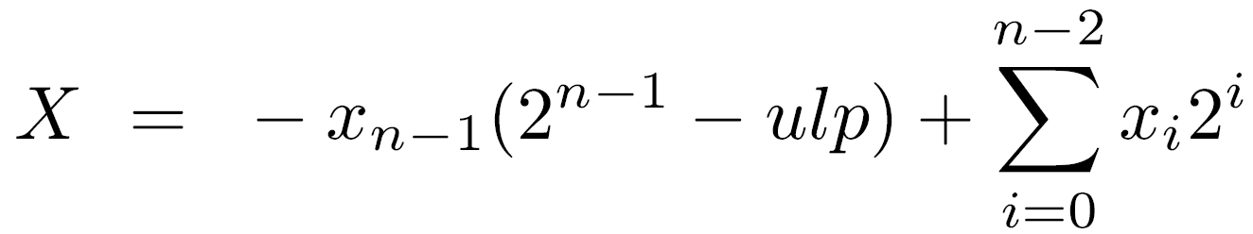
Different Calculation of Numerical Value
Example - 1010 - X=-8+2=-6
Calculating the numerical value of one’s complement
Example - 4-tuple 1001 - X=-7+1=-6

Slide 32
Addition and Subtraction
In signed-magnitude representation -
  Only magnitude bits participate in adding/subtracting - sign bits are treated separately
  Carry-out (or borrow-out) indicates overflow
Example - 0 1001 +9 0 + 0111 +7 0 1 0000 0= 16 mod 16
Final result positive (sum of two positive numbers) but wrong
In both complement representations -
  All digits, including the sign digit, participate in the add or subtract operation
  A carry-out is not necessarily an indication of an overflow

Slide 33
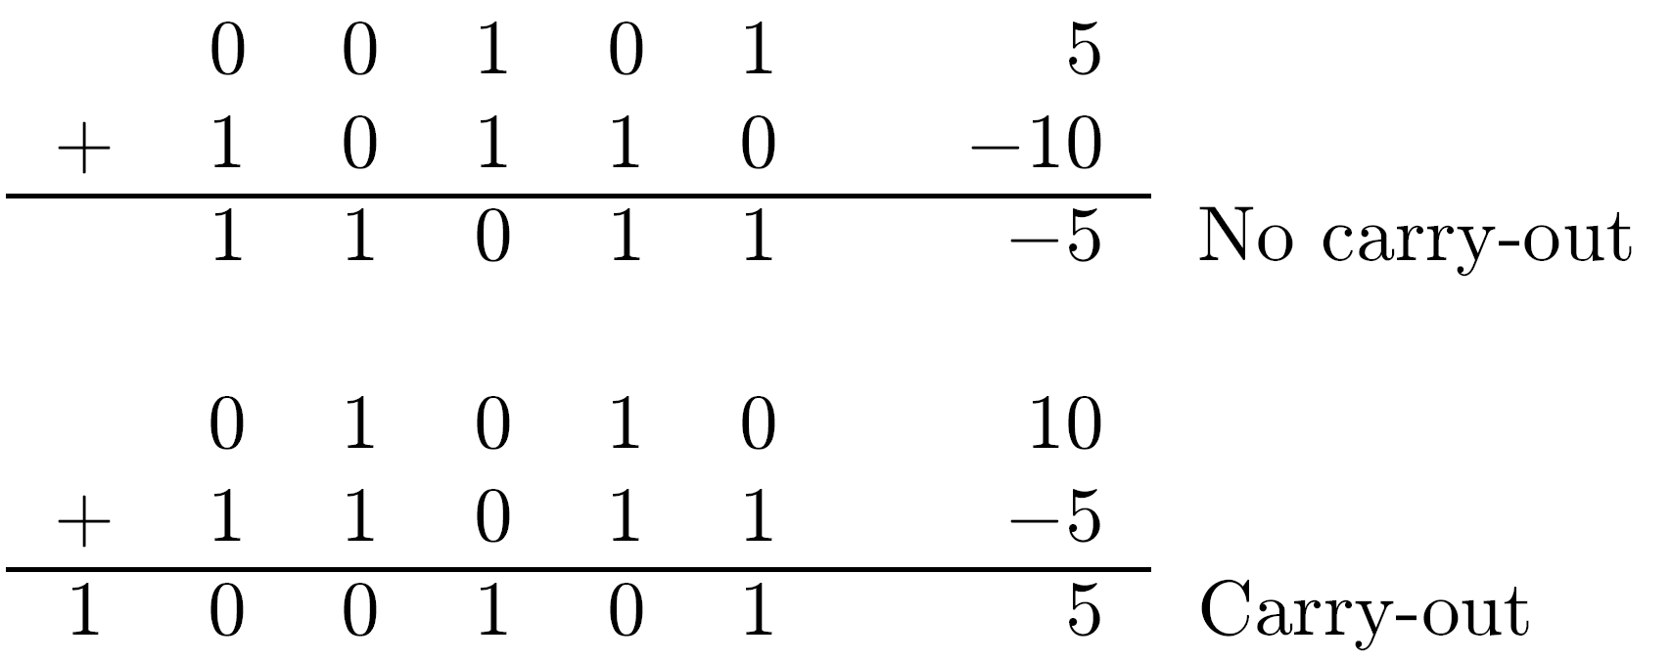
Addition/Subtraction in Complement Methods
Example - (two’s complement) 01001 9 11001 -7 1 00010 2
  Carry-out discarded - does not indicate overflow
In general, if X and Y have opposite signs - no overflow can occur regardless of whether there is a carry-out or not
Examples - (two’s complement)

Slide 34
Addition/Subtraction - Complement - Cont.
If X and Y have the same sign and result has different sign - overflow occurs
Examples - (two’s complement) 10111 -9 10111 -9 1 01110 14 = -18 mod 32
  Carry-out and overflow 01001 9 00111 7 0 10000 -16 = 16 mod 32
  No carry-out but overflow

Slide 35
Addition/Subtraction - One’s Complement
Carry-out - indicates the need for a correction step
Example - adding positive X and negative -Y
X+(2 - ulp )-Y =(2 - ulp)+(X-Y)
If X>Y - correct result is X-Y
2 represents the carry-out bit - discarded in a register of length n
Result is X-Y-ulp - corrected by adding ulp
Example - 01001 9 + 11000 -7 1 00001 Correction 1 ulp 00010 2
The generated carry-out is called end-around carry - it is an indication that a 1 should be added to the least significant position
n
n
n

Slide 36
Addition/Subtraction - One’s Complement -Cont.
If X<Y - the result X-Y=-(Y-X) is negative
Should be represented by (2 -ulp) - (Y-X)
There is no carry-out - no correction is needed
Example - 10110 -9 00111 7 11101 -2
No end-around carry correction is necessary in two's complement addition
n

Slide 37
Subtraction
In both complement systems - subtract operation, X-Y, is performed by adding the complement of Y to X
In the one's complement system - X-Y=X+Y
In the two's complement system - X-Y=X+(Y+ulp )
This still requires only a single adder operation, since ulp is added through the forced carry input to the binary adder
-
-

Slide 38
Arithmetic Shift Operations
Another way of distinguishing among the three representations of negative numbers - the infinite extensions to the right and left of a given number
Signed-magnitude method - the magnitude xn-2,..., x0 can be viewed as the infinite sequence …,0,0,{xn-2,...,x0},0,0,...
Arithmetic operation resulting in a nonzero prefix - an overflow
Radix-complement scheme - the infinite extension is …,xn-1,xn-1,{xn-1,...,x0},0,0,… (xn-1 - the sign digit)
Diminished-radix complement scheme - the sequence is …,xn-1,xn-1,{xn-1,...,x0},xn-1,xn-1,…

Slide 39
Arithmetic Shift Operations - Examples
1010., 11010.0, 111010.00 - all represent -6 in two's complement
1001., 11001.1, 111001.11 - all represent -6 in one's complement
Useful when adding operands with different numbers of bits - shorter extended to longer
Rules for arithmetic shift operations: left and right shift are equivalent to multiply and divide by 2, respectively
Two’s complement One’s complement Sh.L{00110=6}=01100=12 Sh.L{11001=-6}=10011=-12 Sh.R{00110=6}=00011=3 Sh.R{11001=-6}=11100=-3 Sh.L{11010=-6}=10100=-12 Sh.R{11010=-6}=11101=-3

