Slide 1

UNIVERSITY OF MASSACHUSETTS
Dept. of Electrical & Computer Engineering
Digital Computer Arithmetic
ECE 666
Part 4-A
Floating-Point Arithmetic
Israel Koren
Spring 2008

Slide 2
Preliminaries - Representation
Floating-point numbers - provide a dynamic range of representable real numbers without having to scale the operands
Representation - similar to scientific notation
Two parts - significand (or mantissa) M and exponent (or characteristic) E
The floating-point number F represented by the pair (M,E) has the value -
F=Mβ (β - base of exponent)
Base - common to all numbers in a given system - implied - not included in the representation of a floating point number
E

Slide 3
Preliminaries - Precision
n bits partitioned into two parts - significand M and exponent E
n bits - 2 different values
Range between smallest and largest representable values increases ⇒ distance between any two consecutive values increases
  Floating-point numbers sparser than fixed-point numbers - lower precision
Real number between two consecutive floating-point numbers is mapped onto one of the two
  A larger distance between two consecutive numbers results in a lower precision of representation
n

Slide 4
Formats
Significand M and exponent E - signed quantities
Exponent - usually a signed integer
Significand - usually one of two:
  pure fraction, or ∗ a number in the range [1, 2) (for β=2)
Representing negative values - can be different
Until 1980 - no standard - every computer system had its own representation method
  transporting programs/data between two different computers was very difficult
IEEE standard 754 is now used in most floating-point arithmetic units - details later
Few computer systems use formats differing in partitioning of the n bits, representation of each part, or value of the base β

Slide 5
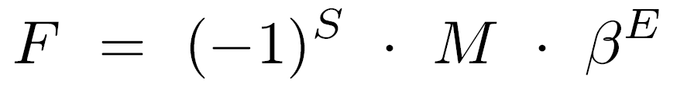
Significand Field
Common case - signed-magnitude fraction
Floating-point format - sign bit S, e bits of exponent E, m bits of unsigned fraction M (m+e+1=n)
Value of (S,E,M) : ((-1) =1 ; (-1) =-1)
Maximal value - Mmax = 1-ulp
ulp -Unit in the last position - weight of the least-significant bit of the fractional significand
Usually - not always - ulp=2
0
1
-m

Slide 6
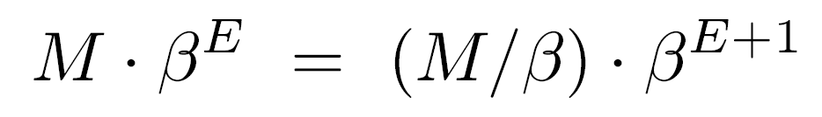
The Base β
k
β is restricted to 2 (k=1,2,…) - simplifies decreasing significand and increasing exponent (and vice versa) at the same time
Necessary when an arithmetic operation results in a significand larger than Mmax = 1-ulp - significand is reduced and exponent increased - value remains unchanged
Smallest increase in E is 1
M/β - a simple arithmetic shift right operation if β is an integral power of radix
If β=r=2 - shifting significand to the right by a single position must be compensated by adding 1 to exponent

Slide 7
Example
100
Result of an arithmetic operation - 01.10100 ⋅ 2 - significand larger than Mmax
Significand reduced by shifting it one position to the right, exponent increased by 1
New result - 0.11010 ⋅ 2
If β=2 - changing exponent by 1 is equivalent to shifting significand by k positions
Consequently - only k-position shifts are allowed
If β=4=2 01.10100 ⋅ 4 = 0.01101 ⋅ 4
101
k
2
010
011

Slide 8
Normalized Form
Floating point representation not unique - 0.11010 ⋅ 2 = 0.01101 ⋅ 2
With E=111 - significand=0.00110 - loss of a significant digit
Preferred representation - one with no leading zeros - maximum number of significant digits - normalized form
Simplifies comparing floating-point numbers - a larger exponent indicates a larger number; significands compared only for equal exponents
For β=2 - significand normalized if there is a nonzero bit in the first k positions
Example: Normalized form of 0.00000110 ⋅ 16 is 0.01100000 ⋅ 16
101
110
k
101
100

Slide 9
Range of Normalized Fractions
Range of significand is smaller than [0,1-ulp]
Smallest and largest allowable values are
Mmin = 1/β ; Mmax = 1-ulp
Range of normalized fractions does not include the value zero - a special representation is needed
A possible representation for zero - M=0 and any exponent E
E=0 is preferred - representation of zero in floating-point is identical to representation in fixed-point
  Execution of a test for zero instruction simplified

Slide 10
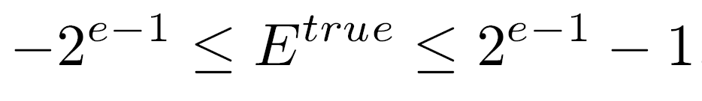
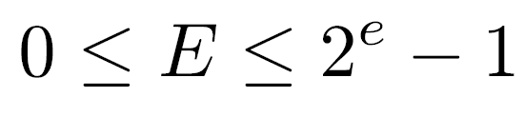
Representation of Exponents
Most common representation - biased exponent
E= E + bias (bias - constant; E - the true value of the exponent represented in two's complement)
Exponent field - e bits ; range:
Bias usually selected as magnitude of most negative exponent 2
Exponent represented in the excess 2 method
Advantages:
  When comparing two exponents (for add/subtract operations) - sign bits ignored; comparison like unsigned numbers
  Floating-points with S,E,M format are compared like binary integers in signed-magnitude representation
  Smallest representable number has the exponent 0
true
true
e-1
e-1

Slide 11
Example: Excess 64
e=7
Range of exponents in two's complement representation is -64 ≤ E ≤ 63
1000000 and 0111111 represent -64 and 63
When adding bias 64, the true values -64 and 63 are represented by 0000000 and 1111111
This is called: excess 64 representation
Excess 2 representation can be obtained by
  Inverting sign bit of two's complement representation, or
  Letting the values 0 and 1 of the sign bit indicate negative and positive numbers, respectively
true
e-1

Slide 12
Range of Normalized Floating-Point Numbers
+
-
Identical subranges for positive (F ) and negative (F ) numbers:
  (Emin, Emax - smallest,largest exponent)
An exponent larger than Emax / smaller than Emin must result in an exponent overflow/underflow indication
Significand normalized - overflow reflected in exponent
Ways of indicating overflow:
  Using a special representation of infinity as result
  stopping computation and interrupting processor
  setting result to largest representable number
Indicating underflow:
  Representation of zero is used for result and an underflow flag is raised - computation can proceed, if appropriate, without interruption

Slide 13
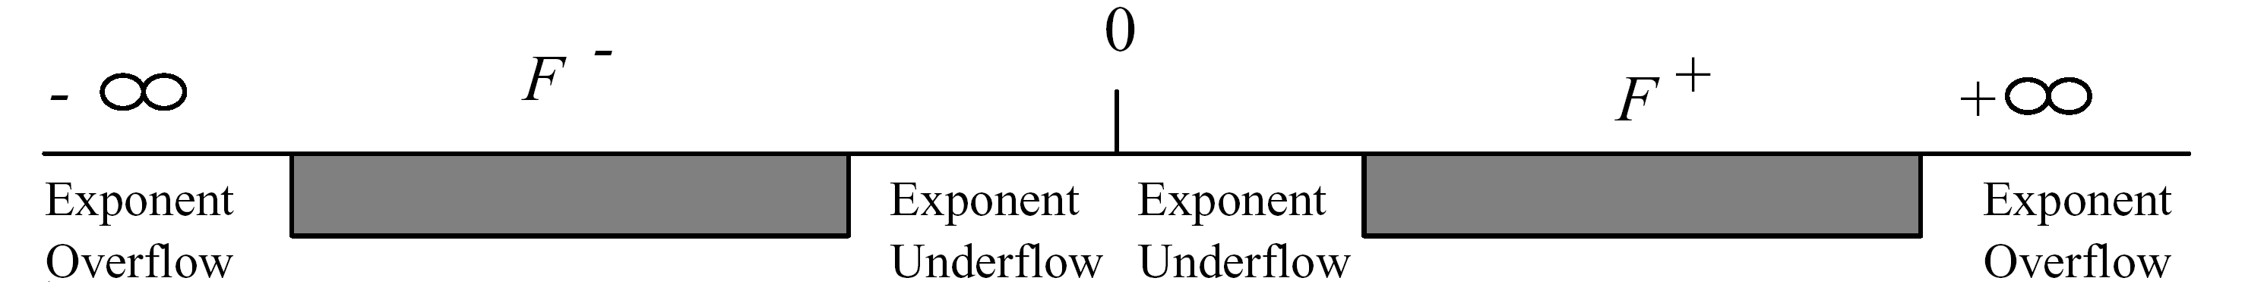
Range of Floating Point Numbers
+
-
Zero is not included in the range of either F or F

Slide 14
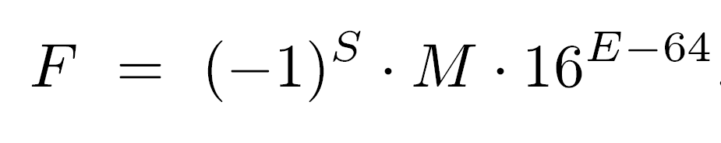
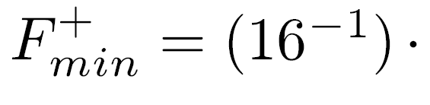
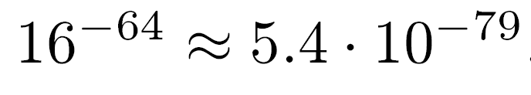
Example - IBM 370
Short floating-point format - 32 bits ; β=16
Emin, Emax represented by 0000000, 1111111 - value of -64, +63
Significand - six hexadecimal digits
Normalized significand satisfies -
Consequently,

Slide 15

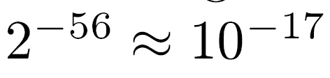
Numerical Example - IBM 370
(S,E,M)=(C1200000)16 in the short IBM format - first byte is (11000001)2
  Sign bit is S=1 - number is negative
  Exponent is 4116 and, bias is 6410=4016, E =(41-40)16=1
  M=0.216, hence
Resolution of representation - distance between two consecutive significands -
  Short format has approximately 7 significant decimal digits
For higher precision use the long floating-point format
Range roughly the same, but resolution:
  17 instead of 7 significant decimal digits
true

Slide 16
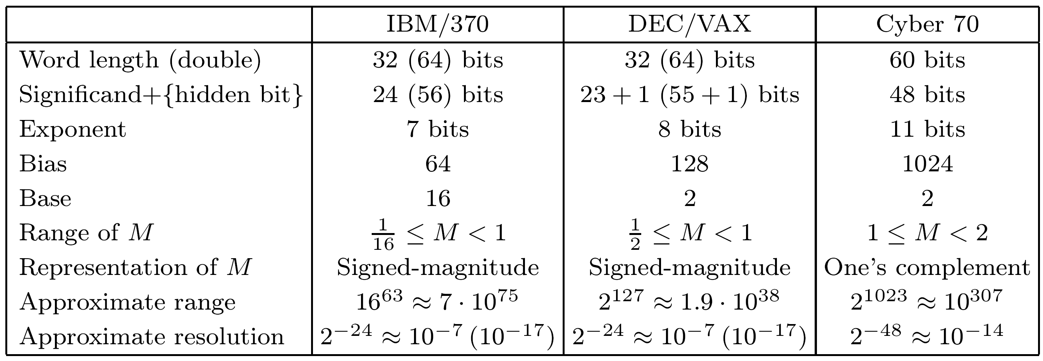
Floating-Point Formats of Three Machines

Slide 17
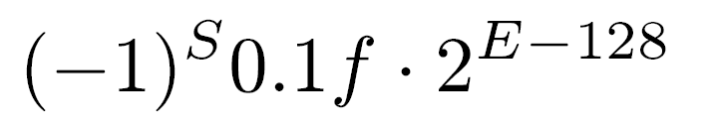
Hidden Bit
A scheme to increase the number of bits in significand to increase precision
For a base of 2 the normalized significand will always have a leading 1 - can be eliminated, allowing inclusion of an extra bit
The resolution becomes ulp=2 instead of 2
The value of a floating-point number (S,f,E) in short DEC format is
f - the pattern of 23 bits in significand field
-24
-23

Slide 18
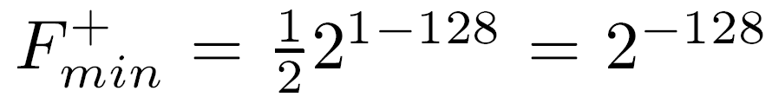
Hidden Bit - representation of zero
A zero significand field (f=0) represents the fraction 0.102=1/2
If f=0 and E=0 - with a hidden bit, this may represent the value 0.1 2 = 2
The floating-point number f=E=0 also represents 0 - a representation without a hidden bit
To avoid double meaning - E=0 reserved for representing zero - smallest exponent for nonzero numbers is E=1
Smallest positive number in the DEC/VAX system -
Largest positive number -
0-128
-129

Slide 19
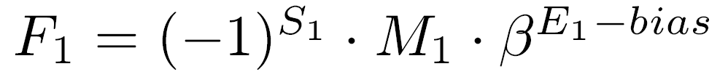
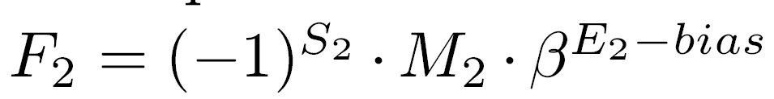

Floating-Point Operations
Execution depends on format used for operands
Assumption: Significands are normalized fractions in signed-magnitude representation ; exponents are biased
Given two numbers
;
Calculate result of a basic arithmetic operation yielding
Multiplication and division are simpler to follow than addition and subtraction

Slide 20
Floating-Point Multiplication
Significands of two operands multiplied like fixed-point numbers - exponents are added - can be done in parallel
Sign S3 positive if signs S1 and S2 are equal - negative if not
When adding two exponents E1 =E1 + bias and E2 =E2 + bias : bias must be subtracted once
For bias=2 (100...0 in binary) - subtracting bias is equivalent to adding bias - accomplished by complementing sign bit
If resulting exponent E3 is larger than Emax / smaller than Emin - overflow/underflow indication must be generated
True
true
e-1

Slide 21
Multiplication - postnormalization
Multiplying significands M1 and M2 - M3 must be normalized
1/β ≤ M1,M2 < 1 - product satisfies 1/β ≤ M1⋅M2 < 1
Significand M3 may need to be shifted one position to the left
Achieved by performing one base- β left shift operation - k base-2 shifts for β=2 - and reducing the exponent by 1
This is called the postnormalization step
After this step - exponent may be smaller than Emin - exponent underflow indication must be generated
2
k

Slide 22
Floating-Point Division
Significands divided - exponents subtracted - bias added to difference E1-E2
If resulting exponent out of range - overflow or underflow indication must be generated
Resultant significand satisfies 1/β ≤ M1/M2 < β
A single base-β shift right of significand + increase of 1 in exponent may be needed in postnormalization step - may lead to an overflow
If divisor=0 - indication of division by zero generated - quotient set to ±∞
If both divisor and dividend=0 - result undefined - in the IEEE 754 standard represented by NaN - not a number - also representing uninitialized variables and the result of 0 ⋅ ∞

Slide 23
Remainder in Floating-Point Division
Fixed-point remainder - R=X-QD (X, Q, D - dividend, quotient, divisor) - |R| ≤ |D| - generated by division algorithm (restoring or nonrestoring)
Flp division - algorithm generates quotient but not remainder - F1 REM F2 = F1-F2⋅Int(F1/F2) (Int(F1/F2) - quotient F1/F2 converted to integer)
Conversion to integer - either truncation (removing fractional part) or rounding-to-nearest
The IEEE standard uses the round-to-nearest-even mode - |F1 REM F2| ≤ |F2| /2
Int(F1/F2) as large as β - high complexity
Floating-point remainder calculated separately - only when required - for example, in argument reduction for periodic functions like sine and cosine
Emax-Emin

Slide 24
Floating-Point Remainder - Cont.
Brute-force - continue direct division algorithm for E1-E2 steps
Problem - E1-E2 can be much greater than number of steps needed to generate m bits of quotient's significand - may take an arbitrary number of clock cycles
Solution - calculate remainder in software
Alternative - Define a REM-step operation - X REM F2 - performs a limited number of divide steps (e.g., limited to number of divide steps required in a regular divide operation)
Initial X=F1, then X=remainder of previous REM-step operation
REM-step repeated until remainder ≤ F2/2

Slide 25
Addition and Subtraction
Exponents of both operands must be equal before adding or subtracting significands
When E1=E2 - β can be factored out and significands M1 and M2 can be added
Significands aligned by shifting the significand of the smaller operand |E1-E2| base-β positions to the right, increasing its exponent, until exponents are equal
E1≥E2 -
Exponent of larger number not decreased - this will result in a significand larger than 1 - a larger significand adder required
E1

Slide 26
Addition/Subtraction - postnormalization
Addition - resultant significand M (sum of two aligned significands) is in range 1/β ≤ M < 2
If M>1 - a postnormalization step - shifting significand to the right to yield M3 and increasing exponent by one - is required (an exponent overflow may occur)
Subtraction - Resultant significand M is in range 0 ≤ |M|<1 - postnormalization step - shifting significand to left and decreasing exponent - is required if M<1/β (an exponent underflow may occur)
In extreme cases, the postnormalization step may require a shift left operation over all bits in significand, yielding a zero result

Slide 27
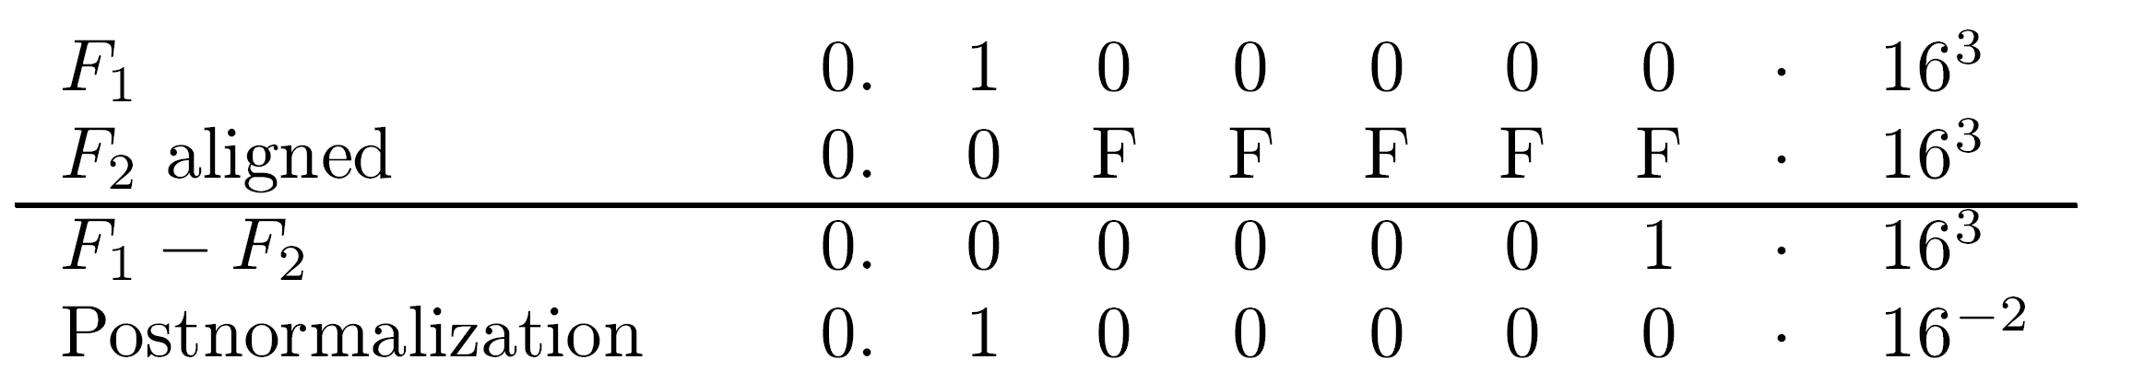
Example
3
2
F1=(0.100000)16 ⋅ 16 ; F2=(0.FFFFFF)16 ⋅ 16
Short IBM format ; calculate F1-F2
Significand of smaller number (F2) is shifted to the right - least-significant digit lost
Shift is time consuming - result is wrong

Slide 28
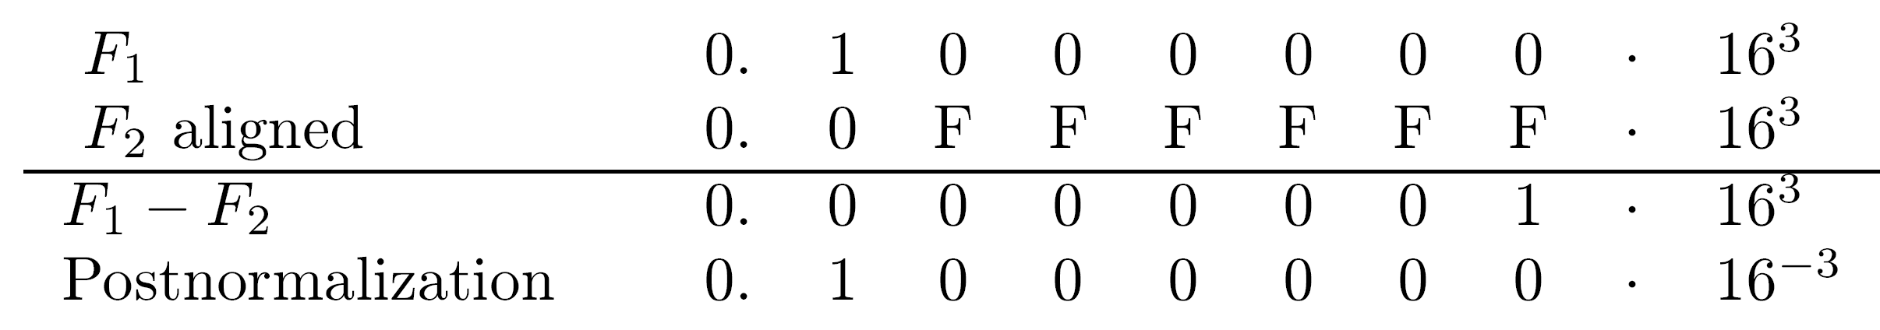
Example - Cont.
Correct result (with “unlimited" number of significand digits)
Error (also called loss of significance) is 0.1 ⋅ 16 - 0.1 ⋅ 16 = 0.F ⋅ 16
Solution to problem - guard digits - additional digits to the right of the significand to hold shifted-out digits
In example - a single (hexadecimal) guard digit is sufficient
-2
-3
-3

Slide 29
Steps in Addition/Subtraction of Floating-Point Numbers
Step 1: Calculate difference d of the two exponents - d=|E1 - E2|
Step 2: Shift significand of smaller number by d base-β positions to the right
Step 3: Add aligned significands and set exponent of result to exponent of larger operand
Step 4: Normalize resultant significand and adjust exponent if necessary
Step 5: Round resultant significand and adjust exponent if necessary

Slide 30
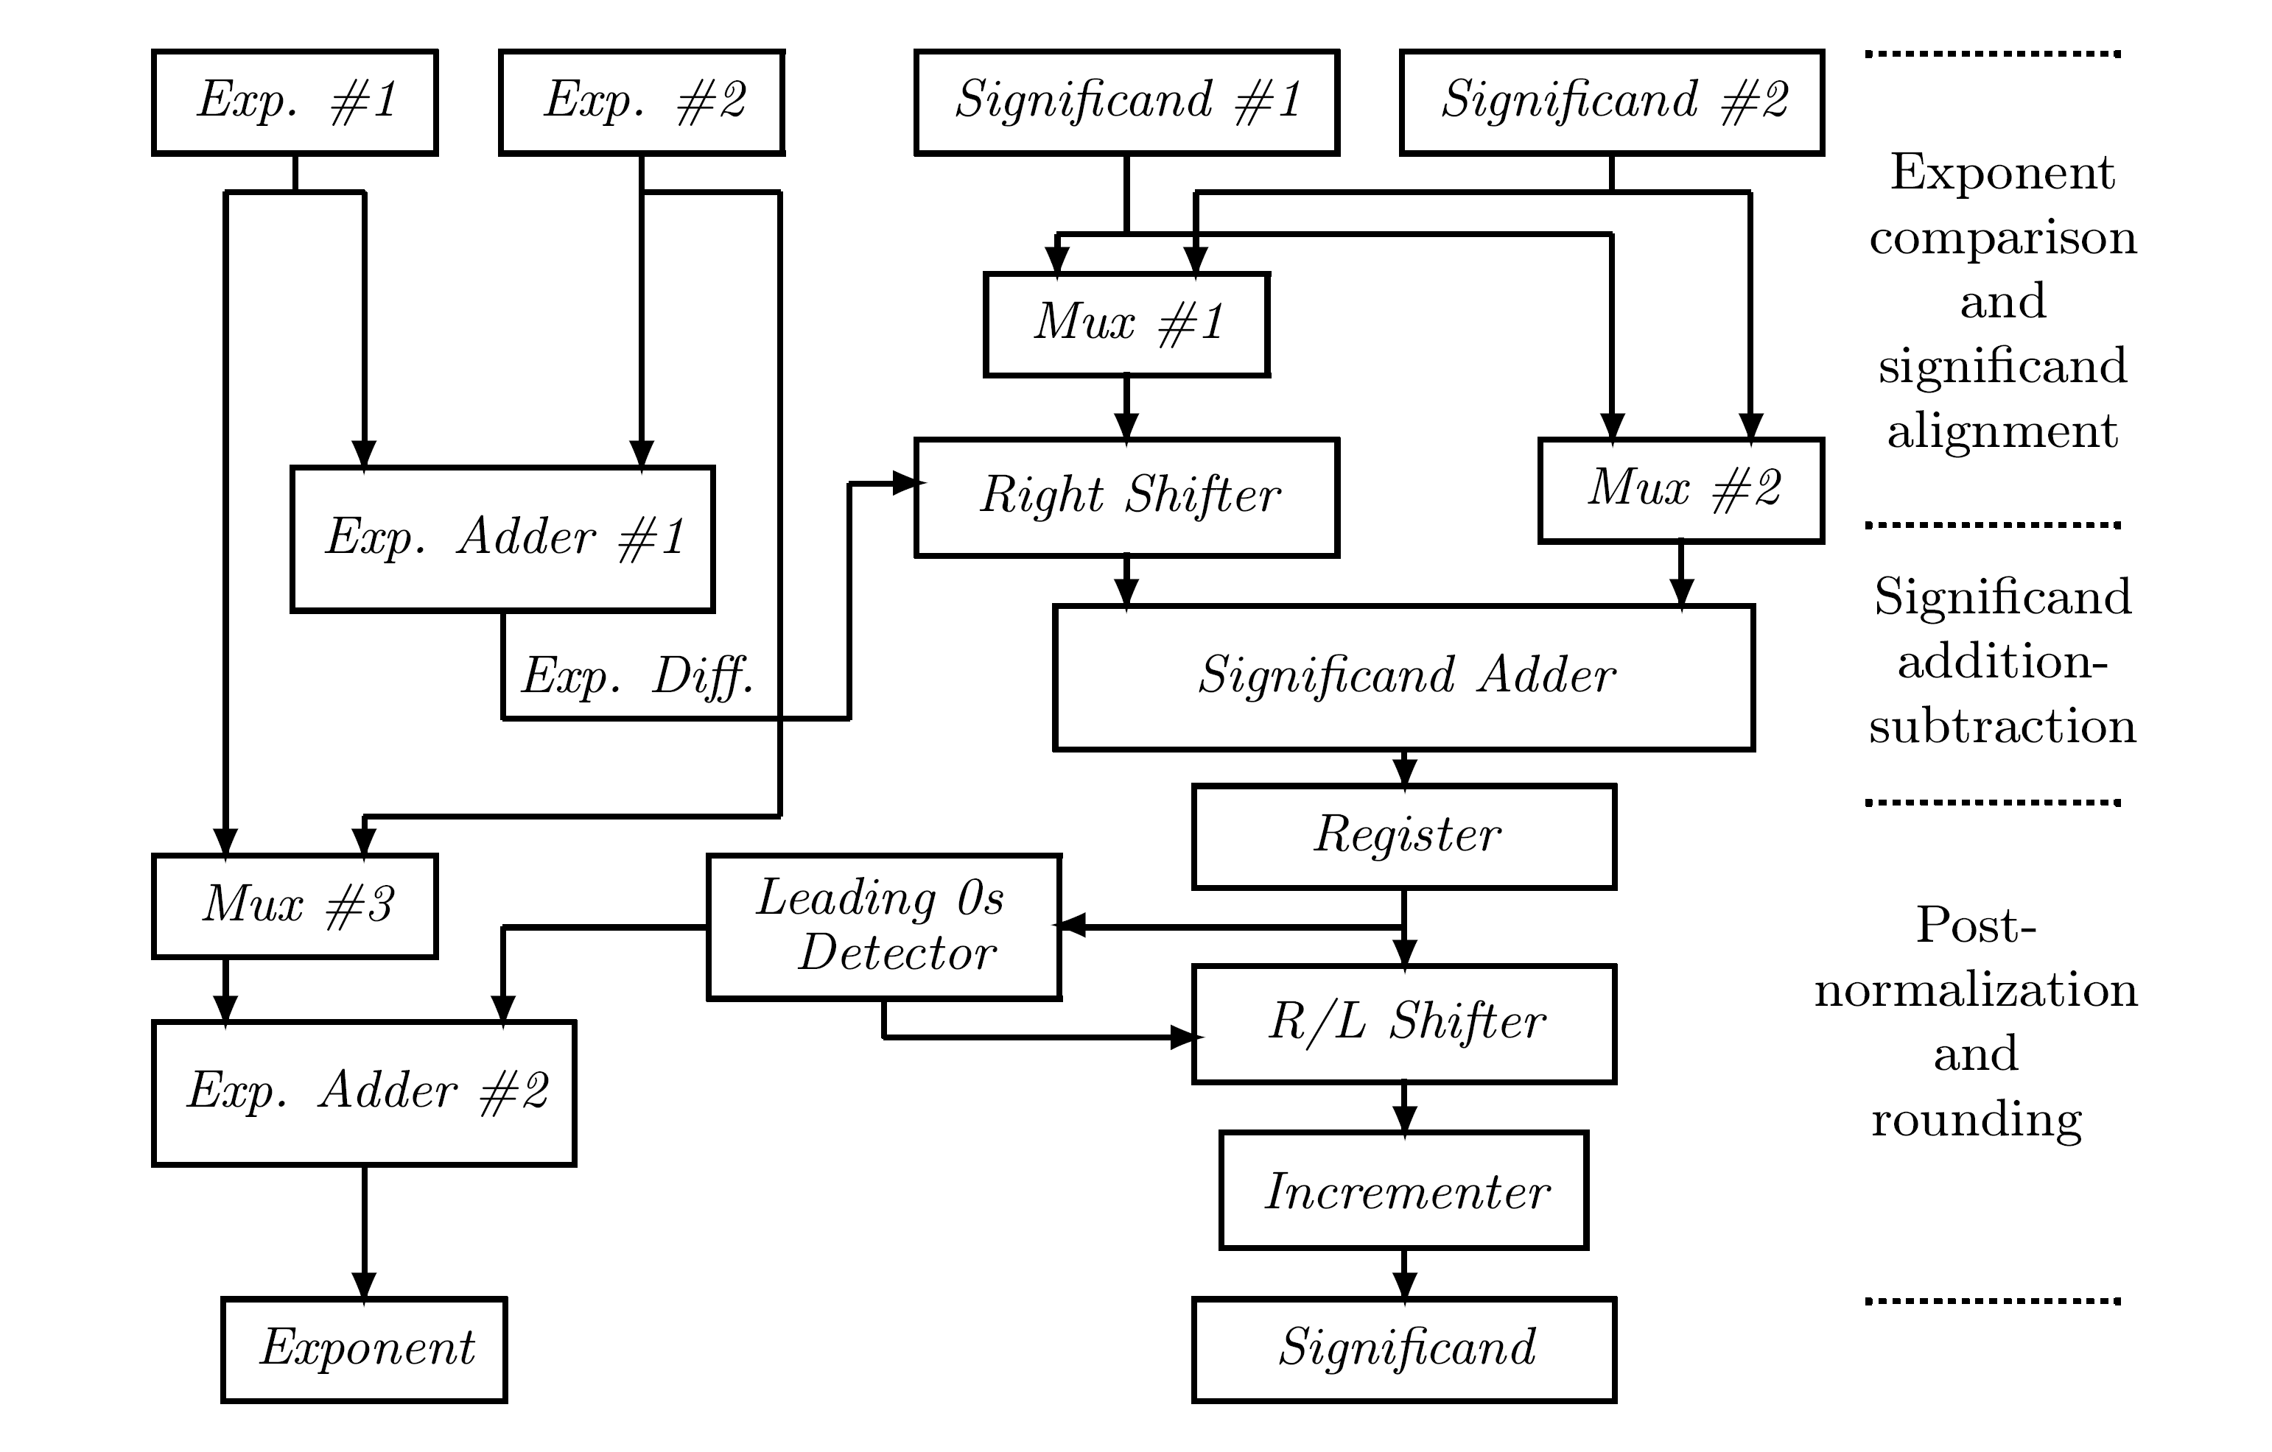
Circuitry for Addition/Subtraction

Slide 31
Shifters
1st shifter - right (alignment) shifts only ; 2nd shifter - right or left (postnormalization) shifts ; both perform large shifts (# of significand digits)
Combinatorial shifter - generate all possible shifted patterns - only one at output according to control bits
  Such shifters capable of circular shifts (rotates) - known as barrel shifters
  Shift registers require a large and variable number of clock cycles, thus combinatorial shifters commonly used
If implemented as a single level array - each input bit is directly connected to m (or more) output lines - conceptually simple design
For m=53 (number of significand bits in IEEE double-precision format) - large number of connections (and large electrical load) - bad solution

Slide 32
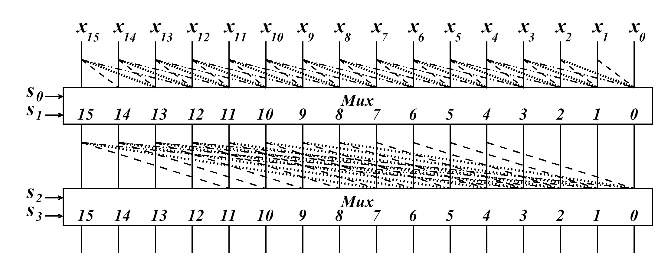
Two levels Barrel Shifters
  first level shifts bits by 0, 1, 2 or 3 bit positions
  second level shift bits by multiples of 4 (0,4,8,...,52)
  shifts between 0 and 53 can be performed
Radix-4 shifter
16 bits
  1st level - each bit has 4 destinations ; 2nd level - each bit has 14 destinations - unbalanced
Radix-8 shifter - 1st level shifts 0 to 7 bit positions ; 2nd level shifts by multiples of 8 (0,8,16,24,...,48)
  1st level - each bit has 8 destinations ; 2nd level - each bit has 7 destinations

Slide 33
Choice of Floating-Point Representation
IEEE standard 754 commonly used - important to understand implications of a particular format
Given n - total number of bits - determine
  m - length of significand field
  e - length of exponent field (m+e+1=n)
  β - value of exponent base
Representation error - error made when using a finite-length floating-point format to represent a high-precision real number
x - a real number ; Fl(x) - its machine representation
Goal when selecting format - small representation error
Error can be measured in several ways

Slide 34

Measuring Representation Error
Every real number x has two consecutive representations F1 and F2 satisfying F1 ≤ x ≤ F2
Fl(x) can be set to either F1 or F2
Fl(x)-x - absolute representation error
δ(x)=(Fl(x)-x)/x - relative representation error
If F1=Mβ then F2=(M+ulp)β
Maximum absolute error = half distance between F1 and F2 = ulp⋅β - increases as exponent increases
E
E
E

Slide 35
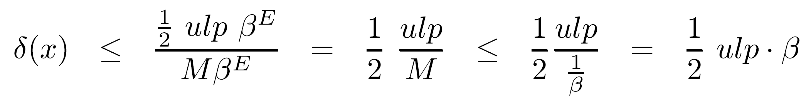
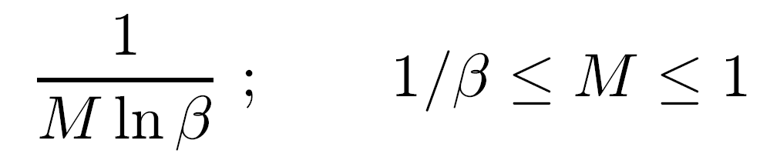
Measure of Representation Accuracy
MRRE - maximum relative representation error - upper bound of δ(x)
MRRE increases with exponent base β - decreases with ulp (or number of significand bits m)
Good measure if operands uniformly distributed
In practice - larger significands less likely to occur
First digit of a decimal floating-point operand will most likely be a 1; 2 is the second most likely
Operands follow the density function

Slide 36
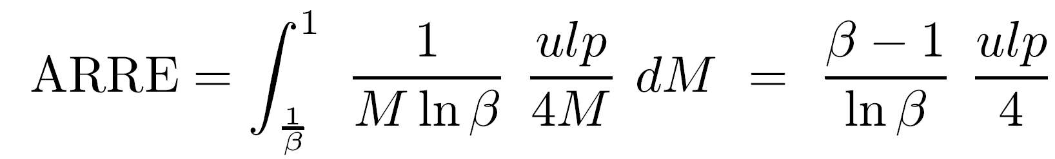
Different Accuracy Measure
ARRE - average relative representation error
Absolute error varies between 0 and 1/2 ulp⋅β
Average absolute error is 1/4 ulp⋅β
Relative error is 1/4 ulp/M
E
E

Slide 37
Range of Representation
The range of the positive floating-point numbers - β - must be considered when selecting a floating-point format
For a large range - increase β and/or number of exponent bits e
Increasing β increases representation error
Increasing e decreases m and increases ulp - higher representation error
Trade-off between range and representation error
Emax

Slide 38
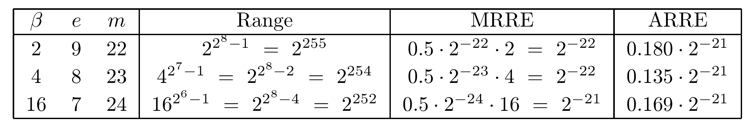
Range - Accuracy Trade-off
If several floating-point representations have same range - select smallest MRRE or ARRE
If several representations have same MRRE (or ARRE) - select the largest range
Example: 32-bit word - m+e=31 - all three representations have about the same range
Using MRRE as measure - β=16 inferior to other two
Using ARRE as measure - β=4 is best
β=2 + hidden bit reduces MRRE and ARRE by a factor of 2 - the smallest representation error

Slide 39
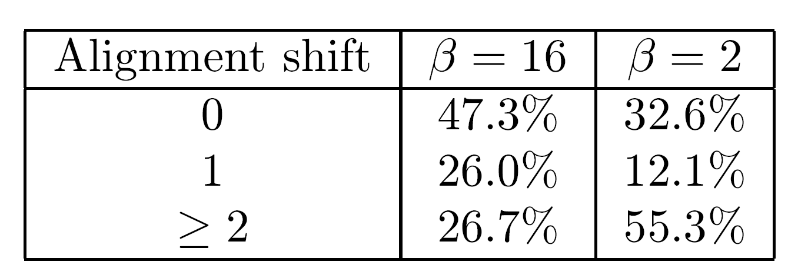
Execution Time of Floating-Point Operations
One more consideration when selecting a format
Two time-consuming steps - aligning of significands before add/subtract operations ; postnormalization in any floating-point operation
Observation - larger β - higher probability of equal exponents in add/subtract operations - no alignment ; lower probability that a postnormalization step needed
No postnormalization in 59.4% of cases for β=2; 82.4% for β=16
This is of limited practical significance when a barrel shifter is used

