Slide 1

UNIVERSITY OF MASSACHUSETTS
Dept. of Electrical & Computer Engineering
Digital Computer Arithmetic
ECE 666
Part 4-B
Floating-Point Arithmetic - II
Israel Koren
Spring 2008

Slide 2
The IEEE Floating-Point Standard
Four formats for floating-point numbers
First two:
  basic single-precision 32-bit format and
  double-precision 64-bit format
Other two - extended formats for intermediate results
Single extended format - at least 44 bits
Double extended format - at least 80 bits
Higher precision and range than corresponding 32- and 64-bit formats

Slide 3
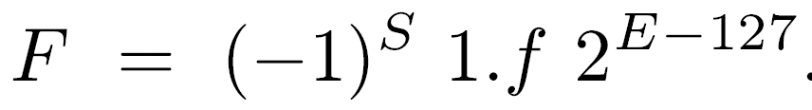
Single-Precision Format
Most important objective - precision of representation
Base 2 allows a hidden bit - similar to DEC format
Exponent field of length 8 bits for a reasonable range
256 combinations of 8 bits in exponent field
  E=0 reserved for zero (with fraction f=0) and denormalized numbers (with fraction f ≠ 0)
  E=255 reserved for ±∞ (with fraction f=0) and NaN (with fraction f ≠ 0)
For 1 ≤ E ≤ 254 -

Slide 4
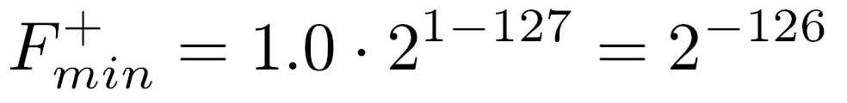
IEEE vs. DEC
e-1
7
Exponent bias - 127 instead of 2 = 2 =128
Larger maximum value of true exponent - 254-127=127 instead of 254-128=126 - larger range
Similar effect - significand of 1.f instead of 0.1f -
Largest and smallest positive numbers -
instead of
Exponent bias and significand range selected to allow reciprocal of all normalized numbers (in particular, F min) to be represented without overflow - not true in DEC format
+

Slide 5
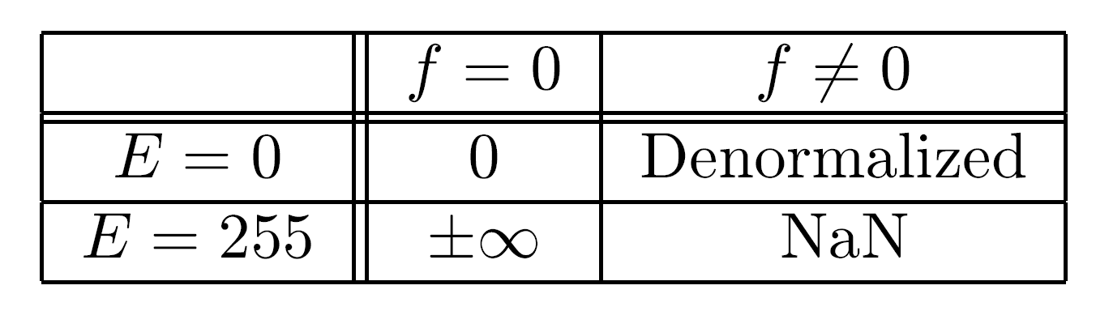
Special Values in IEEE Format
±∞ - represented by f=0, E=255, S=0,1 - must obey all mathematical conventions: F+∞=∞, F/∞=0
Denormalized numbers - represented by E=0 -values smaller than smallest normalized number - lowering probability of exponent underflow
F=(-1) · 0.f·2
Or - F=(-1) · 0.f · 2 - same bias as normalized numbers
S
-126
S
1-127

Slide 6
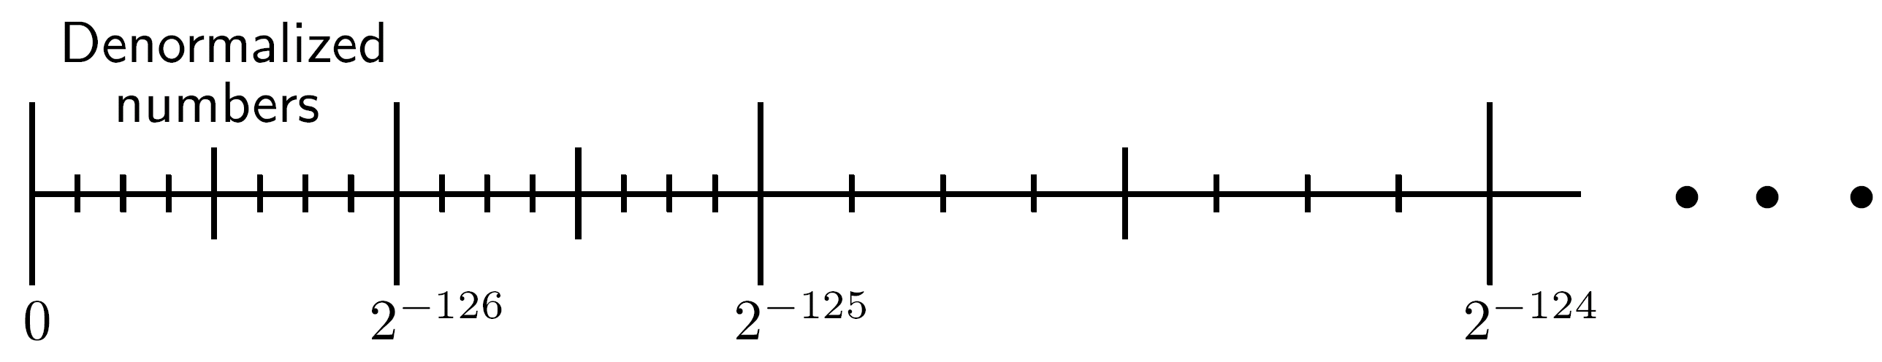
Denormalized Numbers
No hidden bit - significands not normalized
Exponent - -126 selected instead of 0-127=-127 - smallest normalized number is F min= 1⋅2
Smallest representable number is 2 ⋅ 2 = 2 instead of 2 - gradual (or graceful) underflow
Does not eliminate underflow - but reduces gap between smallest representable number and zero; 2 = distance between any two consecutive denormalized numbers = distance between two consecutive normalized numbers with smallest exponent 1-127=-126
+
-126
-23
-126
-149
-126
-149

Slide 7
Denormals & Extended formats
Denormalized numbers not included in all designs of arithmetic units that follow the IEEE standard
  Their handling is different requiring a more complex design and longer execution time
  Even designs that implement them allow programmers to avoid their use if faster execution is desired
The single-extended format for intermediate results within evaluation of complex functions like transcendental and powers
Extends exponent from 8 to 11 bits and significand from 23+1 to 32 or more bits (no hidden bit)
  Total length is at least 1+11+32=44 bits

Slide 8
NaN (E=255)
f≠0 - large number of values
  Two kinds - signaling (or trapping), and quiet (nontrapping) - differentiated by most significant bits of fraction - remaining bits contain system-dependent information
  Example of a signaling NaN - uninitialized variable
  It sets Invalid operation exception flag when arithmetic operation on this NaN is attempted ; Quiet NaN - does not
  Turns into quiet NaN when used as operand if Invalid operation trap is disabled (avoid setting Invalid Op flag later)
  Quiet NaN produced when invalid operation (0 ⋅ ∞) attempted - this operation had already set the Invalid Op flag once. Fraction field may contain a pointer to offending code line
  Quiet NaN as operand will produce quiet NaN result and not set exception. For example, NaN+5=NaN. If both operands quiet NaNs, result is the NaN with smallest significand

Slide 9
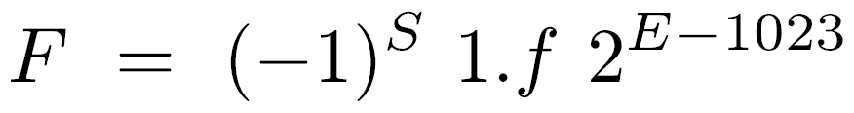
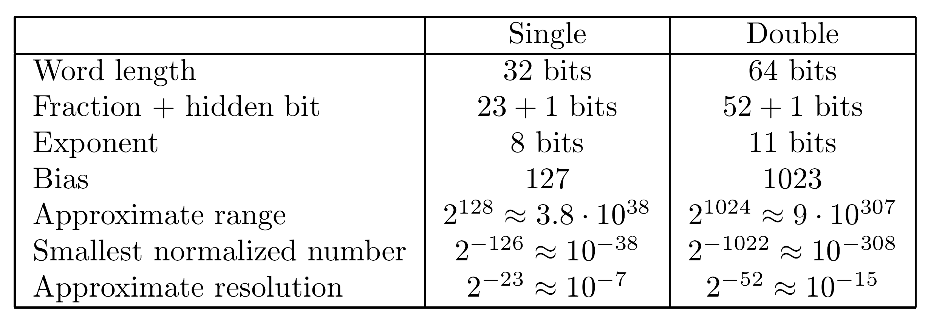
Double-Precision Format
Main consideration - range; exponent field - 11 bits
E=0,2047 reserved for same purposes as in single-precision format
For 1 ≤ E ≤ 2046 -
Double extended format - exponent field - 15 bits, significand field - 64 or more bits (no hidden bit), total number of bits - at least 1+15+64=80

Slide 10
Round-off Schemes
Accuracy of results in floating-point arithmetic is limited even if intermediate results are accurate
Number of computed digits may exceed total number of digits allowed by format - extra digits must be disposed of before storing
Example - multiplying two significands of length m - product of length 2m - must be rounded off to m digits
Considerations when selecting a round-off scheme -
  Accuracy of results (numerical considerations)
  Cost of implementation and speed (machine considerations)

Slide 11
Requirements for Rounding
x,y - real numbers; Fl - set of machine representations in a given floating-point format; Fl(x) - machine representation of x
Conditions for rounding:
  Fl(x) ≤ Fl(y) for x ≤ y
  If x ∈ Fl - Fl(x)=x
  If F1, F2 consecutive in Fl and F1 ≤ x ≤ F2, then either Fl(x)=F1 or Fl(x)=F2
d - number of extra digits kept in arithmetic unit (in addition to m significand digits) before rounding
Assumption - radix point between m most significant digits (of significand) and d extra digits
Example - Rounding 2.9910 into an integer

Slide 12
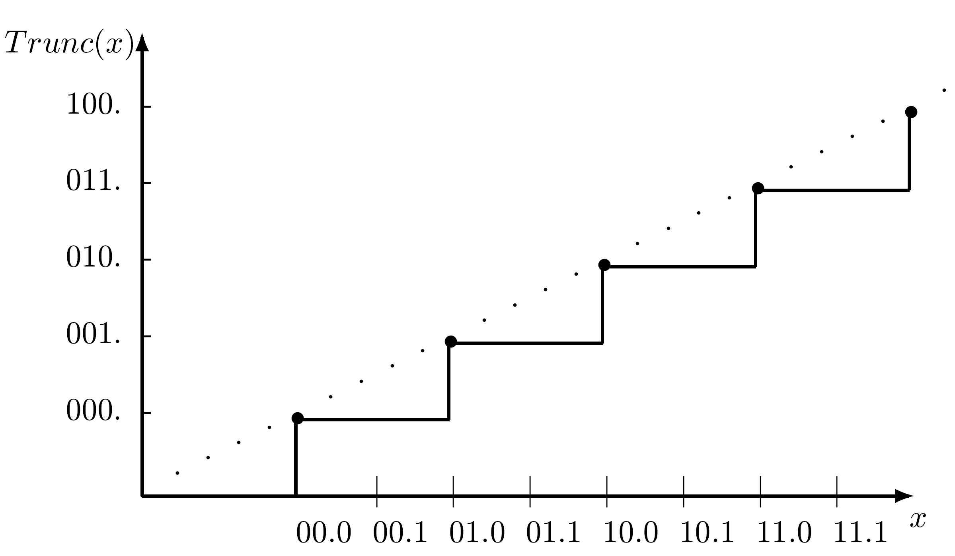
Truncation (Chopping)
d extra digits removed - no change in m remaining digits - rounding towards zero
For F1 ≤ x ≤ F2 - Trunc(x) results in F1 (Trunc(2.99)=2)
Fast method - no extra hardware
Poor numerical performance - Error up to ulp
Trunc(x) lies entirely below ideal dotted line (infinite precision)

Slide 13
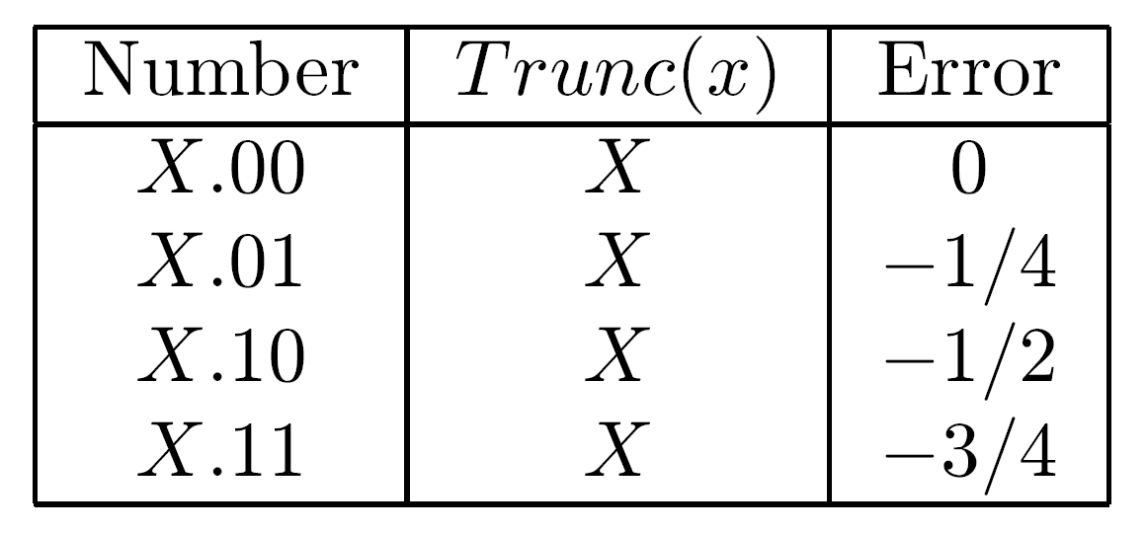
Rounding Bias
Rounding bias - measures tendency of a round-off scheme towards errors of a particular sign
Ideally - scheme is unbiased or has a small bias
Truncation has a negative bias
Definition - Error=Trunc(x)-x ; for a given d - bias is average error for a set of 2 consecutive numbers with a uniform distribution
Example - Truncation, d=2
X is any significand of length m
Sum of errors for all 2 =4 consecutive numbers=-3/2
Bias=average error=-3/8
d
d

Slide 14
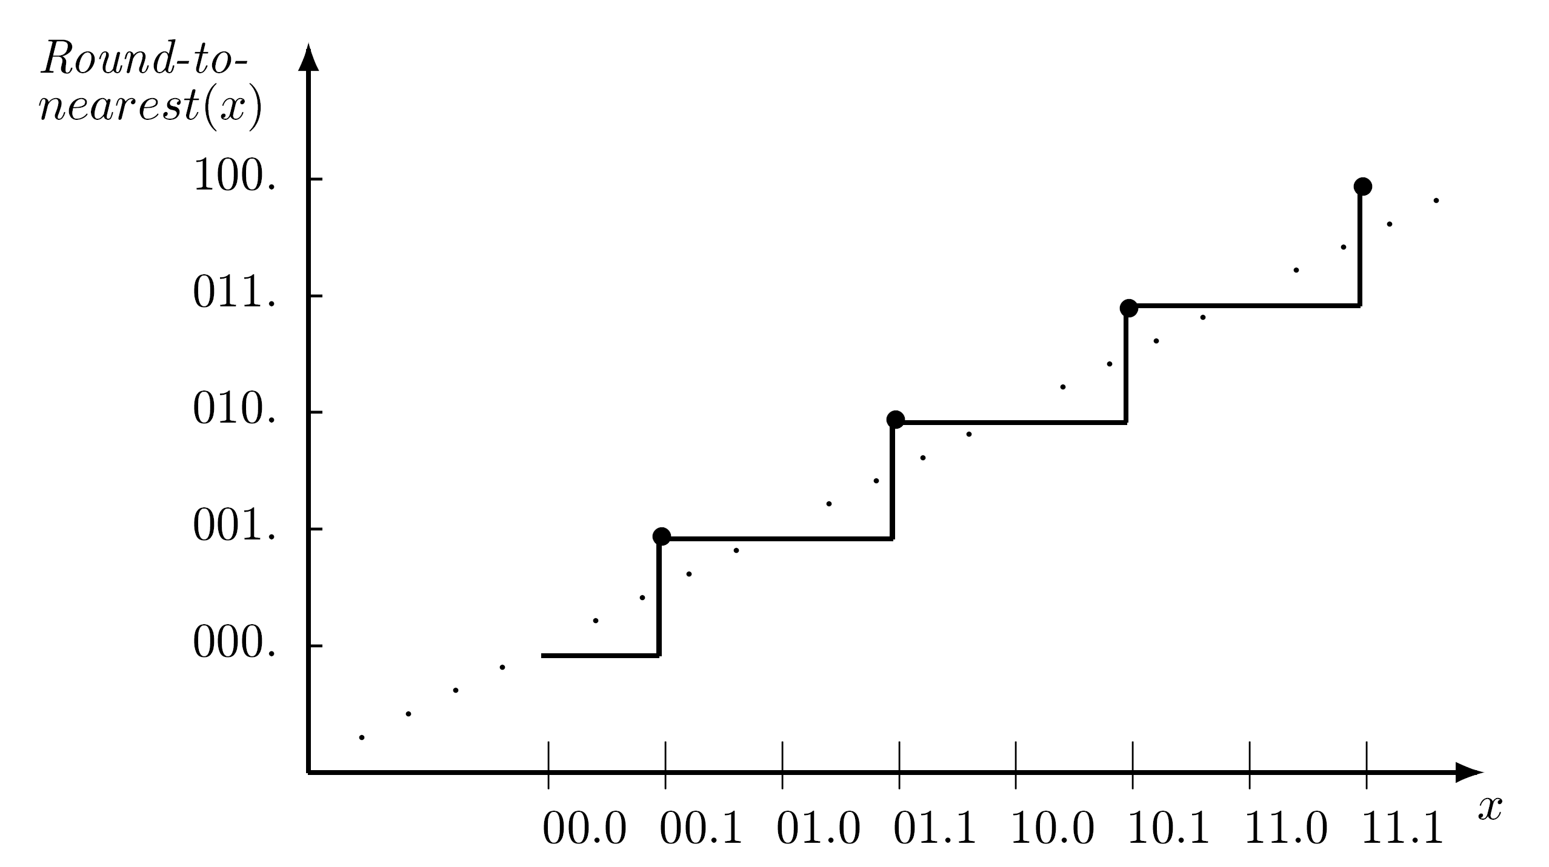
Round to Nearest Scheme
F1 ≤ x ≤ F2 - Round(x)=nearest to x out of F1,F2 - used in many arithmetic units
Obtained by adding 0.12 (half a ulp) to x and retaining the integer (chopping fraction)
Example - x=2.99 - adding 0.5 and chopping off fractional part of 3.49 results in 3
Maximum error - x=2.50 - 2.50+0.50=3.00 - result=3, error=0.5
A single extra digit (d=1) is sufficient

Slide 15
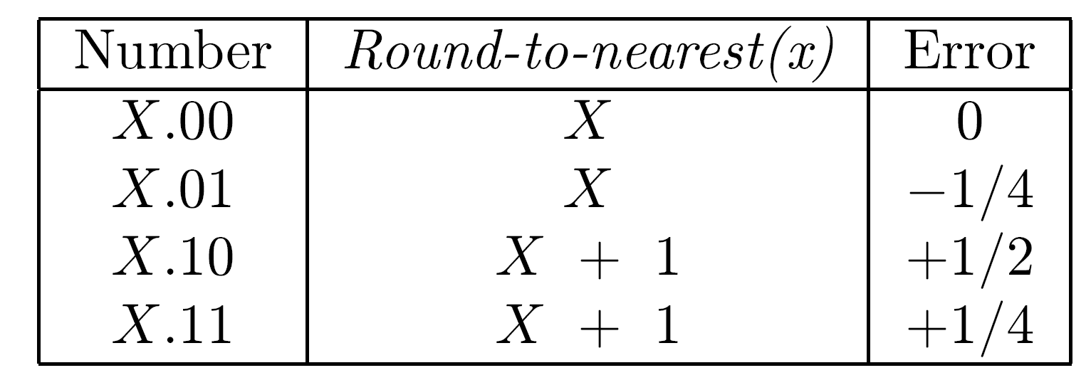
Bias of Round to Nearest
Round(x) - nearly symmetric around ideal line - better than truncation
Slight positive bias - due to round up of X.10
d=2 :
Sum of errors=1/2, bias=1/8, smaller than truncation
Same sum of errors obtained for d>2 - bias=1/2 ⋅ 2
-d

Slide 16
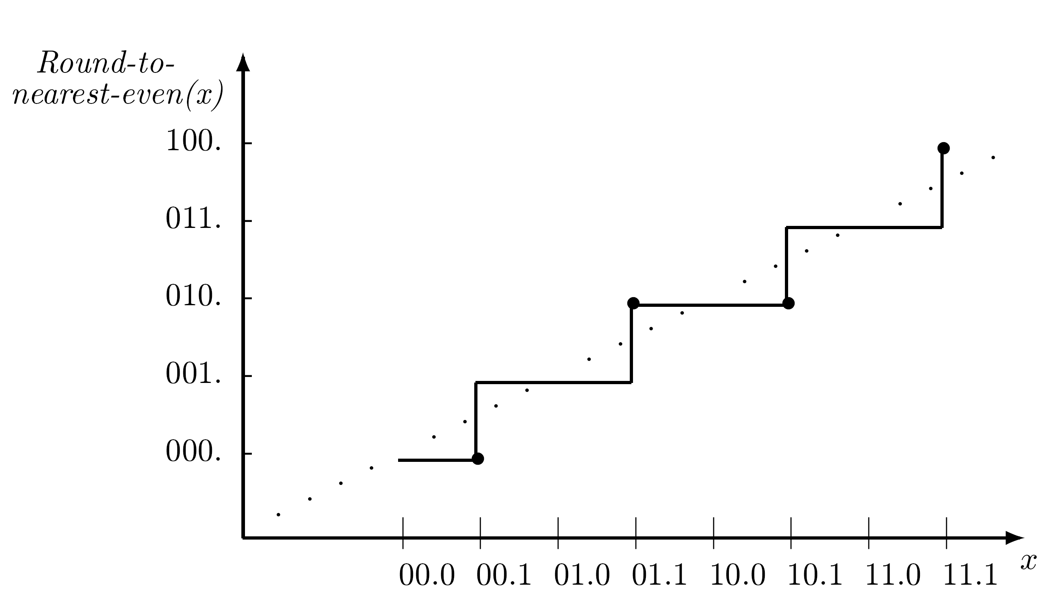
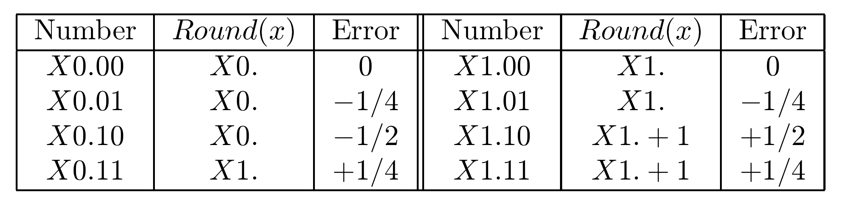
Round to Nearest
Even
In case of a tie (X.10), choose out of F1 and F2 the even one (with least-significant bit 0)
Alternately rounding up and down - unbiased
Round-to-Nearest-Odd - select the one with least-significant bit 1
d=2 :
Sum of errors=0
Bias=0
Mandatory in IEEE floating-point standard

Slide 17
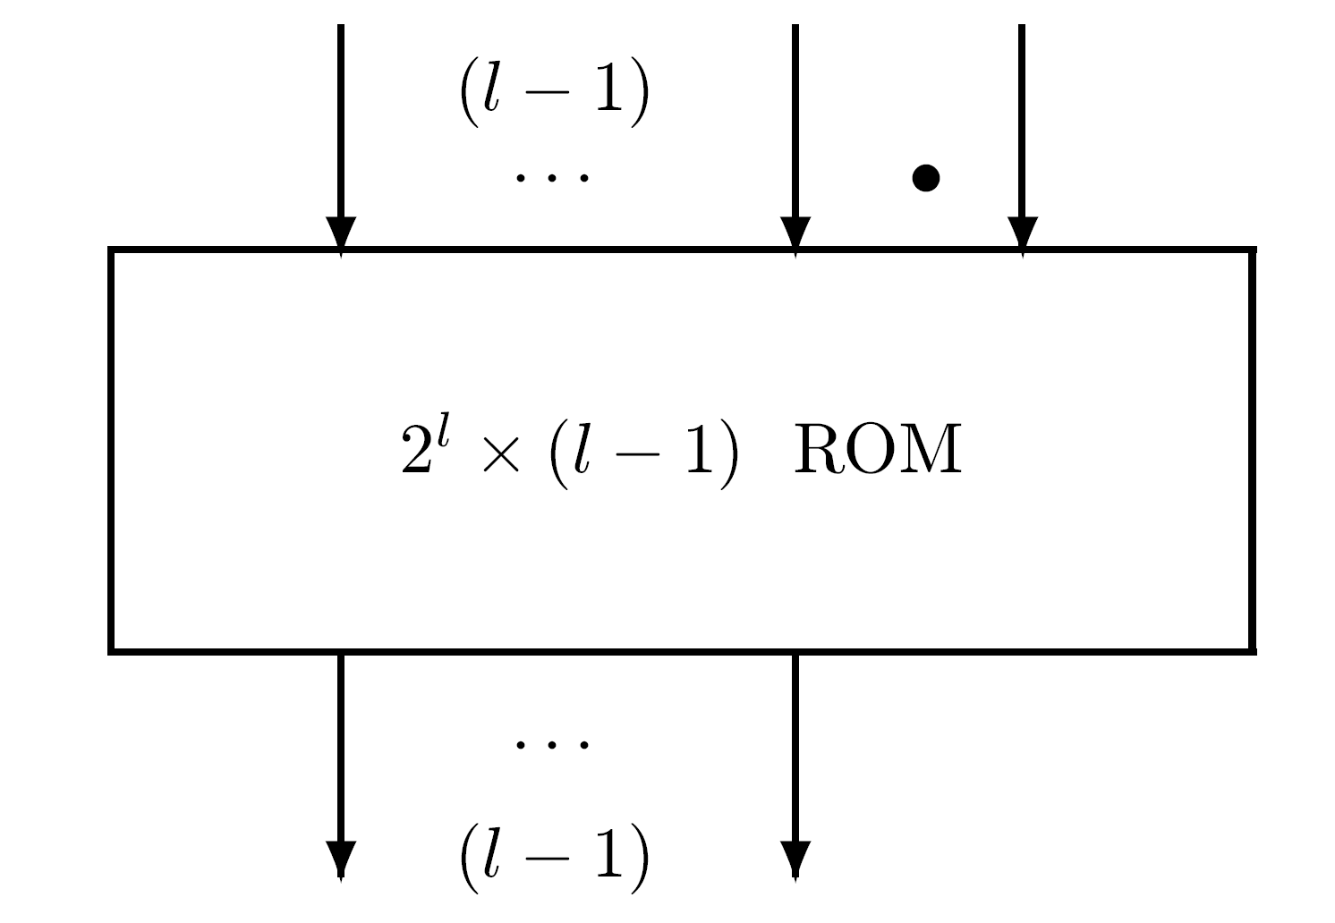
ROM Rounding
Disadvantage of round-to-nearest schemes - require a complete add operation - carry propagation across entire significand
Suggestion - use a ROM (read-only memory) with look-up table for rounded results
Example - a ROM with l address lines - inputs are l-1 (out of m) least significant bits of significand and most significant bit out of d extra bits

Slide 18
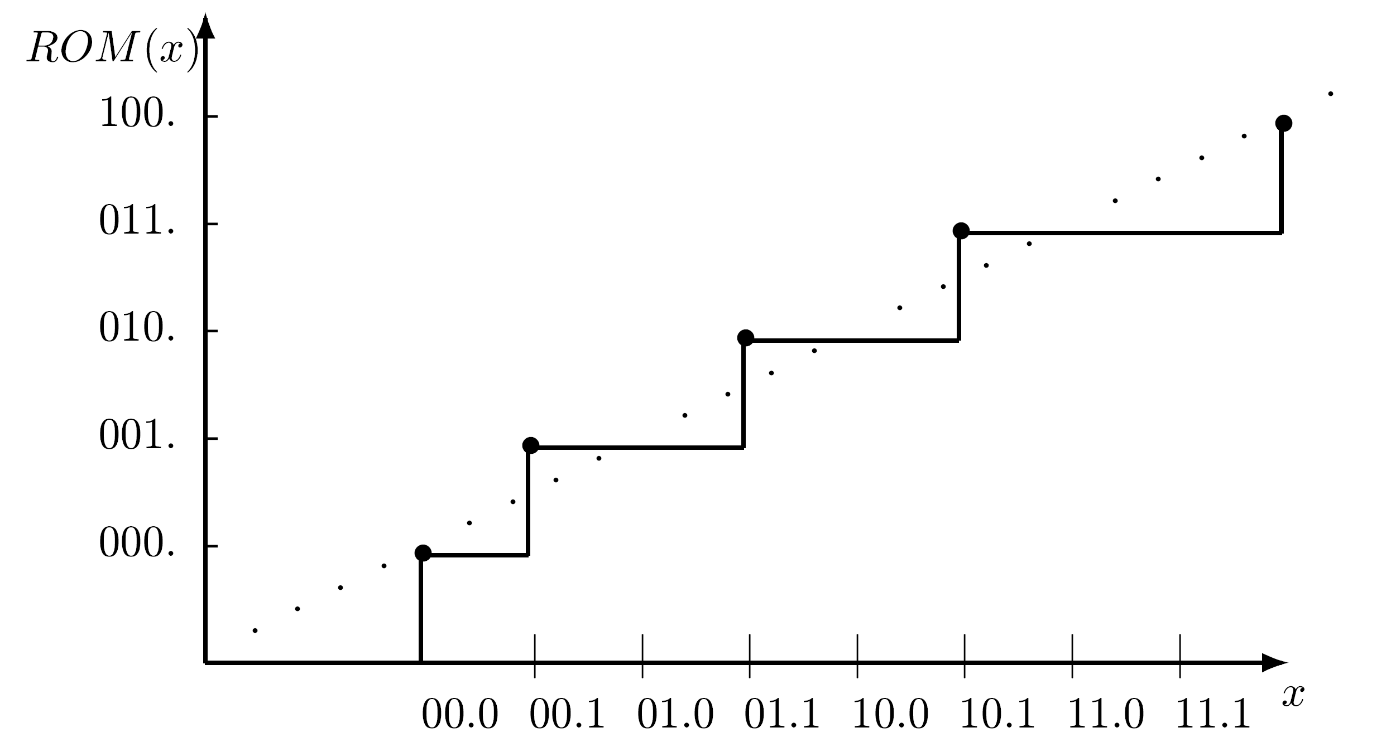
ROM Rounding - Examples
l
ROM has 2 rows of l-1 bit each - correct rounding in most cases
When all l-1 low-order bits of significand are 1's - ROM returns all 1's (truncating instead of rounding) avoiding full addition
Example - l=8 - fast lookup - 255 out of 256 cases are properly rounded
Example: l=3

Slide 19
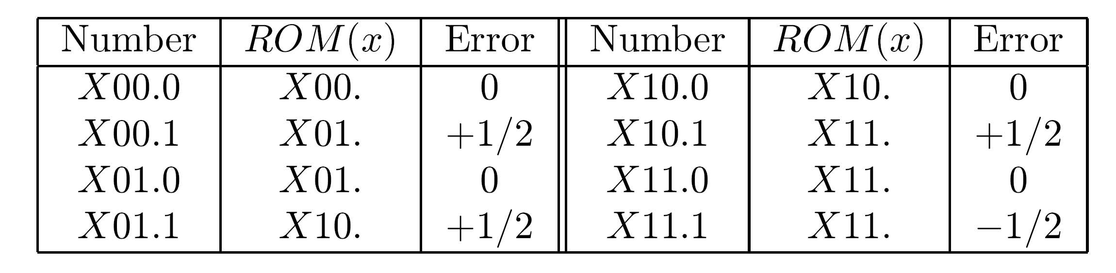
Bias of ROM Rounding
Example - l=3 ; d=1
Sum of errors=1
Bias=1/8
In general - bias=1/2[(1/2) -(1/2) ]
When l is large enough - ROM rounding converges to round-to-nearest - bias converges to 1/2(1/2)
If the round-to-nearest-even modification is adopted - bias of modified ROM rounding converges to zero
d
l-1
d

Slide 20
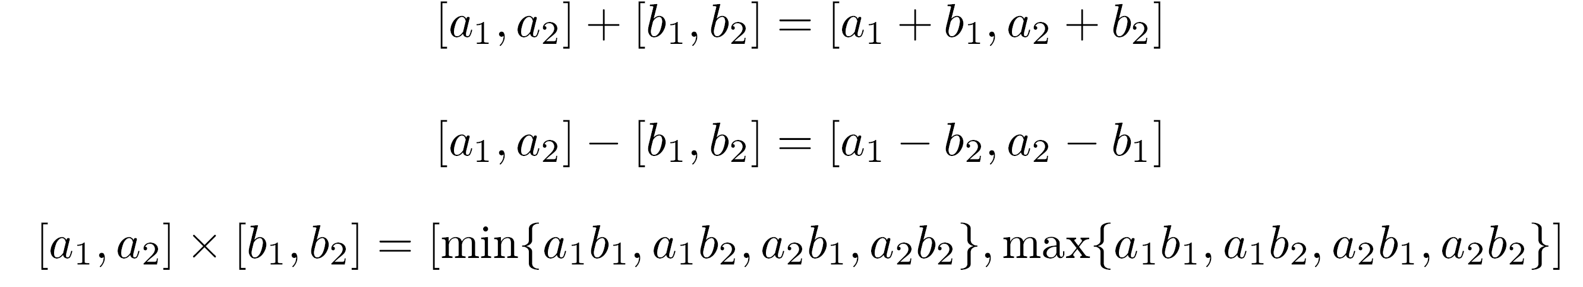
Rounding and Interval Arithmetic
Four rounding modes in IEEE standard
  Round-to-nearest-even (default)
  Round toward zero (truncate)
  Round toward ∞ ∗ Round toward -∞
Last 2 - useful for Interval Arithmetic
  Real number a represented by lower and upper bounds a1 and a2
  Arithmetic operations operate on intervals
  Calculated interval provides estimate on accuracy of computation
  Lower bound rounded toward -∞, upper - toward ∞

Slide 21
Guard Digits for Multiply/Divide
Multiplication has a double-length result - not all extra digits needed for proper rounding
Similar situation - adding or subtracting two numbers with different exponents
How many extra digits are needed for rounding and for postnormalization with leading zeros ?
Division of signed-magnitude fractions - no extra digits - shift right operation may be required
Multiplying two normalized fractions - at most one shift left needed if β=2 (k positions if β =2 ) ⇒ one guard digit (radix β) is sufficient for postnormalization
A second guard digit is needed for round-to-nearest - total of two - G (guard) and R (round)
Exercise - Same for range [1,2) (IEEE standard)
k

Slide 22
Guard, Round and Sticky digits
Round-to-nearest-even - indicator whether all additional digits generated in multiply are zero - detect a tie
Indicator is a single bit - logical OR of all additional bits - sticky bit
Three bits - G, R, S (sticky) - sufficient even for round-to-nearest-even
Computing S when multiplying does not require generating all least significant bits of product
Number of trailing zeros in product equals sum of numbers of zeros in multiplier and multiplicand
Other techniques for computing sticky bit exist

Slide 23
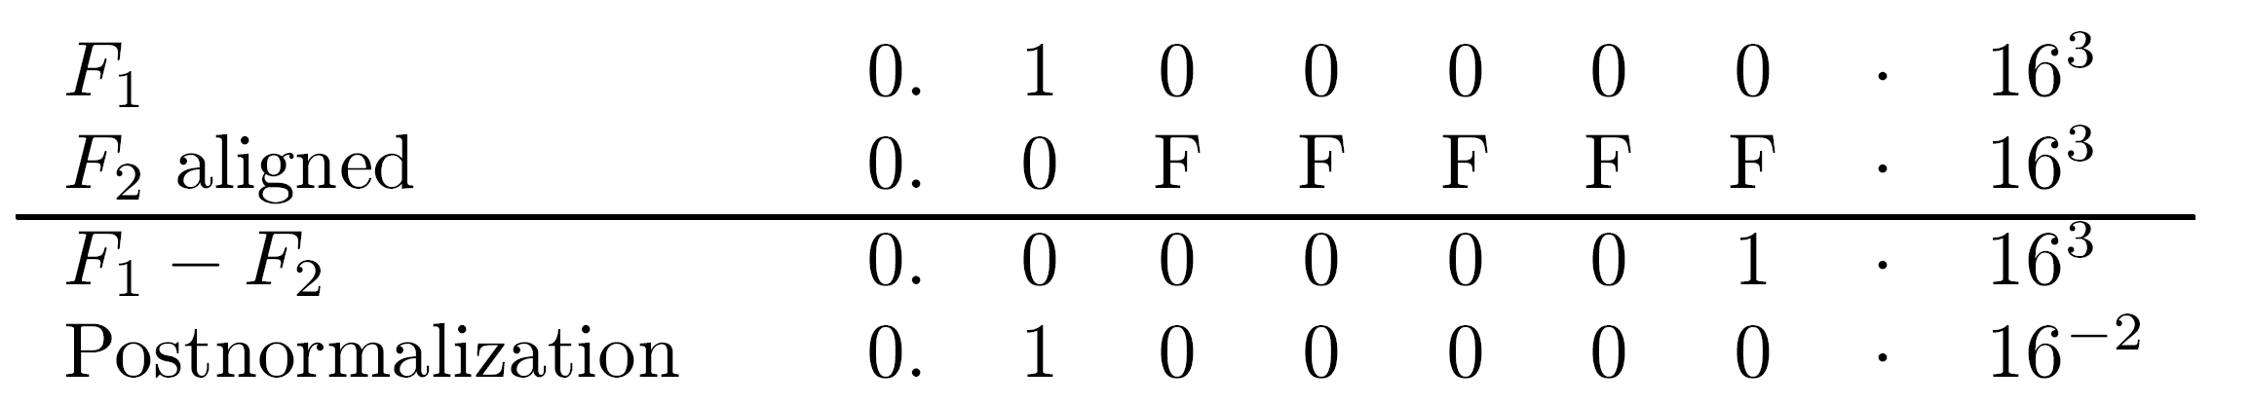
Guard digits for Add/Subtract
Add/subtract more complicated - especially when final operation (after examining sign bits) is subtract
Assumption - normalized signed-magnitude fractions
Subtract - for postnormalization all shifted-out digits of subtrahend may need to participate in subtraction
  Number of required guard digits = number in significand field - double size of significand adder/subtractor
If subtrahend shifted more than 1 position to right (pre- alignment) - difference has at most 1 leading zero
At most one shifted-out digit required for postnormalization

Slide 24
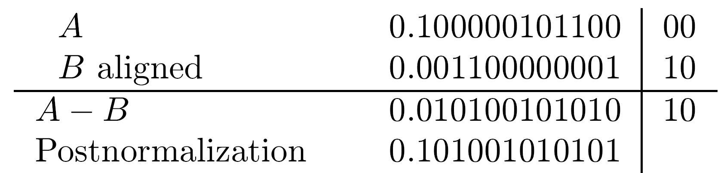
Subtract - Example 1
Calculating A-B
Significands of A and B are 12 bits long, base=2, EA-EB=2 - requiring a 2-bit shift of subtrahend B in pre-alignment step
Same result obtained even if only one guard bit participates in subtraction generating necessary borrow

Slide 25
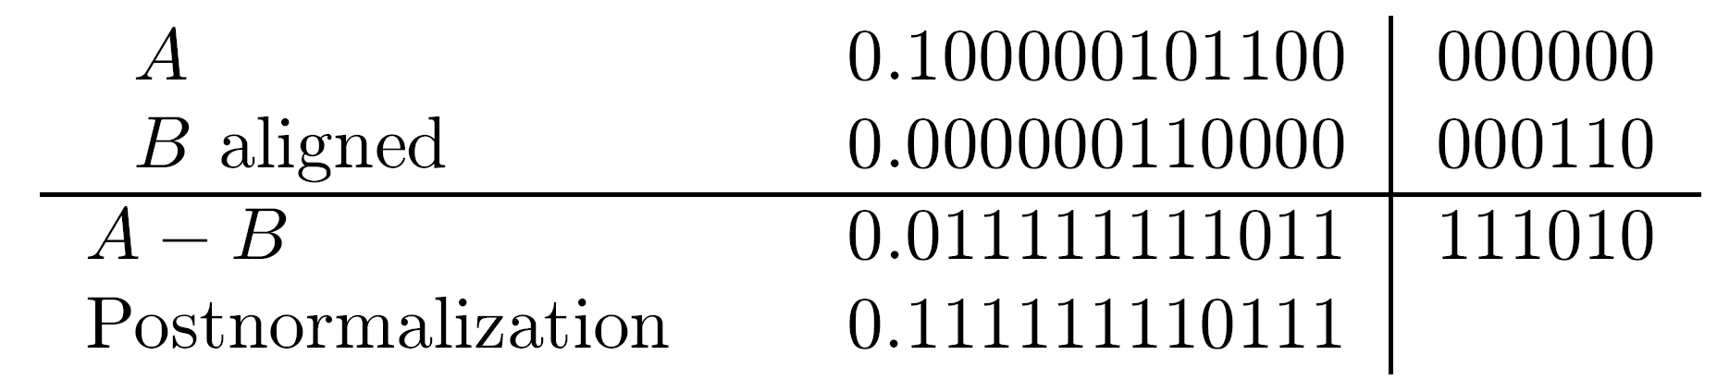
Subtract - Example 2
Different if most significant shifted-out bit is 0
Same two significands - EA-EB=6 → B's significand shifted 6 positions
  If only one guard bit - 4 least significant bits of result after postnormalization would be 1000 instead of 0111
  Long sequence of borrows - seems that all additional digits in B needed to generate a borrow
Possible conclusion : in the worst case - number of digits doubled
Statement : Enough to distinguish between two cases:
  (1) All additional bits (not including the guard bit) are 0
  (2) at least one of the additional bits is 1

Slide 26
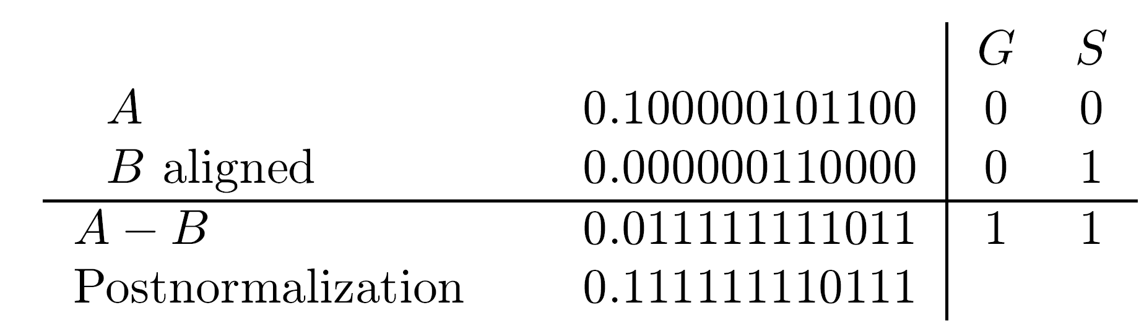
Proof of Statement
  All extra digits in A are zeros (not preshifted)
  Resulting three least significant bits in A-B (011 in example 2) are independent of exact position of 1's in extra digits of B
  We only need to know whether a 1 was shifted out or not - sticky bit can be used - if 1 is shifted into it during alignment it will be 1 - otherwise 0 - logical OR of all extra bits of B
  Sticky bit participates in subtraction and generates necessary borrow
  Using G and S -
  G and S sufficient for postnormalization
  In round-to-nearest - an additional accurate bit needed - sticky bit not enough - G,R,S required

Slide 27
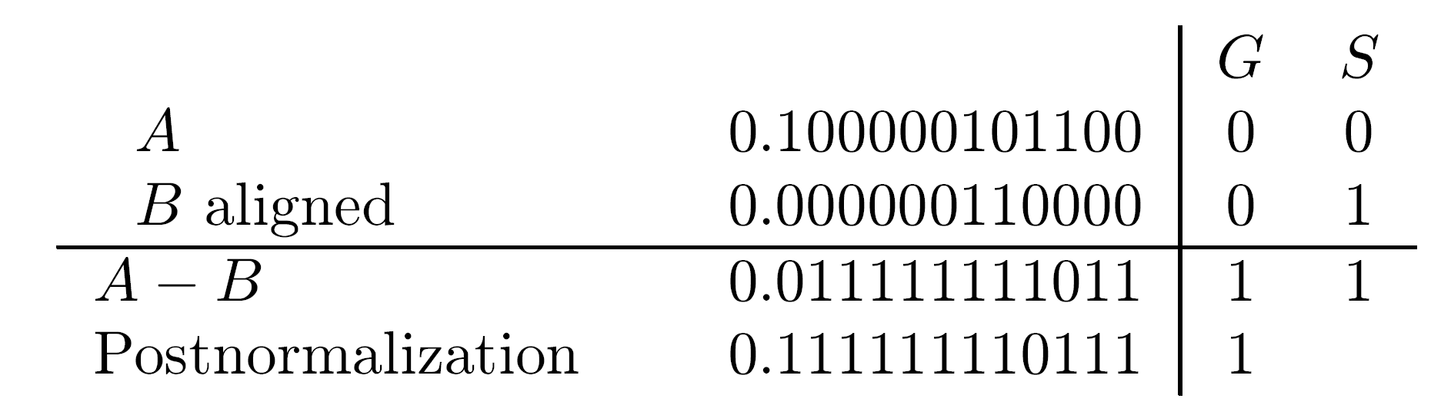
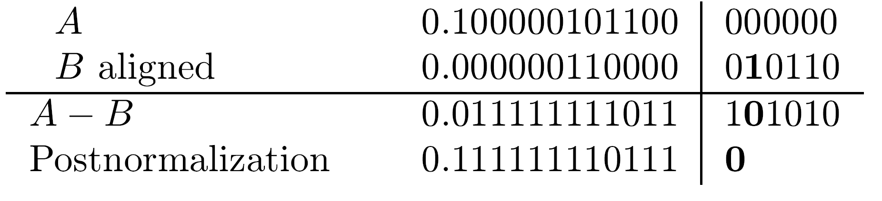
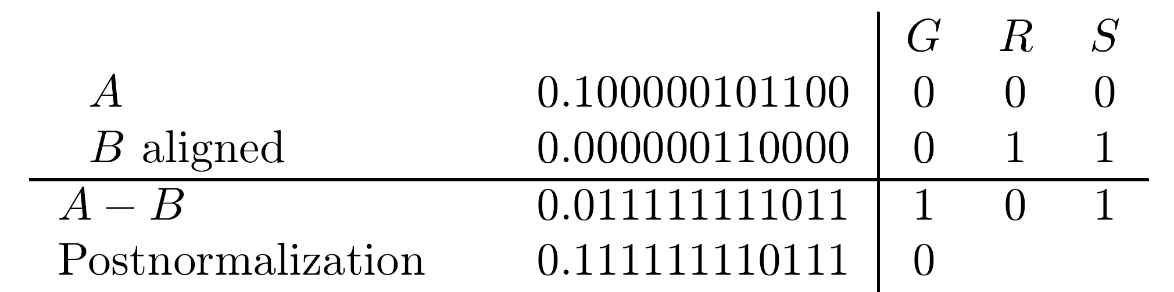
Example 3 (EA-EB=6)
Correct result Using only G and S
Round bit after postnormalization - 0, sticky bit cannot be used for rounding
Using G, R, S
Correct R=0 available for use in round-to-nearest
For round-to-nearest-even: sticky bit needed to detect a tie available - serves two purposes

Slide 28
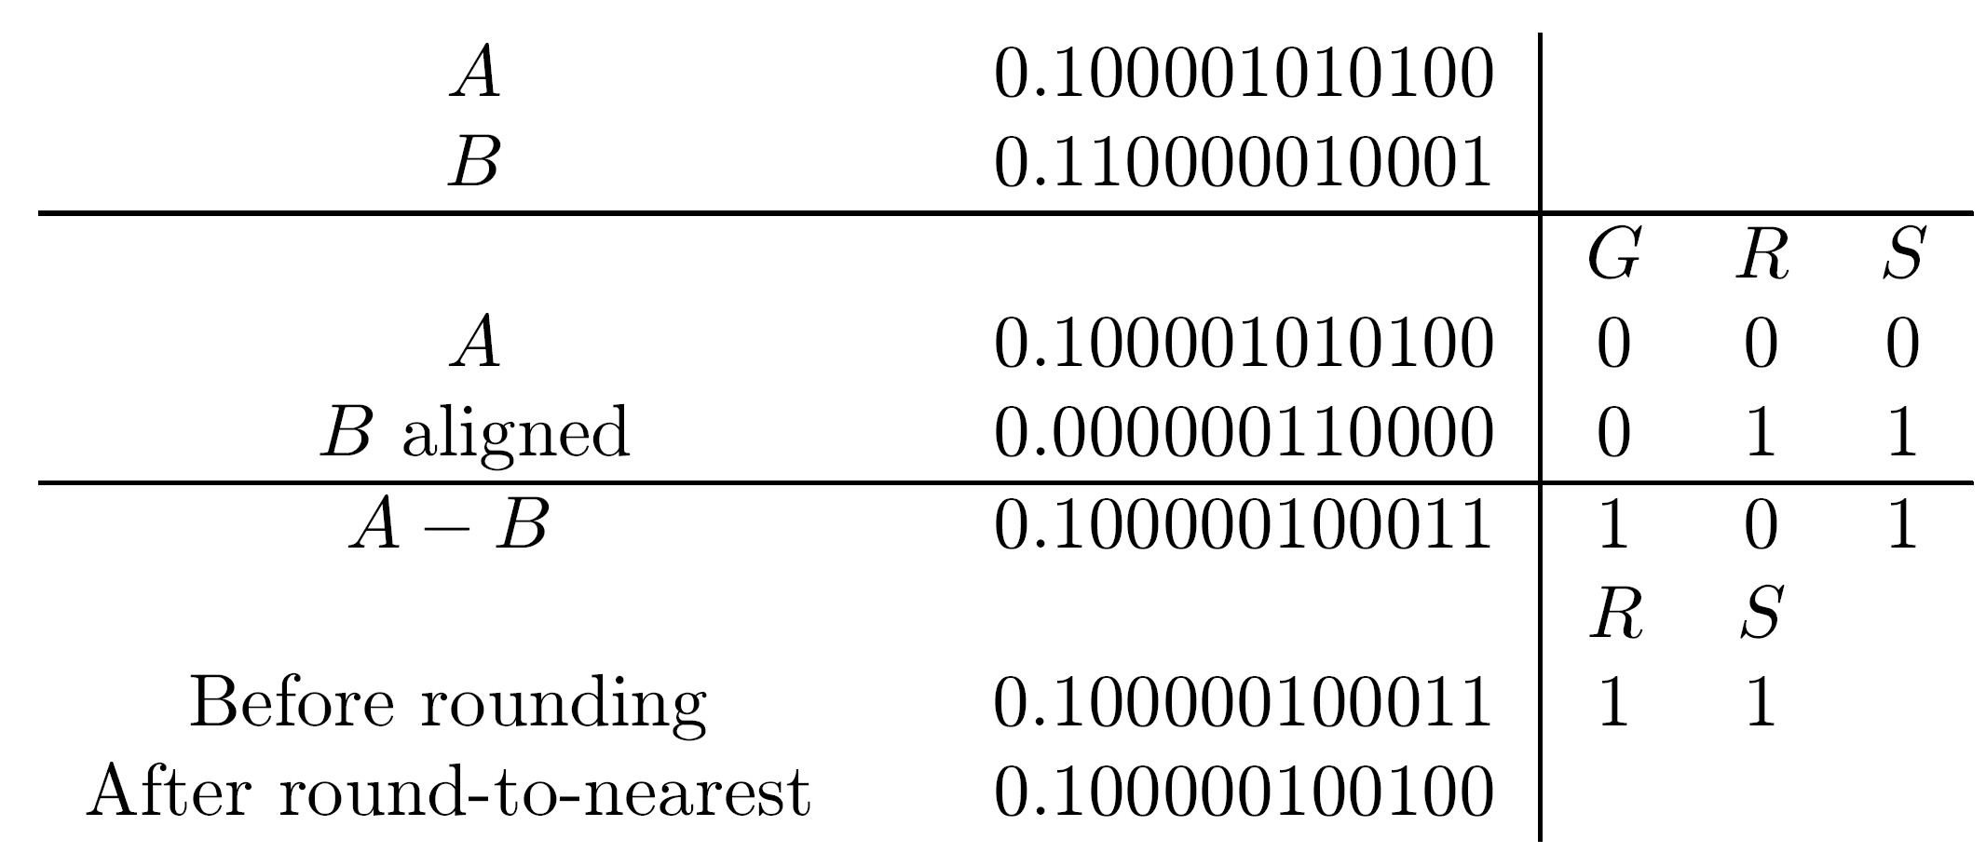
Example 4 - No Postnormalization
Rounding requires a round bit and a sticky bit
For round-to-nearest-even
  original G can be an R bit
  original R and S ORed to generate a new sticky bit S
EA-EB=6

Slide 29
Adding ulp in rounding
If R=0 no rounding required - sticky bit indicates whether final result is exact/inexact (S=0/1)
If R=1 operation in round-to-nearest-even depends on S and least-significant bit (L) of result
If S=1 rounding must be performed by adding ulp
If S=0 - tie case, only if L=1 rounding necessary
Summary - round-to-nearest-even requires adding ulp to significand if RS + RSL = R(S + L) =1
Adding ulp may be needed for directed roundings
Example: in round toward +∞, ulp must be added if result is positive and either R or S equals 1
Similarly - in round toward - ∞ when result negative and R+S=1
-

Slide 30
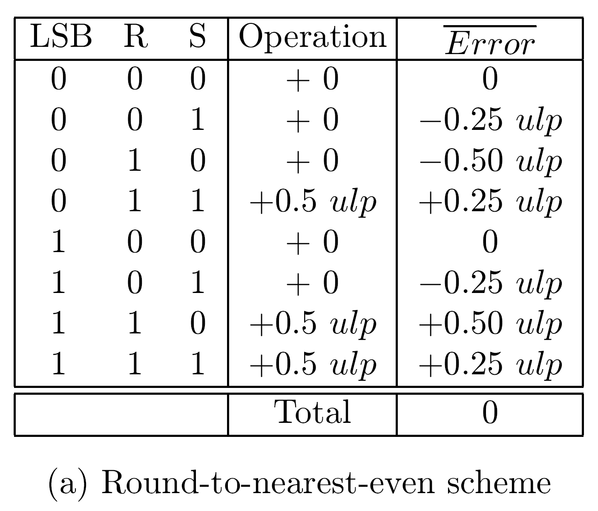
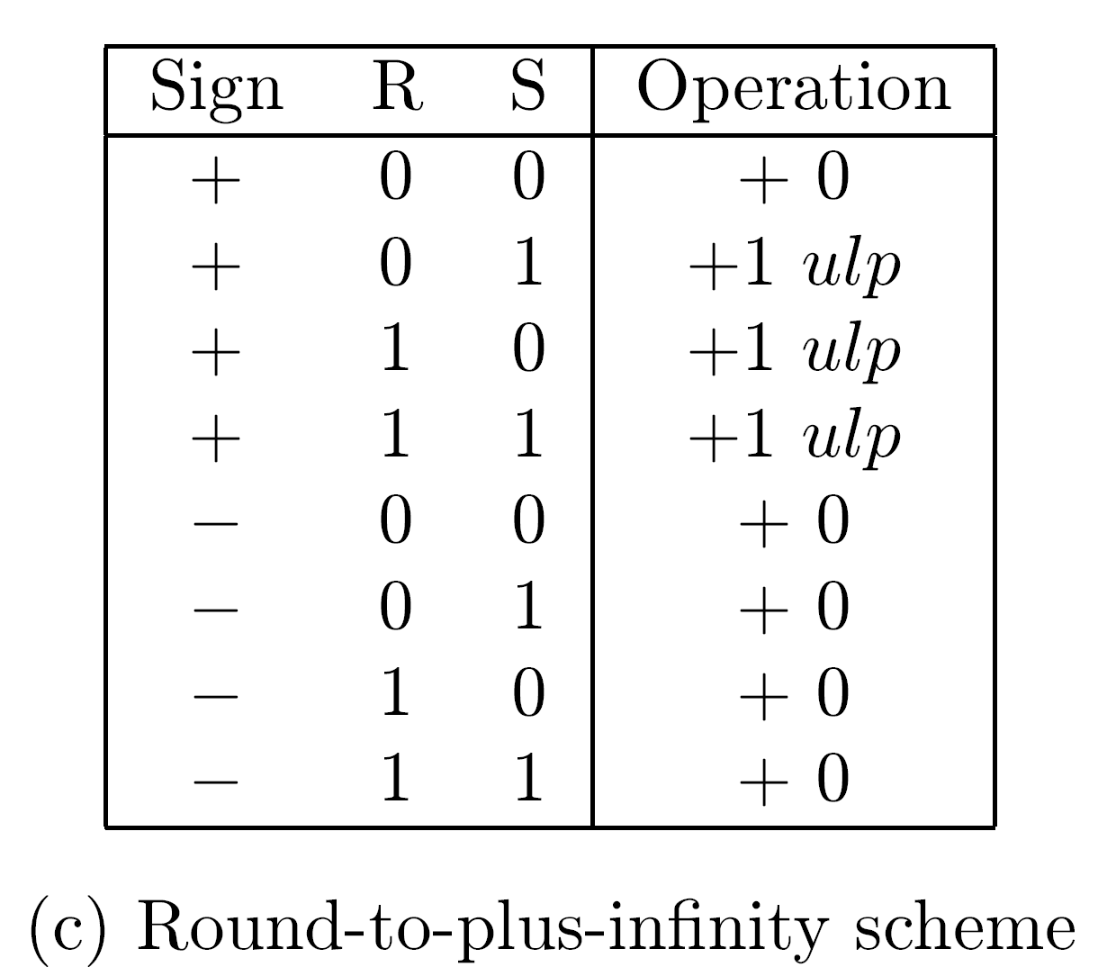
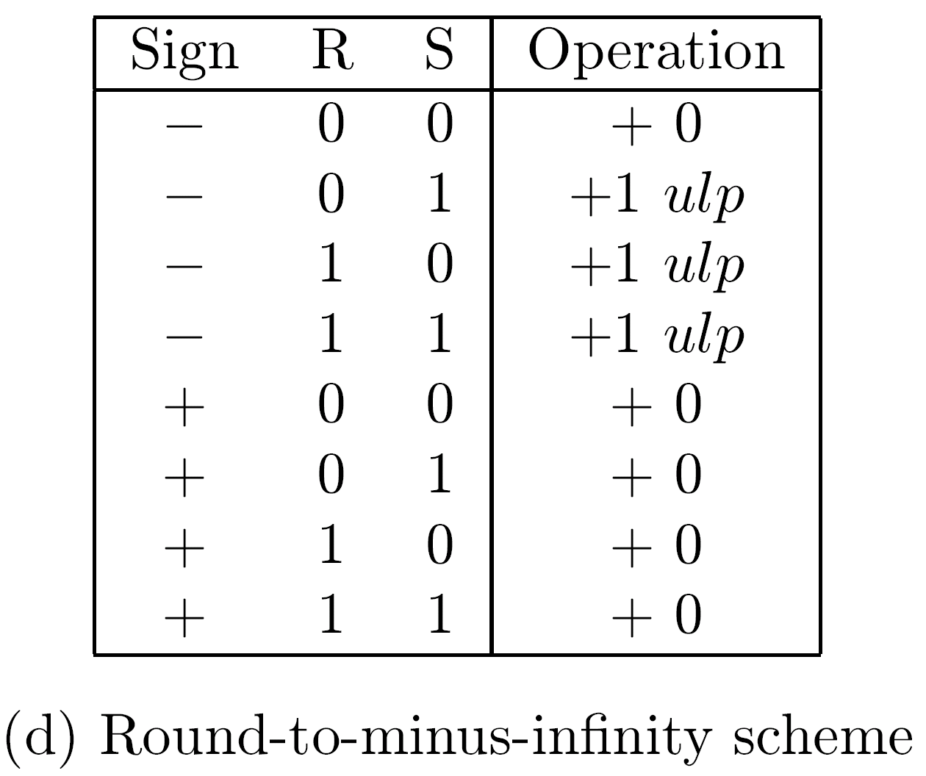
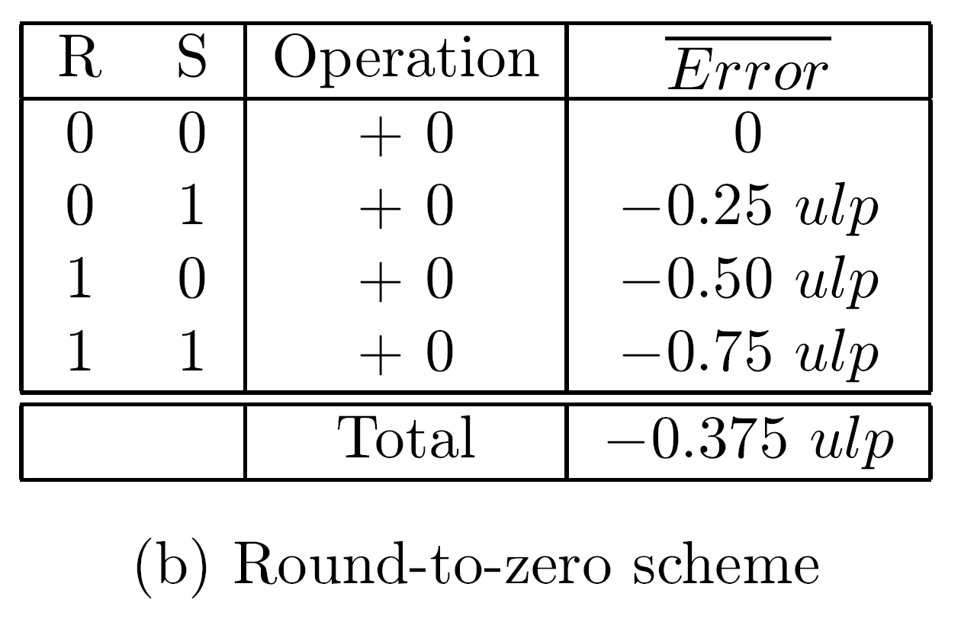
IEEE Format Rounding Rules
a

Slide 31
Adding ulp in rounding
Adding ulp after significands were added increases execution time of add/subtract
Can be avoided - all three guard bits are known before significands added
Adding 1 to L can be done at the same time that significands are added
Exact position of L is not known yet, since a postnormalization may be required
However, it has only two possible positions and two adders can be used in parallel
Can also be achieved using one adder

