Slide 1

UNIVERSITY OF MASSACHUSETTS
Dept. of Electrical & Computer Engineering
Digital Computer Arithmetic
ECE 666
Part 4-C
Floating-Point Arithmetic - III
Israel Koren
Spring 2008

Slide 2
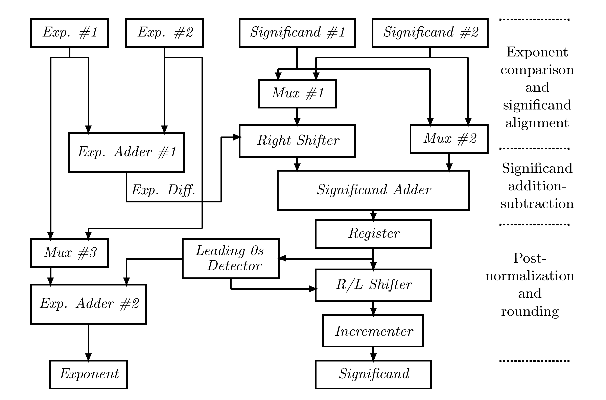
Floating-Point Adders
Addition - large number of steps executed sequentially - some can be executed in parallel

Slide 3
Effective Addition/Subtraction
Distinguish between effective addition and effective subtraction
  Depends on sign bits of operands and instruction executed
Effective addition:
  (1) Calculate exponent difference to determine alignment shift
  (2) Shift significand of smaller operand, add aligned significands
The result can overflow by at most one bit position
  Long postnormalization shift not needed
  Single bit overflow can be detected and, if found, a 1-bit normalization is performed using a multiplexor

Slide 4
Eliminate Increment in Rounding
Significand adder designed to produce two simultaneous results - sum and sum+1
  Called compound adder; can be implemented in various ways (e.g., carry-look-ahead or conditional sum)
Round-to-nearest-even - use rounding bits to determine which of the two should be selected
These two are sufficient even if a single bit overflow occurs
  In case of overflow, 1 is added in R position (instead of LSB position), and since R=1 if rounding needed, a carry will propagate to LSB to generate correct sum+1
Directed roundings - R not necessarily 1 - sum+2 may be needed

Slide 5
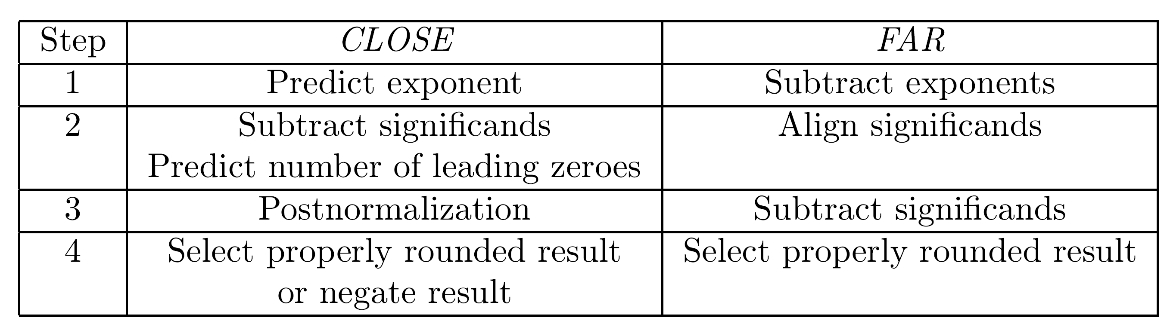
Effective Subtraction
Massive cancellation of most significant bits may occur - resulting in lengthy postnormalization
Happens only when exponents of operands are close (difference ≤ 1) - pre-alignment can be eliminated
Two separate procedures -
  (1) exponents are close (difference ≤ 1) - only a postnormalization shift may be needed
  (2) exponents are far (difference>1) - only a pre-alignment shift may be needed

Slide 6
CLOSE Case
Exponent difference predicted based on two least significant bits of operands - allows subtraction of significands to start as soon as possible
  If 0 - subtract executed with no alignment
  If ±1 - significand of smaller operand is shifted once to the right (using a multiplexor) and then subtracted from other significand
In parallel - true exponent difference calculated
  If > 1 - procedure aborted and FAR procedure followed
  If ≤ 1 - CLOSE procedure continued
In parallel with subtraction - number of leading zeros predicted to determine number of shift positions in postnormalization

Slide 7
CLOSE Case - Normalization and Rounding
Next - normalization of significand and corresponding exponent adjustment
Last - rounding - precomputing sum, sum+1 - selecting the one which is properly rounded - negation of result may be necessary
Result of subtraction usually positive - negation not required
Only when exponents equal - result of significand subtraction may be negative (in two's complement) - requiring a negation step
No pre-alignment - no guard bits - no rounding (exact result)
Negation and rounding steps - mutually exclusive

Slide 8
FAR Case
First - exponent difference calculated
Next - significand of smaller operand shifted to right for alignment
Shifted-out bits used to set sticky bit
Smaller significand subtracted from larger -result either normalized or requiring a single-bit-position left-shift (using a multiplexor)
Last step - rounding

Slide 9
Leading Zeros Prediction Circuit
Predict position of leading non-zero bit in result of subtract before subtraction is completed
Allowing to execute postnormalization shift immediately following subtraction
Examine bits of operands (of subtract) in a serial fashion, starting with most significant bits to determine position of first 1
This serial operation can be accelerated using a parallel scheme similar to carry-look-ahead

Slide 10
Alternative Prediction of Leading 1
Generate in parallel intermediate bits ei - ei=1 if
  (1) ai = bi and
  (2) ai-1 and bi-1 allow propagation of expected carry (at least one is 1)
  Subtract executed by forming one's complement of subtrahend and forcing carry into least significant position - carry expected
ei = (ai ⊕ bi) (ai-1 + bi-1) - ei=1 if carry allowed to propagate to position i
  If forced carry propagates to position i - i-th bit of correct result will also be 1
  If not - correct result will have a 1 in position i-1 instead
  Position of leading 1 - either same as ei or one to the right
Count number of leading zeros in ei - provide count to barrel shifter for postnormalization - at most one bit correction shift (left) needed

Slide 11
Exceptions in IEEE Standard
Five types : overflow, underflow, division-by-zero, invalid operation, inexact result
First three - found in almost all floating-point systems ; last two - peculiar to IEEE standard
When an exception occurs - status flag set (remains set until cleared) - specified result generated
  Example - a correctly signed ∞ for division-by-zero
Separate trap-enable bit for each exception
If bit is on when corresponding exception occurs - user trap handler is called
Sufficient information must be provided by floating-point unit to trap handler to allow taking action
  Example - exact identification of exception causing operation

Slide 12
Overflow - Trap Disabled
Overflow exception flag set whenever exponent of result exceeds largest value allowed
Example - single-precision - overflow occurs if E>254
Final result determined by sign of intermediate (overflowed) result and rounding mode:
  Round-to-nearest-even - ∞ with sign of intermediate result
  Round toward 0 - largest representable number with sign of intermediate result
  Round toward -∞ - largest representable number with a plus sign if intermediate result positive; otherwise -∞
  Round toward ∞ - largest representable number with a minus sign if intermediate result negative; otherwise +∞

Slide 13
Overflow - Trap Enabled
Trap handler receives intermediate result divided by 2 and rounded
a = 192 / 1536 for single / double-precision format
Chosen in order to translate the overflowed result as nearly as possible to middle of exponent range so that it can be used in subsequent operations with less risk of causing further exceptions
a

Slide 14
Example
127
Multiplying 2 (with E=254 in single-precision) by 2 - overflowed product has E=254+254-127 =381 after being adjusted by 127
Result overflows - E>254
If product scaled (multiplied) by 2 - E=381-192=189 - “true” value of 189-127=62
Smaller risk of causing further exceptions
Relatively small operands can result in overflow
Multiply 2 (E=191 in single-precision) by 2 (E=192)
Overflowed product - E=191+192-127=256
Exponent adjusted by 192 - E=256-192=64 - “true” value of 64-127=-63
127
-192
64
65

Slide 15
Underflow - Trap Enabled
Underflow exception flag is set whenever the result is a nonzero number between -2 and 2
Emin=-126 in single-precision format; 1022 in double-precision format
Intermediate result delivered to underflow trap handler is the infinitely precise result multiplied by 2 and rounded
a=192 in single precision format; 1536 in double-precision format
Emin
Emin
a

Slide 16
Underflow - Trap Disabled
Denormalized numbers allowed
Underflow exception flag set only when an extraordinary loss of accuracy occurs while representing intermediate result (with a nonzero value between ±2 ) as a denormalized number
Such a loss of accuracy occurs when either guard bit or sticky bit is nonzero- indicating an inexact result
In an arithmetic unit where denormalized numbers are not implemented - delivered result is either zero or ±2
Emin
Emin

Slide 17
Underflow - Trap Disabled - Example
Denormalized numbers implemented
Multiply 2 by 2
  Result - E=(127-65)+(127-65)-127=-3 < 1
  Cannot be represent as a normalized number
  Result 2 represented as the denormalized number 0.0001 2 - f=.0001 ; E=0
No underflow exception flag is set
If second operand is (1+ulp) 2
  Correct product is (1+ulp) 2
  Converted to a denormalized number - f=.0001 ; E=0
  Now sticky bit = 1
Inexact result - underflow exception flag is set
-65
-65
-130
-126
-65
-130

Slide 18
Invalid Operation
Flag is set if an operand is invalid for operation to be performed
Result - when invalid operation trap is disabled - quiet NaN
Examples of invalid operations :
  Multiplying 0 by ∞
  Dividing 0 by 0 or ∞ by ∞
  Adding +∞ and -∞
  Finding the square root of a negative operand
  Calculating the remainder x REM y where y=0 or x=∞
  Any operation on a signaling NaN

Slide 19
Division by Zero & Inexact Result
Divide-by-zero exception flag is set whenever divisor is zero and dividend is a finite nonzero number
When corresponding trap is disabled - result is a correctly signed ∞
Inexact Result flag is set if rounded result is not exact or if it overflows without an overflow trap
A rounded result is exact only when both guard bit and sticky bit are zero - no precision was lost when rounding
Allows performing integer calculations in a floating-point unit

Slide 20
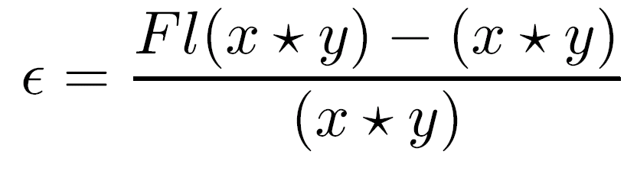
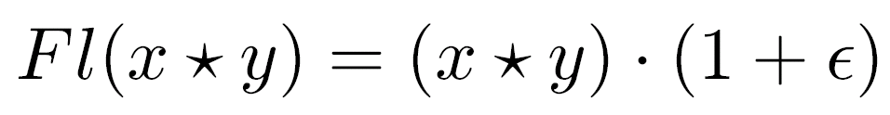
Accumulation of Round-off Errors
Rounding in floating-point operations - even with best rounding schemes - results in errors that tend to accumulate as number of operations increases
  ∈ - relative round-off error in a floating-point operation
  ∗ - any floating-point arithmetic operation +,-,×,÷
  Fl(x ∗ y) - rounded or truncated result of x ∗ y

Slide 21
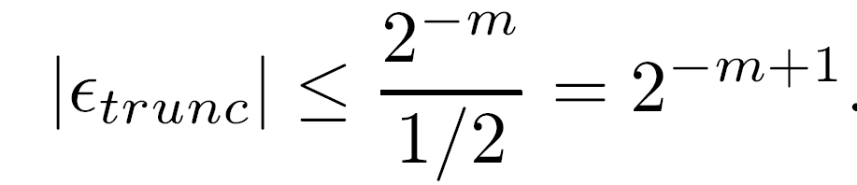
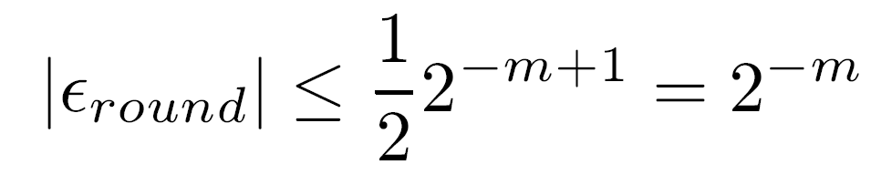
Upper Bounds of Relative Errors
Truncation -
Absolute error - maximum is least-significant digit of significand.
Relative error - worst case when normalized result is smallest
Round-to-nearest -
Absolute error - maximum is half of ulp
Relative error -

Slide 22
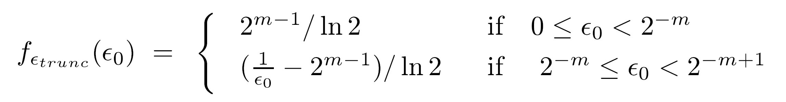
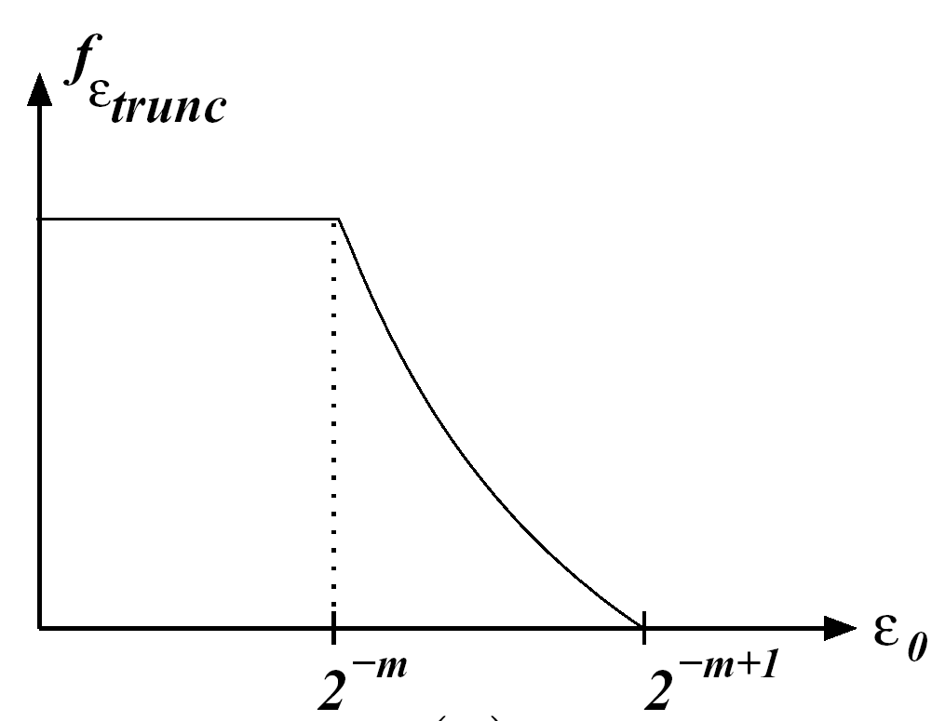
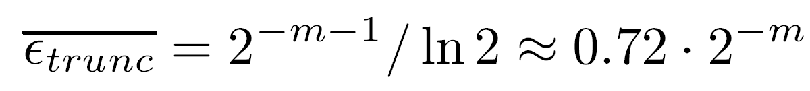
Distribution of Relative Truncation Error
Density function of relative truncation error -
Relative truncation errors -
  uniformly distributed in [0, 2 ]
  reciprocally in [2 , 2 ]
Average relative error -
-m
-m
-m+1

Slide 23
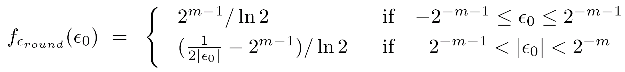
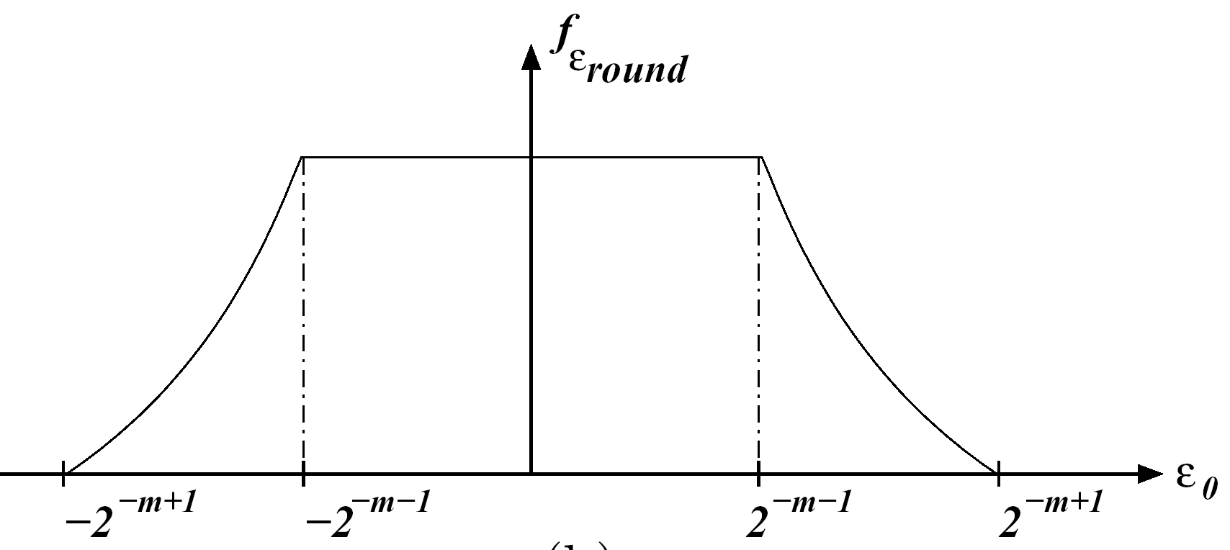
Distribution of Relative Rounding Error
Density function of relative rounding error -
Relative rounding errors -
  uniformly distributed in [-2 , 2 ]
  reciprocally elsewhere
  symmetric
Average relative error = 0
Analytical expressions are in very good agreement with empirical results
-m-1
-m-1

Slide 24
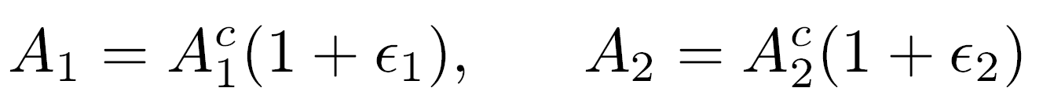
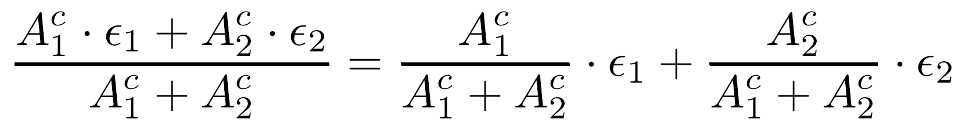
Accumulation of Errors - Addition
Adding two intermediate results A1, A2
  correct values - A1 , A2
  relative errors ∈1, ∈2
Assumption - no new error introduced in addition - relative error of sum
Relative error of sum - weighted average of relative errors of operands
If both operands positive - error in sum dominated by error in larger operand
c
c

Slide 25
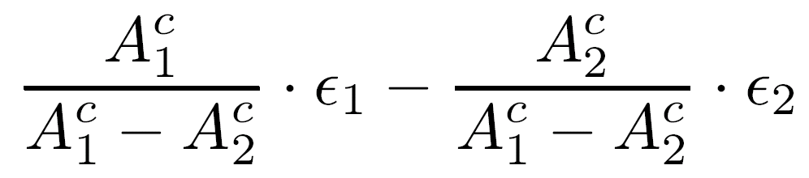
Accumulation of Errors - Subtraction
Subtracting two intermediate results A1, A2 - more severe error accumulation
Relative error -
  If A1, A2 are close positive numbers - accumulated relative error can increase significantly
  If ∈1, ∈2 have opposite signs - inaccuracy can be large
Accumulation of errors for a long sequence of floating-point operations depends on the specific application - difficult to analyze - can be simulated
In most cases - accumulated relative error in truncation is higher than in round-to-nearest

