Slide 1

UNIVERSITY OF MASSACHUSETTS
Dept. of Electrical & Computer Engineering
Digital Computer Arithmetic
ECE 666
Part 5b
Fast Addition - II
Israel Koren
Spring 2008

Slide 2
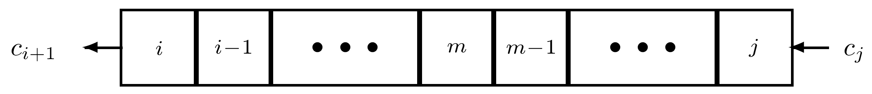
Carry-Look-Ahead Addition Revisited
Generalizing equations for fast adders - carry-look-ahead, carry-select and carry-skip
Notation:
  Pi:j - group-propagated carry
  Gi:j - group-generated carry
for group of bit positions i,i-1,...,j (i ≥ j)
Pi:j=1 when incoming carry into least significant position j, cj, is allowed to propagate through all i-j+1 positions
Gi:j=1 when carry is generated in at least one of positions j to i and propagates to i+1, (ci+1 = 1)
  Generalization of previous equations
  Special case - single bit-position functions Pi and Gi

Slide 3
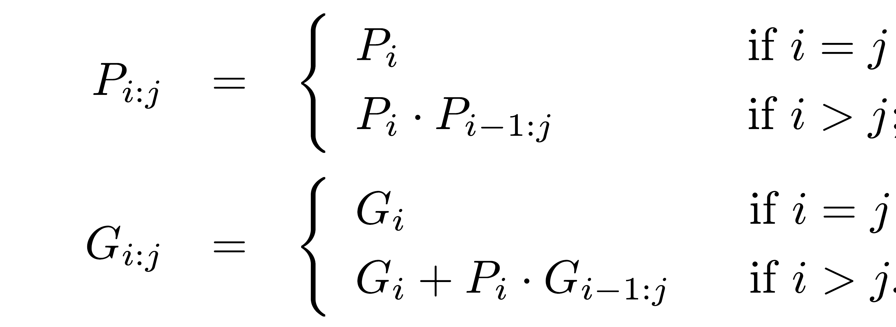
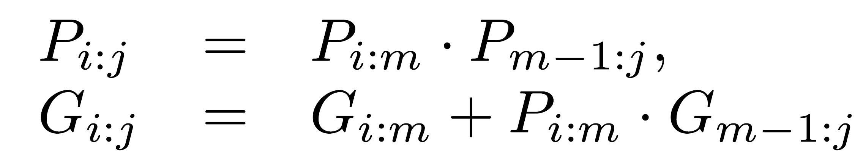
Group-Carry Functions
Boolean equations
Pi:i ≡ Pi ; Gi:i ≡ Gi
Recursive equations can be generalized (i ≥ m ≥ j+1)
Same generalization used for deriving section-carry propagate and generate functions - P** and G**
Proof - induction on m

Slide 4
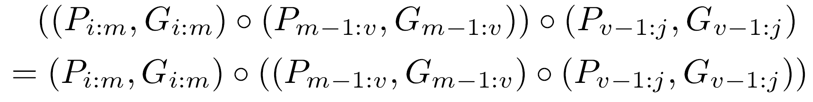
Fundamental Carry Operator
Boolean operator - fundamental carry operator - ο
Using the operator ο
(Pi:j,Gi:j)=(Pi:m,Gi:m) ο (Pm-1:j,Gm-1:j) (i≥m≥j+1)
Operation is associative
Operation is idempotent
Therefore (Pi:j,Gi:j)=(Pi:m,Gi:m) ο (Pv:j,Gv:j) i≥m ; v≥j ; v≥m-1

Slide 5
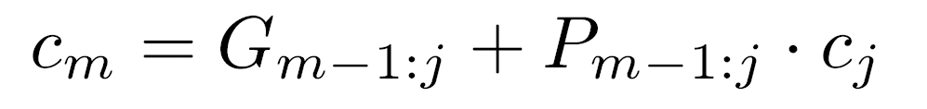
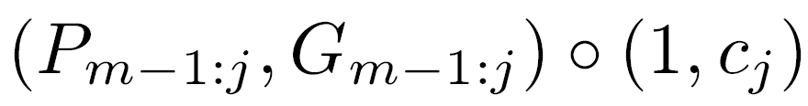
Individual Bit Carry & Sum
Group carries Pi:j and Gi:j calculated from subgroup carries - subgroups are of arbitrary size and may even overlap
Group and subgroup carries used to calculate individual bit carries ci+1, ci,…, cj+1, and sum outputs si, si-1,…, sj
Must take into account “external” carry cj
For the mth bit position, i ≥ m ≥ j -
rewritten as
If Pm = xm ⊕ ym then sm = cm ⊕ Pm
If Pm=xm+ym then sm=cm ⊕ (xm ⊕ ym)

Slide 6
Various Adder Implementations
Equations can be used to derive various implementations of adders - ripple-carry, carry-look-ahead, carry-select, carry-skip, etc.
5-bit ripple-carry adder: All subgroups consist of a single bit position ; computation starts at position 0, proceeds to position 1 and so on
16-bit carry-look-ahead adder: 4 groups of size 4; ripple-carry among groups

Slide 7
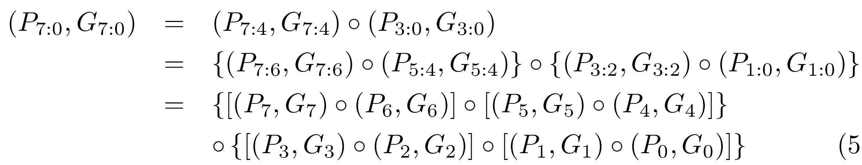
Brent-Kung Adder
Variant of carry-look-ahead adder - blocking factor of 2 → very regular layout tree with log2n levels - total area ≈ n log2n
Consider c16 - incoming carry at stage 16 in a 17-bit (or more) adder and suppose G0=x0 y0+P0 c0
The part that generates (P7:0,G7:0) corresponds to
Each line, except c0, represents two signals - either xm,ym or Pv:m,Gv:m

Slide 8
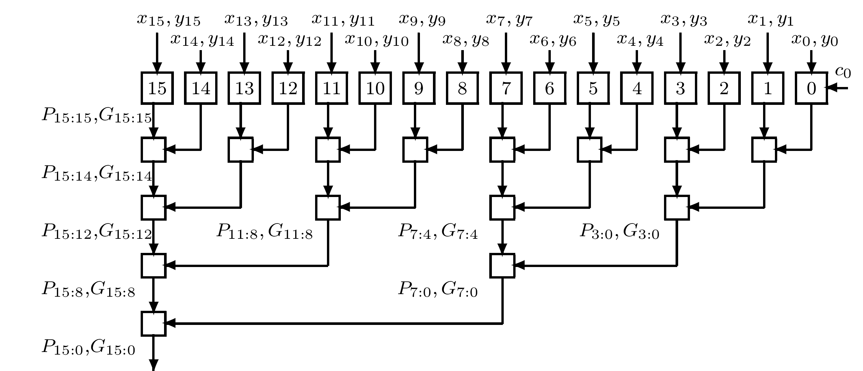
Tree Structure for Calculating C16

Slide 9
Carry Calculation
Circuits in levels 2 to 5 implement fundamental carry op
c16=G15:0 ; Pm=xm⊕ym sum: s16=c16 ⊕ P16
Tree structure also generates carries c2, c4 and c8
Carry bits for remaining positions can be calculated through extra subtrees that can be added
Once all carries are known - corresponding sum bits can be computed
Above - blocking factor = 2
  Different factors for different levels may lead to more efficient use of space and/or shorter interconnections

Slide 10
Prefix Adders
The BK adder is a parallel prefix circuit - a combinational circuit with n inputs x1,x2,...,xn producing outputs x1,x2 ο x1,...,xn ο xn-1 ο ... ο x1
ο is an associative binary operation
First stage of adder generates individual Pi and Gi
Remaining stages constitute the parallel prefix circuit with fundamental carry operation serving as the ο associative binary operation
This part of tree can be designed in different ways

Slide 11
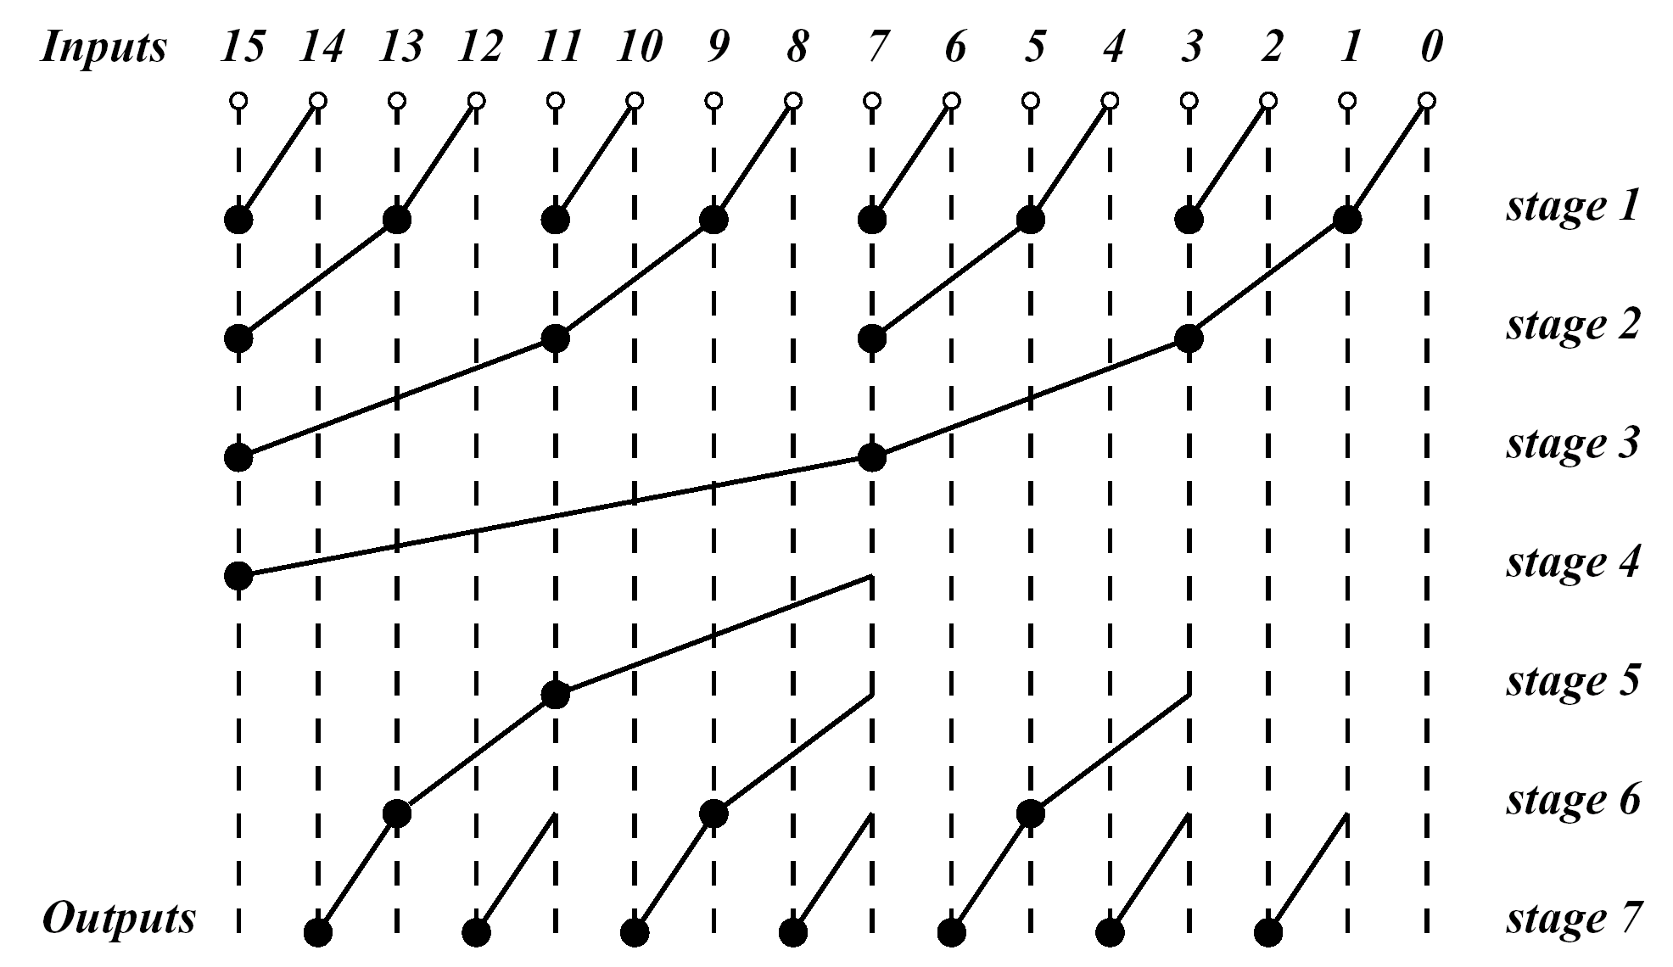
Implementation of the 16-bit Brent-Kung Adder

Slide 12
Brent-Kung Parallel Prefix Graph
Bullets implement the fundamental carry operation - empty circles generate individual Pi and Gi
Number of stages and total delay - can be reduced by modifying structure of parallel prefix graph
Min # of stages = log2n
  4 for n=16
  For BK parallel prefix graph = 2log2n - 1

Slide 13
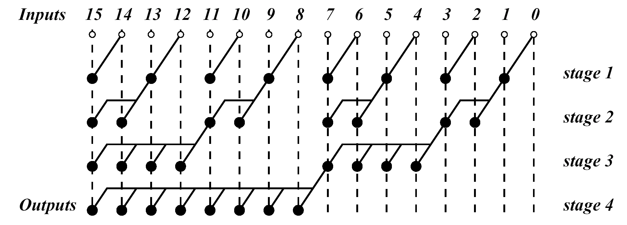
Ladner-Fischer Parallel Prefix Adder
Implementing a 4-stage parallel prefix graph
Unlike BK, LF adder employs fundamental carry operators with a fan-out ≥ 2 - blocking factor varies from 2 to n/2
Fan-out ≤ n/2 requiring buffers - adding to overall delay

Slide 14
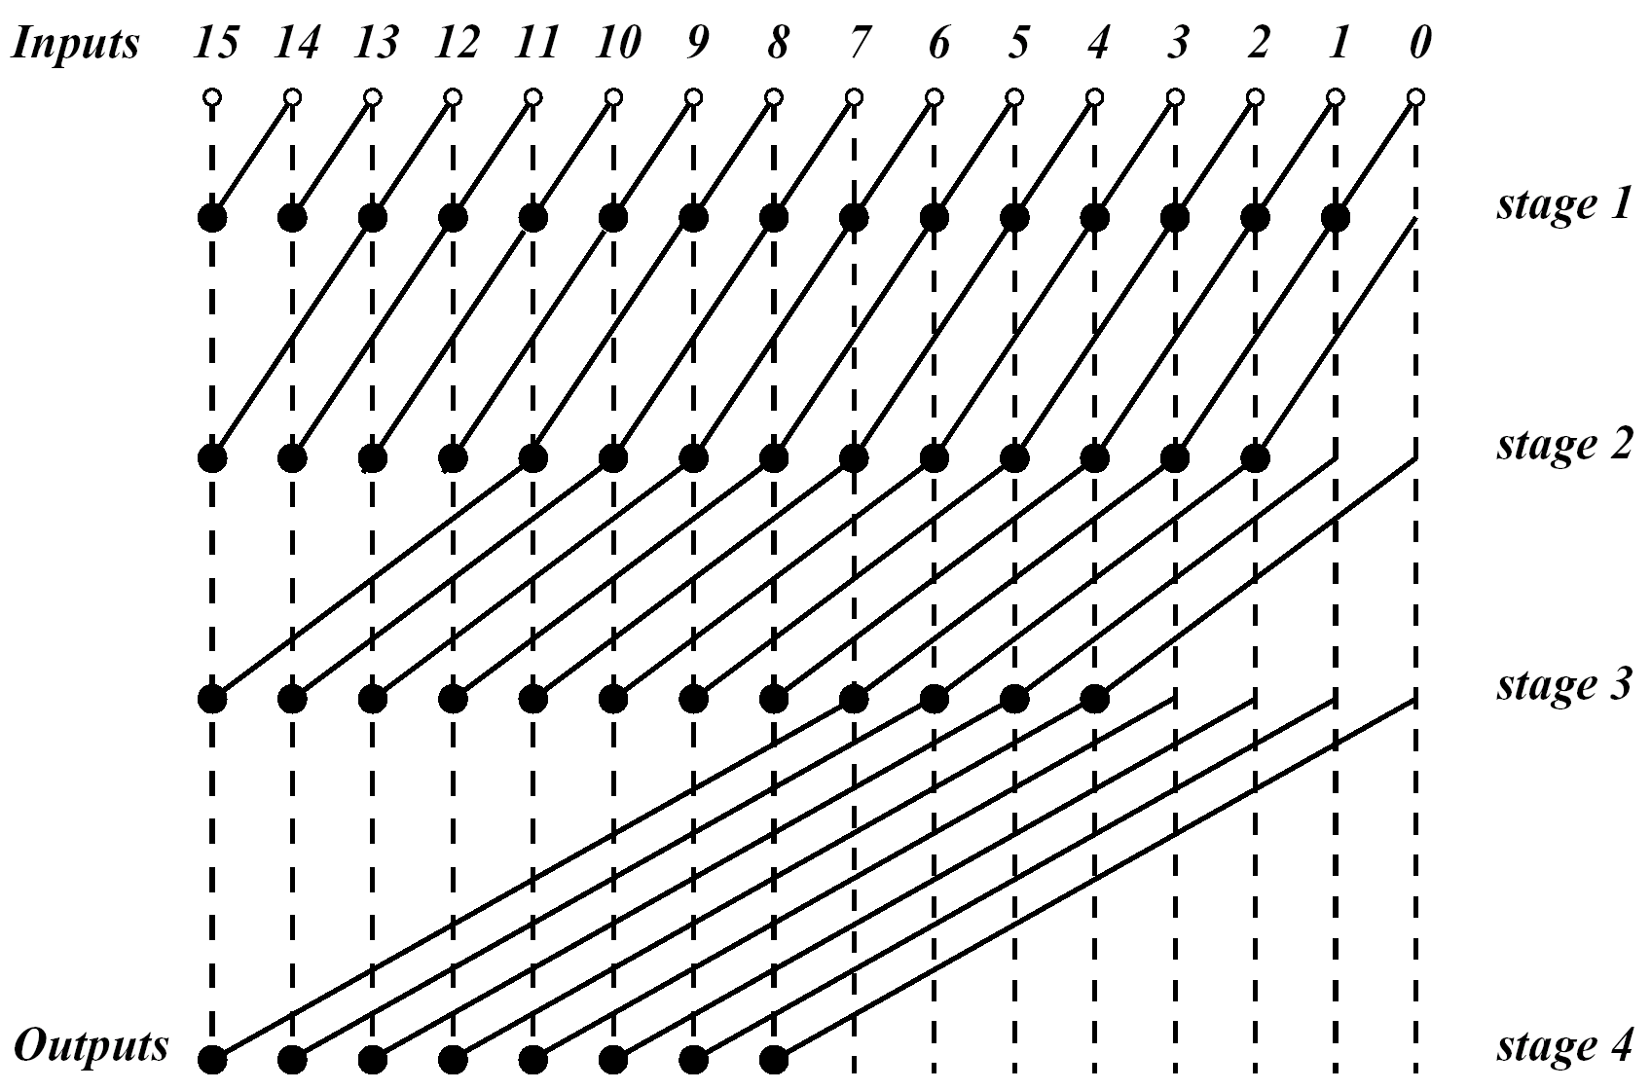
Kogge-Stone Parallel Prefix Adder
log2n stages - but lower fan-out
More lateral wires with long span than BK - requires buffering causing additional delay

Slide 15
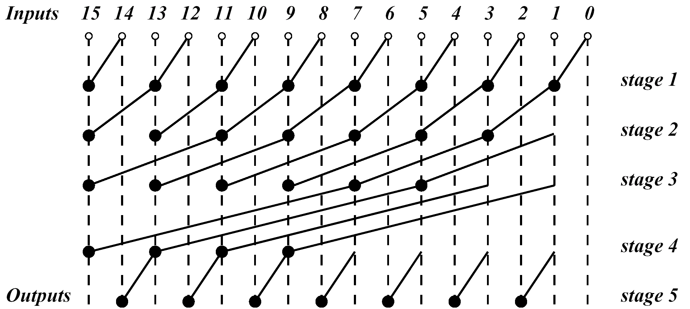
Han-Carlson Parallel Prefix Adder
Other variants - small delay in exchange for high overall area and/or power
  Compromises between wiring simplicity and overall delay
A hybrid design combining stages from BK and KS
  5 stages - middle 3 resembling KS - wires with shorter span than KS

Slide 16
Ling Adders
Variation of carry-look-ahead - simpler version of group-generated carry signal - reduced delay
Example: A carry-look-ahead adder - groups of size 2 - produces signals G1:0,P1:0,G3:2,P3:2,...
Outgoing carry for position 3 - c4=G3:0=G3:2+P3:2 G1:0
where G3:2=G3+P3 G2 ; G1:0=G1+P1 G0 ; P3:2=P3 P2
Either assume c0=0 or set G0=x0 y0+P0 c0
  Also Pi = Xi + Yi
G3:0 =G3+P3 G2+P3 P2 (G1+P1 G0)
since G3 = G3 P3 - G3:0 = P3 H3:0
  where H3:0 = H3:2+P2:1 H1:0 ; H3:2=G3+G2 ; H1:0=G1+G0
Note: P2:1 used instead of P3:2 before

Slide 17
Ling Adders - Cont.
H - alternative to carry generate G
  Similar recursive calculation
  No simple interpretation like G
  Simpler to calculate
Example: H3:0 = G3 + G2 + P2P1 (G1+G0)
Simplified - H3:0 = G3 + G2 + P2G1 + P2P1G0
While - G3:0 = G3 + P3G2 + P3P2G1 + P3P2P1G0
Smaller maximum fan-in → simpler/faster circuits
Variations of G have corresponding variations for H
G3:0 = G3 + P3G2:0 - H3:0 = G3 + T2H2:0 where T2 = x2 + y2
General expression for H -
Hi:0 = Gi + Ti-1Hi-1:0 where Ti-1 = xi-1 + yi-1

Slide 18
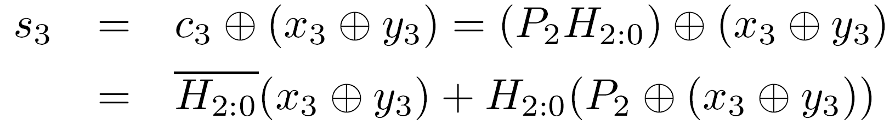
Calculation of Sum Bits in Ling Adder
Slightly more involved than for carry-look-ahead
Example:
Calculation of H2:0 faster than c3 - delay reduced
Other variations of carry-look-ahead and implementations of Ling adders appear in literature

Slide 19
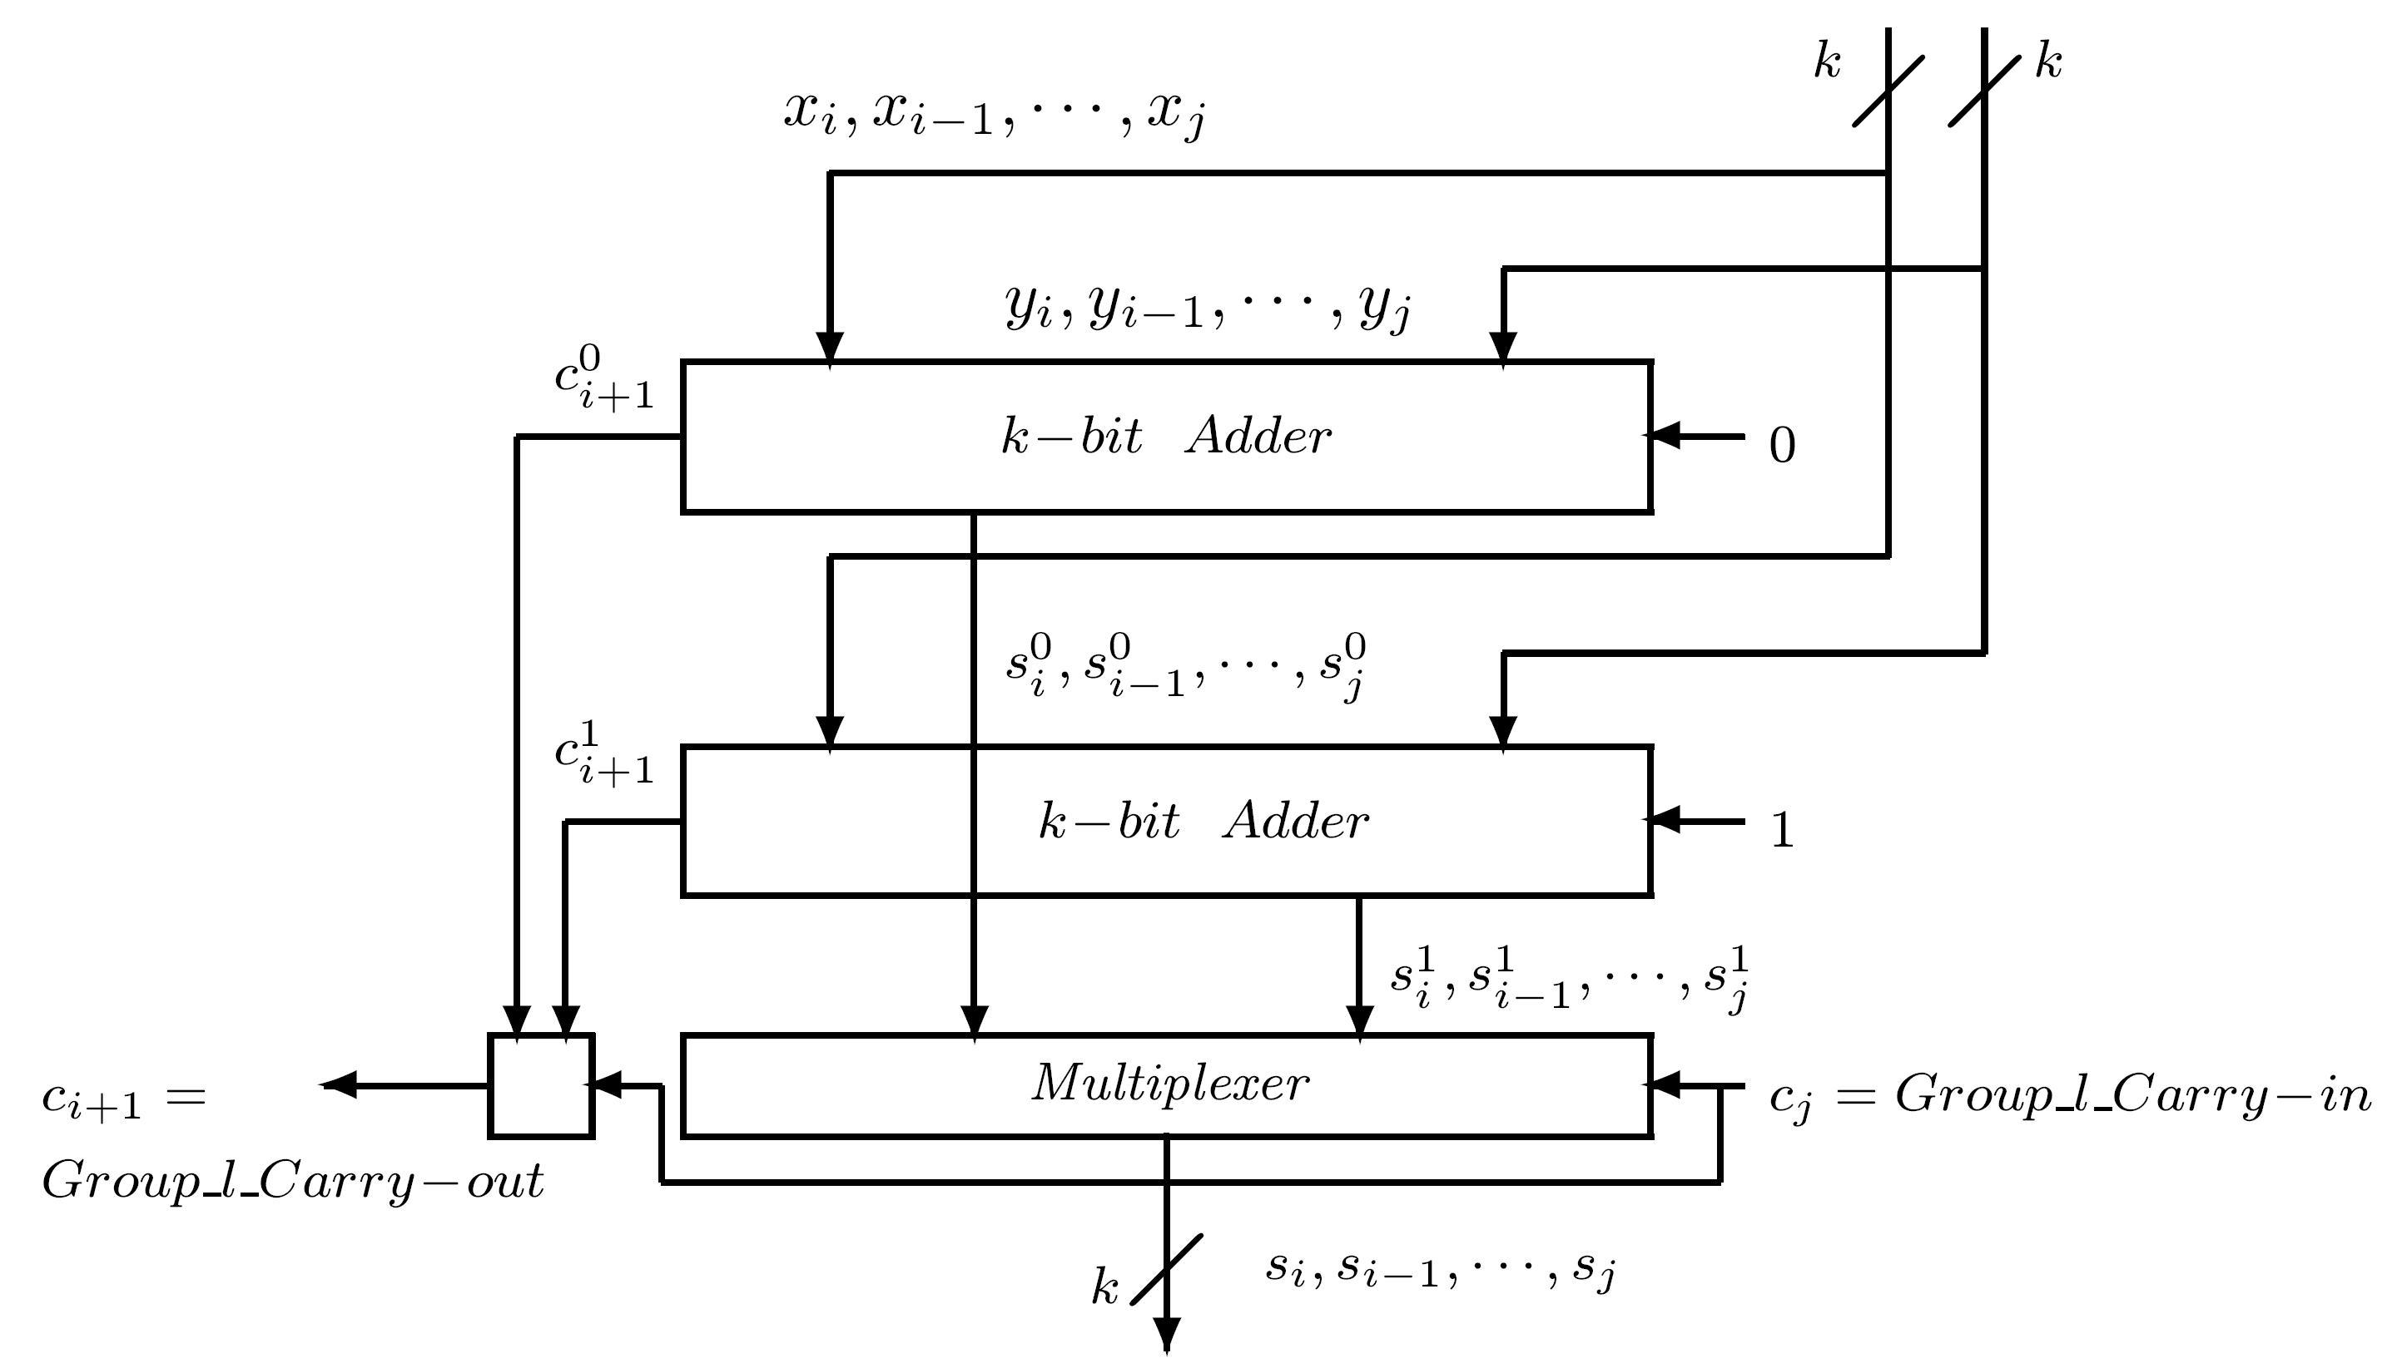
Carry-Select Adders
n bits divided into non-overlapping groups of possibly different lengths - similar to conditional-sum adder
Each group generates two sets of sum and carry; one assumes incoming carry into group is 0, the other 1
the l th group consists of k bit positions starting with j and ending with i=j+k-1

Slide 20
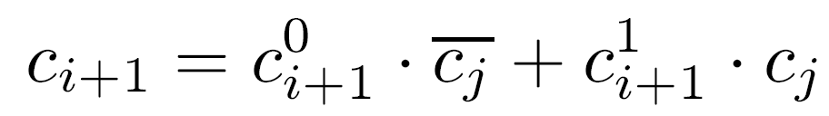
Carry-Select Adder - Equations
Outputs of group: sum bits si, si-1, … , sj and group outgoing carry ci+1
Same notation as for conditional-sum adder
Two sets of outputs can be calculated in a ripple-carry manner

Slide 21
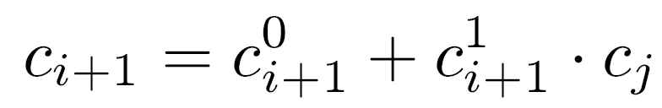
Detailed Expressions
0
1
For bit m - calculate carries from Gm-1:j ; Gm-1:j
Pm-1:j has no superscript - independent of incoming carry
Once individual carries are calculated - corresponding sum bits are
Since ci+1 implies ci+1 -
Group sizes can be either different or all equal to k, with possibly one group smaller
0
1

Slide 22
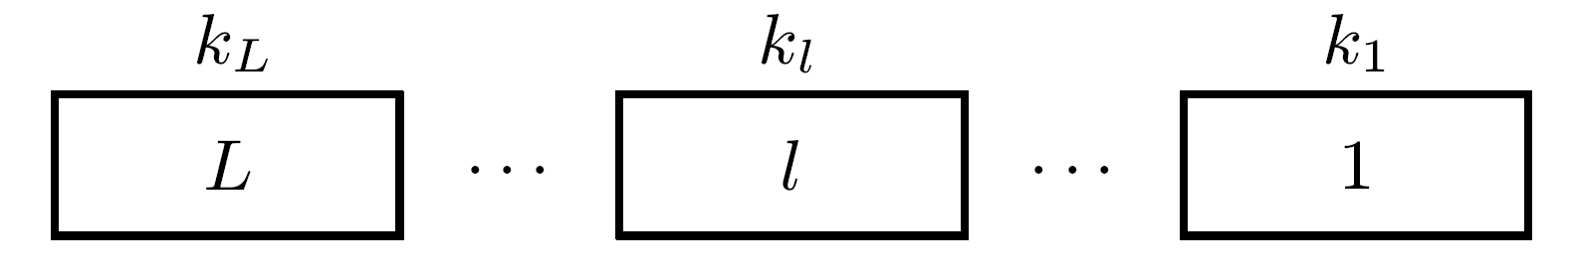
Different Group Sizes
Notations:
  Size of group l - kl
  L - number of groups
  ΔG - delay of a single gate
kl chosen so that delay of ripple-carry within group and delay of carry-select chain from group 1 to l are equal
Actual delays depend on technology and implementation
Example: Two-level gate implementation of MUX
  Delay of carry-select chain through preceding l-1 groups - (l -1)2ΔG
  Delay of ripple-carry in l th group - kl 2ΔG
Equalizing the two - kl = l -1 with kl ≥ 1 ; l =1,2,…,L

Slide 23
Different Group Sizes - Cont.
Resulting group sizes - 1, 1, 2, 3, ...
Sum of group sizes ≥ n
1+L(L-1)/2 ≥ n → L(L-1) ≥ 2(n-1)
Size of largest group and execution time of carry-select adder are of the order of √n
Example: n=32, 9 groups required - one possible choice for sizes: 1, 1, 2, 3, 4, 5, 6, 7 & 3
Total carry propagation time is 18ΔG, instead of 62ΔG for ripple-carry adder
If sizes of L groups are equal - carry-select chain (i.e., generating Group Carry-Out from Group Carry-In) not necessarily ripple-carry type
Single or multiple-level carry-look-ahead can be used
___

Slide 24
Carry-Skip Adders
Reduces time needed to propagate carry by skipping over groups of consecutive adder stages
Generalizes idea behind Manchester Adder
Illustrates dependence of “optimal” algorithm for addition on available technology
  Known for many years, only recently became popular
In VLSI - speed comparable to carry look-ahead (for commonly used word lengths - not asymptotically)
Requires less chip area and consumes less power
Based on following observation:
Carry propagation process can skip any adder stage for which xm ≠ ym (or, Pm = xm ⊕ ym = 1)
Several consecutive stages can be skipped if all satisfy xm ≠ ym

Slide 25
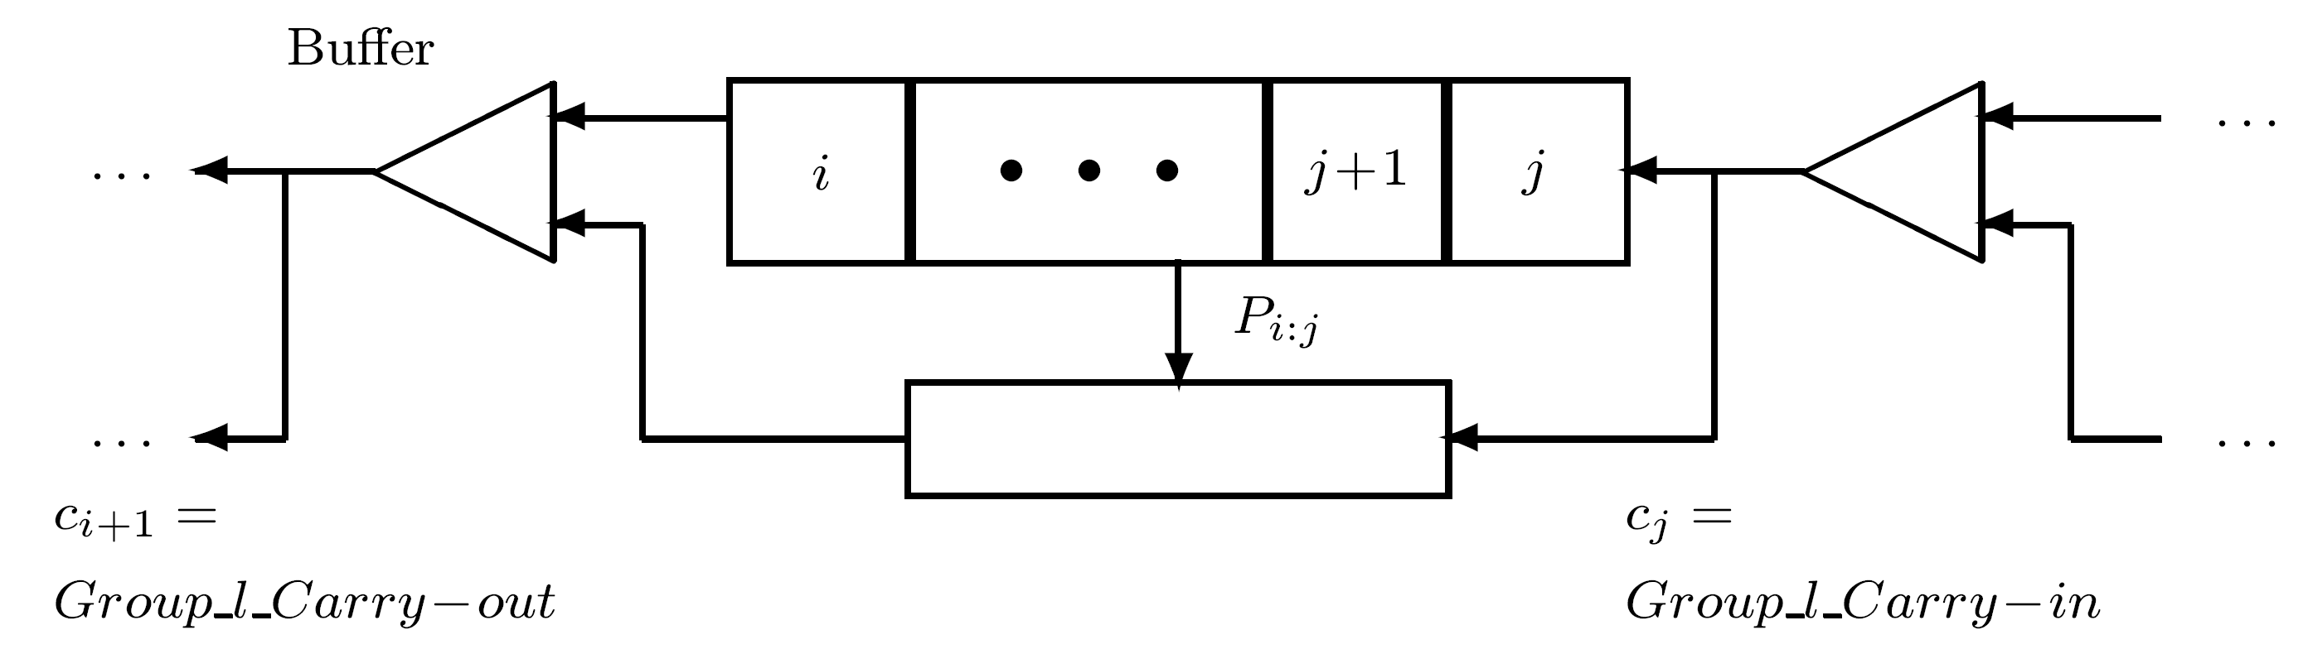
Carry-Skip Adder - Structure
n stages divided into groups of consecutive stages with simple ripple-carry used in each group
Group generates a group-carry-propagate signal that equals 1 if for all internal stages Pm=1
Signal allows an incoming carry into group to “skip” all stages within group and generate a group-carry-out
Group l consists of k bit positions j,j+1,…,j+k-1(=i)

Slide 26
Structure - Cont.
Group_l _Carry-out = Gi:j + Pi:j Group_l _Carry-in
Gi:j = 1 when a carry is generated internal to group and allowed to propagate through all remaining bit positions including i
Pi:j = 1 when k=i-j+1 bit positions allow incoming carry cj to propagate to next position i+1
Buffers realize the OR operation

Slide 27
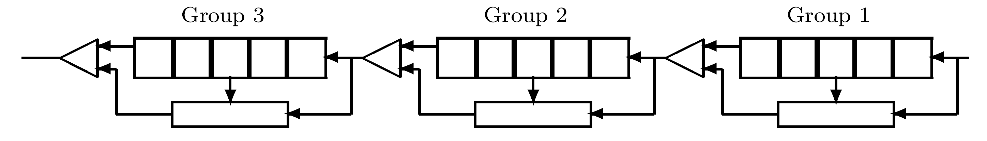
Example - 15-bit carry-skip adder
Consisting of 3 groups of size 5 each
Pi:j for all groups can be generated simultaneously allowing a fast skip of groups which satisfy Pi:j=1

Slide 28
Determining Optimal Group Size k
Assumption: Groups have equal size k - n/k integer
k selected to minimize time for longest carry-propagation chain
Notations:
  tr - carry-ripple time through a single stage
  ts(k) - time to skip a group of size k (for most implementations - independent of k)
  tb - delay of buffer (implements OR) between two groups
  Tcarry - overall carry-propagation time - occurs when a carry is generated in stage 0 and propagates to stage n-1
Carry will ripple through stages 1,2, … ,k-1 within group 1, skip groups 2,3, … , (n/k-1), then ripple through group n/k

Slide 29
Determining Optimal k - Cont.
Tcarry=(k-1)tr+tb+(n/k-2)(ts+tb)+(k-1)tr
Example - two-level gate implementation used for ripple-carry and carry-skip circuits
  tr = ts+tb=2ΔG
  Tcarry=(4k+2n/k-7) ΔG
Differentiating Tcarry with respect to k and equating to 0 -
kopt = √n/2
Group size and carry propagation time proportional to √n - same as for carry-select adder
Example: n=32, 8 groups of size kopt = 4 is best
Topt=25ΔG instead of 62ΔG for ripple-carry adder
_____
___

Slide 30
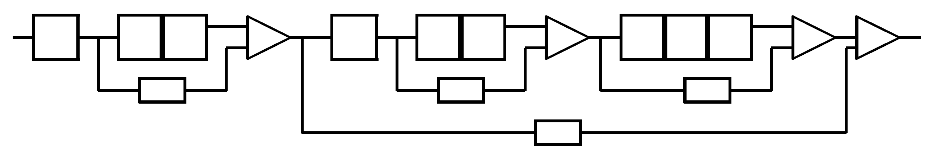
Further Speedup
Size of first and last groups smaller than fixed size k - ripple-carry delay through these is reduced
Size of center groups increased - since skip time is usually independent of group size
Another approach: add second level to allow skipping two or more groups in one step (more levels possible)
Algorithms exist for deriving optimal group sizes for different technologies and implementations (i.e., different values of ratio (ts+tb)/tr)

Slide 31
Variable-Size Groups
Unlike equal-sized group case - cannot restrict to analysis of worst case for carry propagation
This may lead to trivial conclusion: first and last groups consisting of a single stage - remaining n-2 stages constituting a single center group
Carry generated at the beginning of center group may ripple through all other n-3 stages - becoming the worst case
Must consider all possible carry chains starting at arbitrary bit position a (with xa=ya) and stopping at b (xb=yb) where a new carry chain (independent of previous) may start

Slide 32
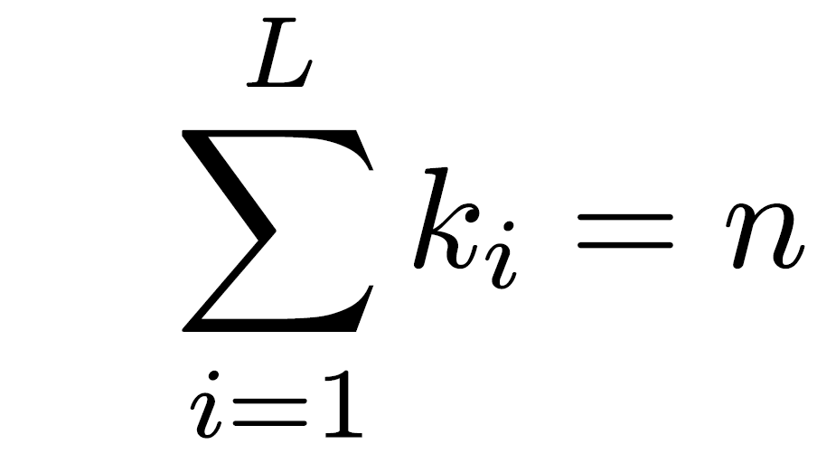
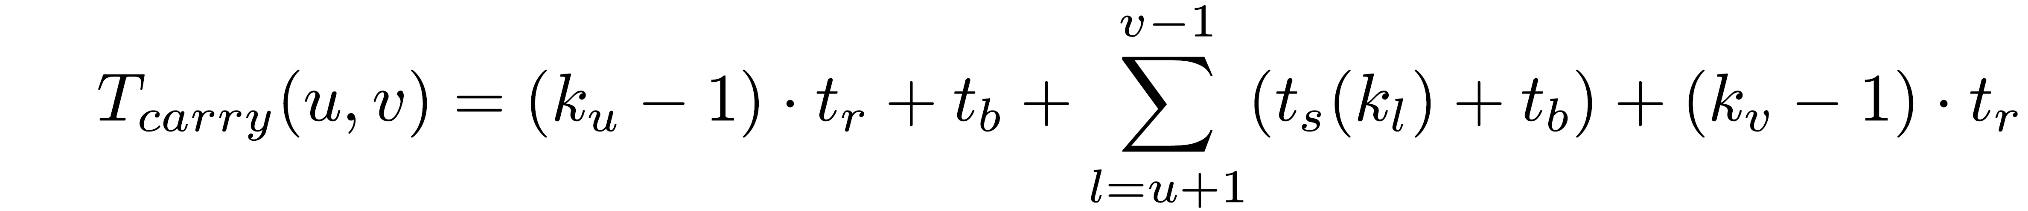
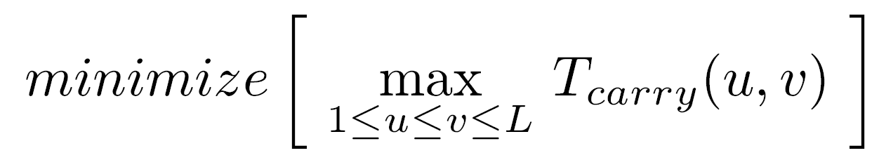
Optimizing Different Size Groups
k1, k2, … , kL - sizes of L groups -
General case: Chain starts within group u, ends within group v, skips groups u+1, u+2, … ,v-1
Worst case - carry generated in first position within u and stops in last position within v
Overall carry-propagation time is
Number of groups L and sizes k1, k2, …, kL selected so that longest carry-propagation chain is minimized -
Solution algorithms developed - geometrical interpretations or dynamic programming

Slide 33
Optimization - Example
32-bit adder with single level carry-skip
ts+tb=tr
Optimal organization - L=10 groups with sizes k1,k2,…,k10 = 1,2,3,4,5,6,5,3,2,1
Resulting in Tcarry ≤ 9 tr
If tr=2 ΔG - Tcarry ≤ 18 ΔG instead of 25 ΔG in equal-size group case
Exercise: Show that any two bit positions in any two groups u and v ( 1 ≤ u ≤ v ≤ 10 ) satisfy Tcarry(u,v) ≤ 9 tr

Slide 34
Carry-skip vs. Carry-select Adder
Strategies behind two schemes sound different
Equations relating group-carry-out with group-carry-in are variations of same basic equation
Both have execution time proportional to √n
Only details of implementation vary, in particular calculation of sum bits
Even this difference is reduced when the multiplexing circuitry is merged into summation logic
___

