Slide 1

UNIVERSITY OF MASSACHUSETTS
Dept. of Electrical & Computer Engineering
Digital Computer Arithmetic
ECE 666
Part 5c
Fast Addition - III
Israel Koren
Spring 2008

Slide 2
Hybrid Adders
Combination of two or more addition methods
Common approach: one method for carry - another for sum
Two hybrid adders combining variation of a carry-select for sum and modified Manchester for carry
  Both divide operands into equal groups - 8 bits each
  First - uses carry-select for sum for each group of 8 bits separately
  Second - uses a variant of conditional-sum
Group carry-in signal that selects one out of two sets of sum bits not generated in ripple-carry
Instead, carries into 8-bit groups generated by a carry-look-ahead tree
64-bit adder - carries are c8,c16,c24,c32,c40,c48,c56

Slide 3
Blocking Factor in Carry Tree
Structure of carry-look-ahead tree for generating carries similar to those seen before
Differences - variations in blocking factor at each level and exact implementation of fundamental carry operator
Restricting to a fixed blocking factor - natural choices include 2, 4 or 8
  2 - largest number of levels in tree, vs.
  8 - complex modules for fundamental carry operator with high delay
Factor of 4 - a reasonable compromise
A Manchester carry propagate/generate module (MCC) with a blocking factor of 4

Slide 4
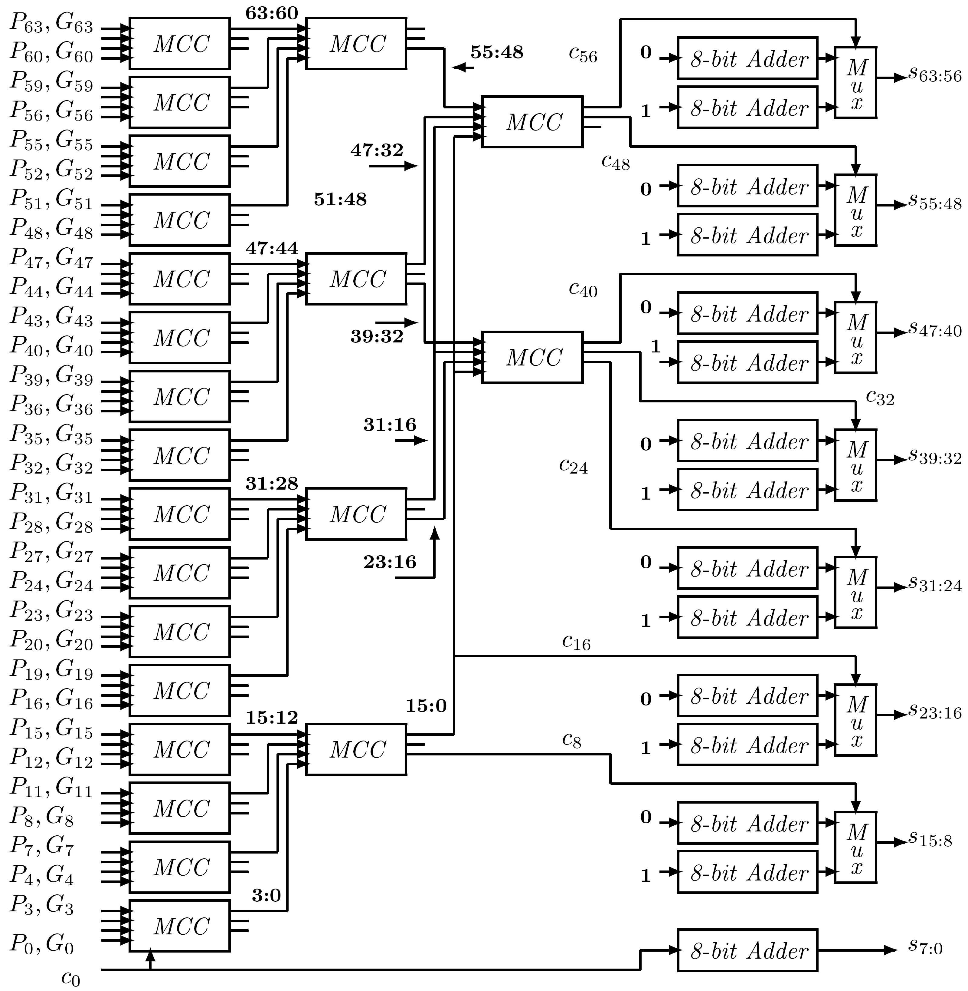
64-bit Hybrid Adder

Slide 5
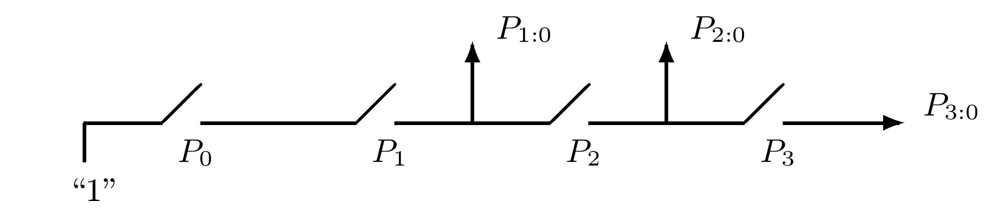
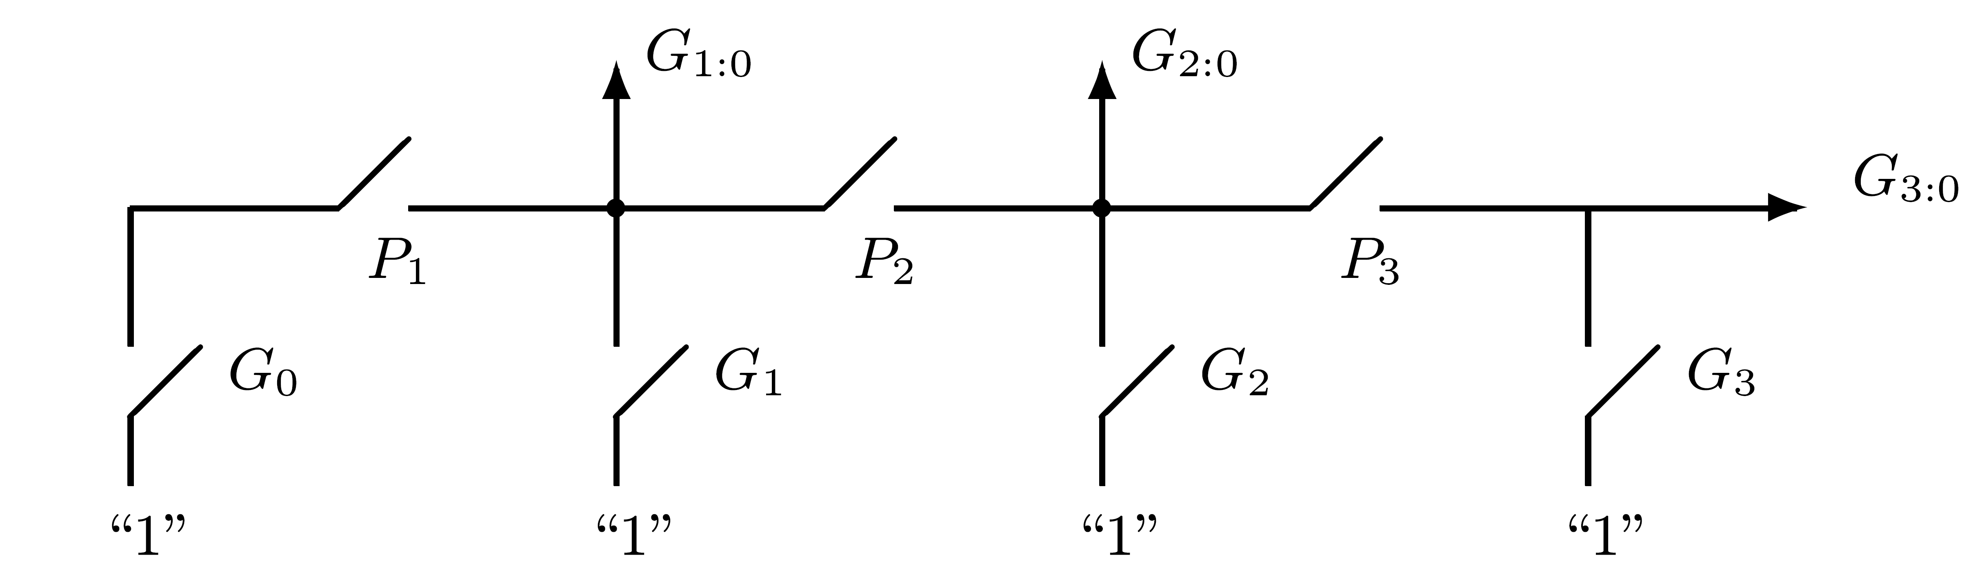
Manchester Carry Module

Slide 6
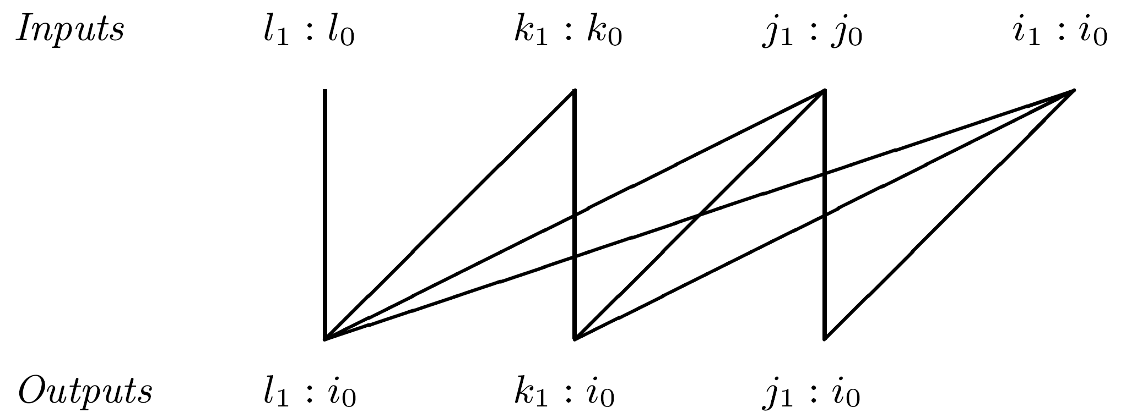
MCC - General Case
MCC accepts 4 pairs of inputs:
(Pi1:i0,Gi1:i0),(Pj1:j0,Gj1:j0),(Pk1:k0,Gk1:k0),(Pl1:l0,Gl1:l0)
where i1 ≥ i0, j1≥ j0, k1 ≥ k0, l1 ≥ l0
Produces 3 pairs of outputs:
(Pj1:i0,Gj1:i0),(Pk1:i0,Gk1:i0),(Pl1:i0,Gl1:i0)
where i1 ≥ j0-1, j1 ≥ k0-1, k1 ≥ l0-1
Allows overlap among input subgroups

Slide 7
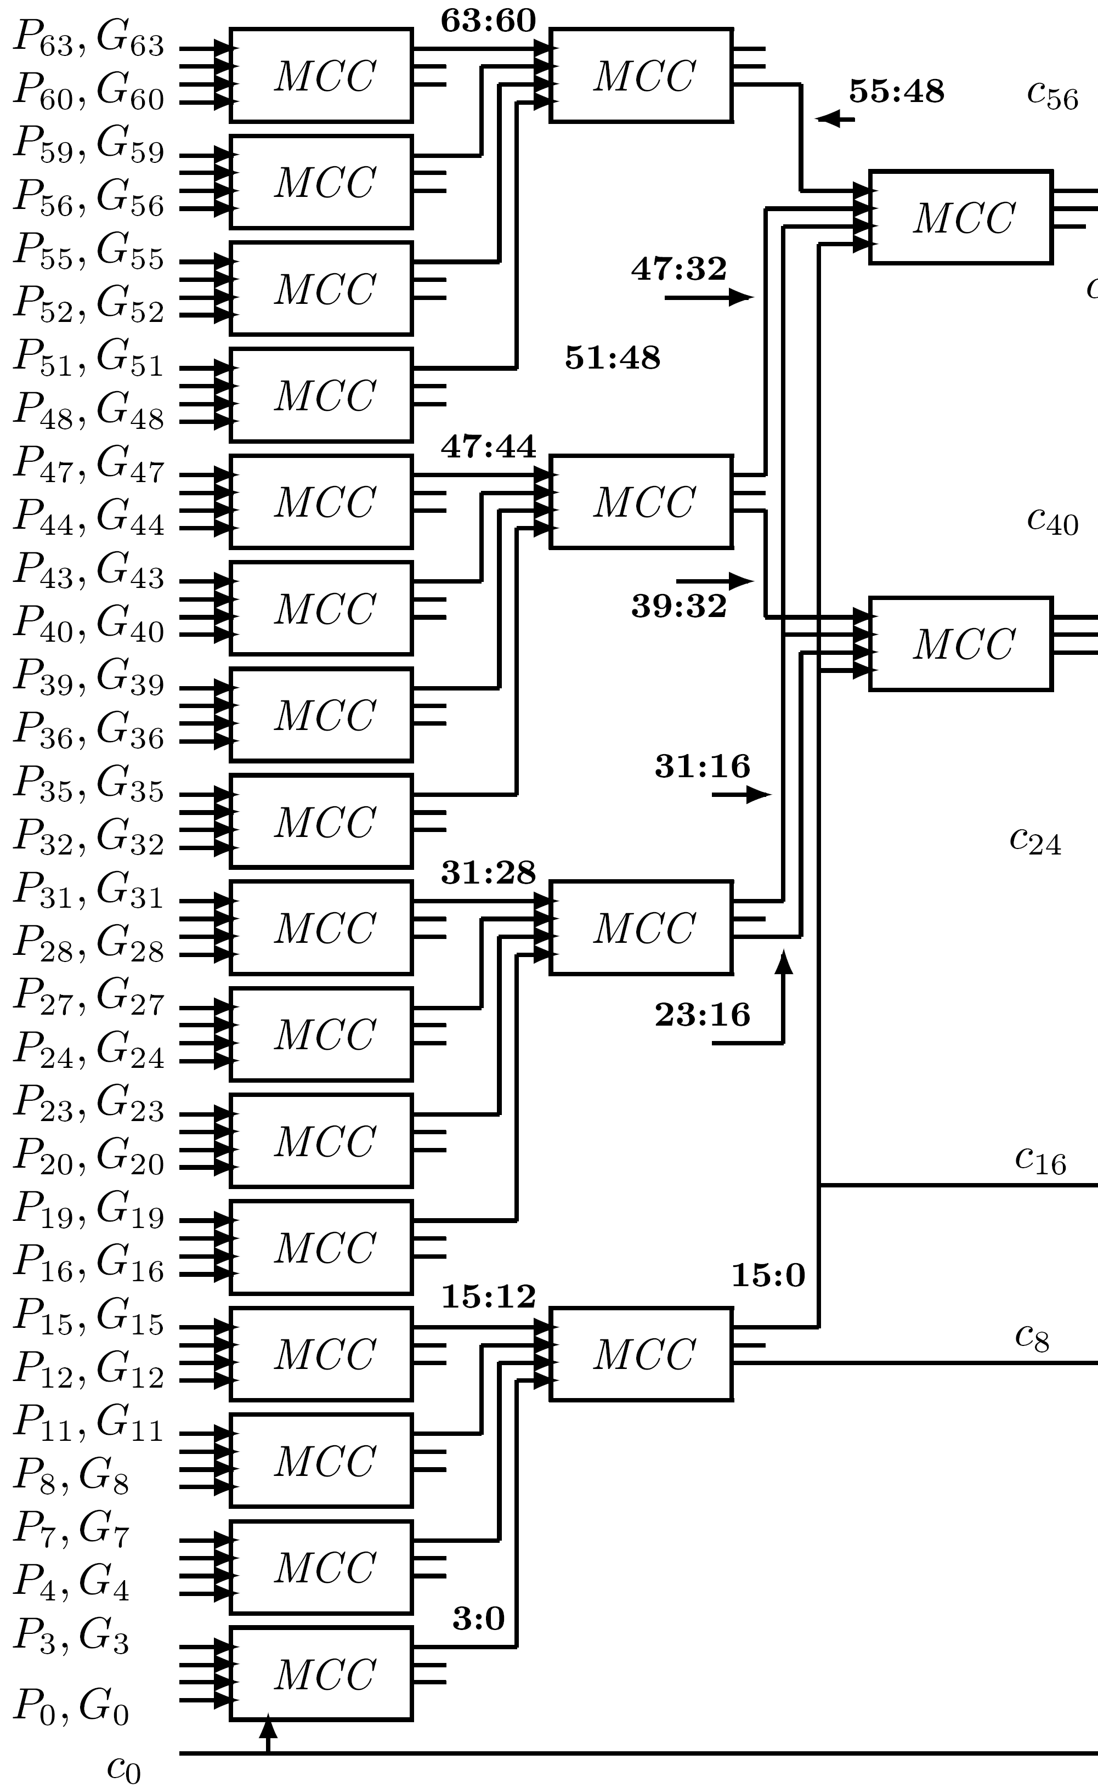
Carry Tree
First level - 14 MCCs calculating (P3:0,G3:0),(P7:4,G7:4),…,(P55:52,G55:52)
  only outputs P3:0 and G3:0 are utilized
Second level: each MCC generates 2 pairs (P3:0, G3:0),(P1:0, G1:0)
Providing (P7:0,G7:0),(P15:0,G15:0), (P23:16,G23:16),(P31:16,G31:16), (P39:32,G39:32),(P47:32,G47:32), (P55:48,G55:48)
Generates c8 & c16 - G7:0 & G15:0
c0 is incorporated into (P3:0, G3:0)

Slide 8
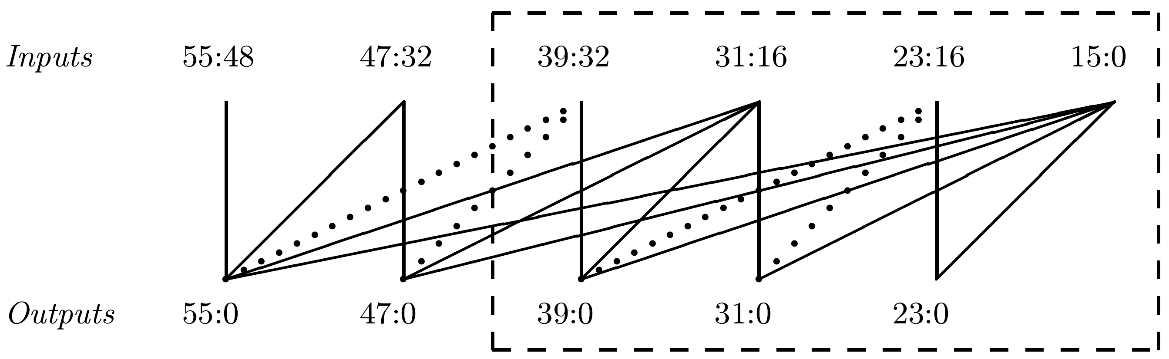
Third level - Two MCCs Sufficient
One for dashed box generating c24, c32 and c40
Second MCC for 2 remaining outputs with inputs 55:48, 47:32, 31:16 and 15:0 generating c48 and c56
MCC in dashed box must implement 2 dotted lines from 23:16 - required for generating 23:0
Above implementation of adder not unique
  does not necessarily minimize overall execution time
Alternate implementations: variable size of carry-select groups and of MCCs at different levels of tree

Slide 9
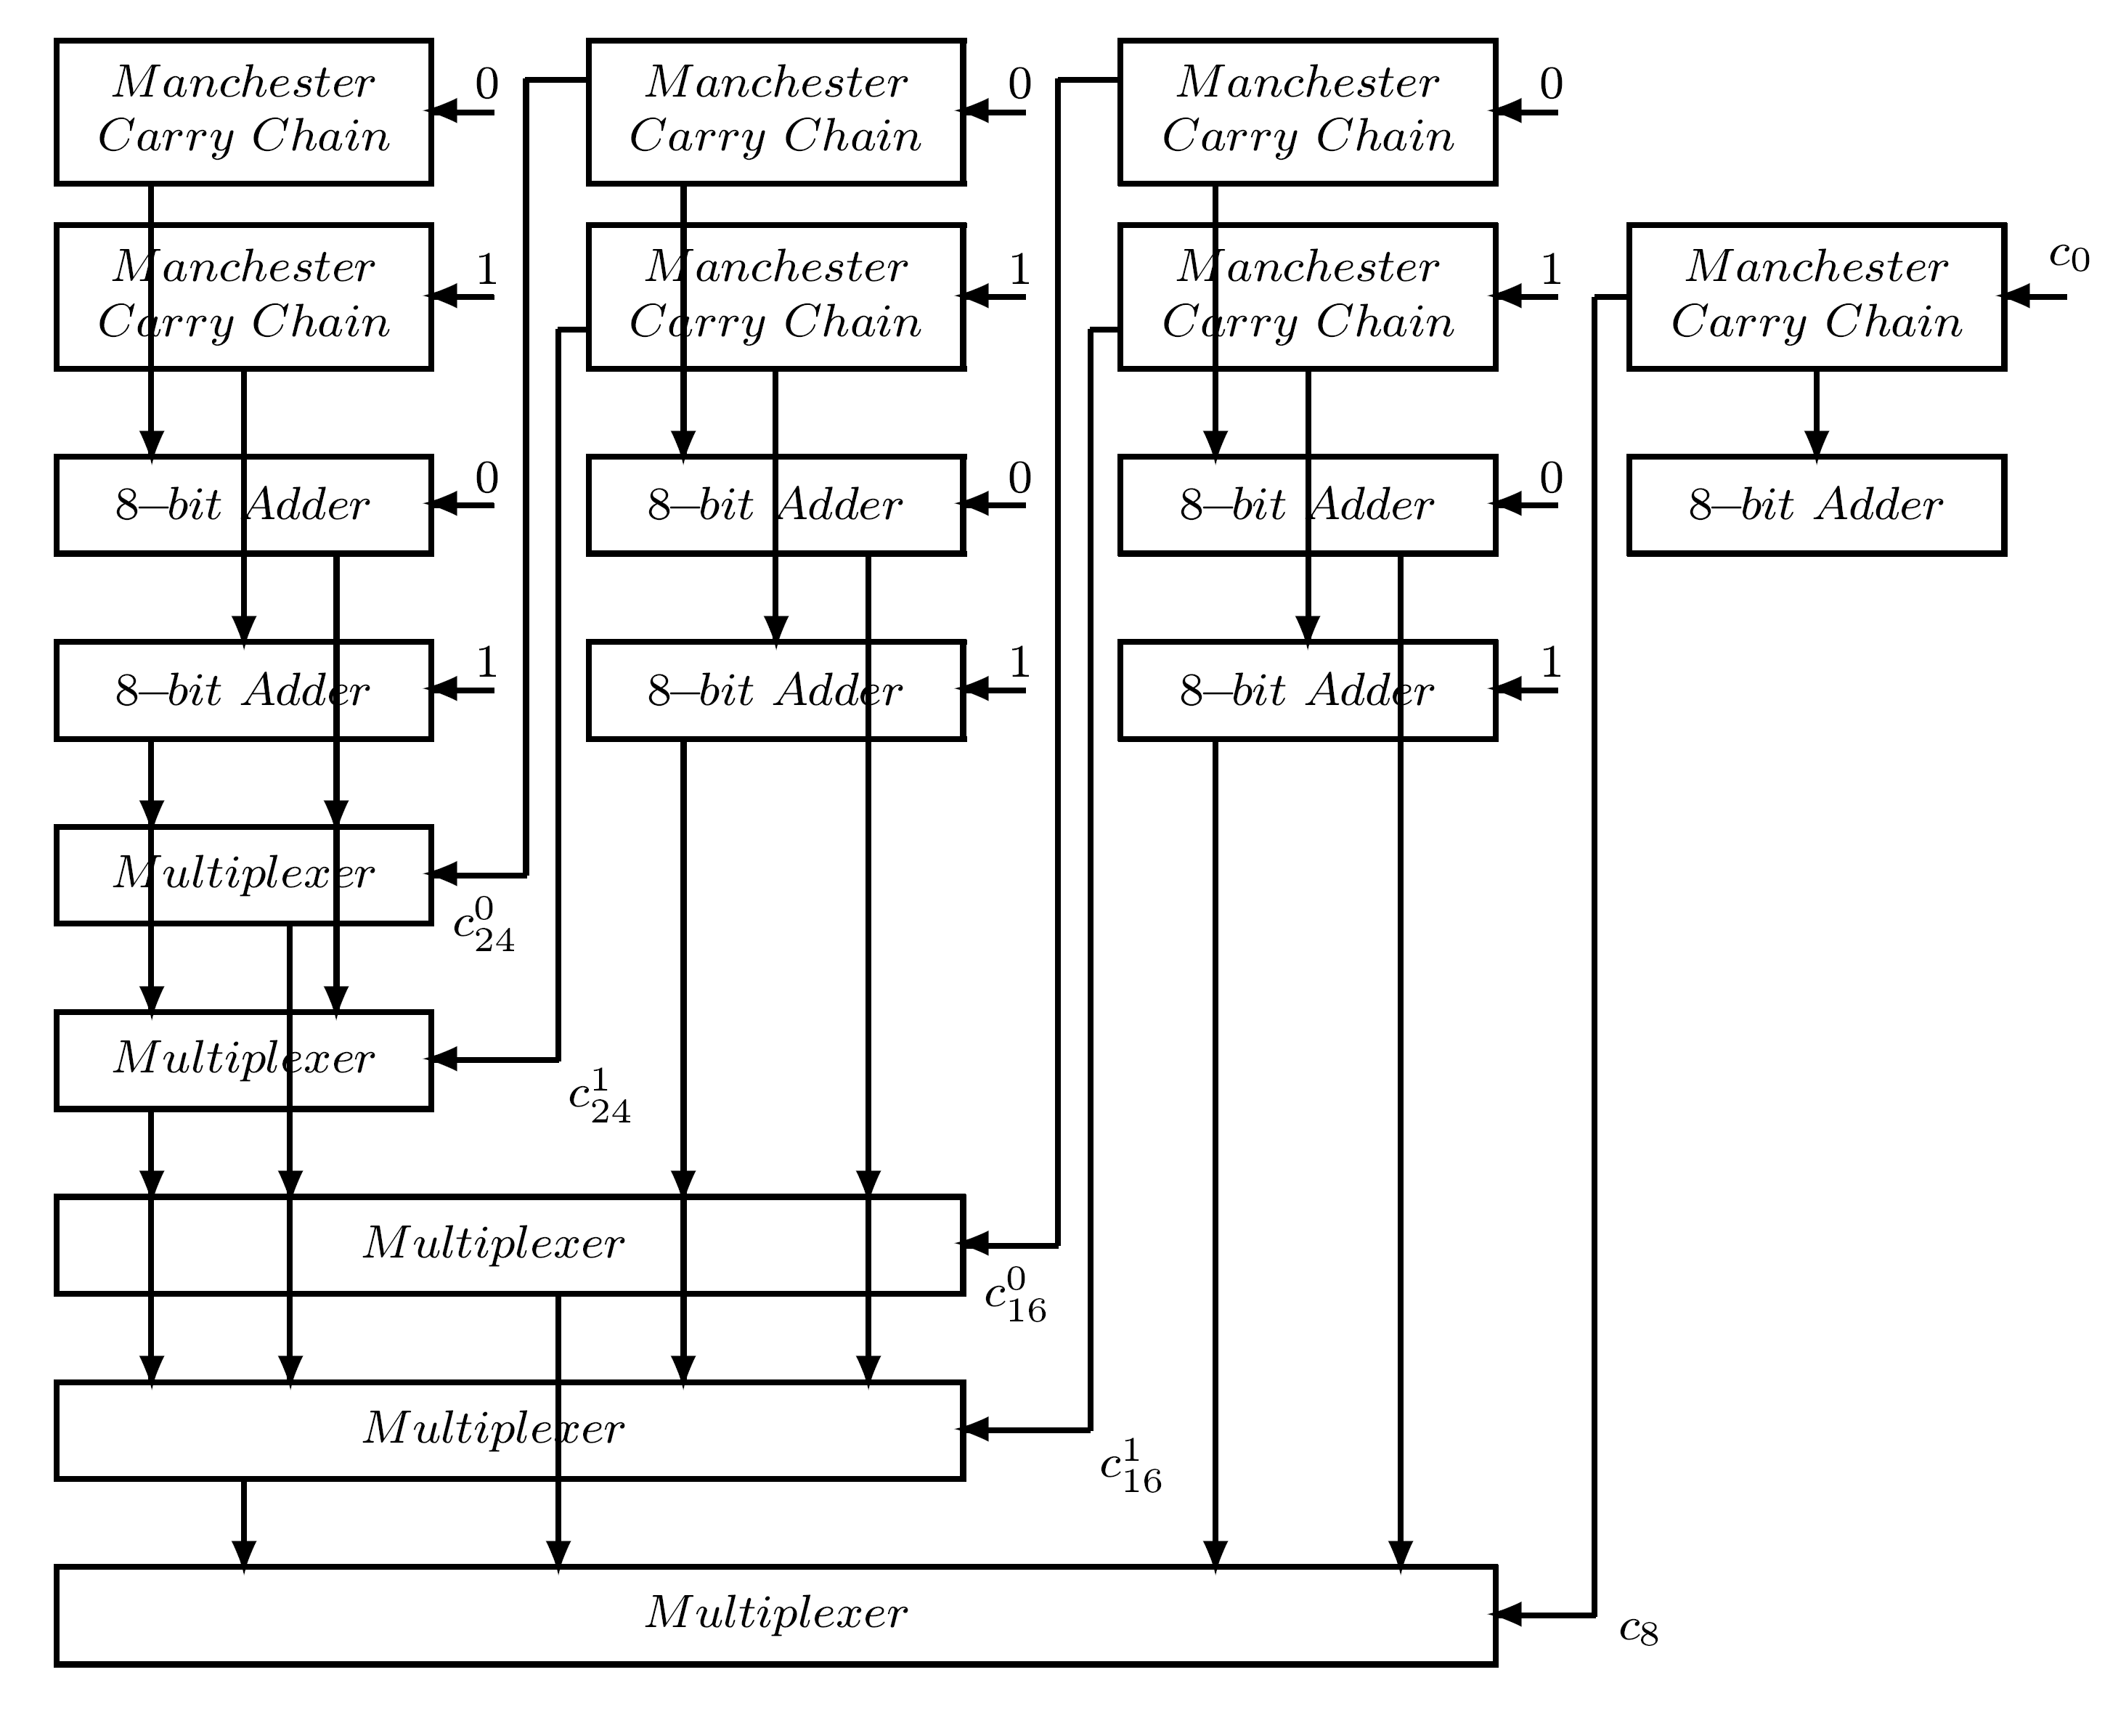
A Schematic Diagram of a 32-bit Hybrid Adder

Slide 10
Grouping of Bits in a 64-bit Adder
64 bits divided into two sets of 32 bits, each set further divided into 4 groups of 8 bits
For every group of 8 bits - 2 sets of conditional sum outputs generated separately
Two most significant groups combined into group of size 16
Further combined with next group of 8 to form group of 24 bits and so on
  principle of conditional-sum addition
  However, the way input carries for basic 8-bit groups are generated is different
MCC generates Pm, Gm and Km and cout ,cout for assumed incoming carries of 0 and 1
Conditional carry-out signals control multiplexers
0
1

Slide 11
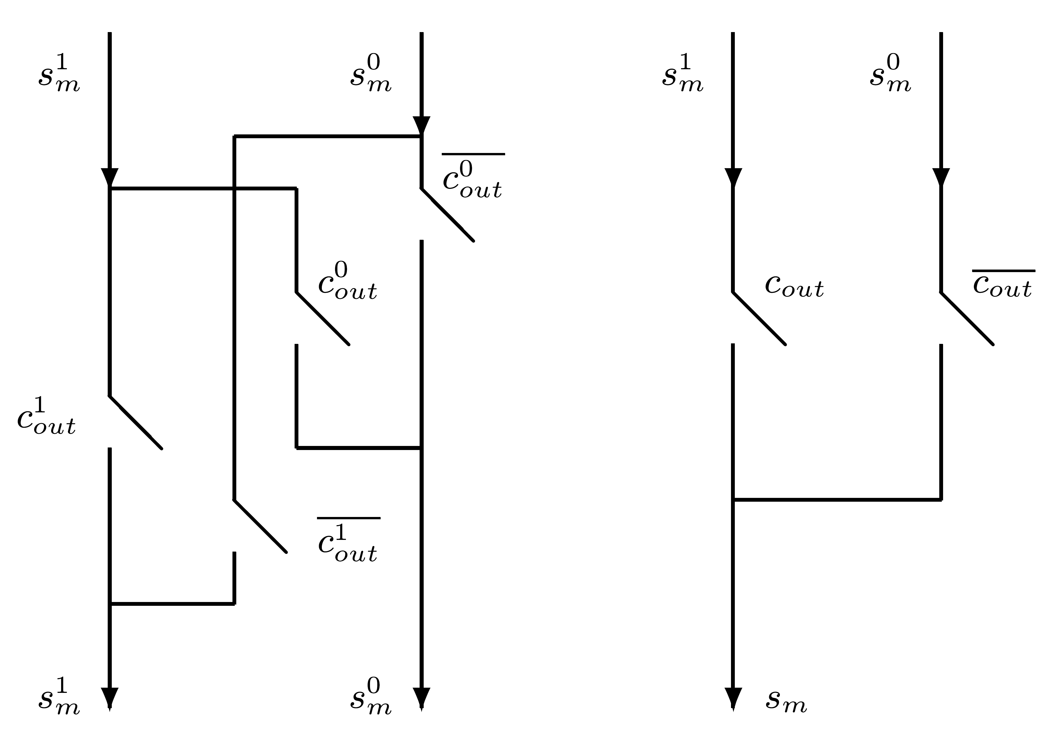
Dual and Regular Multiplexer
Two sets of dual multiplexers (of size 8 and 16)
Single regular multiplexer of size 24

Slide 12
High-Order Half of 64-bit Adder
Similar structure but incoming carry c32 calculated by separate carry-look-ahead circuit
Inputs are conditional carry-out signals generated by 4 MCCs
Allows operation of high-order half to overlap operation of low-order half
Summary: combines variants of 3 different techniques for fast addition: Manchester carry generation, carry-select, conditional-sum
Other designs of hybrid adders exist - e.g., groups with unequal number of bits
“Optimality” of hybrid adders depends on technology and delay parameters

Slide 13
Carry-Save Adders (CSAs)
3 or more operands added simultaneously (e.g., in multiplication) using 2-operand adders
Time-consuming carry-propagation must be repeated several times: k operands - k-1 propagations
Techniques for lowering this penalty exist - most commonly used - carry-save addition
Carry propagates only in last step - other steps generate partial sum and sequence of carries
Basic CSA accepts 3 n-bit operands; generates 2 n-bit results: n-bit partial sum, n-bit carry
Second CSA accepts the 2 sequences and another input operand, generates new partial sum and carry
CSA reduces number of operands to be added from 3 to 2 without carry propagation

Slide 14
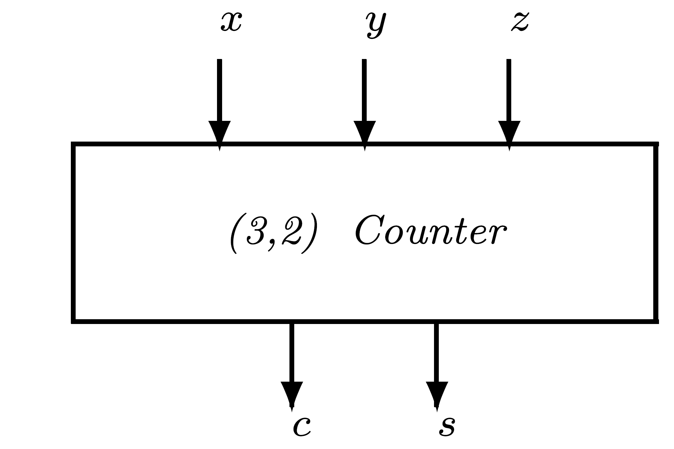
Implementing Carry Save Adders
Simplest implementation - full adder (FA) with 3 inputs x,y,z
x+y+z=2c+s (s,c - sum and carry outputs)
Outputs - weighted binary representation of number of 1's in inputs
FA called a (3,2) counter
n-bit CSA: n (3,2) counters in parallel with no carry links

Slide 15
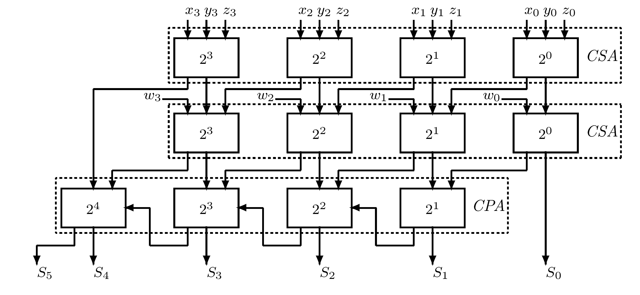
Carry-Save Adder for four 4-bit Operands
  Upper 2 levels - 4-bit CSAs
  3rd level - 4-bit carry-propagating adder (CPA)
  Ripple-carry adder - can be replaced by a carry-look-ahead adder or any other fast CPA
  Partial sum bits and carry bits interconnected to guarantee that only bits having same weight are added by any (3,2) counter

Slide 16
Adding k Operands
(k-2) CSAs + one CPA
If CSAs arranged in cascade - time to add k operands is (k-2)TCSA + TCPA
TCPA ; TCSA - operation time of CPA ; CSA
ΔG ; ΔFA delay of a single gate ; full adder
TCSA = ΔFA ≥ 2 ΔG
Sum of k operands of size n bits each can be as large as k(2 -1)
Final addition result may reach a length of n+⎡log 2 k⎤ bits
n

Slide 17
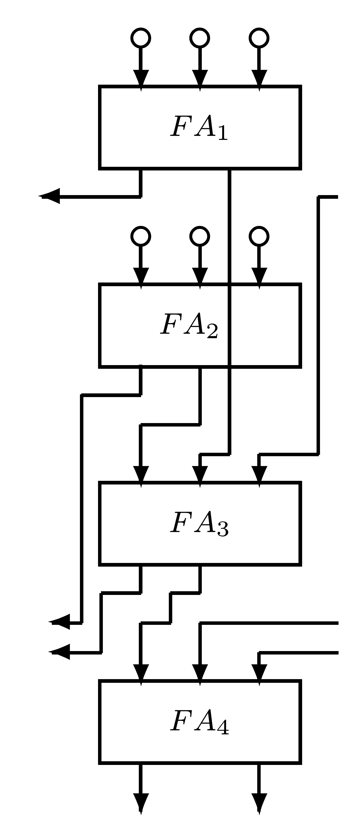
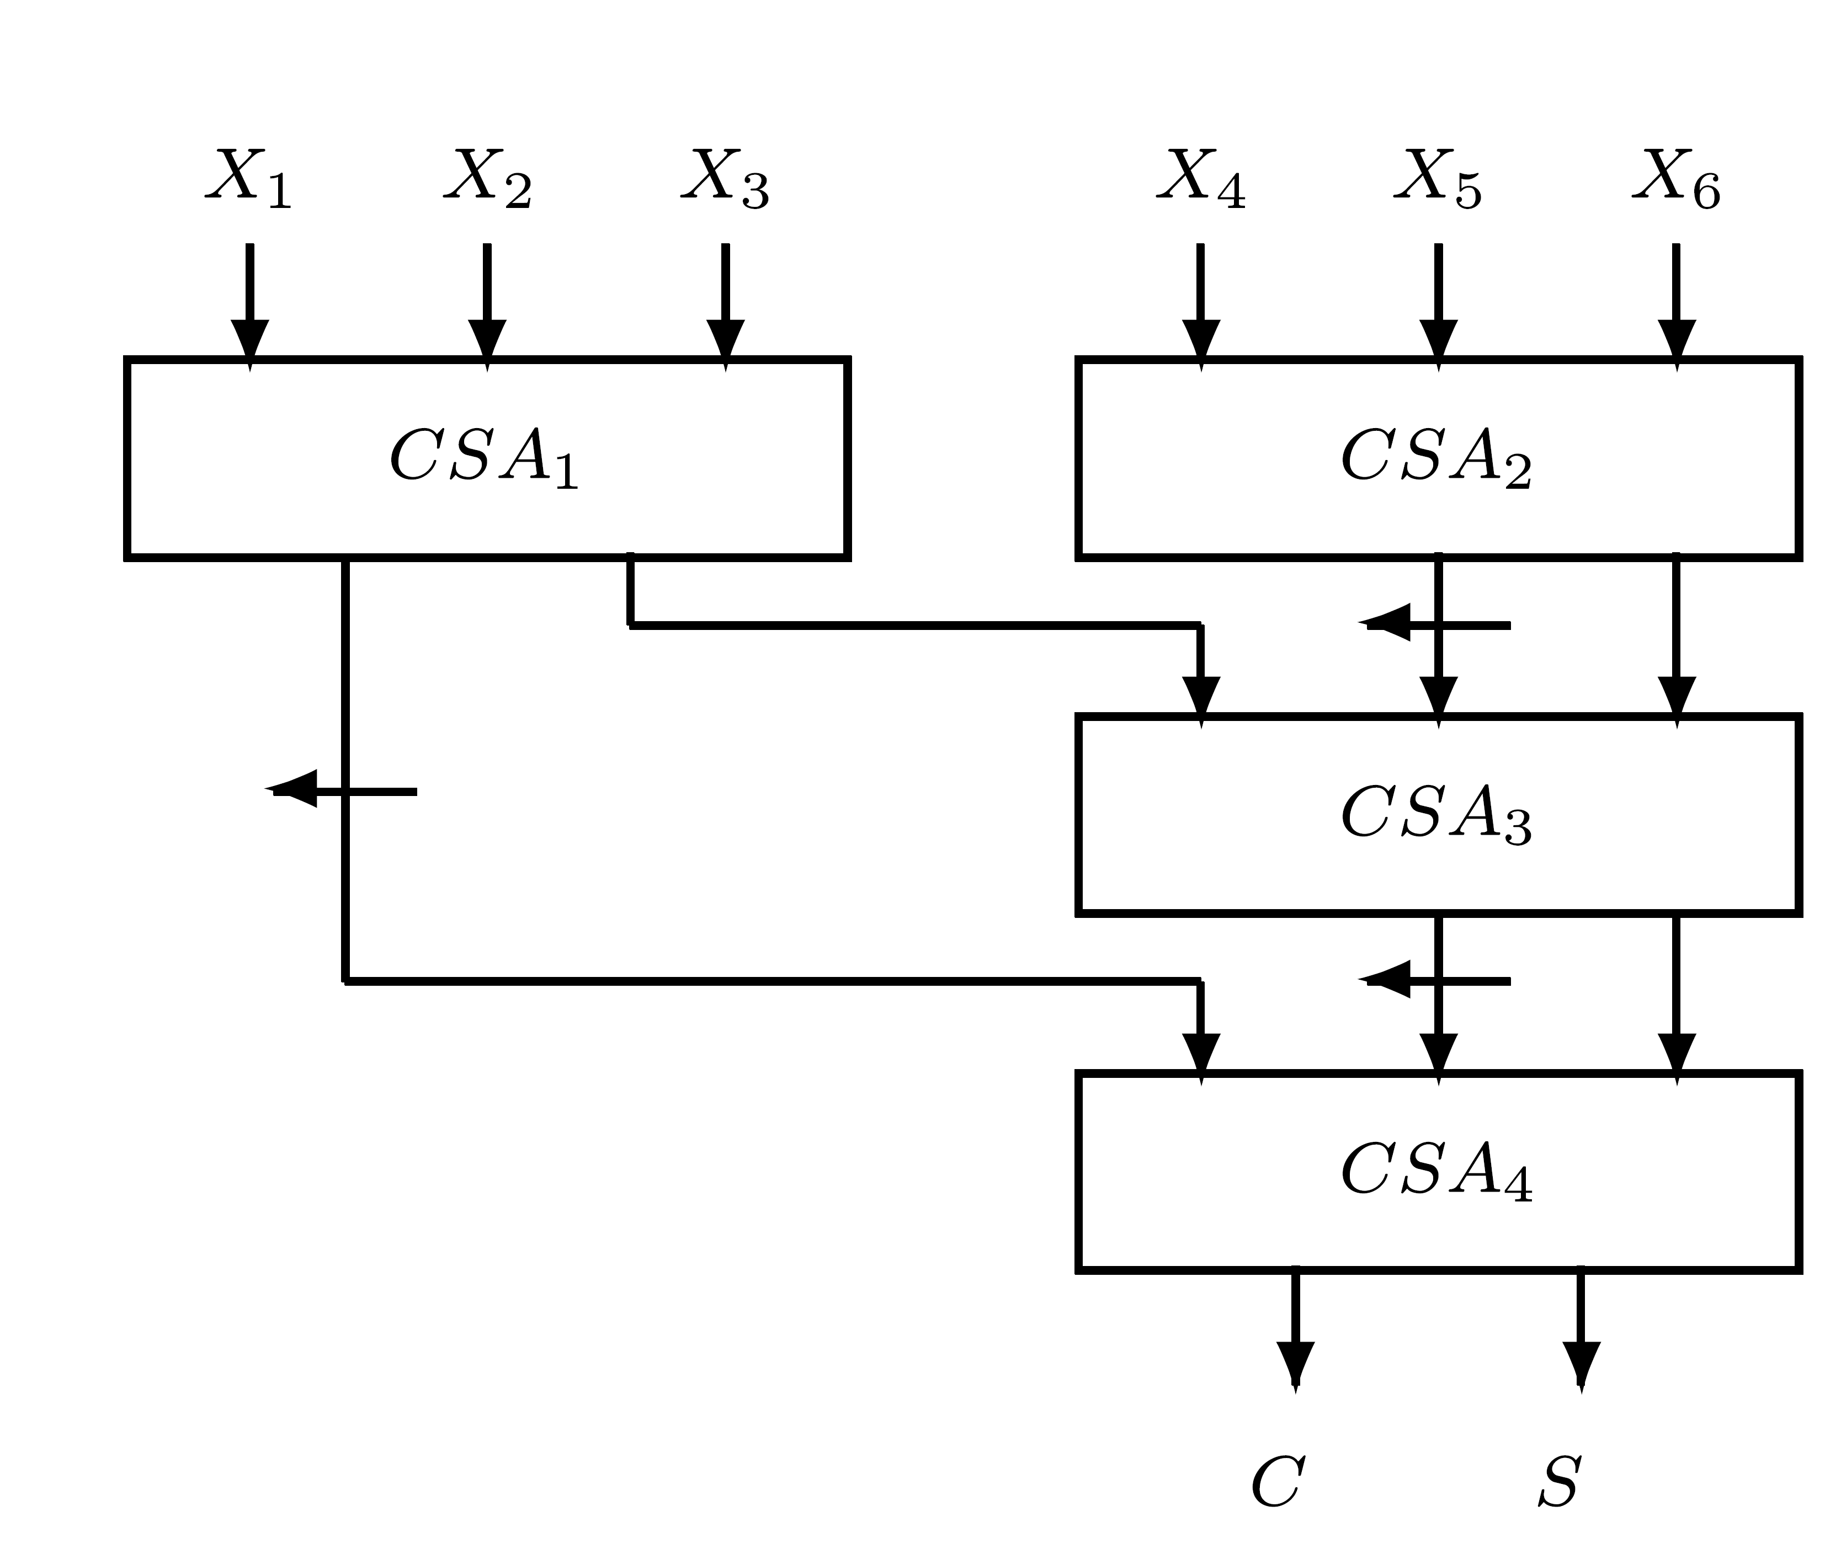
Six-operand Wallace Tree
Better organization for CSAs - faster operation time

Slide 18
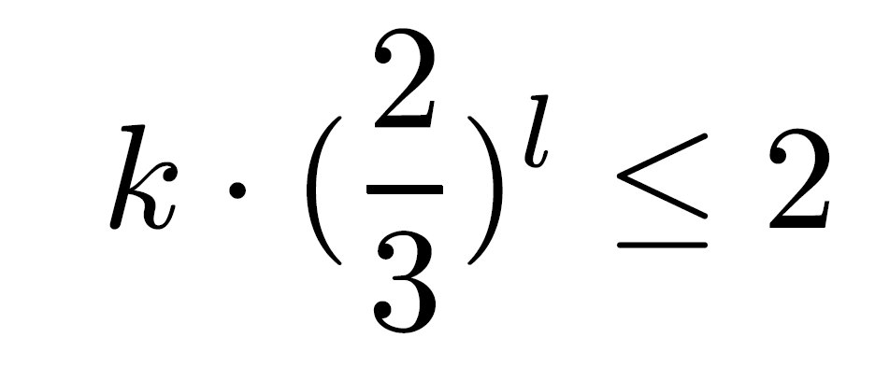
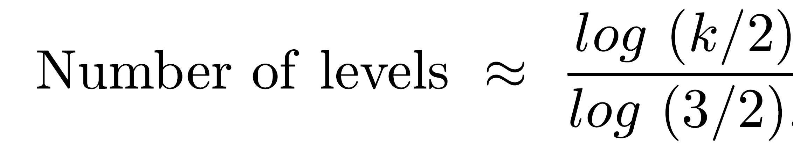
Number of Levels in Wallace Tree
Number of operands reduced by a factor of 2/3 at each level - (l - number of levels)
Consequently, l =
Only an estimate of l - number of operands at each level must be an integer
Ni - number of operands at level i
Ni+1 - at most ⎣3/2 Ni⎦ ( ⎣x⎦ - largest integer smaller than or equal to x )
Bottom level (0) has 2 - maximum at level 1 is 3 - maximum at level 2 is ⎣9/2⎦ =4
Resulting sequence: 2,3,4,6,9,13,19,28,…
For 5 operands - still 3 levels

Slide 19
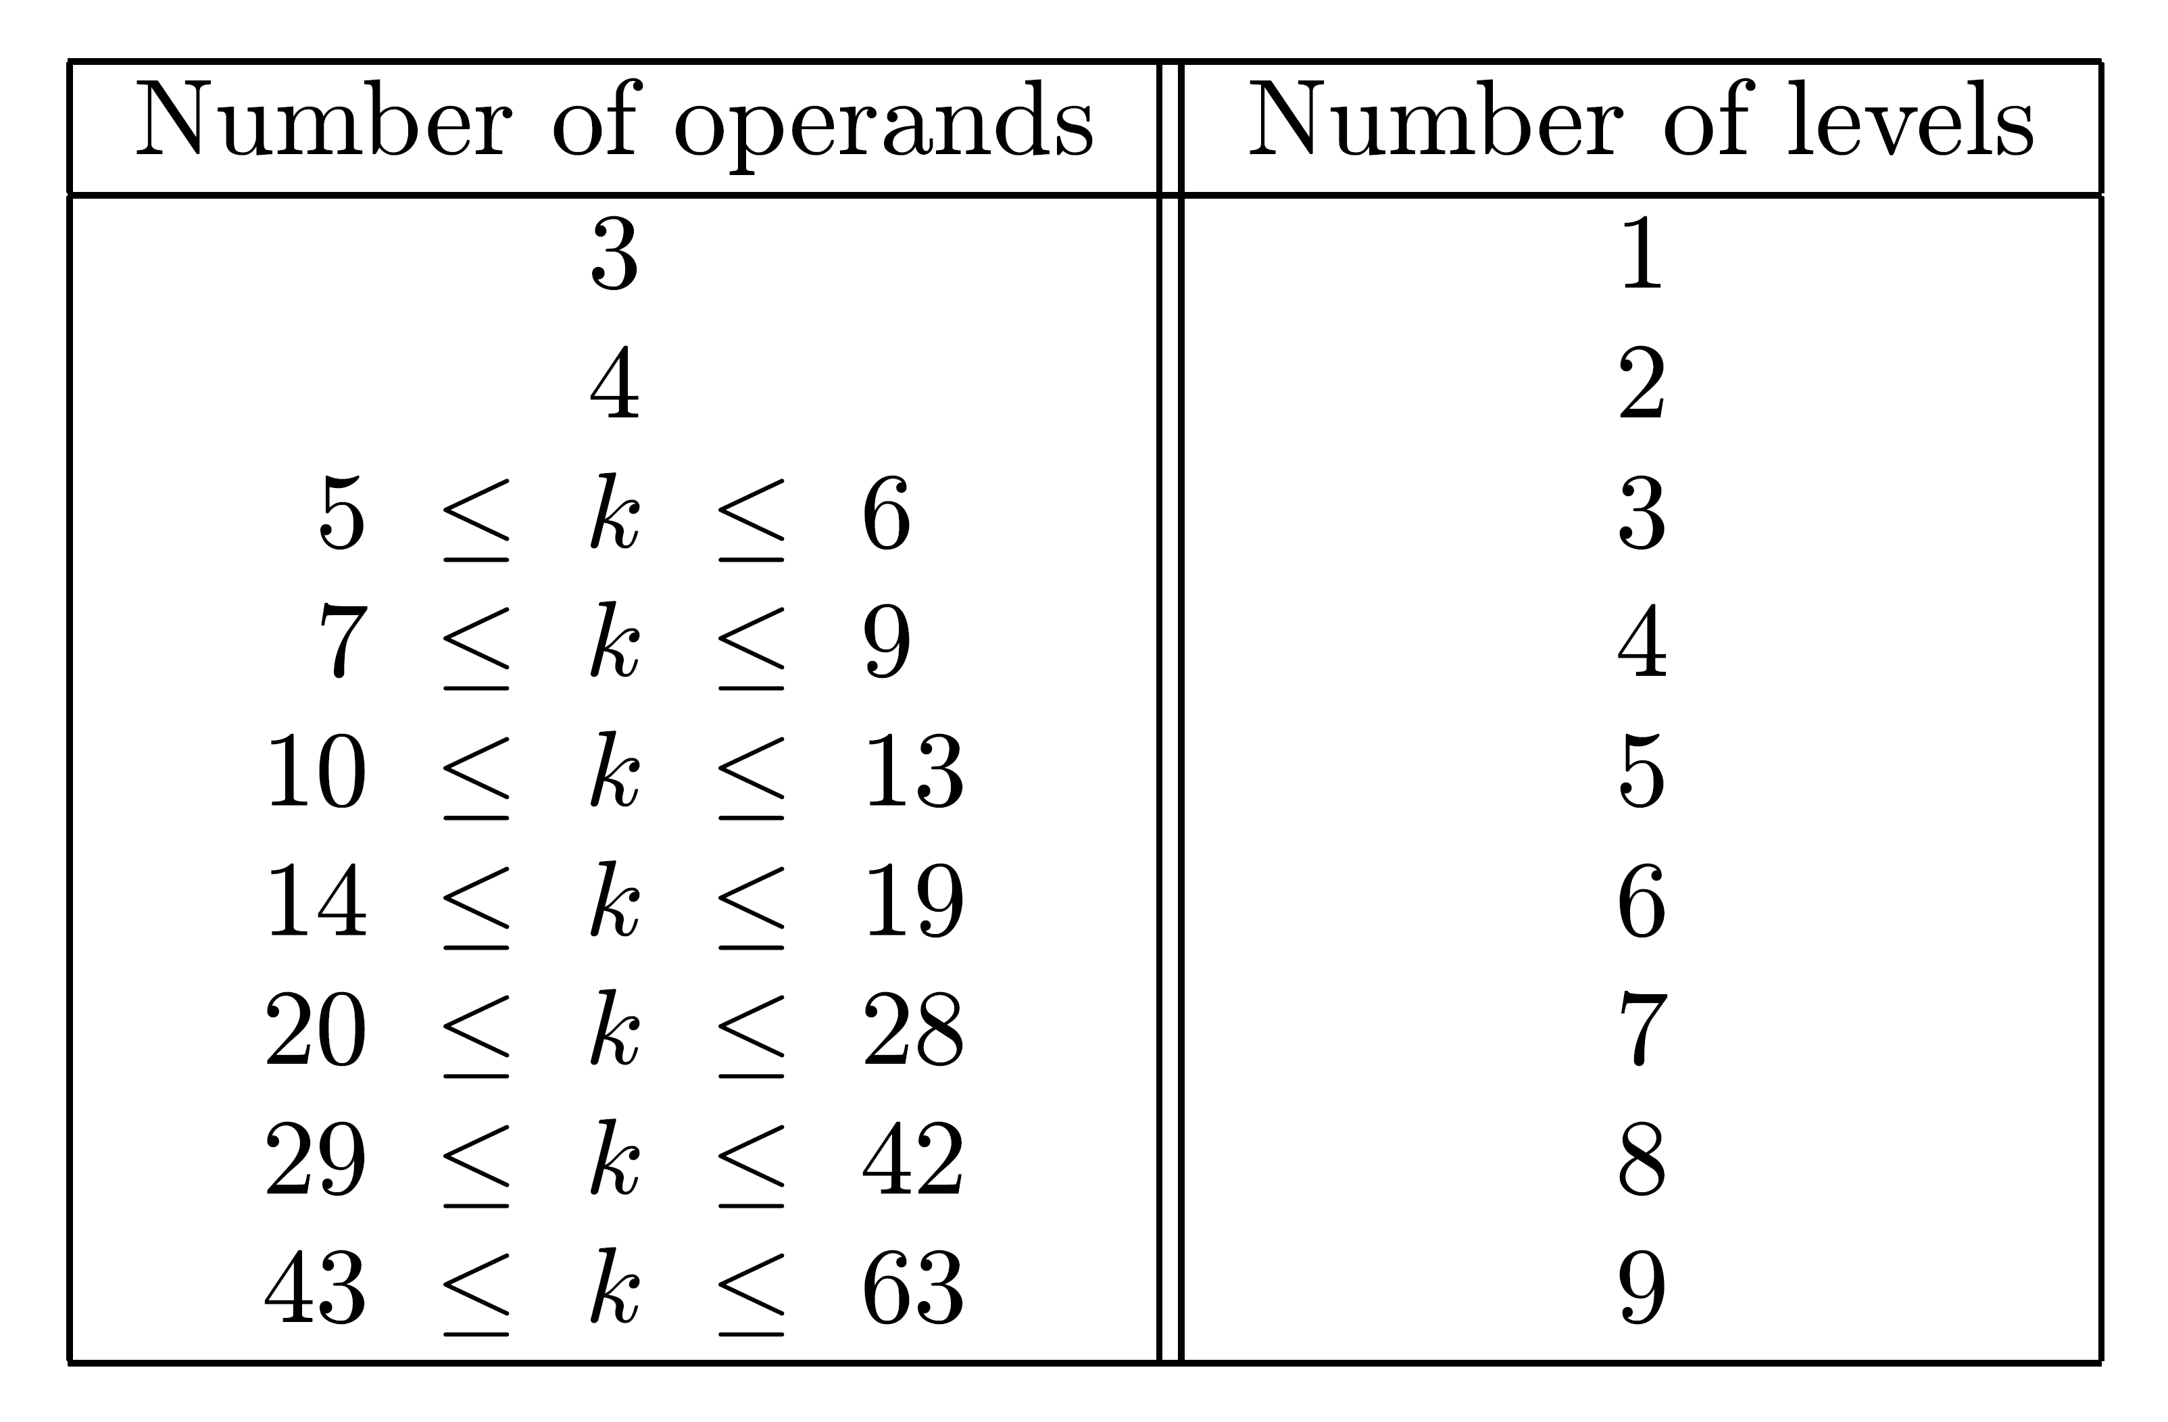
Number of Levels in a CSA Tree for k operands
Example: k=12 - 5 levels - delay of 5TCSA instead of 10TCSA in a linear cascade of 10 CSAs

Slide 20
Most Economical Implementation (Fewer CSAs)
Achieved when number of operands is element of 3,4,6,9,13,19,28,…
If given number of operands, k, not in sequence - use only enough CSAs to reduce k to closest (smaller than k) element
Example: k=27, use 8 CSAs (24 inputs) rather than 9, in top level - number of operands in next level is 8×2+3=19
Remaining part of tree will follow the series

Slide 21
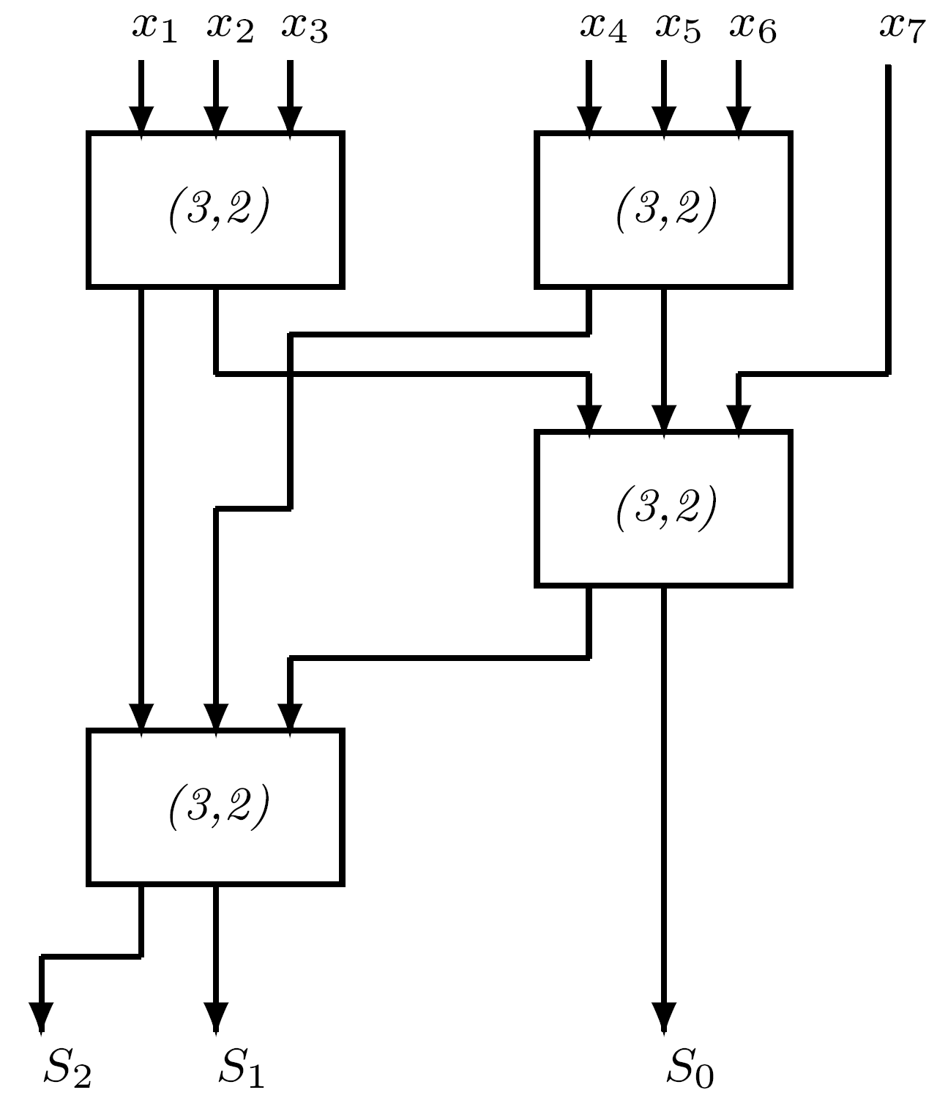
(7,3) and Other Counters
(7,3) counter: 3 outputs - represent number of 1's in 7 inputs
Another example: (15,4) counter
In general: (k,m) counter - k and m satisfy 2 -1 ≥ k or m ≥ ⎣log 2 (k+1)⎦
(7,3) counter using (3,2) counters:
Requires 4 (3,2)’s in 3 levels - no speed-up
m

Slide 22
(7,3) Counters
(7,3) can be implemented as a multilevel circuit - may have smaller delay
Number of interconnections affects silicon area - (7,3) preferrable to (3,2)
  (7,3) has 10 connections and removes 4 bits
  (3,2) has 5 connections and removes only 1 bit
Another implementation of (7,3) - ROM of size 2 x 3= 128 x 3 bits
Access time of ROM unlikely to be small enough
Speed-up may be achieved for ROM implementation of (k,m) counter with higher values of k
7

Slide 23
Avoiding Second Level of Counters
Several (7,3) counters (in parallel) are used to add 7 operands - 3 results obtained
Second level of (3,2) counters needed to reduce the 3 to 2 results (sum and carry) added by a CPA
Similarly - when (15,4) or more complex counters are used - more than two results generated
In some cases - additional level of counters can be combined with first level - more convenient implementation
When combining a (7,3) counter with a (3,2) counter - combined counter called a (7;2) compressor

Slide 24
(k;m) Compressor
Variant of a counter with k primary inputs, all of weight 2 , and m primary outputs of weights 2 ,2 ,...,2
Compressor has several incoming carries of weight 2 from previous compressors, and several outgoing carries of weights 2 and up
Trivial example of a (6;2) compressor:
All outgoing carries have weight 2
Number of outgoing carries = number of incoming carries = k-3 (in general)
i
i
i+1
i+m-1
i
i+1
i+1

Slide 25
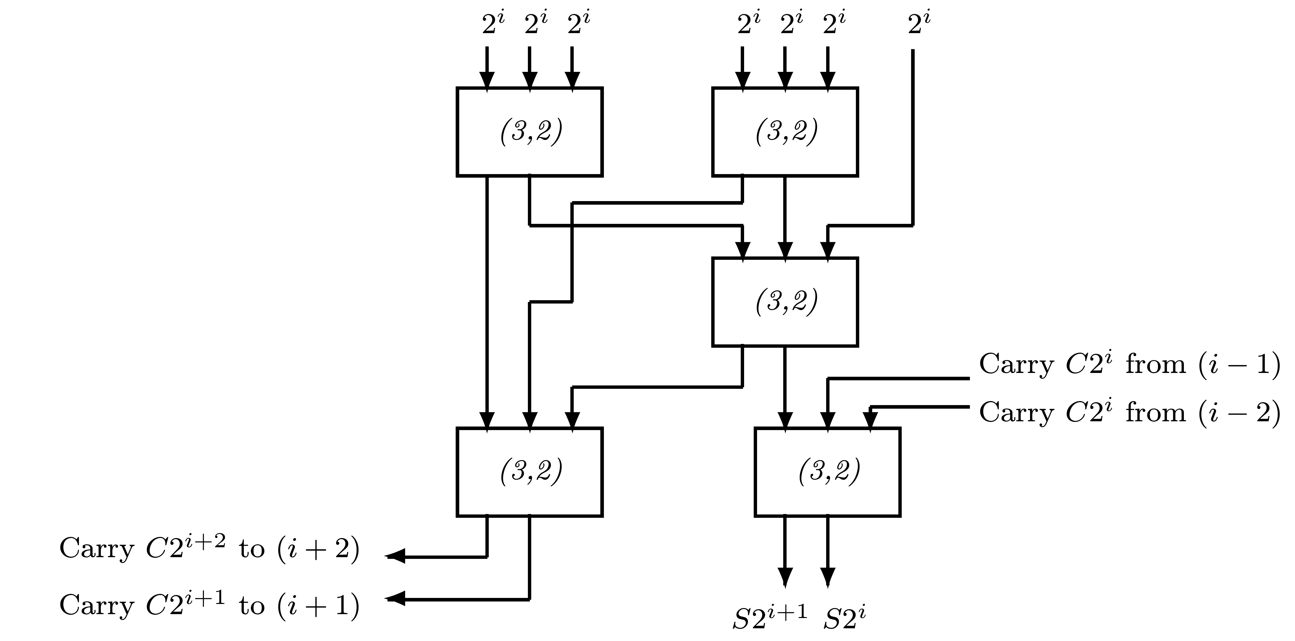
Implementation of a (7;2) Compressor
  Bottom right (3,2) - additional (3,2), while remaining four - ordinary (7,3) counter
  7 primary inputs of weight 2 and 2 carry inputs from columns i-1 and i-2
  2 primary outputs, S2 and S2 , and 2 outgoing carries C2 , C2 , to columns i+1 and i+2
  Input carries do not participate in generation of output carries - avoids slow carry-propagation
  Not a (9,4) counter - 2 outputs with same weight
  Above implementation does not offer any speedup
  Multilevel implementation may yield smaller delay as long as outgoing carries remain independent of incoming carries
i
i
i+1
i+1
i+2

Slide 26
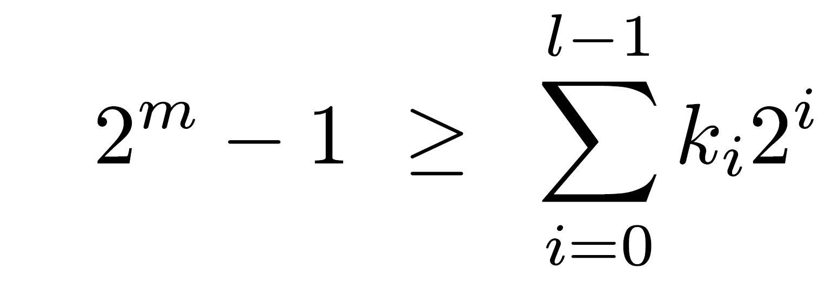
Multiple-column counters
Generalized parallel counter: add l input columns and produce m-bit output - (kl-1,kl-2,...,k0,m)
ki - number of input bits in i-th column with weight 2
(k,m) counter - a special case
Number of outputs m must satisfy
If all l columns have same height k - (k0=k1= ... =kl-1=k) -
2 - 1 ≥ k(2 - 1)
i
m
l

Slide 27
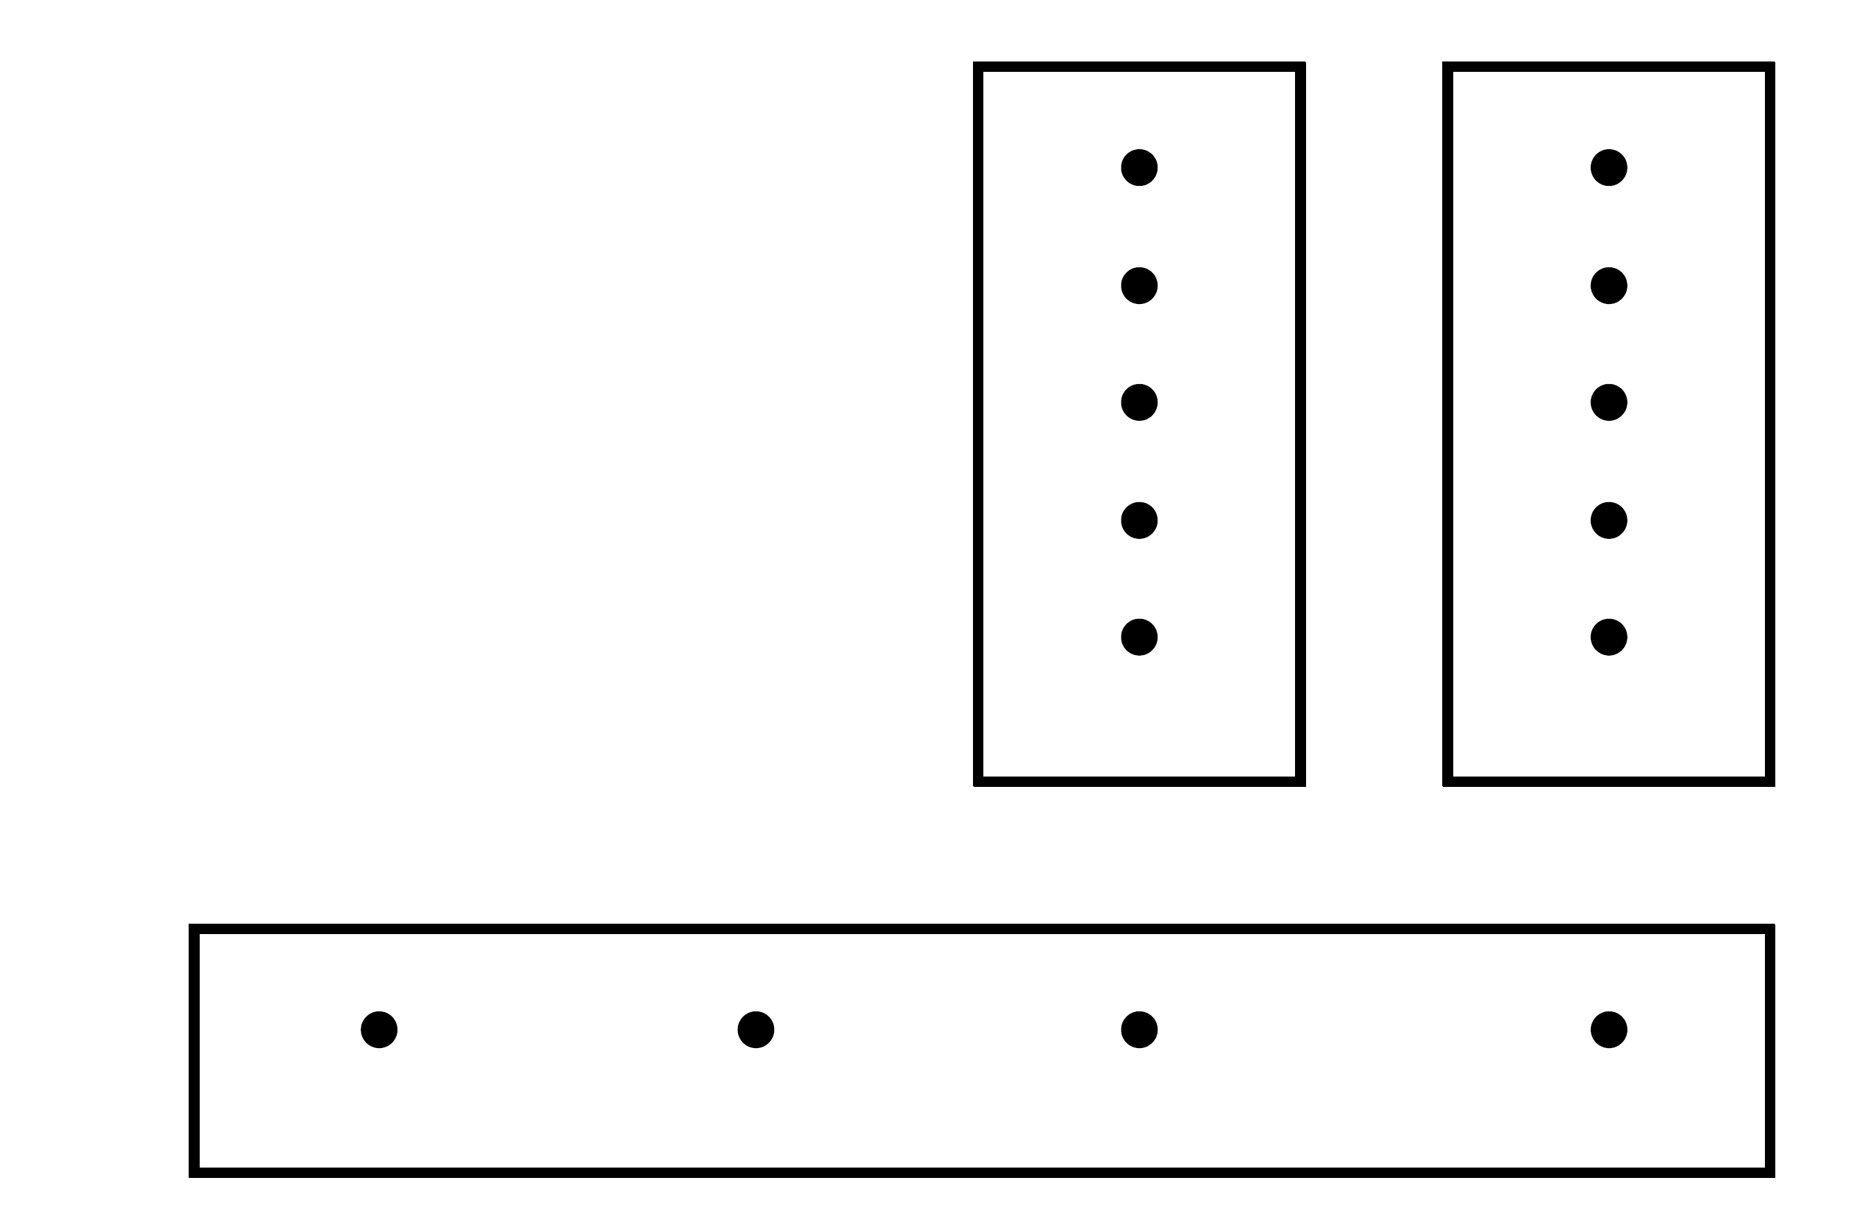
Example - (5,5,4) Counter
k=5,l =2,m=4
2 -1=k(2 -1) - all 16 combinations of output bits are useful
(5,5,4) counters can be used to reduce 5 operands (of any length) to 2 results that can then be added with one CPA
Length of operands determines number of (5,5,4) counters in parallel
Reasonable implementation - using ROMs
For (5,5,4) - 2 x4 (=1024x4) ROM
m
l
5+5

Slide 28
Number of Results of General Counters
String of (k,k,…,k,m) counters may generate more than 2 intermediate results
  requiring additional reduction before CPA
Number of intermediate results:
A set of (k,k,…,k,m) counters, with l columns each, produces m-bit outputs at intervals of l bits
Any column has at most ⎡m/l ⎤ output bits
k operands can be reduced to s= ⎡m/l ⎤ operands
  If s=2 - a single CPA can generate final sum
  Otherwise, reduction from s to 2 needed

Slide 29
Example
Number of bits per column in a 2-column counter (k,k,m) is increased beyond 5 - m ≥ 5 and s= ⎡m/2⎤ > 2
For k=7, 2 -1 ≥ 7 x 3 = 21 ⇒ m=5
(7,7,5) counters generate s=3 operands - another set of (3,2) counters is needed to reduce number of operands to 2
m

Slide 30
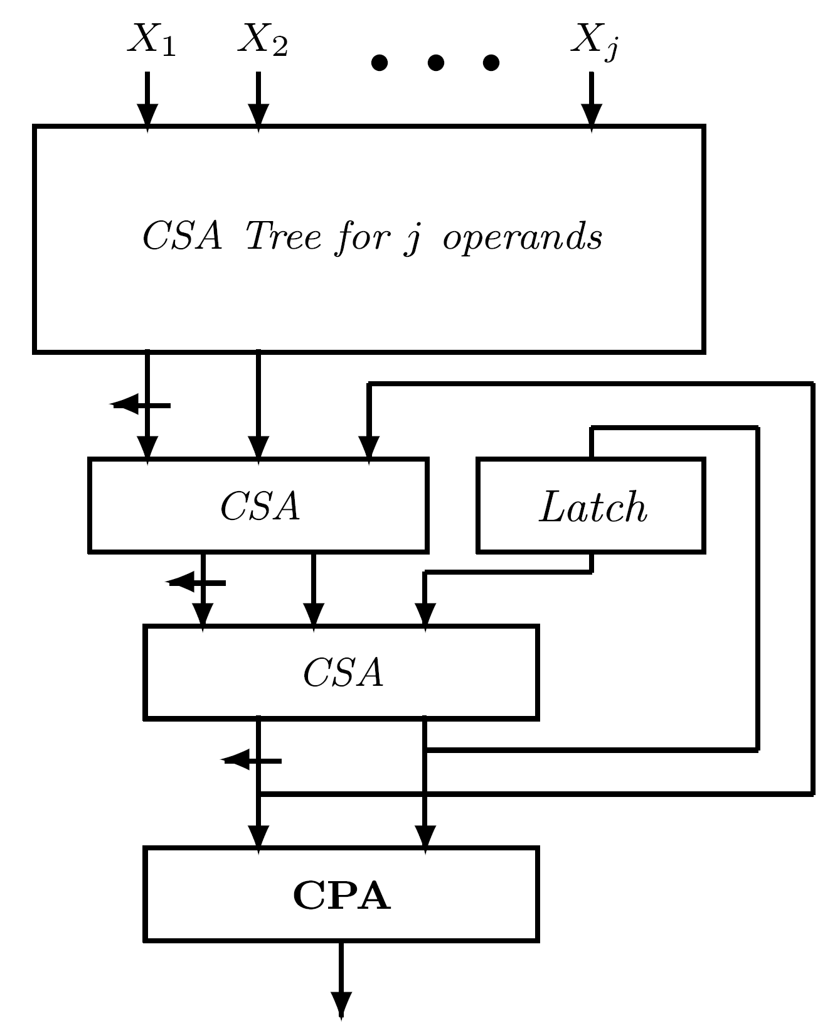
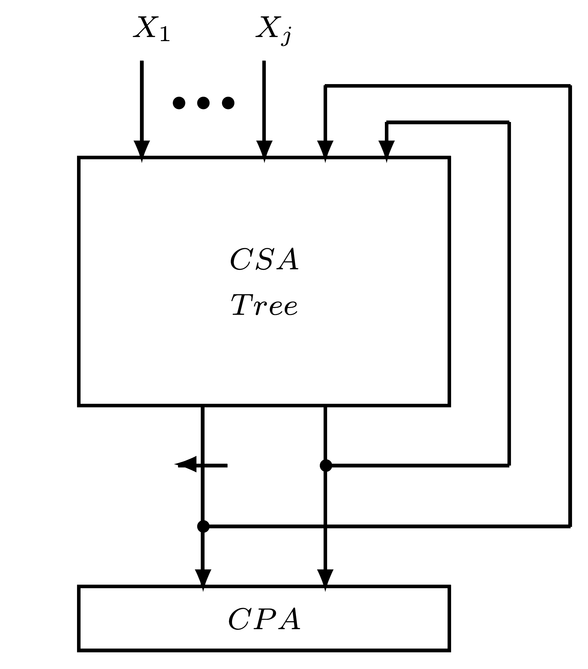
Reducing Hardware Complexity of CSA Tree
Design a smaller carry-save tree - use it iteratively
n operands divided into ⎡n/j⎤ groups of j operands - design a tree for j+2 operands and a CPA
Feedback paths - must complete first pass through CSA tree before second set of j operands is applied
Execution slowed down - pipelining not possible

Slide 31
Pipelining of Arithmetic Operations
Pipelining - well known technique for accelerating execution of successive identical operations
Circuit partitioned into several subcircuits that can operate independently on consecutive sets of operands
Executions of several successive operations overlap - results produced at higher rate
Algorithm divided into several steps - a suitable circuit designed for each step
Pipeline stages operate independently on different sets of operands
Storage elements - latches - added between adjacent stages - when a stage works on one set of operands, preceding stage can work on next set of operands

Slide 32
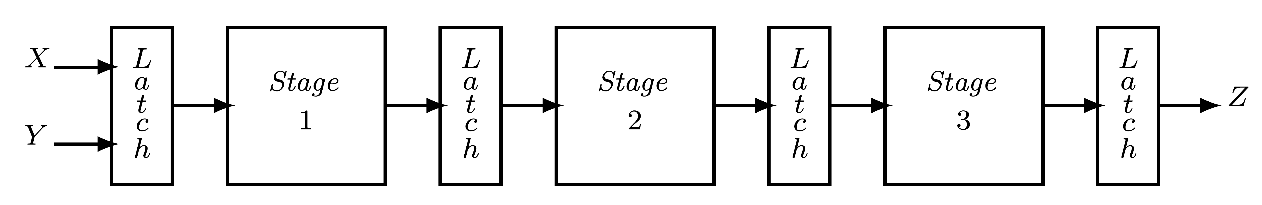
Pipelining - Example
Addition of 2 operands X,Y performed in 3 steps
Latches between stages 1 and 2 store intermediate results of step 1
Used by stage 2 to execute step 2 of algorithm
Stage 1 starts executing step 1 on next set of operands X,Y

Slide 33
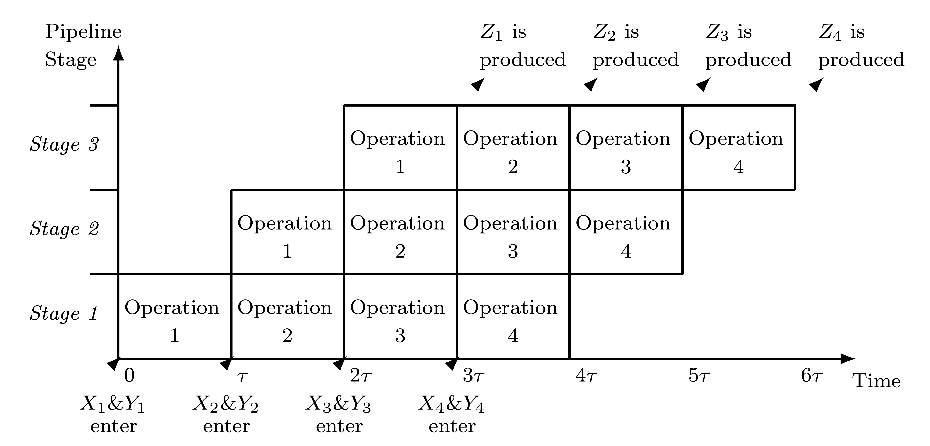
Pipelining Timing Diagram
4 successive additions with operands X1 & Y1, X2 & Y2, X3 & Y3, X4 & Y4 producing results Z1, Z2, Z3, Z4

Slide 34
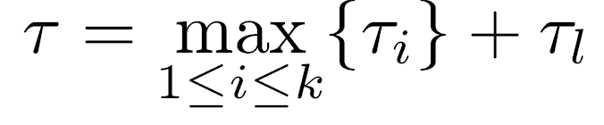
Pipeline Rate
τi - execution time of stage i
τl - time needed to store new data into latch
Delays of different stages not identical - faster stages wait for slowest before switching to next task
τ - time interval between two successive results being produced by pipeline:
k - number of stages
τ - pipeline period ; 1/τ - pipeline rate or bandwidth
Clock period ≥ τ
After latency of 3τ, new results produced at rate 1/τ

Slide 35
Design Decisions
Partitioning of given algorithm into steps to be executed by separate stages
  Steps should have similar execution times - pipeline rate determined by slowest step
Number of steps
  As this number increases, pipeline period decreases, but number of latches (implementation cost) and latency go up
Latency - time elapsed until first result produced
  Especially important when only a single pass through pipeline required
Tradeoff between latency and implementation cost on one hand and pipeline rate on the other hand
Extra delay due to latches, τl , can be lowered by using special circuits like Earl latch

Slide 36
Pipelining of Two-Operand Adders
Two-operand adders - usually not pipelined
Pipelining justified with many successive additions
Conditional-sum adder - easily pipelined
log2n stages corresponding to log2n steps - execution of up to log2n additions can be overlapped
Required number of latches may be excessive
Combining several steps to one stage reduces latches' overhead and latency
Carry-look-ahead adder cannot be pipelined - some carry signals must propagate backward
Different designs can be pipelined - final carries and carry-propagate signals (implemented as Pi=xi⊕yi) used to calculate sum bits - no need for feedback connections

Slide 37
Pipelining in Multiple-Operand Adders
Pipelining more beneficial in multiple-operand adders like carry-save adders
Modifying implementation of CSA trees to form a pipeline is straightforward - requires only addition of latches
Can be added at each level of tree if maximum bandwidth is desired
Or - two (or more) levels of tree can be combined to form a single stage, reducing overall number of latches and pipeline latency

Slide 38
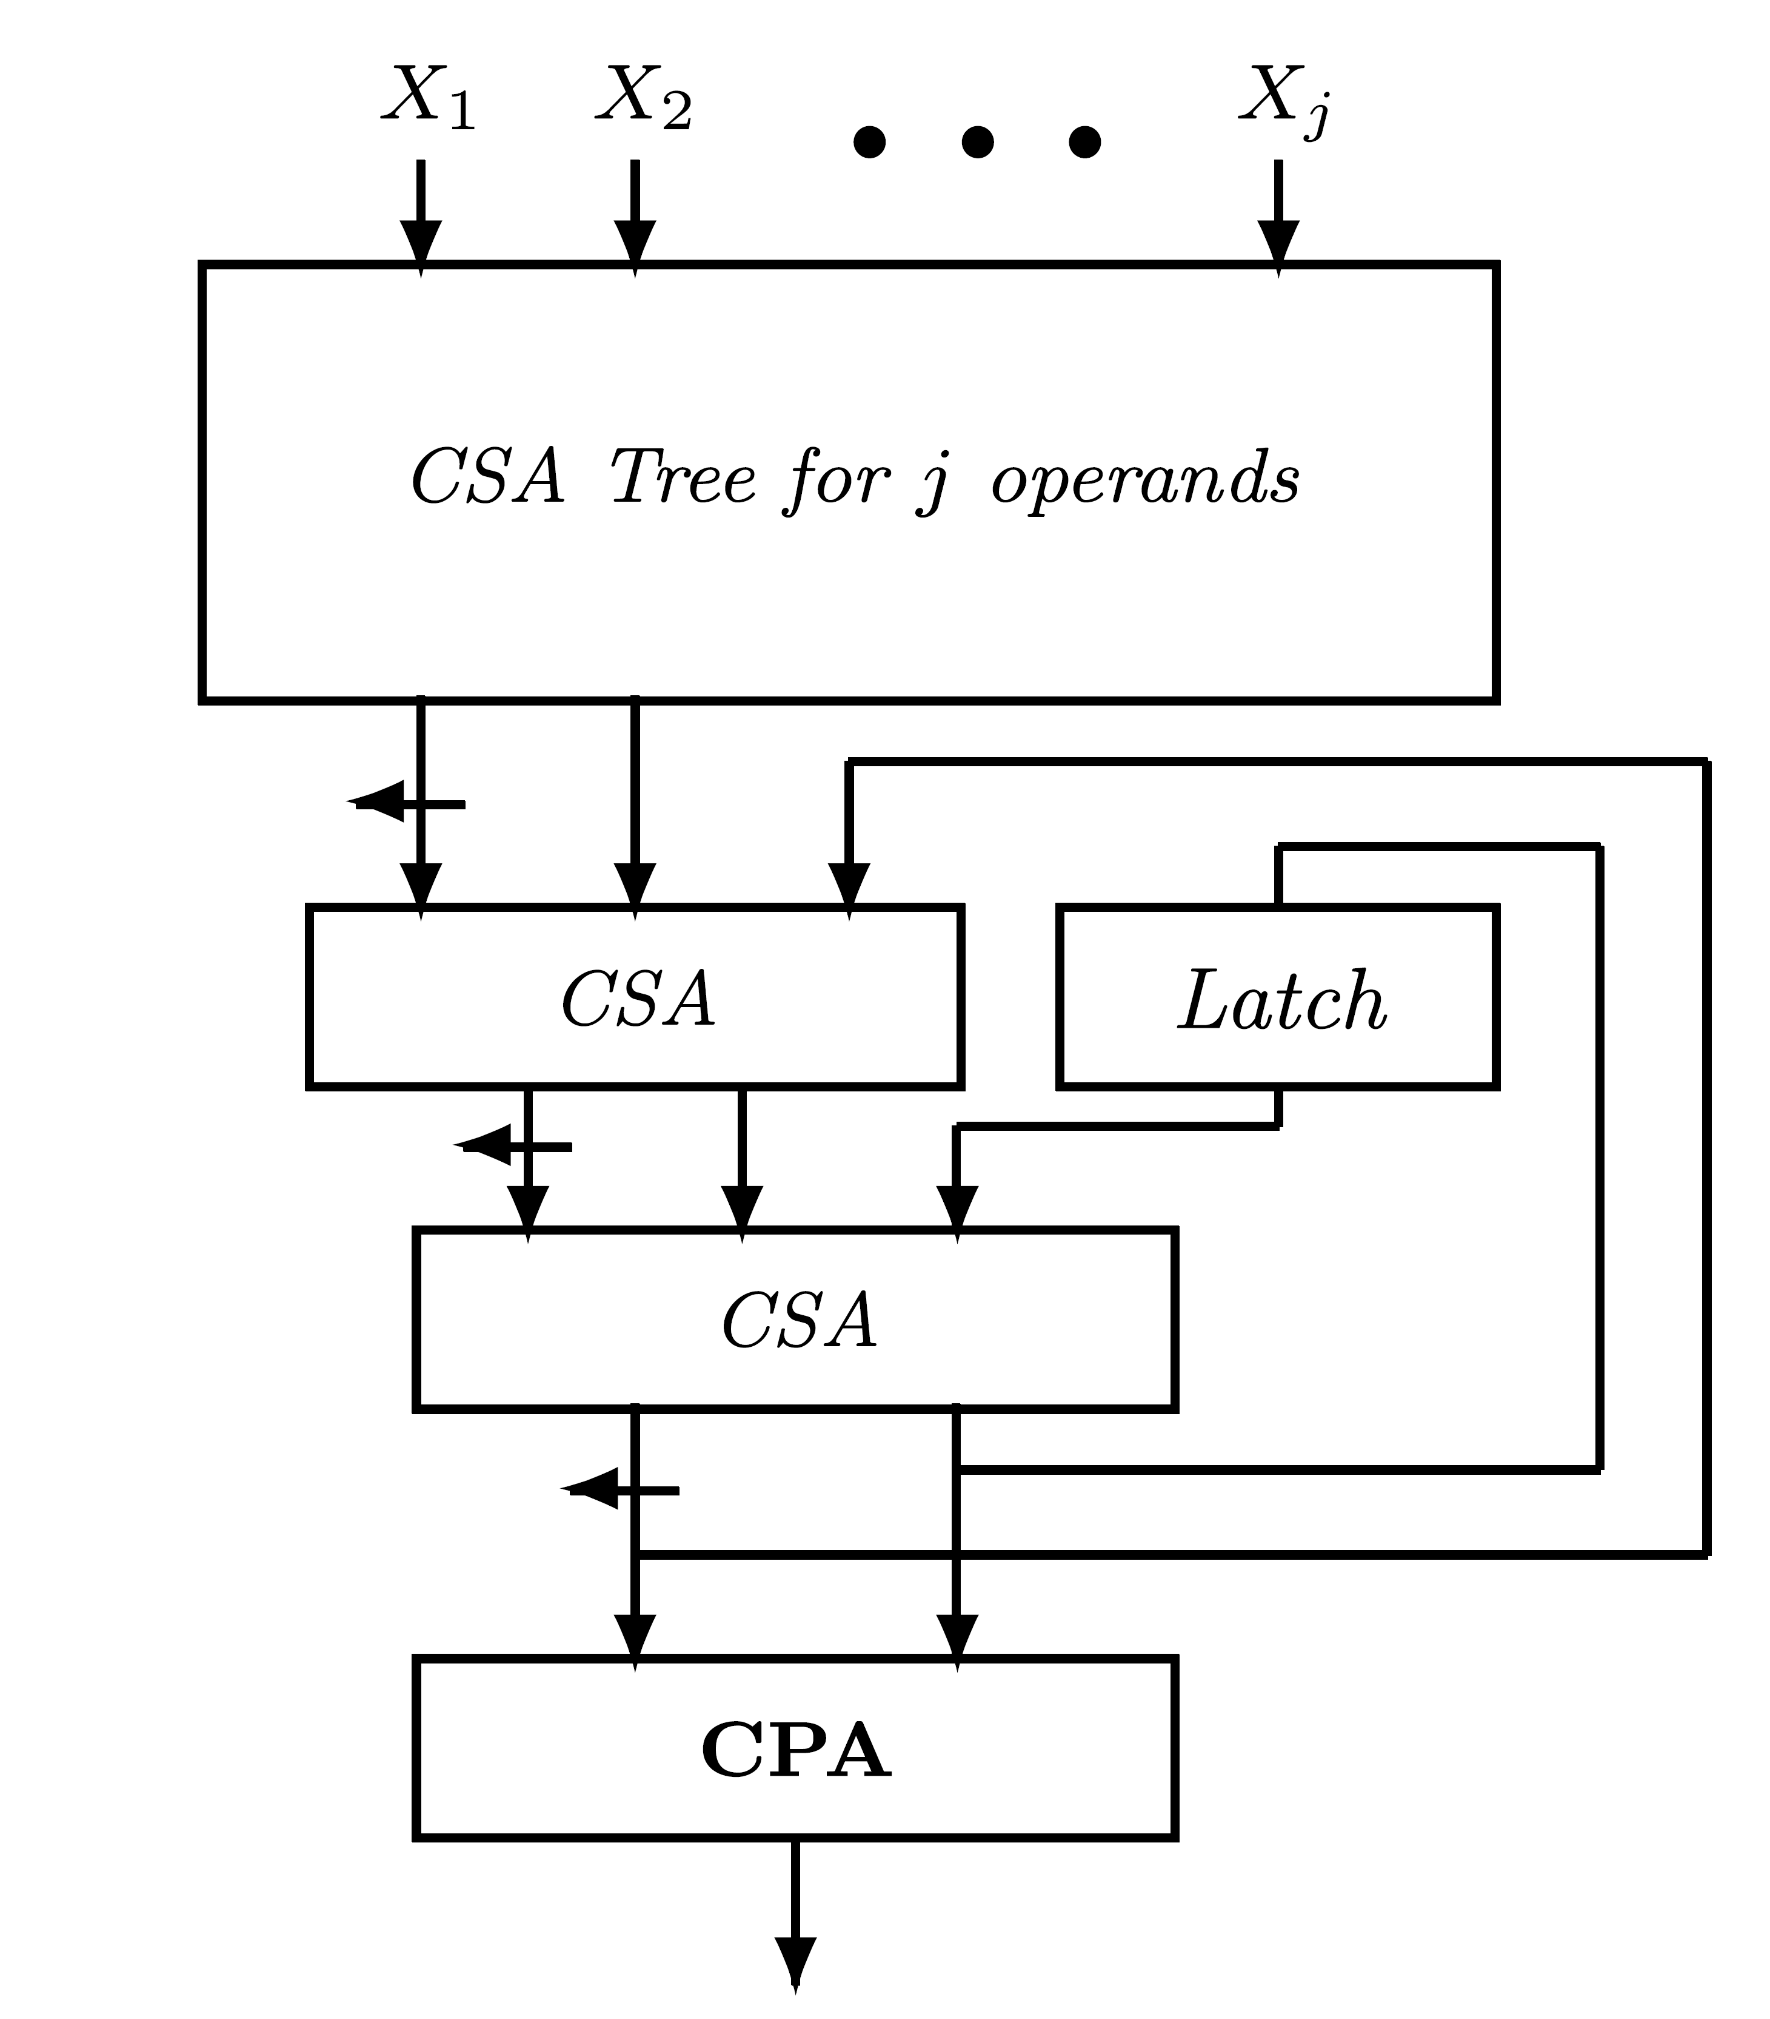
Partial Tree
Reduced hardware complexity of CSA tree - partial tree
Two feedback connections prevent pipelining
Modification - intermediate results of CSA tree connected to bottom level of tree
Smaller tree with j inputs, 2 separate CSAs, and a set of latches at the bottom
CSAs and latches form a pipeline stage
Top CSA tree for j operands can be pipelined too - overall time reduced

