Slide 1

UNIVERSITY OF MASSACHUSETTS
Dept. of Electrical & Computer Engineering
Digital Computer Arithmetic
ECE 666
Part 6a
High-Speed Multiplication - I
Israel Koren
Spring 2008

Slide 2
Speeding Up Multiplication
Multiplication involves 2 basic operations - generation of partial products + their accumulation
2 ways to speed up - reducing number of partial products and/or accelerating accumulation
3 types of high-speed multipliers:
Sequential multiplier - generates partial products sequentially and adds each newly generated product to previously accumulated partial product
Parallel multiplier - generates partial products in parallel, accumulates using a fast multi-operand adder
Array multiplier - array of identical cells generating new partial products; accumulating them simultaneously
  No separate circuits for generation and accumulation
  Reduced execution time but increased hardware complexity

Slide 3
Reducing Number of Partial Products
Examining 2 or more bits of multiplier at a time
Requires generating A (multiplicand), 2A, 3A
Reduces number of partial products to n/2 - each step more complex
Several algorithm which do not increase complexity proposed - one is Booth's algorithm
Fewer partial products generated for groups of consecutive 0’s and 1’s

Slide 4
Booth’s Algorithm
Group of consecutive 0’s in multiplier - no new partial product - only shift partial product right one bit position for every 0
Group of m consecutive 1's in multiplier - less than m partial products generated
...01…110... = ...10...000... - ...00...010...
Using SD (signed-digit) notation =...100...010...
Example:
...011110... = ...100000... - ...000010... = ...100010... (decimal notation: 15=16-1)
Instead of generating all m partial products - only 2 partial products generated
First partial product added - second subtracted - number of single-bit shift-right operations still m
-
-

Slide 5
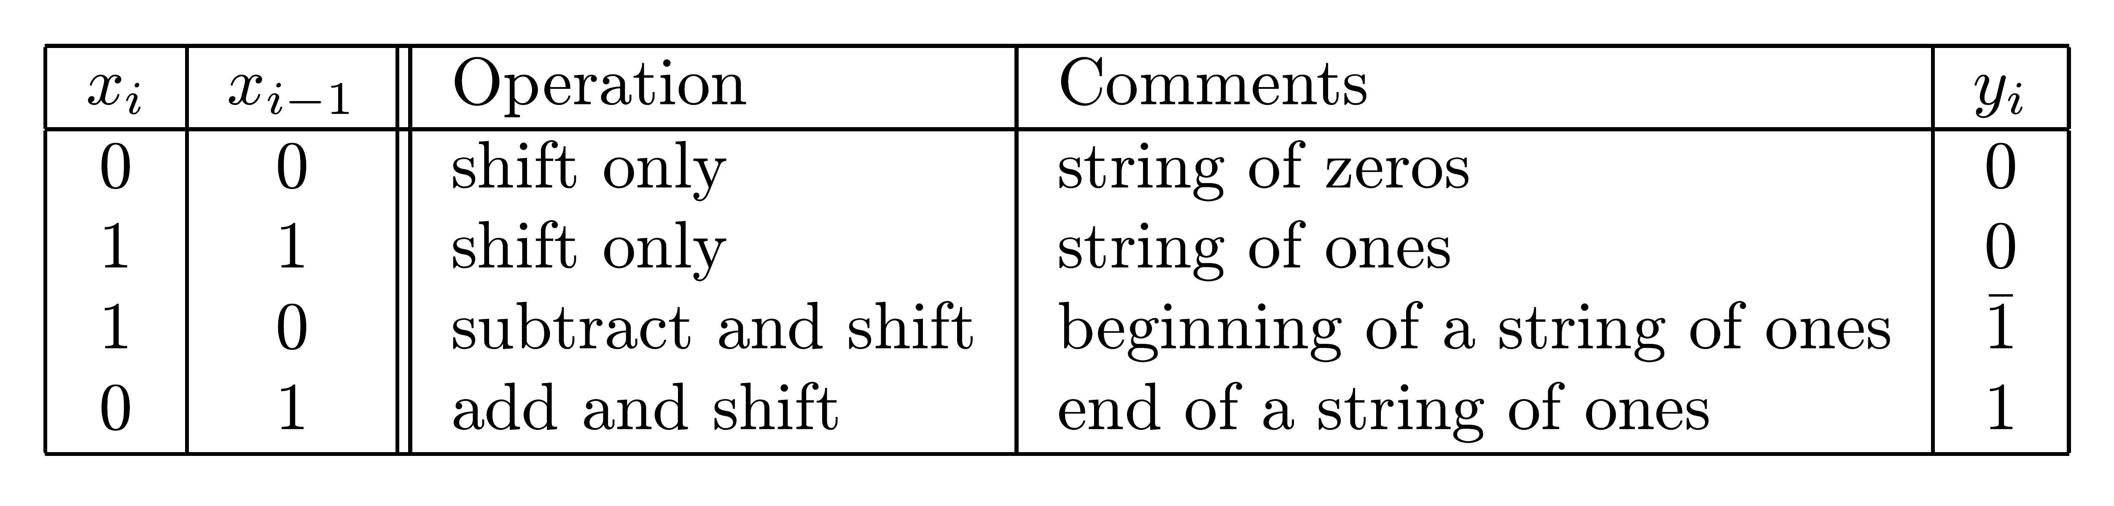
Booth’s Algorithm - Rules
Recoding multiplier xn-1 xn- 2...x1 x0 in SD code
Recoded multiplier yn-1 yn-2 ... y1 y0
xi,xi-1 of multiplier examined to generate yi
Previous bit - xi-1 - only reference bit
i=0 - reference bit x-1=0
Simple recoding - yi = xi-1 - xi
No special order - bits can be recoded in parallel
Example: Multiplier 0011110011(0) recoded as 0100010101 - 4 instead of 6 add/subtracts
-
-

Slide 6
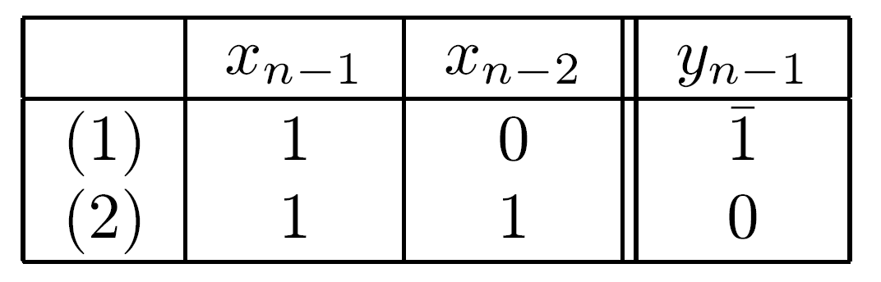
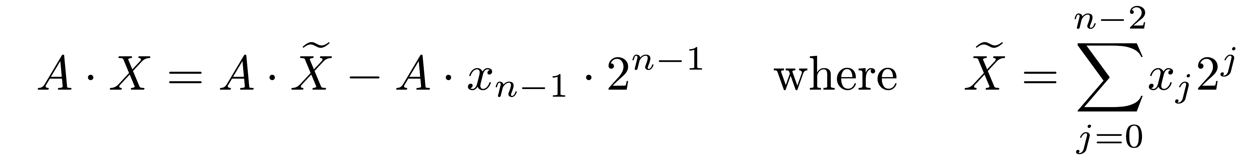
Sign Bit
Two's complement - sign bit xn-1 must be used
Deciding on add or subtract operation - no shift required - only prepares for next step
Verify only for negative values of X (xn-1=1)
2 cases
Case 1 - A subtracted - necessary correction
Case 2 - without sign bit - scan over a string of 1's and perform an addition for position n-1
  When xn-1=1 considered - required addition not done
  Equivalent to subtracting A⋅2 - correction term
n-1

Slide 7
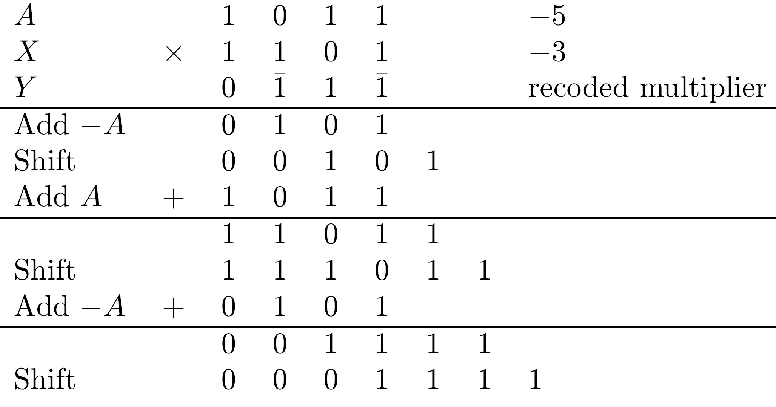
Example

Slide 8
Booth’s Algorithm - Properties
Multiplication starts from least significant bit
If started from most significant bit - longer adder/subtractor to allow for carry propagation
No need to generate recoded SD multiplier (requiring 2 bits per digit)
  Bits of original multiplier scanned - control signals for adder/subtractor generated
Booth's algorithm can handle two's complement multipliers
  If unsigned numbers multiplied - 0 added to left of multiplier (xn=0) to ensure correctness

Slide 9
Drawbacks to Booth's Algorithm
Variable number of add/subtract operations and of shift operations between two consecutive add/subtract operations
  Inconvenient when designing a synchronous multiplier
Algorithm inefficient with isolated 1's
Example:
001010101(0) recoded as 011111111, requiring 8 instead of 4 operations
Situation can be improved by examining 3 bits of X at a time rather than 2
-
-
-
-

Slide 10
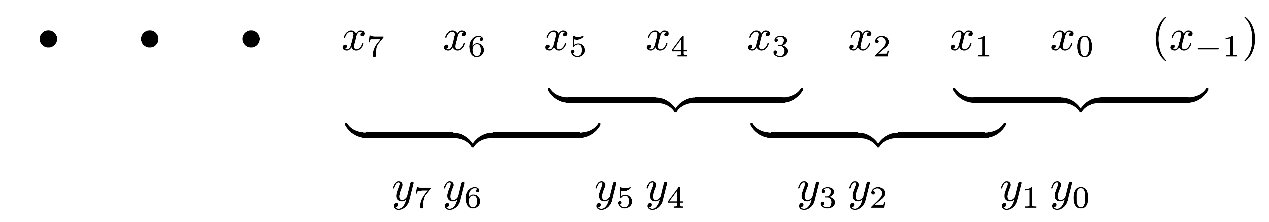
Radix-4 Modified Booth Algorithm
Bits xi and xi-1 recoded into yi and yi-1 - xi-2 serves as reference bit
Separately - xi-2 and xi-3 recoded into yi-2 and yi-3 - xi-4 serves as reference bit
Groups of 3 bits each overlap - rightmost being x1 x0 (x-1), next x3 x2 (x1), and so on

Slide 11
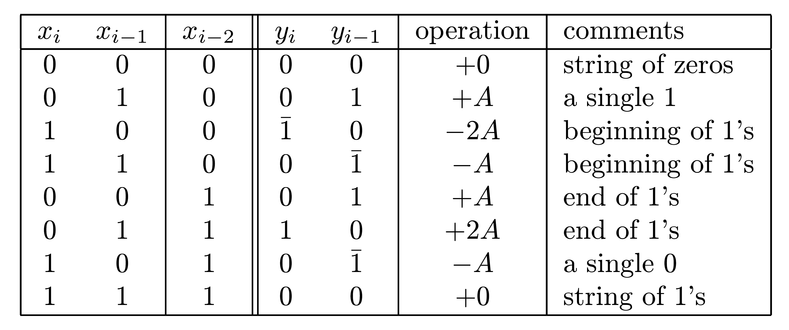
Radix-4 Algorithm - Rules
i=1,3,5,…
Isolated 0/1 handled efficiently
If xi-1 is an isolated 1, yi-1=1 - only a single operation needed
Similarly - xi-1 an isolated 0 in a string of 1's -...10(1)… recoded as ...11... or ...01… - single operation performed
Exercise: To find required operation - calculate xi-1+xi-2-2xi for odd i’s and represent result as a 2-bit binary number yiyi-1 in SD
-
-

Slide 12
Radix-4 vs. Radix-2 Algorithm
01|01|01|01|(0) yields 01|01|01|01| - number of operations remains 4 - the minimum
00|10|10|10|(0) yields 01|01|01|10|, requiring 4, instead of 3, operations
Compared to radix-2 Booth's algorithm - less patterns with more partial products; Smaller increase in number of operations
Can design n-bit synchronous multiplier that generates exactly n/2 partial products
Even n - two's complement multipliers handled correctly; Odd n - extension of sign bit needed
Adding a 0 to left of multiplier needed if unsigned numbers are multiplied and n odd - 2 0’s if n even
-
-
-

Slide 13
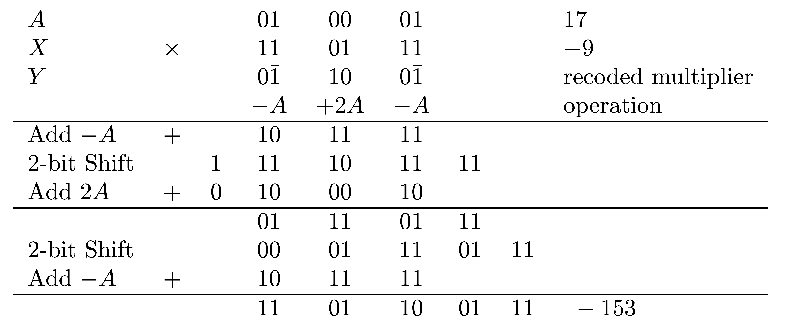
Example
n/2=3 steps ; 2 multiplier bits in each step
All shift operations are 2 bit position shifts
Additional bit for storing correct sign required to properly handle addition of 2A

Slide 14
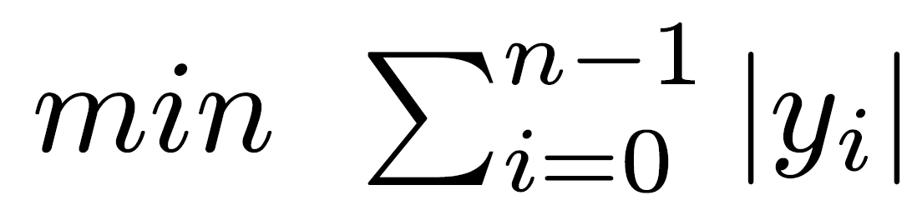
Radix-8 Modified Booth's Algorithm
Recoding extended to 3 bits at a time - overlapping groups of 4 bits each
Only n/3 partial products generated - multiple 3A needed - more complex basic step
Example: recoding 010(1) yields yi yi-1 yi-2=011
Technique for simplifying generation and accumulation of ±3A exists
To find minimal number of add/subtract ops required for a given multiplier - find minimal SD representation of multiplier
Representation with smallest number of nonzero digits -

Slide 15
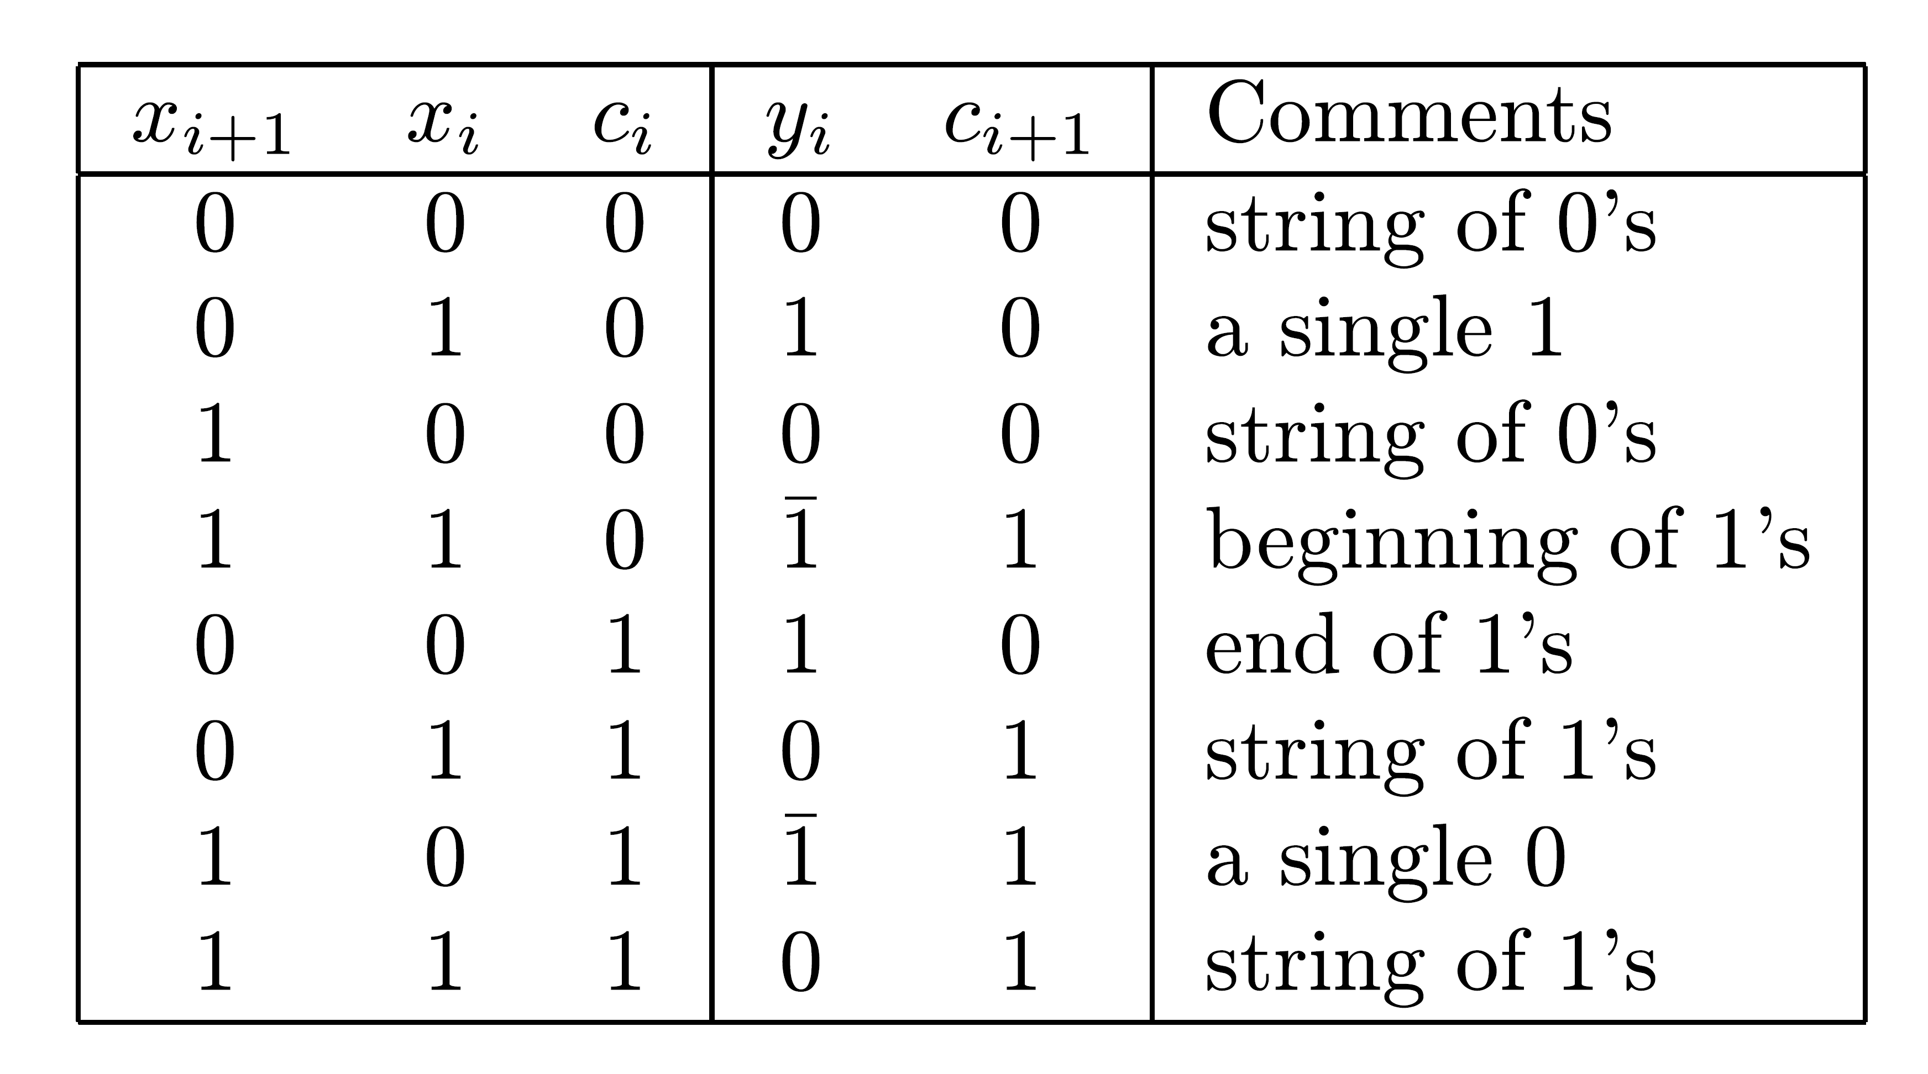
Obtaining Minimal Representation of X
yn-1yn-2... y0 is a minimal representation of an SD number if yi⋅yi-1=0 for 1≤ i≤ n-1, given that most significant bits can satisfy yn-1⋅yn-2 ≠ 1
Example: Representation of 7 with 3 bits 111 minimal representation although yi⋅yi-1 ≠ 0
For any X - add a 0 to its left to satisfy above condition

Slide 16
Canonical Recoding
Multiplier bits examined one at a time from right; xi+1 - reference bit
To correctly handle a single 0/1 in string of 1's/0’s - need information on string to right
“Carry” bit - 0 for 0's and 1 for 1's
As before, recoded multiplier can be used without correction if represented in two's complement
Extend sign bit xn-1 - xn-1xn-1xn-2…x0
Can be expanded to two or more bits at a time
Multiples needed for 2 bits - ±A and ±2A

Slide 17
Disadvantages of Canonical Recoding
Bits of multiplier generated sequentially
In Booth’s algorithm - no “carry” propagation - partial products generated in parallel and a fast multi-operand adder used
To take full advantage of minimum number of operations - number of add/subtracts and length of shifts must be variable - difficult to implement
For uniforms shifts - n/2 partial products - more than the minimum in canonical recoding

Slide 18
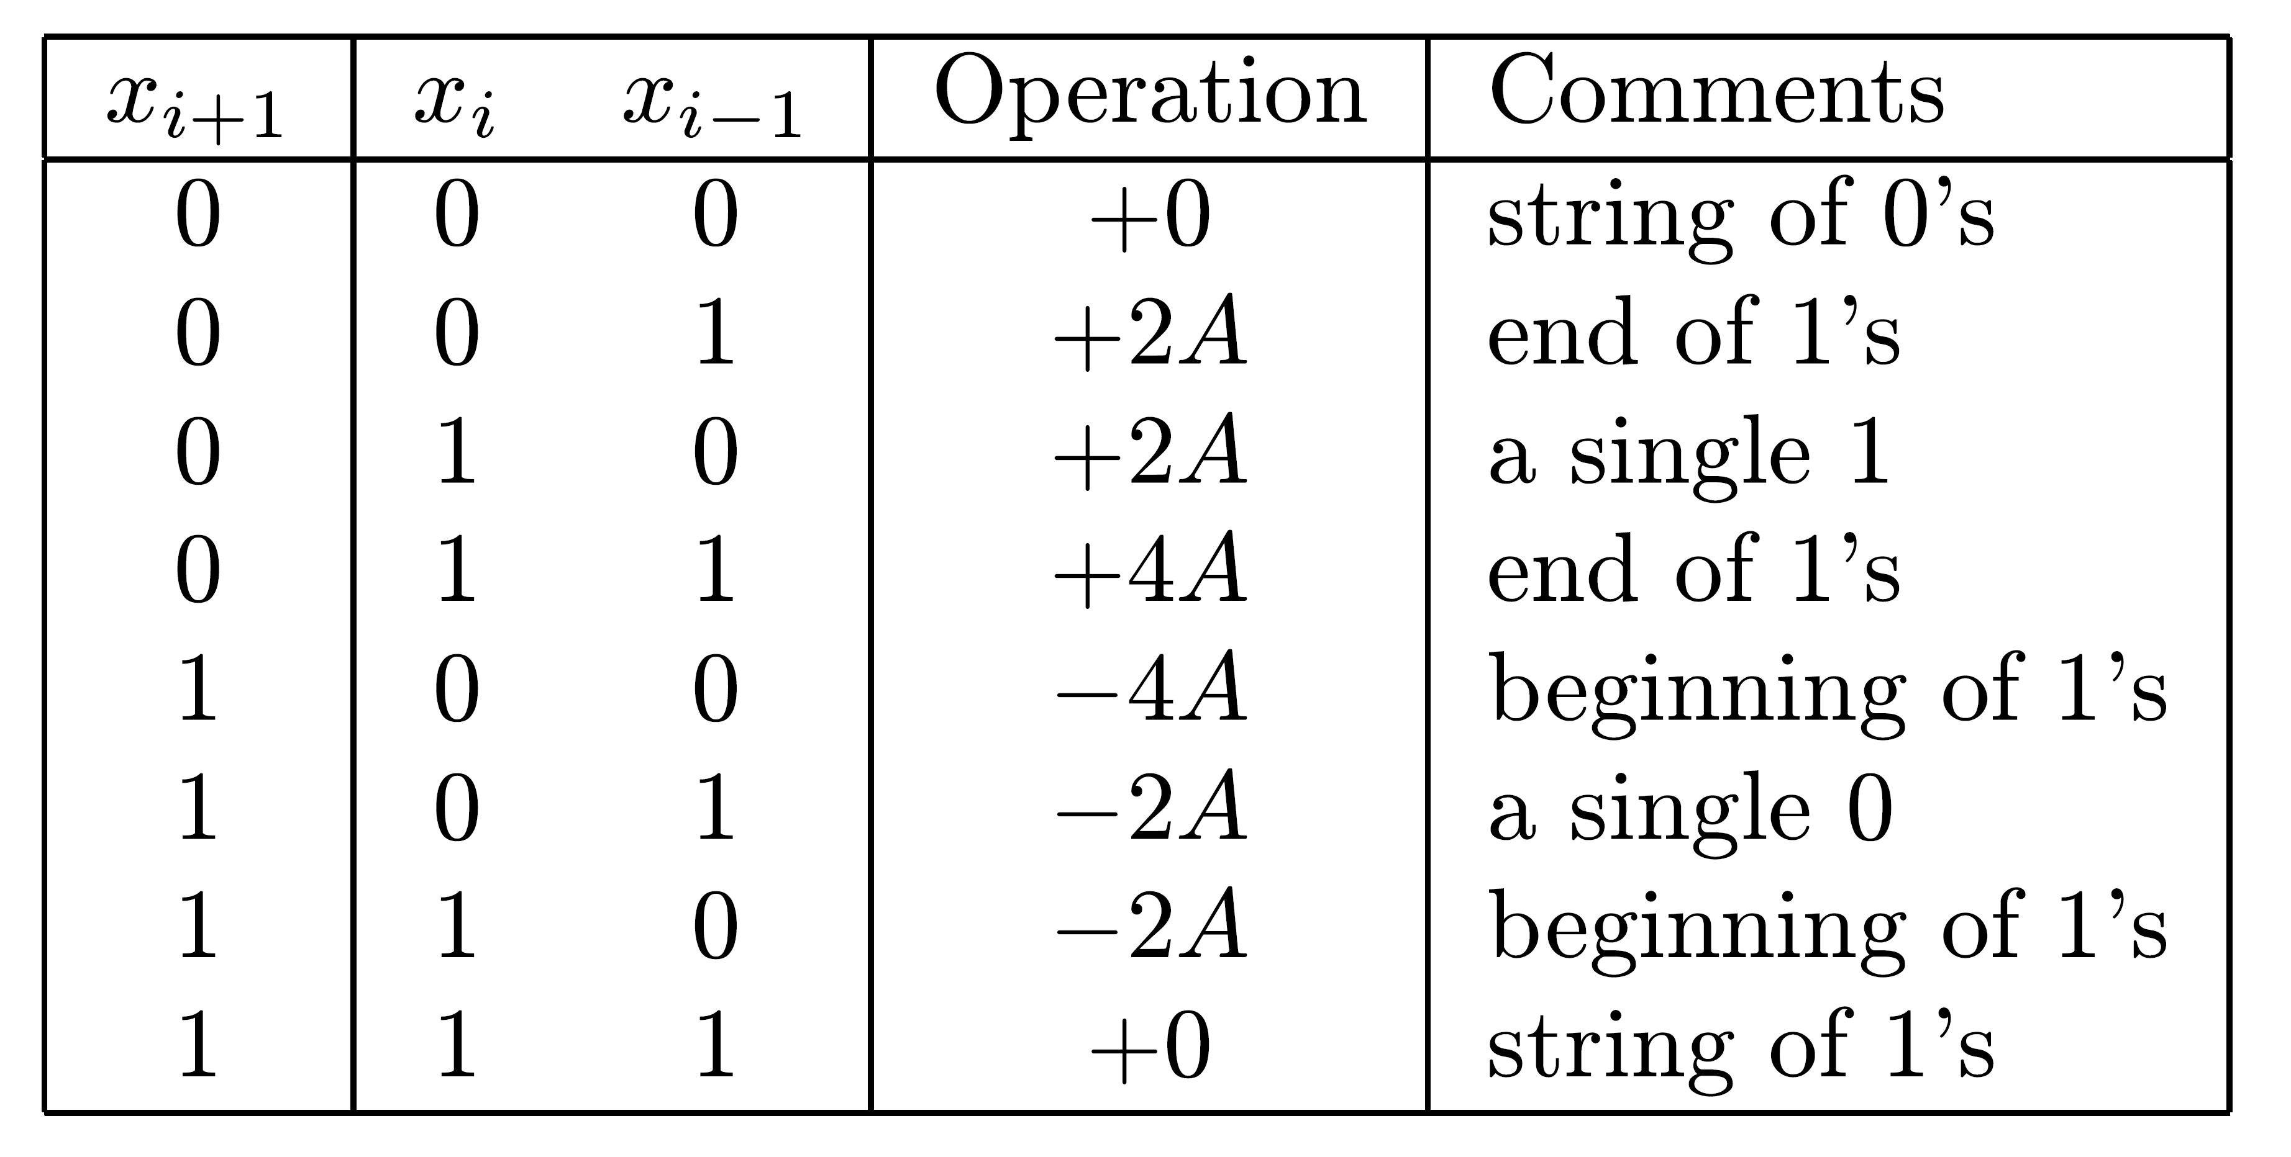
Alternate 2-bit-at-a-time Algorithm
Reducing number of partial products but still uniform shifts of 2 bits each
xi+1 reference bit for xi xi-1 - i odd
±2A,±4A can be generated using shifts
4A generated when (xi+1)xi xi-1=(0)11 - group of 1's - not for (xi+3)xi+2 xi+1 - 0 in rightmost position
  Not recoding - cannot express 4 in 2 bits
  Number of partial products - always n/2
  Two's complement multipliers - extend sign bit
  Unsigned numbers - 1 or 2 0’s added to left of multiplier

Slide 19
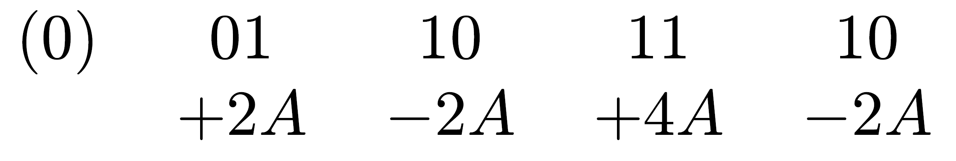
Example
Multiplier 01101110 - partial products:
Translates to the SD number 010110010 - not minimal - includes 2 adjacent nonzero digits
Canonical recoding yields 010010010 - minimal representation

Slide 20
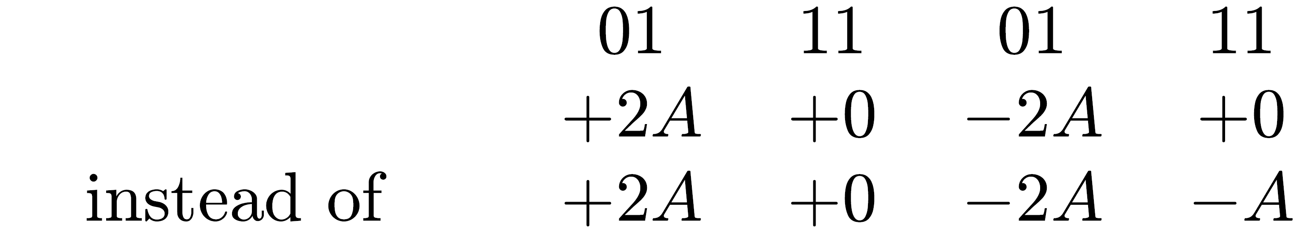
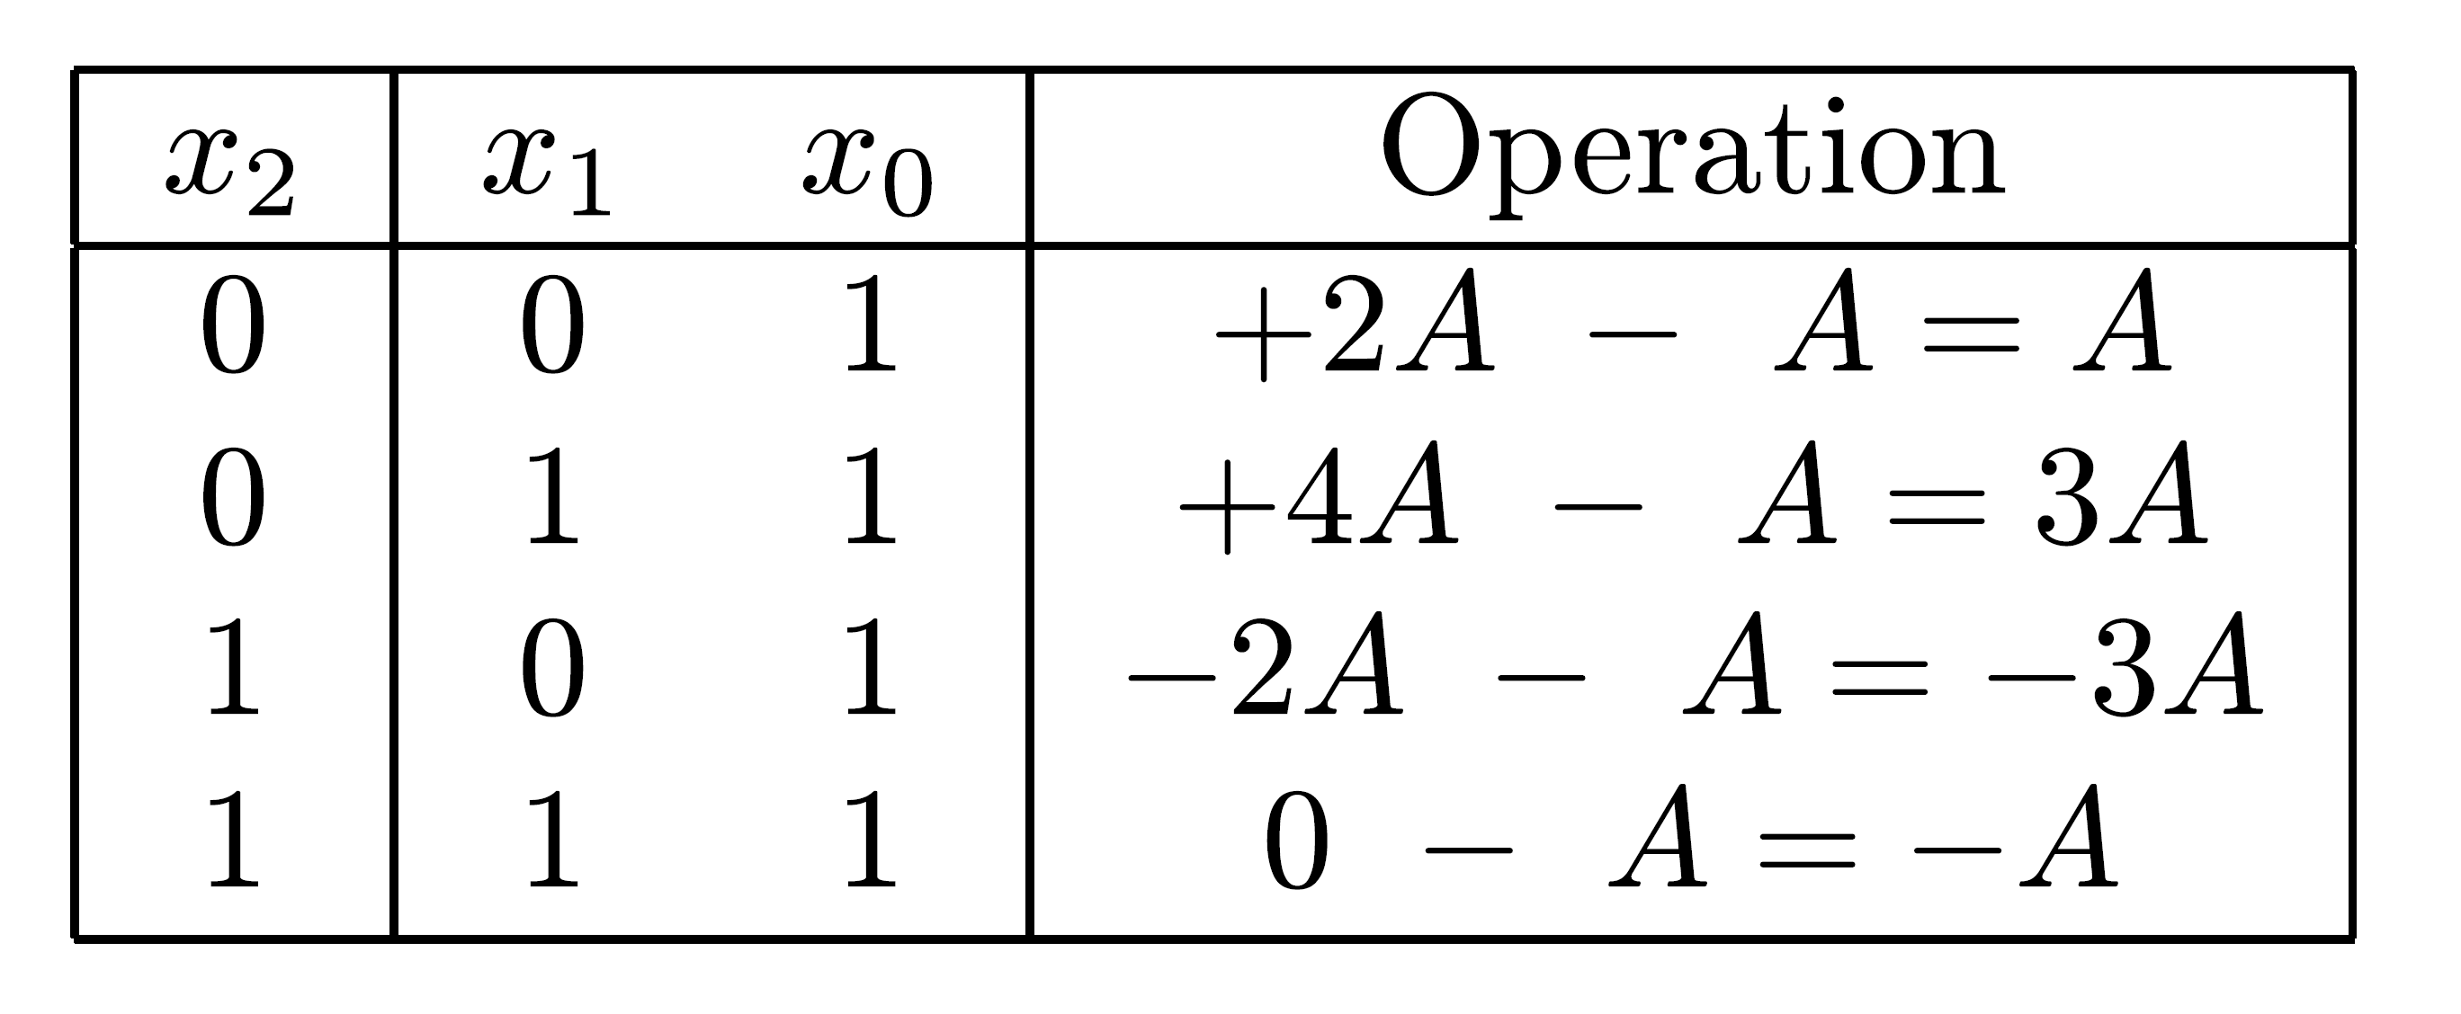
Dealing with Least significant Bit
For the rightmost pair x1x0, if x0 = 1 - considered continuation of string of 1's that never really started - no subtraction took place
Example: multiplier 01110111 - partial products:
Correction: when x0=1 - set initial partial product to -A instead of 0
4 possible cases:

Slide 21
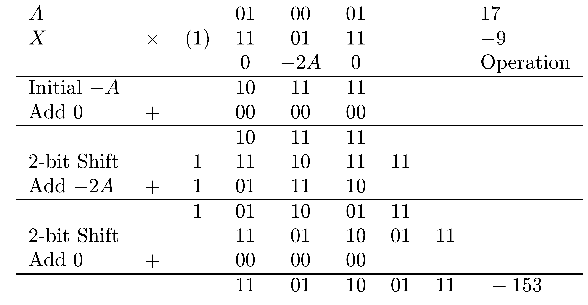
Example
Previous example -
Multiplier's sign bit extended in order to decide that no operation needed for first pair of multiplier bits
As before - additional bit for holding correct sign is needed, because of multiples like -2A

Slide 22
Extending the Alternative Algorithm
The above method can be extended to three bits or more at each step
However, here too, multiples of A like 3A or even 6A are needed and
  Prepare in advance and store
  Perform two additions in a single step
For example, for (0)101 we need 8-2=6, and for (1)001, -8+2=-6

Slide 23
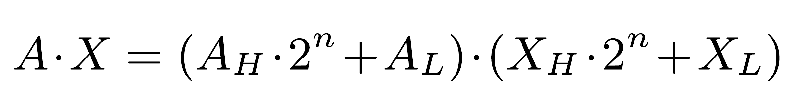
Implementing Large Multipliers Using Smaller Ones
Implementing n x n bit multiplier as a single integrated circuit - several such circuits for implementing larger multipliers can be used
2n x 2n bit multiplier can be constructed out of 4 n x n bit multipliers based on :
AH , AL - most and least significant halves of A ; XH , XL - same for X

Slide 24
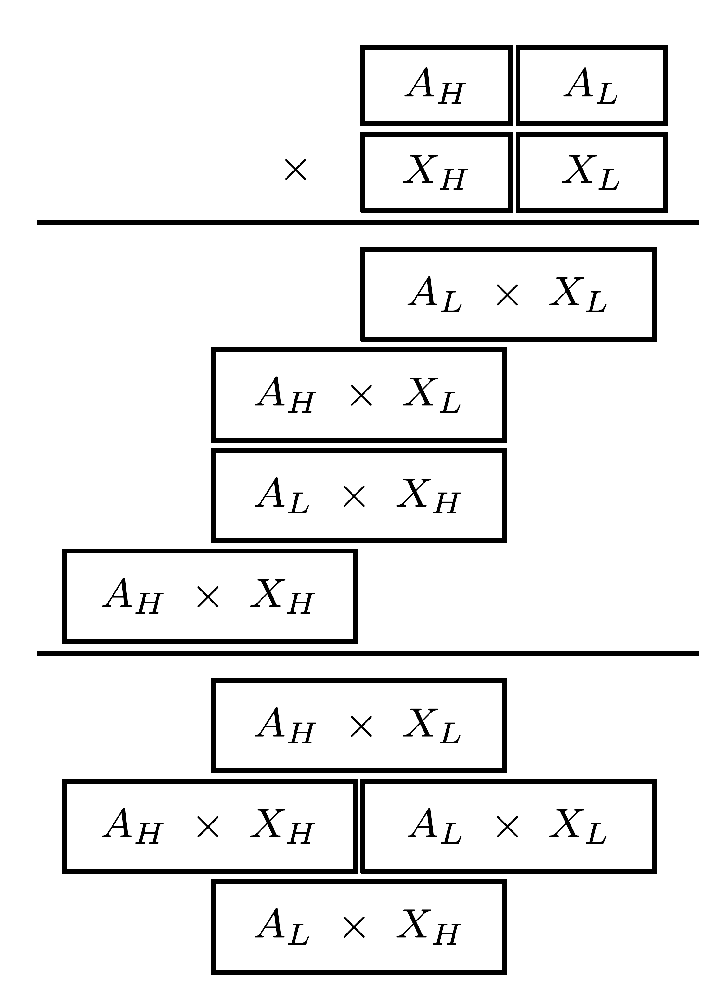
Aligning Partial Products
4 partial products of 2n bits - correctly aligned before adding
Last arrangement - minimum height of matrix - 1 level of carry-save addition and a CPA
n least significant bits - already bits of final product - no further addition needed
2n center bits - added by 2n-bit CSA with outputs connected to a CPA
n most significant bits connected to same CPA, since center bits may generate carry into most significant bits - 3n-bit CPA needed

Slide 25
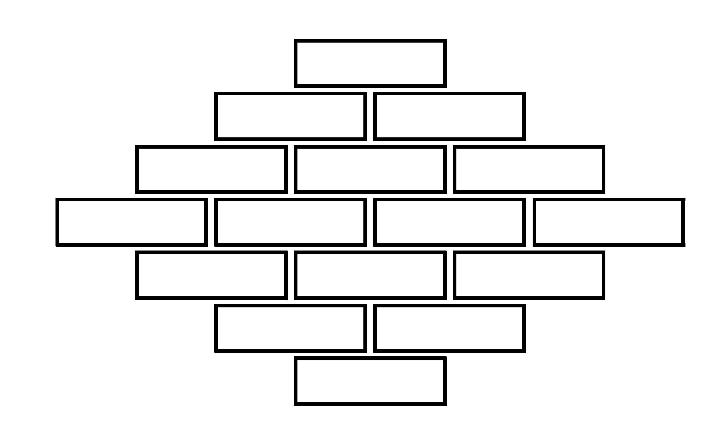
Decomposing a Large Multiplier into Smaller Ones - Extension
Basic multiplier - n x m bits - n ≠ m
Multipliers larger than 2n x 2m can be implemented
Example: 4n x 4n bit multiplier - implemented using n x n bit multipliers
  4n x 4n bit multiplier requires 4 2n x 2n bit multipliers
  2n x 2n bit multiplier requires 4 n x n bit multipliers
  Total of 16 n x n bit multipliers
  16 partial products - aligned before being added
Similarly - for any kn x kn bit multiplier with integer k

Slide 26
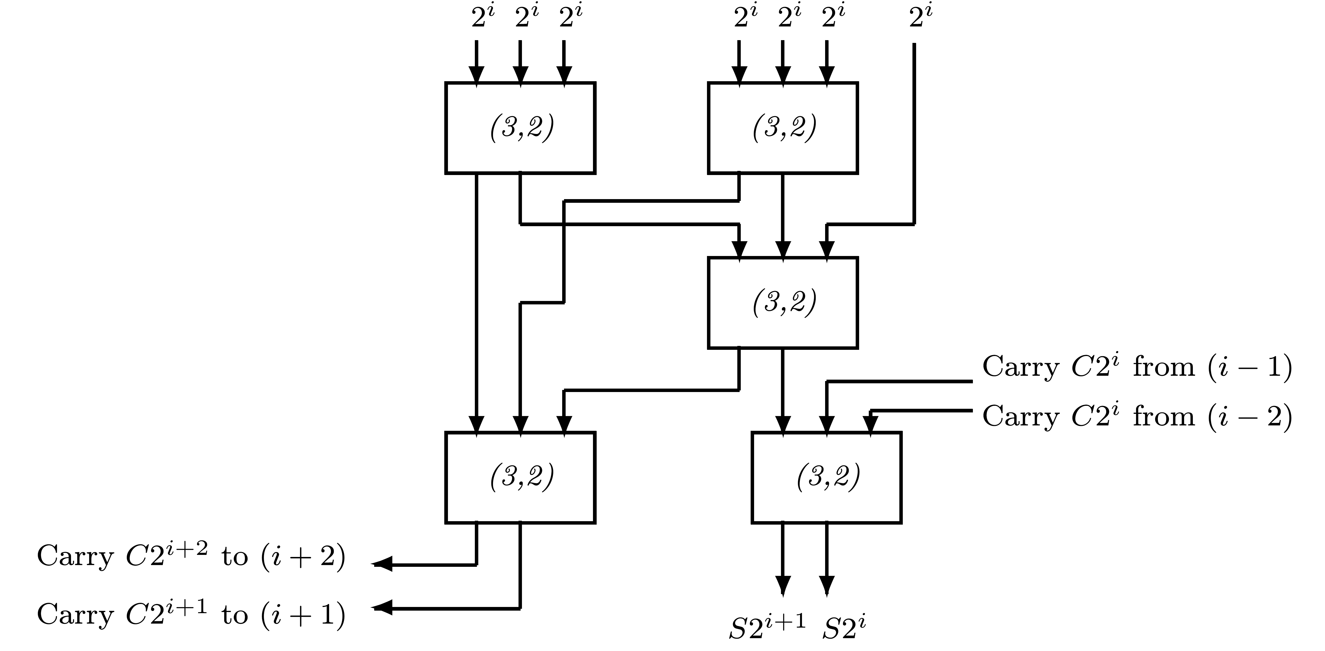
Adding Partial Products
After aligning 16 products - 7 bits in one column need to be added
Method 1: (7,3) counters - generating 3 operands added by (3,2) counters - generating 2 operands added by a CPA
Method 2: Combining 2 sets of counters into a set of (7;2) compressors
Selecting more economical multi-operand adder - discussed next

