Slide 1

UNIVERSITY OF MASSACHUSETTS
Dept. of Electrical & Computer Engineering
Digital Computer Arithmetic
ECE 666
Part 6c
High-Speed Multiplication - III
Israel Koren
Spring 2008

Slide 2
Array Multipliers
The two basic operations - generation and summation of partial products - can be merged, avoiding overhead and speeding up multiplication
Iterative array multipliers (or array multipliers) consist of identical cells, each forming a new partial product and adding it to previously accumulated partial product
  Gain in speed obtained at expense of extra hardware
  Can be implemented so as to support a high rate of pipelining

Slide 3
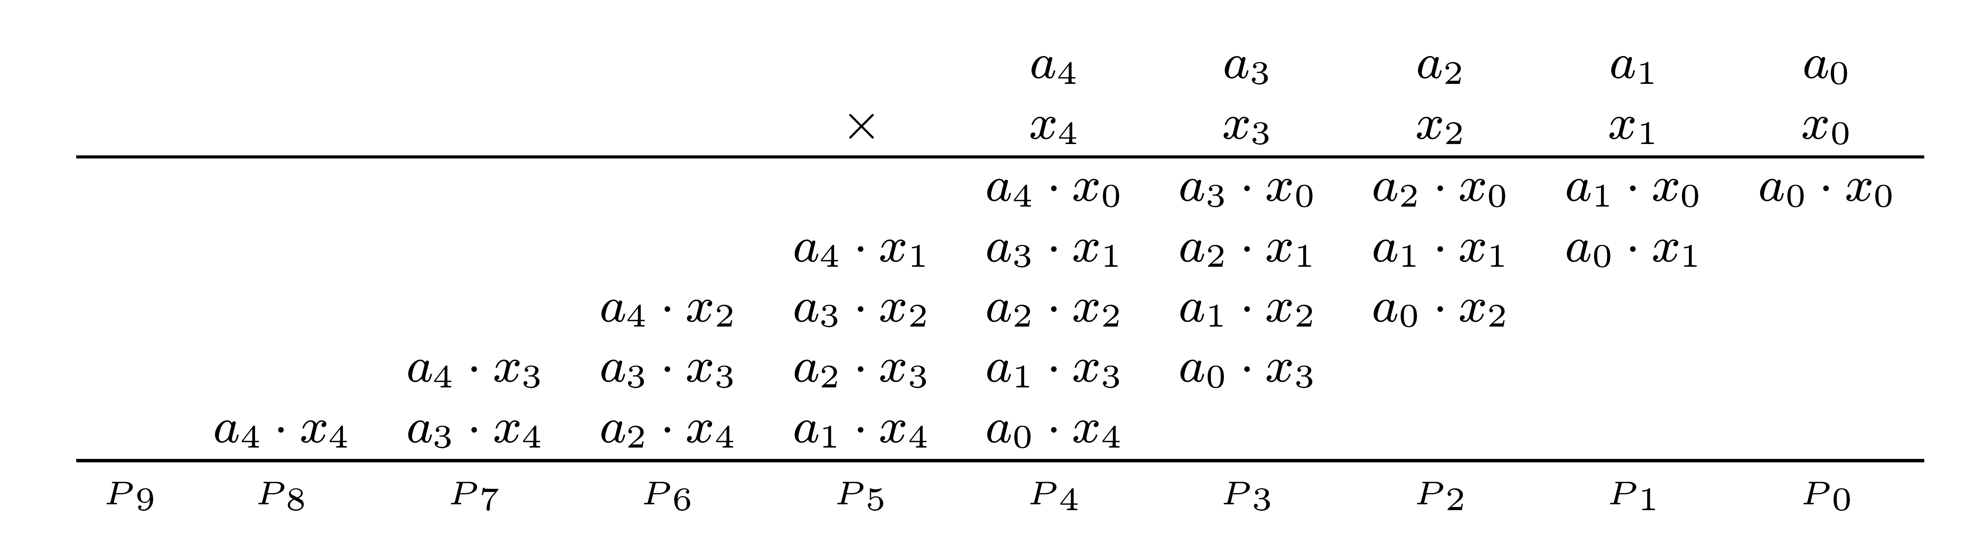
Illustration - 5 x 5 Multiplication
Straightforward implementation -
  Add first 2 partial products (a4x0, a3x0,…,a0 x0 and a4x1, a3x1,…,a0x1) in row 1 after proper alignment
  The results of row 1 are then added to a4x2, a3x2,…,a0x2 in row 2, and so on

Slide 4
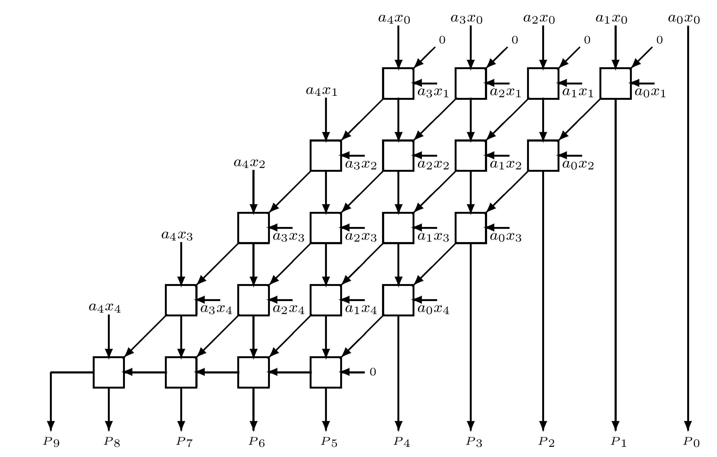
5 x 5 Array Multiplier for Unsigned Numbers
Basic cell - FA accepting one bit of new partial product aixj + one bit of previously accumulated partial product + carry-in bit
No horizontal carry propagation in first 4 rows - carry-save type addition - accumulated partial product consists of intermediate sum and carry bits
Last row is a ripple-carry adder - can be replaced by a fast 2-operand adder (e.g., carry-look-ahead adder)

Slide 5
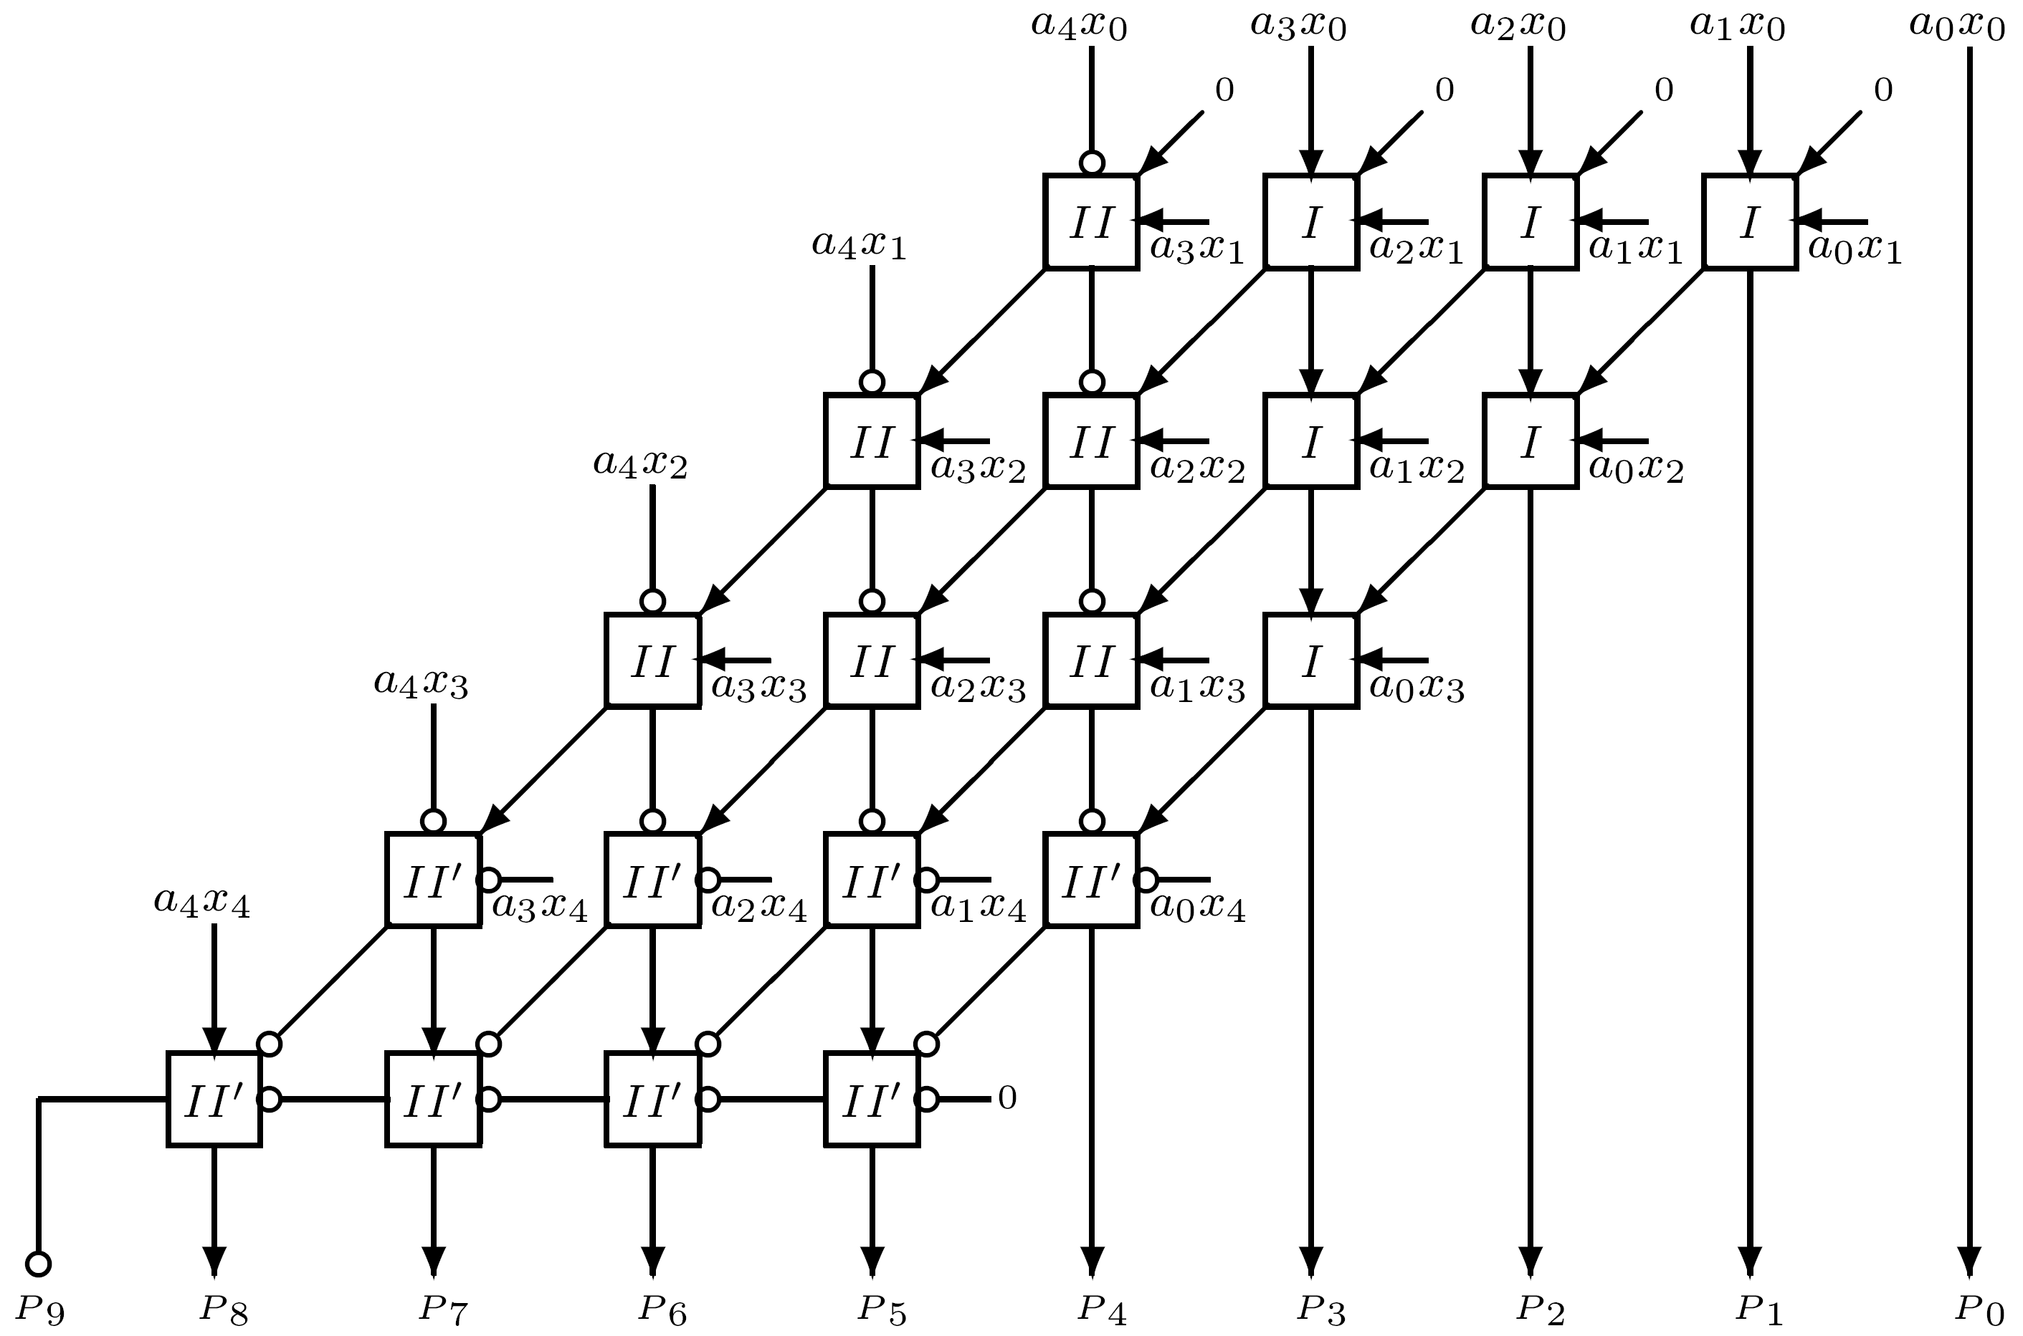
Array Multiplier for Two’s Complement Numbers
Product bits like a4x0 and a0x4 have negative weight
Should be subtracted instead of added

Slide 6
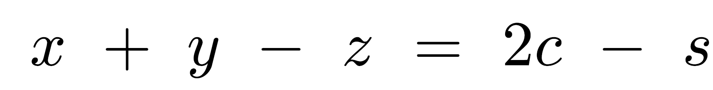
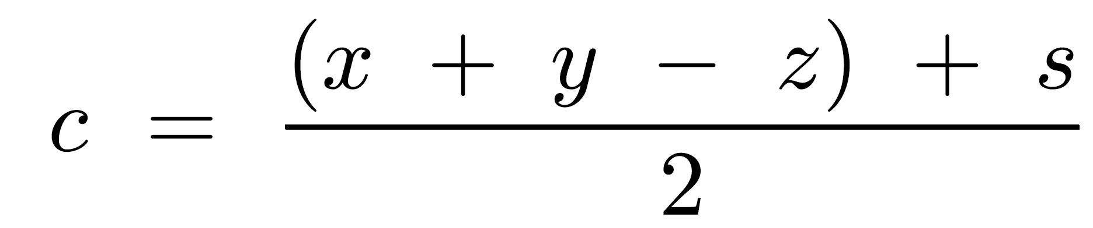
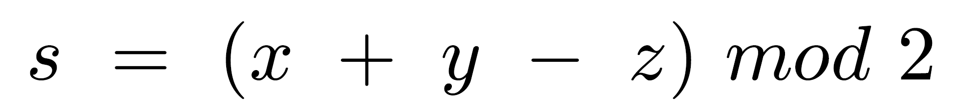
Type I and II Cells
Type I cells: 3 positive inputs - ordinary FAs
Type II cells: 1 negative and 2 positive inputs
Sum of 3 inputs of type II cell can vary from -1 to 2
  c output has weight +2
  s output has weight -1
Arithmetic operation of type II cell -
s and c outputs given by
II

Slide 7
Type I’ and II’ Cells
Type II' cells: 2 negative inputs and 1 positive
Sum of inputs varies from -2 to 1
  c output has weight -2
  s output has weight +1
Type I' cell: all negative inputs - has negatively weighted c and s outputs
Counts number of -1's at its inputs - represents this number through c and s outputs
Same logic operation as type I cell - same gate implementation
Similarly - types II and II' have the same gate implementation
II’

Slide 8
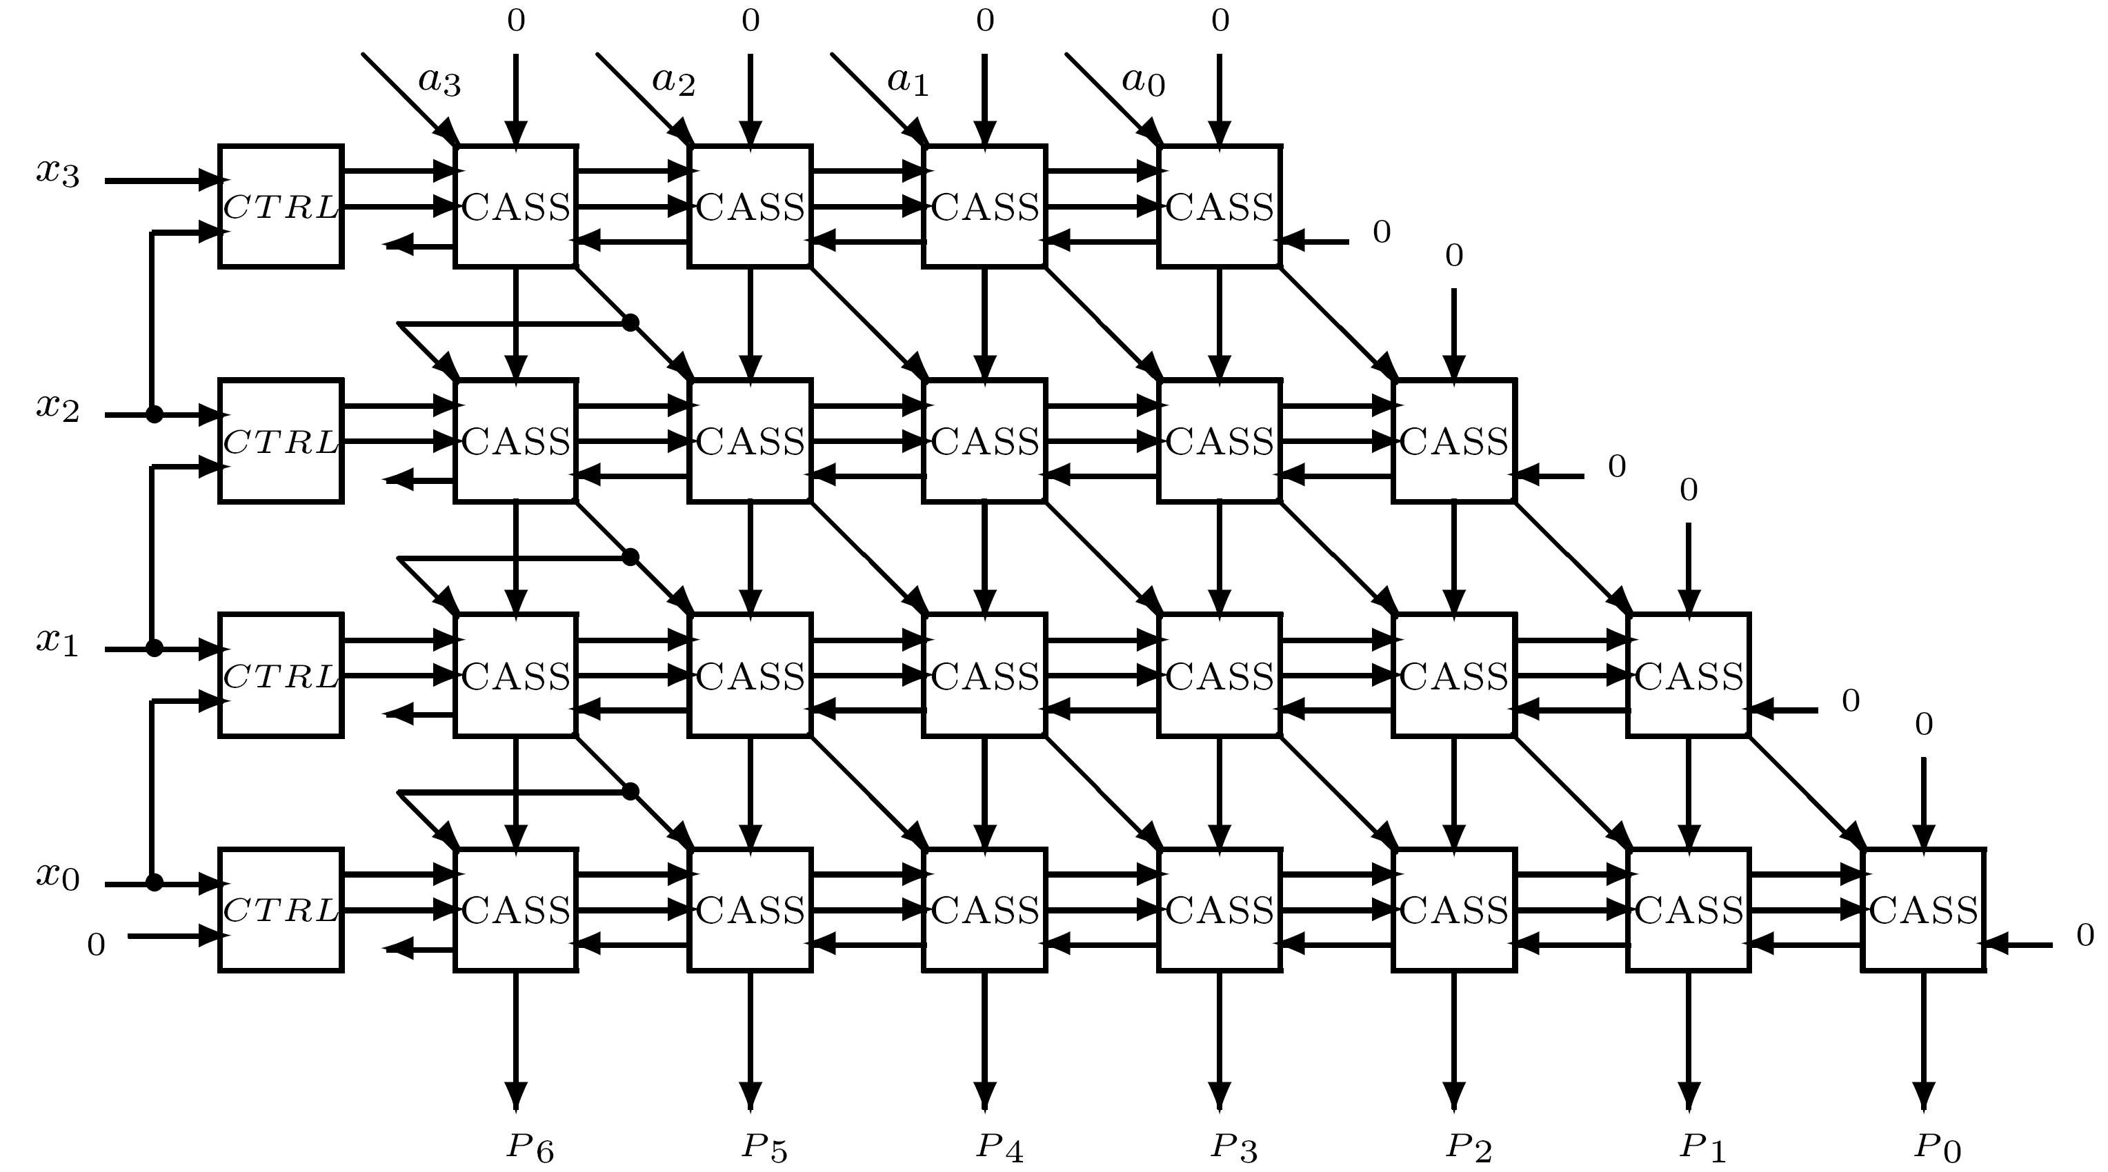
Booth’s Algorithm Array Multiplier
For two's complement operands
n rows of basic cells - each row capable of adding or subtracting a properly aligned multiplicand to previously accumulated partial product
  Cells in row i perform an add, subtract or transfer-only operation, depending on xi and reference bit
4-bit operands
Controlled add/ subtract/shift (CASS)

Slide 9
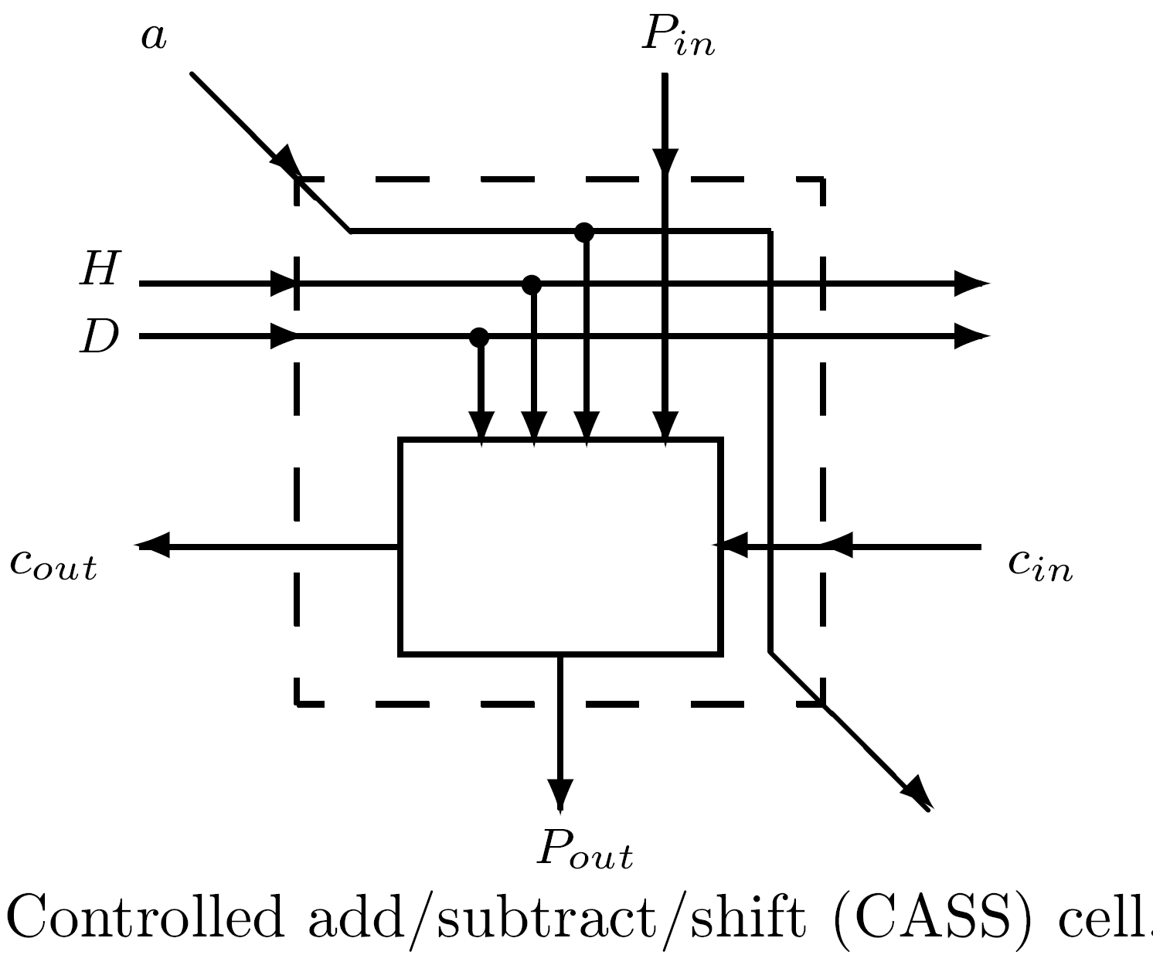
Controlled add/subtract/shift - CASS
H and D: control signals indicating type of operation
H=0: no arithmetic operation done
H=1: arithmetic operation performed - new Pout
  Type of arithmetic operation indicated by D signal
  D=0: multiplicand bit, a, added to Pin with cin as incoming carry - generating Pout and cout as outgoing carry
  D=1: multiplicand bit, a, subtracted from Pin with incoming borrow and outgoing borrow
Pout=Pin⊕(a H)⊕(cin H) cout=(Pin⊕D)(a+cin) + a cin
Alternative: combination of multiplexer (0, +a and -a) and FA
H and D generated by CTRL - based on xi and reference bit x{i-1}

Slide 10
Booth’s Algorithm Array Multiplier - details
First row - most significant bit of multiplier
Resulting partial product need be shifted left before adding/subtracting next multiple of multiplicand
A new cell with input Pin=0 is added
Number of bits in partial product increases by one each row - expand multiplicand before adding/subtracting it
Accomplished by replicating sign bit of multiplicand

Slide 11
Properties and Delay
Cannot take advantage of strings of 0's or 1's - cannot eliminate or skip rows
Only advantage: ability to multiply negative numbers in two's complement with no need for correction
Operation in row i need not be delayed until all upper (i-1) rows have completed their operation
P0, generated after one CASS delay (plus delay of CTRL), P1 generated after two CASS delays, and P{2n-2}, generated after (2n-1) CASS delays
Similarly can implement higher-radix multiplication requiring less rows
Building block: multiplexer-adder circuit that selects correct multiple of multiplicand A and adds it to previously accumulated partial product

Slide 12
Pipelining
Important characteristic of array multipliers - allow pipelining
Execution of separate multiplications overlaps
The long delay of carry-propagating addition must be minimized
Achieved by replacing CPA with several additional rows - allow carry propagation of only one position between consecutive rows
To support pipelining, all cells must include latches - each row handles a separate multiplier-multiplicand pair
Registers needed to propagate multiplier bits to their destination, and propagate completed product bits

Slide 13
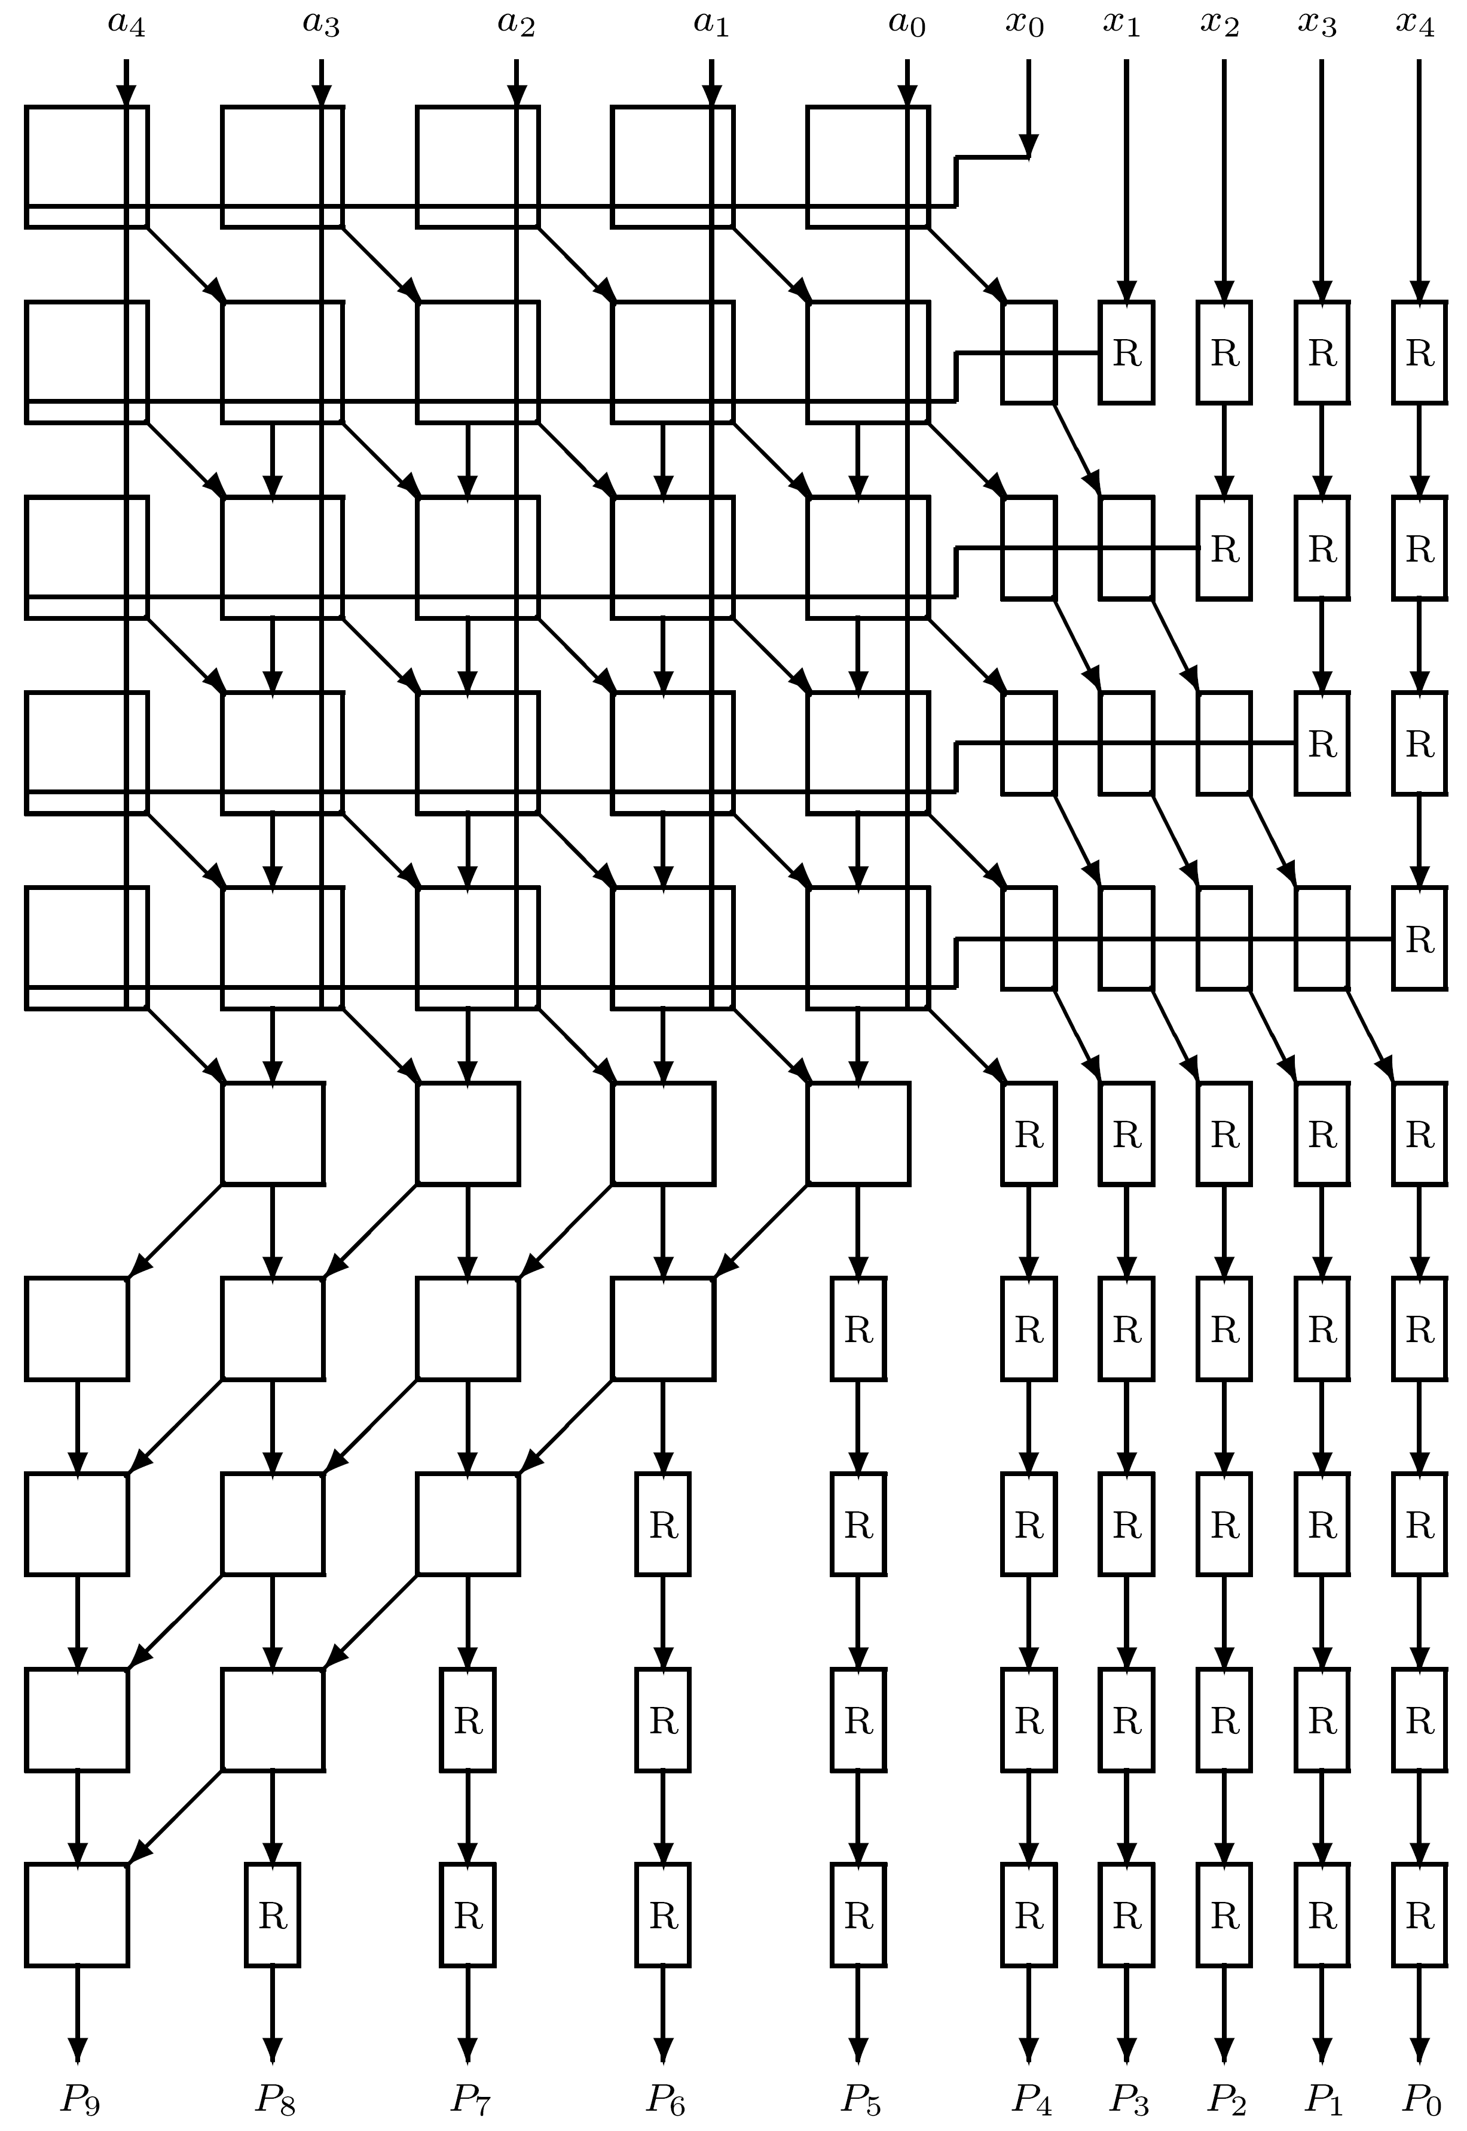
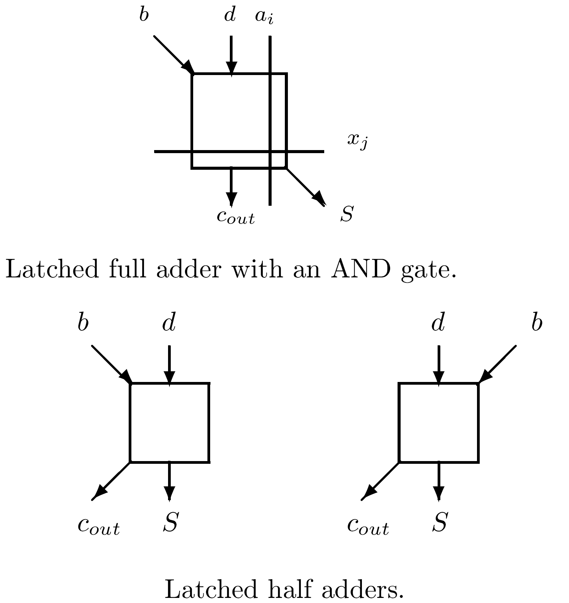
Pipelined Array Multiplier

Slide 14
Optimality of Multiplier Implementations
Bounds on performance of algorithms for multiplication
Theoretical bounds for multiplication similar to those for addition
Adopting the idealized model using (f,r) gates:
Execution time of a multiply circuit for two operands with n bits satisfies
Tmult ≥ ⎡ log f 2n ⎤
If residue number system is employed:
Tmult ≥ ⎡ log f 2m ⎤
m - number of digits needed to represent largest modulus in residue number system

Slide 15
Optimal Implementations
Need to compare performance (execution time) and implementation costs (e.g., regularity of design, total area, etc.)
Objective function like A T can be used
A - area and T - execution time
A more general objective function: A T
  α can be either smaller or larger than 1
α

Slide 16
Basic Array Multiplier
Very regular structure - can be implemented as a rectangular-shaped array - no waste of chip area
n least significant bits of final product are produced on right side of rectangle; n most significant bits are outputs of bottom row of rectangle
Highly regular and simple layout but has two drawbacks:
  Requires a very large area, proportional to n², since it contains about n² FAs and AND gates
  Long execution time T of about 2 n ΔFA (ΔFA - delay of FA)
More precisely, T consists of (n-1)ΔFA for first (n-1) rows and (n-1)ΔFA for CPA (ripple-carry adder)
AT is proportional to n³

Slide 17
Pipelined & Booth Array Multipliers
Required area increases even further (CPA replaced)
Latency of a single multiply operation increases
However, pipeline period (⇒ pipeline rate) shorter
Booth based array multiplier offers no advantage
  A - order of n² and T - linear in n
Radix-4 Booth can potentially be better - only n/2 rows - could reduce T and A by factor of two
However, actual delay & area higher - recoding logic and, more importantly, partial product selectors, add complexity & interconnections - longer delay per row
Also, since relative shift between adjacent rows is two bits, must allow carry to propagate horizontally
  Can be achieved locally or in last row - then carry propagation through 2n-1 bits (instead of n-1)
Exact reduction depends on design and technology

Slide 18
Radix-8 Booth & CSA Tree
Similar problems with radix-8 Booth's array multiplier
  In addition, 3A should be precalculated
  Reduction in delay and area may be less than expected 1/3
  Still, may be cost-effective in certain technologies and design styles
Partial products can be accumulated using a cascade or a tree structure with shorter execution time
But CSA tree structures have irregular interconnects - no area-efficient layout with a rectangular shape
Moreover - overall width 2n usually required - multiplier area of order 2n log k
AT may increase as 2n log² k

Slide 19
Delay of Balanced Delay Tree
Balanced delay tree - more regular structure
  Increments in number of operands - 3,3,5,7,9...
  Sum of series - order of k=j (j - number of elements in series, k - number of operands)
Number of levels - determines overall delay - linear in j= √ k
Compare to log k - number of levels in complete binary tree
Proof: exercise
Above expressions - theoretical, limited practical significance
Detailed analysis of alternative designs is necessary for specific technology
2

