Slide 1

UNIVERSITY OF MASSACHUSETTS
Dept. of Electrical & Computer Engineering
Digital Computer Arithmetic
ECE 666
Part 7a
Fast Division - I
Israel Koren
Spring 2008

Slide 2
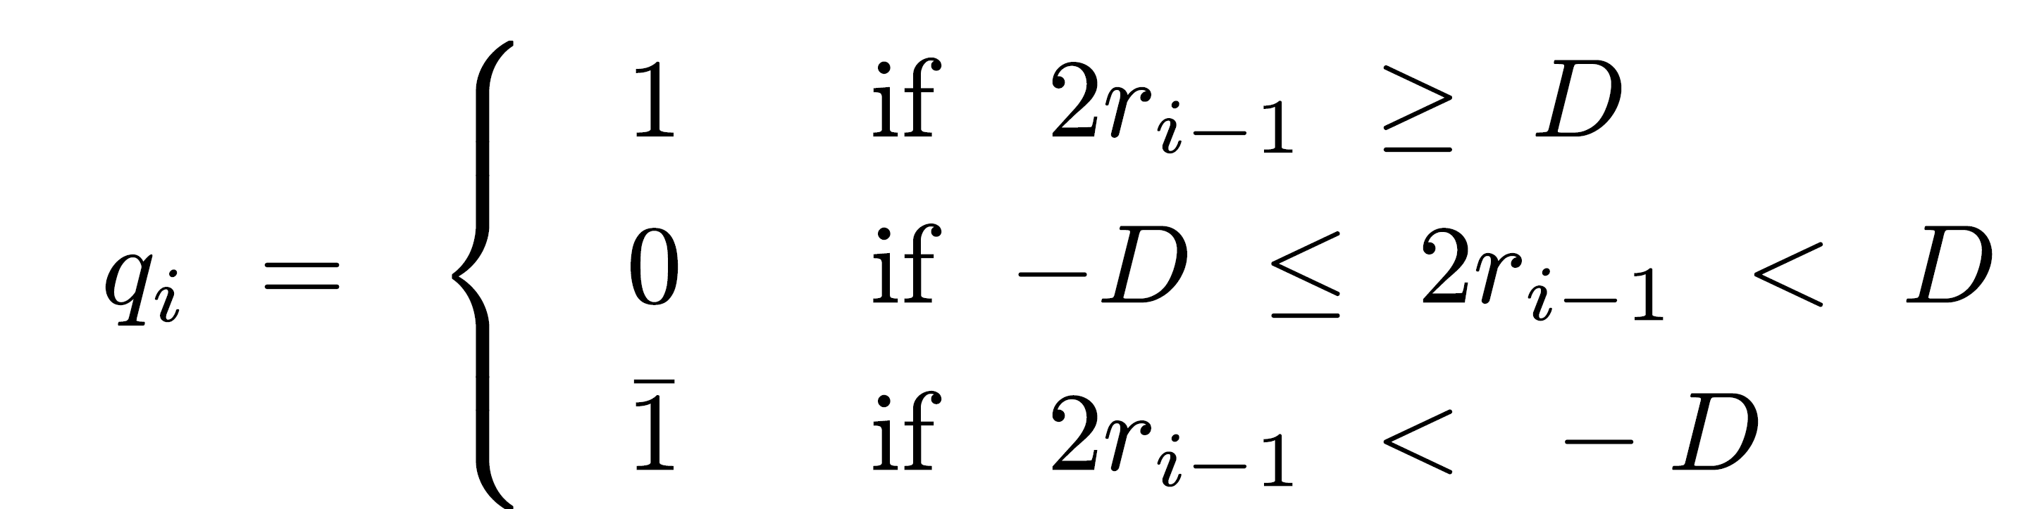
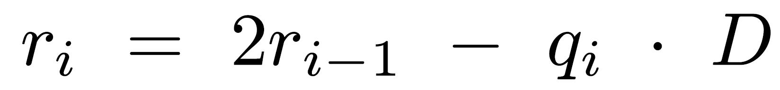
Fast Division - SRT Algorithm
2 approaches:
  First - conventional - uses add/subtract+shift, number of operations linearly proportional to word size n
  Second - uses multiplication, number of operations logarithmic in n, but each step more complex
  SRT - first approach
Most well known division algorithm - named after Sweeney, Robertson, and Tocher
Speed up nonrestoring division (n add/subtracts) - allows 0 as a quotient digit - no add/subtract:

Slide 3
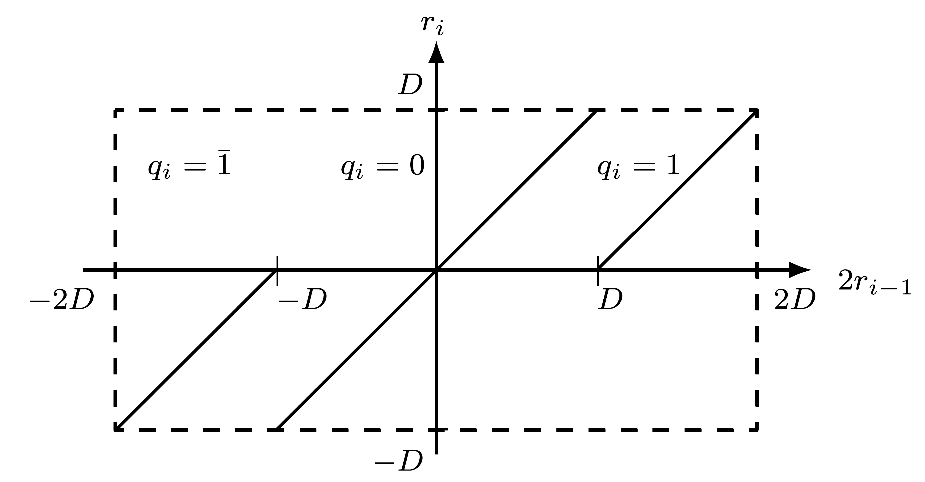
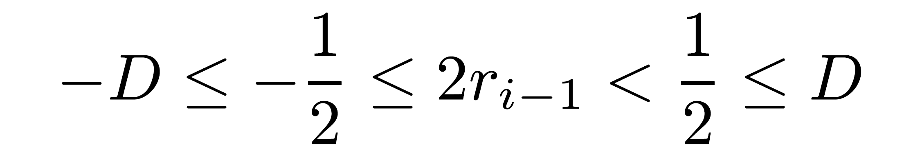
Modified Nonrestoring Division
Problem: full comparison of 2ri-1 with either D or -D required
Solution: restricting D to normalized fraction 1/2≤|D|<1
Region of 2ri-1 for which qi=0 reduced to

Slide 4
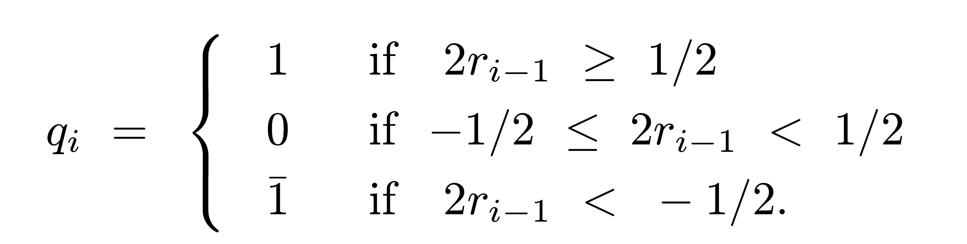
Modified Nonrestoring → SRT
Advantage: Comparing partial remainder 2ri-1 to 1/2 or -1/2, not D or -D
Binary fraction in two's complement representation
  ≥ 1/2 if and only if it starts with 0.1
  ≤ -1/2 if and only if it starts with 1.0
Only 2 bits of 2ri-1 examined - not full comparison between 2ri-1 and D
  In some cases (e.g., dividend X>1/2) - shifted partial remainder needs an integer bit in addition to sign bit - 3 bits of 2ri-1 examined
Selecting quotient digit:

Slide 5
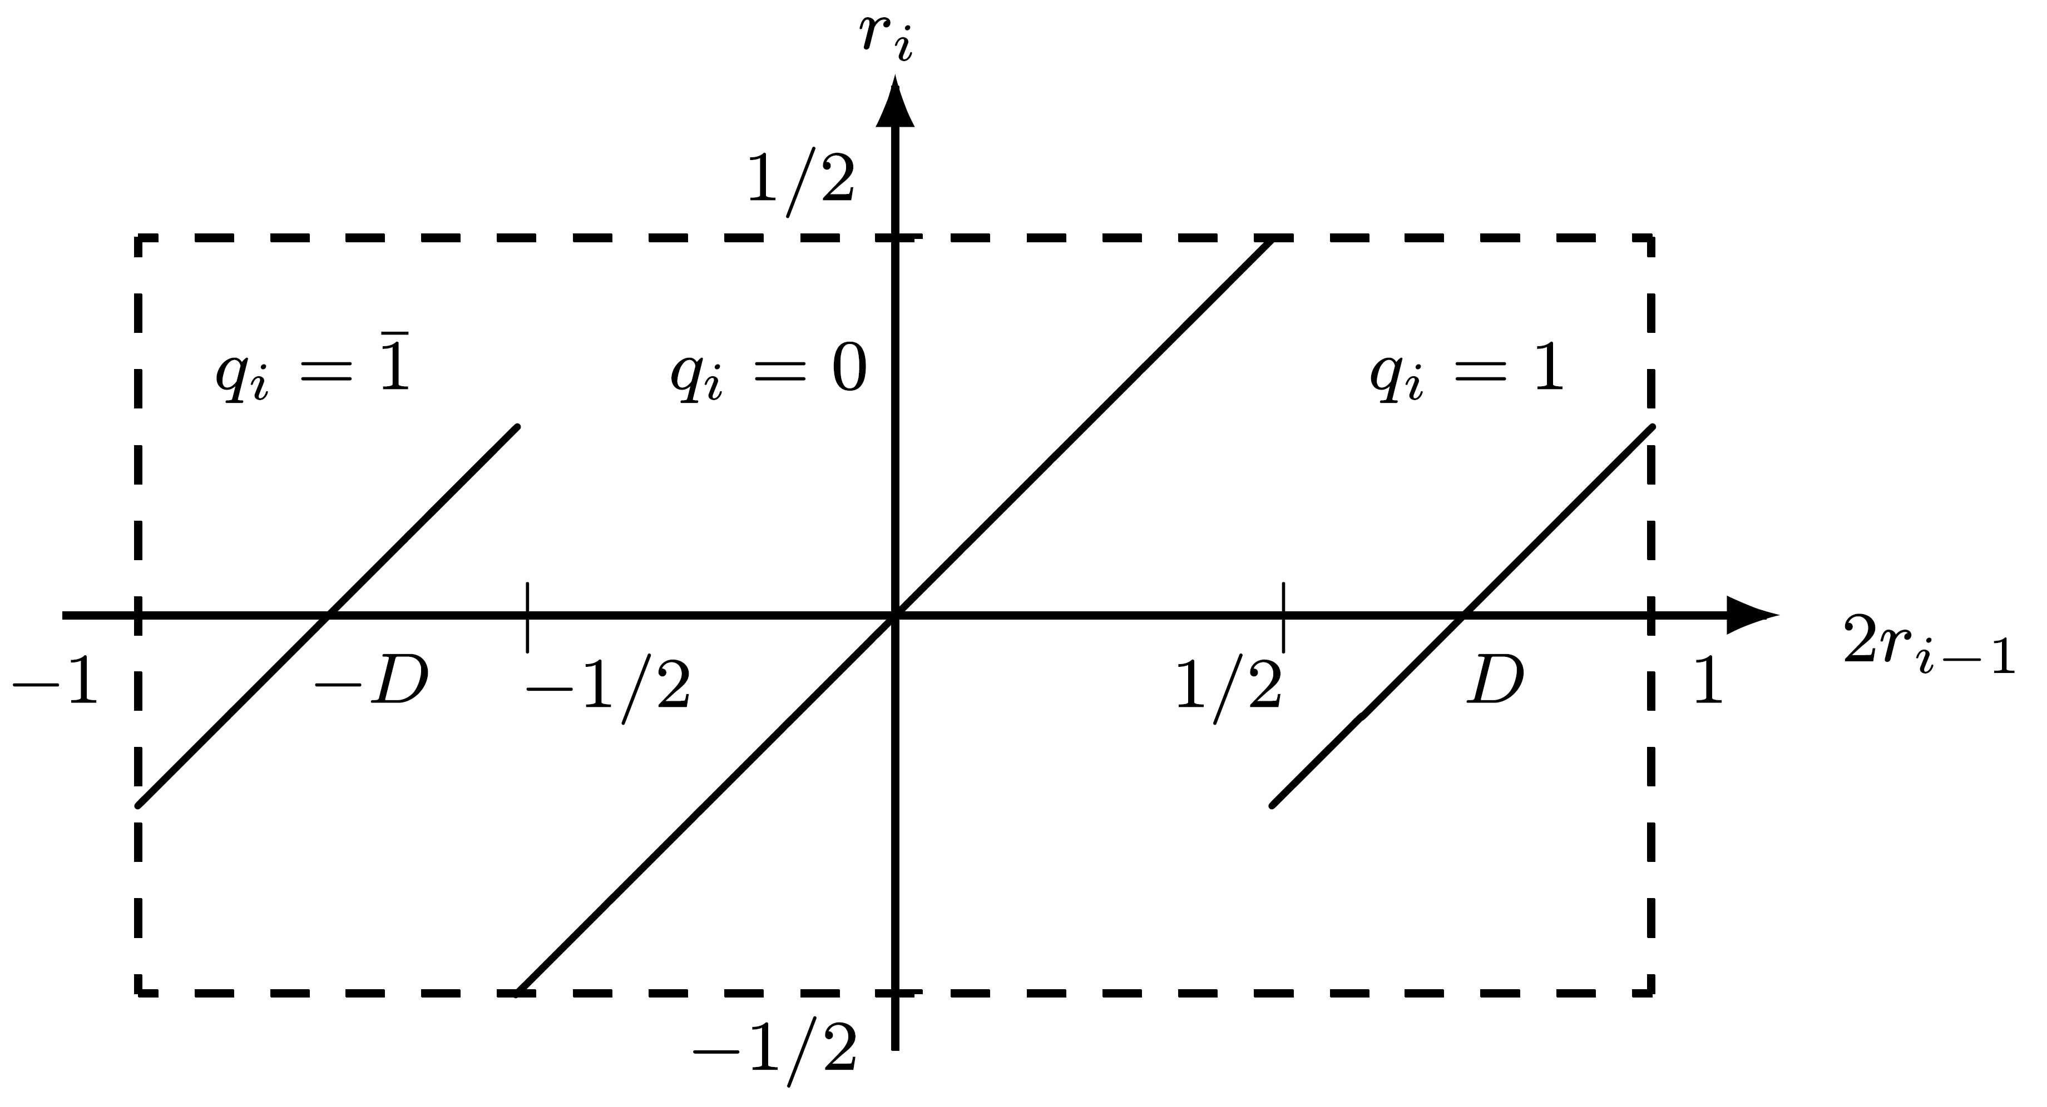
SRT Division Algorithm
Quotient digits selected so |ri| ≤ |D| ⇒ final remainder < |D|
Process starts with normalized divisor - normalizing partial remainder by shifting over leading 0's/1’s if positive/negative
Example:
  2ri-1=0.001xxxx (x - 0/1); 2ri-1<1/2 - set qi=0, 2ri=0.01xxxx and so on
  2ri-1=1.110xxxx; 2ri-1>-1/2 - set qi=0, 2ri=1.10xxxx
SRT is nonrestoring division with normalized divisor and remainder

Slide 6
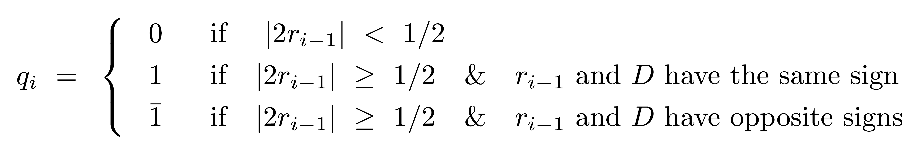
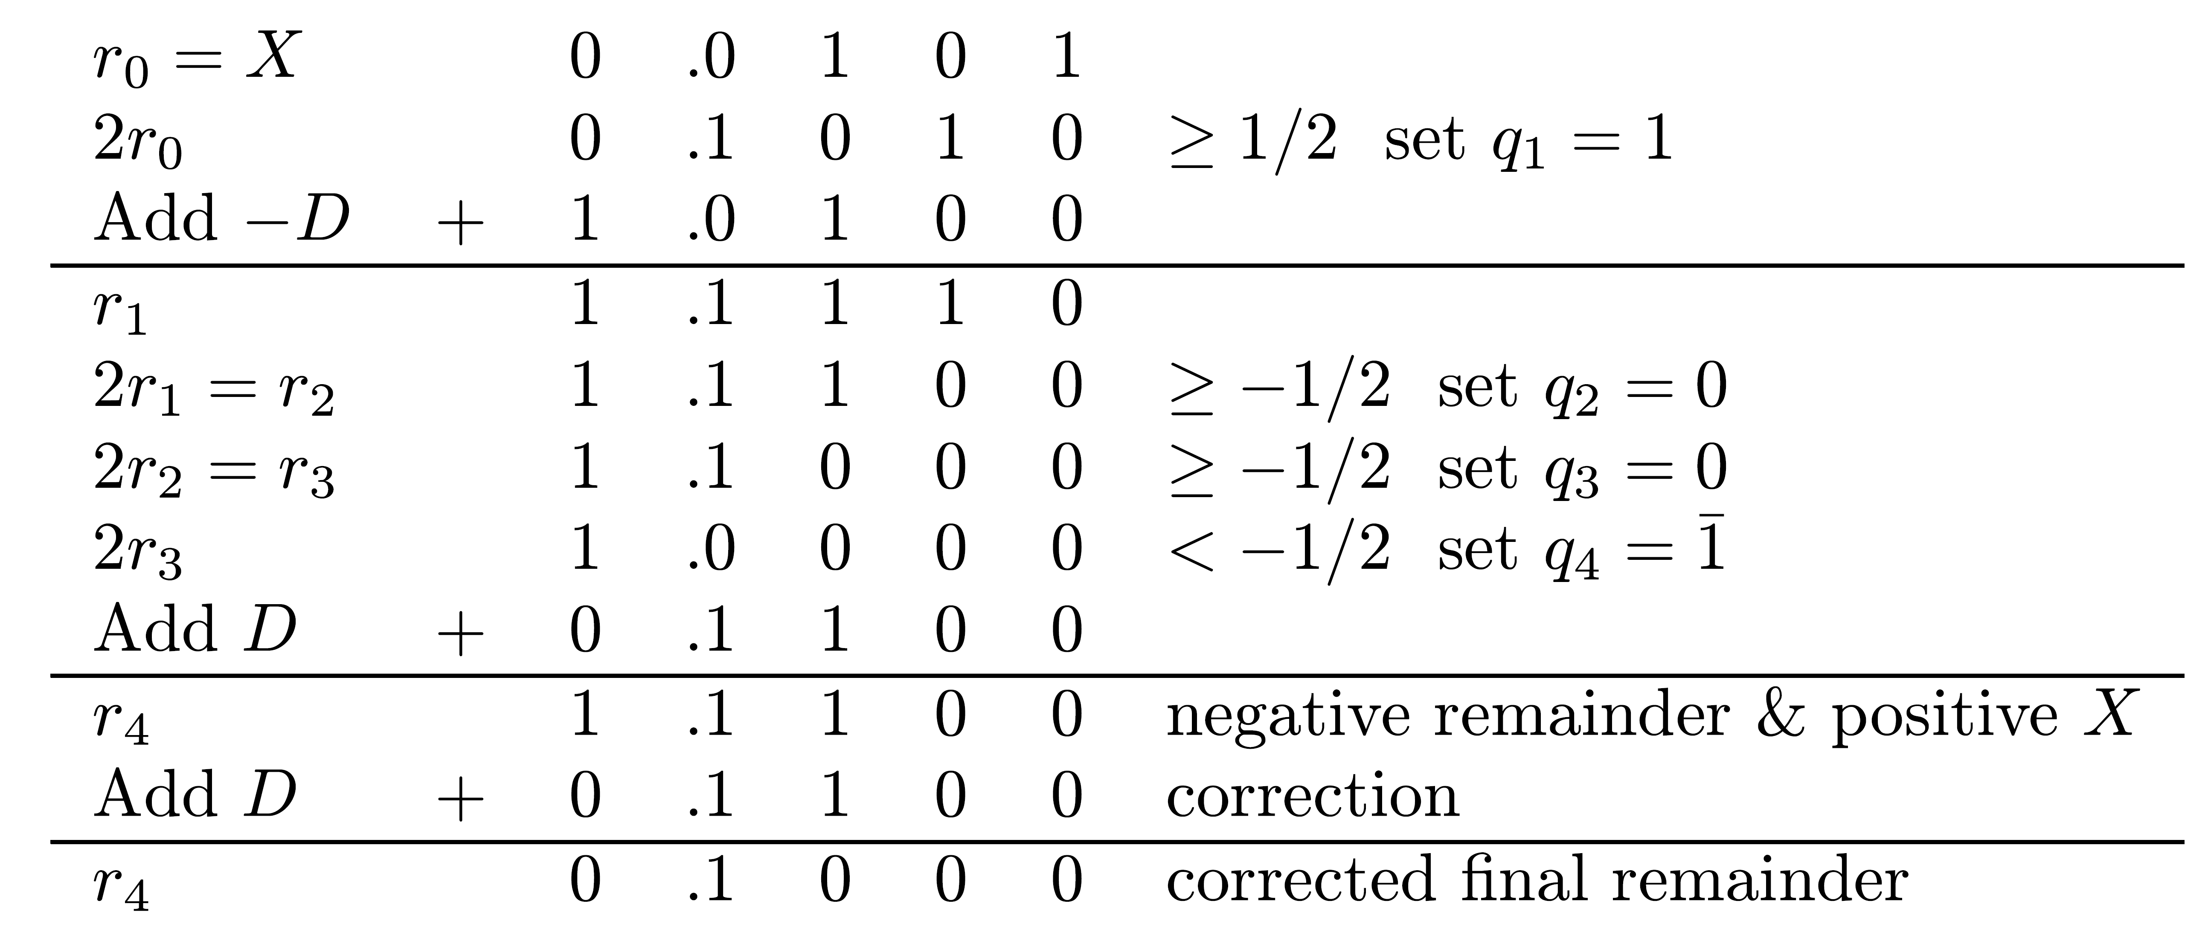
Extension to Negative Divisors
Example: Dividend X=(0.0101)2 =5/16 Divisor D=(0.1100)2 =3/4
Before correction Q=0.1001 - minimal SD repr. of Q=0.0111 - minimal number of add/subtracts
After correction, Q = 0.0111-ulp = 0.01102 = 3/8 ; final remainder = 1/2 ⋅2 =1/32
_
-4

Slide 7
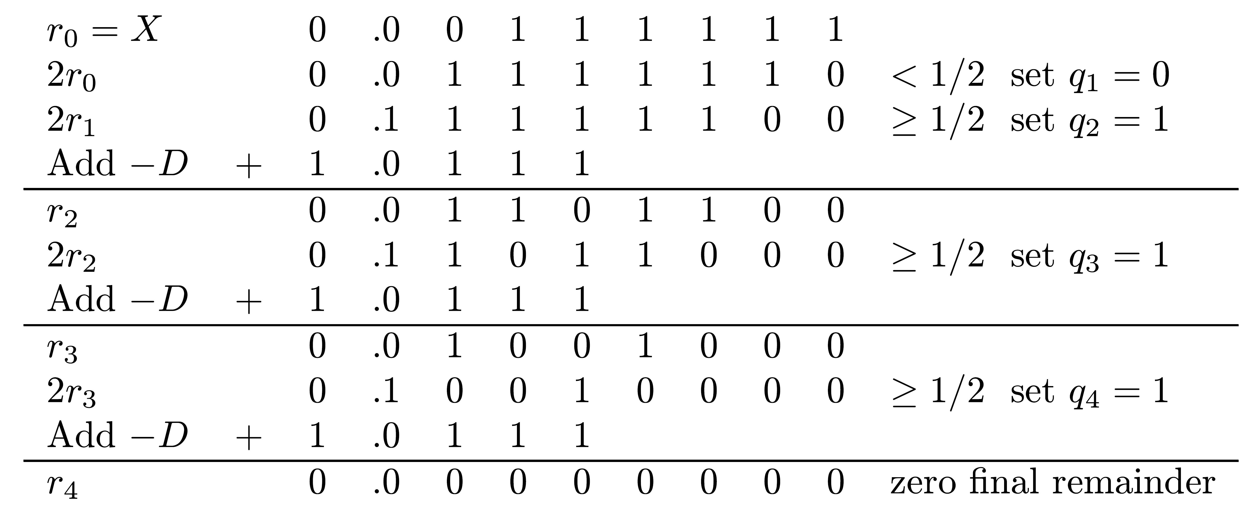
Example
X=(0.00111111)2=63/256 D=(0.1001)2=9/16
Q =0.01112=7/16 - not a minimal representation in SD form
Conclusion: Number of add/subtracts can be reduced further

Slide 8
Properties of SRT
Based on simulations and analysis:
1.Average “shift”=2.67 - n/2.67 operations for dividend of length n
  24/2.67 ~ 9 operations on average for n=24
2.Actual number of operations depends on divisor D - smallest when 17/28 ≤ D ≤ 3/4 - average shift of 3
If D out of range (3/5 ≤ D ≤ 3/4) - SRT can be modified to reduce number of add/subtracts
2 ways to modify SRT

Slide 9
Two Modifications of SRT
Scheme 1: In some steps during division -
  If D too small - use a multiple of D like 2D
  If D too large - use D/2
  Subtracting 2D (D/2) instead of D - equivalent to performing subtraction one position earlier (later)
Motivation for Scheme 1:
  Small D may generate a sequence of 1's in quotient one bit at a time, with subtract operation per each bit
  Subtracting 2D instead of D (equivalent to subtracting D in previous step) may generate negative partial remainder, generating sequence of 0's as quotient bits while normalizing partial remainder
Scheme 2: Change comparison constant K=1/2 if D outside optimal range - allowed because ratio D/K matters - partial remainder compared to K not D

Slide 10
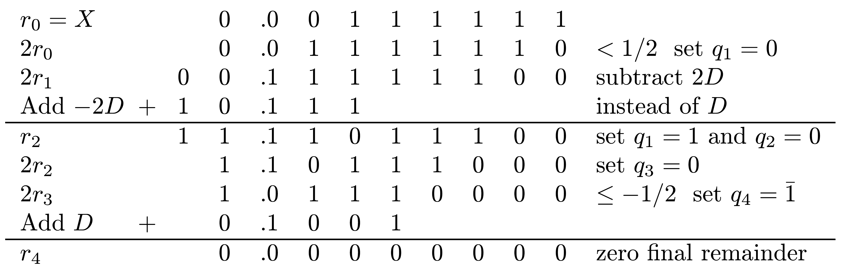
Example - Scheme 1 (Using 2D)
Same as previous example -
X=(0.00111111)2=63/256 D=(0.1001)2=9/16
Q =0.10012=7/16 - minimal SD representation
_

Slide 11
Scheme 1 (Using D/2)
Large D - one 0 in sequence of 1's in quotient may result in 2 consecutive add/subtracts instead of one
Adding D/2 instead of D for last 1 before the single 0 - equivalent to performing addition one position later - may generate negative partial remainder
Allows properly handling single 0
Then continue normalizing partial remainder until end of sequence of 1's

Slide 12
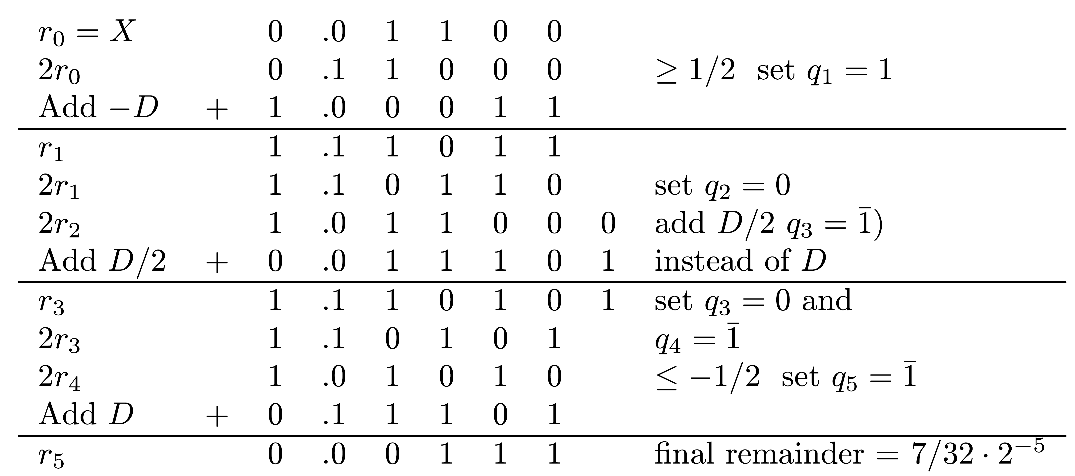
Example
X=(0.01100)2=3/8 ; D=(0.11101)2=29/32
Correct 5-bit quotient - Q=(0.01101)2=13/32
Applying basic SRT algorithm - Q=0.10111 - single 0 not handled efficiently
Using multiple D/2 -
Q =(0.10011)2=13/32 - single 0 handled properly
-
-
_
_

Slide 13
Implementing Scheme 1
Two adders needed
  One to add or subtract D
  Second to add/subtract 2D if D too small (starts with 0.10 in its true form) or add/subtract D/2 if D too large (starts with 0.11)
Output of primary adder used, unless output of alternate adder has larger normalizing shift
Additional multiples of D possible - 3D/2 or 3D/4
Provide higher overall average shift - about 3.7 - but more complex implementation

Slide 14
Modifying SRT - Scheme 2
For K=1/2, ratio D/K in optimal range 3/5≤D≤3/4 is
6/5 ≤ D/K = D/(1/2) ≤ 3/2 or (6/5)K ≤ D ≤ (3/2)K
If D not in optimal range for K=1/2 - choose a different comparison constant K
Region 1/2 ≤ |D|<1 can be divided into 5 (not equally sized) sub-regions
Each has a different comparison constant Ki

Slide 15
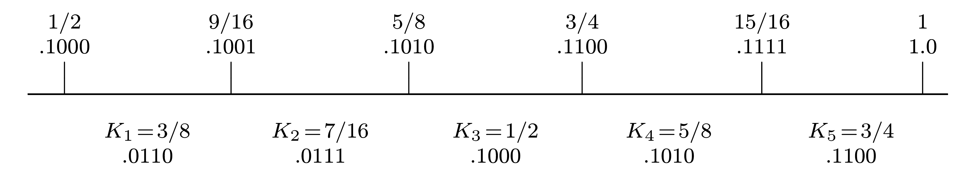
Division into Sub-regions
4 bits of divisor examined for selecting comparison constant
It has only 4 bits compared to 4 most significant bits of remainder
Determination of sub-regions for divisor and comparison constants - numerical search
Reason: Both are binary fractions with small number of bits to simplify division algorithm

Slide 16
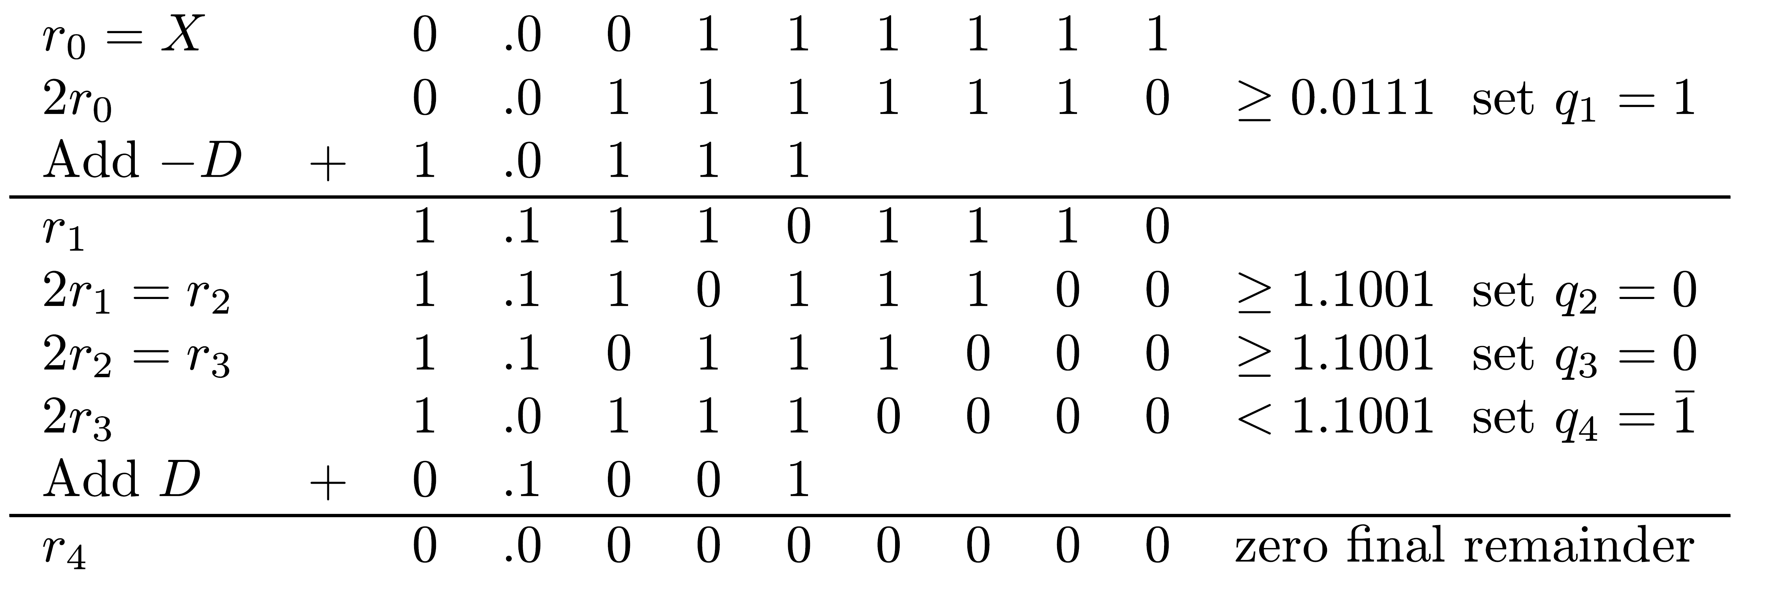
Example
X=(0.00111111)2=63/256 ; D=(0.1001)2=9/16
Appropriate comparison constant - K2=7/16=0.01112
If remainder negative - compare to two's complement of K2 =1.10012
Q=0.1001=0.01112=7/16 - minimal SD form
_

