Slide 1

UNIVERSITY OF MASSACHUSETTS
Dept. of Electrical & Computer Engineering
Digital Computer Arithmetic
ECE 666
Part 7b
Fast Division - II
Israel Koren
Spring 2008

Slide 2
High Radix Division
  Number of add/subtracts in radix-2 SRT is data-dependent
  Asynchronous circuit needed to use reduced number of nonzero bits in quotient
  Increasing number of 0’s in quotient - limited practical significance
Number of add/subtracts reduced by increasing radix β
  β = 2 - m quotient bits generated each step
  Number of steps reduced to ⎡n/m⎤
Recursive equation for remainder -
ri = β ri-1 - qi D
  Multiply by β=2 - shift left remainder by m bit positions
Digit set for quotient:
  0,1,...,β-1 for restoring division
  Up to β-1,...,1,0,1,...,β-1 for high-radix SRT division
m
m

Slide 3
High Radix Restoring Division
All previous division algorithms can use radix > 2
Restoring division -
  Initial guess qi=1
  If remainder βri-1-D>0 - increase to qi=2
  Subtract D from temporary remainder: βri-1-2D
  Repeat until qi=j: temporary remainder βri-1-jD negative
  Remainder restored by adding D: βri-1-(j-1)D ; qi=j-1
Time-consuming - no advantage over binary algorithm
Can be parallelized by circuits comparing βri-1 to several multiples jD - selecting smallest positive remainder; substantial hardware requirement
Binary nonrestoring division - similar changes

Slide 4
High-Radix SRT Algorithm
Faster than binary version
Quotient digit qi - signed digit in range α,α-1,…,1,0,1,...α, where ⎡1/2(β-1)⎤ ≤ α ≤ β-1
Finding possible choices for α in high-radix division:
Quotient digit qi selected so that |ri| < |D|; otherwise, next quotient digit may be β or larger
  Guarantees convergence of division procedure
  For maximal remainder ri-1=D-ulp and positive D, largest value for qi=α should guarantee ri in allowable region

Slide 5
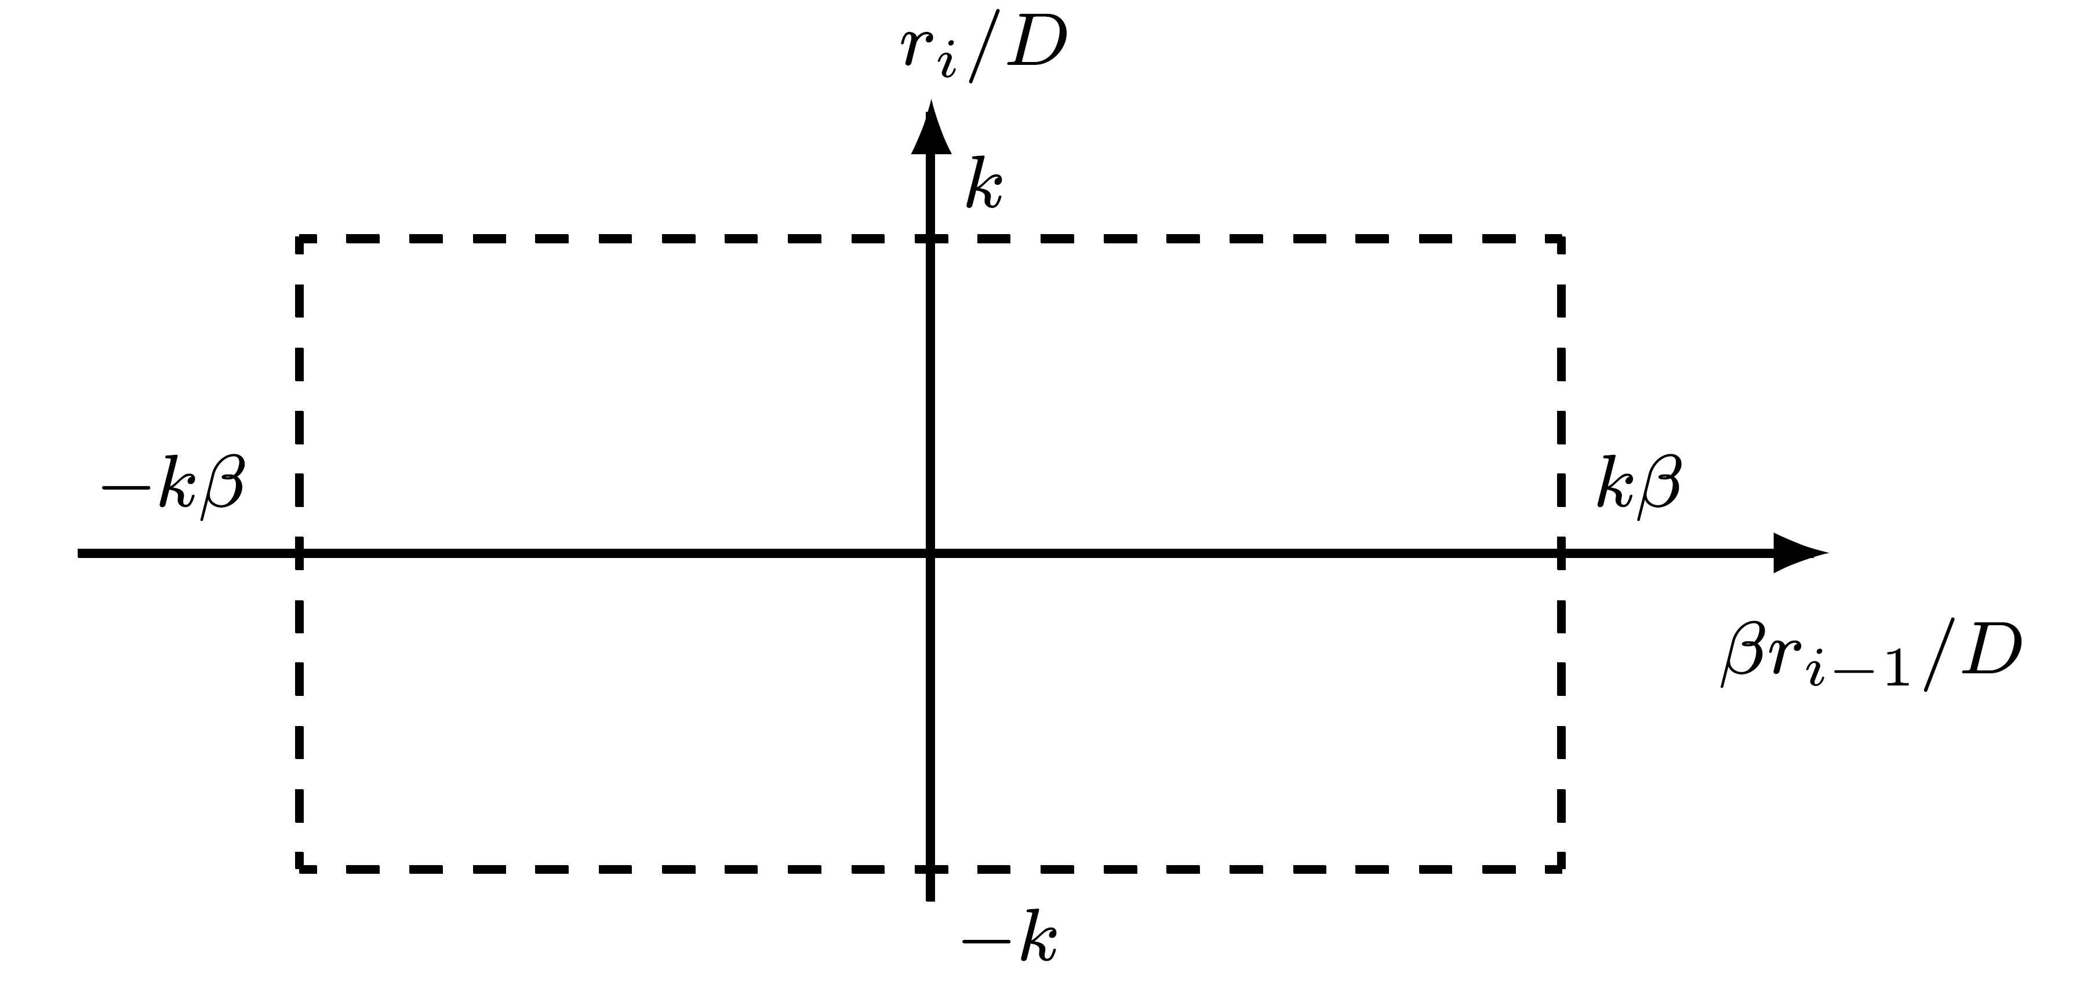
Reducing Remainder Range
ri = β (D-ulp) - αD ≤ D-ulp
Select for α only maximum value β-1
May consider division where |ri| ≤ k|D|, ( k is a fraction)
  reduce size of allowable region for remainder:
ri =β k(D-ulp)-αD ≤ k(D-ulp)
α ≥ k(β-1) ⇒ k ≤ α/(β-1)
  1/2 ≤ k ≤ 1 allows selection of any α in ⎡(β-1)/2⎤ ≤ α ≤ β-1
  Larger k ⇒ larger redundancy for quotient

Slide 6
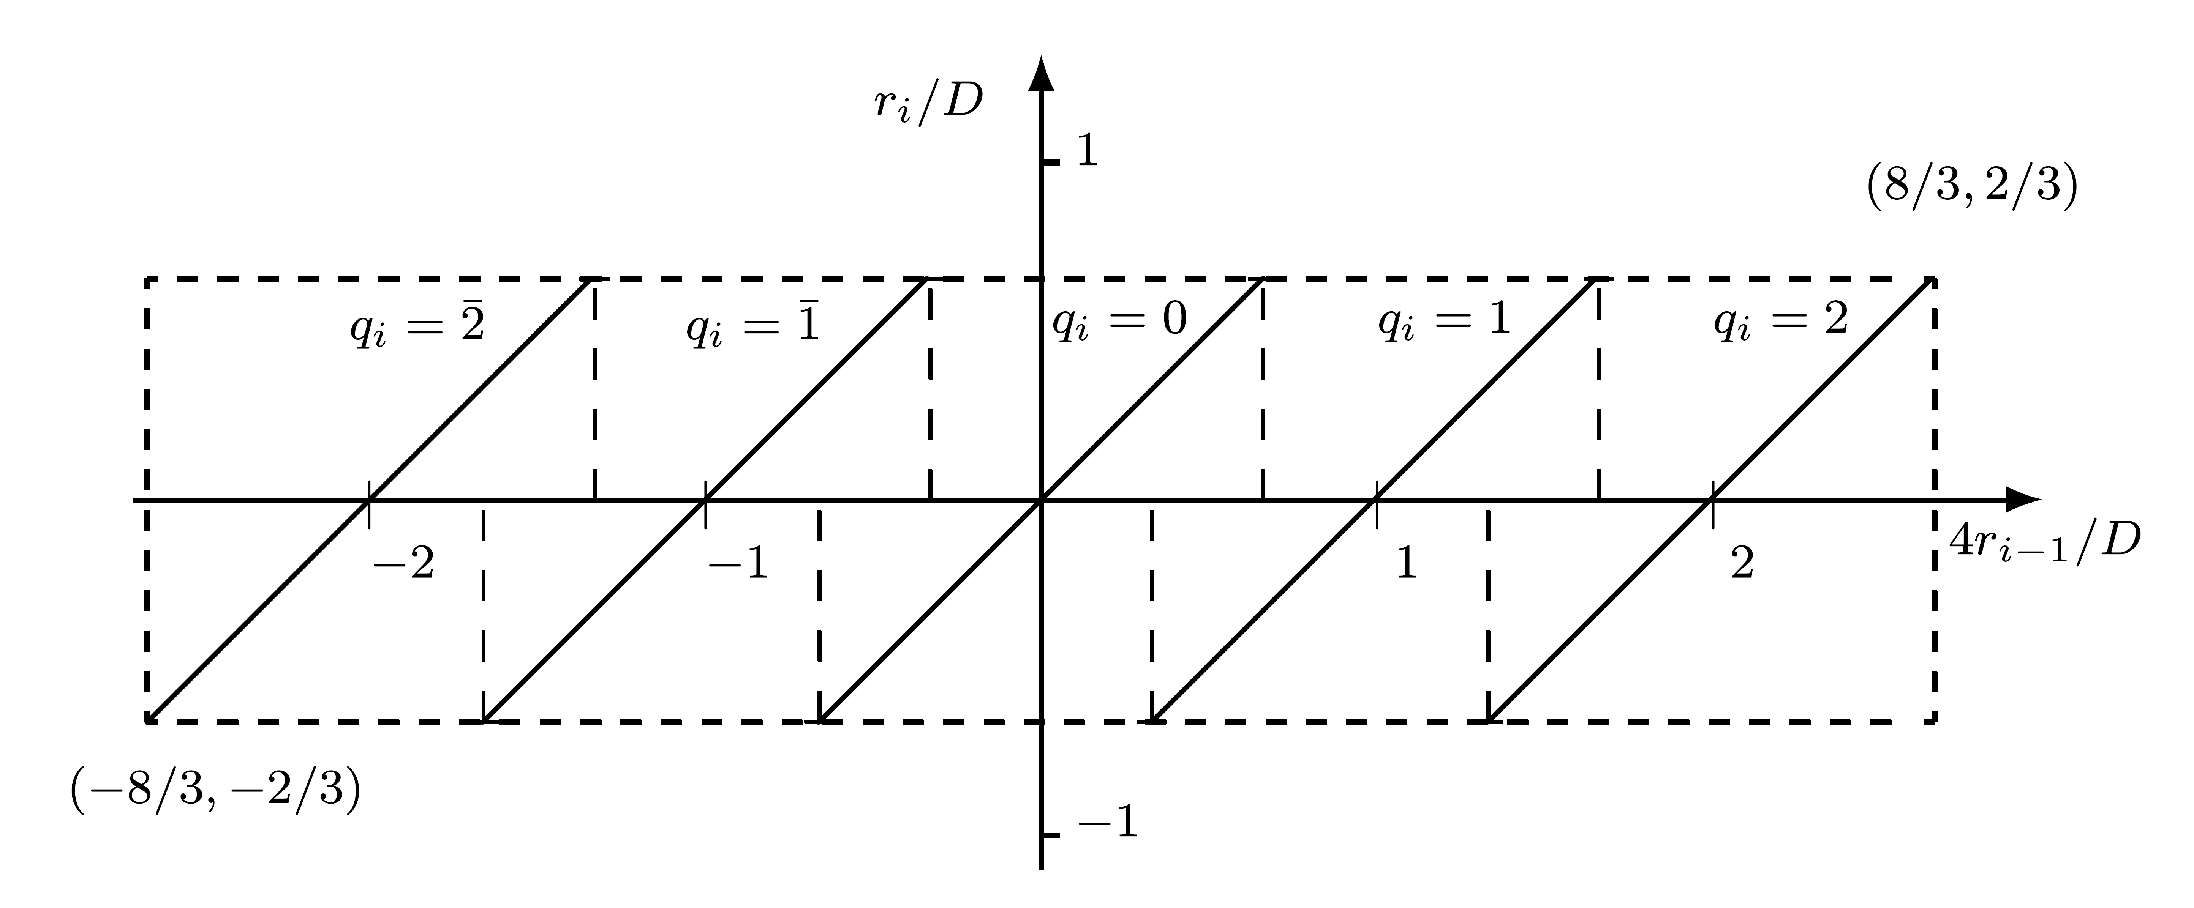
Example
β=4 ; α=2 ; k=α/(β-1) = 2/3
  |ri| ≤ kD = 2/3 D ; |βri-1| = |4ri-1| ≤ 8/3 D or |ri/D| ≤ 2/3 and |4ri-1/D| ≤ 8/3
Digit set for qi ={2,1,0,1,2}
Region for selecting q : -2/3 ≤ 4ri-1/D - q ≤ 2/3 or -2/3 +q ≤ 4ri-1/D ≤ 2/3 +q
Region examples:
  For selecting qi=2 : 4/3 ≤ 4ri-1/D ≤ 8/3
  For selecting qi=1 : 1/3 ≤ 4ri-1/D ≤ 5/3
  Overlapping region: 4/3 ≤ 4ri-1/D ≤ 5/3 select either qi=1 or qi=2
  Similar overlapping regions exist for any 2 adjoining digits
_
_

Slide 7
Measure of Redundancy
Ratio k=α/(β-1) - measure of redundancy in representation of quotient
  Larger k ⇒ larger overlap regions in plot of ri/D vs βri-1/D
Example: α=3; β=4; k=1 - maximum redundancy
  Region for qi=1 : 0 ≤ 4ri-1/D ≤ 2,
  Region for qi=2 : 1 ≤ 4ri-1/D ≤ 3
  Overlapping region : 1 ≤ 4ri-1/D ≤ 2
Larger than overlap region for α=2;β=4; k=2/3:

Slide 8
Implication of Overlap Region
Provides choice of comparison constants for partial remainder and divisor
  Can be selected to require as few digits as possible
  Reducing execution time of comparison step when determining quotient digit
Larger α ⇒ larger overlap region ⇒ larger choice ⇒ fewer digits
On the other hand, larger α ⇒ more αD multiples ⇒ extra hardware and/or time required
For given α - determining number of bits of partial remainder and divisor to be examined is the most difficult step when developing high-radix SRT
  Can be done numerically, analytically, graphically, or by combination of techniques

Slide 9
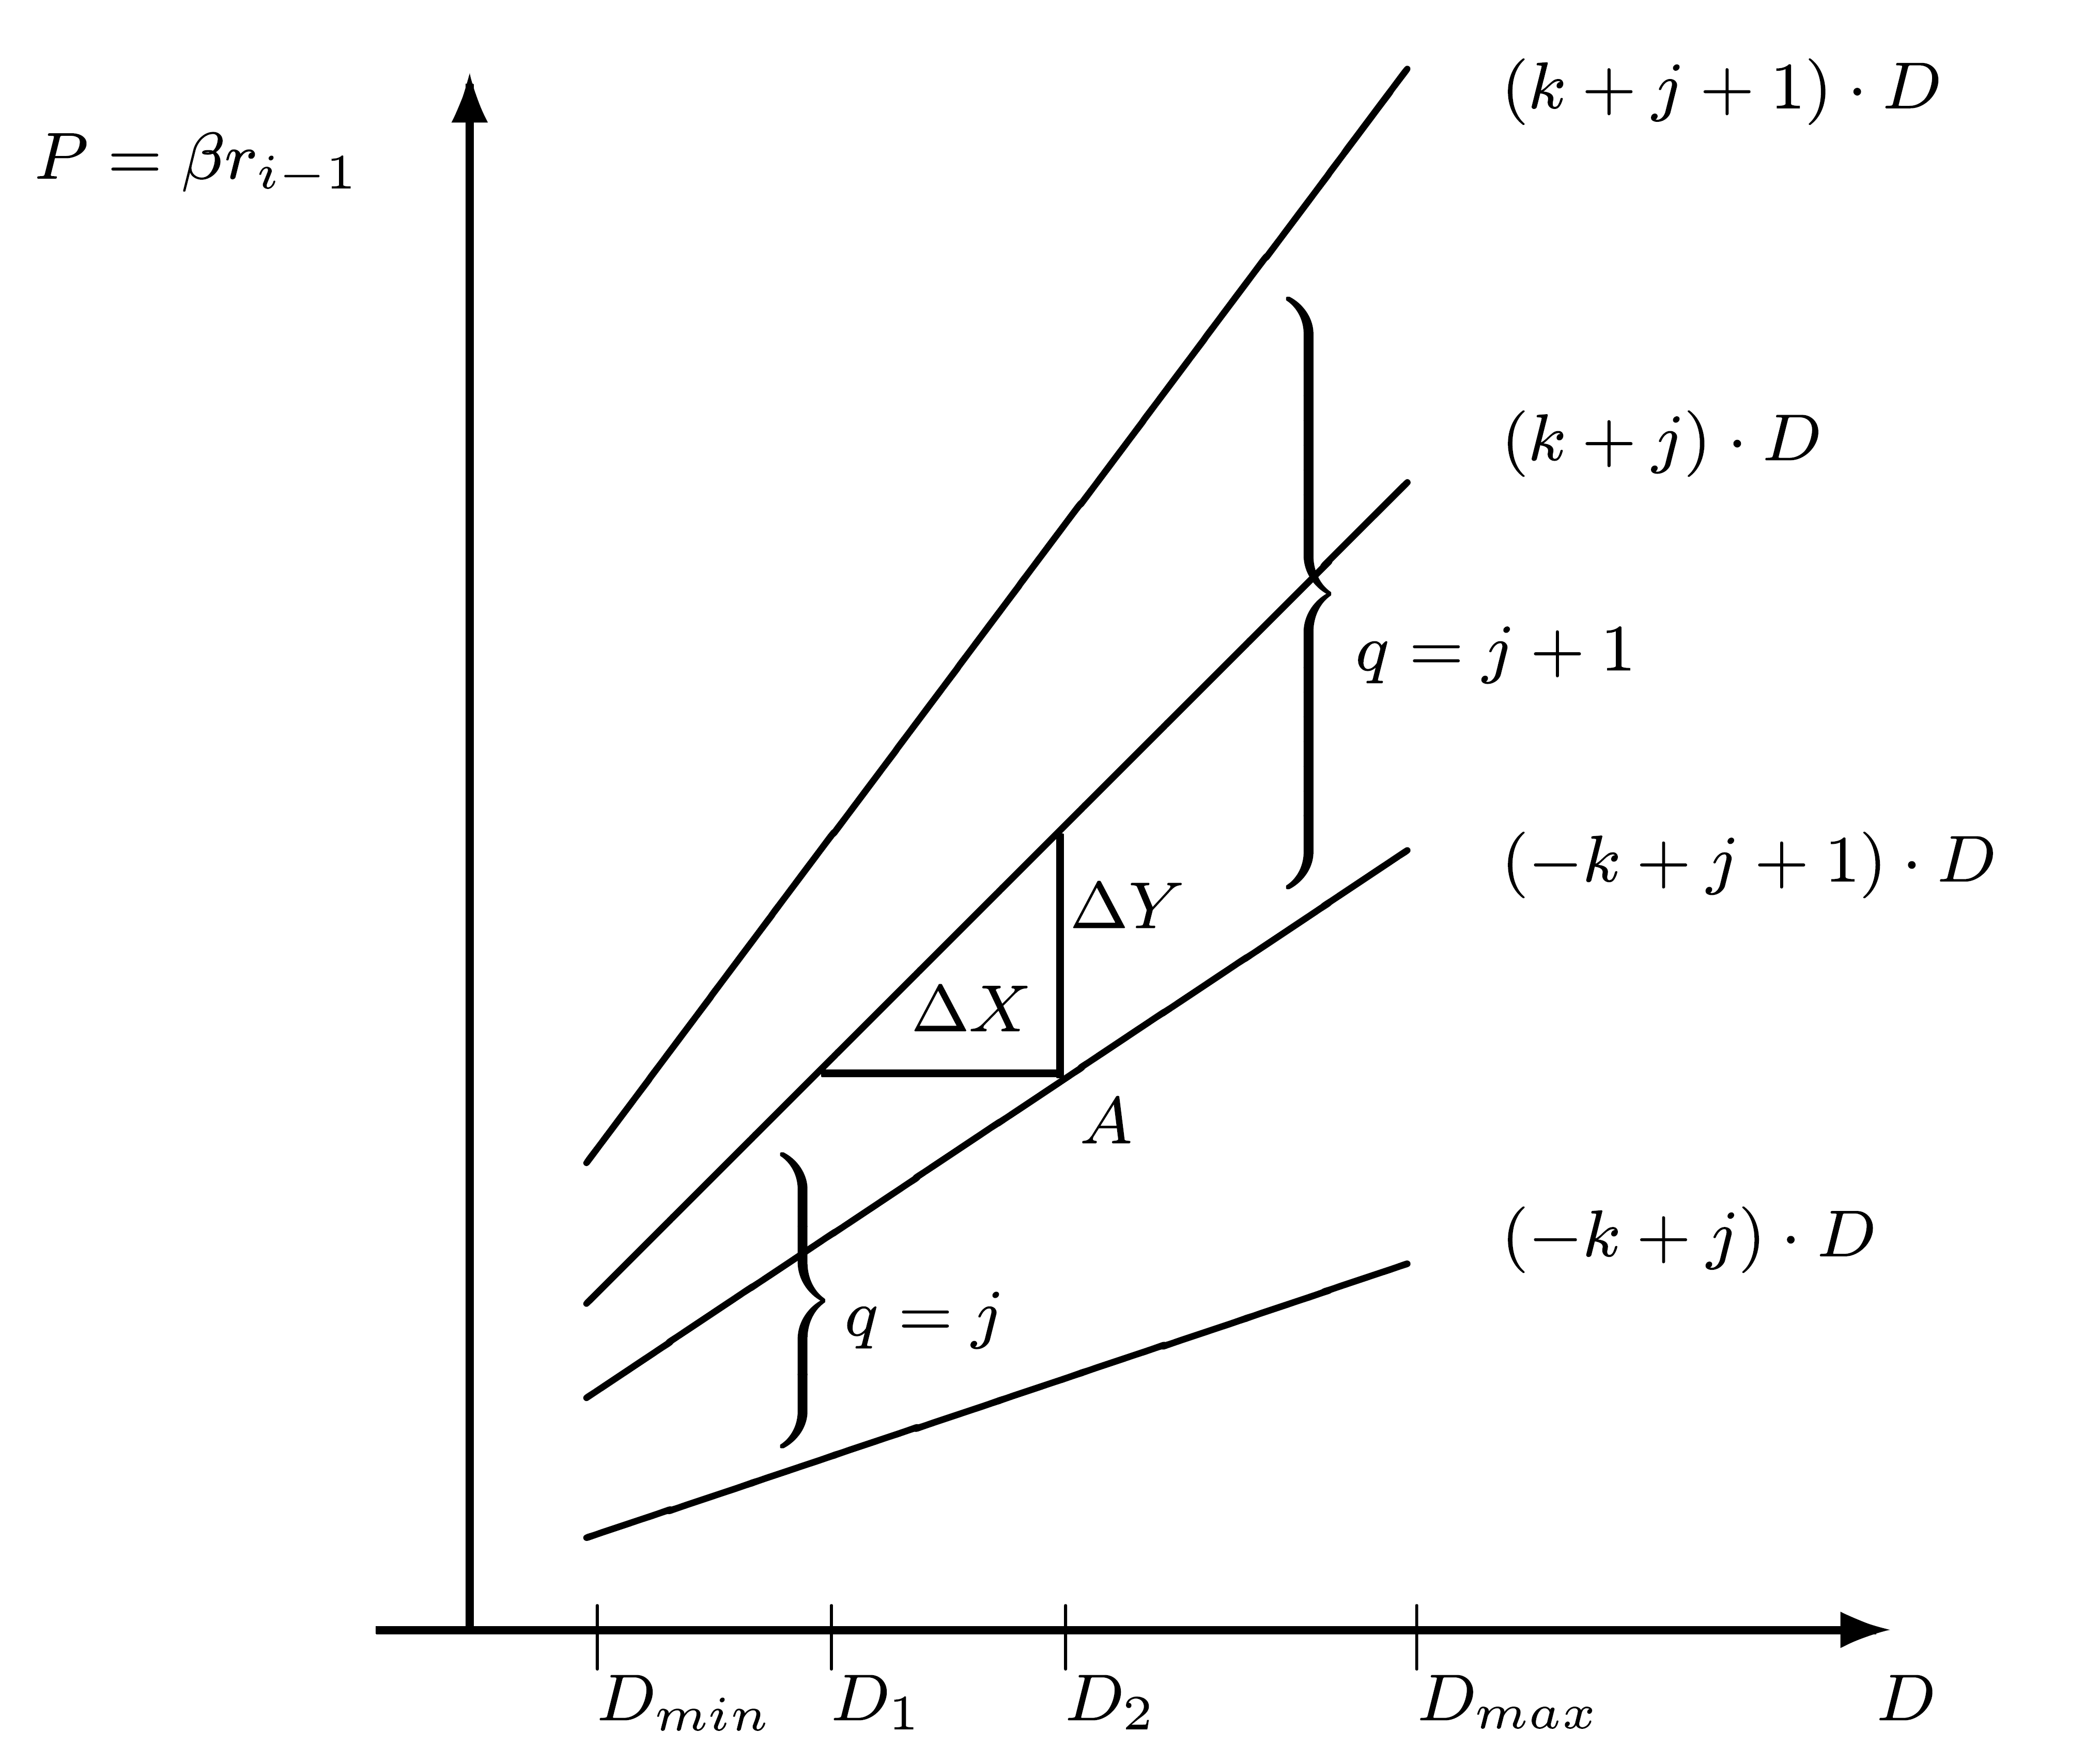
Graphical Approach: P-D Plot
Basic equation for partial remainder - βri-1=ri+qiD
Notation: P = previous partial remainder βri-1
  Partial remainder vs. Divisor plot - indicates regions in which given values of q may be selected
  Limits on P for given q:
  - k D ≤ ri ≤ k D
  Pmin=(-k+q)D ; Pmax=(k+q)D
  Regions for q=j and q=j+1 overlap
  Only positive values of divisor and partial remainder - 1/4 of complete P-D plot - plot symmetric about both axes
  Only values of |D| in [Dmin,Dmax] are of interest - e.g. [0.5,1);[1,2) (IEEE floating-point)

Slide 10
Separating Selection Regions
Value of P separating selection regions of q=j & q=j+1
  Serves as comparison constant
  Its number of bits determines necessary precision when examining partial remainder to select q
Line separating regions is horizontal (P=c ; selection of q independent of D) if and only if
(k+j)Dmin ≥ c ≥ (-k+j+1)Dmax
Otherwise - line is stairstep:
  partitioning [Dmin,Dmax) into sub-intervals
  “Stepping” points determine precision - number of digits - of examining D
  Height of steps determines precision of examining partial remainder

Slide 11
Determining Precision
Notation: ΔX (ΔY) - maximum width (height) of a step between D1 and D2
  Horizontal (vertical) distance between the 2 lines defining overlap region
ΔX=D2-D1=P/(-k+j+1)-P/(k+j) =P(2k-1)/[j(j+1)+k(1-k)]
  ΔX minimal when j is max and P is min
  jmax=α-1; P minimal when D1=Dmin
  ΔXmin=Dmin(k+α-1)(2k-1)/ [α(α-1)+k(1-k)]
  ΔY=(k+j)D-(-k+j+1)D=(2k-1)D
  ΔY is minimal when D = Dmin
It is sufficient to consider overlapping region between q=α and q=α-1 near Dmin

Slide 12
Precision - Cont.
Notation: NP (ND) - number of examined bits of partial remainder (divisor) ; εP (εD) - number of fractional bits in NP (ND)
Selecting q - look-up table implemented in a PLA (programmable logic array) with NP+ND inputs
Minimizing size of look-up table speeds up division
Precision of partial remainder (“truncated” divisor) - 2 (2 )
2 ≤ ΔXmin ; 2 ≤ ΔYmin
Only upper bounds for precision - the 2 extreme points ΔX,ΔY may require higher precision - more than εP,εD fractional bits
-εp
-εD
-εD
-εp

Slide 13
Using P-D Plot
  To determine precision
  To select q for each P,D when truncated to NP,ND bits
  Limited precision taken into account
Point (P,D) represents all partial remainder-divisor pairs with P ≤ partial remainder ≤ P+2 D ≤ divisor ≤ D+2
Selected q must be legitimate for all pairs in range
Example: Point A
Divisor=D2 - select q=j+1 ; divisor=D2+2 - select q=j
Conclusion: do not select q=j+1 for point A or any other point in overlap region whose horizontal distance from the line (-k+j+1)D ≤ 2
-εp
-εD
-εD
-εD

Slide 14
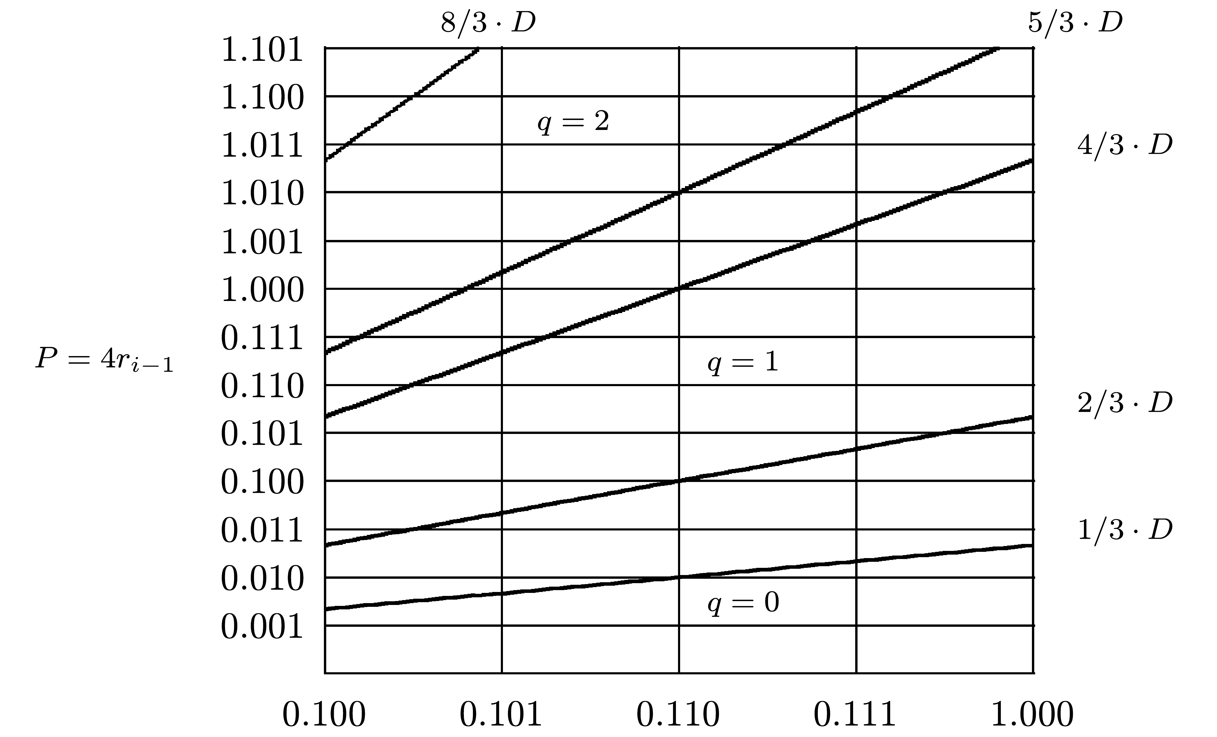
Example: P-D Plot for β=4,α=2,D∈[0.5,1)
Overlapping region for q=1,q=2 - between P=(k+α-1)D=5/3 D and P=(-k+α)D=4/3 D
Single horizontal line?
  (k+1)Dmin=5/6 < (-k+2)Dmax=4/3 - no single line
Smallest horizontal and vertical distances:
  ΔXmin=Dmin⋅5/3⋅3/20=1/8=2 ⇒ εD ≥ 3
  ΔYmin=Dmin⋅1/3=1/6 ⇒ εp ≥ 3
For pair (0.110,.100) - no q legitimate for all points in corresponding rectangle - resolved by εD=4
-3

Slide 15
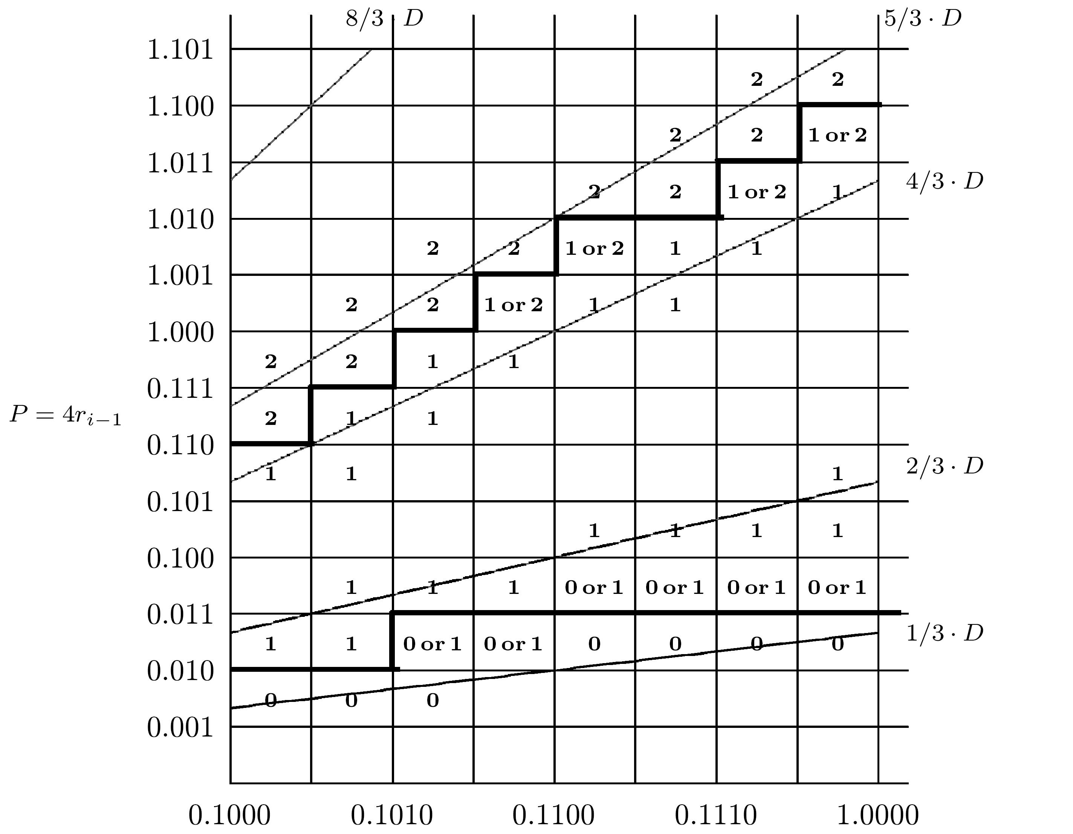
Example Cont.: εp=3 ; εD=4
Heavy lines - one out of many possible separations
Designer can select solution to minimize PLA (look-up table for q)
PLA has ND+NP=4+6 inputs - 3 more bits needed for integer part of remainder and its sign (-8/3 ≥ P ≥ 8/3)
Number of inputs can be reduced to NP+ND-1=9 - most significant bit of D is always 1 - can be omitted
2/3⋅1/2 ≤ 1/3 ⇒ single line possible between q=1,q=0 - requires high-precision comparison of partial remainder - divisor interval partitioned into two subintervals

Slide 16
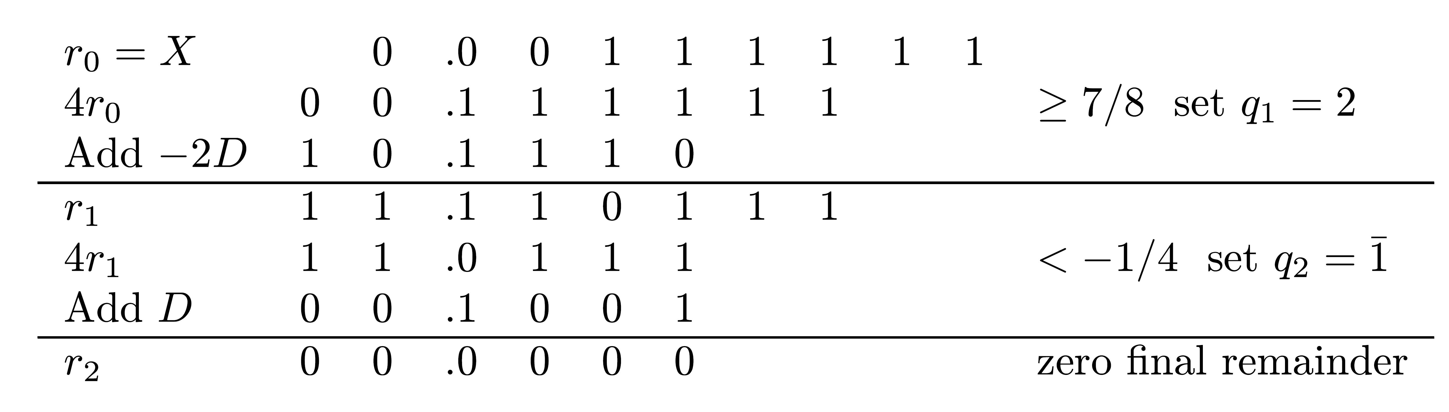
Example
X=(0.00111111)2=63/256 ; D=(0.1001)2=9/16
Comparison constants - 1/4 (0.010) , 7/8 (0.111)
Resulting quotient: Q=0.214=0.10012 =0.01112=7/16
_
_

Slide 17
Numerical Calculation of Look Up Table
Example- start with initial guess εp=εD=3 - attempt to calculate q for D=0.100 and P=0.110 (worst case)
Divisor truncated - consider values from 0.100 to 0.101 ; partial remainder from 0.110 to 0.111
P/D between 0.110/0.101=1.2 (q=1) and 0.111/0.100=1.75 (q=2)
Insufficient precision - increase number of bits of either divisor or partial remainder - try again
Numerical search determining q for each (P,D) pair can be programmed

Slide 18
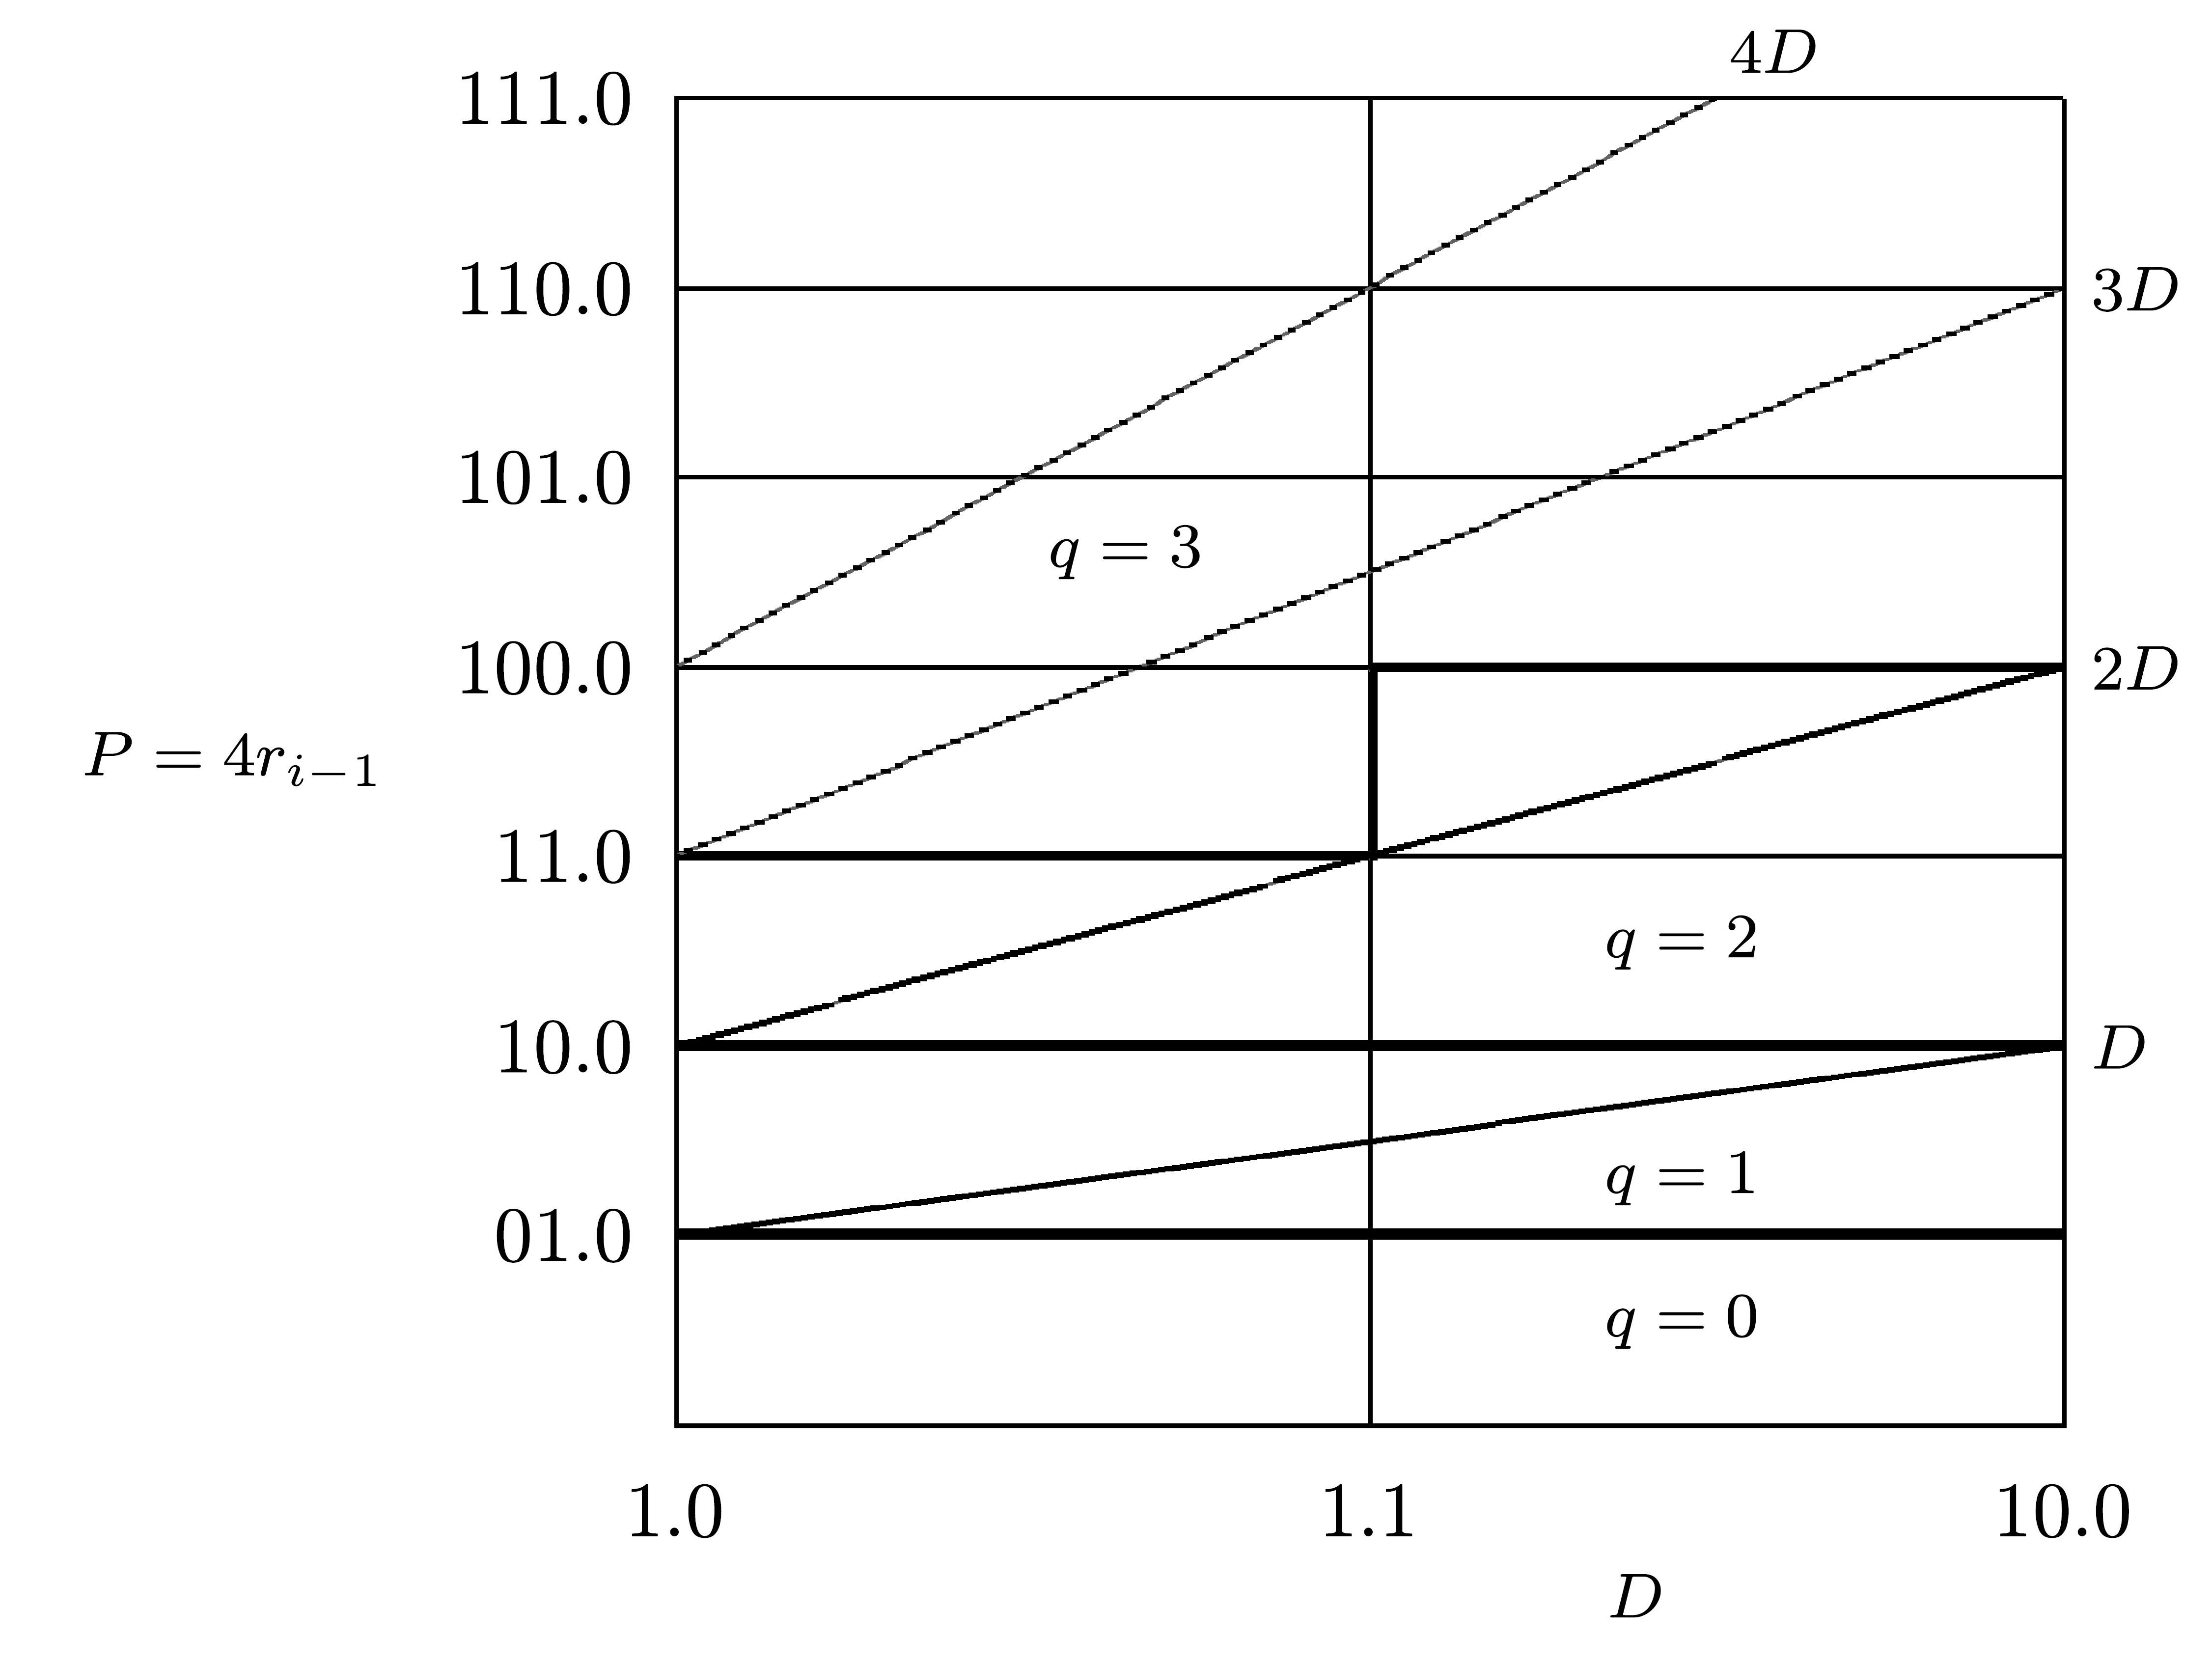
Example - Lower Precision of Higher α
β=4; α=3; k=α/(β-1)=1
Region for q=2 - between P=(k+q)D=3D ; P=(-k+q)D=D
Region for q=3 - between P=4D ; P=2D
Overlapping region - between P=3D and P=2D
For D∈[1,2) (IEEE standard):
  ΔXmin=Dmin⋅3⋅1/6=3/6=2 ⇒ εD ≥ 1
  ΔYmin=Dmin⋅1=1 ⇒ εp ≥ 0
Based on diagram - εD=1 ; εp=0 - ND=2 ; NP=4 instead of ND=4 ; NP=6 for α=2
Simpler quotient selection logic - costly multiple 3D
-1

Slide 19
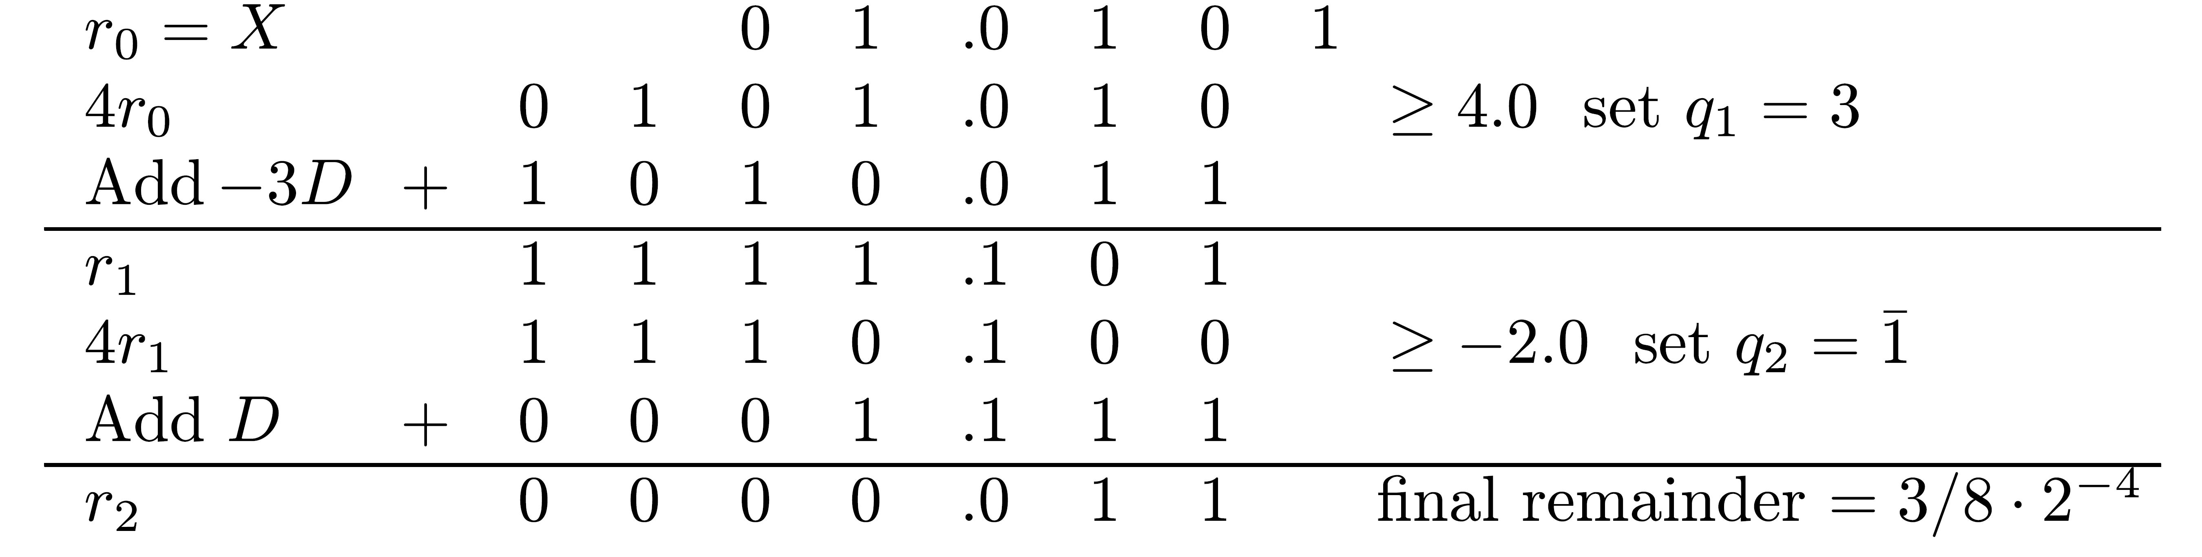
Example
X=(01.0101)2=21/16 ; D=(01.1110)2=15/8
Partial remainder comparison constants - 1,2,4
Quotient: Q=(0.31)4=(0.1101)2 = 11/16
Verification: QD+R = 11/16⋅15/8+3/128 = 168/128 = 21/16=X
_
_

