Slide 1

UNIVERSITY OF MASSACHUSETTS
Dept. of Electrical & Computer Engineering
Digital Computer Arithmetic
ECE 666
Part 8
Division through Multiplication
Israel Koren
Spring 2008

Slide 2
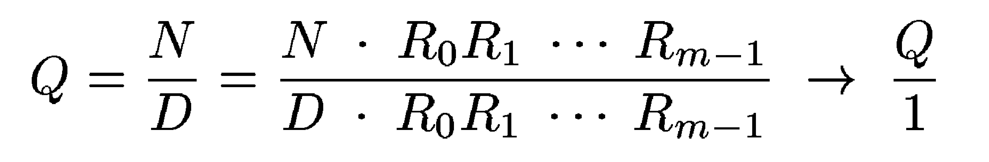
Division by Convergence
Number of steps proportional to log 2 n
Basic operation - multiply ; fast parallel multiplier necessary
Q=N / D - same quotient if numerator and denominator multiplied by R0,R1,…,Rm-1
Ri’s selected so that denominator converges to 1 ⇒ numerator converges to Q:
Only quotient calculated - separate computation needed for remainder
Scheme more suitable for floating-point division

Slide 3
Selection of Factors
Factors selected so that denominator converges to 1
D - normalized binary fraction 0.1xxxx (x is 0 or 1)
  1/2 ≤ D < 1 ⇒ D = 1-y with y ≤ 1/2
Step 1: Select R0 = 1+y
  New denominator: D1 = D ⋅ R0 = (1-y) ⋅ (1+y) = 1- y²
  y² ≤ 1/4 ⇒ D1 ≥ 3/4 - closer to 1 than D
  D1=0.11xxxx
Step 2: Select R1=1+y²
  New denominator: D2=D1 ⋅ R1=(1-y²) ⋅ (1+y²)=1-y ≥ 15/16
  D2=0.1111xxxx - closer to 1 than D1
Step i+1: Di = 1-yi where yi = y²
  At least 2 leading 1's
  Next multiplying factor Ri=1+yi ; Di+1=Di Ri has at least 2 leading 1's - closer to 1
4
i
i
i+1

Slide 4
Formal Proof of Convergence
4
4
(1-y)⋅[(1+y)(1+y²)(1+y ) …]=(1+y)⋅[(1-y)(1+y²)(1+y ) …]
Term within brackets on right - series expansion of 1/(1+y) for 0 ≤ y ≤ ½
lim i→∞ Di = (1+y) ⋅ 1/(1+y) = 1
Multiplying by Ri repeated until Di converges to 1 - more precisely, to 0.11…1 (=1-ulp)
Number of leading 1's in Di doubled at each step
Number of iterations is m=⎡log 2 n⎤
  Quadratic convergence
Multiplying factor Ri obtained from Di
Ri=2-Di - two's complement of fraction Di
Each step consists of 2 multiplications: Di+1=Di⋅Ri & Ni+1=Ni⋅Ri and two's complement Ri+1=2-Di+1

Slide 5
Example: 15-bit Numbers
N=0.011,010,000,000,000 =0.4062510
D=0.110,000,000,000,000 =0.7510
R0=2-D=1.010,000,000,000,000
N1=N⋅R0=0.100,000,100,000,000
D1=D⋅R0=0.111,100,000,000,000
R1=2-D1=1.000,100,000,000,000
N2=N1⋅R1=0.100,010,100,010,000
D2=D1⋅R1=0.111,111,110,000,000
Number of leading 1's in D2 doubled from 4 to 8
R2=2-D2=1.000,000,010,000,000
N3=N2⋅R2=0.100,010,101,010,101
D3=D2⋅R2=0.111,111,111,111,111
Convergence (D3=1-ulp) in 3 steps
Q=N3=0.5416510 - exact result is infinite fraction 0.5416610

Slide 6
Speed-Up Techniques
Total number of steps: order of log 2 n
  Algorithms based on add/subtract: linear in n
Each step - 2 multiplications
Need to further reduce number of steps
Speed up first few steps - slow convergence
  After step 1, only two leading 1's guaranteed
  After step 2 - only four 1's
Instead of R0 = 1+y, use a look-up table - multiplier ensuring D1 with k leading 1's (k ≥ 3)
Next denominator with 2k leading 1's, and so on
Table size (in ROM) increases exponentially with k
k determined so that table size is reasonable

Slide 7
Example: IBM 360/91 Floating-Point Division
If R0 =1+y, ⎡log 2 56⎤ =6 steps needed
  Requiring 12 multiplications of 56 bits each
  Only 11- no need to calculate D5 in last step
Look-up table for R0 so that D1 has at least k=7 leading 1's, yielding: 1 → 7 → 14 → 28 → 56
  Only 4 steps requiring 7 multiplications
7 bits of D needed and 10 bits of R1 stored at each location: ROM of size 128 × 10
Row corresponding to D=1-y - 10-bit approximation of (1+y)(1+y²)(1+y )
At full precision would get 8 leading 1's
No error - multiplies both numerator and denominator
  Previous convergence scheme initiated at this point
4

Slide 8
Speed Up by Using Shorter Multipliers
Use truncated multipliers for some products
No error - numerator and denominator multiplied by same factor
Not for last product - high accuracy is needed
Step i+1: generate Di+1 with a (≥ 2 ) leading 1's by multiplying Di (a/2 leading 1's) by Ri
Instead of Ri=2-Di=1+yi use truncated RiT - two's complement of first a bits of Di - truncated DiT
RiT=2-DiT; denote RiT=1+yT → error in truncated multiplier is α=yT-yi - 0 ≤ α <2
Multiplying truncated multiplier by untruncated denominator:
i+1
-a

Slide 9
Shorter Multipliers - Resulting “Error”
Substituting yT = yi + α :
“Error” in Di+1 is α(1- yi) - 0 ≤ α(1- yi) ≤ α < 2
  “Error” is always positive
Di+1 still has a leading 1's - may converge toward 1 from below/above (Di+1=0.11...1xxxx/Di+1=1.00...0xxxx)
In truncated multiplication factors - first half of bits identical - all 0's or all 1's
If multiplier Ri recoded in SD - leading 0's or 1's will not generate nonzero partial products
  Execution time of multiplication further reduced
-a

Slide 10
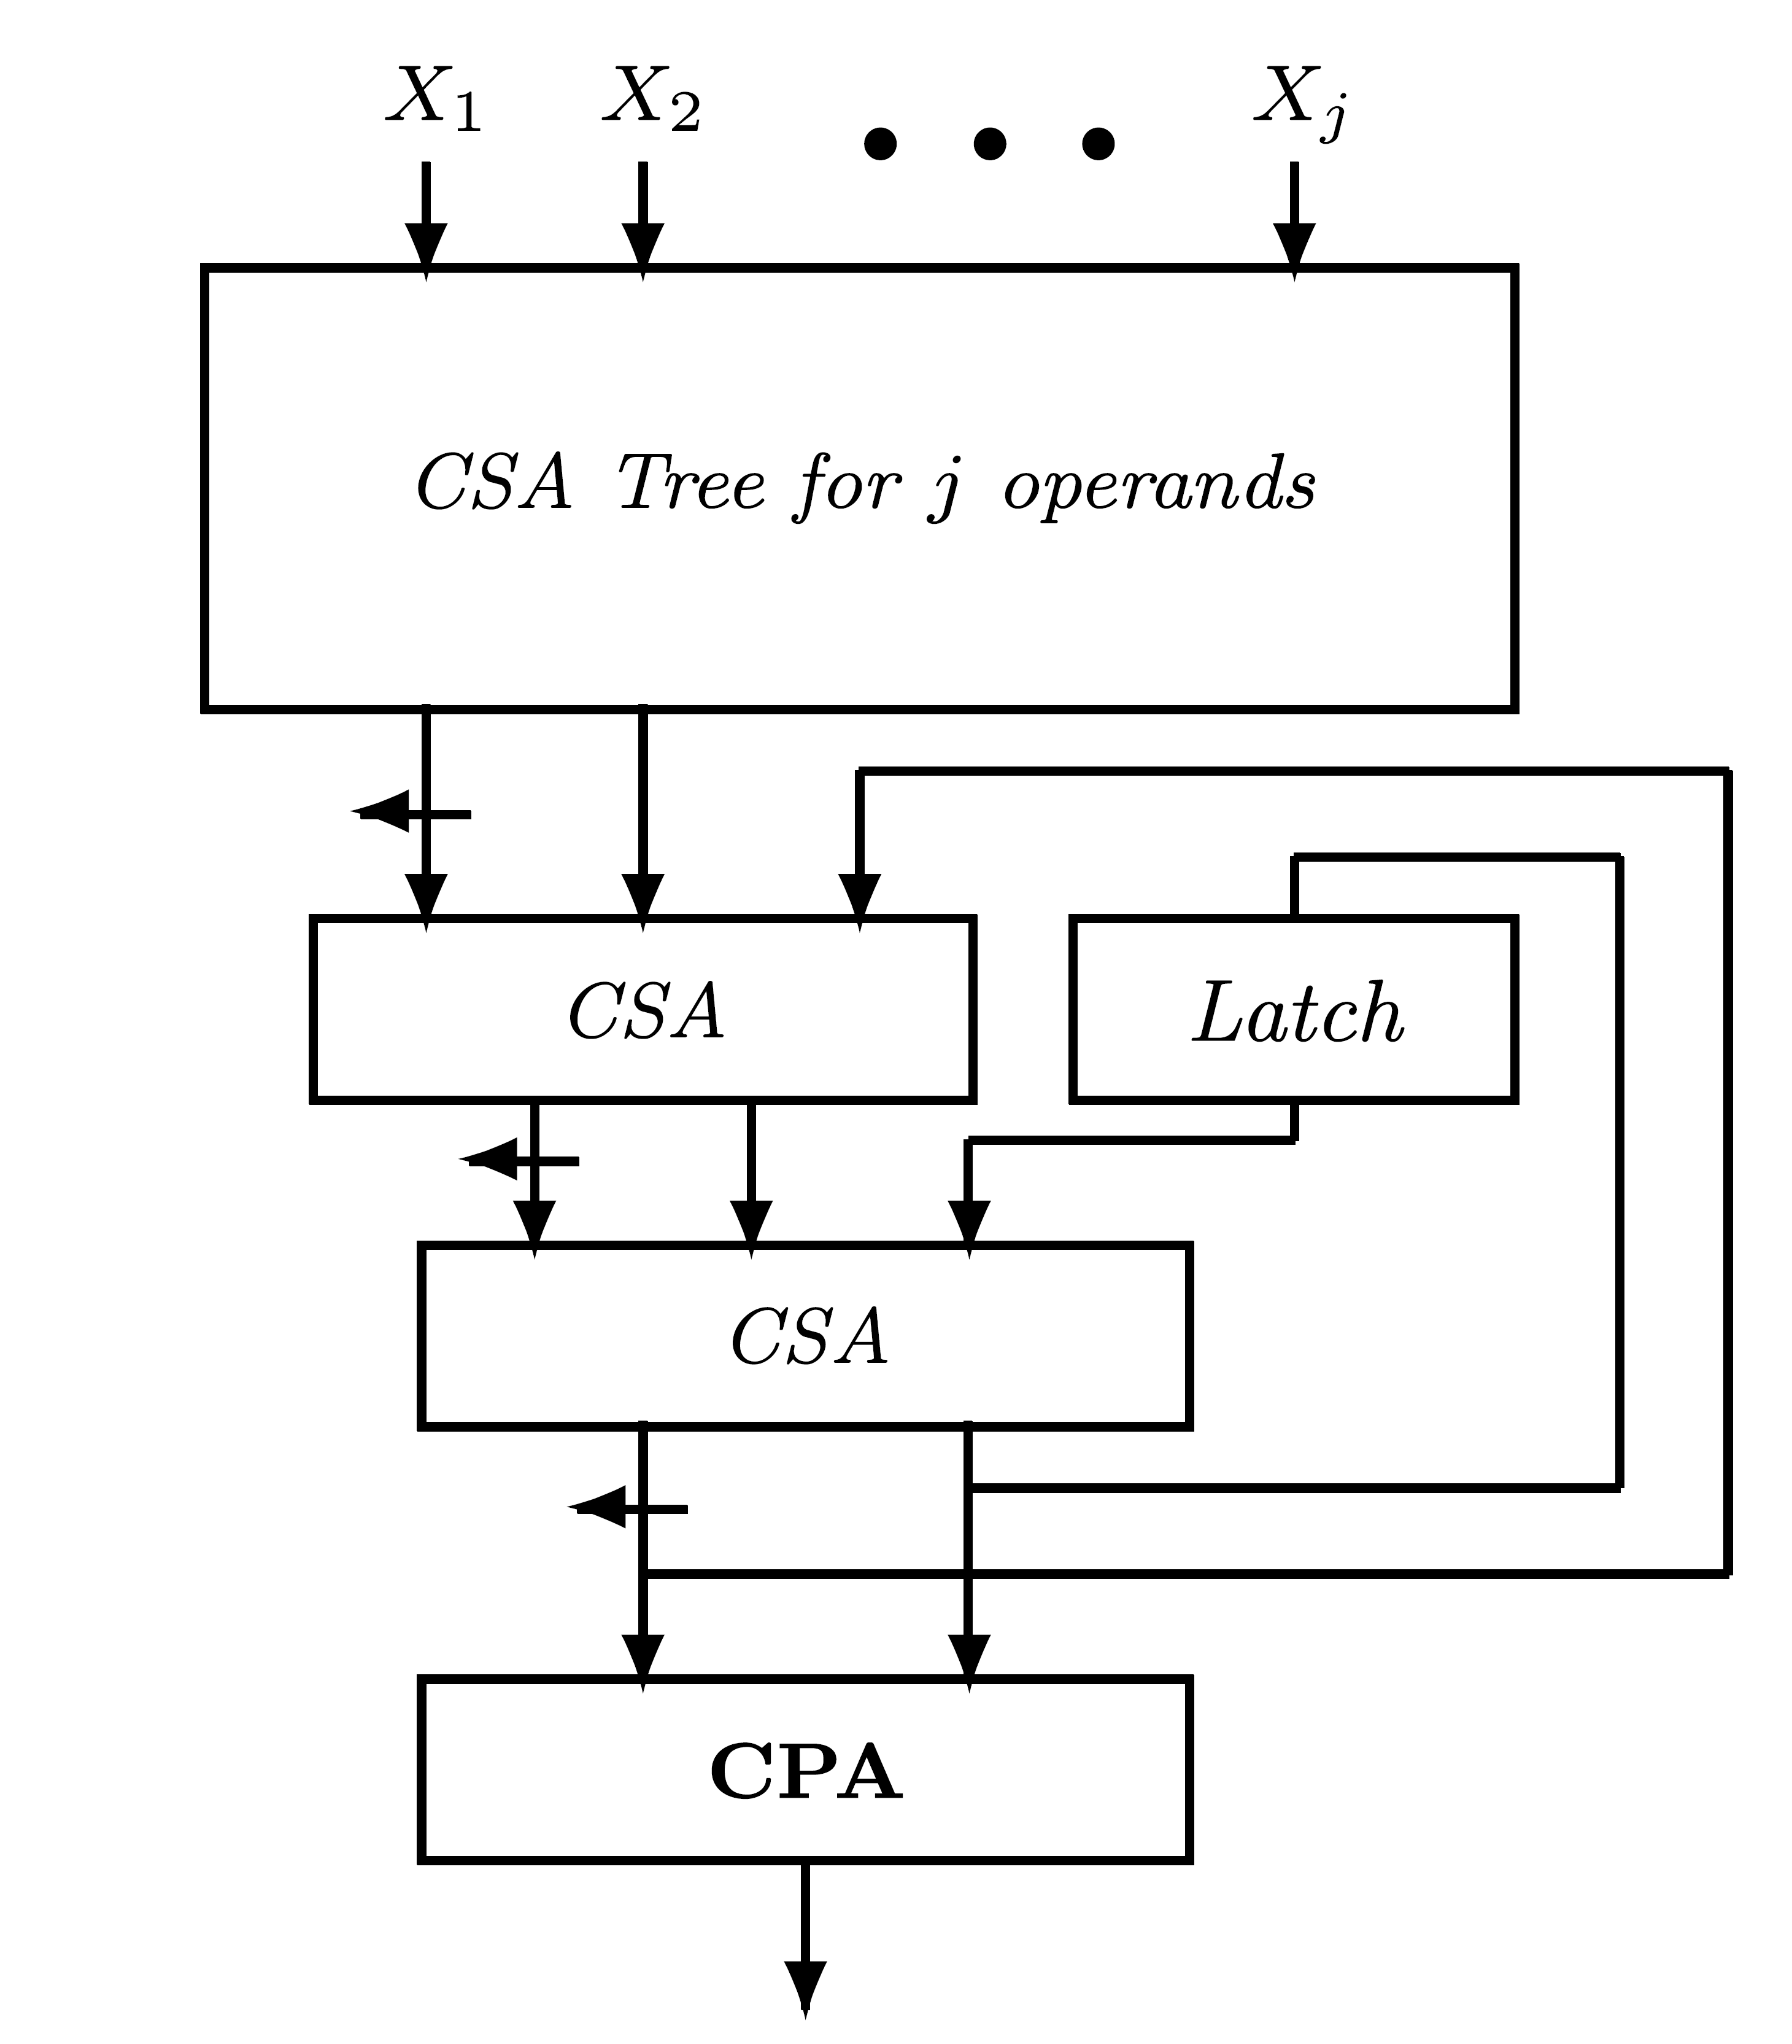
Example - Floating-Point Fast Multiplier in IBM 360/91
Operands of 56 bits - uses algorithm in Table 6.5
Generates partial products 0,±2A,±4A
28 partial products require 26 carry-save adders
Carry-save tree for 8 operands
  6 new partial products added to 2 previous intermediate results
  Used 5 times
  Pipeline allows overlapping consecutive sets of 6 partial products
  Accumulating all 28 partial products takes 6 clock cycles
  Overlapping possible among sets of partial products corresponding to same multiply operation
j=6

Slide 11
Example - Overlapping Multiplications
Overlapping 2 different multiply ops achievable if number of generated partial products ≤ 6
Carry-save tree passed only once per multiply operation - no need to use feedback connections
Limiting to 6 partial products (or less) can speed up execution of consecutive multiplications
To get sequence of Di with 7,14,28,56 leading 1’s (or 0’s) - need multipliers Ri with 10,14,28,56 bits
First multiplier - out of ROM - generates only 5 partial products
Other 3 multipliers contain 7, 14, and 28 leading 0’s (or 1’s) which can be skipped
  No need to generate partial products
  Just identify first and last bits of group of identical bits

Slide 12
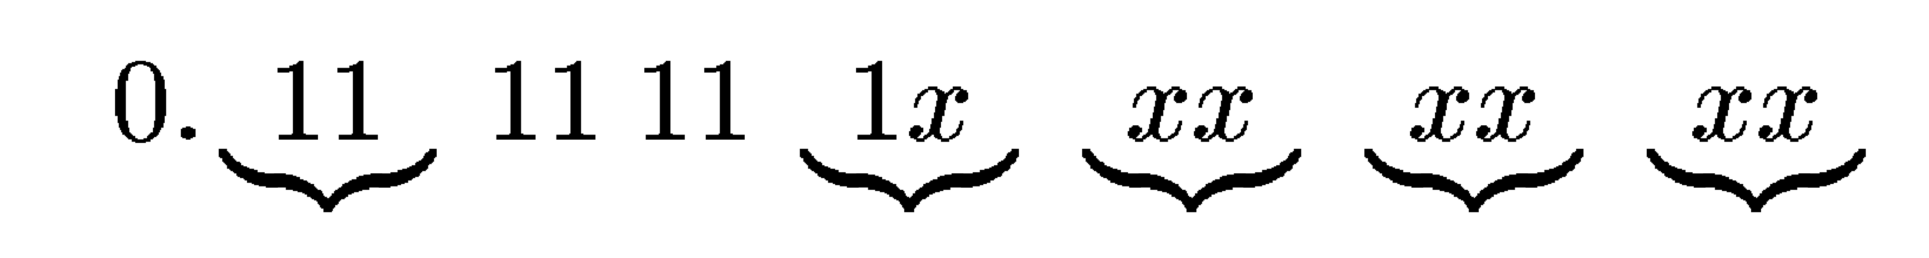
Example - Further Multiplier Truncation
Second multiplier (14 bits), generates only 5 partial products - feedback connections not used
3rd multiplier (28 bits), generates 9 partial products, requiring use of feedback connection
Can be avoided by additional truncation of multiplier
Can add 9 bits to 14 leading identical bits (total of 23 bits) - still only 6 partial products:
New denominator only guaranteed to have 14+9=23 leading identical bits instead of 28
  Proof - exercise

Slide 13
Example - Summary
Next multiplier - only 23 leading identical bits - can add 9 extra bits without use of feedback
Denominator has 23+9=32 leading identical bits
Two's complement of it → multiplier with 32 leading identical bits - number of leading identical bits in denominator increases to 64 and convergence achieved
Last multiply operation - feedback used - all available 56 bits used
Sequence of 5 multiplication factors of length 10,14,23,32,56 bits, increasing number of multiply operations from 7 to 9
All can be overlapped -total execution time of 18 clock cycles

Slide 14
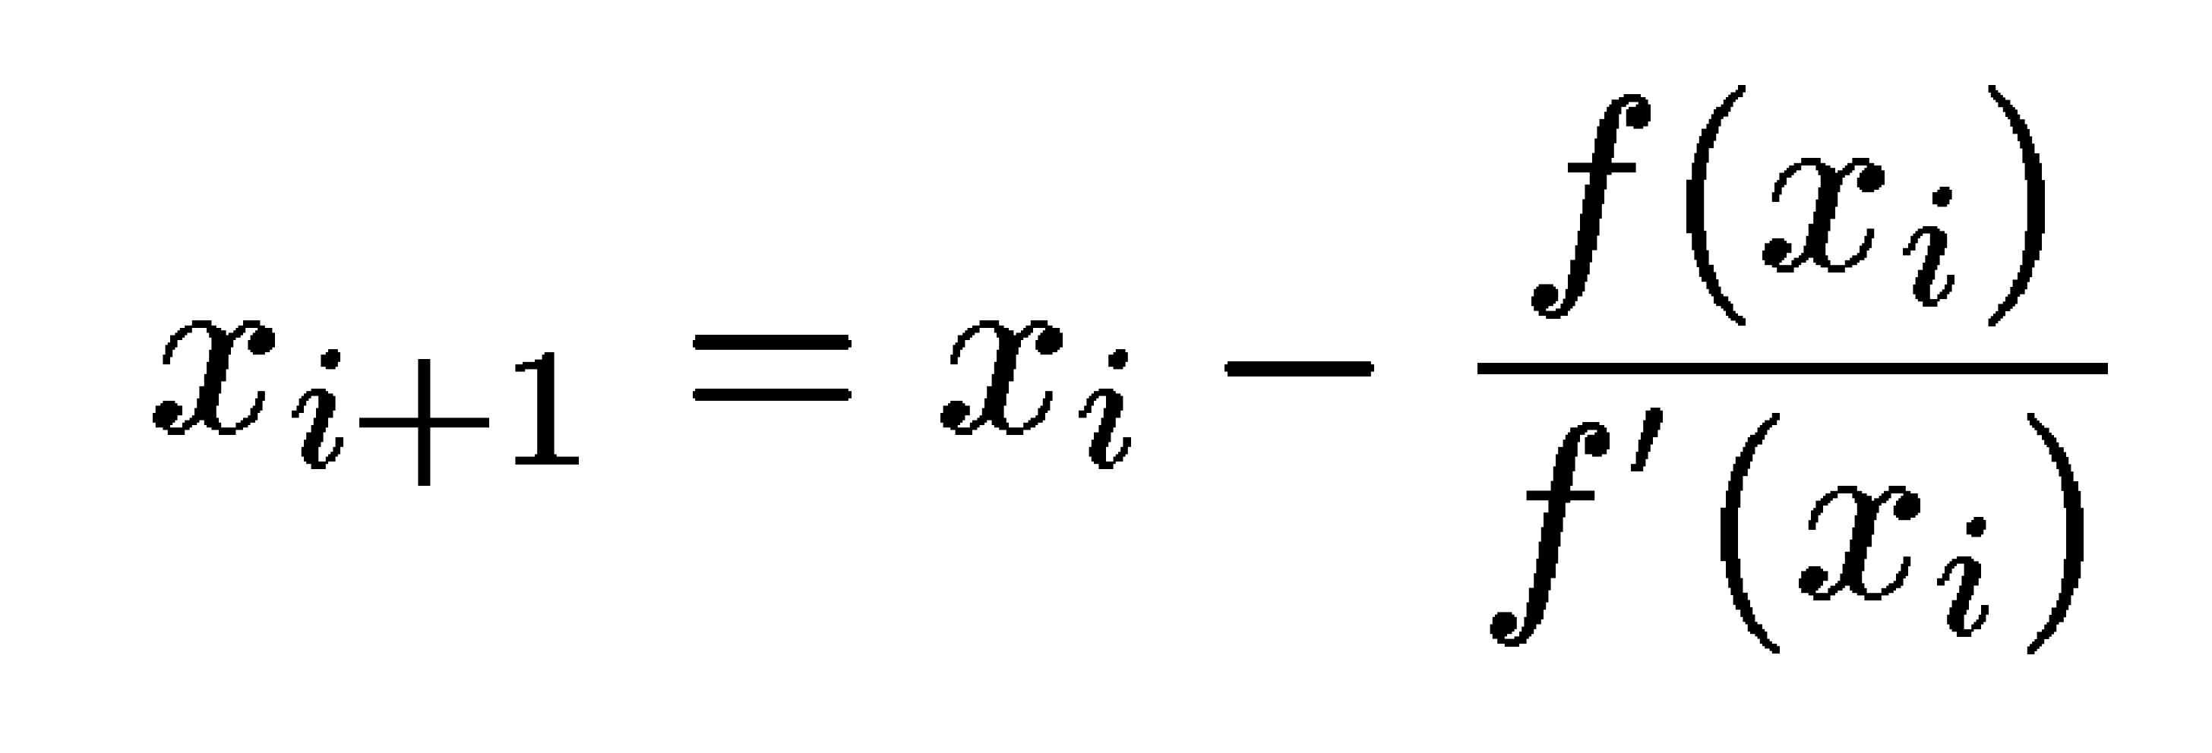
Division by Reciprocation
Reciprocal of divisor D multiplied by dividend
Reciprocal calculated using Newton-Raphson iteration method - finding zero of function f(x) (solution of f(x)=0)
x0 - first approximation ; xi - ith step estimate for zero ; f'(x) - derivative of f(x)
f(x)={1/x}-D has a zero at x=1/D
f'(x)=-1/x
xi+1= xi (2-D xi)
xi+1 converges to reciprocal of D
Convergence is quadratic
2

Slide 15
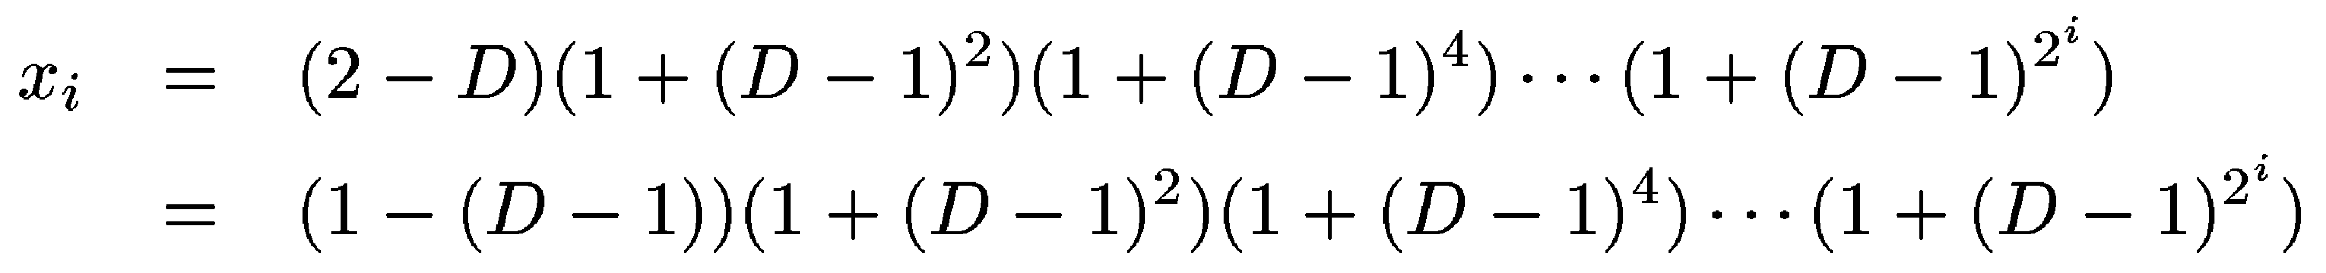
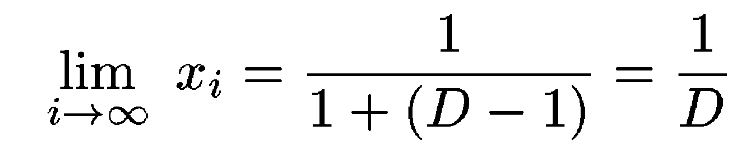
Proof of Convergence
Δi = 1/D - xi - error in ith step
Simple algebraic manipulations - Δi+1=D Δi
D normalized fraction (½≤D<1) ⇒ Δi ≤ 1 - error decreases quadratically
x0=1, x1=2-D,
Repeatedly substitution results in
y=1-D ; 0<y≤ ½
2

Slide 16
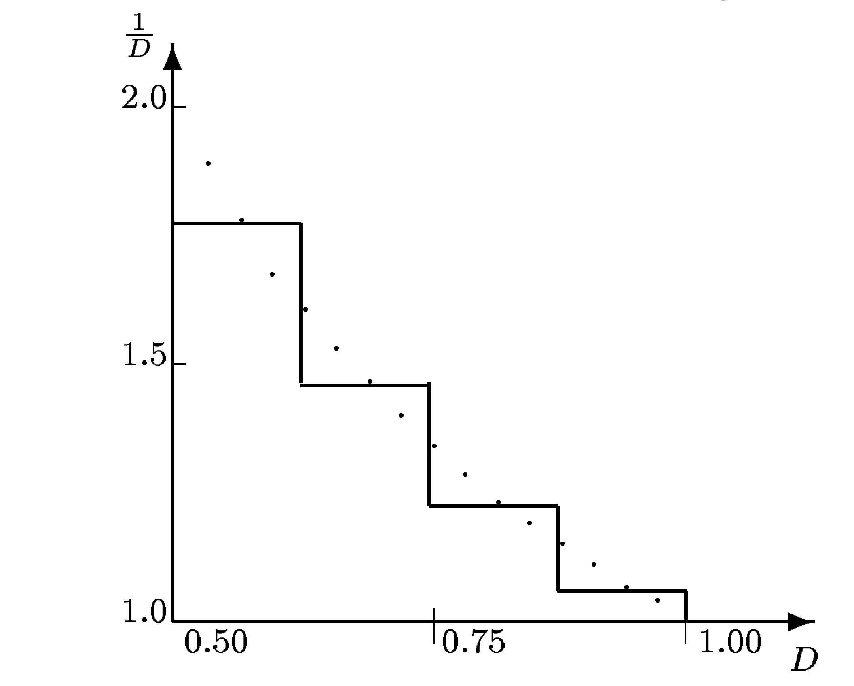
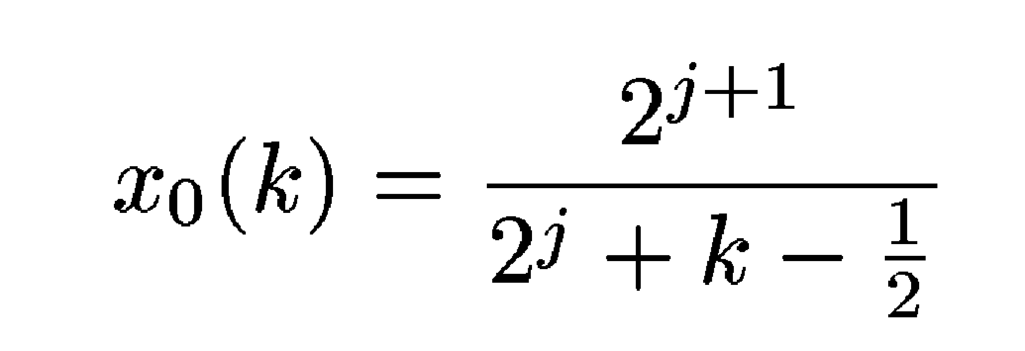
Reducing Number of Steps
Using table for first step rather than x0=1
Table (ROM) accepts j most significant digits of D (except first =1) - produces approximation to 1/D
Range [0.5,1) divided into 2 intervals (of size Δ=0.5⋅2 ) - optimum value of x0 for kth interval (k=1,2,…,2 ) is reciprocal of middle point of interval
Middle point is ½ + (k- ½)Δ
j
-j
j
j=2
Piecewise linear approximation - more complicated but higher accuracy

Slide 17
Implementation in the 64-bit ZS-1
Uses IEEE floating-point - significand 1 ≤ d < 2
15 most significant bits of divisor (excluding hidden bit), 1.d1 d2…d15, address a ROM look-up table for initial approximation x0
Table size 32K×16 bits - 0.5 ≤ x0 < 1
x0 =0.1y2 y3…y16
Approximation is reciprocal of mid-point between 1.d1 d2…d15 and its successor - 1.d1d2…d15 1
Reciprocal rounded by adding 2 - result truncated to yield 16 bits: 0.1y2 y3…y16
Precision: |x0-1/d| <1.5 2
Two iterations needed to achieve precision of 53 bits
  Four multiplications and two complement operations
-17
-16

Slide 18
Reducing Execution Time
First iteration: x1=x0 (2-d x0)
16 bits of x0 multiplied by 32 most significant bits of d - result rounded to 32, instead of 48, bits
One's complement - avoid carry-propagation
  Introduces an error of size 2
Multiply 16 bits of x0 by 32 bits of multiplicand → 32-bit product → x1 accurate to approx. 31 bits
Second iteration: similar operations
In x1 d, only 64 bits generated and only one's complement calculated - x1 (2-d x1) performed producing approximated value of 1/d
Multiply by N and approximated Q' rounded (one of four IEEE rounding schemes)
  Final rounding does not guarantee an accurately rounded result for all values of d
-31

Slide 19
Accuracy
Most implementations of division-by-reciprocation - accuracy smaller than for add/subtract type division
Corrective actions can be taken to guarantee correctly rounded least significant bit
Additional computation slows down division
When deciding on a division algorithm consider: precision, speed, and cost tradeoffs
  Final decision depends on available technology
Precision required by IEEE standard achieved at a reasonable cost and speed in IBM RISC/6000
Double-width datapath - all operations done in a fused multiply-add unit resulting a double-length estimate Q' of quotient

Slide 20
IBM RISC/6000
Remainder R=N-DQ' (fused multiply-add) - used to compute properly rounded result (fused multiply-add) in desired rounding mode
Q=Q'+R × 1/D - can use fused multiply-add unit
1/D result of Newton-Raphson iterations
Different solution: estimate error in Q' by calculating N'=D Q'
Q' is sufficiently accurate (at least to n+1 bits; n is number of bits in significand), least significant bits of N' provide direction of error in Q'
Based on this and desired rounding mode, Q' can be corrected by either adding or subtracting 1 at the n+1 bit position or by truncating it

