Slide 1

UNIVERSITY OF MASSACHUSETTS
Dept. of Electrical & Computer Engineering
Digital Computer Arithmetic
ECE 666
Part 9a
Evaluation of Elementary Functions - I
Israel Koren
Spring 2008

Slide 2
Efficient Algorithms for
Evaluating Elementary Functions
Hardware algorithms which are accurate and fast compared to software algorithms
Useful for scientific hand-held calculators and numerical processors
Examples: e , ln x, sin x, cos x
Straightforward method: look-up table
x,y of length n bits
To evaluate y=F(x) - ROM of size 2 × n
Prohibitive for n ≥ 20 - size ≥ 16 M
Second method: Taylor series expansion
x
n

Slide 3
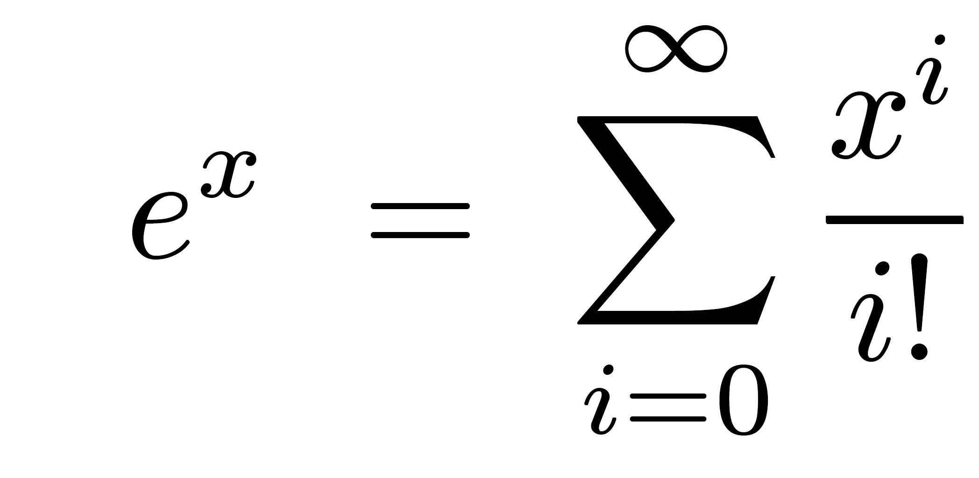
Taylor Series Expansion
Example:
Converges rapidly when x is a fraction
Converges slowly for x close to 1
Hardware implementation complex - separate logical networks for different functions
Algorithms requiring a smaller number of computational steps for same precision exist
Most commonly used methods: based on either polynomial or rational approximations

Slide 4
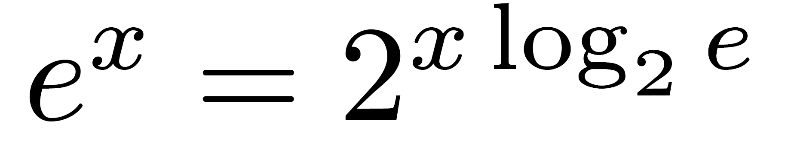
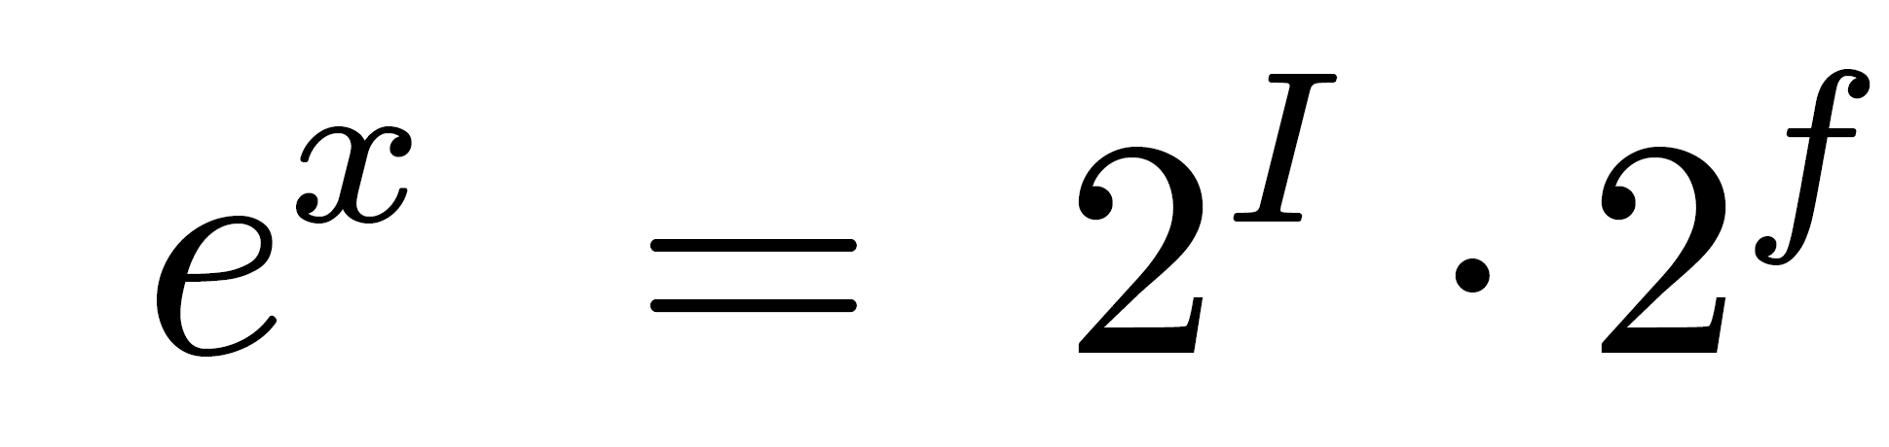
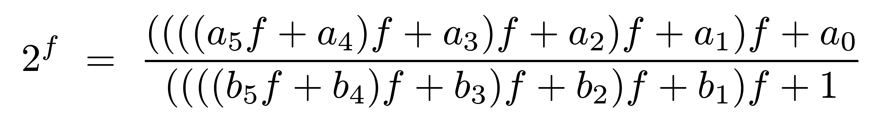
Example - Exponential Function
Exponent divided into integer part I and fractional part f : x log 2 e = I+f
Calculation of 2 in either fixed-point or floating-point - straightforward
Calculation of 2 - rational approximation - ratio between 2 polynomials
Example: Two degree-5 polynomials
ai,bi (i=0,1,...,5) known constants - 10 multiplications, 10 additions, 1 division
Approximations with smaller execution time exist
I
f

Slide 5
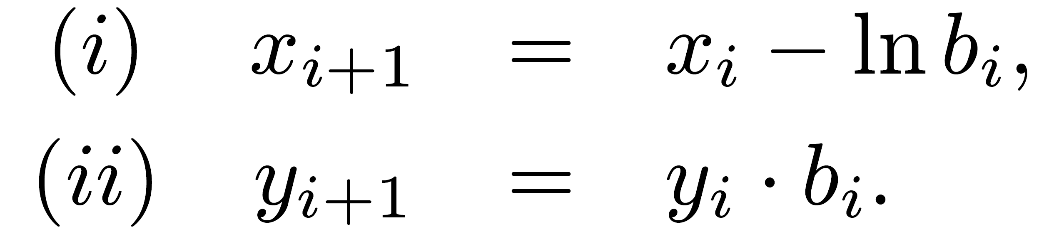
Alternative Methods for Evaluating Elementary Functions
Similar to division-by-convergence
2 (or more) recursive formulas - one is forced to a constant while other yields result
Example: Evaluating y=e for some fraction x0
bi's selection - x0,x1,…,xm approach 0
m - number of iterations needed to ensure xm=0
Linear convergence - m linear function of number of bits n
x
0

Slide 6
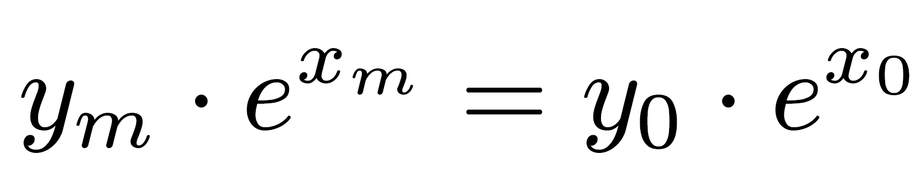
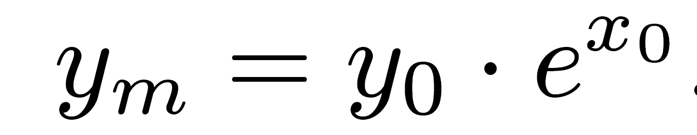
Exponential Function
In particular:
xm=0 ⇒
Similar to division-by-convergence - product yi e remains constant for all bi's
Need a simple way to select bi's to ensure convergence of xi+1 to 0
Also, multiplication by bi should be simple and fast
  Use the form bi =(1+si 2 ), where si ∈ {-1,0,1}
  Multiplication reduced to shift and add
The term ln bi=ln (1+si2 ) can be positive or negative
  Must ensure convergence of positive or negative xi+1 to 0
xi
-i
-i

Slide 7
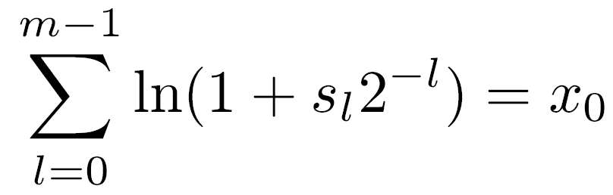
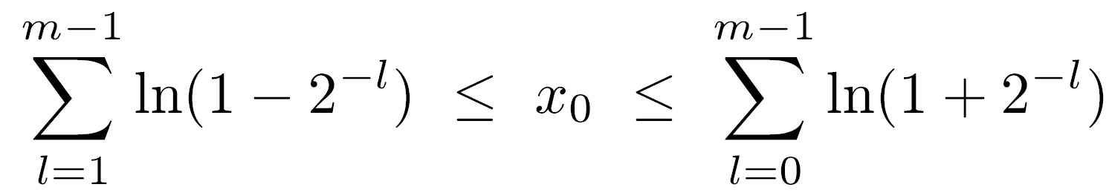
Precalculated ln(1±2 )
-i
Online calculation too slow
Stored in a look-up table (ROM of size 2n×n)
(i) xi+1=xi -ln (1+si 2 )
(ii) yi+1=yi (1+si 2 )
To calculate e - find the vector
s={s0,s1,…,sm-1} so that xm=0 or
If sl restricted to {-1,0,1} - smallest/largest x0 correspond to all sl =-1 / sl =1
For every x0 in interval there exists vector s guaranteeing convergence to 0
-i
-i
x

Slide 8
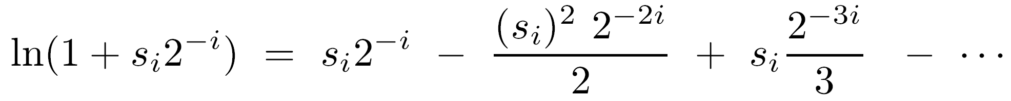
Domain of x0
For large m (≥20) bounds converge: -1.24 ≤ x0 ≤ 1.56
If x0 positive fraction - simple scheme for selecting si - one-sided selection rule: si ∈ {0,1}
  Similar to quotient-bit selection in restoring division
In step i+1 form difference D=xi-ln (1+2 )
  If D positive or zero - set si=1 and xi+1=D
  If D negative - set si=0 and xi+1=xi
Analyze subtract in xi+1 - examine Taylor series:
  At step i can cancel bit of weight 2 by subtracting ln (1+si 2 ) from xi
  Up to n steps needed to ensure convergence of n-bit fraction to 0 - convergence linear and m=n
-i
-i
-i

Slide 9
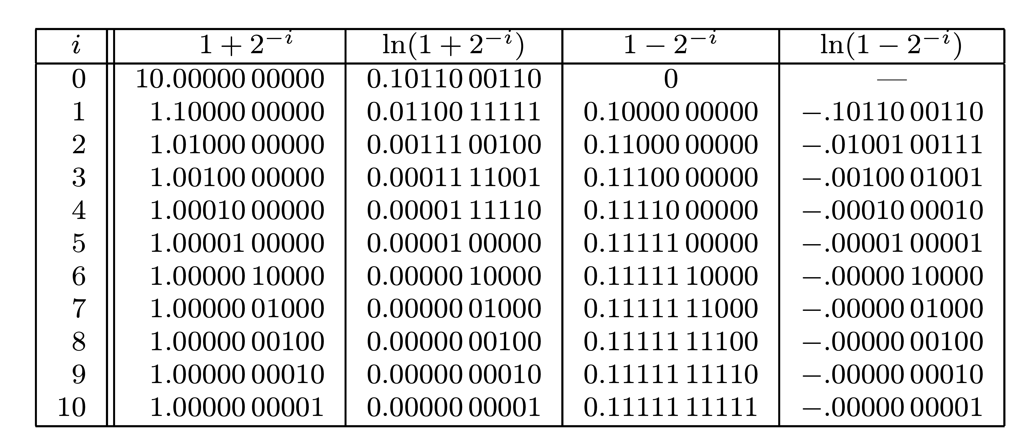
Modify Selection Rule
Improves performance of algorithm
If bit in ith position =1 - select si=1 and calculate xi+1=xi-ln (1+si 2 )
If 0 - select si=0, go to next step without subtract - capability of skipping over 0’s
More complex selection rules can be used as well
-i
Example
-i
ln(1±2 ) for i=0,1,2,…,10
  10 fractional bits
  rounded-to-nearest
ln(1±2 )=±2 for i≥ 6
-i
-i

Slide 10
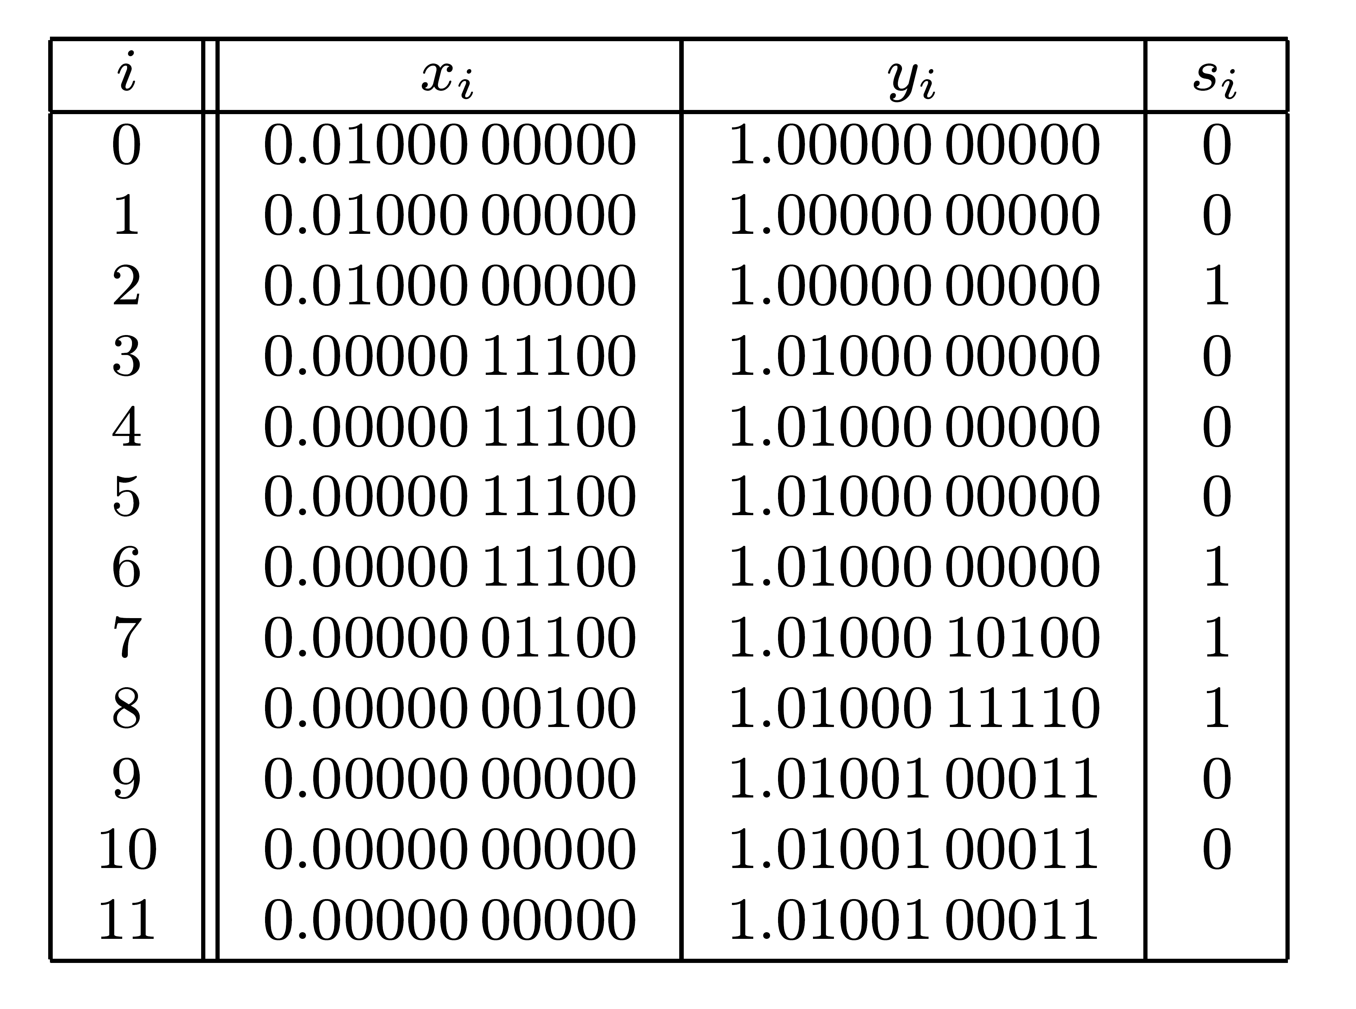
Example: e in 10-bit precision
0.25
One-sided selection rule
x0=0.2510= 0.01000 0000002
x0<ln (1+2 ) ⇒ s0=s1=0 ⇒ x2=x0
Select s2=1 and obtain x3=x2-0.00111 00100 = 0.00000 11100
Set s3=s4=0 ⇒ s5=0 , s6=s7=s8=1, and s9=s10=0
Yielding x11=0
-1

Slide 11
Example - Cont.
-2
-6
-7
-8
In parallel :y11=y0(1+2 )(1+2 )(1+2 )(1+2 ) yielding y11=1.01001 000112 = 1.2841810
Exact value (to 5 five decimal digits)=1.2840310
Approximation error =0.158·2
If si=-1 allowed - selected values (s0,…,s10)=0,1,-1,1,0,0,0,1,1,1,1
x11=0 ; y11=1.01001 000102
Approximation error=0.842·2
-10
-10

Slide 12
Extending Argument of Exponential Function
x = x log 2 e ln 2
x log 2 e = I + f (I - integer ; 0 ≤ f < 1)
Calculate y=e =e =e =2 e
Set x0=f ln 2 ⇒ 0 ≤ x0 < ln 2 =0.693
2 is easily dealt with
  Incorporation into exponent part of floating-point number
  Through a shift operation for fixed-point arithmetic
x
(I+f)ln2
I ln2+f ln2
I
f ln2
I

Slide 13
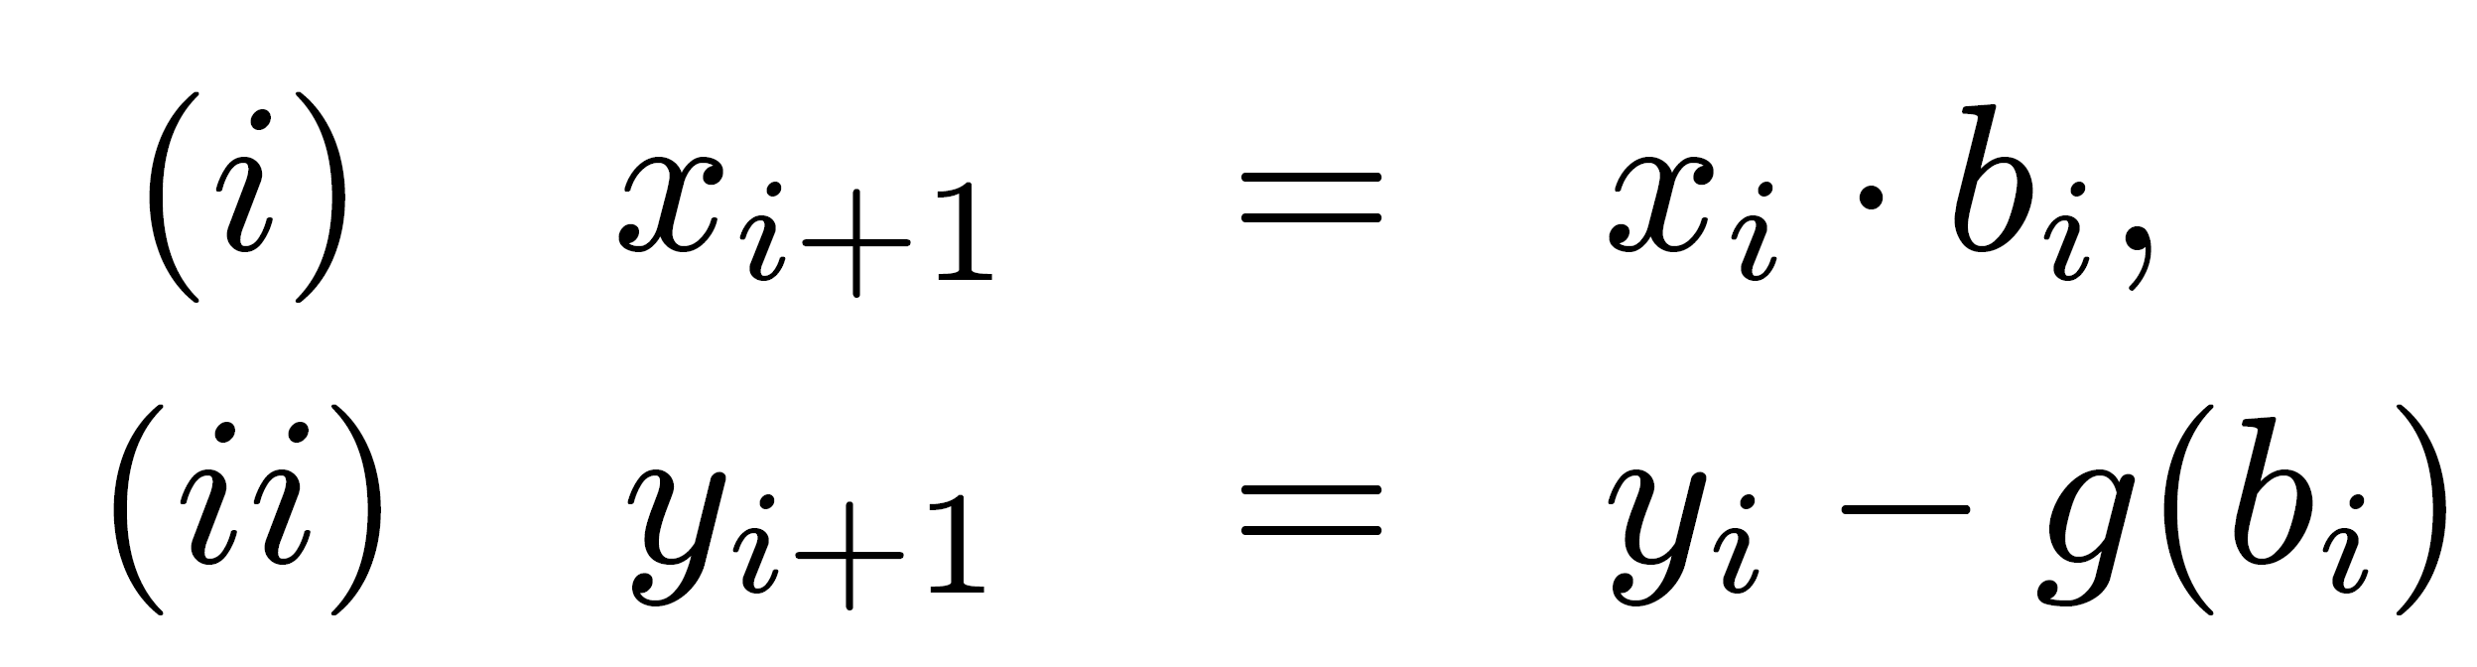
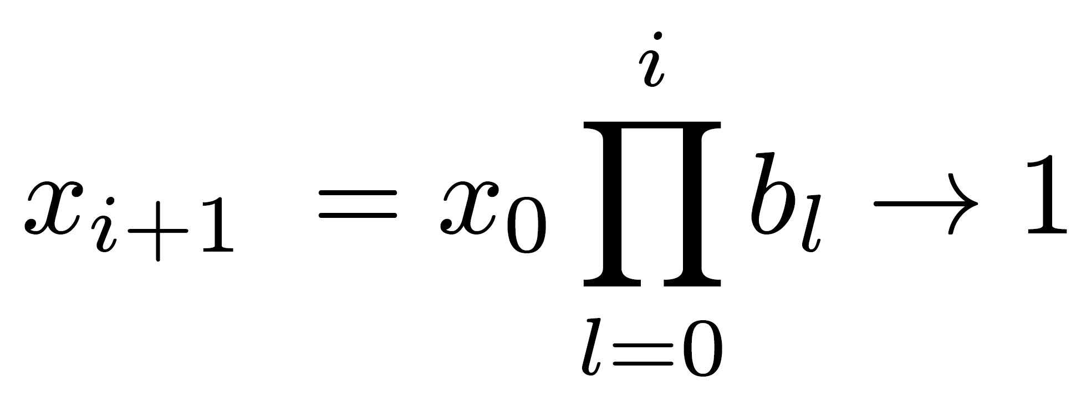
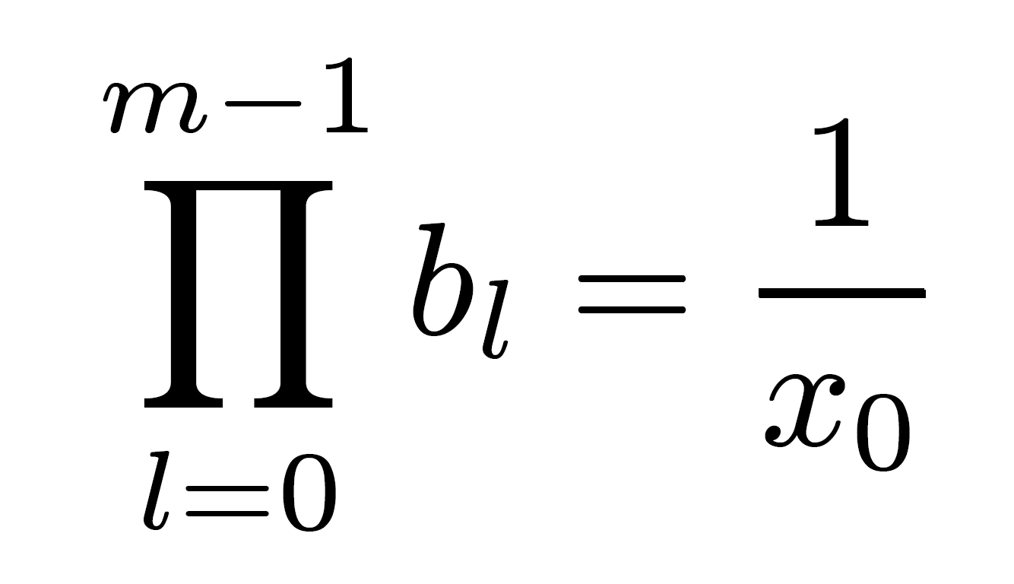
The Logarithm Function
x
Calculating e - continued summation of terms ln (1+si 2 ) to force convergence of xi to 0 - additive normalization
Multiplicative normalization - xi is forced to 1 (or some other nonzero constant) by continued multiplication with precalculated factors
bi selected so that
After m steps (multiplicative inverse)
-i

Slide 14
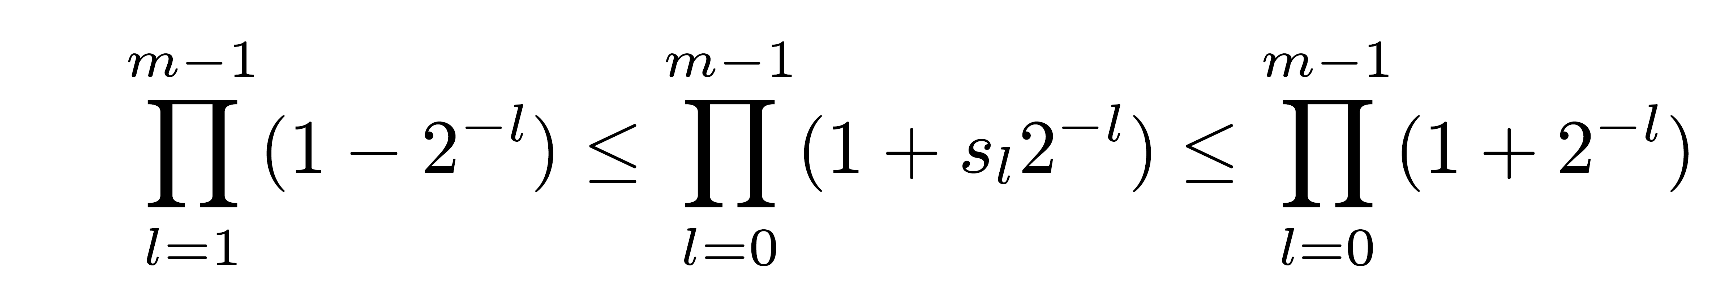
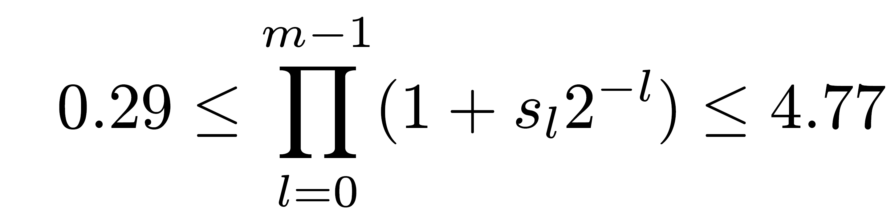
Domain of Algorithm
-i
Multiplication factor bi: 1+si 2 for si∈{-1,0,1}
Domain:
For large m:
Domain for x0: 0.21 ≤ x0 ≤ 3.45
Positive normalized fractions are in domain
If argument not normalized floating-point number - rewrite as x=x0·2 ; 0.5 ≤ x0<1
ln x=ln x0+Ex ln 2
Ex

Slide 15
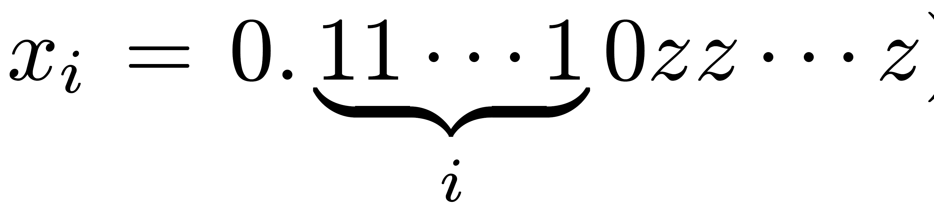
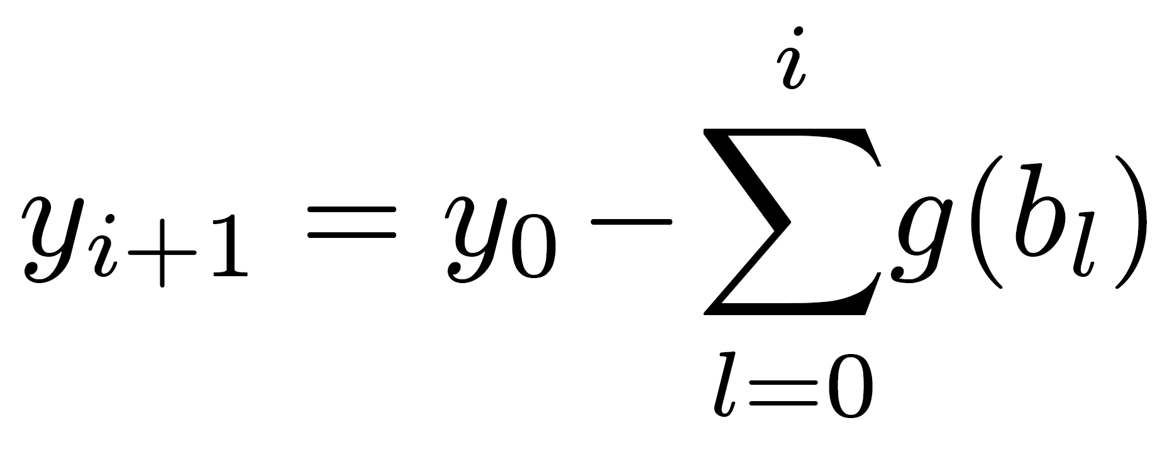
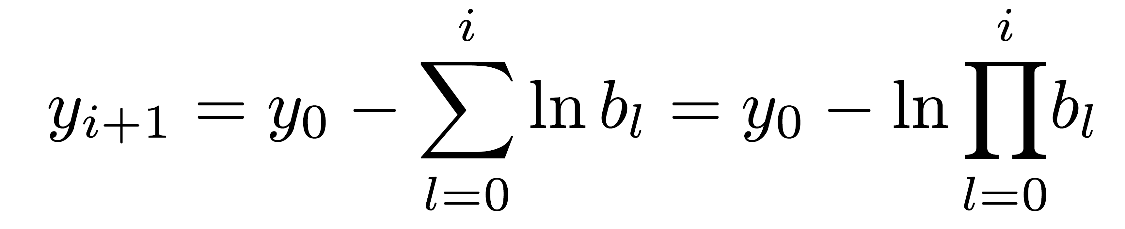
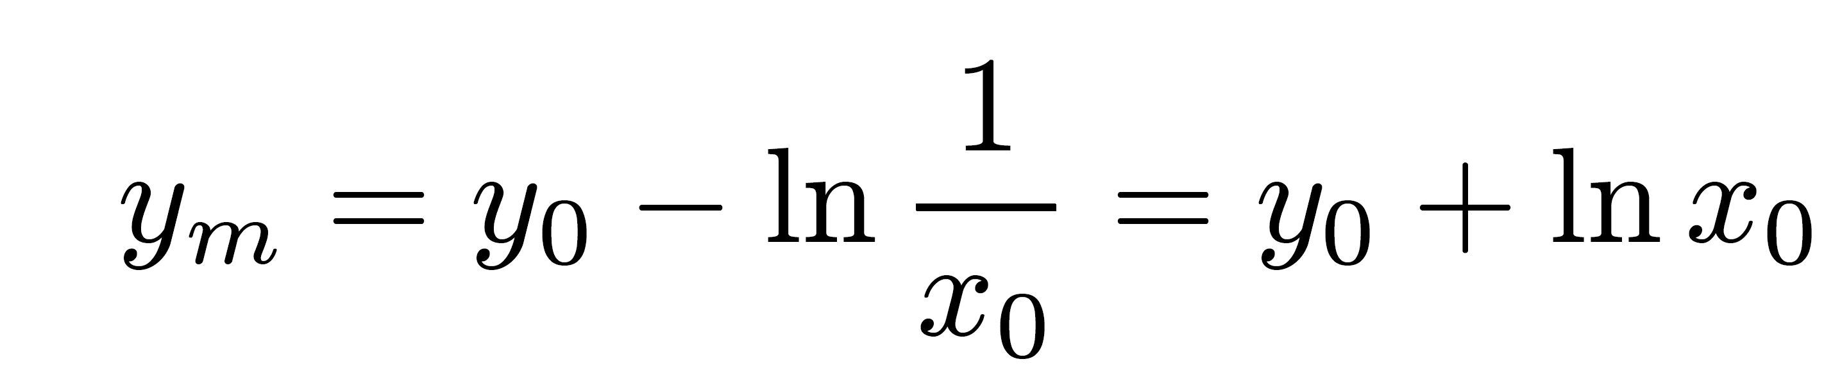
One Sided Selection Rule si∈{0,1}
has i leading 1's ⇒ xi+1=xibi=xi+xisi2 (with si=1) has (i+1) leading 1's
In yi+1 formula:
g(bl)=ln(bl) ⇒
xi+1 approaches 1 ⇒ yi+1 converges to
-i

Slide 16
Calculating Natural Logarithm
-i
Same table of ln (1+si 2 ) needed here
Base e can be replaced by any other base
Base 10 - used in hand-held calculators
Finally:
yi+1 + ln xi+1 = (yi-ln bi)+(ln xi+ln bi)= yi+ln xi is a constant
xi+1 approaches 1 ⇒ yi+1 approaches y0+ln x0

Slide 17
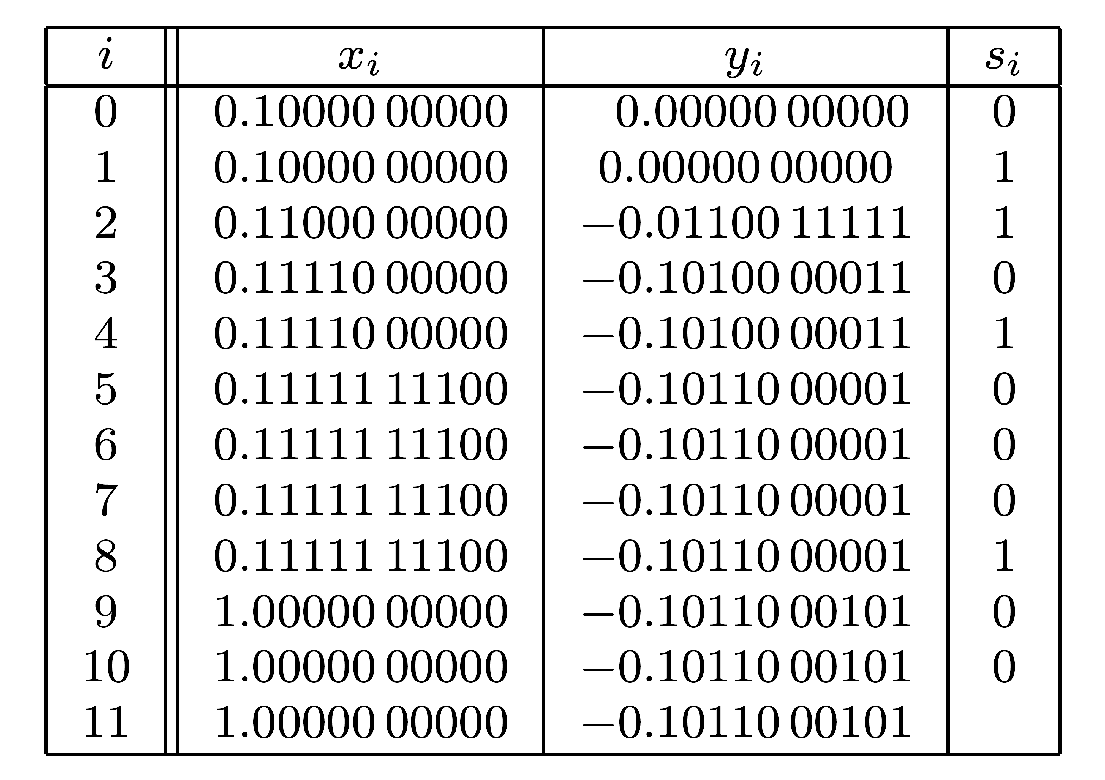
Example - ln (0.50) in 10-bit precision
y11=-0.10110 001012=-0.6923810
Exact result (in 5 decimal digits) = -0.69315
Approximation error = 0.783·2
-10

Slide 18
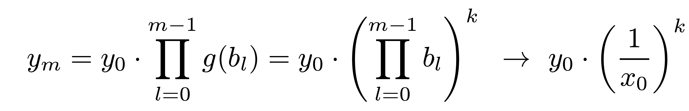
Operation in (ii) - Multiplication
k
g(bi)=bi (k - any real number):
Example:
  k=1 : yi+1 → y0 / x0 - divide operation
  k=1/2 : yi+1 → y0 / √ x0 - reciprocal of square root
  y0=x0 : yi+1 → √ x0 - square root calculated
g(bi)=√ bi ; for simplicity g(bi)=(1+si 2 )
Multiplication by bi more complex - not efficient for square root extraction
-i

Slide 19
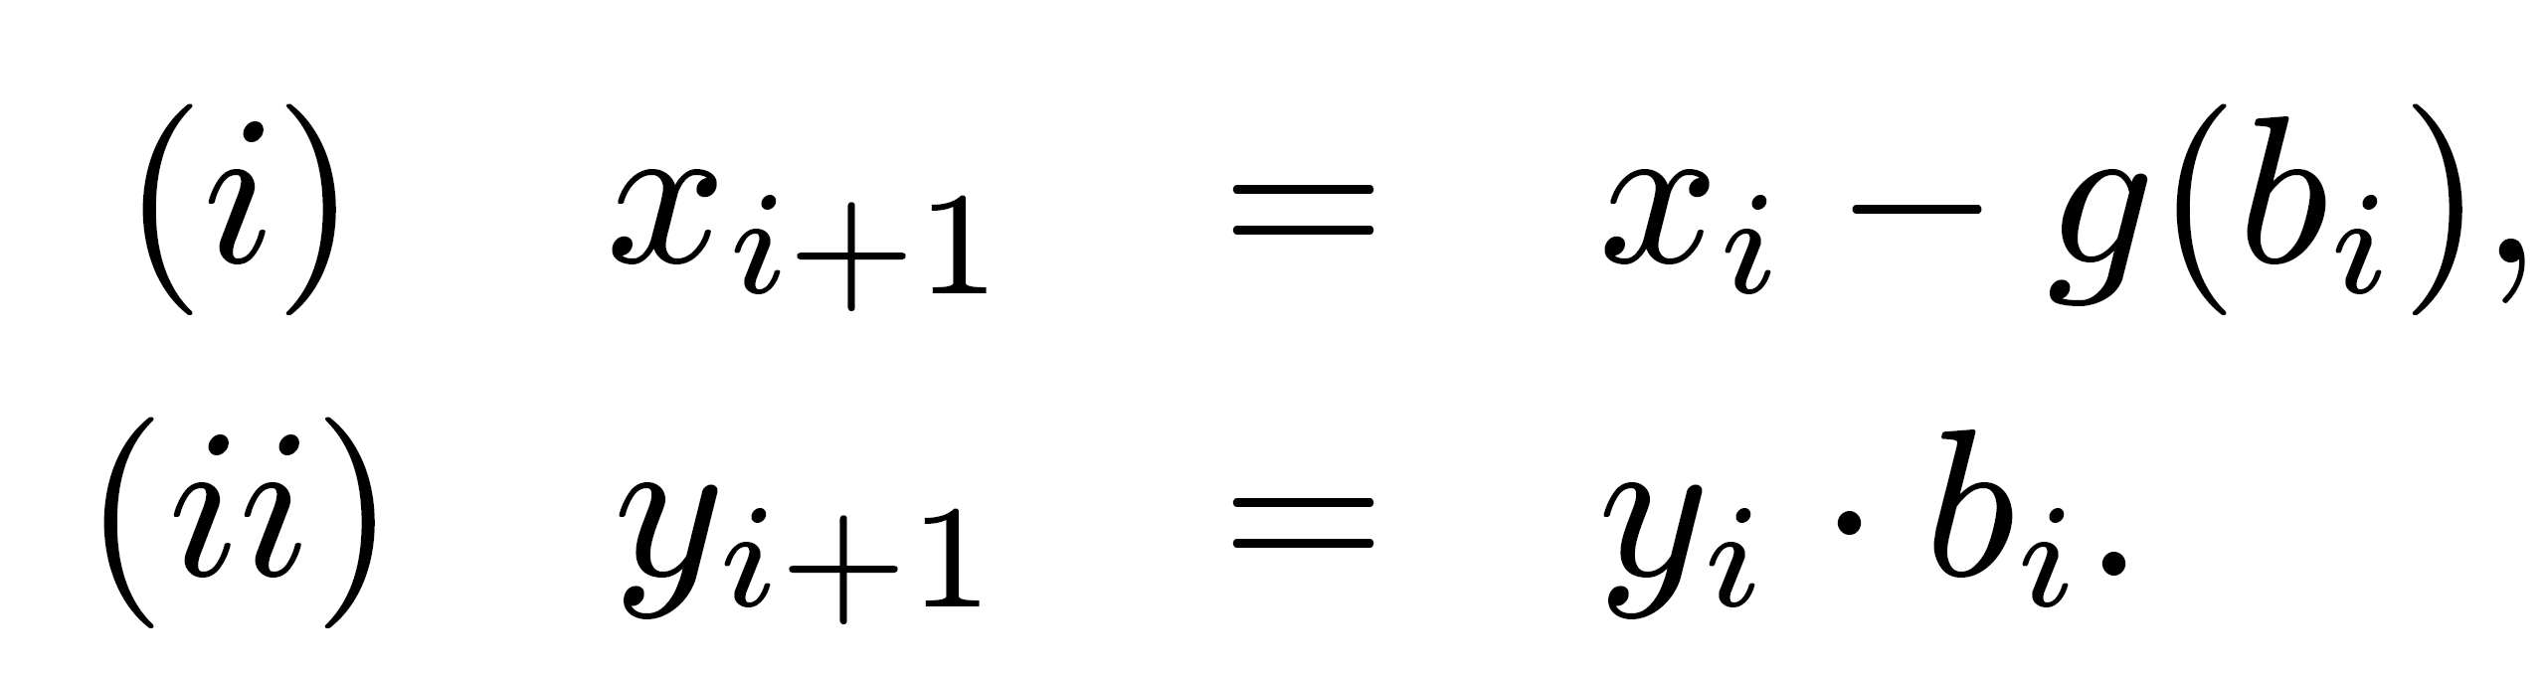
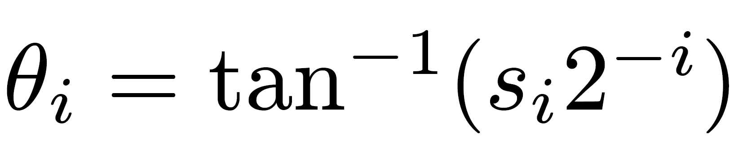
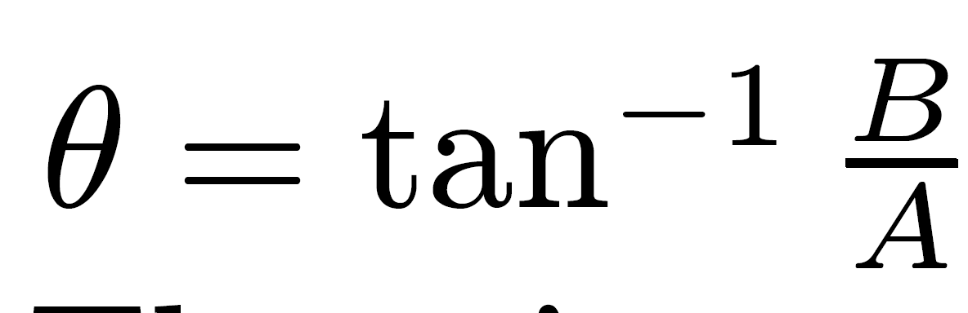
Trigonometric Functions
jx
E = cos x + j sin x where j= √-1
For exponential function:
For trigonometric functions select bi=(1+jsi 2 )
This complex number can be written as
where
Polar form of complex numbers
where
-i

Slide 20
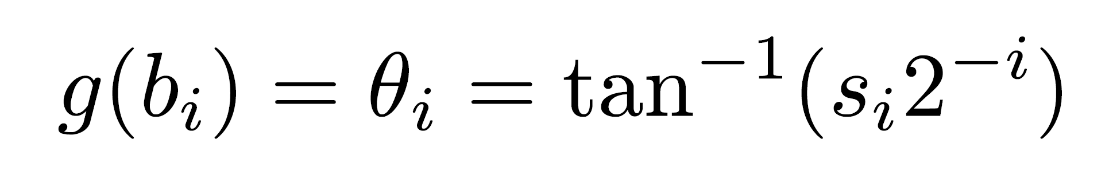
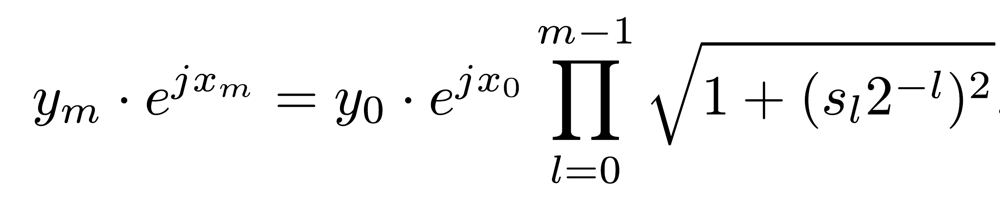
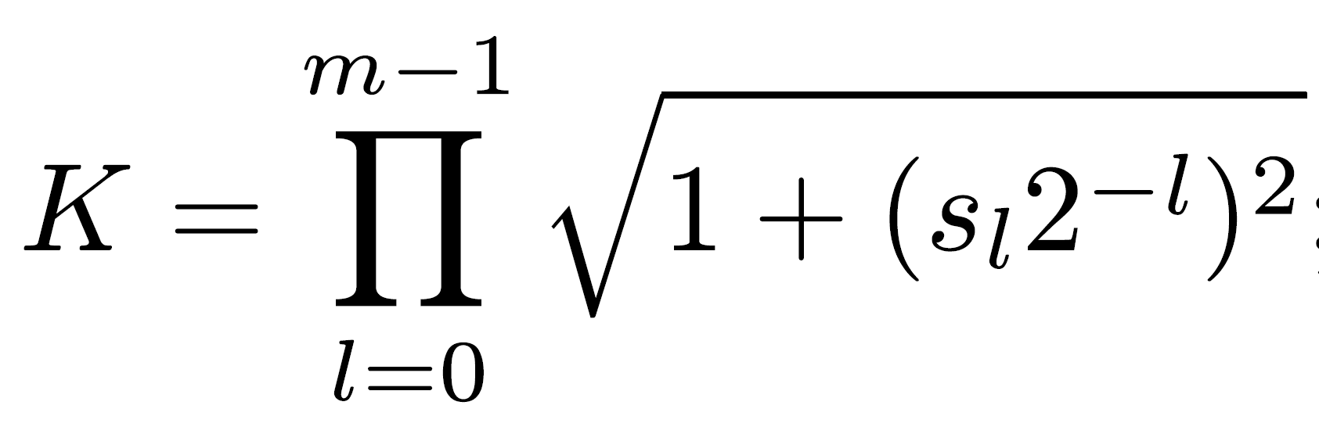
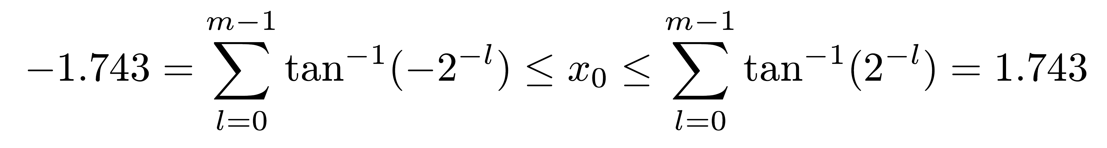
Domain for Trigonometric Functions
si's selected so that x0,x1,…,xm → 0
⇒
Denoting:
Then:
Convergence domain for m ≥ 20 : (including 0 ≤ x0 ≤π/2 = 1.57)
⇒

Slide 21
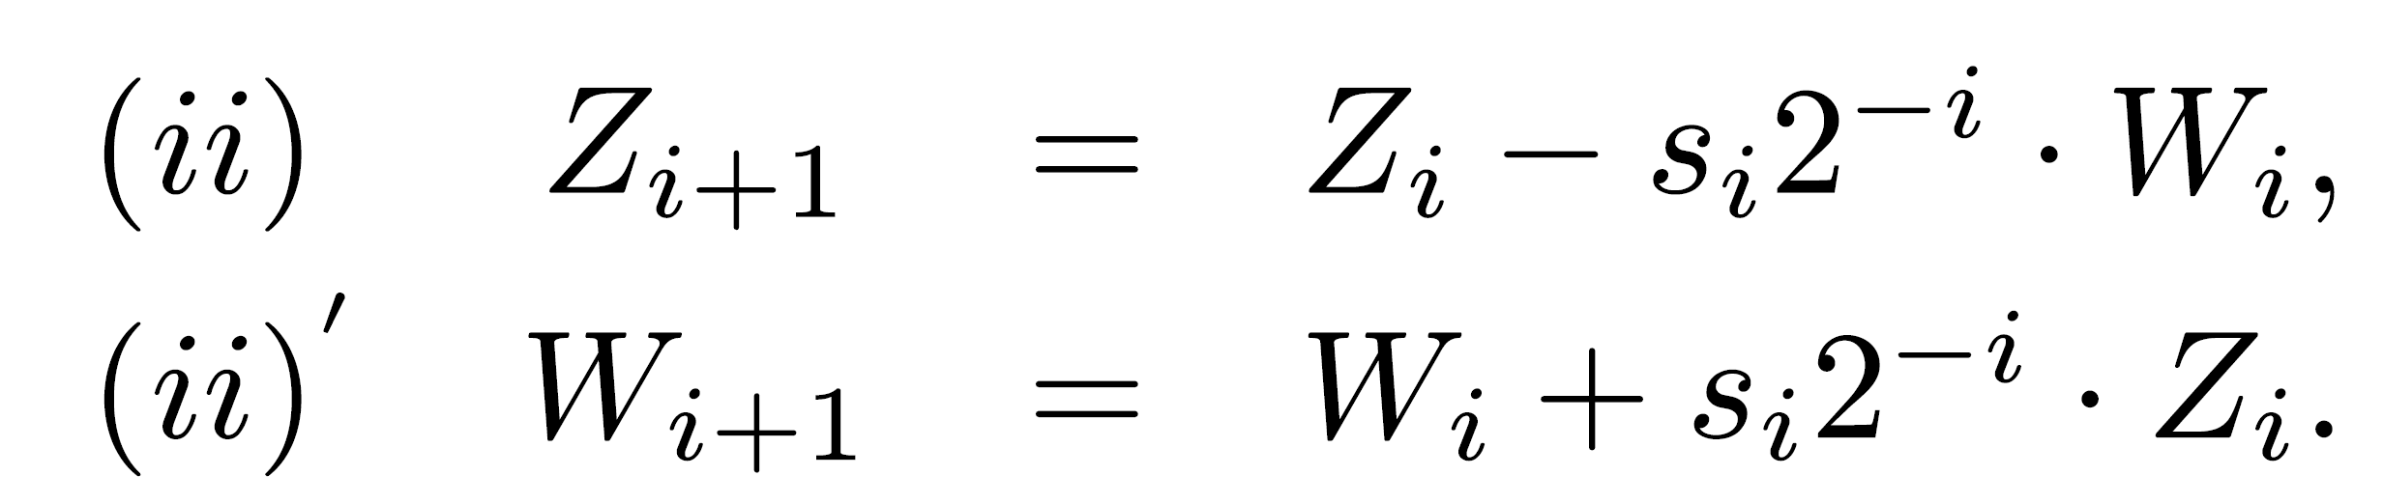
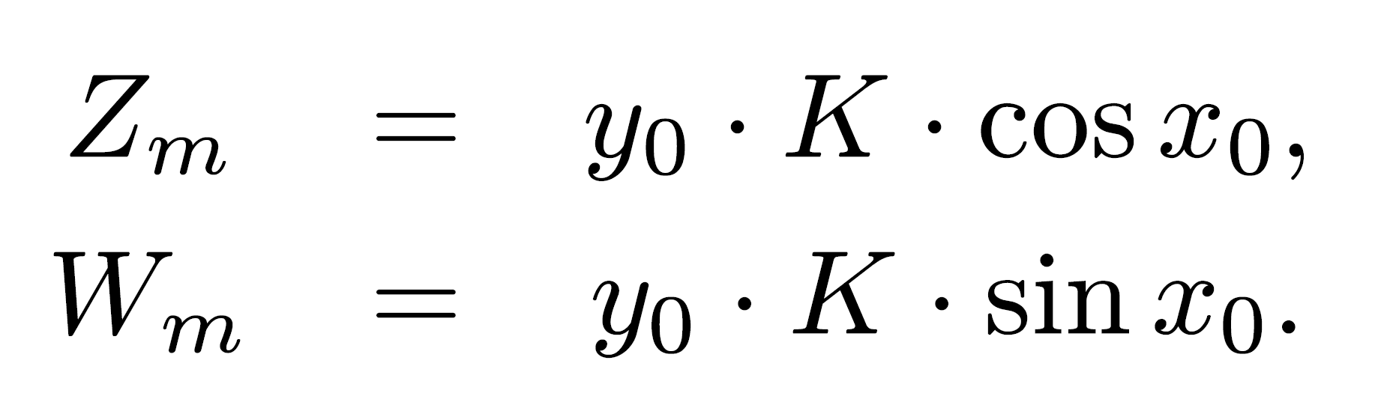
Equations for x and y
xi's real numbers - yi's complex numbers
yi=Zi + jWi (Zi - real part ; Wi - imaginary part)
Initial value y0 can be complex - Z0+jW0
Setting W0=0, Z0=y0 - desired values obtained:
Volder developed differently using rotations in polar system - CORDIC (COordinated Rotation DIgital Computer)

Slide 22
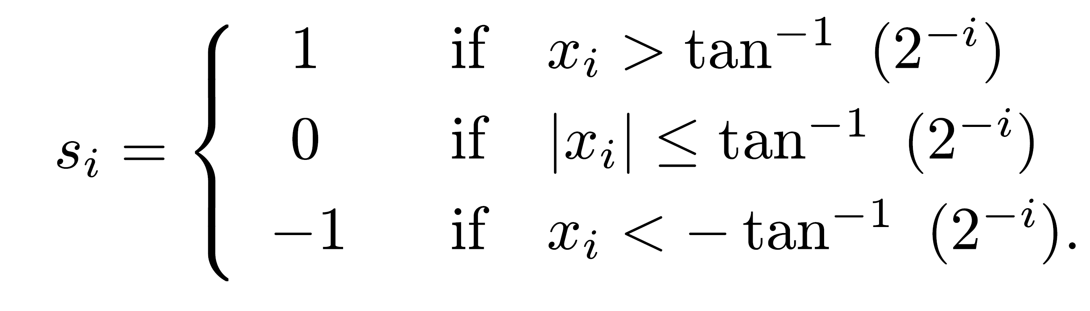
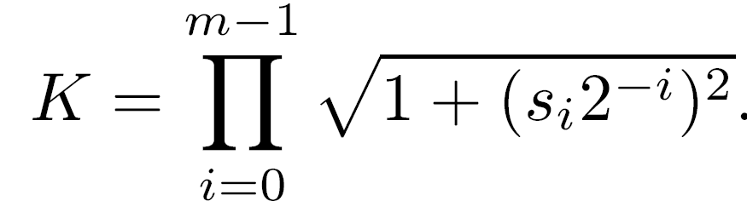
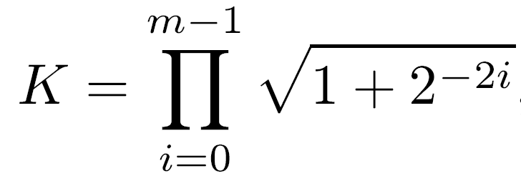
Selection Rule for Si
-1
-i
tan (si 2 )= si tan (2 )
  n constants stored in ROM
For si ∈{-1,0,1}
K not constant - depends on s which depends on x0
Also, full-length comparison between xi & tan (2 )
If si restricted to {-1,1} -
Constant that can be precalculated
For m > 16, K=1.6468 - set y0=1/K Zm =cos x0 ; Wm = sin x0
-1
-i
-1
-i

Slide 23
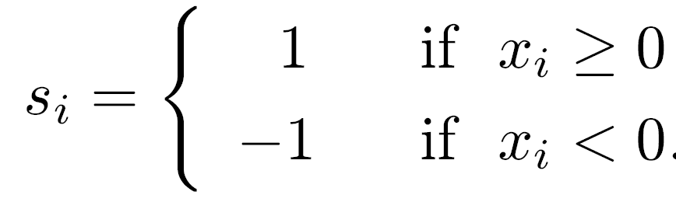
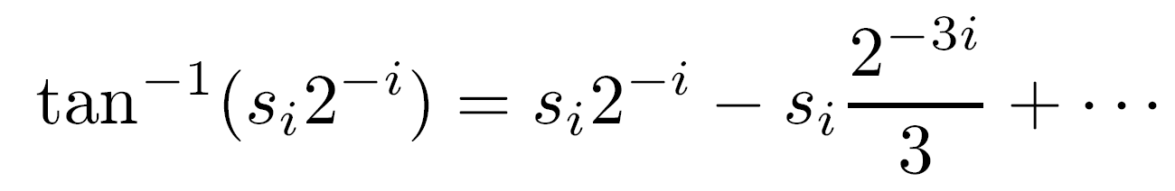
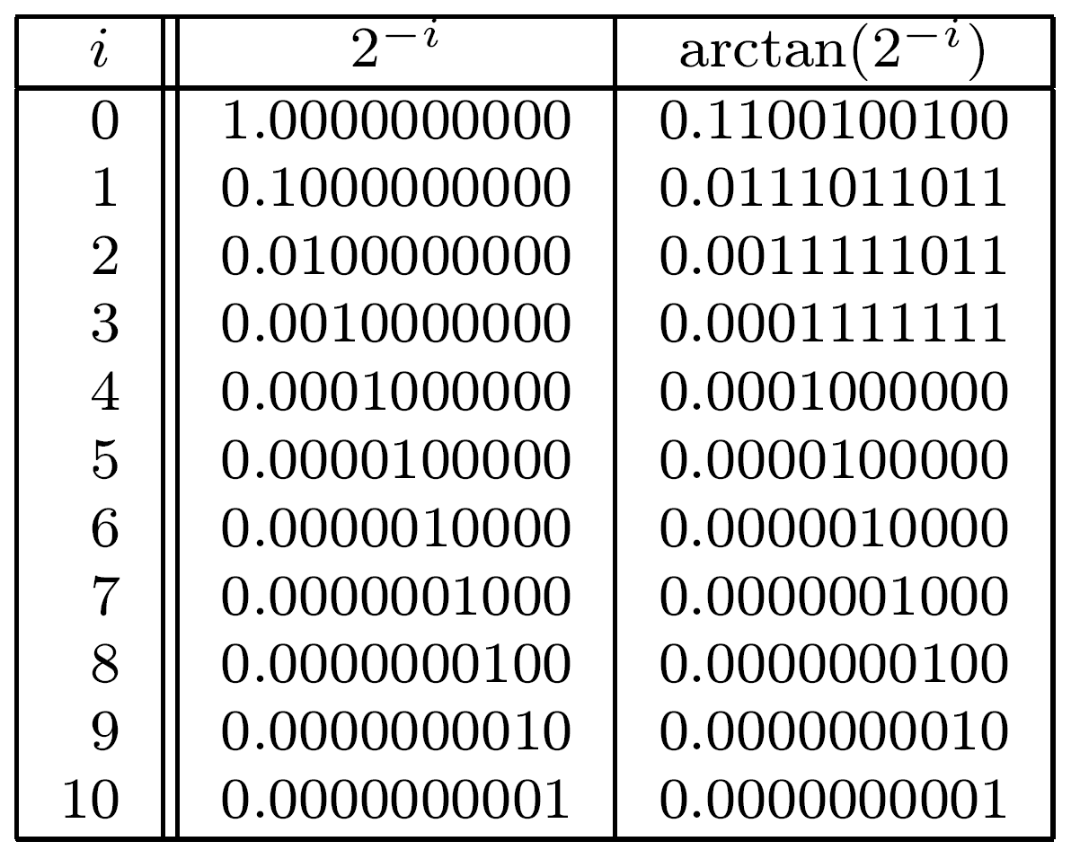
Selection Rule - Modified
Selection rule becomes
  Similar to rule for nonrestoring division
Examine convergence rate of xi+1 to 0 - Taylor series expansion of tan (si2 ) (in radians):
  Linear convergence
For i>n/3, all terms except first negligible - reduce size of ROM
-1
-i
Table for 10 fractional bits:
-i
-i
arctan (2 )= 2 for i≥4

Slide 24
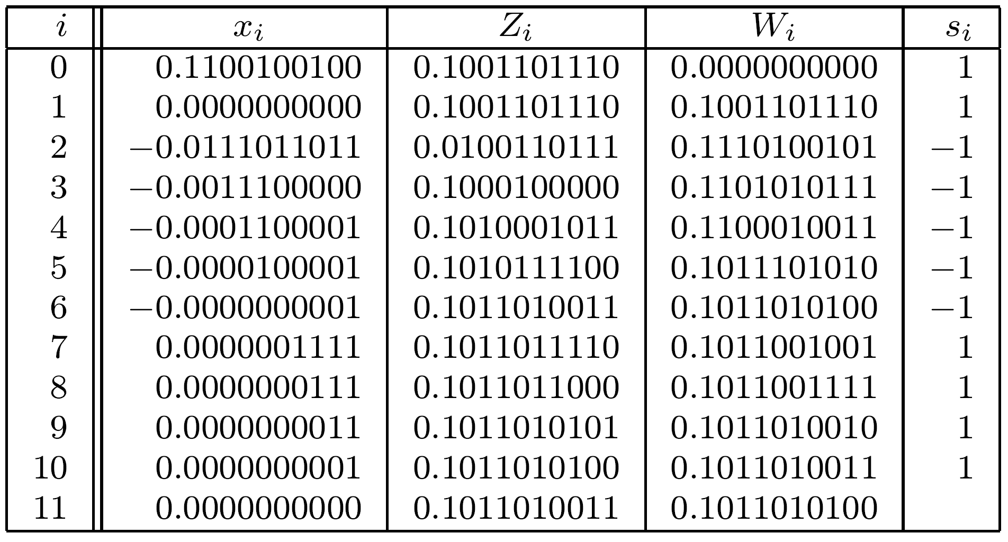
Example: sin(π/4) in 10-bit precision
π/4=0.78539810=0.11001001002
Initially Z0=1/K=0.10011011102 (=0.607410)
Set si=sign(xi)
Final results: Z11=0.10110100112 and W11=0.10110101002
“exact” results in 10-bit precision: both 0.10110101002= 0.707110
Approximation error not larger than 2
-10

