Slide 1

UNIVERSITY OF MASSACHUSETTS
Dept. of Electrical & Computer Engineering
Digital Computer Arithmetic
ECE 666
Part 9b
Evaluation of Elementary Functions - II
Israel Koren
Spring 2008

Slide 2
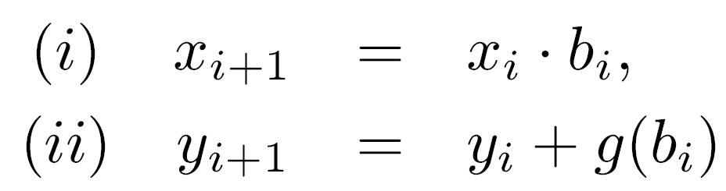
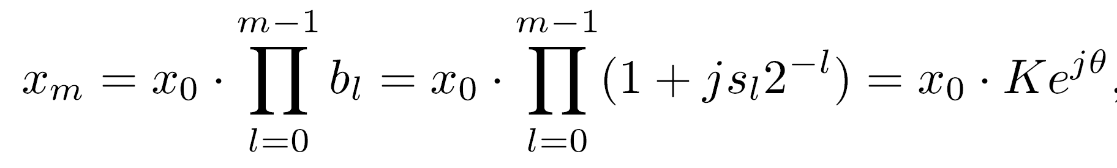
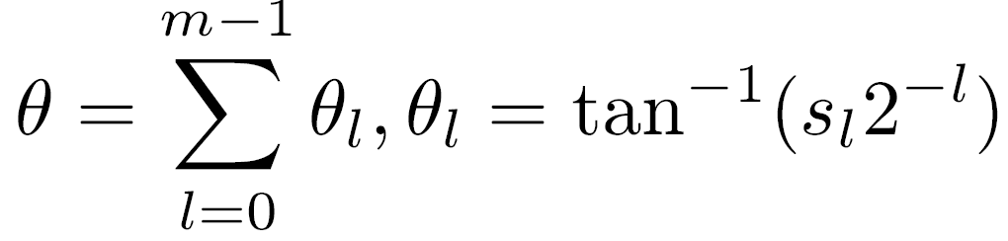
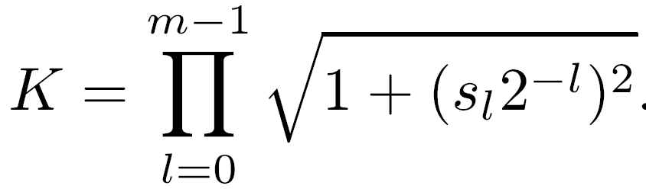
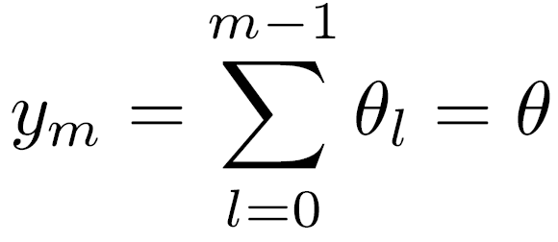
Inverse Trigonometric Functions
Multiplicative normalization
bi=(1+j si 2 )
where
If g(bi)=θi=arctan(si 2 ) & y0=0
xi complex variable = Ui + jVi
Recursive formulas for real and imaginary parts:
(i) Ui+1 + j Vi+1 = (Ui+jVi) (1+j si 2 )
(i) Ui+1= Ui - si 2 Vi
(i)’ Vi+1= Vi + si 2 Ui
-i
-i
-i
-i
-i

Slide 3
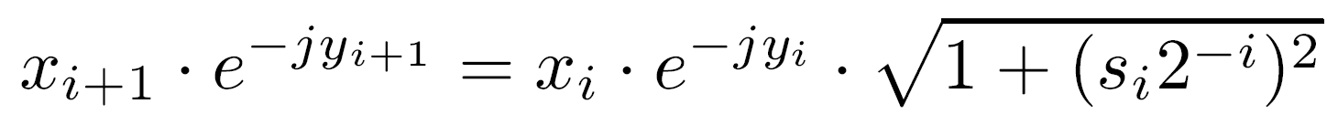
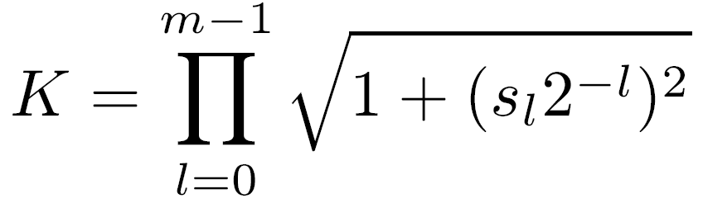
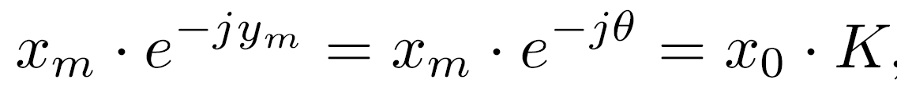
Final Values of Um and Vm
Relationship between Um, Vm and ym :
Substituting bi and g(bi)
Replacing xm and x0 by real and imaginary parts
(Um + jVm) (cos θ -j sin θ ) = K (U0+jV0)
Um cos θ +Vm sin θ =K U0
-Um sin θ +Vm cos θ =K V0
Set V0=0 & U0=1/K : Um=cos θ and Vm=sin θ
K constant if si∈{-1, 1}

Slide 4
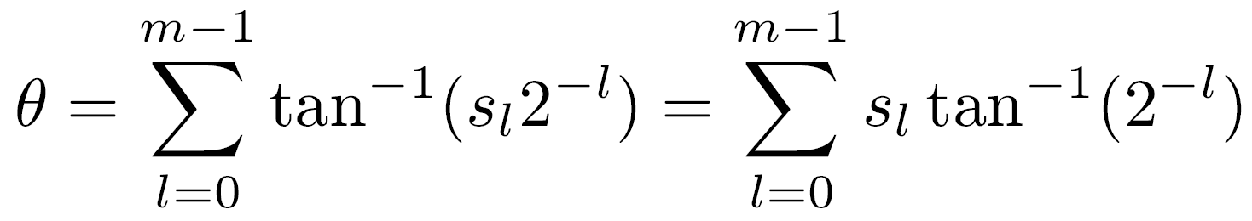
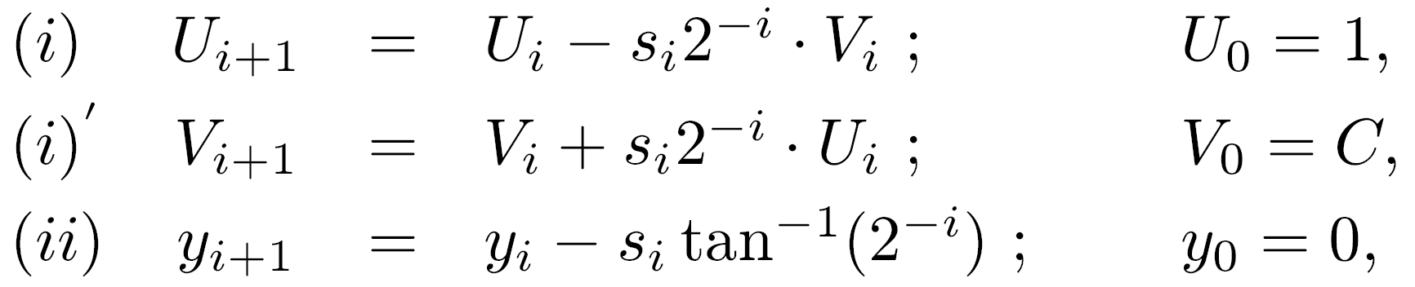
Calculate ϕ =arccos C for given C
Select si's - Um → C ⇒ θ → ϕ
θ obtained from ym=θ,
Table of arctan(2 ) needed as for sine and cosine
To calculate ϕ =arcsin D select si's so that Vm → D and θ → ϕ
arctan C: Vm →0 - tan θ=-V0/U0 & θ=-arctan(V0/U0)
Set V0=C, U0=1: arctan C=-θ
In summary
si in {-1, 1} according to signs of Vi and Ui so that Vi+1 is closer to 0
-i

Slide 5
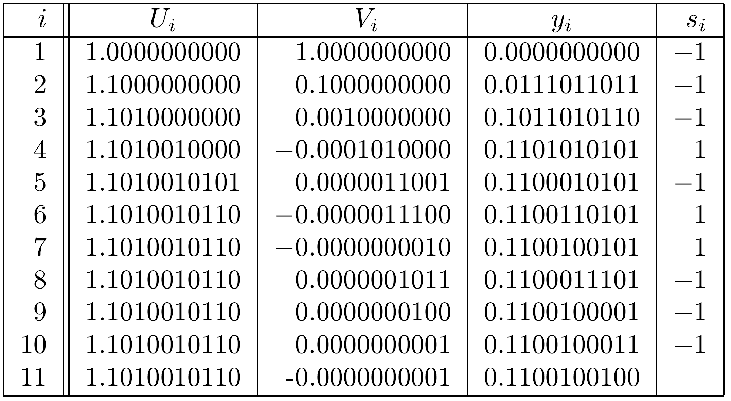
Example: arctan(1.0) in 10-bit Precision
Final result: y11=0.11001001002
Equal to “exact” result in 10-bit precision

Slide 6
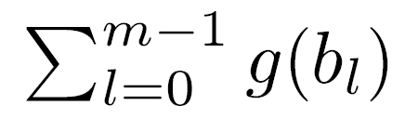
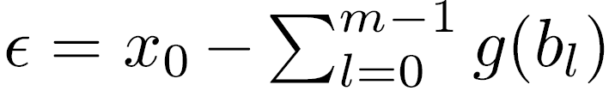
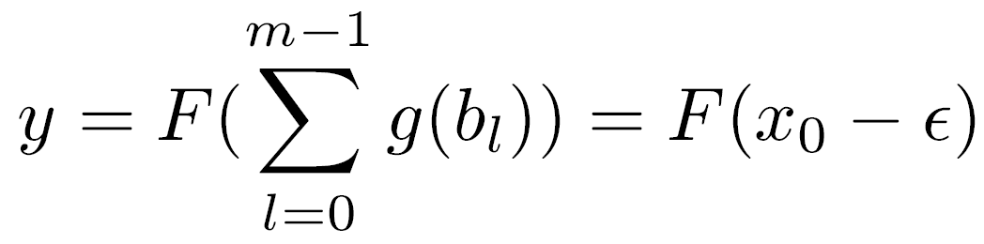
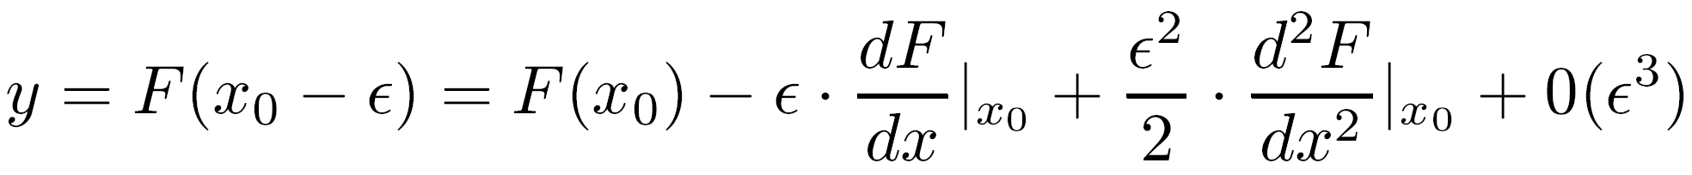
Approximation Error: Additive normalization
x0 n-bit fraction - approaches x0
Error - |ε|≤2
Evaluate y=F(x0) by calculating
Taylor series expansion:
ε is of order 2 - last two terms negligible
Error δ in y of order ε dF/dx|x0
  Magnitude of error depends on function F(x0)
Example - exponential function F(x0)=e dF/dx|x0=e - thus |δ| ≤ 2 e =2 for x0≤ ln 2
  Maximum error double size of error in argument
  Can be reduced by increasing number of bits in xi
-n
-n
x0
x0
-n
ln 2
-(n-1)

Slide 7
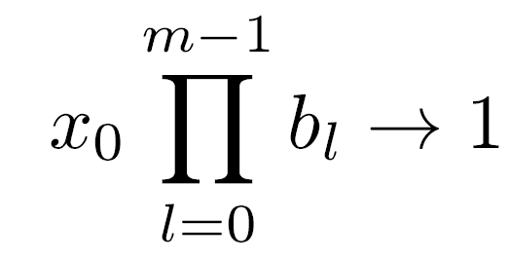
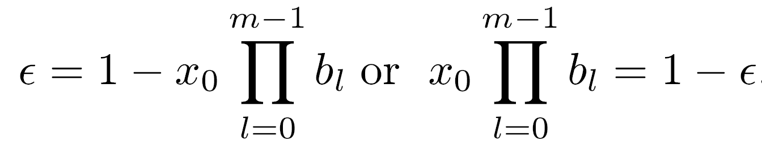
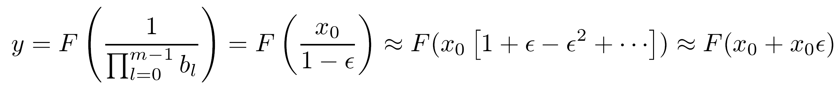
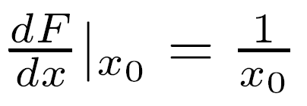
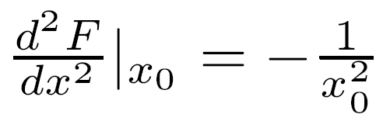
Approx Error: Multiplicative Normalization
Error is
Instead of F(x0) we calculate
Taylor series expansion
Natural logarithm F(x0)= ln x0
y=F(x0)+ ε +0(ε²)
Error in y: |δ| ≈ |ε| ≤ 2 - satisfactory precision
-n

Slide 8
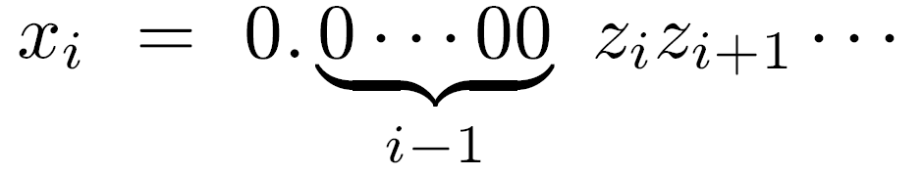
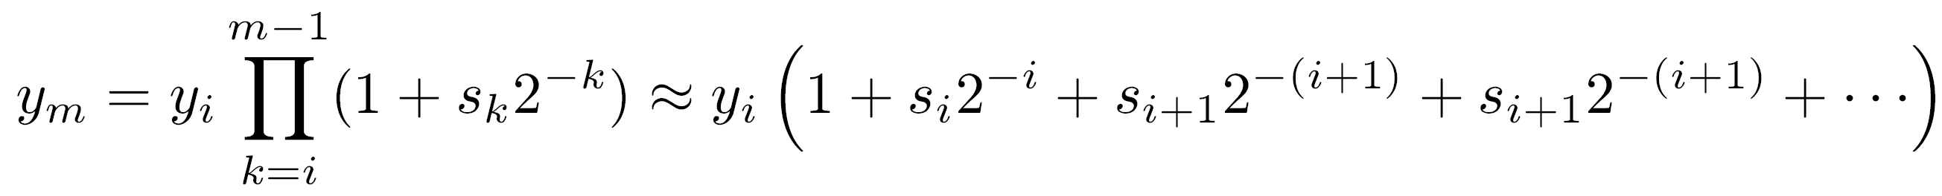
Speed-up Techniques: Exponential Function
-i
For i>n/2 - approximately si 2
  Smaller ROM & Replace last n/2 steps by a single operation
Previously canceled at least first (i-1) bits in xi:
  zk (k=i, i+1, … ) - single bit
To cancel remaining nonzero bits in xi (i≥n/2) select sk=zk (k>i)
  All remaining sk's can be predicted ahead of time
In last steps calculate
Since sk=zk - last term is (1+xi) ⇒ ym = yi (1+xi )
  Called Termination Algorithm

Slide 9
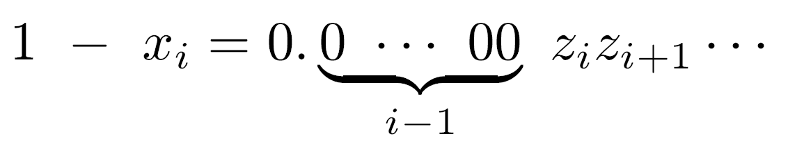
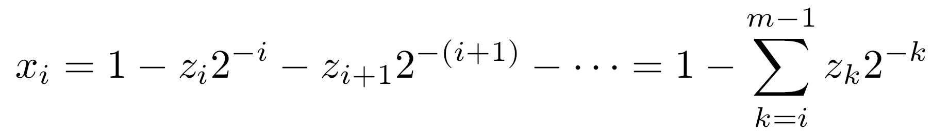
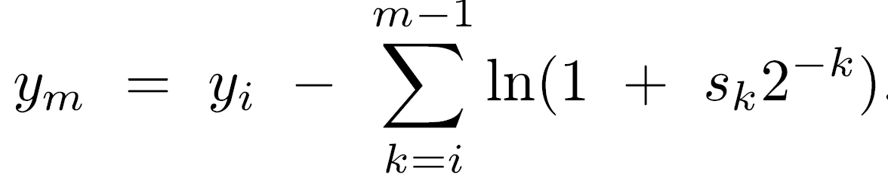
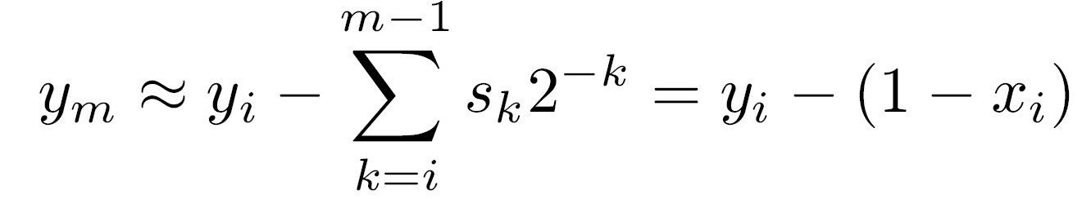
Termination Algorithm
Required - fast multiplier
  If not available - can still benefit - perform all additions of products in carry-save manner
Also for F(x0)=ln x0
xi has the form:
or
Formula for xi+1
For xi+1 →1 select sk=zk for k≥i
In parallel calculate
Based on Taylor series for ln (1+sk 2 ) - terminal approximation for i≥n/2 :
-k

Slide 10
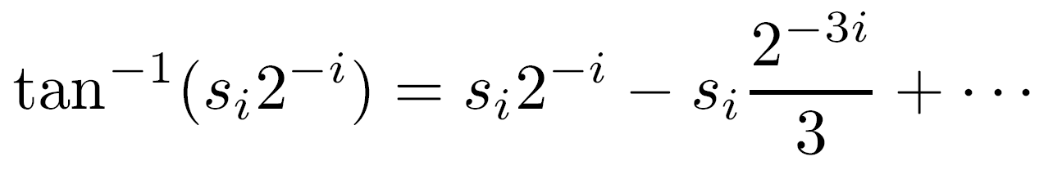
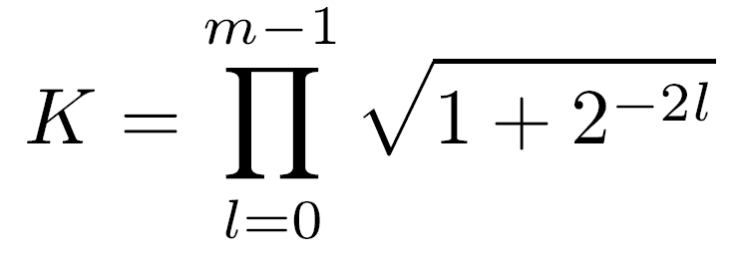
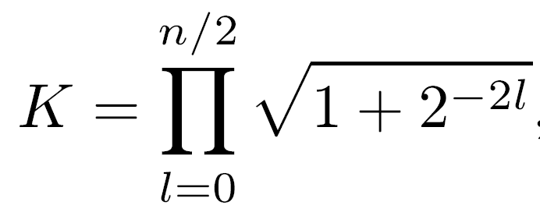
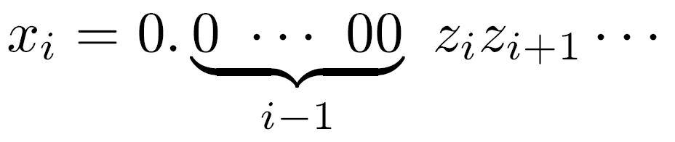
Accelerate Trigonometric Functions
Predict si's based on
To obtain constant K - si restricted to {-1,1}
If replaced by
-n
Deviation from exact value < 2
For i>n/2, may select sk (k≥i) from {0,1} and predict sk=zk, where:
  Can perform additions for xi, Zi and Wi in carry-save manner
Reexamining series expansion of arctan - may predict sl 's for i ≤ l ≤ 3i at once
Corresponding terms added in carry-save adder
For l <n/2 - still use {-1,1}

Slide 11
Speeding-Up First steps
0 ≤ i ≤ n/2
Use radix > 2
Example: g(bi)=1+si r (r - power of 2, say r=2 ) si ∈ {-(r-1),-(r-2),…,-1,0,1,…,r-1}
q bits of x in a single step - but increased complexity of step - si has larger range
Some improvement in speed is possible
Another method: allow si to assume values in {-1, 0,1} - modify selection rule so that probability of si=0 maximized
Similar to variations of SRT
i
q

Slide 12
Other Techniques for Evaluating Elementary Functions
(1) Use rational approximations (commonly used in software)
When fast adder and multiplier available and high precision is required; e.g., extended double-precision IEEE floating-point
  Hardware implementation of rational approximations can compete with continued summations and multiplications when execution time and chip area are considered
(2) Use polynomial approximations with look-up table

Slide 13
Polynomial Approximations with look-up table
Domain of argument x of f(x) divided into smaller intervals (usually of equal size) - f(xi) kept in look-up table
Value of f(x) at x calculated based on f(xi), for xi closest to x, and a polynomial approximation p(x-xi) for f(x-xi)
Distance (x-xi) is small - simple polynomial requiring less time than a rational approximation
Overall algorithm has three steps:
  (1) Find closest boundary point xi and calculate “reduction transformation” - usually distance d=x-xi
  (2) Calculate p(d)
  (3) Combine f(xi) with p(d) to calculate f(x)

Slide 14
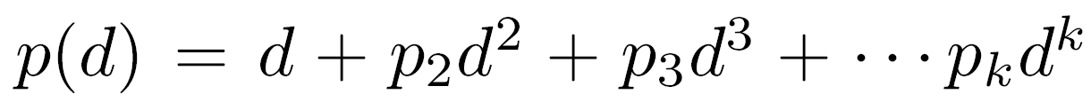
Example - Calculating 2 in [-1,1]
x
32 boundary points xi=i/32, i=0,1,…,31
  2 precalculated and stored in look-up table
Step 1: search for xi such that |x-m-xi| ≤ 1/64, where m=-1,0,1; calculate d=(x-m-xi) ln 2
d satisfies e =2 , and |d|≤ (ln 2)/64
Step 2: approximation for e -1 using a polynomial
  p2, p3 … pk precalculated coefficients of polynomial approximation of e -1 on [-(ln 2)/64, (ln 2)/64 ]
Step 3: reconstruct 2 using
Error bounded by 0.556 ulp (ulp=2 )
xi
d
x-m-xi
d
d
x
-52

