Slide 1

UNIVERSITY OF MASSACHUSETTS
Dept. of Electrical & Computer Engineering
Digital Computer Arithmetic
ECE 666
Mid-Term II
Sample Exam
Israel Koren
Spring 2008

Slide 2
1. To speed-up the SRT algorithm for fast division (for divisors in the range [0.5,1]) it has been suggested to use the first two bits of the divisor as a comparison constant K. For example, for D=0.1101 the most significant bits of the partial remainder will be compared to K=0.11.
(a) Will the number of add/subtract operations in the suggested method be smaller than, equal to, or greater than the number of these operations in the original SRT method (with K=0.1) in the following three cases: (i) D=0.1001 and X=0.10000111; (ii) D=0.1101 and X=0.01011011

Slide 3
1. (iii) D=0.1111 and X=0.01001011
(b) Would you recommend the use of the above algorithm?

Slide 4
2. For single-precision floating-point operands in the IEEE format a 24×24 significand multiplier has to be designed using 8×8 multiplier library cells (with 16-bit result), (5,5,4) counters and a carry look-ahead adder.
(a) If all 48 bits have to be generated, how many 8×8 multipliers and (5,5,4) counters are needed?

Slide 5
2. (b) Assuming that the cell library includes 4-bit adder and a 4-bit carry-look-ahead module, how many such cells are needed to design the fastest carry look-ahead adder?

Slide 6
2. (c) If the product has to be represented in the single-precision IEEE floating-point format after rounding (to nearest-even), can some of the 8×8 multipliers and (5,5,4) counters be deleted? If your answer is negative explain why. If it is positive repeat part (a).

Slide 7
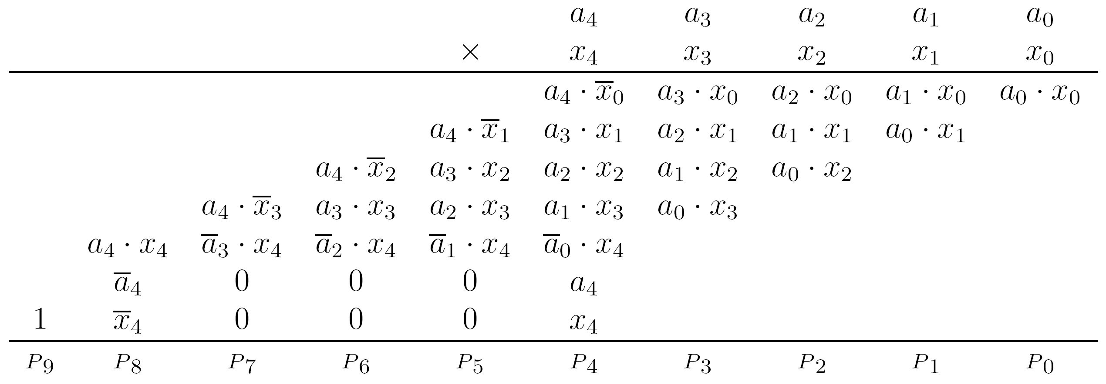
3. Prove that the arrangement of partial product bits shown below produces the correct product of two 5-bit two's complement operands, where x_i = 1-x_i and similarly a_i = 1-a_i.
Briefly compare this multiplier to alternative two's complement array multipliers considering the amount of hardware and execution time.

