Slide 1
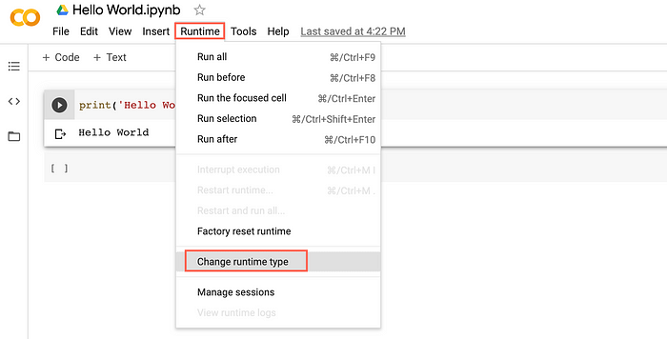
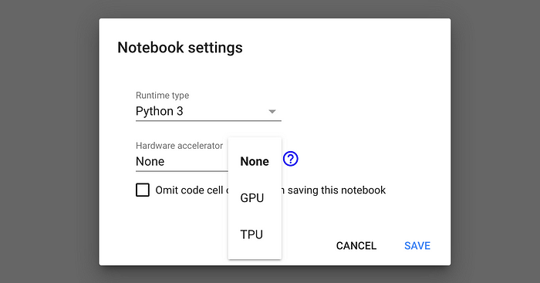

Slide 2




Read on
Read on
OnlineE-Book
PDF Document

