Slide 1
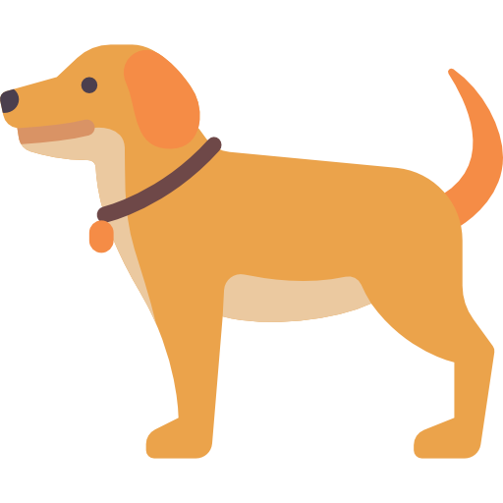


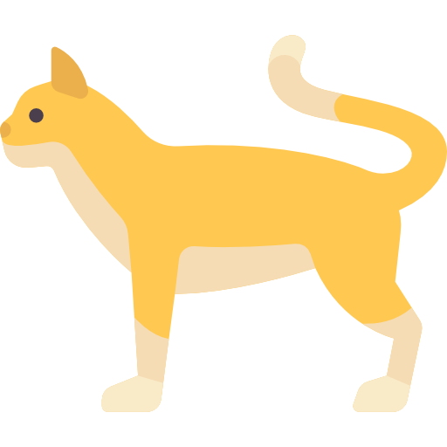


Input Raw Data
Output
Dog
Labeling Data
Algorithm
Training Model
Cat

Slide 2
Algorithm

Slide 3
:labeled data

