Slide 1
Support Vector
X₁
間隔寬度
X₂

Slide 2
y
y
x
x

Slide 3
z
x
y

Slide 4
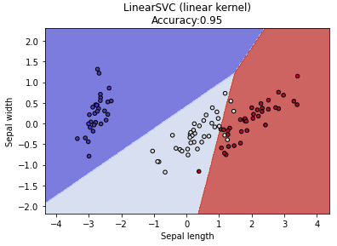
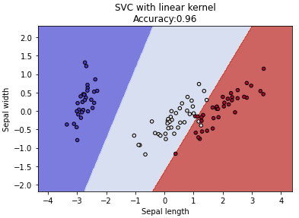
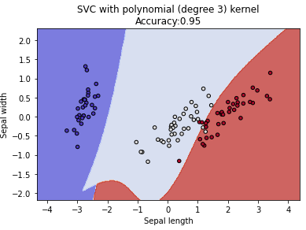
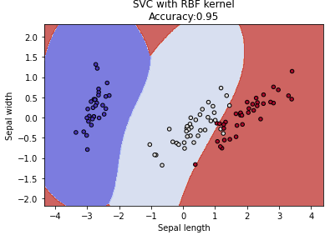

Slide 5



y
$$f\left(x\right)+ ε$$
$$f\left(x\right)=wTx+b$$
$$f\left(x\right)− ε$$
x

Slide 6
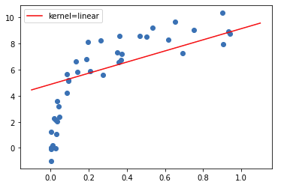
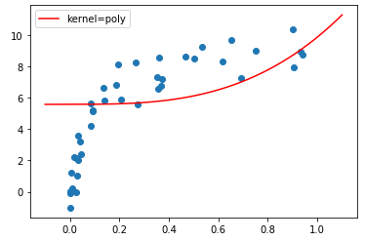
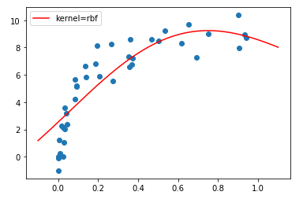
Linear
Polynomial
Radial Basis Function

