Slide 2




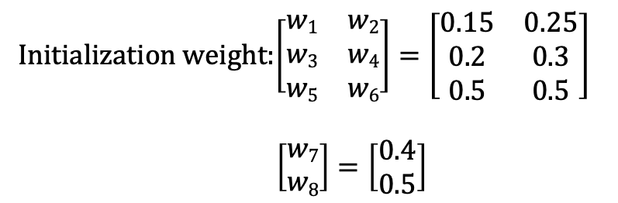
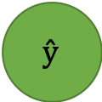






Input Layer
Hidden Layer 1
Output Layer
$$x1$$
w₁
w₂
$$H1$$
w₇
w₃
$$ŷ$$
L
$$x2$$
$$y$$
w₄
w₈
w₅
$$H2$$
$$b$$
w₆
Initialization weight:$\left[\begin{matrix}w1 & w2 \\ w3 & w4 \\ w5 & w6\end{matrix}\right]=\left[\begin{matrix}0.15 & 0.25 \\ 0.2 & 0.3 \\ 0.5 & 0.5\end{matrix}\right]$
$\left[\begin{matrix}w7 \\ w8\end{matrix}\right]=\left[\begin{matrix}0.4 \\ 0.5\end{matrix}\right]$
Data:$x1=2，x2=−1 ，$ $b=1，y=0.01$
Activation function: $f\left(x\right)=\frac{1}{1+e^{−x}}$
Loss function: $L=\frac{1}{2}{(d−y)}^{2}$
Hyperparameter: $η=0.5$

Slide 3

Forward Pass
H₁=$f$( ($x$₁* $w$₁)+($x$₂* $w$₃)+($b$* $w$₅) )
=$f$( (2*0.15)+(-1*0.2)+(1*0.5) )
=0.645656
H₂=$f$( ($x$₁* $w$₂)+($x$₂* $w$₄)+($b$* $w$₆) )
=$f$( (2*0.15)+(-1*0.2)+(1*0.5) )
=0.645656
y =$f$( ($x$₁* $w$₇)+(x₂* $w$₈))
=$f$( (0.6457*0.4)+(0.6682*0.5))
=0.64391

Slide 4

Backward Pass (calculate descent)
$δy$ =$y\left(1−y\right)∗(d−y)$
= 0.6439*(1-0.6439)*(0.01-0.6439)
= -0.145348
$δH1$=$H1\left(1−H1\right)∗(δy−w7)$
= 0.6457*(1- 0.6457)*(-0.1453-0.4)
= -0.013296
$δH2$=$H2\left(1−H2\right)∗(δy−w8)$
= 0.6682*(1- 0.6682)*(-0.1453-0.5)
= -0.01610

Slide 5
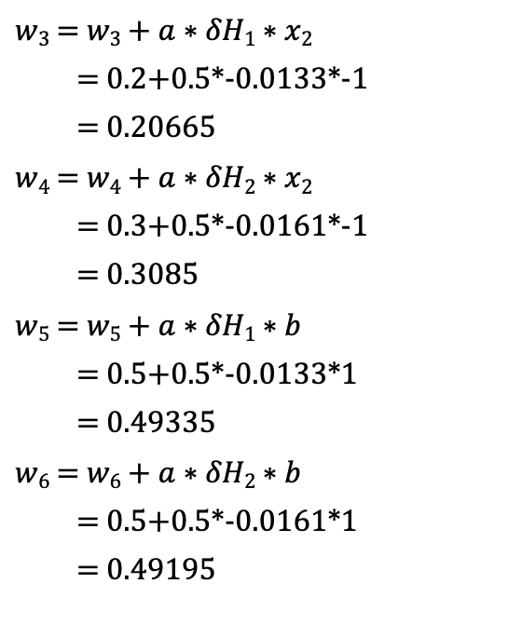
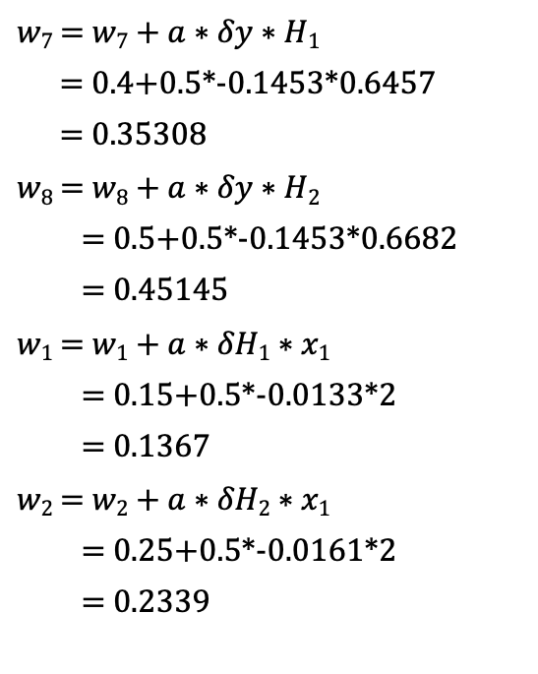
Backward Pass (update weight)
$w7$ =$w7+a∗δy∗H1$
= 0.4+0.5*-0.1453*0.6457
= 0.35308
$w8$ =$w8+a∗δy∗H2$
= 0.5+0.5*-0.1453*0.6682
= 0.45145
$w1$ =$w1+a∗δH1∗x1$
= 0.15+0.5*-0.0133*2
= 0.1367
$w2$ =$w2+a∗δH2∗x1$
= 0.25+0.5*-0.0161*2
= 0.2339
$w3$ =$w3+a∗δH1∗x2$
= 0.2+0.5*-0.0133*-1
= 0.20665
$w4$ =$w4+a∗δH2∗x2$
= 0.3+0.5*-0.0161*-1
= 0.3085
$w5$ =$w5+a∗δH1∗b$
= 0.5+0.5*-0.0133*1
= 0.49335
$w6$ =$w6+a∗δH2∗b$
= 0.5+0.5*-0.0161*1
= 0.49195

