Slide 1
系統晶片設計實習
指導老師：陳朝烈
學號：F107112112
姓名：施辰佑

Slide 2
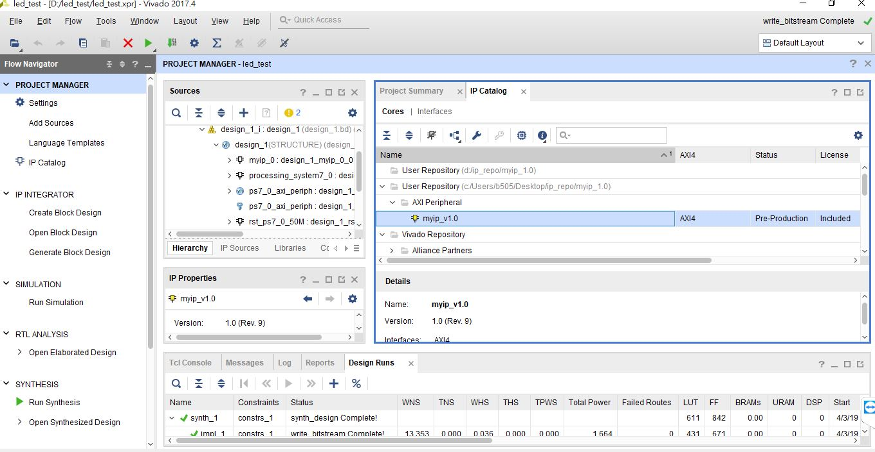
IP Catalog
右鍵點選myip_v1.0
選擇edit in IP Packager

Slide 3
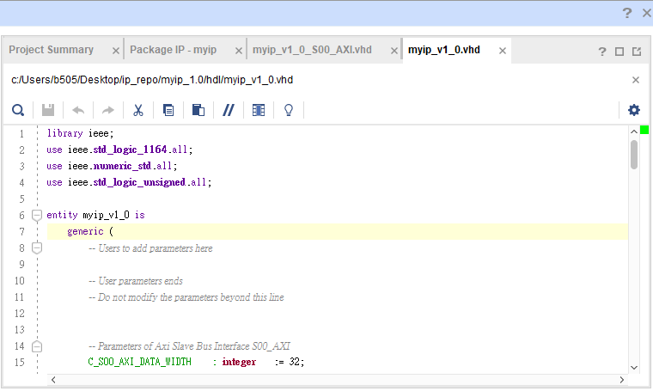
Myip_v1_0.vhd

Slide 4
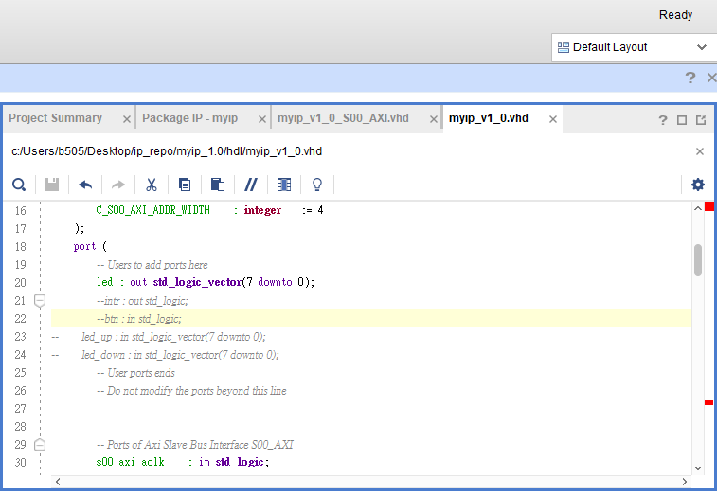
Myip_v1_0.vhd

Slide 5
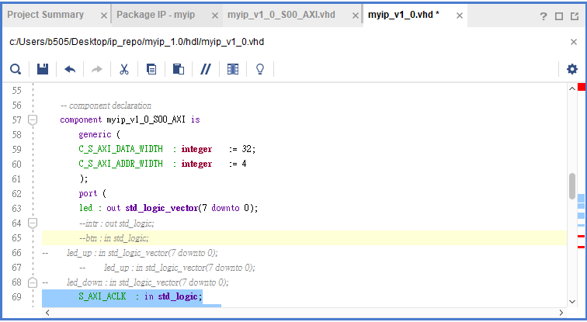
Myip_v1_0.vhd

Slide 6
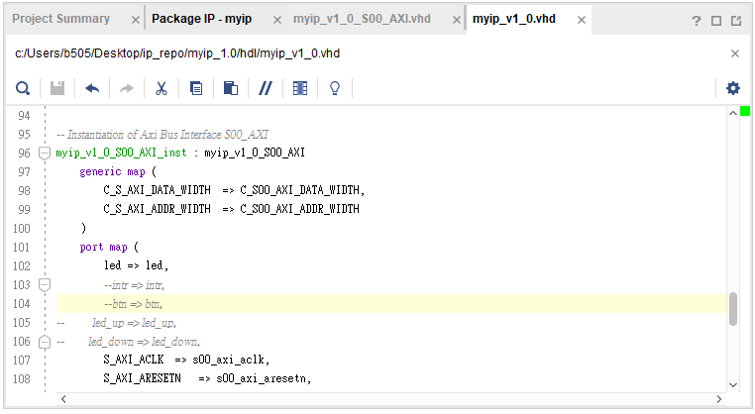
Myip_v1_0.vhd

Slide 7
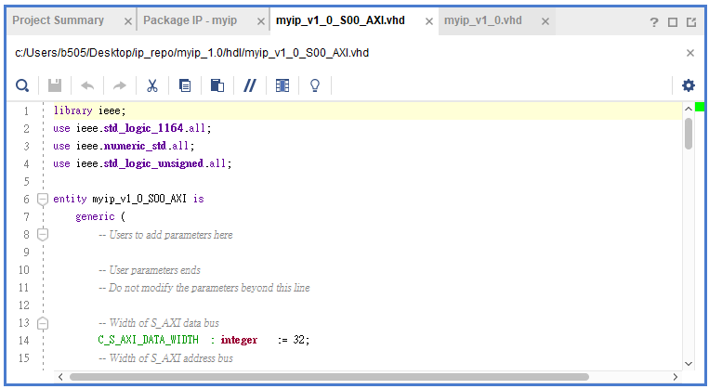
Myip_v1_0_S00_AXI.vhd

Slide 8
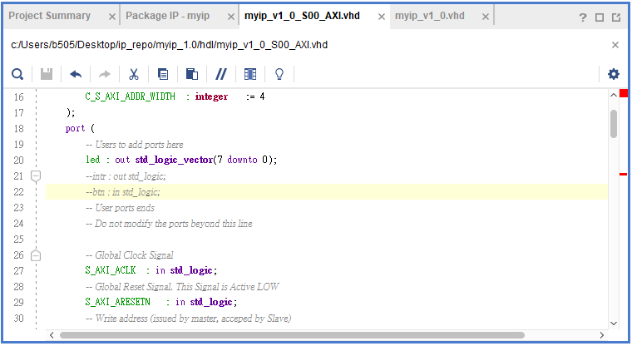
Myip_v1_0_S00_AXI.vhd

Slide 9
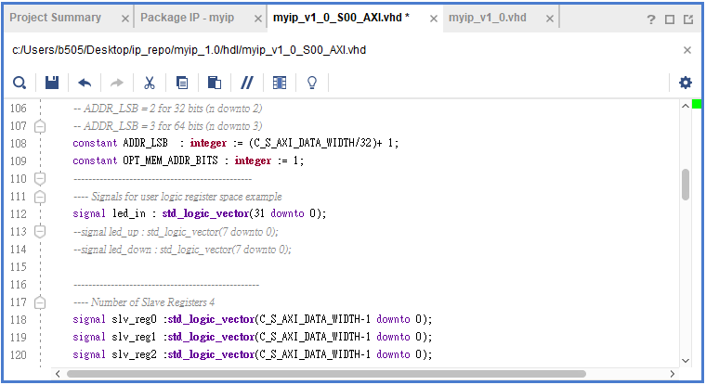
Myip_v1_0_S00_AXI.vhd

Slide 10
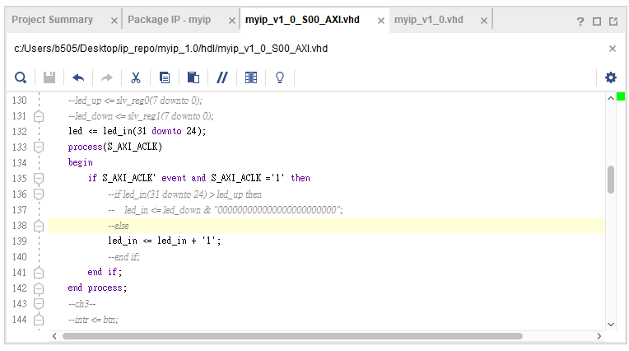
Myip_v1_0_S00_AXI.vhd

Slide 11
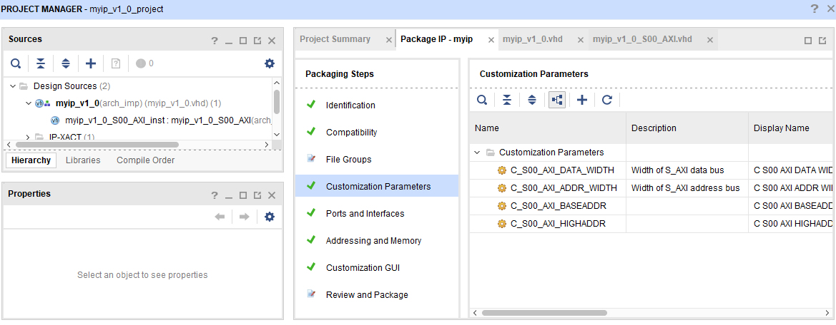
Merge Changes

Slide 12
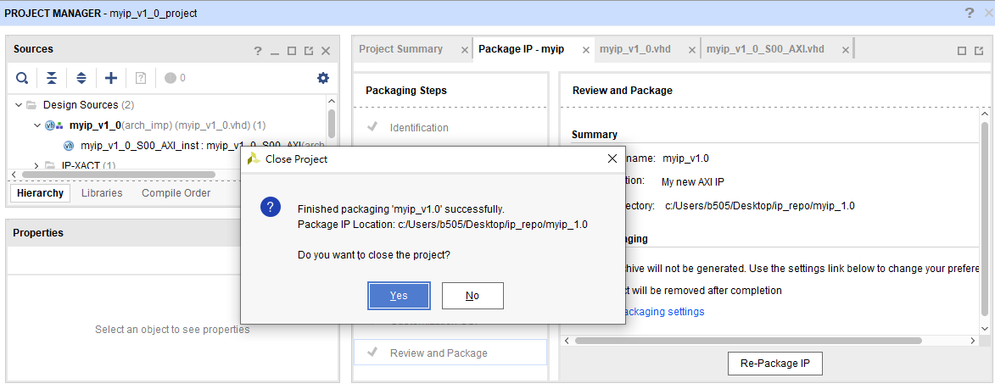
Re-Package IP

Slide 13
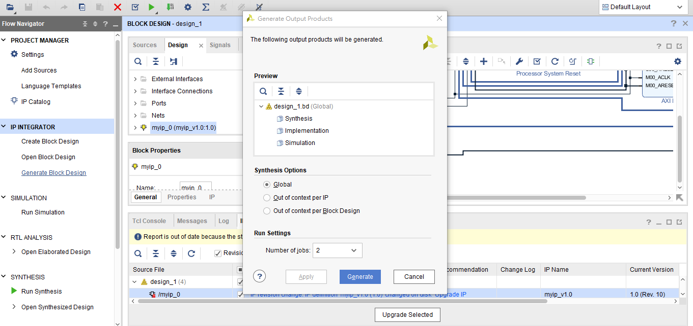
Generate Block Design

Slide 14
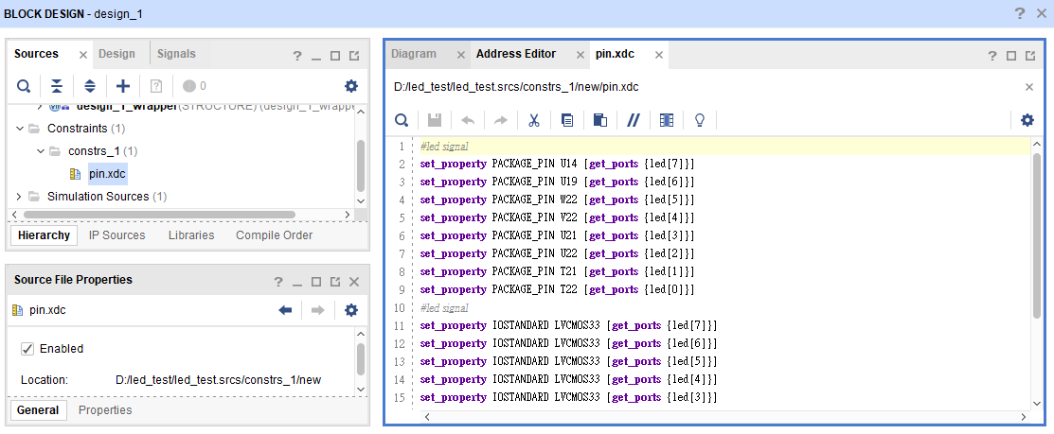
pin.xdc

Slide 15
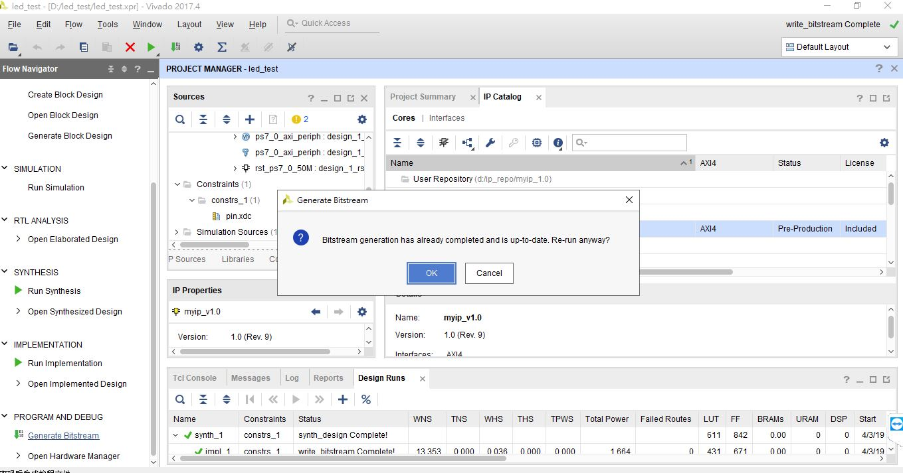
Generate Bitstream

Slide 16
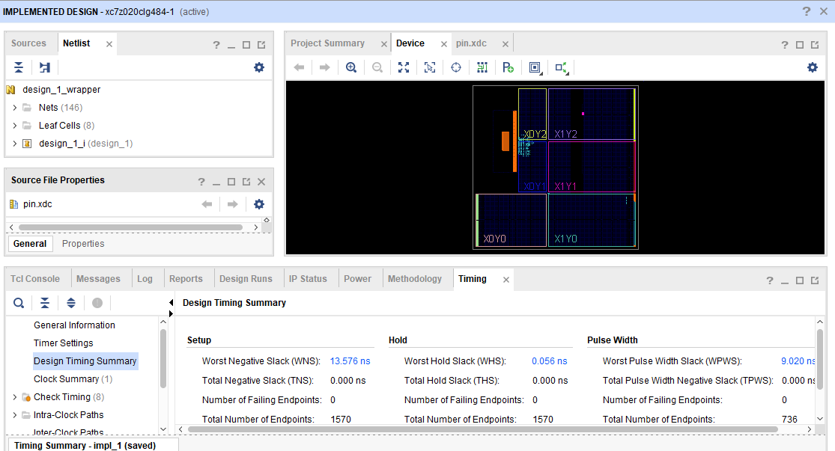
Generate Bitstream

Slide 17
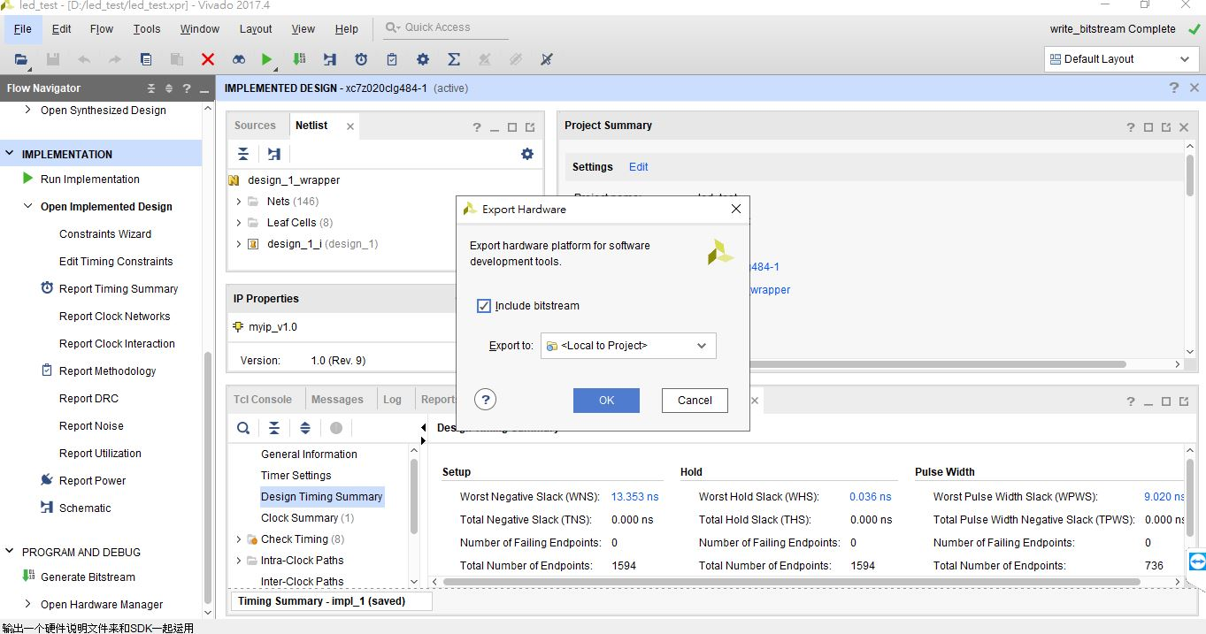
Export Hardware

